Slide 1
SAVING
Transparent, wallet-controlled savings
• Enterprise Financial DApp · Sepolia prototype
• Zeran Yao · G2509029A · Sole contributor
• Python API · three roles · charts · fee preview · testnet only.
Zeran Yao · G2509029A / Sepolia prototype
1
Notes:
Introduce the student identity and sponsor-funded savings scope. Do not describe this as a bank or a production investment product.

Slide 2
01 / PROBLEM
Can members verify the rules?
• Proposed setting: a crypto-literate membership savings incentive
• Member needs: visible principal, executable withdrawals and explainable rewards
• Sponsor funds interest; there is no external yield source
• Problem demand has not been validated with a real organisation.
Zeran Yao · G2509029A / Sepolia prototype
2
Notes:
Explain why an operator spreadsheet cannot independently enforce custody rules. Label the use case as proposed rather than interviewed.

Slide 3
02 / EVIDENCE
Context supports investigation, not adoption claims
• World Bank Findex 2025: formal saving reached 40% of adults in developing economies in 2024 [1]
• This does not establish demand for a crypto savings app.
• BIS Papers 156 discusses DeFi asymmetry and stability risks [2].
• A bank or ordinary portal may be the better option for many users.
Zeran Yao · G2509029A / Sepolia prototype
3
Notes:
Cite report references 1 and 2. Explain the limited applicability of global inclusion statistics to an existing-wallet target group.

Slide 4
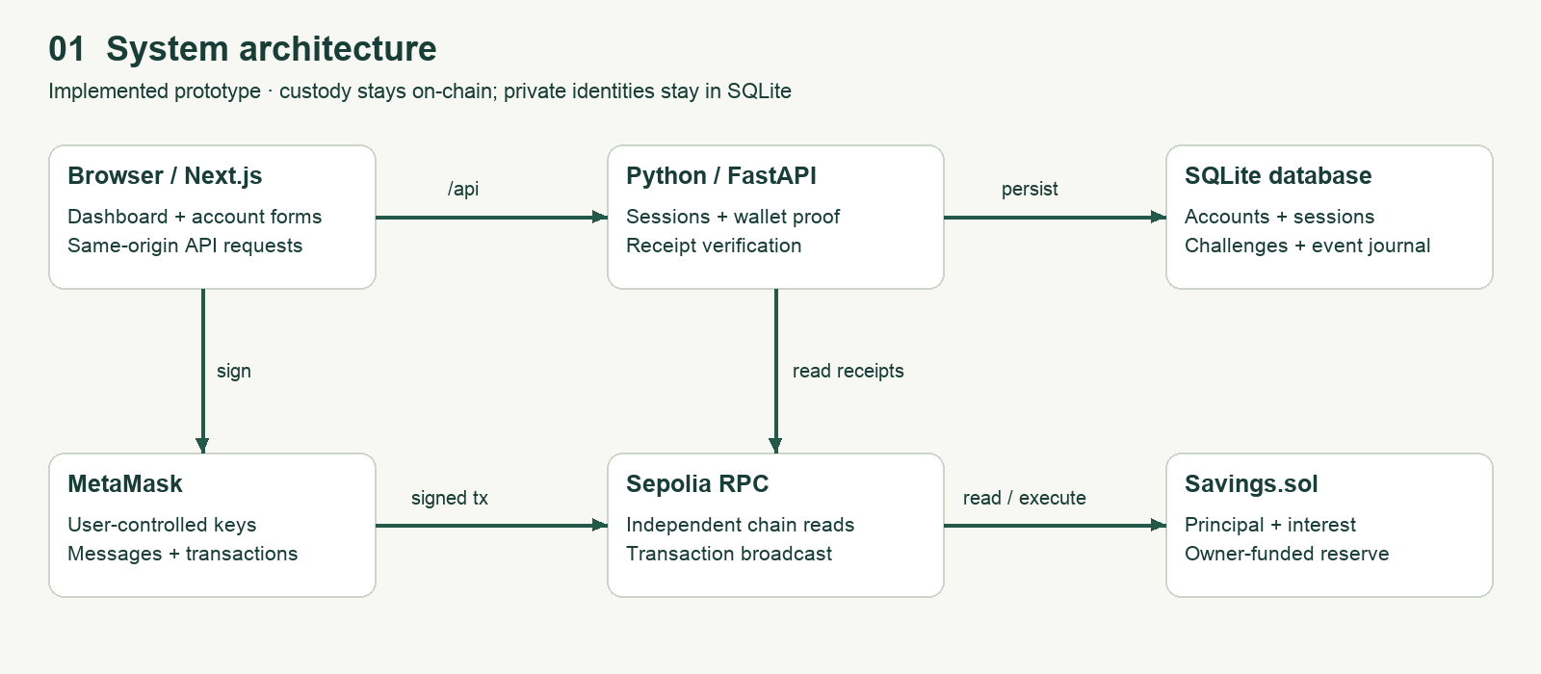
03 / ARCHITECTURE
Identity and custody are separate
Zeran Yao · G2509029A / Sepolia prototype
4
Notes:
Walk through the browser, MetaMask, API, SQLite and vault. A password session controls portal access; wallet signatures control funds.

Slide 5
04 / ACCOUNTING
Four business transaction types
• Deposit → increase principal
• Withdraw → reduce principal and send ETH
• Claim → pay accrued interest from reserve
• Fund → owner supplies reserve; no admin access to member principal
Zeran Yao · G2509029A / Sepolia prototype
5
Notes:
Show the single implemented contract. At five percent simple interest, one ETH over a 365-day year earns 0.05 ETH. Reserve exhaustion delays interest claims.

Slide 6
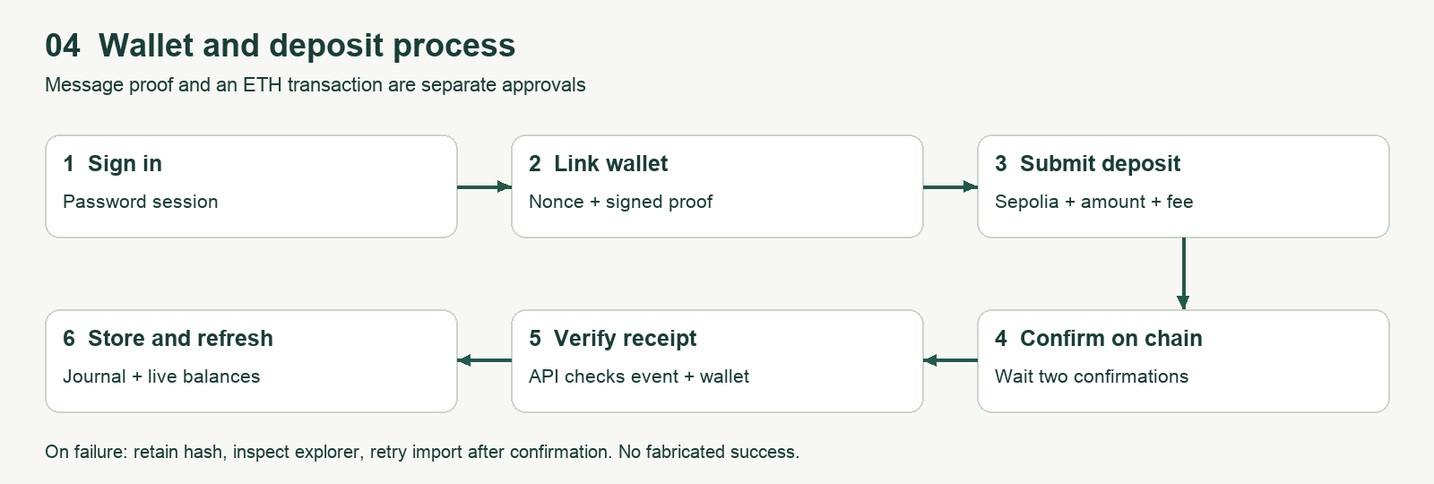
05 / LIVE WORKFLOW
Sign, confirm, verify, record
Zeran Yao · G2509029A / Sepolia prototype
6
Notes:
Run the customer demonstration. Inspect the MetaMask network, destination and gas fee. If the transaction is pending, preserve its hash and use a clearly labelled earlier receipt.

Slide 7
06 / TEST EVIDENCE
Local checks pass; scope is bounded
• Python: 19 cases, including migration, auditors, receipts and scoped history
• EVM: three tests covering reserve, accrual, top-ups and withdrawals
• Solidity compile, frontend lint and production build pass
• No live MetaMask, stakeholder pilot or independent security audit claimed.
Zeran Yao · G2509029A / Sepolia prototype
7
Notes:
Use captured logs in evidence/. Explain that assertion counts are not independent test counts. Simulated time is not real Sepolia elapsed time.

Slide 8
07 / GAS
Optimizer comparison, measured locally
• Deployment gas: 1017375 → 545131 (46.42% reduction)
• Creation bytecode: 4812 → 2366 bytes
• Optimized receipt gas: deposit 94735, fund 22724, claim 53951, withdraw 40698
• One controlled Ganache scenario; no current gas-price or latency claim
Zeran Yao · G2509029A / Sepolia prototype
8
Notes:
Explain optimizer off/on, 200 runs, compiler 0.8.30, Shanghai target and identical operation sequence. Fees depend on gas price. See testing report.

Slide 9
08 / SECURITY
Principal protection is only one control
• Interest claims cannot consume principal
• Reentrancy guard and accounting before ETH transfer
• Salted password hashing, expiring cookies and one-use wallet challenges
• Open risks: finite reserve, lost wallet keys, RPC trust and missing recovery
Zeran Yao · G2509029A / Sepolia prototype
9
Notes:
Discuss public ledger privacy and email-to-wallet linkage. Passing tests do not establish audited safety or sustainable funding.

Slide 10
09 / DEPLOYMENT
Docker-ready; public evidence is pending
• Next.js standalone + Python/FastAPI + SQLite persistent disk
• Python runtime Docker build and browser-origin/session smoke passed
• No public Render URL, Sepolia address or GitHub history supplied
• Live deployment, restart persistence and performed demonstration still required.
Zeran Yao · G2509029A / Sepolia prototype
10
Notes:
Show the actual deployment register. Do not substitute localhost for the required public URL. Show real explorer evidence only if available.

Slide 11
10 / SCOPE
Focused scope, transparent limits
• Implemented: Customer, Administrator and read-only Auditor
• Charting, paginated history, CSV, audit trail and fee preview
• One vault and four meaningful workflows retained under owner-authorised flexibility
• Public deployment, real MetaMask acceptance and performed demo remain pending
Zeran Yao · G2509029A / Sepolia prototype
11
Notes:
Explain the agreed flexible scope and practical improvements. Retain the original-count comparison without adding unrelated functionality.

Slide 12
11 / CONTRIBUTION
An inspectable prototype, with a clear next step
• Zeran Yao · G2509029A · 100% sole project contribution
• Artifacts: source, 14-page report, five diagrams, tests, manual and slides
• Next: finish mandatory workflows, deploy, validate with users and record live evidence
• No return, adoption or enterprise-readiness claim is made.
Zeran Yao · G2509029A / Sepolia prototype
12
Notes:
Conclude the ten-minute demonstration. Answer questions from actual evidence, identify limitations and do not invent contribution history.

