Slide 1

The Impact of Big Data on the Online Grocery Industry
Group 6
Ku Jun Hao 1201203310
Lim Jun Jie 1201103290
Lim Sir Yuean 1211307746
Yap Jack 1211103024
Notes:
Hello, this is group 6. Today, we will be presenting the Impact of big data on the online grocery industry
Our group members consists of Ku Jun Hao, Lim Jun Jie, Lim Sir Yuean, and Yap Jack.

Slide 2
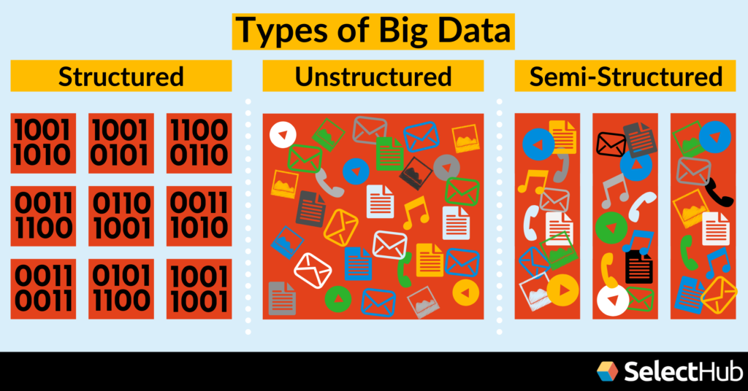
What is big data?
Large and diverse collection of structured and unstructured data.
Structured data: Name, email addresses, prices etc.
Unstructured data: Product images, text reviews, search queries etc.
Semi-Structured Data: Combination of both
Constantly generated by various online systems.
Notes:
So, first of all, what is big data? Big Data means a large and diverse collection of structured and unstructured data.
As an example, structured data could range from name, email addresses, or prices. It is data that can be easily understood and mine insights by normal humans with everyday computation methods.
On the other hand, unstructured data could range from product images, text reviews, or search queries. It is data that cannot be easily understood or extract insights from without using complex computation methods.
There are also a combination of both in rare cases.
Regardless of the data types, big data is constantly growing as users interact with digital systems daily, contributing to the expansion of big data every second on earth.

Slide 3



How does it benefit online groceries?
Optimize customer experience
Improve operational efficiency
Data-driven decision making
Notes:
So how does big data useful in the online grocery industry?
As online groceries continue to expand to many areas, it often encounter issues such as insufficient stockings, late deliveries, lowering profitability, and most importantly, inconsistent customer experience on their platforms.
Big data is able to optimize customer experience, improve operational efficiency, and drive data-oriented decision making. Tackling these issues head on with significant positive results.

Slide 4
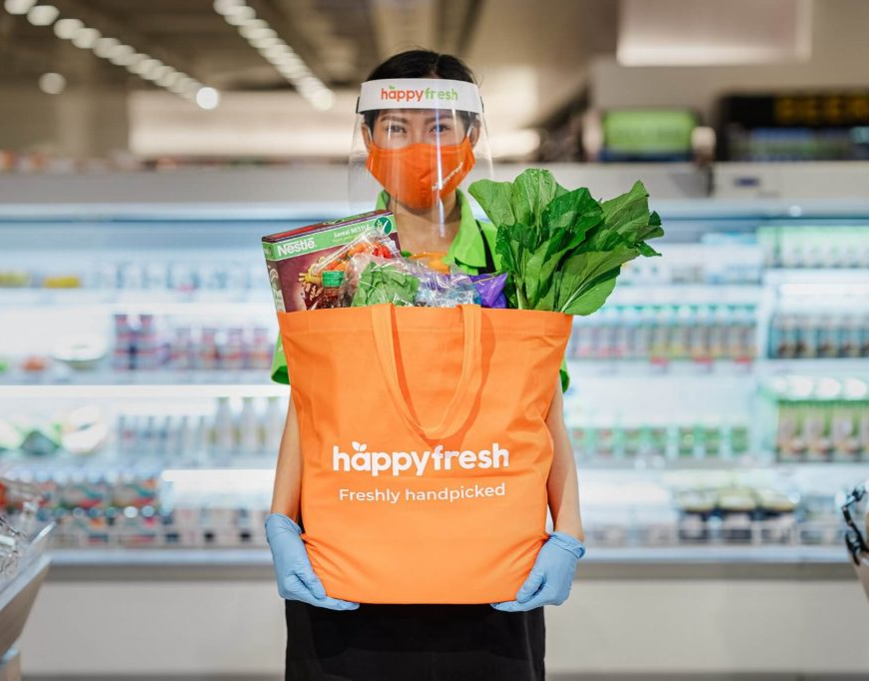
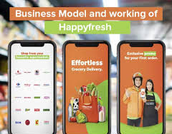
Personalized Recommendations
Recommend products based on profile purchasing behaviors.
Achieve consistent and satisfying customer purchasing experience.
Happyfresh uses big data to attract and retain customers.
Notes:
The first and most popular impact Big Data has on online groceries stores is the feature of personalized recommendations.
These recommendations can be generated based on a particular user’s purchasing behavior, search history, time of purchase or even purchasing frequency. This feature allows the online groceries to provide a customer-centric approach in their stocking methods. Providing a consistent yet satisfying experience.
For example, HappyFresh has in-house advertising model that provides a personalized user purchasing journey. Aiming to attract or retain existing customers on their online grocery platform.

Slide 5

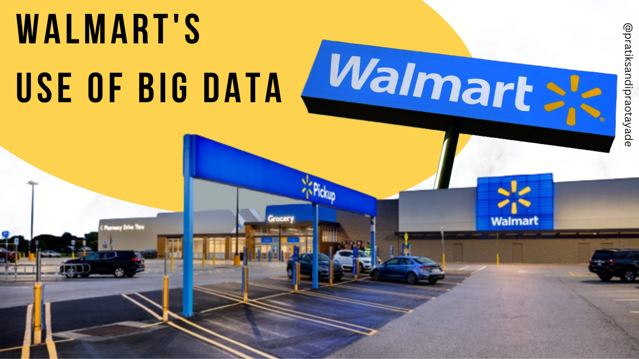
Demand forecasting and inventory management
Predict inventory demands to reduce wastes and costs.
Optimize inventory management to avoid surpluses or shortages.
Notes:
Its second impact is the ability to forecast consumer demands for its inventory management systems.
By anticipating which products will be in-demand, online groceries could exploit the data to avoid excessive surpluses or shortages when serving consumers. For example, Walmart uses it inventory management system across its supply chains to strike a balance between consumer demand and stocking levels to respond to fluctuating consumer demand. Making sure of Walmart’s online and offline platforms are stocked sufficiently.

Slide 6
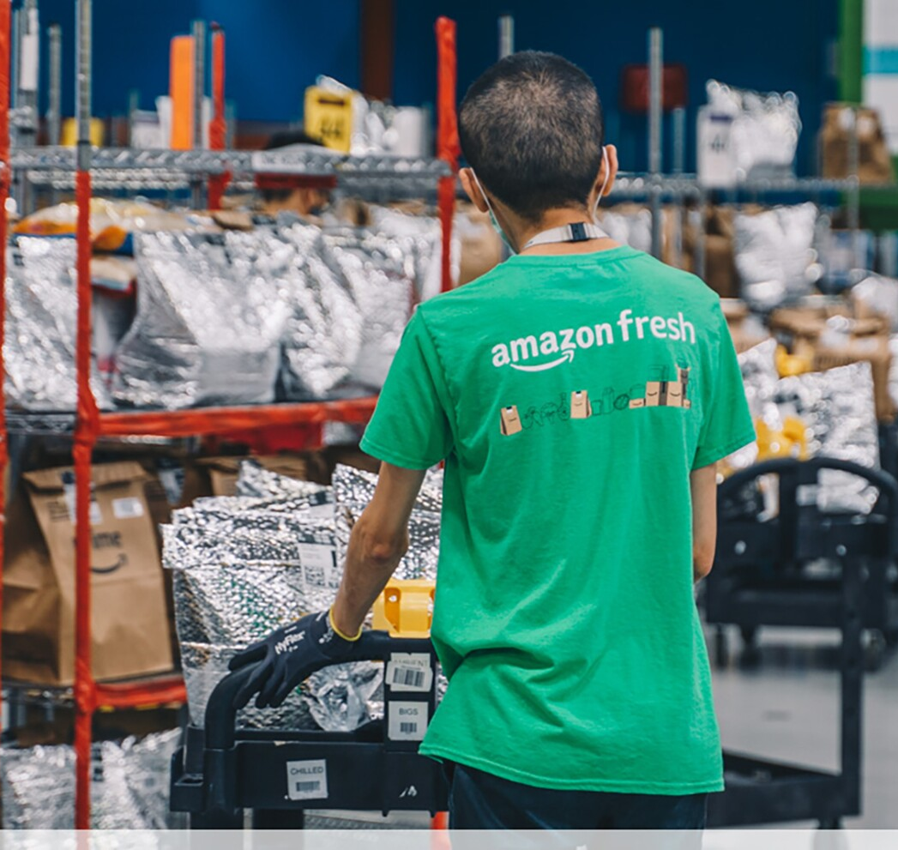
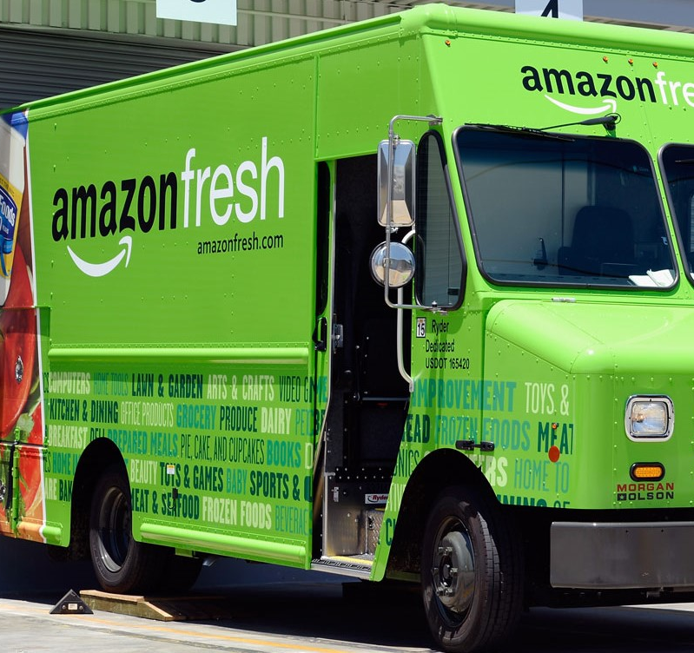
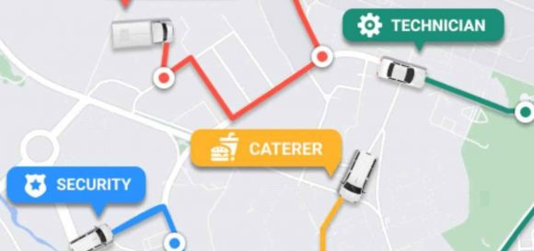
Route and Delivery Optimization
Uses Big Data to deliver goods to consumers efficiently.
Unforeseen benefits such as waste reduction, fuel cost optimization, and shipment weight reduction.
Notes:
For its third impact, route and delivery optimization
Whereby online grocers analyze traffic data, delivery schedules and weather conditions to optimize its delivery processes.
One good example is Amazon Fresh’s use of route and distance analytics to deliver packages faster.
In the process, they realized additional data analysis from weather conditions, delivery vehicles, and geography was able to help is reduce wasteful packaging and shipment weights.

Slide 7


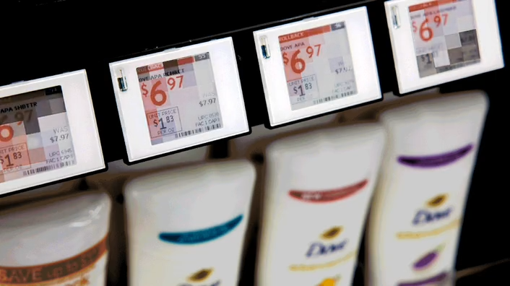
Dynamic Pricing Strategies
Inspect competitor prices, demand trends, and purchasing patterns.
Efficient pricing to be competitive and boost sales
Notes:
Finally, Big Data allows online groceries to conduct dynamic pricing strategies to become more competitive and boost more sales.
This can be achieved by inspecting competitor prices, demand trends, and purchasing patterns to determine the best strategy in achieving growth.
For example, Walmart was recorded to replace price stickers with digital labels that interacts directly with big data, updating prices based on real-time observations in the market without replace the price stickers one by one.
Discounts were also swiftly implemented based on a goods expiration date.

Slide 8

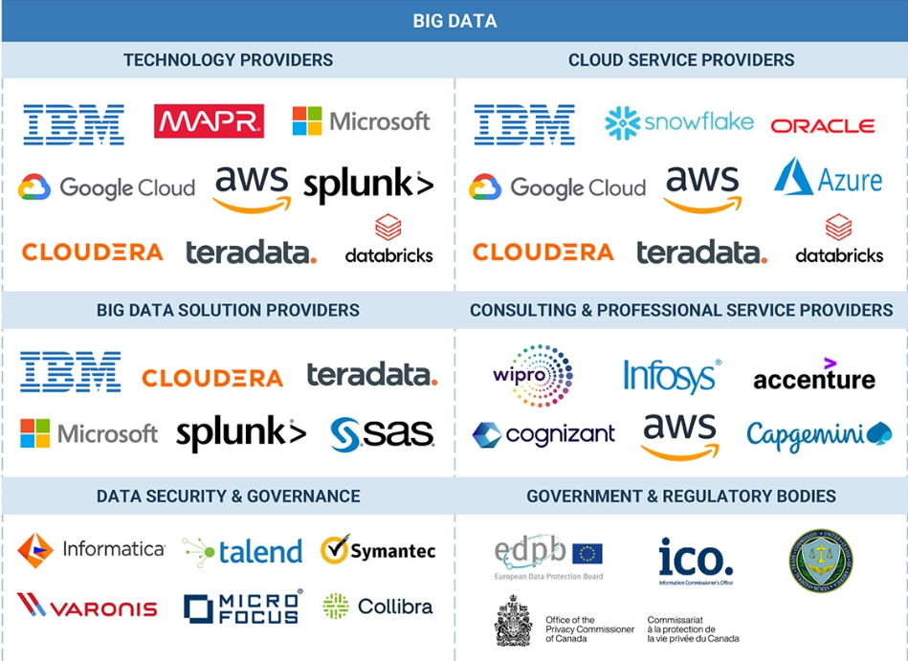

Key Takeaways
From startups to global giants, Big data is invaluable.
Scale operations and boost sales quicker.
But it exploits users for more profit.
Notes:
So, what do these impacts mean. The key takeaways is that companies, whether small or big are consistently using big data to gain an advantage in the industry. Always trying to scale and optimize operations quickly, while ensuring profitability stays high.
However, this practice may lead to easier exploitation of user data to get more profit. Which can be an unethical or even illegal.

Slide 9



Conclusion
Big data provides efficiency, personalization, and sustainability enhancements to online groceries.
Crucial component in a data-driven market
Notes:
In conclusion, an efficient use of big data provides the possibility of efficiency, personalization, and sustainability in he online grocery industry with little side effects.
Making it an essential component in todays data-driven market.

