Slide 1
Automated Covariate-Model Building for Population PK
Nlmixr2 Ecosystem vs. NONMEM
Traditional SCM and cutting-edge VAE
Presenter: Yaping Liu (PMX intern)
Manager: Matt Fidler
Date: 08/17/2026
Notes:
My name is Yaping Liu, and today I will present my internship project on automated covariate-model building for population pharmacokinetics, comparing the nlmixr2 ecosystem with the traditional NONMEM-based workflow.

Slide 2
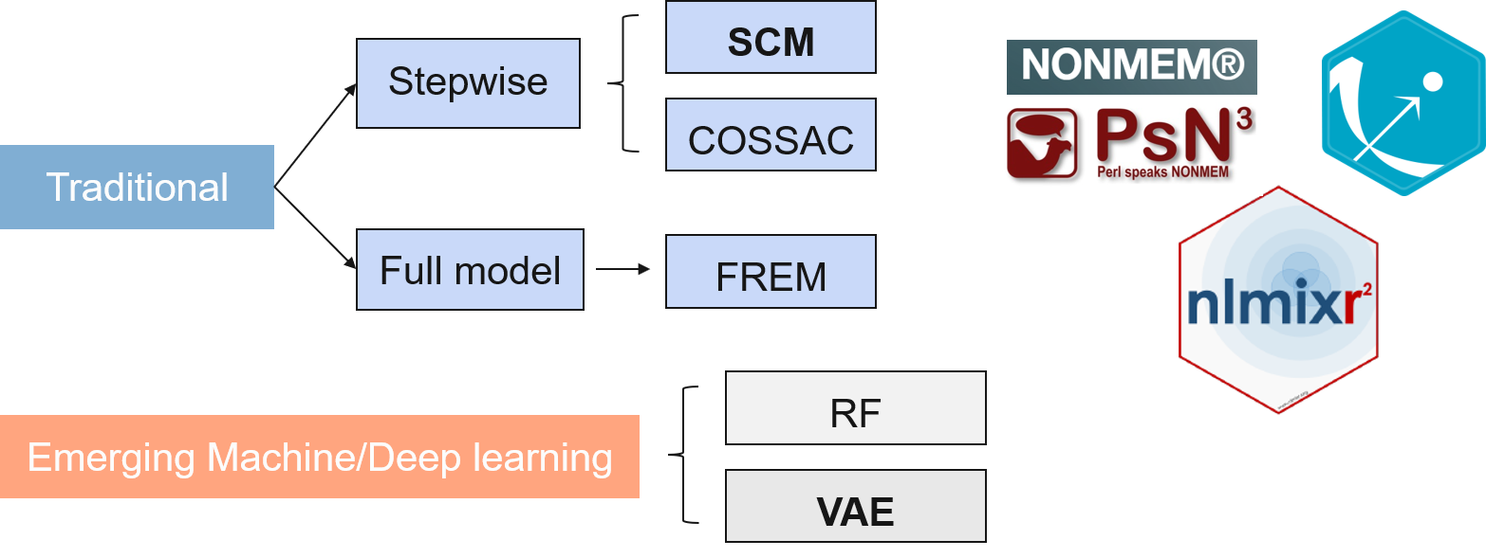
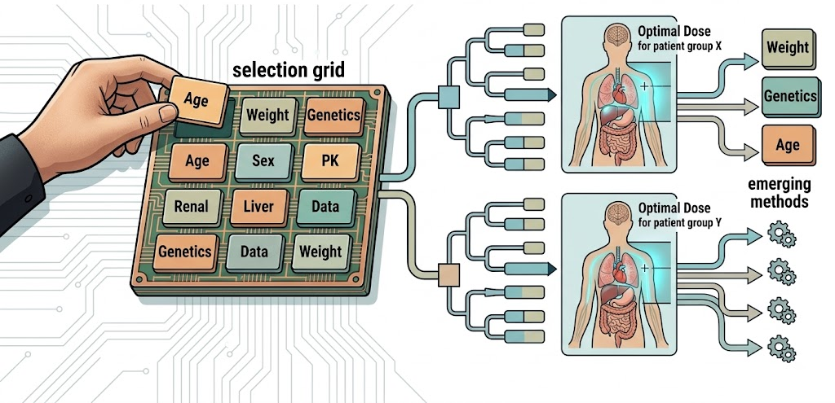
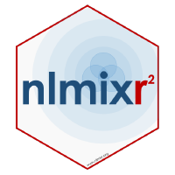


Executive Summary
Covariate selection matters for
dose optimization
2. Tradition & emerging methods & software
(variational autoencoder)
3. Objective: rigorously benchmark nlmixr2-SCM/VAE with NONMEM-SCM
SCM
SCM
VAE
2
Notes:
Why this matters
Covariate model building identifies patient factors that explain interindividual PK variability
Supports dose optimization, trial design, and regulatory submission
Current challenge
Covariate model building is typically done using the stepwise covariate modeling (SCM) in Pearl speaks NONMEM with NONMEM.
However, NONMEM-SCM can be computationally heavy and depends on commercial softwares.
This motivate the development of Open-source and faster alternatives, especially in the nlmixr2 ecosystem, such as, SCM, variational autoencoder (VAE).
However this emerging methods and tools hasn’t been rigorously evaluated against NONMEM-SCM.
Objective: to Evaluate whether the open-source nlmixr2 ecosystem can provide matching performance with the NONMEM standard?

Slide 3
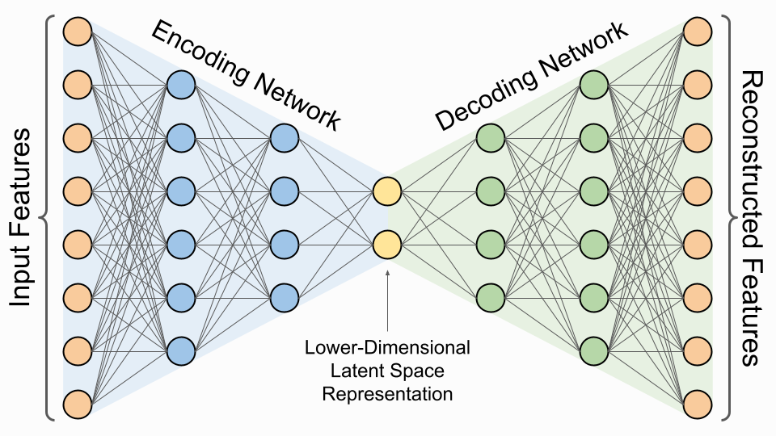
SCM builds the model by adding, then pruning, covariates one at a time
Forward inclusion
Backward elimination
Yes (add, repeat)
Yes (remove, repeat)
LRT
p < 0.05?
p > 0.01?
Base model
Add the most significant
candidate
Remove weakest
Final
model
No
No
VAE can estimate population parameters and covariate effects in a training loop
Pharmaceutical Research 15 (1998): 1463–1468.
3
Notes:
This slide shows how SCM and VAE work.
The key message is that
SCM…
VAE, is a deep leaning methods with encoder and decoder modules.
It can …

Slide 4
Identical simulated data feeds all three workflows for a fair test
1
2
3
Simulate
virtual population
Build
covariate models
Evaluate
operating characteristics
NHANES
Base model
Winner vs. True model
+
Nlmixr2
Reliability
Two compartment linear PK
With known covariate effects
covariates
VAE
Power
SCM
Accuracy
Nonmem
Efficiency
Winner model
3 sample sizes* 2 model parameterization * 16 covariate scenarios * 100 datasets * 3 workflows = 28,800
4
Notes:
Now, let’s look at the overall study design, which has had three steps.
First, we simulated virtual patient populations from NHAENS to get realistic covariate distributions.
Second, using the same simulated datasets as input, we conduct covariate selection with all three covariate-building workflows: nlmixr2 SCM, PsN-NONMEM SCM, and nlmixr2 VAE.
Third, we compared the selected models against the known true model and evaluate operating characteristics, including reliability, power, selection pattern, estimation accuracy, and efficiency.
Because all methods used the same datasets, the statistical comparison was paired, which improves fairness and power.

Slide 5
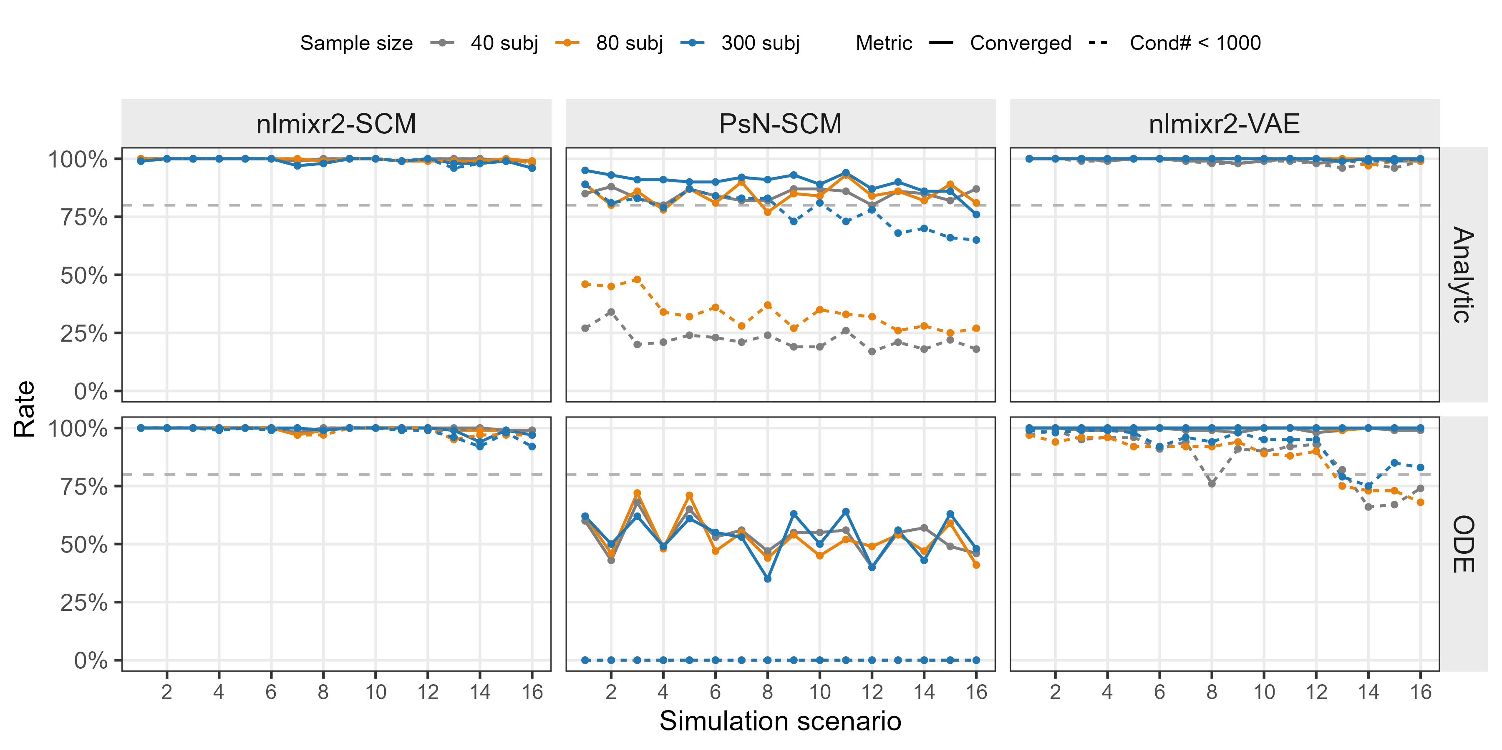
nlmixr2 matches or exceeds NONMEM on convergence & cov_step
1 Reliability
2 Power
3 Accuracy
4 Runtime
Notes:
Now, let’s walk through the results together, The first performance metrics is convergence rate & condition number- based model reliability.
Each column,
Each row
Solid line
Dashed line
When comparing nlmixr2 SCM with PsN-NONMEM SCM, nlmixr2 matched or exceeded NONMEM in convergence-related metrics.
This suggests that for this benchmark, the open-source nlmixr2 SCM workflow was at least as reliable as the NONMEM-based standard.
NONMEM fail to calculate covariance step for ODE, and low convergene rate

Slide 6
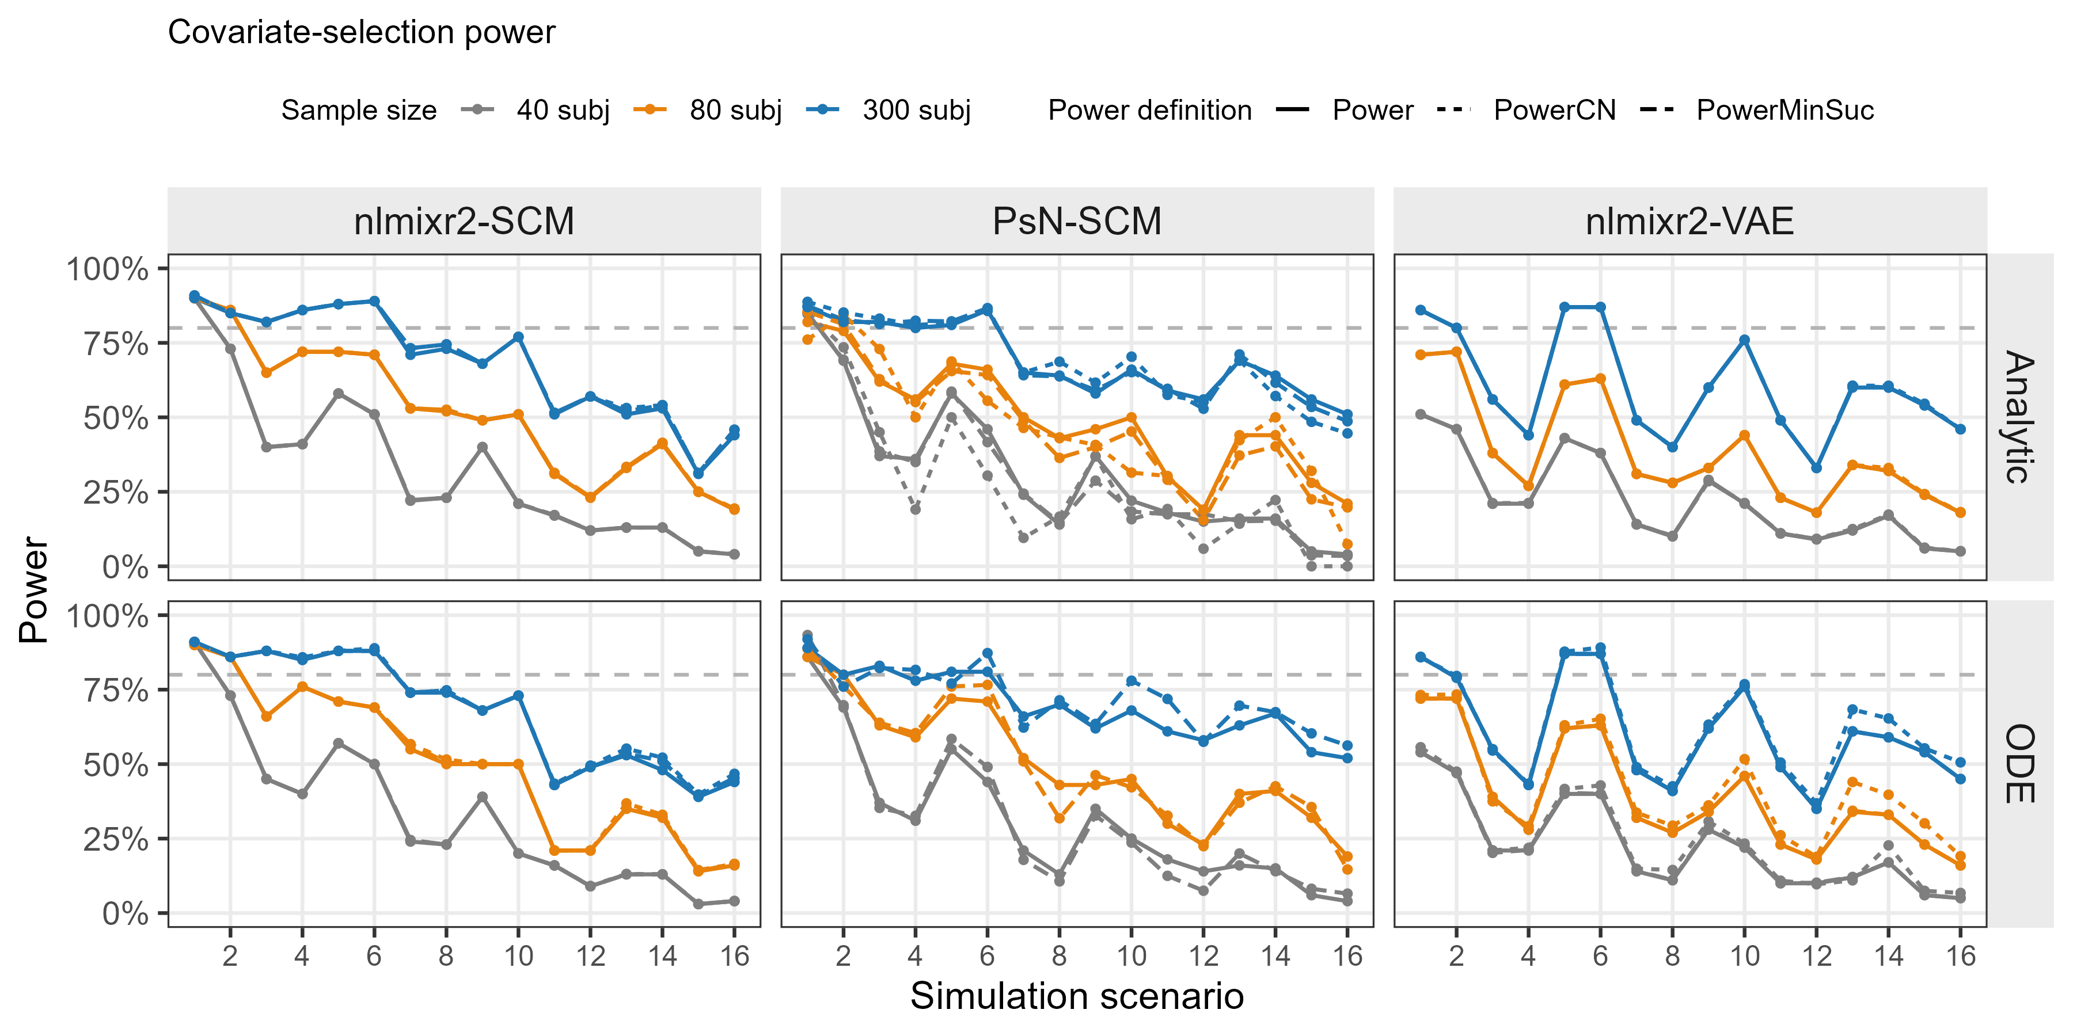

SCM power is comparable across nlmixr2 and NONMEM, and ≥ VAE
Median power over 16 scenarios
Power = $\frac{N_{exact_match}}{N_{total}}$
73%
66%
58%
33%
50%
45%
Power & linear
23%
23%
19%
BW vs. BMI
1 Reliability
2 Power
3 Accuracy
4 Runtime
6
Notes:
The second performance metrics is
The power is unconditional & conditional on stable models.
The numbers are median power over 16 scenarios.
Similar power trend was found across the three workflow.
Nlmixr2-scm similar to NONMEM > VAE
Power loss concentrated on two cases 1. competing shapes 2. highly colinear covariate pairs.

Slide 7
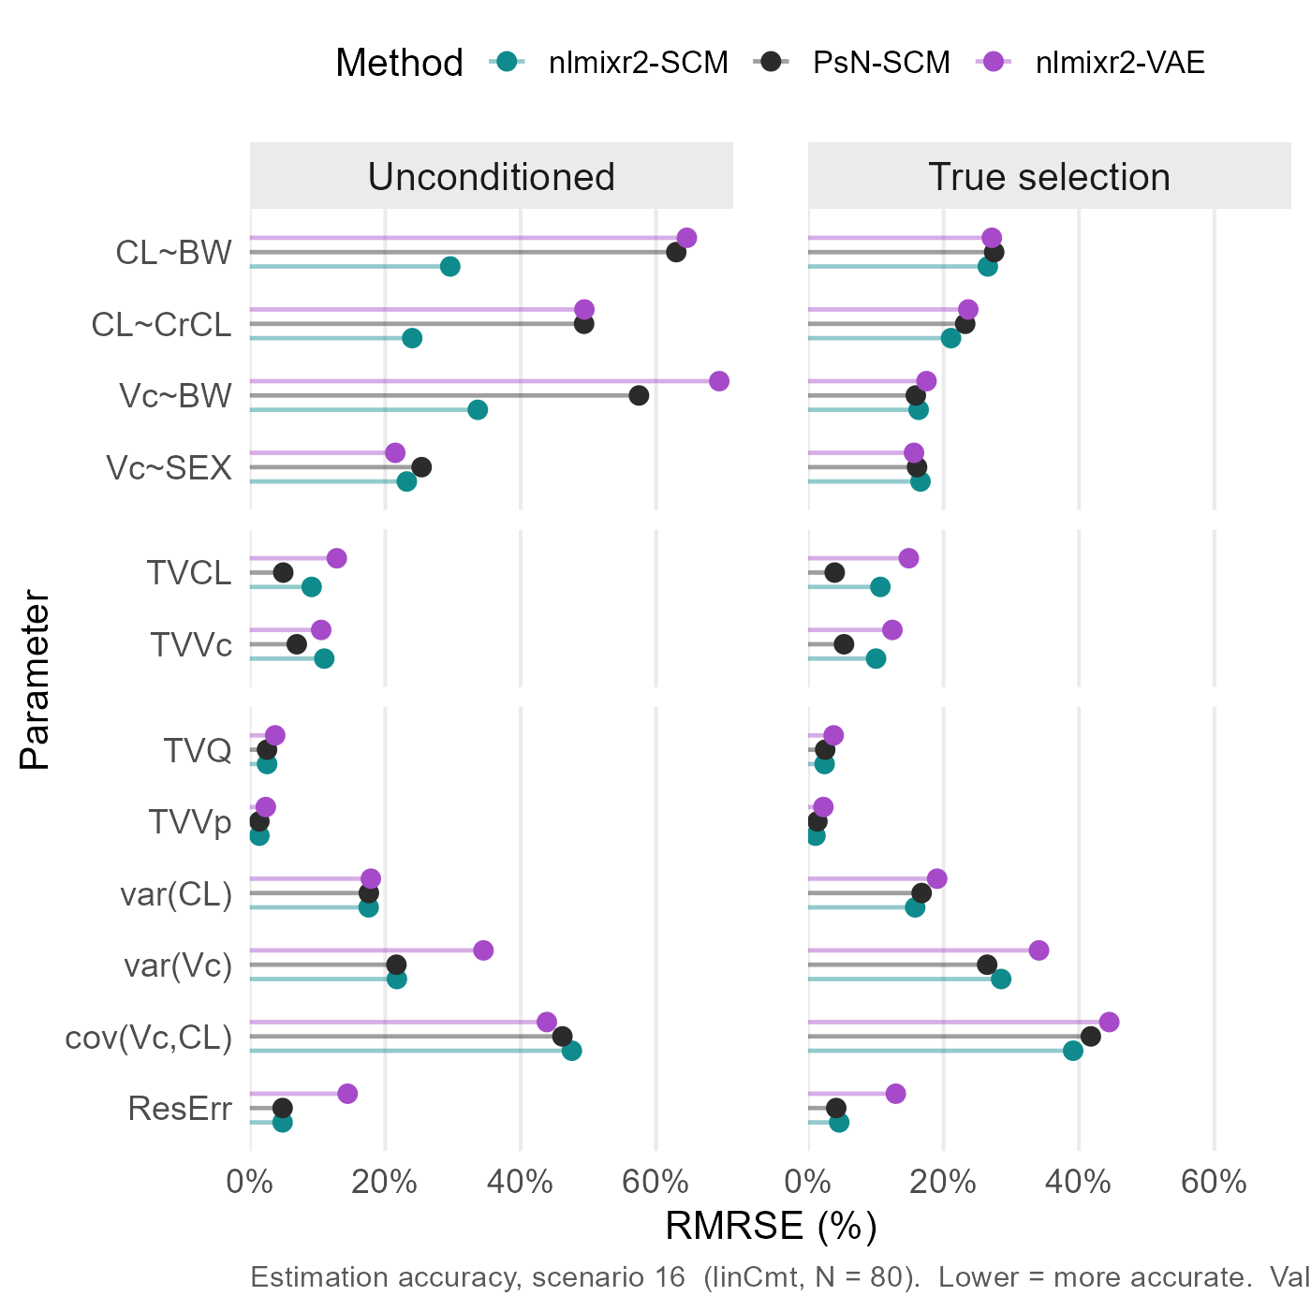
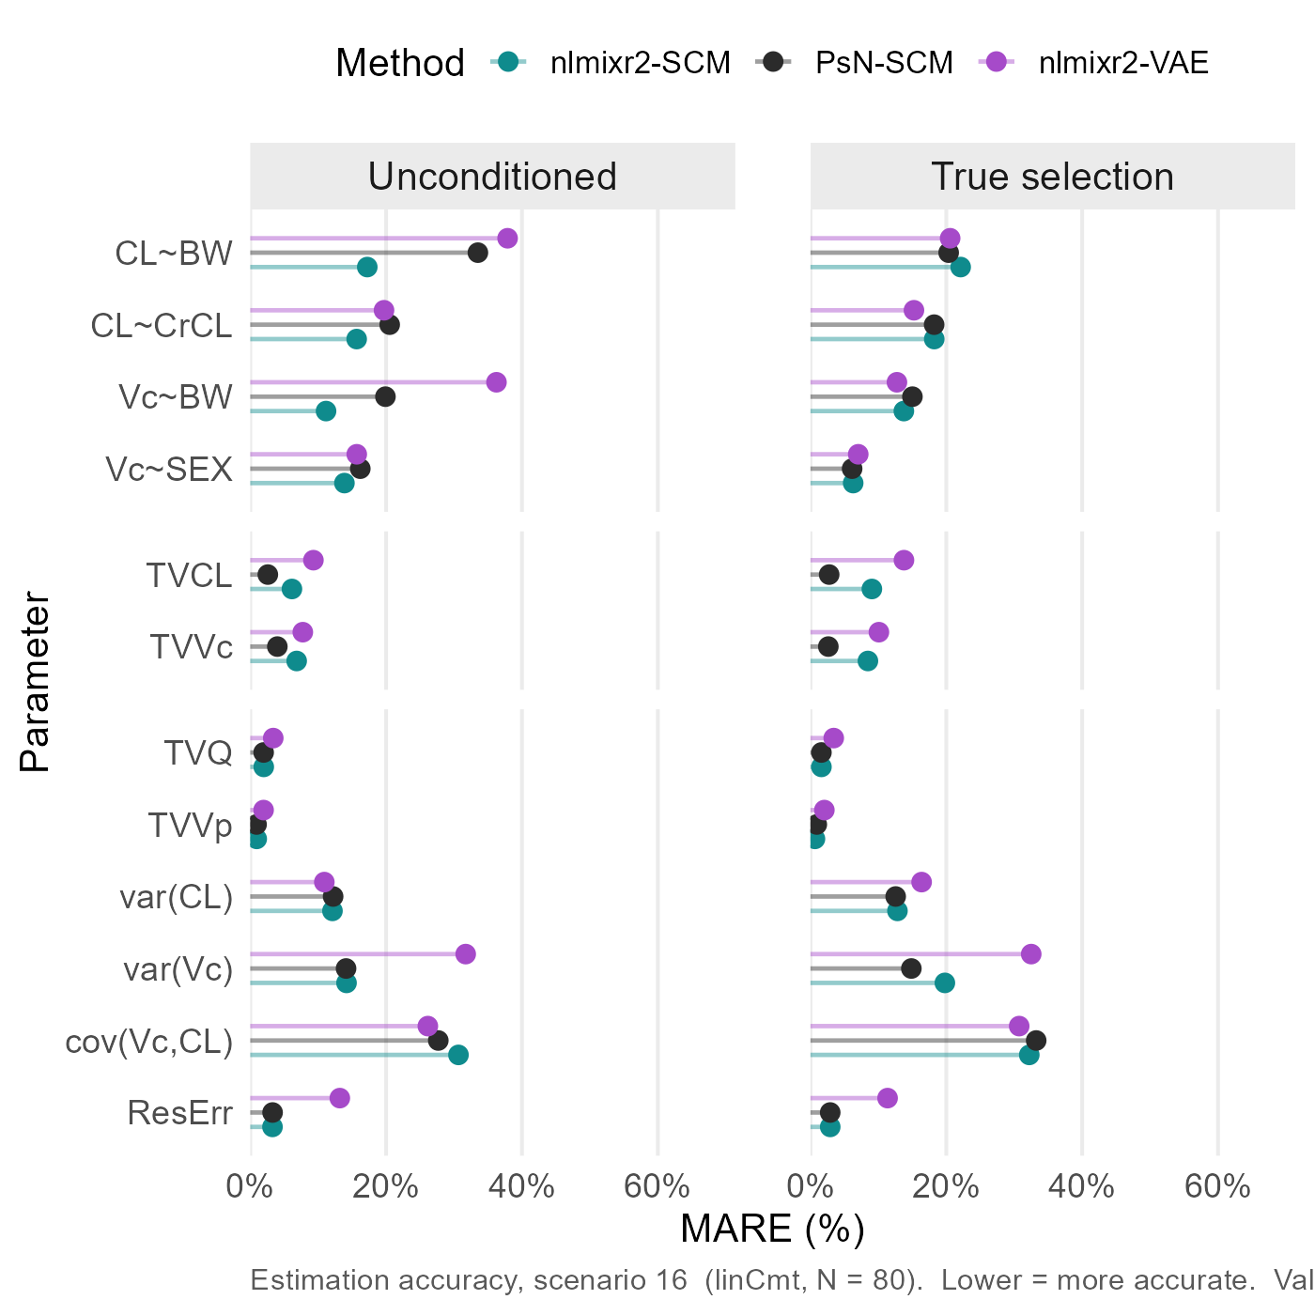
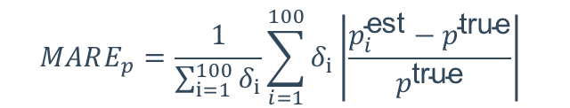
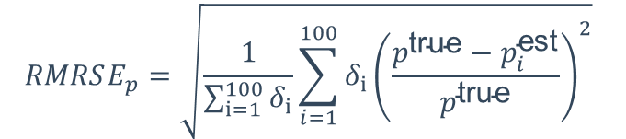
Estimation accuracy is comparable across nlmixr2, NONMEM, and VAE
Scn16 + N80 + Analytic
$$RMRSE_{p}=\sqrt{\frac{1}{\sum_{i=1}^{100}{δ_{i}}}\sum_{i=1}^{100}{δ_{i}{\left(\frac{p^{\text{true}}−p_{i}^{\text{est}}}{p^{\text{true}}}\right)}^{2}}}$$
$$MARE_{p}=\frac{1}{\sum_{i=1}^{100}{δ_{i}}}\sum_{i=1}^{100}{δ_{i}\left|\frac{p_{i}^{\text{est}}−p^{\text{true}}}{p^{\text{true}}}\right|}$$
Estimation accuracy: nlmixr2-SCM $≈\text{PsN}\text{_}\text{SCM}≈\text{nlmixr}\text{2}\text{−}\text{VAE}$
Estimation difficulty: covariance> variance $≈$covariate effect > typical value
1 Reliability
2 Power
3 Accuracy
4 Runtime

Slide 8
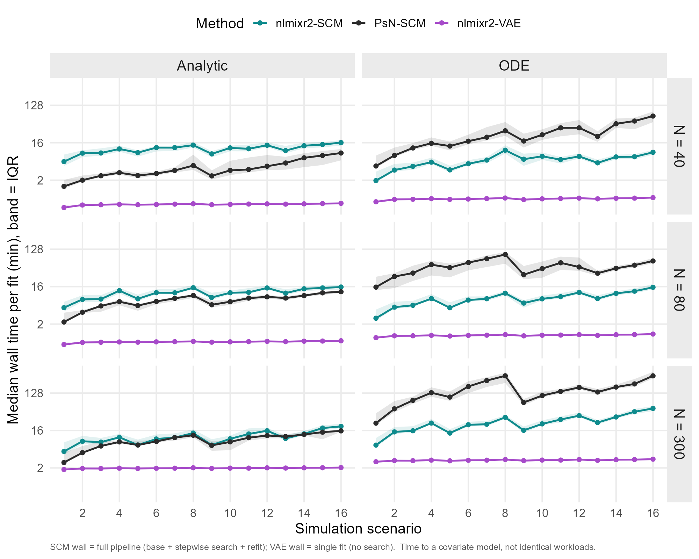
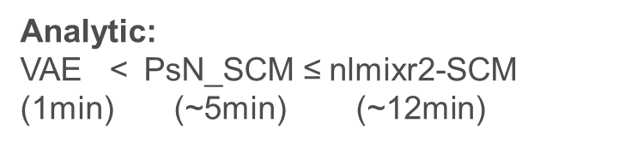
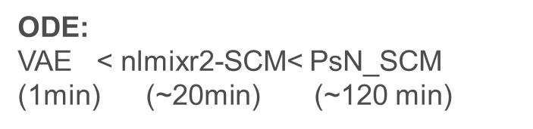
The VAE can be substantially than NONMEM-SCM_ODE
4 CPU cores
Log Scale
Run time:
VAE << nlmixr2 < NONMEM
Analytic << ODE
sample size ↓, runtime ↓
Analytic:
VAE < $\text{PsN}\text{_}\text{SCM}$ ≤ nlmixr2-SCM (1min) (~5min) (~12min)
ODE:
VAE < nlmixr2-SCM< $\text{PsN}\text{_}\text{SCM}$ (1min) (~20min) (~120 min)
1 Reliability
2 Power
3 Accuracy
4 Runtime
8
Notes:
Here is the runtime comparison across three platform.
Run time of covariate selection varies across workflow, and is associated with sample size and model structure.
For analytical solution, VAE is extremely faster than SCM, with NONMEM slightly faster than nlmixr2
For ODE, VAE is still extremely faster than SCM, with nlmixr2 substantially faster than NONMEM.
Different optimizer
Different covariate selection procedures. For nlmixr2, all var-covar-shape is fitted at each step, where as NONMEM deal with shape in a Warmup
Analytic (left): PsN (black) and nlmixr2-SCM (teal) are comparable — PsN slightly cheaper at low scenarios (2–9 min), nlmixr2-SCM ~10–13 min. Both climb mildly with scenario complexity.ODE (right) — the headline: PsN explodes to 15–95 min (median), roughly 3× nlmixr2-SCM across all 16 scenarios. nlmixr2-SCM stays flat at ~10–20 min. The gap is large and consistent — exactly where you expected.VAE (purple): flat ~1–1.5 min everywhere, structure-independent (single fit, no search) — an order of magnitude below both SCM pipelines. Caveat annotated.

Slide 9
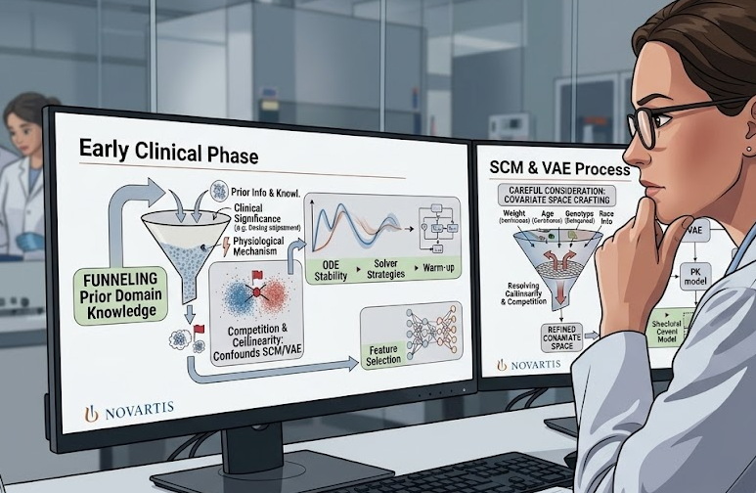
Collinearity and Small samples remain the main challenges
Competing shapes + Collinearity confound selection → Domian knowledge → clinical significance/biological plausibility
Small N sharply reduces power
→ interpret covariate models cautiously
9
Notes:
This reinforces the importance of domain knowledge. Covariate selection should not be treated as a purely automated process. Clinical relevance, biological plausibility, and interpretability still matter.
From a computational perspective, analytic solutions were generally more stable and efficient than ODE-based models.
For complex ODE models, a warm-start strategy such as the Brent-based approach may help improve robustness.

Slide 10
Open-source nlmixr2 SCM matches/outperforms NONMEM
SCM:
Comparable power & accuracy
Faster; Better Reliability; Open source
SCM
VAE：
Extremely Faster; Open source
Comparable power & accuracy for easy covariate space
10
Notes:
To conclude, this project showed that open-source nlmixr2 SCM can match or outperform the traditional PsN-NONMEM SCM workflow in this simulation benchmark.
For SCM, nlmixr2 showed:
comparable power, comparable estimation accuracy,
strong reliability, faster runtime, and the advantage of being open source.
For the VAE method, the main strength is speed. It was much faster and showed comparable accuracy and reasonable power in easier covariate spaces.
However, in more complex scenarios, SCM still performed better for exact covariate recovery.
So the overall take-home message is:
nlmixr2 SCM is a credible open-source alternative to NONMEM SCM, while VAE is a promising fast screening method that may complement, but not yet replace, traditional SCM.

Slide 11
References
1.Lane S, Al-Zubiedi S, Hatch E, et al. The population pharmacokinetics of R- and S-warfarin: effect of genetic and clinical factors. Br J Clin Pharmacol. 2012;73(1):66-76. doi:10.1111/j.1365-2125.2011.04051.x
2. Ribbing J, Nyberg J, Caster O, Jonsson EN. The lasso--a novel method for predictive covariate model building in nonlinear mixed effects models. J Pharmacokinet Pharmacodyn. 2007;34(4):485-517. doi:10.1007/s10928-007-9057-1
3. Karlsen M, Khier S, Fabre D, et al. Covariate Model Selection Approaches for Population Pharmacokinetics: A Systematic Review of Existing Methods, From SCM to AI. CPT Pharmacometrics Syst Pharmacol. 2025;14(4):621-639. doi:10.1002/psp4.13306
4. Jonsson EN, Karlsson MO. Automated covariate model building within NONMEM. Pharm Res. 1998;15(9):1463-1468. doi:10.1023/a:1011970125687
5. Rohleff J, Bachmann F, Nahum U, et al. Redefining Parameter Estimation and Covariate Selection via Variational Autoencoders: One Run Is All You Need. CPT Pharmacometrics Syst Pharmacol. 2025;14(12):2232-2243. doi:10.1002/psp4.70129
6. Ahamadi M, Largajolli A, Diderichsen PM, et al. Operating characteristics of stepwise covariate selection in pharmacometric modeling. J Pharmacokinet Pharmacodyn. 2019;46(3):273-285. doi:10.1007/s10928-019-09635-6
7. https://github.com/nlmixr2/nlmixr2/blob/main/vignettes/articles/vaeNeonatal.Rmd

Slide 12
Acknowledgement
Matt Fidler
Justin Wilkins and the rest nlmixr2 development team
PMX team
Notes:
I am incredibly grateful for my manager, Matt Fidler. This project wouldn’t be possible without his guidance and support.
I also want to thank Justin Wilkins, who is the other primary developer of nlmixer2scm R package. As well as the whole nlmixr2 development team for their enthusiasm and passion and contribution to open science.
PMX team for this platform to learn from all of you.

Slide 13
Thank you for your attention! Any questions?

