Slide 1
Automated Covariate-Model Building for Population PK
Nlmixr2 Ecosystem vs. NONMEM
Traditional SCM and cutting-edge VAE
Presenter: Yaping Liu (PMX intern)
Manager: Matt Fidler
Date: 08/18/2026
Notes:
Good morning, everyone. My name is Yaping Liu. I am a summer PMX intern, working with Matt Fidler. I PhD at the University of Michigan Ann Arbor. My research sits at the intersection of precision oncology, biomarker research and pharmacometics.
And today I will present my internship project: Automated Covariate-Model Building for Population PK — benchmarking the nlmixr2 ecosystem against NONMEM.

Slide 2
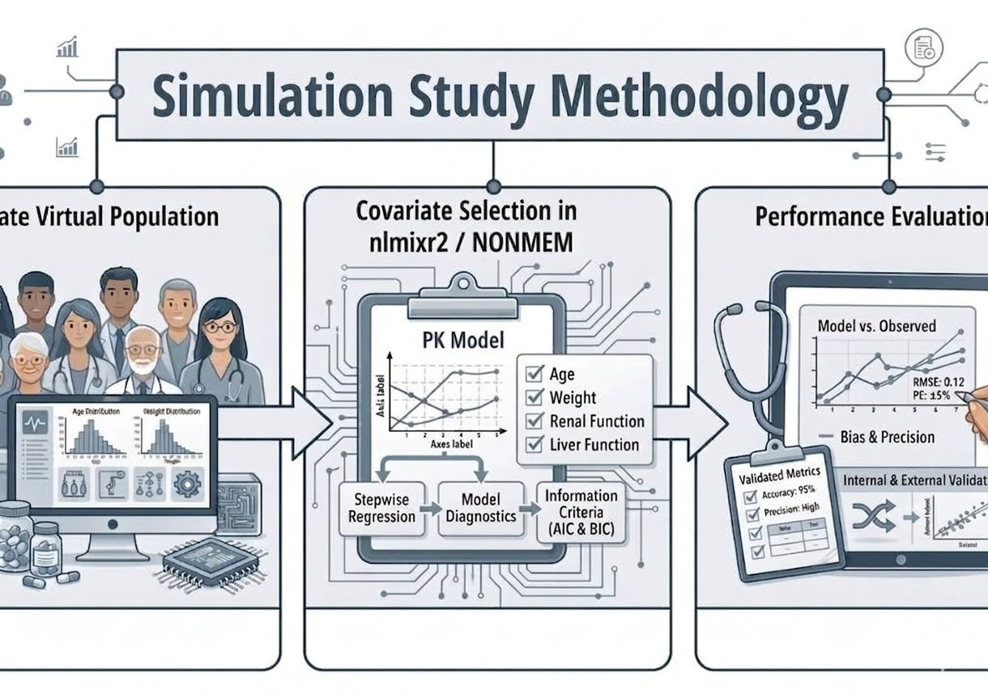
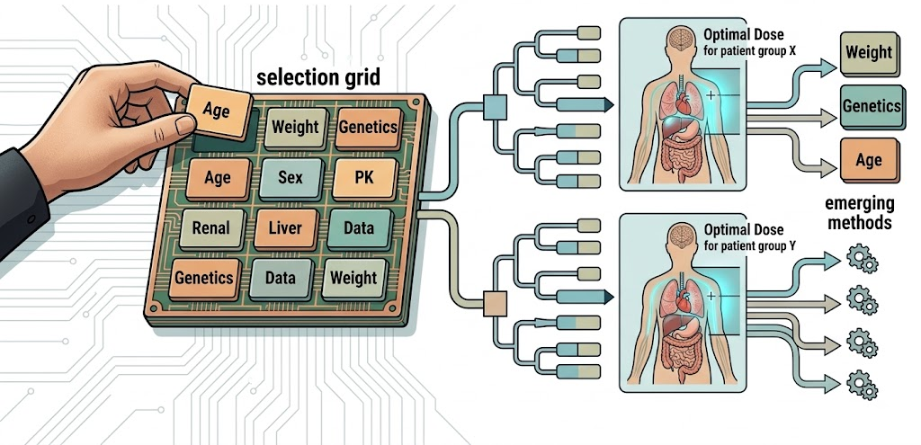






Roadmap
1. Covariate selection matters for dose optimization
2. Benchmark nlmixr2 vs. NONMEM
3. nlmixr2 matches NONMEM
4. Cautious interpretation & domain knowledge
$$≈$$
$$>$$
Notes:
Here is the roadmap.
I will start with the background: why covariate selection matters clinically, and what methods and tools are available today.
Then I will walk through the methods — how I simulated virtual populations, built covariate models, and evaluated performance.
Then the results, where I will show you that the nlmixr2 ecosystem matches NONMEM on covariate selection — and beats it on reliability and, for ODE models, on speed.
And I will close with the limitations and the take-away messages.

Slide 3
1 Background
2 Methods
3 Results
4 Discussion
3
Notes:
So let's start with the background.

Slide 4
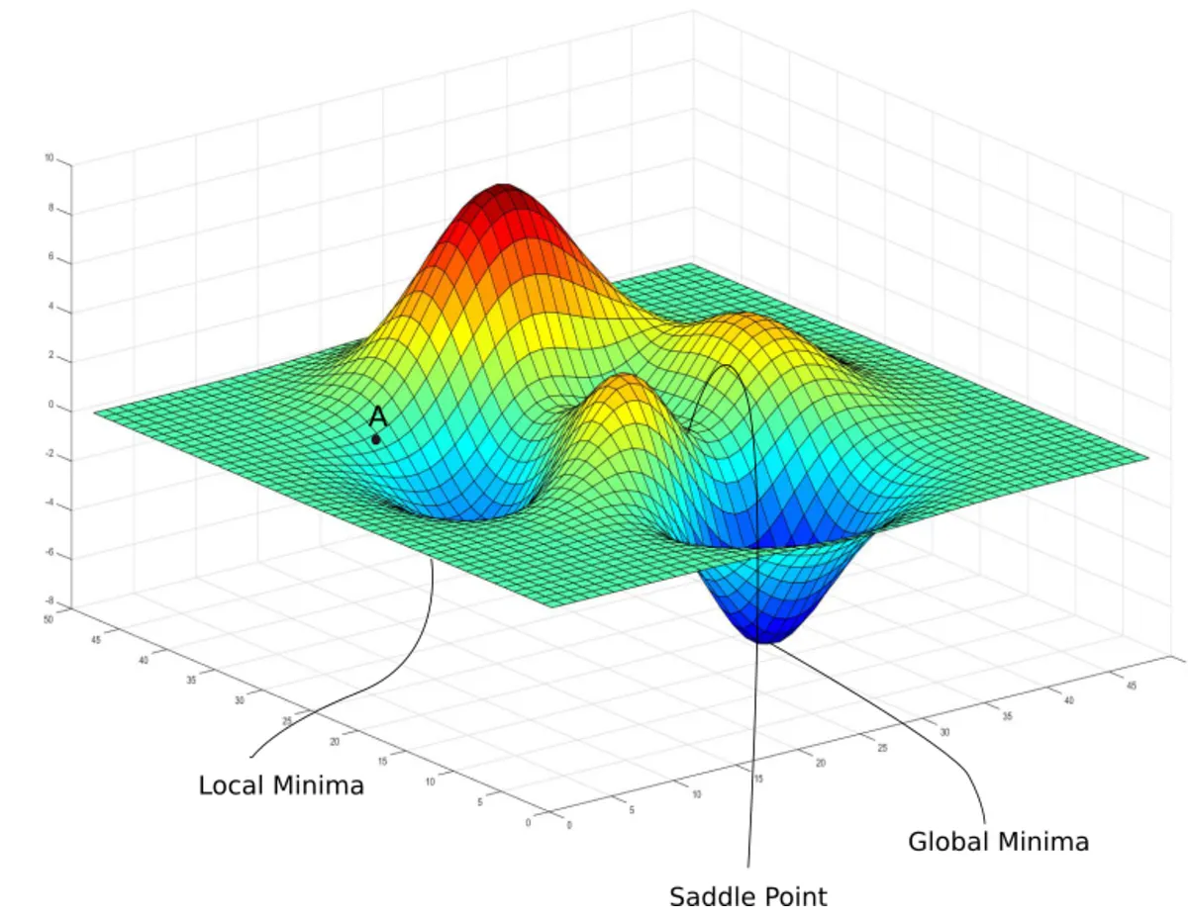
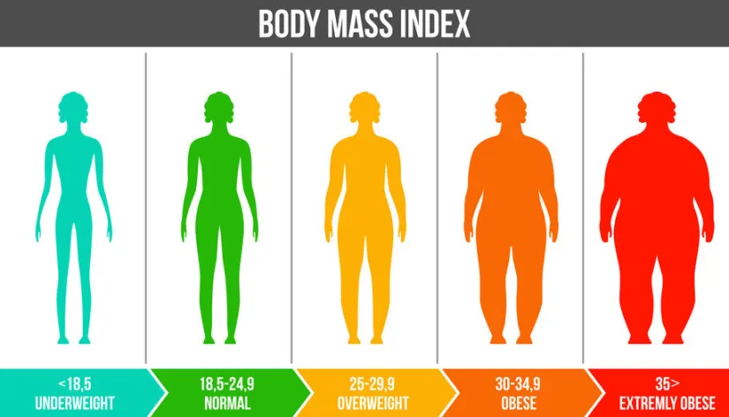

Population PK explains why drug exposure differs between patients
Nonlinear Mixed effect Models
Max(likelihood) Min(objective function)
Residual variability
C
Inter-individual variability
BW~CL
Time
https://pub.towardsai.net/from-probability-to-loss-how-mle-builds-machine-learning-part-1-52fe0efa43a9
4
Notes:
Some of you may not work with population PK every day, so let me set the stage.
At its core, a population PK model is a nonlinear mixed-effects model. What it does is explain why drug exposure differs between patients.
Look at the black curve. That is our typical patient — body weight is the median of the population. Now assume body weight is associated with clearance.
The underweight patient, in green, has lower clearance, so higher exposure. The overweight patient, in orange, has higher clearance, so lower exposure.
That spread between the individual curves and the typical curve is the inter-individual variability
And the distance from the green curve to the green dots — the actual observations — is the unexplained residual variability.
The model finds its parameters by maximizing the likelihood of the observations, which is the same thing as minimizing the objective function.

Slide 5




The right covariates turn patient traits into Safer, more effective doses
Example — Warfarin
Narrow therapeutic narrow-therapeutic-index anticoagulant
Dose optimization
Clinical trial design
Clotting
Bleeding
Special-population labeling
CYP2C9 genotype, age, weight, comedication
Regulatory submissions
Br J Clin Pharmacol. 2012;73(1):66-76.
5
Notes:
So population PK tells us that patients differ. The next question is: can we explain that difference with something we can measure in the clinic?
That is exactly what covariate selection does. The right covariates turn patient characteristics into safer and more effective doses.
The classic example is warfarin — a narrow therapeutic index anticoagulant. If the dose is too high, the patient risks bleeding. If the dose is too low, the patient risks clotting. Studies have shown that CYP2C9 genotype, age, weight, and comedication can guide dose selection for these patients.
More broadly, covariate analysis supports dose optimization, clinical trial design, special-population labeling, and regulatory submissions.
So covariate model building is not just a modeling exercise. It feeds directly into drug development decisions. That is why the tool we use for it matters.

Slide 6

Traditional stepwise methods are FDA-ready,
with advanced methods emerging
SCM
Stepwise
COSSAC
Traditional
Full model
FREM
RF
Emerging Machine/Deep learning
VAE
CPT Pharmacometrics Syst Pharmacol. 2025;14(12):2232-2243.
Journal of Pharmacokinetics and Pharmacodynamics 34 (2007): 485–517.
Pharmaceutical Research 15 (1998): 1463–1468.
CPT: Pharmacometrics & Systems Pharmacology, 2025; 14:621–639
Notes:
So how do people build covariate models today?
There are many methods.
The traditional and most widely accepted approach is stepwise covariate modeling — SCM. It is usually run with PsN and NONMEM, and it has a long track record in regulatory submissions. That is our benchmark today.
COSSAC is another stepwise method, available in Monolix, another popular commercial software. There are also full-model approaches, such as FREM.
And more recently we see machine learning and deep learning methods — random forests, and variational autoencoders, or VAE.
Now, the nlmixr2 ecosystem offers both ends of this spectrum: the traditional SCM, and the cutting-edge VAE. Both are open source and free.
But neither has been rigorously tested against NONMEM. That gap is the reason for this project.

Slide 7
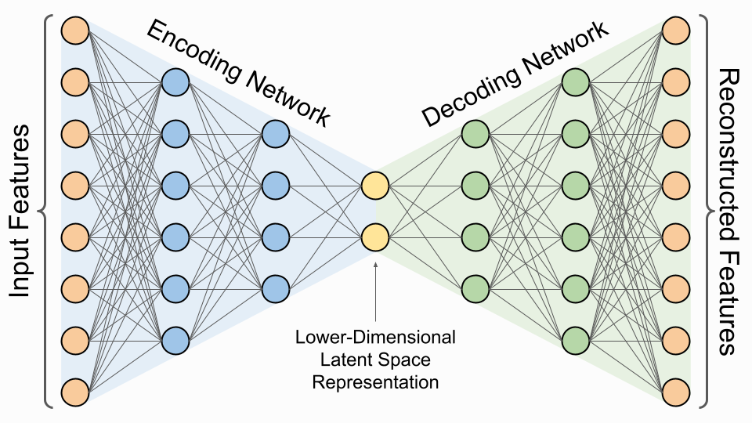
SCM builds the model by adding, then pruning, covariates one at a time
Forward inclusion
Backward elimination
Yes (add, repeat)
Yes (remove, repeat)
LRT
p < 0.05?
p > 0.01?
Base model
Add the most significant
candidate
Remove weakest
Final
model
No
No
VAE can estimate population parameters and covariate effects in a single run
Pharmaceutical Research 15 (1998): 1463–1468.
7
Notes:
Before I state the objective, let me make sure the two methods we are benchmarking are clear, because their difference explains almost every result later.
The key message on this slide is the contrast.
SCM builds the model one covariate at a time. In forward inclusion, it starts from a base model with no covariates, tests every candidate, and adds the most significant one — here, using a likelihood ratio test with p below 0.05. Then it repeats. In backward elimination, it removes covariates one at a time, keeping only those that survive a stricter criterion, p below 0.01.
This is intuitive and accepted — but it requires many, many model fits.
The VAE does something fundamentally different. It estimates the population parameters and the covariate effects in a single run. One fit, not hundreds. So we expect it to be far more efficient than SCM.

Slide 8
We benchmark nlmixr2's SCM and VAE against the NONMEM standard
To evaluate the operating characteristics of traditional (i.e., SCM) and novel (i.e., VAE) covariate model building methods in the open-source nlmixr2 ecosystem, benchmarking against PsN-NONMEM-SCM.
8
Notes:
The objective of this project was to evaluate the operating characteristics of the traditional method, SCM, and the novel method, the VAE, inside the open-source nlmixr2 ecosystem — benchmarked against the PsN-NONMEM SCM standard.
So, three workflows throughout this talk: nlmixr2-SCM, nlmixr2-VAE, and PsN-NONMEM-SCM as the reference. And four questions about each: is it reliable, does it find the true model, are the estimates accurate, and how fast is it.

Slide 9
1 Background
2 Methods
3 Results
4 Discussion
9
Notes:
Now the methods. I will cover how I simulated the virtual populations, how the covariate models were built, and how performance was evaluated.

Slide 10
Identical simulated data feeds all three workflows for a fair test
1
2
3
Simulate
virtual population
Build
covariate models
Evaluate
operating characteristics
NHANES
Base model
Winner vs. True model
+
Nlmixr2
Reliability
True PopPK
Full model
covariates
VAE
Power
SCM
Accuracy
Nonmem
Efficiency
Winner model
Paired Statistical Test
3 sample size * 2 model parameterization* 16 scenarios * 100 datasets * 3 workflows = 28,800 tasks
10
Notes:
Here is the overall study design, which has three main steps.
First, we simulated virtual patient populations using NHAENS national survey and a true linear PK model.
Second, we built covariate models using the same simulated datasets as input to all three covariate-building workflows: nlmixr2 SCM, PsN-NONMEM SCM, and nlmixr2 VAE.
Third, we compared the selected models against the known true model, and evaluate several operating characteristics, including reliability, power, estimation accuracy, and efficiency.
Because all methods used the same datasets, the statistical comparison was paired, which improves fairness and statistical power.

Slide 11
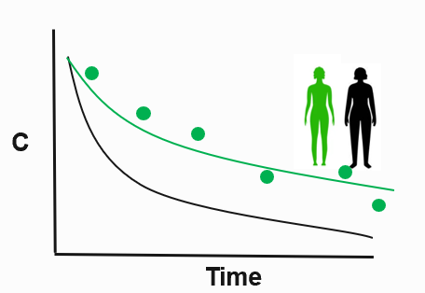
Simulate virtual populations with realistic covariate correlation & PK
1
2
Dose
NHANES
Ka
Vp
Q
Vc
CL
Stratified
Bootstrap
N= 300
N= 80
N= 40
|delta_correlation| < 0.05
Cohort, Dataset, ID, Wt, BMI, CrCL, Sex, Race
Scenario, Time, Dose, Concentration
J Pharmacokinet Pharmacodyn. 2019;46(3):273-285.
11
Notes:
Let me unpack each step, starting with the simulation.
From the NHANES, national survey, We used stratified bootstrapping by sex and race to preserve realistic covariate distributions and correlations.
We simulated three sample sizes and checked the difference in covariate correlations between NHANES and the simulated datasets was below 0.05. So the realistic correlation structure is preserved.
That gives us virtual patients with body weight, BMI, creatinine clearance sex and race.
Now that we have the covariate values,
we could further simulate concentrations from the full PK model with known covariate effects, which is a two-compartment linear PK model with first-order absorption.
Use the same example in the background, this step give us the green dots, the PK observations

Slide 12
Design 16 scenarios with easy → complex covariate effects from the overall covariate space
Overall covariate space
Power
Linear
Wt
Sex
Wt
Vc
Vc
Wt
Base Model (No covariate)
BMI
Full Model
BMI
CL
CL
CrCl
Wt
CrCl
CrCl
Categorical
Scenario 1
(Easiest)
Scenario 16
(Most complex)
Scn2-15
Race
Sex
(16 combinations in total)
J Pharmacokinet Pharmacodyn. 2019;46(3):273-285.
12
Notes:
We designed sixteen scenarios, from easy to complex. The candidate space has three continuous covariates — weight, BMI, and creatinine clearance.
For each of them, the relationship with the PK parameter can be power or linear on the log scale And we have two categorical covariates, sex and race. Any of these can act on clearance or on volume of distribution.
Scenario 1 is the easiest: no covariate effect at all, just the base model. Scenario 16 is the most complex: weight and sex on volume, plus creatinine clearance on clearance. Scenarios 2 through 15 fill the space in between.
Two features of this design are deliberate, and they will come back in the results: competing shapes — the same covariate can enter as linear or as power — and collinearity — weight and BMI are strongly correlated. Both are traps, on purpose.

Slide 13
Set up three workflows for benchmarking
 | Nlmixr2-SCM | PsN-SCM | Nlmixr2-VAE
Model type | lincmt (analytic) ODE | ADVAN4 (analytic) ADVAN13 (ODE) | lincmt (analytic) ODE
Estimator | FOCEI | FOCEI | VAE
Convergence-related settings | Sigdig =4 Tol=1e-6 Atol=1e-8 | Sigdig =4 Tol=1e-6 Atol=1e-8 | Sigdig =4 Tol=1e-6 Atol=1e-8
LRT criteria | Forward p<0.05 / Backward p<0.01 | Forward p<0.05/ Backward p<0.01 | N.A.
Warm Start | Yes | N.A. | N.A.
Parallelism | HPCE/CPU core = 4 | HPCE/CPU core = 4 | HPCE/CPU core = 4
N.A., not applicable
13
Notes:
For a fair comparison, the configurations other than the tool differences should be held identical across workflows.
Each workflow is run with both parameterizations — the analytic solution and the ODE form. For both SCM workflows the estimator is FOCEI; for the VAE it is the VAE algorithm. The convergence settings are identical — four significant digits, the same solver tolerances. The likelihood ratio test criteria are the same: forward p below 0.05, backward p below 0.01.
There is one asymmetry, and I want to be transparent about it. We added a warm start to the nlmixr2 search to improve selection performance. NONMEM has no equivalent setting — but NONMEM has its own internal machinery
Finally, every task ran on the same HPC cluster with four CPU cores, so the runtime comparison is apples to apples.
Now, let’s look at the settings for covariate selection in the three workflows. The principle here is keep the shared settings that may affect covariate selection performance the same for fair comparison.
sigdig is the convergence target, atol/rtol are ODE-solver accuracy sigdig = 4 drives the FOCEi outer optimizer's stopping/convergence criterion (internally translated into OFV/parameter tolerances — "stop when stable to ~4 significant figures"). This is the one directly tied to "convergence."atol = 1e-8, rtol = 1e-6 are the rxode2 ODE integration tolerances — how accurately the concentration-time curve is solved per evaluation. They affect convergence only indirectly (via objective noise).

Slide 14
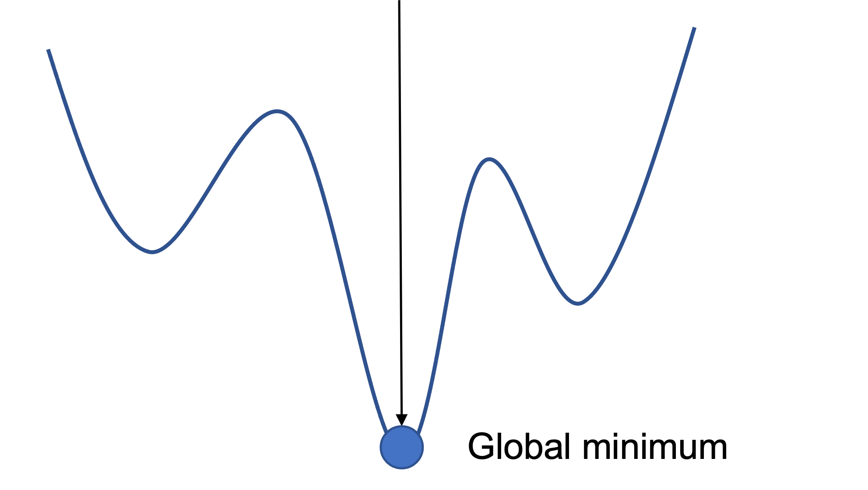
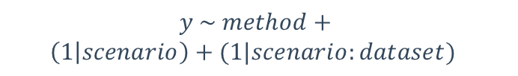


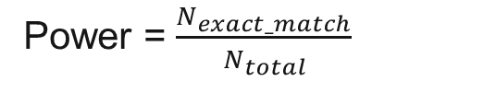

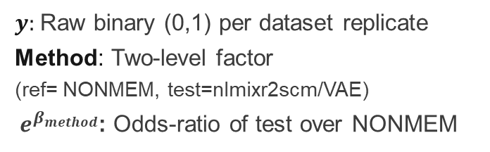

Four operating characteristics score every method
1
2
Primary statistical test
paired mixed-effects model
Model Reliability
Power (Exact match)
Convergence
Power = $\frac{N_{exact_match}}{N_{total}}$
$$y \sim method+$$
$$\left(1 | scenario\right)+(1|scenario:dataset)$$
${\text{Power}}_{MinSuc}$ = $\frac{N_{exact_match}}{N_{total}}$
$y:$Raw binary (0,1) per dataset replicate
Method: Two-level factor (ref= NONMEM, test=nlmixr2scm/VAE)
$e^{β_{method}}$: Odds-ratio of test over NONMEM
$$MinSuc$$
${\text{Power}}_{CN}$ = $\frac{N_{exact_match}}{N_{total}}$
$$\#CN<1000$$
Condition Number
nlmixr2&NONMEM
Fallback: exact McNemarTest
#CN ≤ 1000
Under ceiling / separation (e.g., Convergence rates pinned at 100%)
14
Notes:
So: same data, same truth, same settings. Now, how do we score them?
Four operating characteristics
The first is model reliability — can the software actually fit the model? We look at the convergence rate, and at the condition number below 1000, which is the empirical threshold for numerically stable estimation.
The second is power — the proportion of replicate datasets where the selected model exactly matches the true model. We report it two ways: unconditionally, and conditional on stable runs only.
Regarding statistics tests, the primary analysis is a paired mixed-effects model,
where y is binary endpoint for each dataset replicate and
the method is a two-level factor — NONMEM as the reference, and either nlmixr2-SCM or the VAE as the test.
Because scenarios and datasets differ in difficulty, they enter as random intercepts.
The exponentiated coefficient is then the odds ratio of the test method versus NONMEM.
When the data had ceiling effects or perfect separation, such as convergence rates pinned at 100%, we used an exact McNemar test as a fallback.

Slide 15
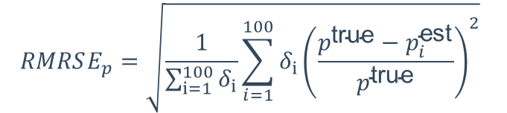
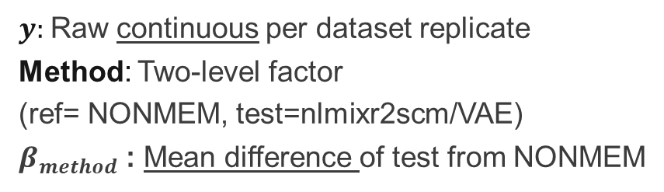
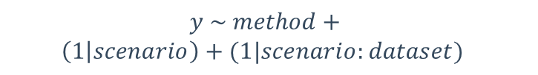
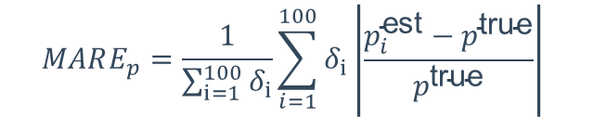
Four operating characteristics score every method
3
Estimation accuracy
Primary statistical test
paired mixed-effects model
RMRSE — outlier-sensitive
$$RMRSE_{p}=\sqrt{\frac{1}{\sum_{i=1}^{100}{δ_{i}}}\sum_{i=1}^{100}{δ_{i}{\left(\frac{p^{\text{true}}−p_{i}^{\text{est}}}{p^{\text{true}}}\right)}^{2}}}$$
$$y \sim method+$$
$$\left(1 | scenario\right)+(1|scenario:dataset)$$
MARE — robust
$y:$Raw continuous per dataset replicate
Method: Two-level factor (ref= NONMEM, test=nlmixr2scm/VAE)
$β_{method}$: Mean difference of test from NONMEM
$$MARE_{p}=\frac{1}{\sum_{i=1}^{100}{δ_{i}}}\sum_{i=1}^{100}{δ_{i}\left|\frac{p_{i}^{\text{est}}−p^{\text{true}}}{p^{\text{true}}}\right|}$$
$$δ_{i}=1, exact_{match};0 otherwise$$
4
Run-time
Practical-equivalence band: relative change over NONMEM >=10%
HPCE CPU core=4
Notes:
The third is estimation accuracy. We use two complementary metrics: RMRSE(root-mean relative squared error ), , which is sensitive to outliers, and MARE, which is robust. Again reported both unconditionally and conditional on exact match.
The fourth is runtime, on the same four-core setup.
so we use the same paired mixed-effects framework, because these are continuous endpoint, so the coefficient is the mean difference from NONMEM rather than an odds ratio.
One last point. With 100 datasets across 16 scenarios, even a trivial difference can be statistically significant. So we pre-specified a practical-equivalence band: a relative change smaller than 10% is not a meaningful difference, even if the p-value is small.
You will see that band used on the scorecard at the end.
so each metric is tested on the raw per-replicate records (keyed by dataset_id) rather than on the aggregated medians, pairing on the composite key (scenario, dataset_id)
Testing is stratified by structure (fit separately within Analytic and within ODE), Multiplicity across the tested comparisons is controlled with the Holm step-down correction.
The primary test for each metric × structure is a mixed-effects model with PsN-SCM as the reference level of a two-level method factor。 With 100 datasets * 16 scenario, trivial small gap canbe statistically significant. SO add a Practical-equivalence band

Slide 16


$$≈$$
$$>$$
1 Background
2 Methods
3 Results
4 Discussion
16
Notes:
In the results, I will compare the three workflows on the same four dimensions, in the same order: reliability, power, accuracy, and runtime.

Slide 17
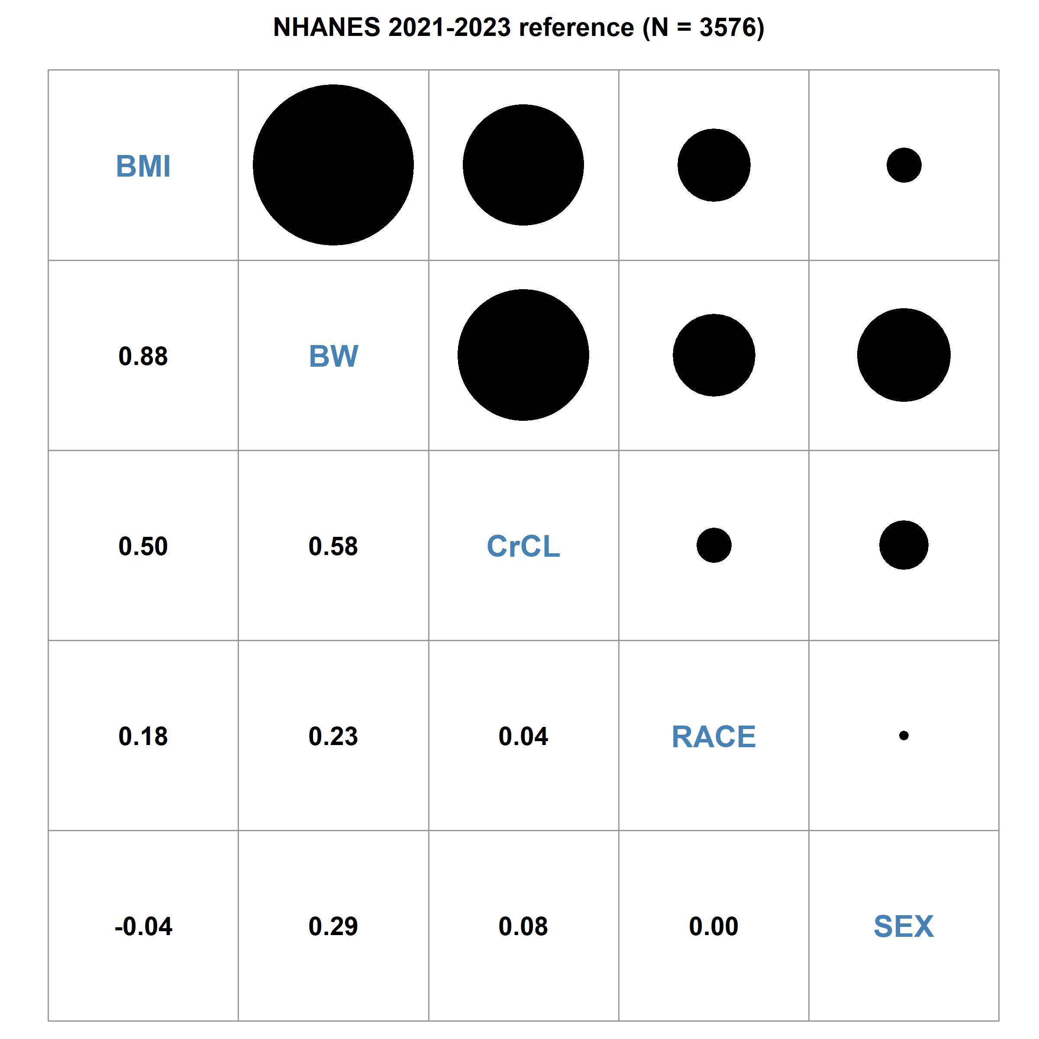

Simulated datasets retained the correlation structure from NHAENS
Weight and BMI are highly collinear — a selection trap
Notes:
Before comparing methods, one sanity check: did the virtual patients come out right?
On the left is the covariate correlation structure from NHANES.
On the right, from our simulated datasets. They look almost identical. So the NHANES-based stratified bootstrap does preserve realistic correlations.
And notice this cell: weight and BMI are strongly collinear. That is intentional. It is our selection trap, and I will come back to it when we look at power.

Slide 18
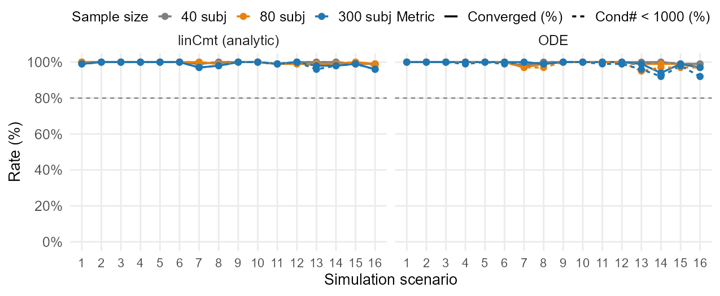
nlmixr2 SCM converges reliably in both analytic and ODE forms
Nlmixr2 SCM
High convergence rate and condition number <1000 for both analytic and ODE setting
1 Reliability
2 Power
3 Accuracy
4 Runtime
18
Notes:
This is nlmixr2-SCM alone.
For both the analytic solution and the ODE model, and at every sample size, convergence is close to 100%, with condition numbers below 1000.
This matters because it shows that the open-source R package can offer stable estimation when run thousands of times

Slide 19
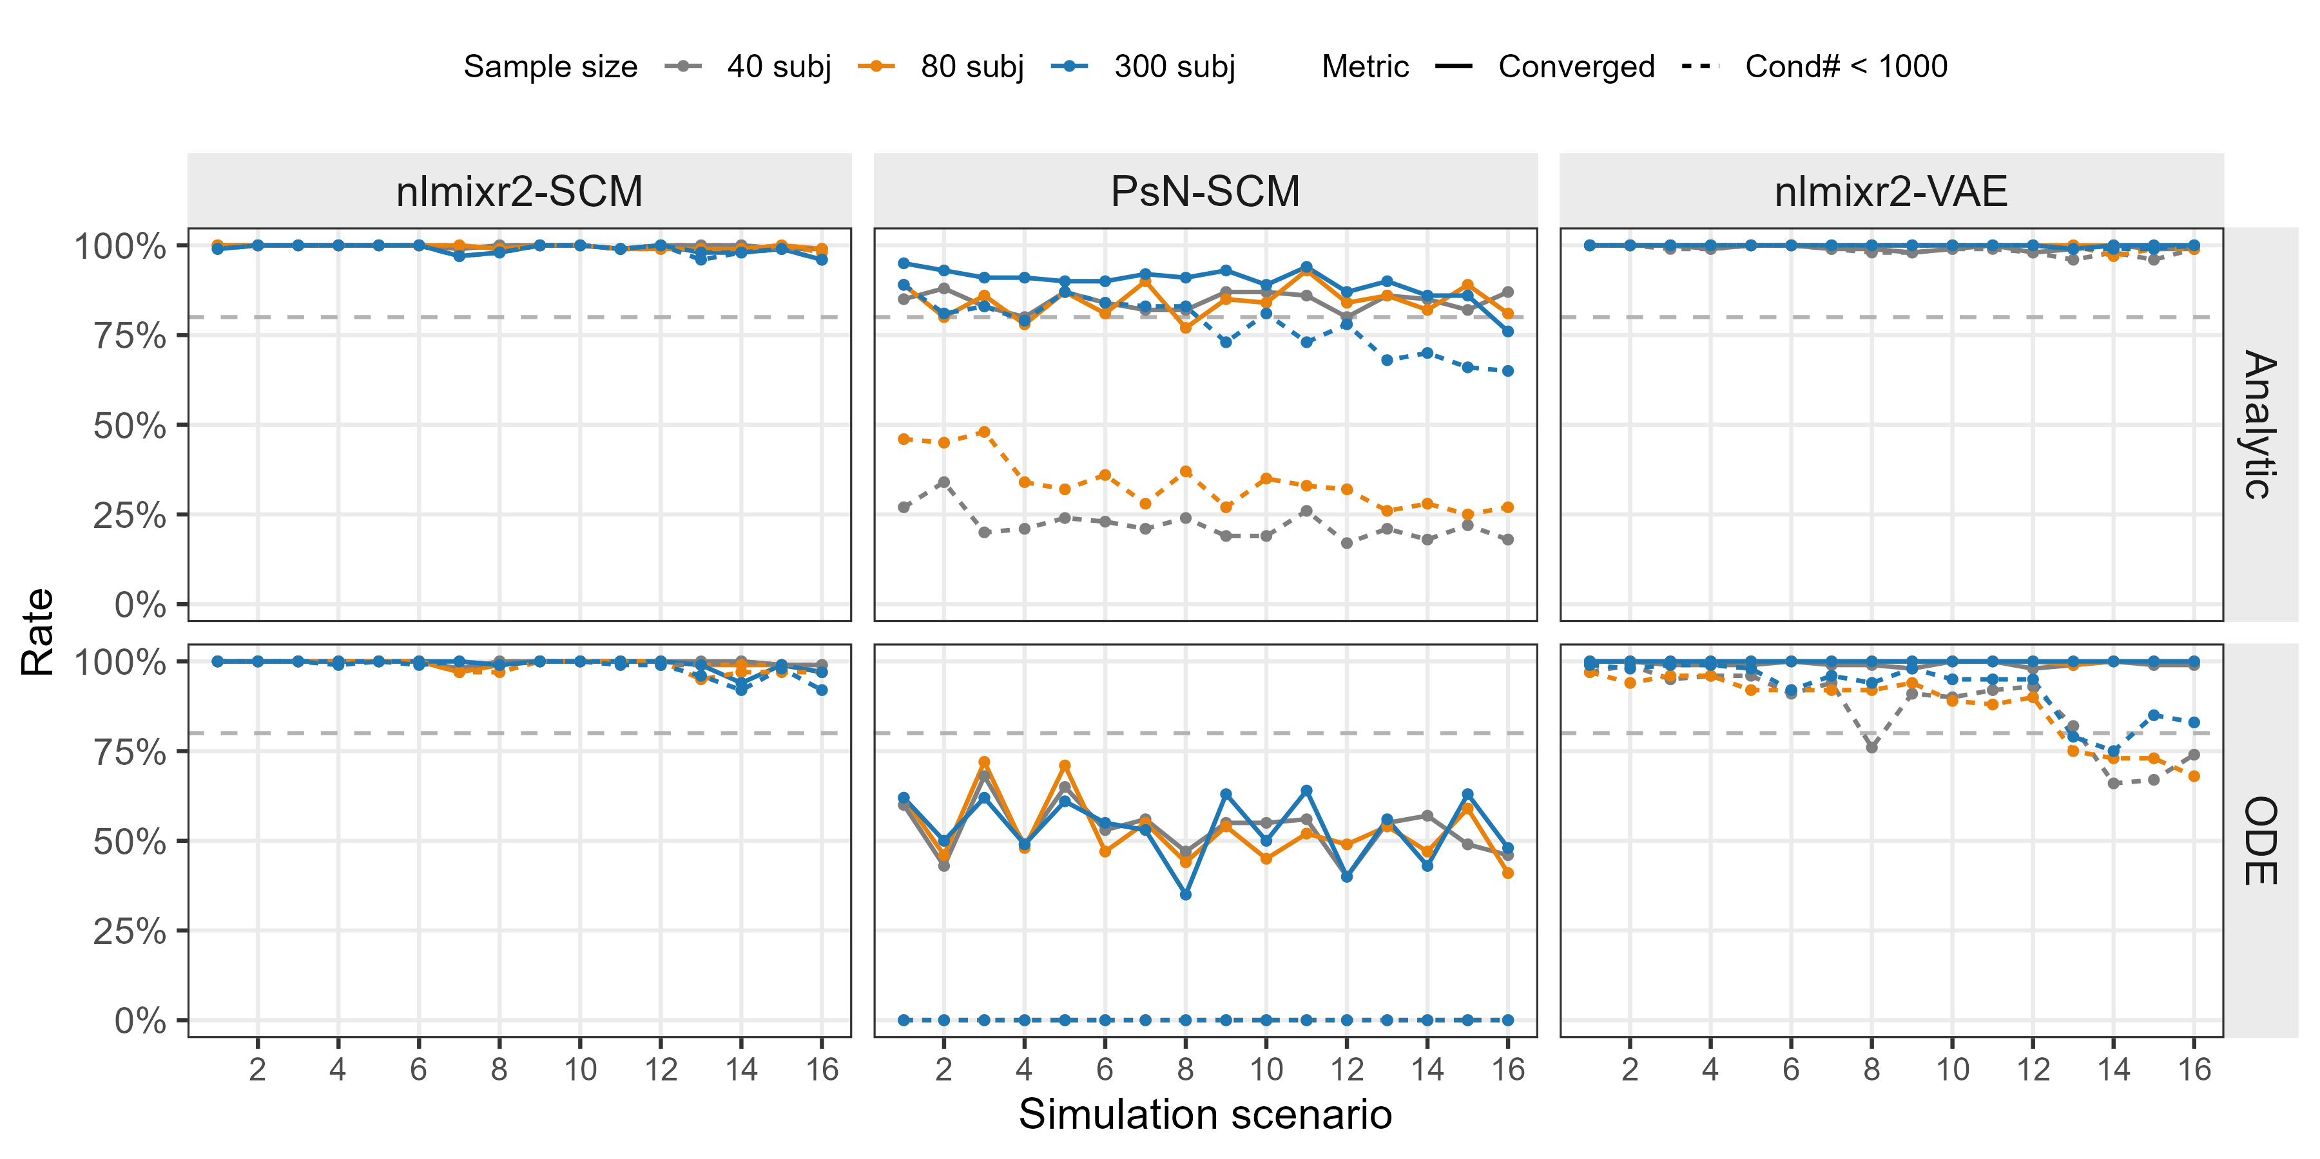
nlmixr2 matches or exceeds NONMEM on convergence & cov_step
1 Reliability
2 Power
3 Accuracy
4 Runtime
Notes:
Now the comparison.
The nlmixr2-based workflows keep that very high convergence rate.
NONMEM does not — and the gap is largest for ODE models,
where, under the same convergence settings, NONMEM converges only about half the time, and fails to complete the covariance step.
So the first of my three messages: on reliability, nlmixr2 does not merely match NONMEM — it is significantly better, and the difference is concentrated in ODE models.

Slide 20
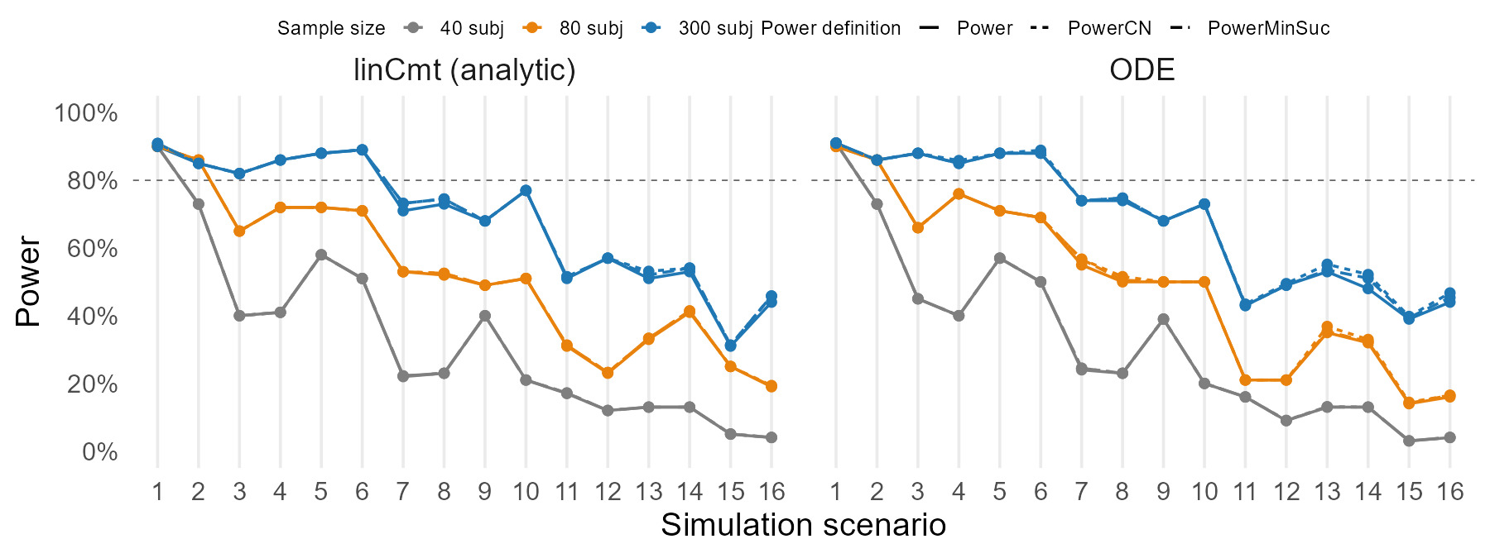

Power rises with sample size and falls with model complexity
nlmixr2 SCM
Lincmt $≈$ODE
N ↓, Power ↓
1 Reliability
2 Power
3 Accuracy
4 Runtime
20
Notes:
But reliability only means the model runs. The real question is whether it finds the right covariates. That is power.
Again, nlmixr2-SCM alone first.
You see three curves and they overlap almost completely since convergence and condition number are near-perfect.
And the pattern is the same for the analytic and the ODE parameterization.
Two patterns hold everywhere, and they will hold for every method: as model complexity increases, power decreases. As sample size decreases, power decreases.

Slide 21
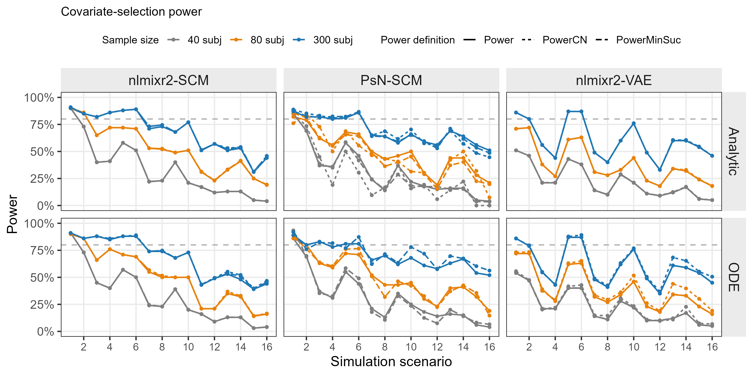
SCM power is comparable across nlmixr2 and NONMEM, and ≥ VAE
Median of power over 16 scenarios
73%
66%
58%
33%
50%
45%
Power & linear
23%
23%
19%
BW vs. BMI
1 Reliability
2 Power
3 Accuracy
4 Runtime
21
Notes:
Here are all three workflows. The two patterns still hold — complexity increase, power down; sample size decrease, power down.
Power for nlmixr2-SCM and NONMEM-SCM is very similar, with nlmixr2 having a slightly higher median across the 16 scenarios. Both SCM workflows are somewhat better than the VAE.
And the power loss concentrates in two situations.
The first is competing shapes: the same PK parameter and covariate pair can enter as linear or as power. That is particularly hard for the VAE, as you can see here.
The second is a highly collinear covariate pair — in our case weight and BMI.
So the second of my three messages: for exact recovery of the true model, nlmixr2-SCM is on par with NONMEM. The VAE gives up some power, and it gives it up specifically where shapes compete.

Slide 22
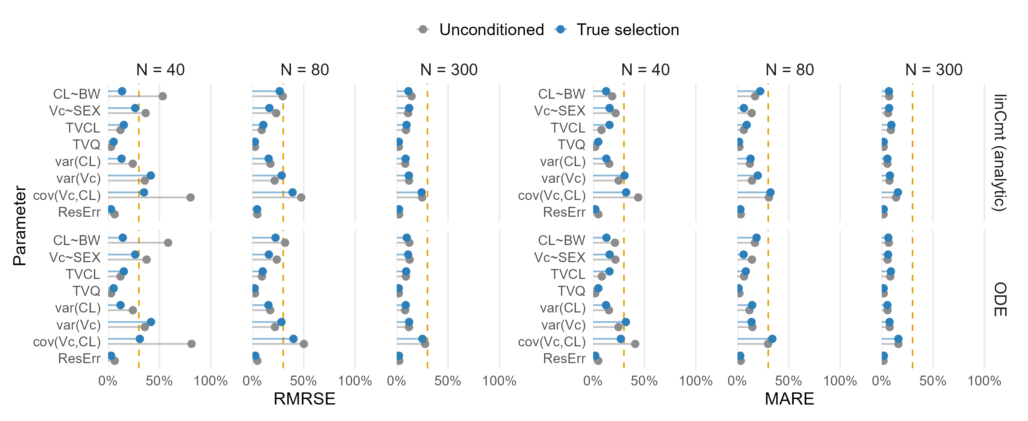

Covariate-effect errors are low; variance terms are the hard part
Nlmixr2 SCM
Lincmt $≈$ODE
N ↓, RMRSE & MARE ↑
Estimation difficulty: covariance> variance > covariate effect > typical value
1 Reliability
2 Power
3 Accuracy
4 Runtime
22
Notes:
Selecting the right covariates is one thing. Estimating them correctly is another.
This is estimation accuracy for nlmixr2-SCM.
First, the model parameterization does not matter much — analytic and ODE give similar accuracy. Second, as sample size decreases, accuracy gets worse, which is what we would expect.
And there is a clear ranking of difficulty: the covariance terms are hardest to estimate, then the variances, then the covariate effects, and the typical values are easiest.
So the parameters we care most about for dose selection — the covariate effects — are estimated comparatively well.

Slide 23
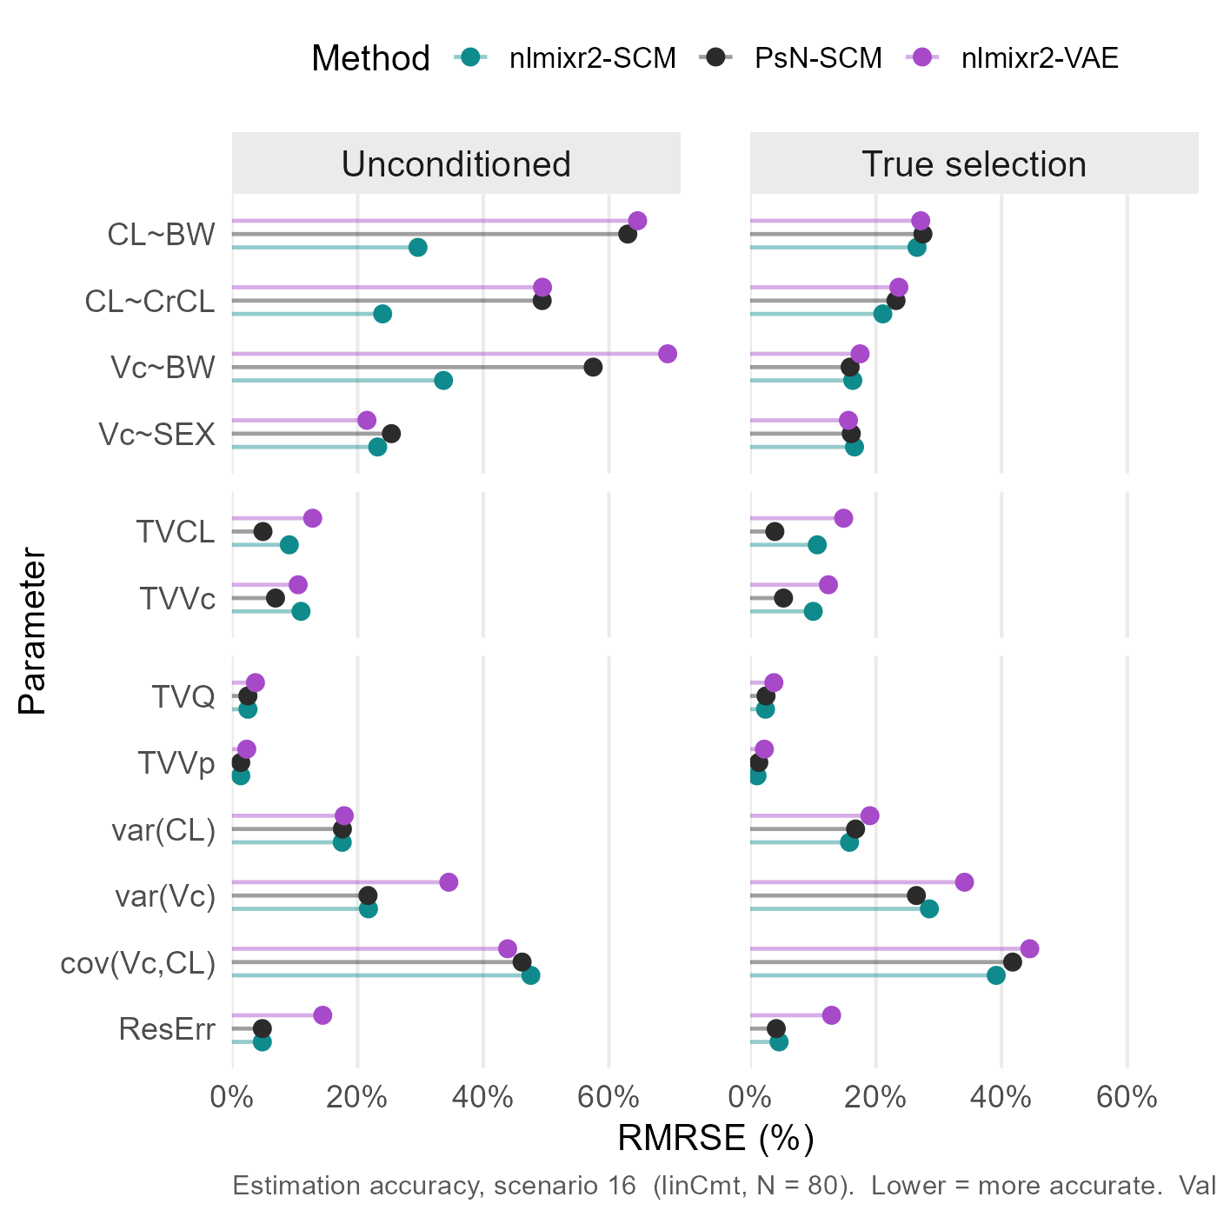
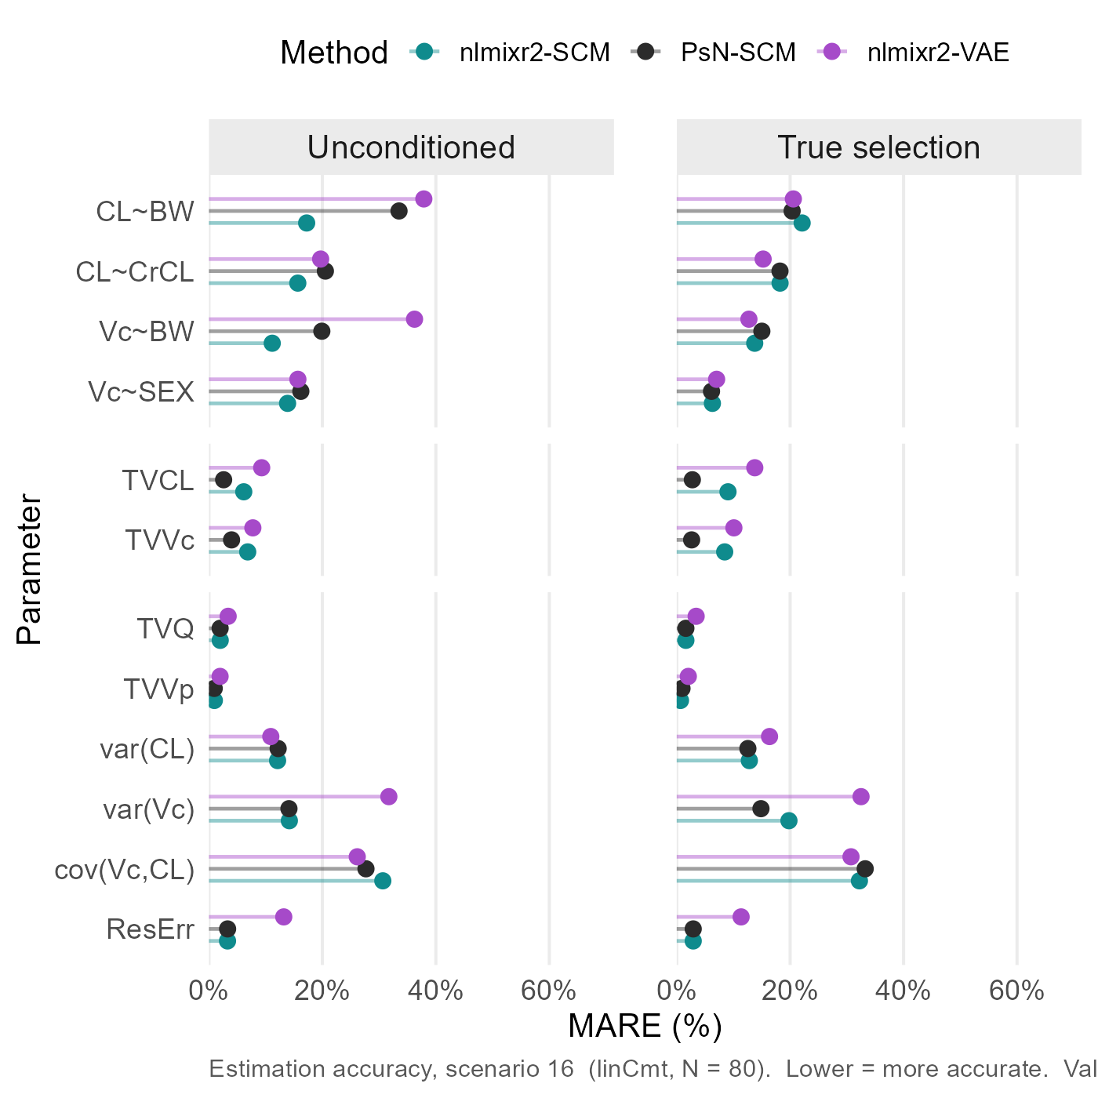
Estimation accuracy is comparable across nlmixr2, NONMEM, and VAE
Scn16 + N80 + Analytic
Estimation accuracy: nlmixr2-SCM $≈\text{PsN}\text{_}\text{SCM}≈\text{nlmixr}\text{2−}\text{VAE}$
1 Reliability
2 Power
3 Accuracy
4 Runtime
Notes:
And here is the comparison. Estimation accuracy is very similar across all three workflows
That is worth stating plainly: the VAE's power cost does not come with an accuracy cost. When it picks the right model, it estimates it just as well.

Slide 24
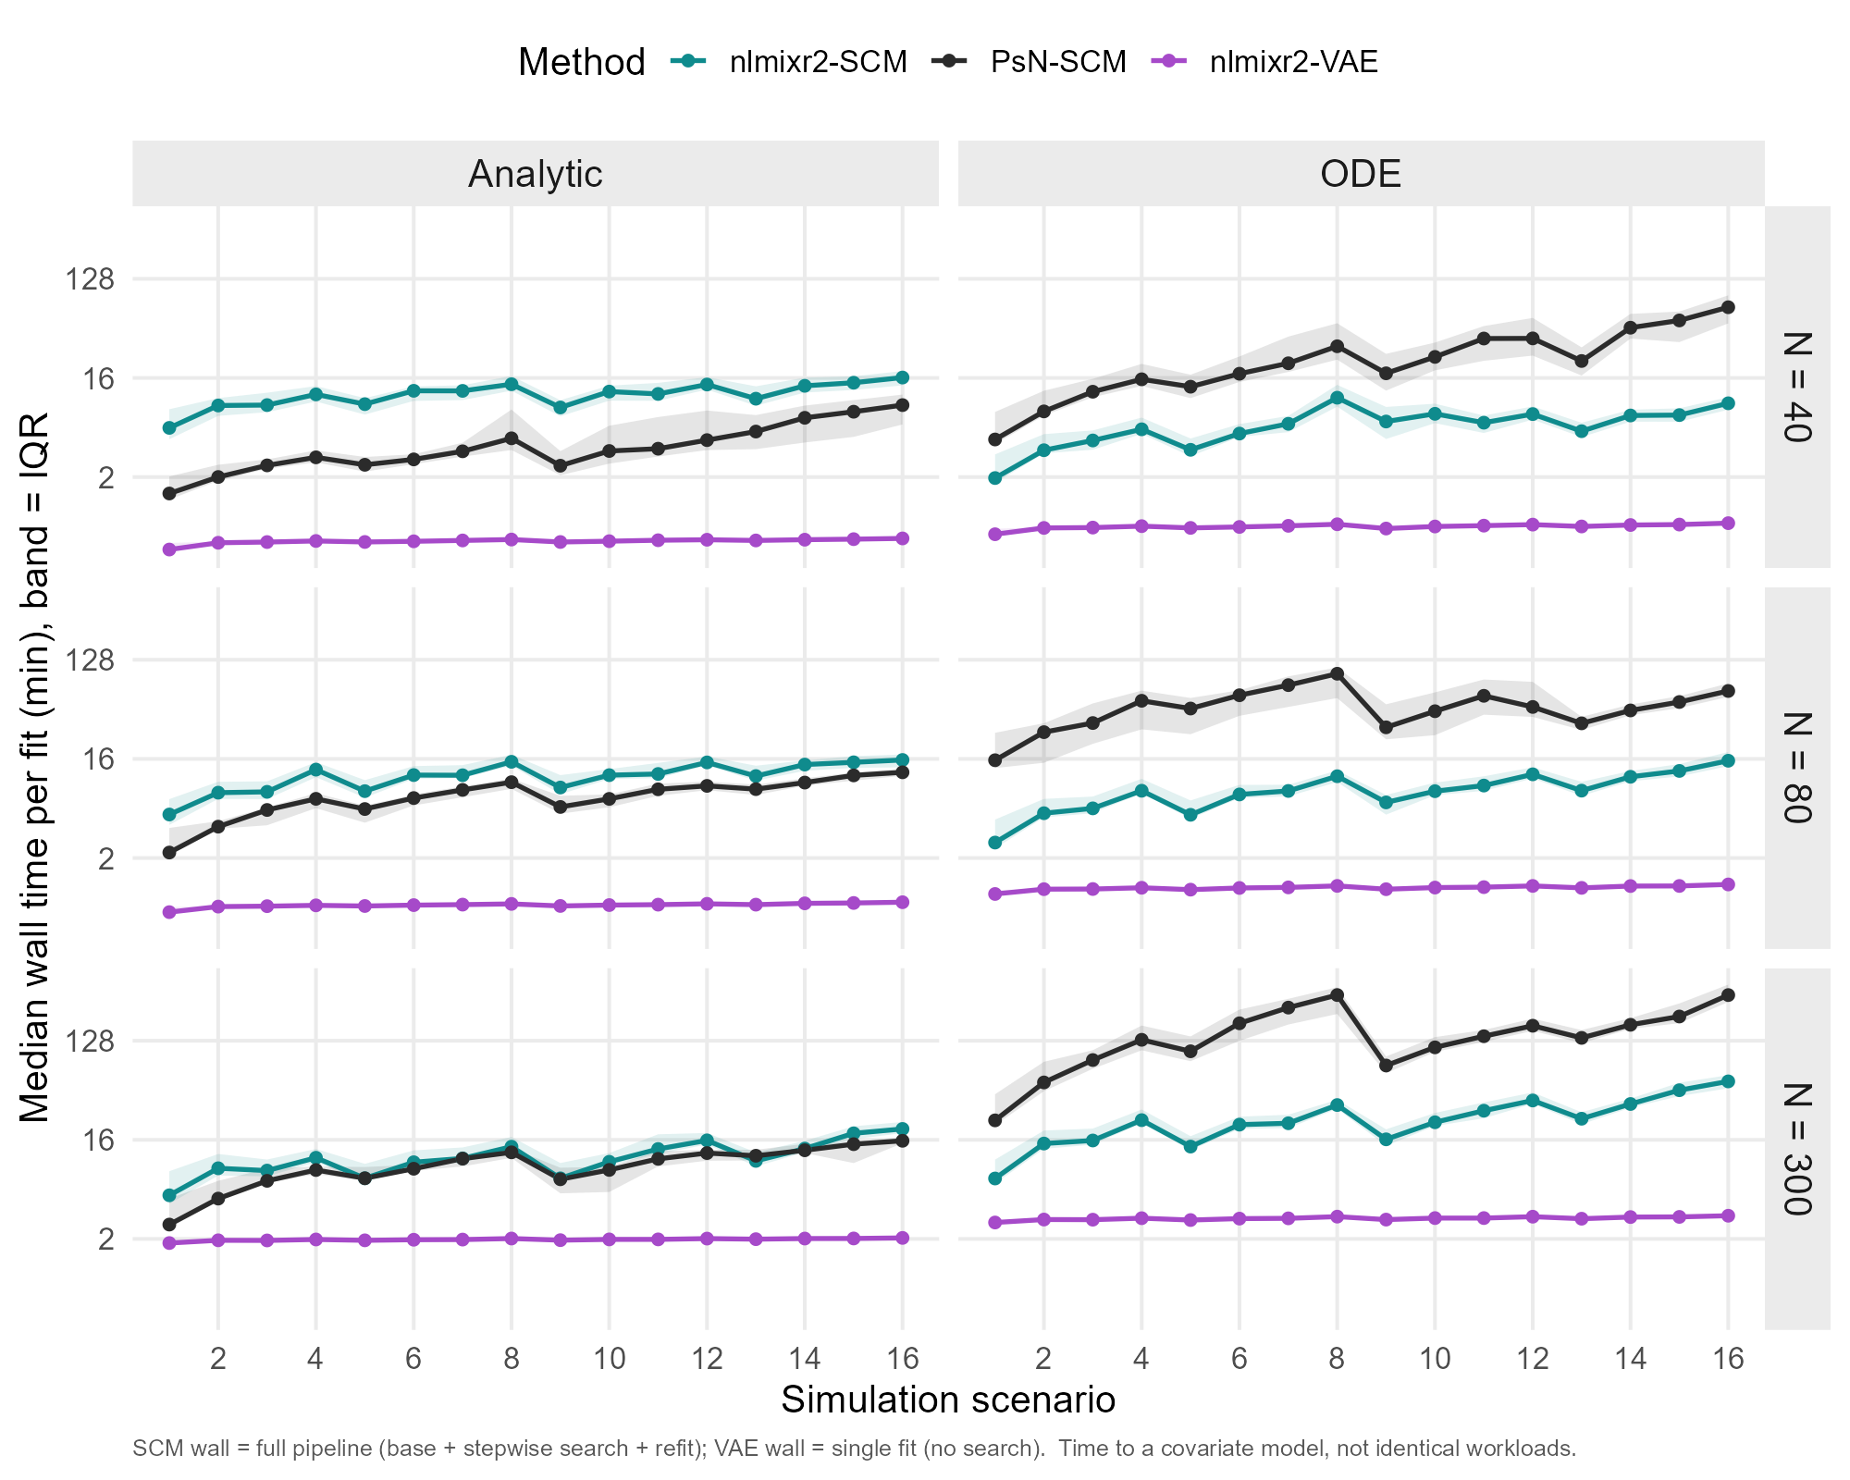
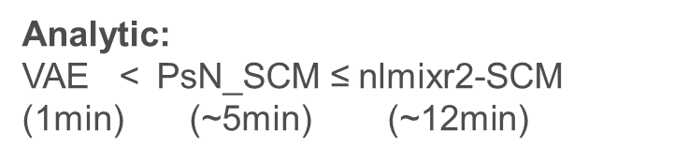
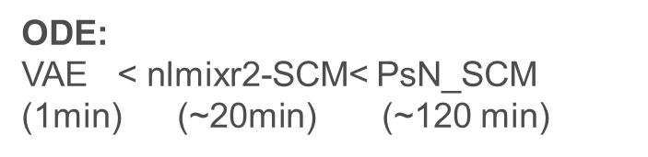
The VAE can be substantially than NONMEM-SCM_ODE
4 CPU cores
Log Scale
Run time:
VAE << nlmixr2 < NONMEM
Analytic << ODE
sample size ↓, runtime ↓
Analytic:
VAE < $\text{PsN}\text{_}\text{SCM}$ ≤ nlmixr2-SCM (1min) (~5min) (~12min)
ODE:
VAE < nlmixr2-SCM< $\text{PsN}\text{_}\text{SCM}$ (1min) (~20min) (~120 min)
1 Reliability
2 Power
3 Accuracy
4 Runtime
24
Notes:
So far, reliability favors nlmixr2, and power and accuracy are a tie. The last dimension is the one where the differences are dramatic: runtime.
Every task here ran on the same cluster with four CPU cores. Note the log scale on the y-axis.
Three drivers for runtime difference : the workflow, the parameterization, and the sample size.
The purple curve is the VAE, and it is dramatically faster than both SCM workflows — around one to two minutes, regardless of everything else. That makes sense: one fit instead of a search.
For the analytic solution, NONMEM is slightly faster than nlmixr2-SCM, and both finish well inside about fifteen minutes. That difference is small.
For ODE models, NONMEM is roughly five times slower than nlmixr2-SCM across all sixteen scenarios, with the hardest scenarios running well over two hours
And as sample size increases, runtime increases modestly, as you can see here.
Here is the runtime comparison across three platform.
Run time of covariate selection varies across workflow, and is associated with sample size and model structure.
For analytical solution, VAE is extremely faster than SCM, with NONMEM slightly faster than nlmixr2
For ODE, VAE is still extremely faster than SCM, with nlmixr2 substantially faster than NONMEM.
Different optimizer
Different covariate selection procedures. For nlmixr2, all var-covar-shape is fitted at each step, where as NONMEM deal with shape in a Warmup
Analytic (left): PsN (black) and nlmixr2-SCM (teal) are comparable — PsN slightly cheaper at low scenarios (2–9 min), nlmixr2-SCM ~10–13 min. Both climb mildly with scenario complexity.ODE (right) — the headline: PsN explodes to 15–95 min (median), roughly 3× nlmixr2-SCM across all 16 scenarios. nlmixr2-SCM stays flat at ~10–20 min. The gap is large and consistent — exactly where you expected.VAE (purple): flat ~1–1.5 min everywhere, structure-independent (single fit, no search) — an order of magnitude below both SCM pipelines. Caveat annotated.

Slide 25
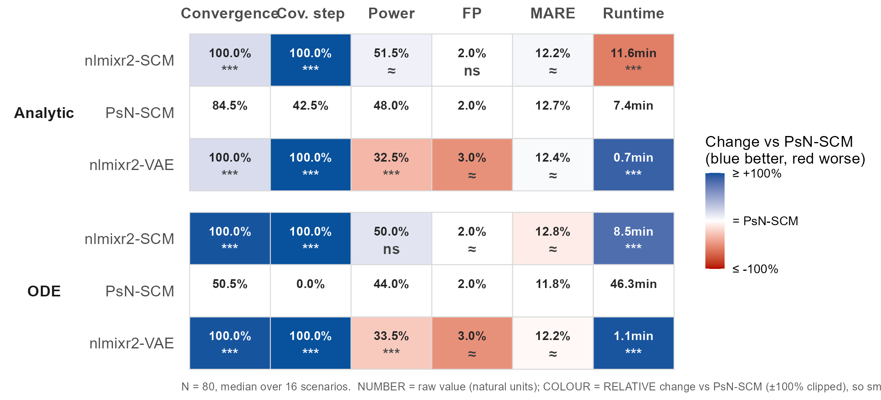
Scorecard: nlmixr2 –SCM matching NONMEM, with VAE being substantially faster
Number is median over 16 scenarios (natural units), Colored by relative change vs PsN-SCM (method-PsN)/PsN
***statistically significant Beta_method ≠ 0 & meaningfully different; ≈, statistically significant but not meaningfully different (<±10%)
Notes:
This is the summary scorecard, and it carries three layers of information.
The numbers inside each cell are the median over the 16 scenarios, in natural units.
The color shows the relative change of the test method versus NONMEM.
And the asterisks mark results that are both statistically significant and meaningfully different — that is, the relative change exceeds our pre-specified 10% threshold.
Where a difference is statistically significant but smaller than that, we mark it with the approximately-equal sign instead.
Reading it across, for nlmixr2-SCM: reliability is consistently and significantly better than NONMEM; power and estimation accuracy are equivalent; and for ODE models it is significantly faster.
For nlmixr2-VAE: the headline is speed — dramatically faster than NONMEM — but that comes at the expense of some selection power.

Slide 26
1 Background
2 Methods
3 Results
4 Discussion
26

Slide 27
Collinearity and Small samples remain the main challenges
Competing shapes + Collinearity confound selection
→ Domian knowledge/clinical significance/biological plausibility
Small N sharply reduces power
→ Interpret covariate models cautiously for early phase clinical trials
Analytic solution > ODE
Turn on 1D profile-based warm up for complex ODE
27
Notes:
Let me finish with what this means in practice.
Four points.
First, covariate selection is confounded by competing shapes and by collinearity between covariates. No method solved this — not NONMEM, not nlmixr2, not the VAE. That is why domain knowledge is so valuable before you start: the candidate covariate space should be curated for clinical relevance and biological plausibility.
Second, small sample size sharply reduces power. And small samples are exactly the situation in early-phase trials. So covariate models built from early-phase data should be interpreted with caution.
Third, a practical tip: when your PK model is linear, use the analytic solution rather than the ODE. Our results show similar power with much faster runs.
Fourth, for complex ODE models, turn on the one-dimensional profile-based warm start. In our runs it improved selection power

Slide 28
Open-source nlmixr2 SCM matches/outperforms NONMEM
SCM:
Comparable power & accuracy
Faster; Better Reliability; Open source
SCM
VAE：
Production Estimation
Extremely Faster; Open source
Comparable power & accuracy for easy covariate space
28
Notes:
To conclude.
In this benchmark, the open-source nlmixr2-SCM matched or outperformed PsN-NONMEM-SCM. It gave comparable power and estimation accuracy, better reliability, faster runtimes for ODE models — and it is open source.
The VAE's strength is speed, with comparable accuracy and reasonable power in the easier covariate scenarios.
So the take-home message is this. nlmixr2-SCM is a credible open-source alternative to NONMEM-SCM.
And the VAE is a promising fast screening method that can complement traditional SCM — though not yet replace it in high-stakes confirmatory settings.

Slide 29
References
1.Lane S, Al-Zubiedi S, Hatch E, et al. The population pharmacokinetics of R- and S-warfarin: effect of genetic and clinical factors. Br J Clin Pharmacol. 2012;73(1):66-76. doi:10.1111/j.1365-2125.2011.04051.x
2. Ribbing J, Nyberg J, Caster O, Jonsson EN. The lasso--a novel method for predictive covariate model building in nonlinear mixed effects models. J Pharmacokinet Pharmacodyn. 2007;34(4):485-517. doi:10.1007/s10928-007-9057-1
3. Karlsen M, Khier S, Fabre D, et al. Covariate Model Selection Approaches for Population Pharmacokinetics: A Systematic Review of Existing Methods, From SCM to AI. CPT Pharmacometrics Syst Pharmacol. 2025;14(4):621-639. doi:10.1002/psp4.13306
4. Jonsson EN, Karlsson MO. Automated covariate model building within NONMEM. Pharm Res. 1998;15(9):1463-1468. doi:10.1023/a:1011970125687
5. Rohleff J, Bachmann F, Nahum U, et al. Redefining Parameter Estimation and Covariate Selection via Variational Autoencoders: One Run Is All You Need. CPT Pharmacometrics Syst Pharmacol. 2025;14(12):2232-2243. doi:10.1002/psp4.70129
6. Ahamadi M, Largajolli A, Diderichsen PM, et al. Operating characteristics of stepwise covariate selection in pharmacometric modeling. J Pharmacokinet Pharmacodyn. 2019;46(3):273-285. doi:10.1007/s10928-019-09635-6
7. https://github.com/nlmixr2/nlmixr2/blob/main/vignettes/articles/vaeNeonatal.Rmd

Slide 30
Acknowledgement
Matt Fidler
Justin Wilkins and the rest nlmixr2 development team
PMX, PKS, AQS team
Talent acquisition team
Fellow interns
Notes:
I am very grateful to my manager, Matt Fidler — this project would not have been possible without his guidance and support.
Thank you to Justin Wilkins, the other primary developer of the nlmixr2 SCM package, and to the whole nlmixr2 development team, whose commitment to open science genuinely inspired me.
Thank you to the PMX, PKS, and AQS teams, especially those who shared their career journeys with me, and to the talent acquisition team and my fellow interns for making this internship so memorable.

Slide 31
Thank you for your attention! Any questions?

Slide 32
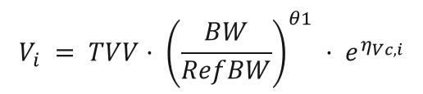



Population PK explains why exposure differs between patients
Nonlinear Mixed effect Models
Max(likelihood) Min(objective function)
Fixed effect
$C\left(φ_{i},t_{i,j}\right)=$ $\frac{Dose}{V_{i}}·e^{\left(−K_{i}·t\right)}$
$$K_{i} = TVK· e^{η_{k,i}}$$
Intersubject variability
$$V_{i} = TVV· {\left(\frac{BW}{RefBW}\right)}^{θ1} · e^{η_{Vc,i}}$$
Residual variability
$$y_{i,j}=C\left(φ_{i},t_{i,j}\right) (1+a·ε_{i,j})$$
https://pub.towardsai.net/from-probability-to-loss-how-mle-builds-machine-learning-part-1-52fe0efa43a9
32
Notes:
Equation? I know many of you may come from a statistics background and are unfamiliar with population PK. Population pharmacokinetics, or PopPK, is used to explain why drug exposure differs across patients.
At its core, popPK models are nonlinear mixed-effects models, which separate variability into three parts:
fixed effects, which describe the typical value and explainable covariate effects, for example, patients with different weights have different volume of distribution
intersubject variability, which describes how individual patients differ from the typical patient,
and residual variability, which captures unexplained error or measurement noise.
PopPk optimize population parameters by maximize likelihood of observations

Slide 33
Landscape of covariate selection: Methods & Software
Family / approach
Representative methods
Production software
Regulatory readiness
Stepwise
SCM SCM+ · COSSAC · SAMBA
PsN + NONMEM Monolix · nlmixr2
Standard
Accepted
Full-model
FFEM · FREM
PsN + NONMEM
Accepted
Penalized regression
LASSO · AALASSO
PsN + NONMEM (lasso)
Capable; rare in submissions
Machine learning (EBE)
RF · XGB · ridge
R / Python packages
Exploratory
Generative AI
VAE
nlmixr2 · PyTorch
Exploratory
EBE (Empirical Bayesian Estimates)
FDA“accepted” = track record in submissions + reviewer use + sponsor validation (GxP)
Journal of Pharmacokinetics and Pharmacodynamics 34 (2007): 485–517.
Pharmaceutical Research 15 (1998): 1463–1468.
CPT: Pharmacometrics & Systems Pharmacology, 2025; 14:621–639
33
Notes:
The FDA does not certify software; “accepted” = track record in submissions + reviewer use + sponsor validation (GxP). nlmixr2 & the VAE are open-source/research — benchmarked here against the accepted NONMEM reference.
nlmixr2 is gaining acceptance, especially in academia and for research/exploratory pharmacometrics, but it is still less established than NONMEM, Monolix, or Phoenix NLME for high-stakes industry and FDA regulatory submissions. For FDA use, the key issue is not whether FDA has “approved” nlmixr2, but whether the sponsor can validate, document, reproduce, and justify the analysis.
nlmixr2 is scientifically credible and increasingly used, especially in R-centered pharmacometrics workflows. But for FDA-facing analyses, it is still safer to view it as an emerging regulatory tool rather than a universally accepted standard. If used in a submission, the analysis should be highly reproducible, well validated, and ideally benchmarked against established software when possible.
nlmixr2 may be used for:
Exploratory modeling
Internal benchmarking
Rapid model prototyping
Teaching and training
Reproducible R-based workflows
Cross-checking results from NONMEM or Monolix

Slide 34
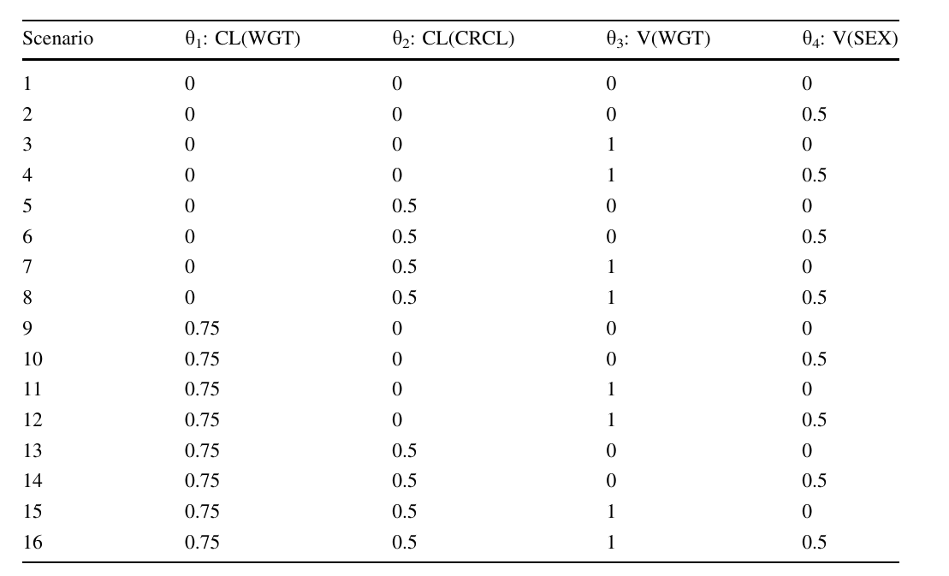
Design 16 scenarios with easy → complex covariate effects from the overall covariate space
34

Slide 35
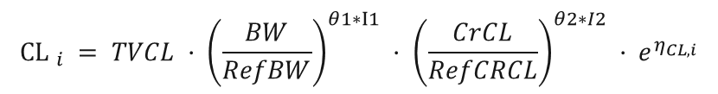
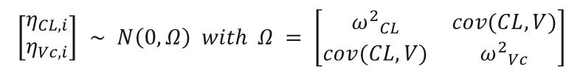
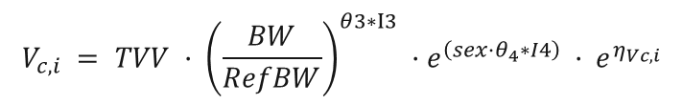
NHANES-based virtual patients preserve real covariate correlations
TVCL = 0.6 L/h Q = 1.8 L/h
TVVc = 20 L,
TVVp = 80 L,
Ka = 0.7/h
Ref_BW = 70 Kg
Ref_CRCL = 95 mL/min
θ₁ =0.75
θ₂ =0.5
θ₃ =1
θ₄ = log(1.5)
Var_CL= 0.01
Var_Vc= 0.01
Cov_CL_Vc= 0.02
I1-4=0 or 1 (different scenario)
dose = 100 mg T= 0, 0.05, 0.1, 0.5, 1, 3 * t1/2
Ka
Vc
Q
Vp
NHANES 2021-2023
CL
Stratified bootstrapping by Sex*Race
(|delta_correlation| < 0.05)
N= 300/80/40 patients
100 datasets each case
$$CL _{i} = TVCL · {\left(\frac{BW}{RefBW}\right)}^{θ1∗I1} · {\left(\frac{CrCL}{RefCRCL}\right)}^{θ2∗I2} · e^{η_{CL,i}}$$
$$V_{c,i} = TVV · {\left(\frac{BW}{RefBW}\right)}^{θ3∗I3} ·e^{\left(sex·θ_{4}∗I4\right)} · e^{η_{Vc,i}}$$
$$\left[\begin{matrix}η_{CL,i} \\ η_{Vc,i}\end{matrix}\right] ∼ N\left(0, Ω\right) with Ω = \left[\begin{matrix}{ω^{2}}_{CL} & cov(CL,V) \\ cov(CL,V) & {ω^{2}}_{Vc}\end{matrix}\right]$$
Cohort, Dataset, ID,Weight, BMI, CrCL, Sex, Race
Scenario, Time, Dose, Concentration
35
Notes:
Bootstrap stratified by Sex*Race to retain a realistic covariate correlation structure

Slide 36
vae
A VAE-NLME fit alternates three pieces per iteration:
1. **Encoder (LSTM).**: A single-layer LSTM reads each subject's observation sequence (and its covariates) and outputs a Gaussian posterior over that subject's individual parameters -- a mean and a Cholesky factor.
2. **Decoder (the structural model).** The sampled individual parameters are pushed through the ODE model to produce predictions. In `nlmixr2` the decoder is your ordinary `rxode2` model, so any compartment structure, error model, dosing or event handling is supported
3. **Population M-step.** A stochastic-approximation update refreshes the population means, the between-subject variances (`omega`) and the residual error, and runs the covariate selection. Each latent parameter is regressed on the candidate covariates under an L0 (BICc-style) penalty`RSS/omega + log(N) * (number of covariates)`;

Slide 37
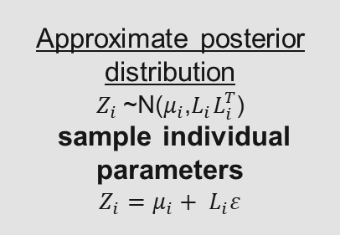
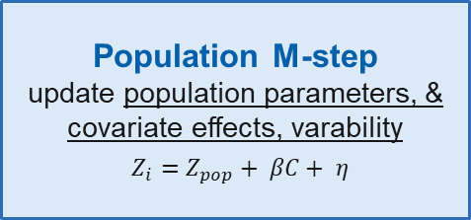
VAE can estimate population parameters while screening covariate effects in a single run
Approximate posterior distribution $Z_{i}$~N($μ_{i}$,$L_{i}L_{i}^{T}$) sample individual parameters
$$Z_{i}=μ_{i}+ L_{i}ε$$
Patient data
(Observations, time, covariates)
LSTM encoder
ODE decoder
(structural model; error model)
Predictions
Population M-step update population parameters, & covariate effects, varability
$Z_{i}=Z_{pop}+ βC+ η$
Penalized objective
Converged?
One run →
params + selected covariates
No, update parameters
Yes → converged
Covariate selection is built in: individual latent parameters are regressed on candidate covariates, and an L0 BICc-style penalty keeps only covariate effects that improve fit enough to justify added complexity
β (params × covariates)
CPT Pharmacometrics Syst Pharmacol. 2025;14(12):2232-2243.
37
Notes:
“This slide shows how the VAE-NLME workflow estimates population parameters and screens covariate effects in one training loop. First, the patient data, including observations, time, and covariates, are passed into an LSTM encoder. The encoder estimates an approximate posterior distribution for each subject’s latent individual parameters. From that distribution, the model samples individual parameters using the reparameterization trick, $z_{i}=μ_{i}+L_{i}ε$.
These sampled individual parameters are then passed into the ODE decoder, which is the structural pharmacometric model. The decoder uses $z_{i}$to generate predictions and compare them with the observed data.
Next, the population M-step updates the population model. It explains the inferred individual parameters using population means, covariate effects, and random variability: $z_{i}=z_{pop}+βc_{i}+η_{i}$. This is also where covariate selection happens. Each latent parameter is regressed on candidate covariates, and an L0 BICc-style penalty keeps only covariate effects that improve the fit enough to justify the added complexity.
Finally, the algorithm checks whether the penalized objective has converged. If not, it updates the model parameters and repeats. If yes, the final output is the estimated parameters and selected covariate effects.”
individual parameters, and the decoder uses those parameters in the structural model to predict observations’

Slide 38
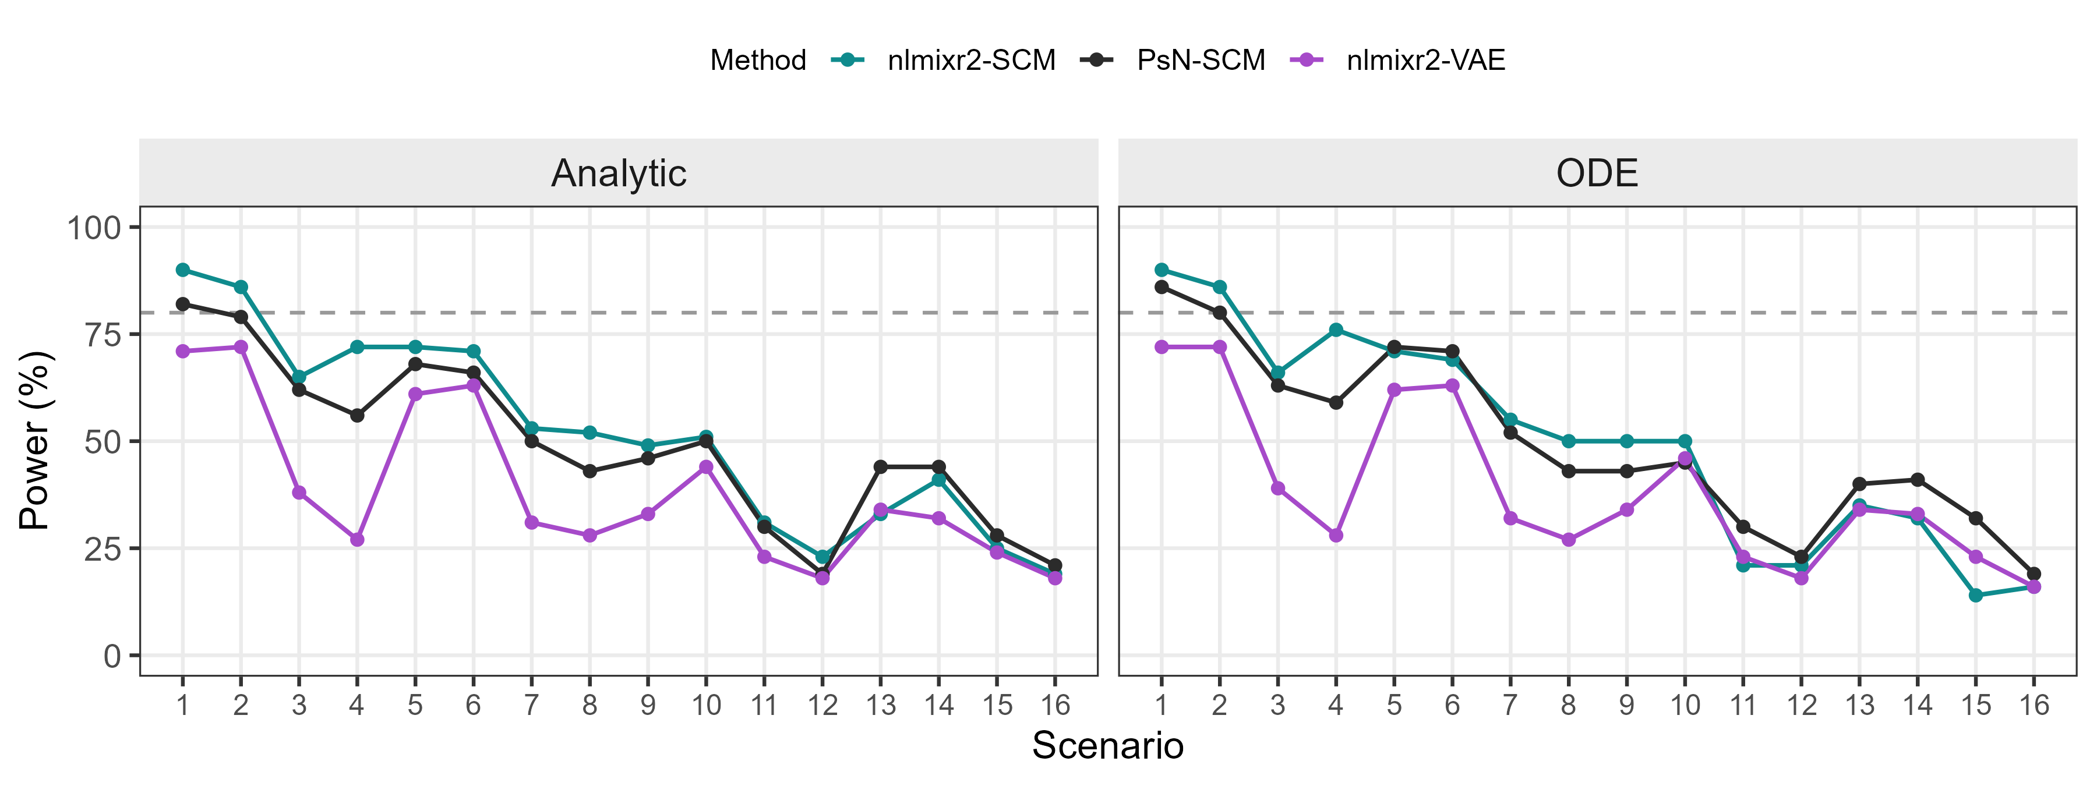
SCM power is comparable across nlmixr2 and NONMEM, and ≥ the VAE
N=80
Power: nlmixr2-SCM $≈\text{PsN}\text{_}\text{SCM} \text{> }\text{nlmixr}\text{2}\text{−}\text{VAE}$

Slide 39
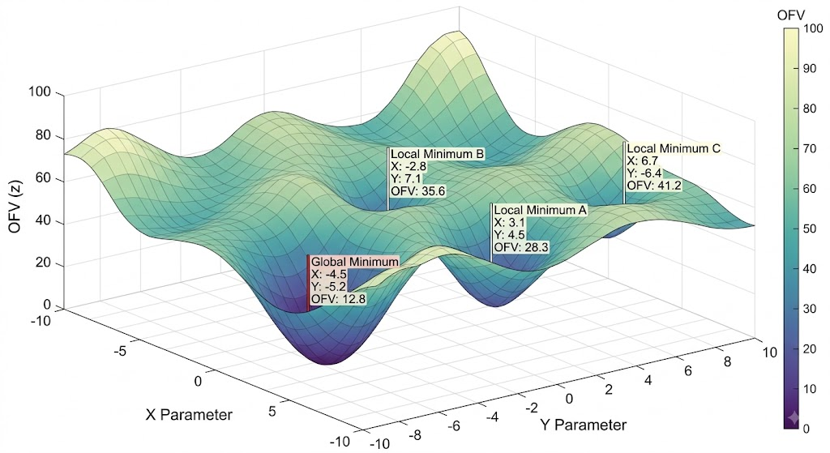
1-D profile warmup fixes other parameters and use covariate estimate as initial value
1-D warmup
Delta_OFV (forward selection)= OFV$parent –OFV$candidate
Stuck at initial estimates(Delta_OFV =0)
Candidate model worse than parent model (Delta_OFV <0)
Notes:
a nested (candidate) model cannot legitimately be worse than its parent at a true optimum, because the parent is a special case (covariate coefficient = 0) nested inside the candidate.

Slide 40
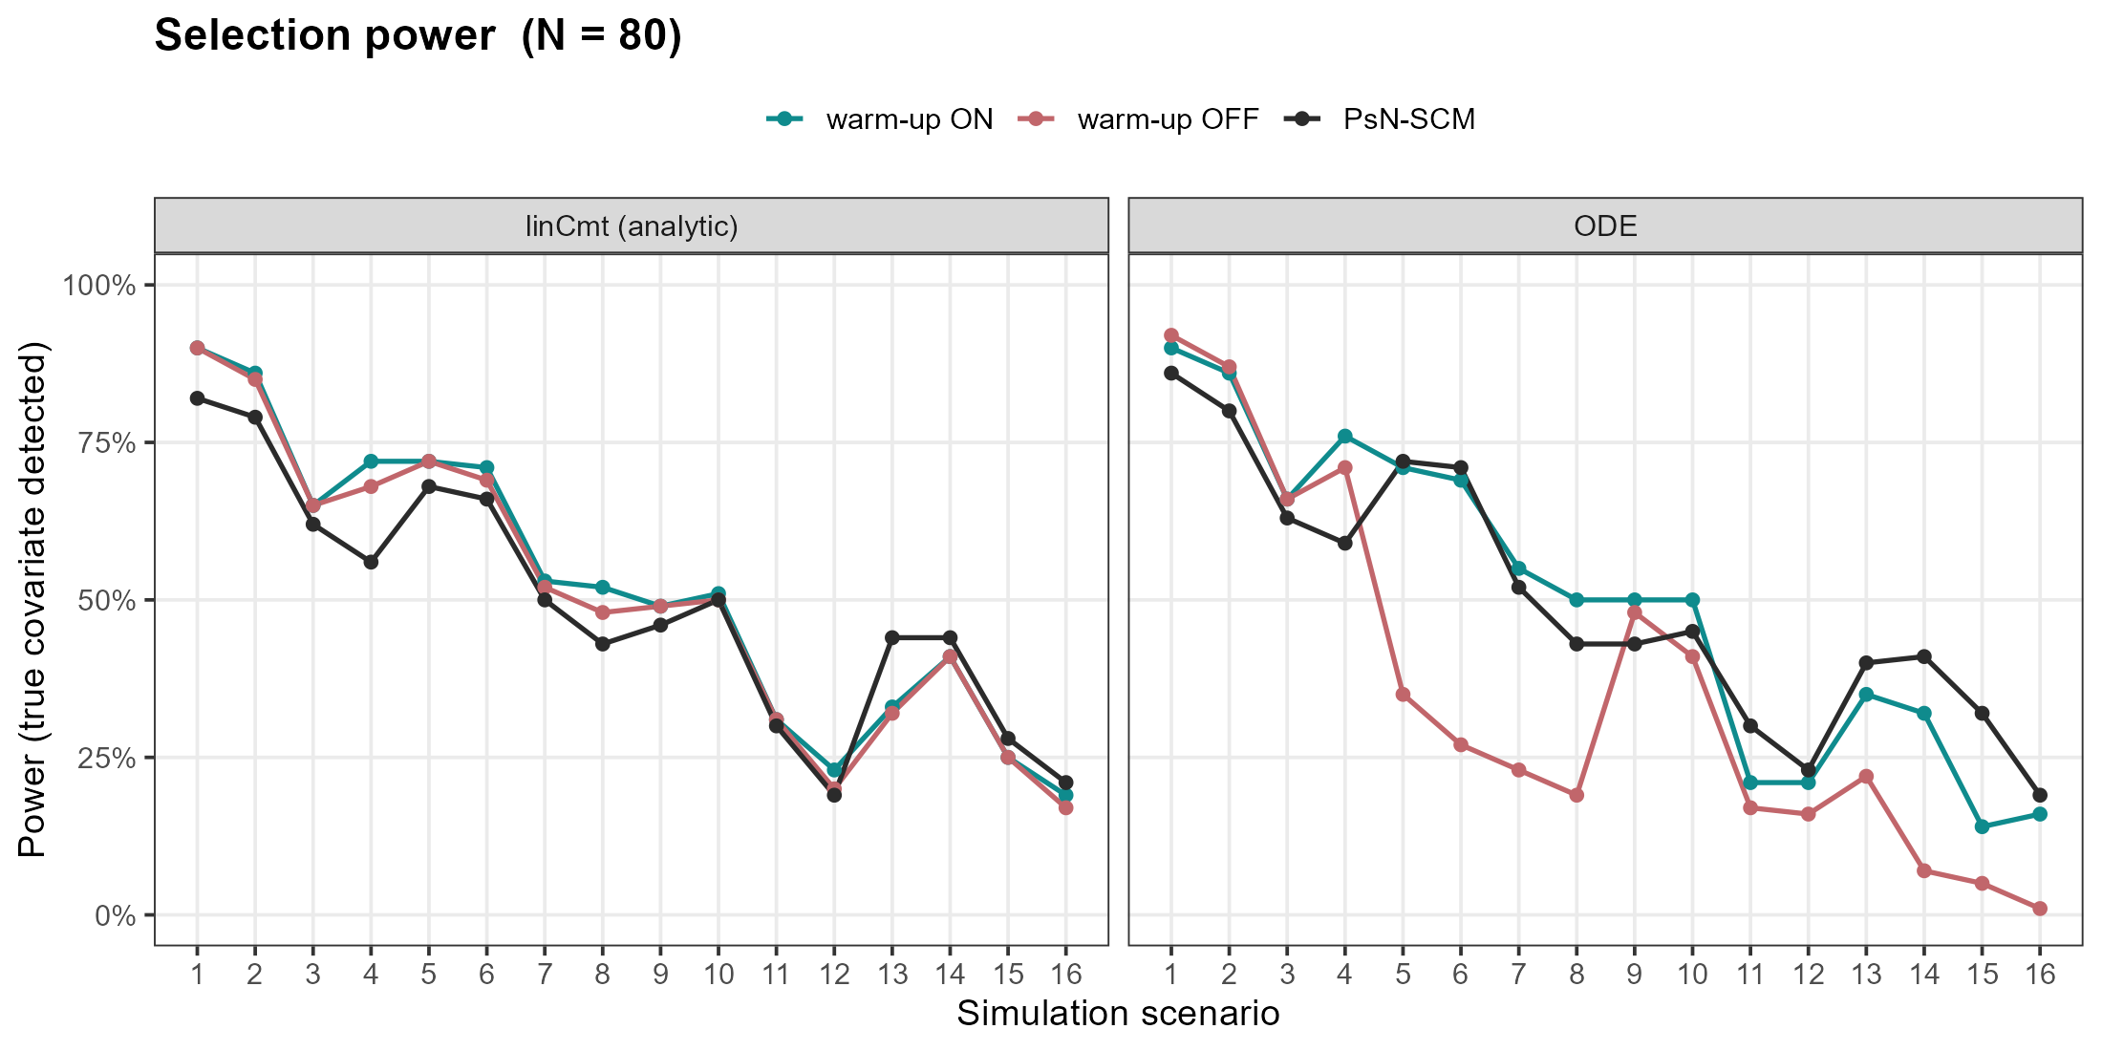
Warm up is necessary to maintain power in complex scenarios for ODE models
Notes:
NONMEM's FOCE uses its own line-search/quasi-Newton type scheme with analytic-ish gradients and internal step control that is robust at flat starting regions foceif [try again] lgfbsXX – finite difference & analytic gradient nonmem-> use foceif

Slide 41
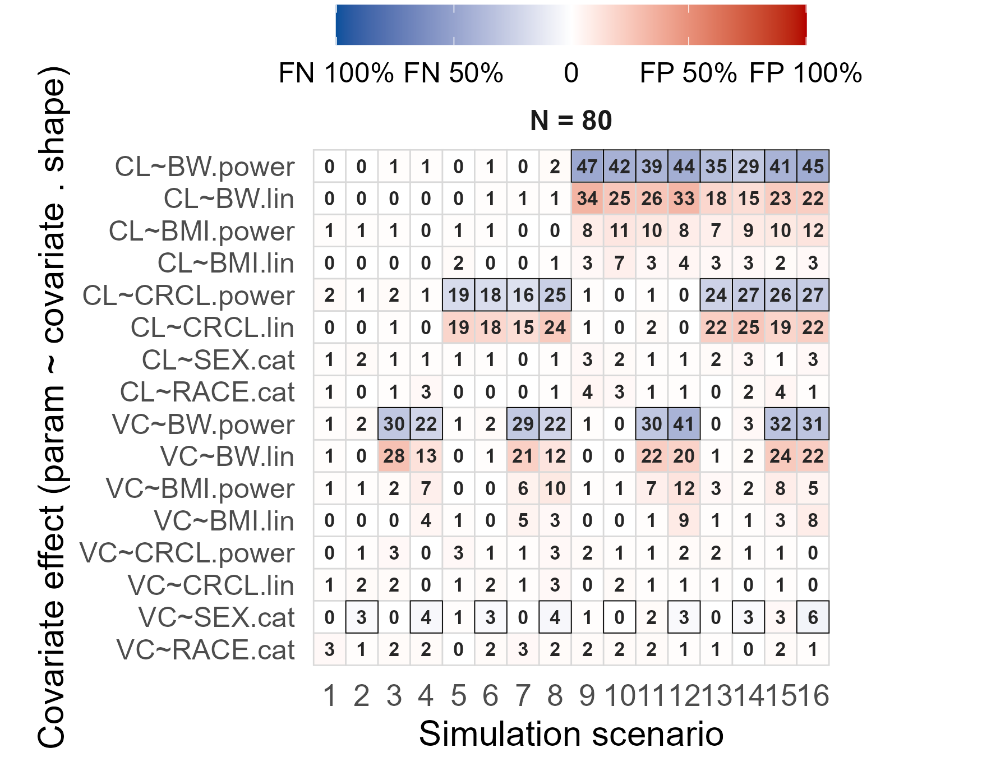
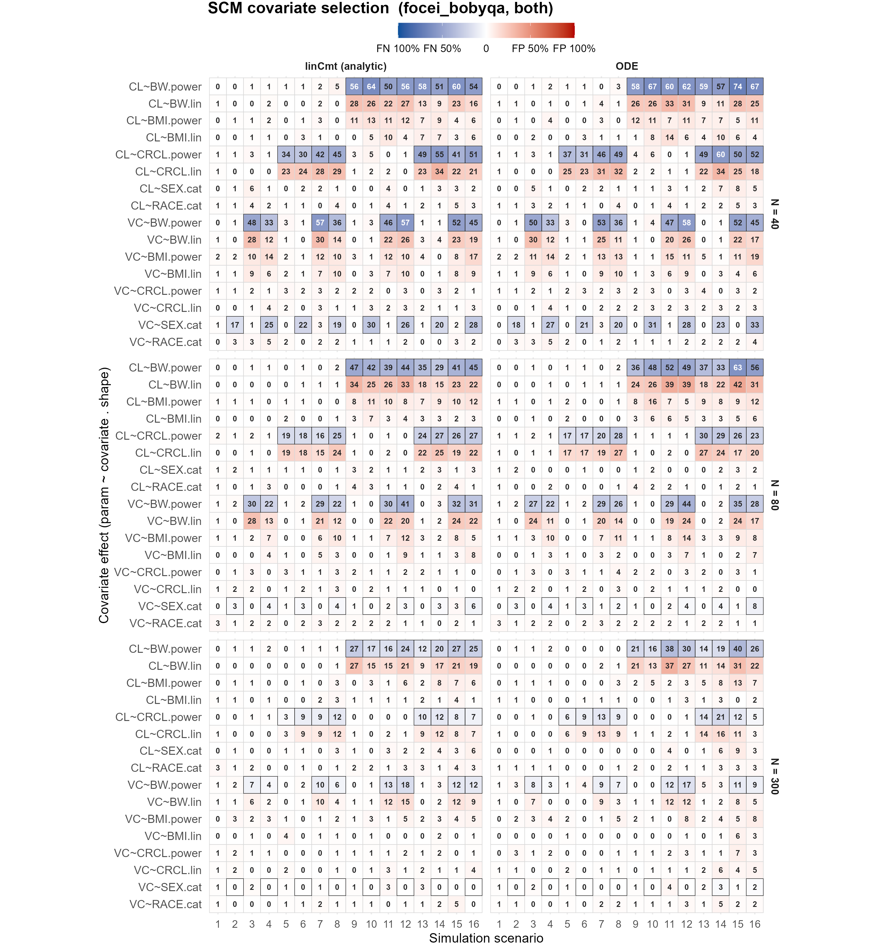

False selection concentrates on competing shapes & collinear distractor
Same var-covar, different shape
Covariates with high collinearity
Lincmt $≈$ODE
N ↓ FP&FN↑
41

Slide 42
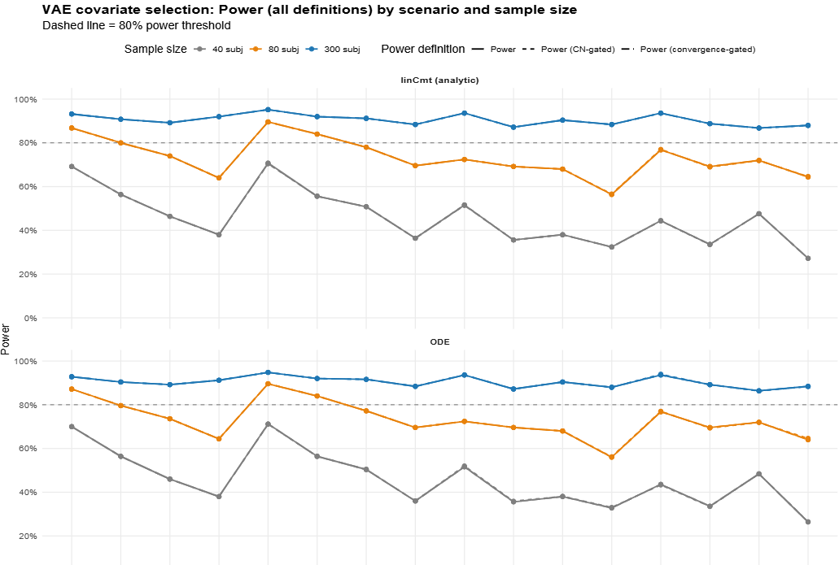
Power of VAE with no competing shapes

Slide 43
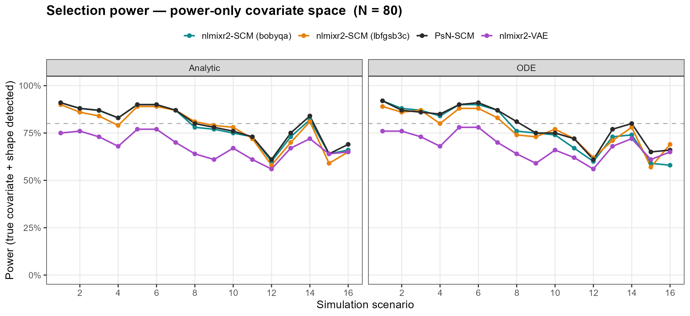
Power shape only

Slide 44
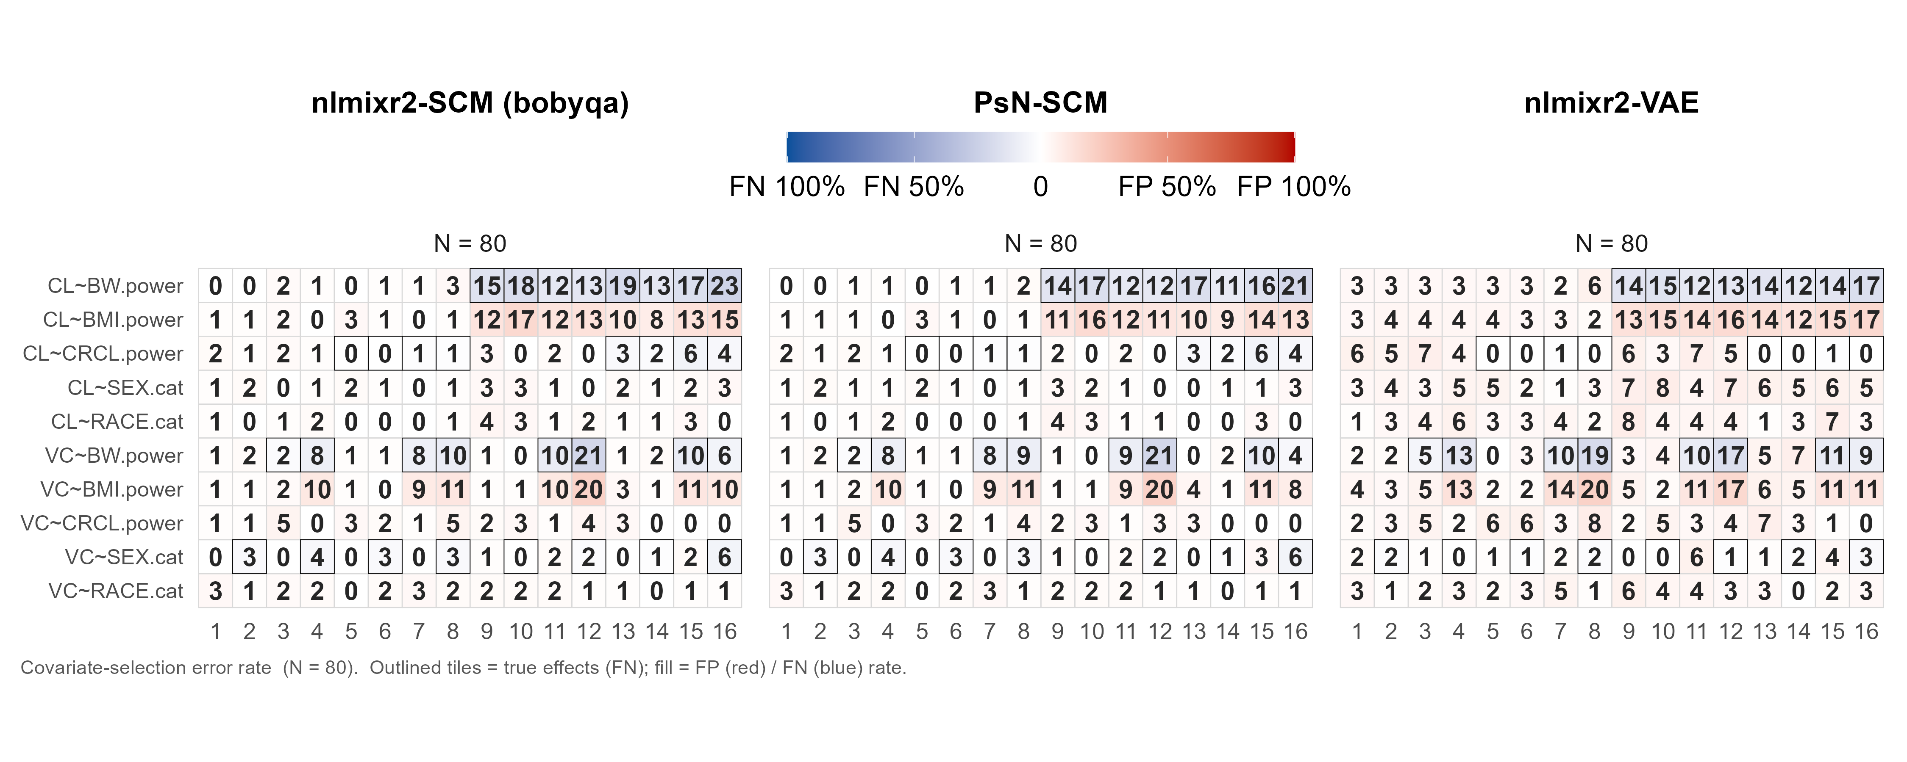
Power shape only

Slide 45
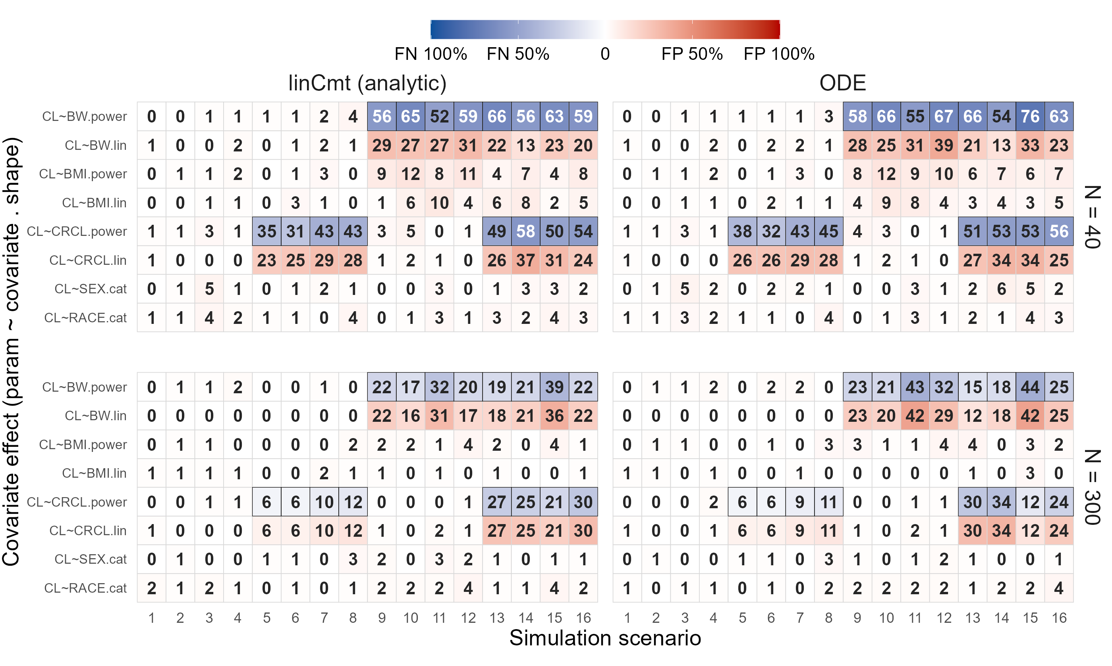

False selection concentrates on competing shapes & collinear distractor
Lincmt $≈$ODE
N ↓ FP&FN↑
Competing shape
Colinear covariate

Slide 46
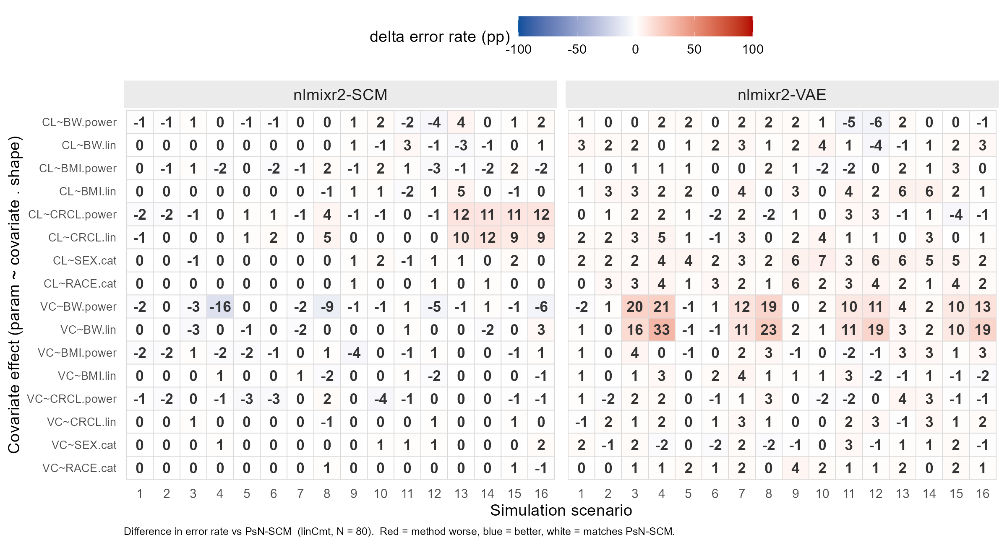
FP & FN rate Nlmixr2-SCM $≈$ NONMEM-SCM < nlmixr2VAE
FN
FP
FN
FP
Delta error rate: nlmixr2/VAE - NONMEM

