Slide 1
InfoLadder
How Much Structure Does Physical Inference Need?
Measuring Usable Information Across a Floorplan Representation Spectrum
Weekly supervision meeting 1 · 2026-07-21
Yaqoob Ansari · TopoField thread T4 · target: ICLR (mid-September 2026)
github.com/YaqoobAnsari/InfoLadder

Slide 2
The thesis
A floorplan is not a picture — it is a deliberately engineered encoding.
Architects put circulation, access control, zoning and egress logic INTO the drawing by convention.
That information is present but locked in pixels: not bioavailable to models.
Graph representations of increasing richness progressively unlock it.
We measure — for the first time under a formal protocol — how much each tier unlocks,
and what each tier costs to build.

Slide 3
A.
Context, question, and research gap

Slide 4
The problem
• Building-graph representations range from bare room connectivity to typed, directed, hierarchical graphs.
• Nobody knows which structural content downstream inference actually needs.
• Consequences today:
– annotation effort is spent blind — richness is added by habit, not by measured value;
– architectures are chosen by convention (“use a GNN”) without knowing what the input carries;
– industry tiers information need (ISO 7817-1:2024) with NO quantitative selection method.

Slide 5
The formal research question
• For a nested ladder of representations T0 ⊆ T1 ⊆ … ⊆ T5 of the same floorplan,
• measure usable information I_V(T_k → Y) — what a bounded predictor family V can extract about target Y —
• as a curve over tiers, per task, per predictor capacity.
• Derived quantities:
– annotation gain: nats of usable information per human annotation hour, per tier increment (first in the literature);
– capacity compensation: can bigger models on poor representations match small models on rich ones, at what sample cost;
– three currencies — structure (hours), capacity (compute), samples (data) — priced against each other.

Slide 6
Why this matters now (verified evidence)
• ISO 7817-1:2024 “Level of Information Need” standardizes exactly this richness tiering — with no measurement method behind it.
• Scan-to-BIM semantic enrichment costs 200–400 manual hours per project — the cost axis we price.
• A 2026 publication wave (FloorplanQA/ICML26, FMLM/CVPR26 Highlight, floorplan tokenization, SVG-decomposition studies) shows the field circling the question without the measurement.
• The measurement tool itself (predictive V-information, ICLR 2020) is mature, trusted, and has never been pointed at input representation tiers.

Slide 7
Research landscape (adversarially verified, July 2026)
Work | What it does | What it lacks vs. ours
V-information line (Xu ICLR'20; Ethayarajh ICML'22) | usable info of embeddings / dataset difficulty | never input tiers, cost, or graphs
Almudévar & Ortega '26 | V-info to compare learned representations | hidden activations, not input formats
Clio (RSS'24, MIT-SPARK) | IB-selects scene-graph granularity for a task | online compression, no measurement/cost/capacity
KG-construction benchmark '26 | construction choice scored by downstream GNN | accuracy-only, unordered variants, no cost
FloorplanQA (ICML'26) | LLM accuracy across floorplan text formats | prompting eval; no nesting, probing, or cost
Homophily / label-informativeness (Platonov '23) | when structure helps, on fixed graphs | binary use-vs-ignore; not which tier to build
Full threat analysis with sources: docs/audits/project_audit_2026-07-16.md

Slide 8
The gap, precisely
• “Representation matters” is folklore — ablations, domain observations, and 2026 benchmarks all attest to it.
• What has never existed, in any domain, is the combination:
– a NESTED refinement spectrum (each tier provably recoverable from the next by forgetting);
– measured under a formal usable-information protocol with probe-CAPACITY sweeps;
– tied to the ANNOTATION COST of each refinement;
– on an instrument CALIBRATED against planted ground truth before any real-data claim.
• No published relative combines any two of these four ingredients.

Slide 9
What we claim — and what we deliberately do not
• Claim: the six-tier spectrum formalization with cost semantics (C1).
• Claim: the first usable-information measurement over input representation tiers, as a calibrated instrument (C2).
• Claim: annotation gain in nats/hour (C3); information-richness curves + capacity/scale analyses (C4); domain generality check (C5).
• NOT claimed: a new probing method (we apply Xu et al.), a new GNN, or deployed physical-field inference.
• Wording discipline: the novelty is the PROTOCOL — “first to study representation effects on floorplans” is no longer defensible and is never said.

Slide 10
Measurement framework in one slide
• Predictive V-information (Xu et al., ICLR 2020): H_V(Y|X) = best expected log-loss achievable by predictor family V; I_V(X→Y) = H_V(Y) − H_V(Y|X).
• Key property: unlike Shannon MI, PROCESSING CAN INCREASE usable information — annotation is computation done in advance.
• Because tiers are nested, every tier is a coarsening of T5: the study is V-information under structured coarsening.
• MDL prequential codelength (Voita & Titov 2020) reported alongside — the probe-effort-sensitive, optimization-robust complement.
• All estimates are lower bounds achieved by optimization → best-of-3 restarts × 3 seeds, never single probes.

Slide 11
B.
The six-tier representation spectrum
Every tier derives from the raster floorplan through one real parsing pipeline; downgrades are deterministic forgetting maps.

Slide 12
The ladder at a glance
Tier | Adds | Derivation | Cost
T0 skeleton | spaces (rooms, corridor hubs, stairs/elevators) + undirected connectivity; centroids kept | automatic (forget of T2) | free
T1 named spaces | node kinds (room/corridor/transition) + recognized text labels | automatic (CRAFT text) | free
T2 doored structure | door NODES with subtypes (room–corridor, room–room, corridor–corridor, exit) | automatic (door detector) | free
T3 measured geometry | per-node measures: area, eq. radius, inradius, subnode count, door count | automatic (pipeline stats) | free
T4 access control | direction/restriction on connections (one-way, staff-only) | MANUAL annotation, timed | ≈0.5–1 h/bldg
T5 organization | zone/wing containment hierarchy + outdoor marking | MANUAL annotation, timed | ≈1–2 h/bldg
Strict refinement: forget(T_{k+1}) = T_k, tested property. Thermal/crowding annotations are TARGETS, never representation content (leakage).

Slide 13
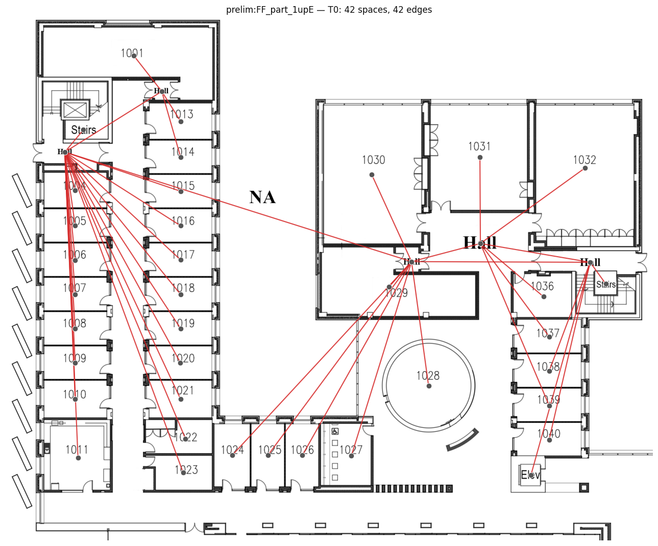
T0 — untyped skeleton
• What: every space is a node with only its position; edges mean “connected through an opening”.
• Why this floor: the minimum a model could receive — pure topology + layout.
• Every question answerable here is free; everything above is measured against this floor.
Institutional test building (FF sheet), T0: 42 spaces, untyped, connectivity only.

Slide 14
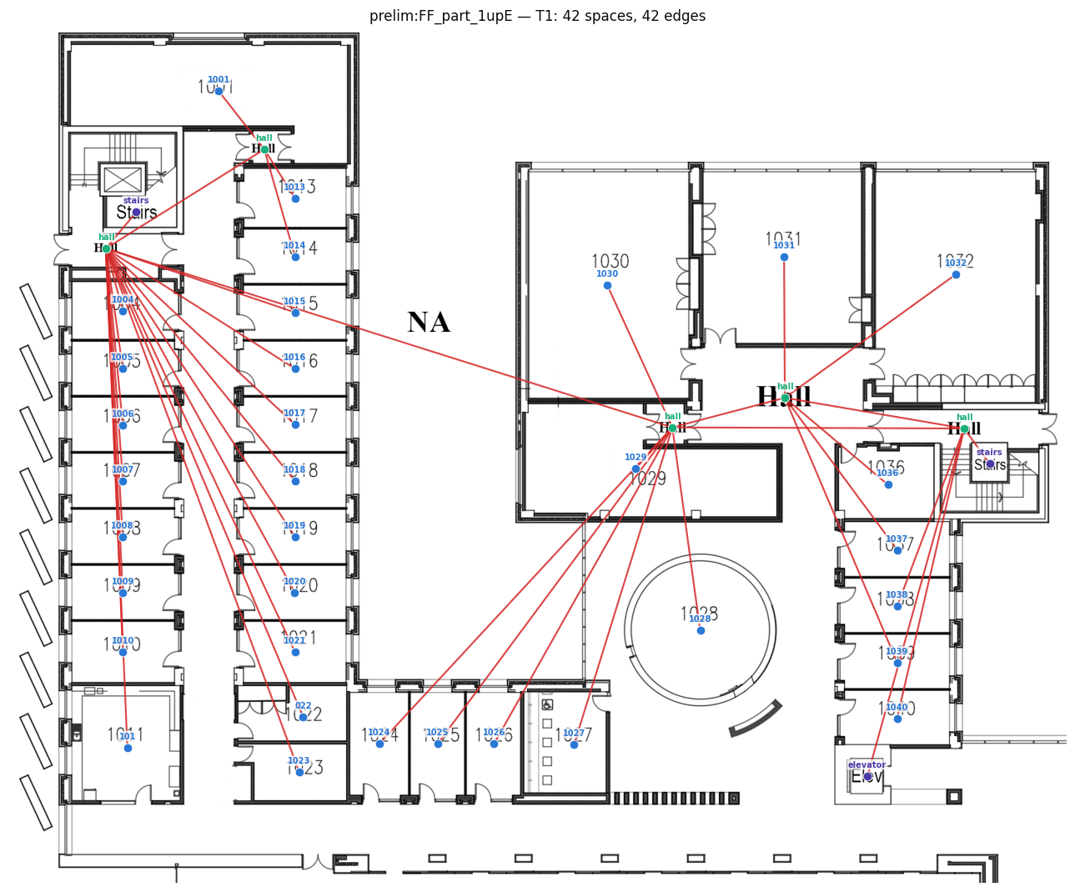
T1 — named spaces
• Adds: node kinds (room / corridor / stairs / elevator) + the drawing's text (room numbers, ‘hall’).
• Why: the first semantic increment — what each thing IS; still free (text is read from the sheet).
• Semantic key on our sheets: numbers = rooms, ‘hall’ = corridors, ‘NA’ = outdoor (excluded).
T1: same structure, now typed and labeled; corridors are the hall-text identities.

Slide 15
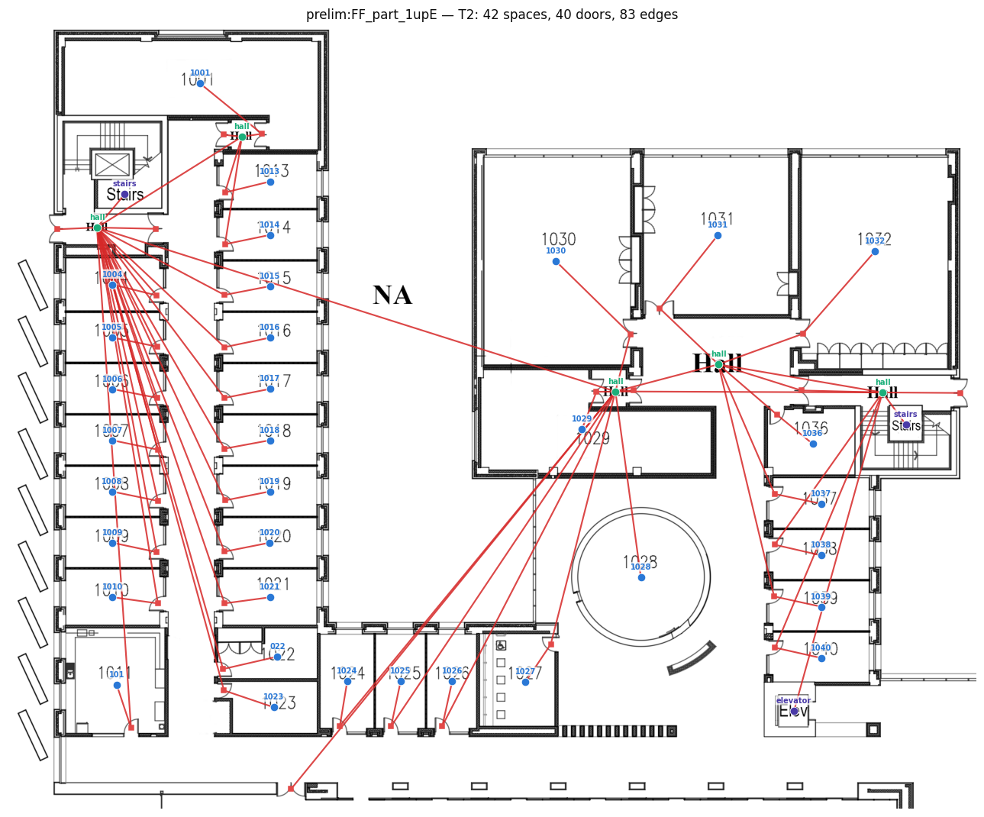
T2 — doored structure
• Adds: doors as first-class typed nodes (room–corridor, room–room, corridor–corridor, exit).
• Why: connection TYPE is physical structure — a wall shares heat, a door passes people.
• This is where circulation logic becomes explicit; detector-derived on rasters, annotation-derived on ArchCAD.
T2: 42 spaces + 38 typed door nodes + 79 edges; doors sit on the drawn openings.

Slide 16
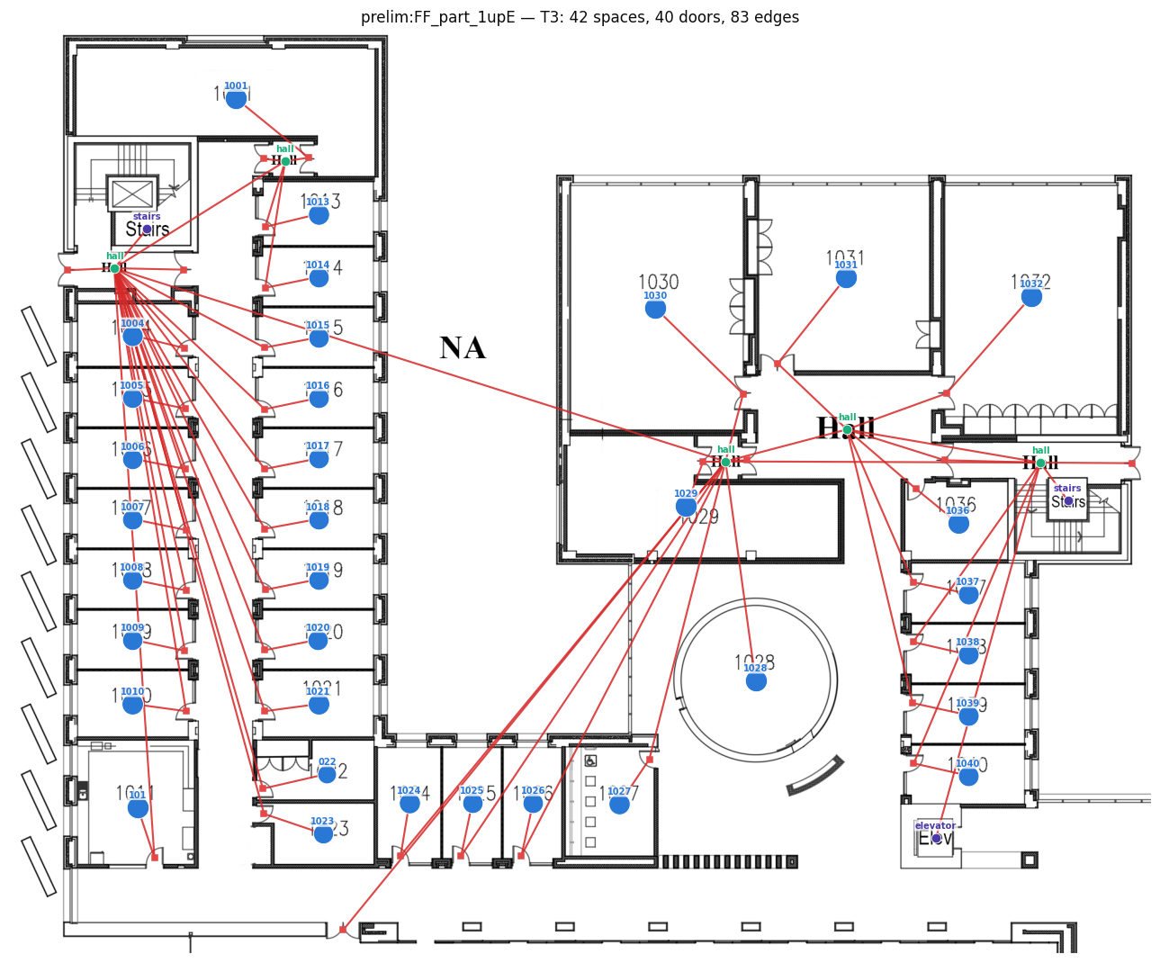
T3 — measured geometry
• Adds: numeric measures per space — area, equivalent radius, inradius, sub-node count, door count.
• Why: physical capacity and shape complexity, surfaced as features; still fully automatic.
• T3 closes the FREE tiers: everything above requires human hours.
T3: node size now encodes measured area; all measures carried as attributes.

Slide 17
T4 + T5 — the paid tiers (built only if the stage gate opens)
• T4 access control: direction/restriction per connection (one-way exits, staff-only doors) — the egress-relevant increment; ~0.5–1 h/building, timed.
• T5 organization: zone/wing containment forest + outdoor regions — the facility-manager's mental model; ~1–2 h/building, timed.
• Timing sheets make these the first measured c(k→k+1) figures — the denominator of annotation gain (C3).
• An annotation tool over the pipeline's pre-fill is designed but deliberately deferred (future TODO).

Slide 18
Why nesting is load-bearing (not a design nicety)
• Each tier is recoverable from the one above by a deterministic forgetting map φ — tested: determinism, idempotence, chain composition.
• This makes the ladder a measurement SCALE: differences between tiers are attributable to the added content, nothing else.
• Proposition 1: if the probe family is closed under composition with φ, I_V is monotone in tier — closure failure makes non-monotonicity (S9) a testable prediction, not an anecdote.
• Schema v2 enforces tier-licensed content (doors only at T2+, measures at T3+, direction at T4+, hierarchy at T5) — 113 automated tests.

Slide 19
Stage-gated execution (risk control)
• Phase 1 (now): build T0–T3 at corpus scale — thousands of accurate, visually inspectable graphs.
• Phase 2: run the full probing grid on the four FREE tiers.
• GATE: only an established, statistically supported information ordering across T0–T3 unlocks the manual T4/T5 investment.
• Rationale: never spend 40 annotation hours before the instrument demonstrates the effect on free tiers.

Slide 20
C.
Raster-first construction pipeline
One real pipeline builds every tier from the pixel input — the thesis is honored in the construction, not just the framing.

Slide 21
Pipeline architecture
• Engine: Tesseract2 (our own SIGSPATIAL lineage) — CRAFT text detection → semantic interpreter → flood-fill space segmentation → Faster R-CNN door detection → navigable graph.
• Tier factory (this project): contracts the navigation graph into tier graphs —
– room sub-nodes → parent rooms; corridor waypoint meshes → hall-text identities (spatial territory assignment);
– recognized text joined deterministically from the interpreter sidecar (rooms=numbers, hall, NA→outside);
– typed doors, stairs/elevators as transitions; measures from pipeline statistics → validated T3 → forget() → T2/T1/T0.
• Fallback lane: classical morphology (watershed on wall masks) — kept as QA cross-check and for annotation-free sources.

Slide 22
Flagship result — the institutional test building at T2
FF sheet: 42 spaces, 38 typed doors, 79 edges. Every numbered room is one node; doors sit on drawn openings; each hall text is a corridor identity serving its own territory. This graph passed the owner's manual inspection.

Slide 23
Validating the pipeline against ground truth (the MSD loop)
• MSD (ECCV'24) ships true room polygons, types, and access graphs for 4,167 usable plans.
• We RENDER its geometry to clean rasters (walls + room-type text + door symbols), run the FULL raster pipeline, and score the output against the shipped truth.
• This turns ‘is your graph even right?’ into a table: room detection F1, type accuracy, adjacency agreement — at thousands-of-plans scale.
• Renders are deterministic (seeded per plan) and auditable; the room-type→vocabulary remap is recorded per plan.

Slide 24
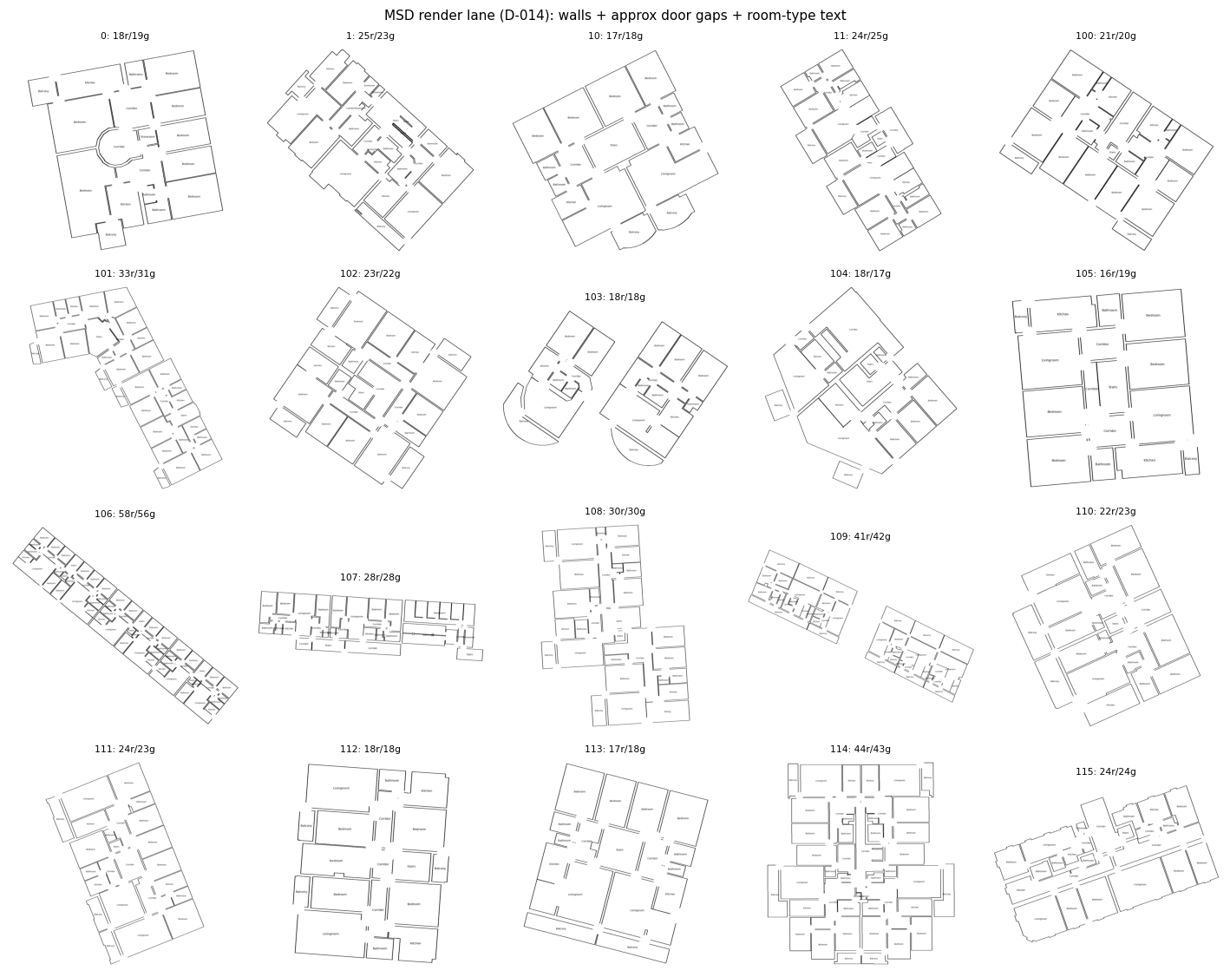
MSD ground-truth renders (validation corpus)
20-plan render sample: walls from true polygons, room-type text for the text stage, door symbols at true openings. 4,167 plans rendered at 30–60 px/m.

Slide 25
Pipeline accuracy vs. MSD ground truth (first 119 scored plans)
Metric | Value | Interpretation
Room detection precision / recall / F1 | 0.996 / 0.977 / 0.986 | space segmentation is essentially solved
Room-type accuracy (text → label) | 0.823 batch; 16/16 after vocabulary fixes | reading is clean; residual = vocabulary mapping
Adjacency F1 (door-contracted) | 0.125 | the door bottleneck, quantified (below)
Door-symbol detection rate | 34.9% (3,687 rendered arcs) | style gap vs. detector's training distribution
Isolated rooms after graphing | 0 | connectivity is preserved even pre-door-fix
Full-corpus re-scoring in flight (2,883 graphs built and growing; failure accounting reconciles every missing output).

Slide 26
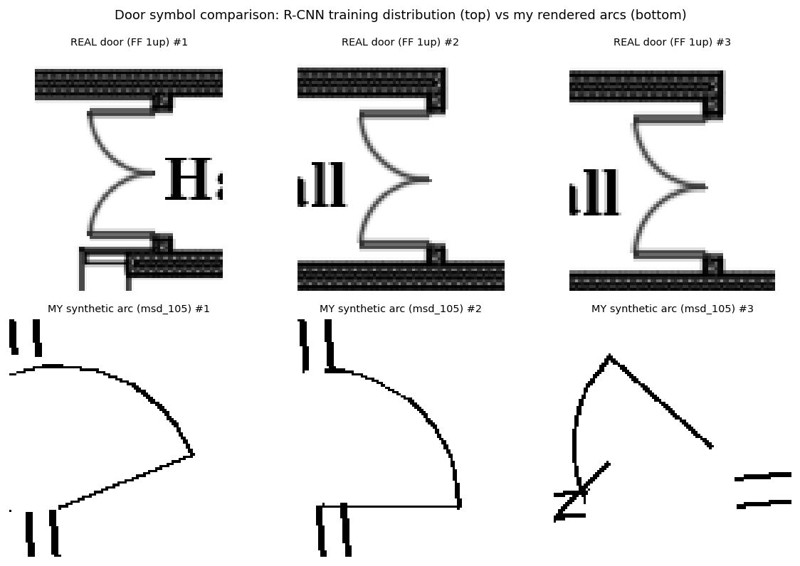
The door bottleneck, diagnosed
• The detector was trained on bold double-swing symbols seated in thick hatched walls (top row).
• Naive synthetic arcs (bottom) are thin, isolated, sometimes overlapping → 2/19 detected on the gate plan.
• Decision: retrain the detector on synthetic doors — unlimited exact labels are generatable from ground truth.
Real training-distribution doors vs. first-generation synthetic arcs — the style/context gap in one figure.

Slide 27
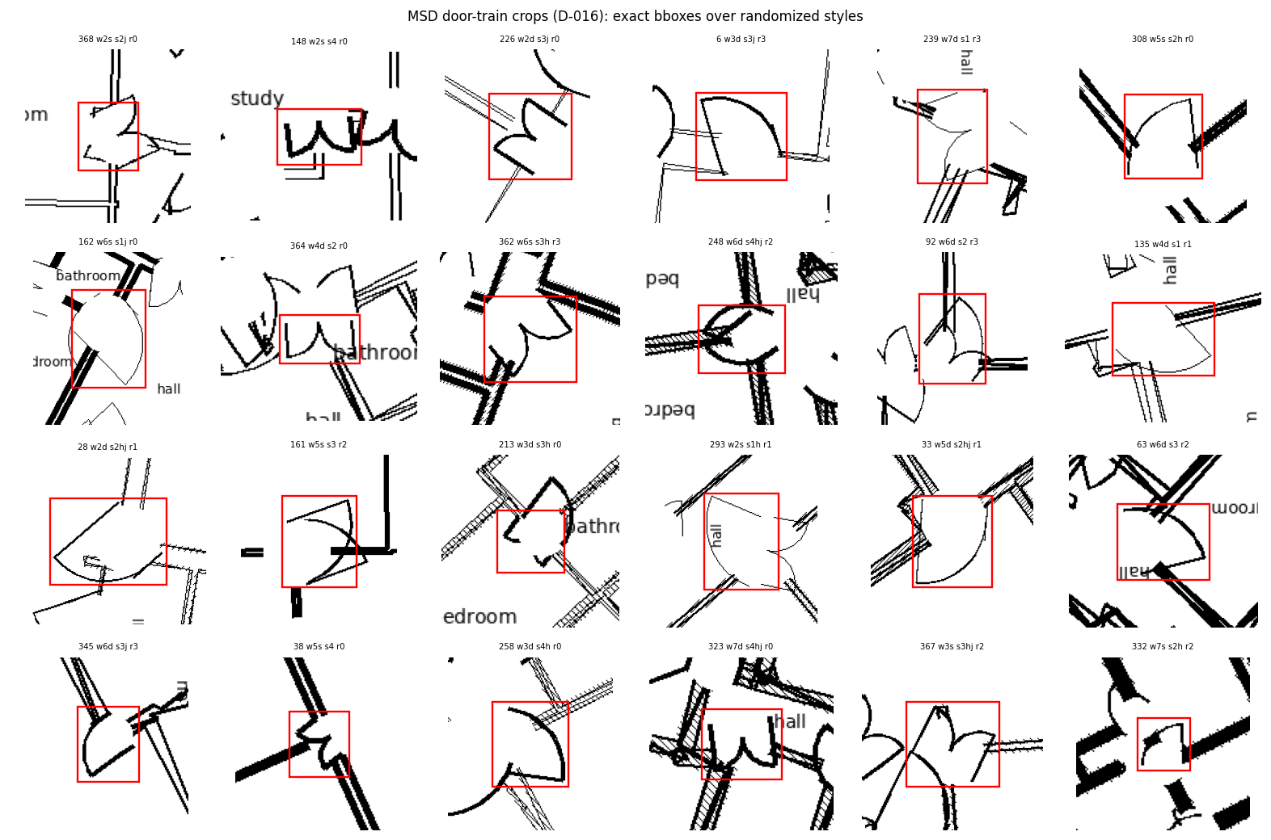
Door training set: 12,290 exact boxes across 400 plans
Bounding boxes emitted analytically at render time (nothing detected, nothing hand-labeled). Domain randomization: wall thickness/line-style/hatching, stroke weight, single/double swing, hinge side, jambs, text presence, rotations. Plan-level 15% holdout; 100% ink-coverage self-check.

Slide 28
Detector fine-tune: first iteration results
• Held-out synthetic recall: 0.048 (original detector) → 0.523 after 18 minutes of fine-tuning (precision 0.817) — an 11× gain, gate is ≥0.80.
• On the REAL sheets: +38% more detections while preserving 84.6% of the original detections' positions —
– pending manual QA: extra doors real (gate was mis-specified) vs. hallucinated (needs anchoring).
• v2 planned: longer training, per-subtype labels, real-sheet verdict folded in.
• Deployment discipline: original checkpoint preserved; nothing deploys until both gates pass AND the running corpus finishes (consistency).

Slide 29
Robustness engineering (what broke and what we did)
• Segmentation-palette crash: plans without corridors/balconies crashed the door classifier (~36% of MSD) — root-caused, minimally patched, verified; patch archived for upstreaming.
• Every missing output is ACCOUNTED: failure fingerprinting buckets each absent graph by its crash stage — nothing is silently lost.
• Batches are resumable and idempotent; renders are seeded-deterministic; the failed 785 plans are being swept right now with the patch live (0 new failures so far).

Slide 30
D.
Corpora — what we have, quantified

Slide 31
Corpus overview
Corpus | Scale | Annotations | Doors | Role
Prelim pool (ours) | 21 sheets: 1 institutional building (FF×8, LF×2, SF×1 + variants) + 10 residential | text labels (numbers / hall / NA) | drawn symbols (detector) | pipeline testbed; Gate-b gold candidate
MSD (ECCV'24) | 5,372 public; 4,167 usable; ≈140k spaces | room polygons, 9 types, access graphs, zones | edge attribute only (no geometry) | GROUND TRUTH validation + residential scale
FloorPlanCAD (ICCV'21) | 11,602 SVGs (6,965/3,827/810) | 35 classes, line-grained, per-primitive | drawn symbols, 6 classes | parser template; textless-lane source
ArchCAD-400K (NeurIPS'25) | 41,097 slices, 14 m × 14 m | numeric per-primitive semantics | GROUND-TRUTH typed (4 classes + instances) | institutional regime (S4); survey-gated
Code graphs (planned) | 1 established defect dataset | AST → +dataflow → +call ladder | n/a | generality check C5, hard-capped

Slide 32
Prelim pool — the owner-verified anchor (quantified)
• 21 sheets; the institutional building spans FF (8 sheets), LF (2), SF (1) with text-annotation variants deduplicated.
• Tier graphs at T3: 359 spaces, 368 typed doors, 733 edges; 17.1 spaces/sheet average; 100% of spaces carry labels.
• Text key: rooms = numbers (e.g., 1001–1040), corridors = ‘hall’, outdoor = ‘NA’, stairs/elevator recognized.
• Quality: manually inspected by the building's owner; corridor territories and labels verified against reality.
• Residential file_N renders excluded from measurement (furniture-at-wall-thickness defeats morphology; documented).

Slide 33
MSD — Modified Swiss Dwellings (validation + residential scale)
• 5,372 public multi-unit plans; ONLY the 4,167 train plans ship geometry (test withholds it) — corpus arithmetic corrected early.
• ≈140k spaces; 33.6 spaces/plan average (measured on the 200-plan subset: 6,720 spaces).
• Room types (9 area classes), access edges typed door/passage/entrance; NO access direction; NO door geometry (approximated at nearest boundary points when rendering).
• Leakage found & neutralized: shipped zones are a deterministic function of room type → zone targets use APARTMENT grouping (access components cut at entrance doors), which is genuinely tier-exclusive.
• License CC BY 4.0; 2,883 plans already carried through the full pipeline to tier graphs.

Slide 34
FloorPlanCAD + ArchCAD-400K — the institutional axis
• FloorPlanCAD: 11,602 annotated SVGs incl. schools/hospitals/malls; 35 line-grained classes; doors drawn (6 classes).
– Caveat found by exhaustive search: every sheet is a 140×140-unit CROP; zero self-contained plans in the val split → role restricted to parser template + textless-lane source.
• ArchCAD-400K (gated access approved): 41,097 slices of professional drawings; walls/glass/columns/stairs/elevators labeled;
– doors are GROUND-TRUTH typed instances → the door tier needs no detector on this corpus;
– no room polygons and no text → rooms derived by our watershed lane; an ENCLOSURE SURVEY across all slices gates admission (crops again).
• Licenses: CC BY-NC 4.0 (both), ArchCAD additionally gated non-commercial; research-use, cited, never redistributed.

Slide 35
Data risk register (found early, neutralized)
• Zone-label determinism (MSD): would leak the T5 target through the T1 room label → apartment-mode zones adopted as default.
• Base-rate channel (synthetic): uneven per-building label rates let probes read building identity, not labels — caught by the calibration instrument itself, closed by balanced design.
• Crop fragmentation (FloorPlanCAD, ArchCAD): admission gates by enclosure, usable fractions reported, never assumed.
• Detector style-transfer (doors): quantified (34.9%), retrain program running, ArchCAD path is annotation-based and unaffected.

Slide 36
E.
The calibrated measurement instrument

Slide 37
Why the instrument must be calibrated first
• Every I_V estimate is a lower bound achieved by optimization — an uncalibrated estimator is an article of faith.
• Design: synthetic buildings where each target is PLANTED at a known tier by construction —
– degree (T0), semantic label (T1), door subtype (T2), numeric attribute (T3), direction (T4), zone secret (T5).
• PASS iff the measured surface jumps exactly at each planted tier, is flat elsewhere, and shuffled controls extract nothing.
• This doubles as the paper's Figure 2 — the instrument's license to make real-data claims.

Slide 38
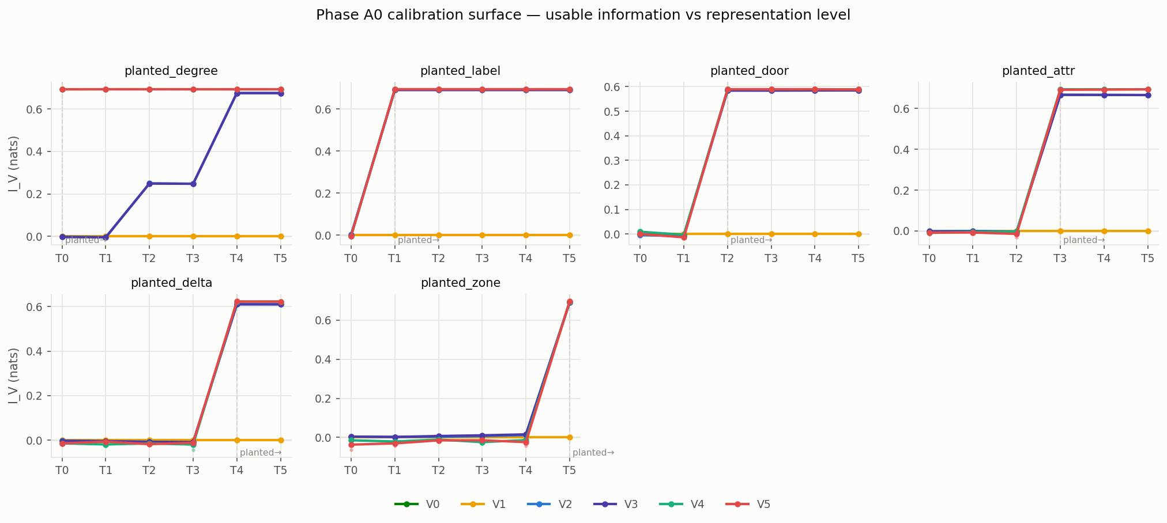
Calibration result: PASS — 71/71 checks (V1–V5) + 19/19 (V6, GPU)
Each panel is one planted target; the dashed line marks where the answer was hidden. Every readable family jumps exactly at the planted tier and is flat below it; the V0 parameter-free readout at T5 extracts 0.73 of the 0.73 available nats — richness converts learning into lookup.

Slide 39
The instrument earned trust by catching real bugs
• Base-rate channel: shuffled-label controls extracted +0.115 nats via building-identifying features — a 2/53-check FAIL that exposed a design flaw, fixed by balanced planting.
• Degenerate MDL blocks: single-class training prefixes crashed the linear family — now degrades to the marginal predictor (regression-tested).
• Mean-aggregation blindness: mean-pooled GNNs provably cannot count — switched to sum aggregation after the degree control failed.
• Each catch is documented as a decision record; failed runs stay in the registry — nothing is retried-until-green silently.

Slide 40
The probe ladder (the capacity sweep V)
Rung | Family | Question it answers
V0 | parameter-free readout (0 params) | is the answer literally written in the representation?
V1 | predict-from-prior | the floor: what does the label marginal give?
V2 / V3 | linear / linear + spectral encodings | is the information on the surface of node features?
V4 / V5 | 1- / 2-layer GNNs (sum aggregation) | is it extractable with local computation?
V6 | 4-layer GraphGPS-style transformer (≤ 2M params, GPU) | is it extractable at all (bounded ceiling)?
V7 (planned) | frozen small LM over serialized graphs | pre-empts ‘why not an LLM?’ (appendix tier)
Fixed architectures across tiers (fairness); every curve sandwiched between shuffled-label floors and oracle skylines.

Slide 41
Evaluation metric suite (revised after methods review)
• Core: I_V per (tier, target, family, seed) + prequential MDL codelength — both in nats, both released raw.
• Tier increments measured as CONDITIONAL V-information I_V(ΔT → Y | T_k) — the established ‘information beyond a baseline’ construction, not noisy differencing.
• Adopted additions (each neutralizes a known objection at marginal cost):
– pointwise V-information + dataset-artifact audit (per-instance difficulty; Data-Checklist lineage, COLM 2024);
– loss-data-curve summaries from the MDL blocks we already compute (sample-efficiency view).
• Considered and rejected with reasons: PID, graph information bottleneck, neural MI estimators, effective information, intrinsic dimension, concept-erasure probing.

Slide 42
Statistical protocol (pre-registered before the grid runs)
• Building-level splits, never floor-level; split assignment hashed and frozen.
• 3 seeds × best-of-3 restarts; 1000-resample cluster bootstrap (clusters = buildings) for every CI.
• Paired Wilcoxon across buildings for tier comparisons, Holm-corrected within each tier family.
• Hard validity gates: shuffled controls must extract nothing (one-sided); oracle skylines must dominate; calibration must be PASS.
• Negative and flat results are published with equal prominence — committed in writing.

Slide 43
Methodological guard: separating structure from annotation content
• Confound: adding door nodes (T2) or hierarchy (T5) changes graph TOPOLOGY — commute times and effective resistance shift — so gains could be partly ‘free structure’.
• Controls added to the grid design:
– free-structure baselines: virtual-node / Louvain-clustering hierarchies vs. the manual T5; untyped added nodes vs. typed doors;
– per-tier effective-resistance deltas reported; an MLP ablation isolates feature- from structure-carried information.
• Without these, nats-per-annotation-hour is attackable; with them, it is the paper's most defensible number.

Slide 44
F.
Targets, applications, hypotheses, and plan

Slide 45
Target suite with 2D-validity verdicts
Target | Definition | Verdict
Y_pde | steady-state diffusion field solved exactly on the true 2D geometry | KEEP — reframed as an analytic geometric functional; exact by construction, immune to simulator objections
Y_zone | plan-level thermal zoning (ASHRAE-grounded archetypes, assumptions disclosed) | KEEP — zoning is a plan-level design activity
Y_rank | pairwise room ordering on the diffusion field | KEEP, DEMOTED — renamed away from ‘temperature prediction’ (field data refute plan-only prediction of real temperatures)
Y_egress | evacuation bottleneck membership (+ betweenness reference) | PROMOTED to co-headline — fully 2D-native, high-impact
Y_syntax (proposed) | space-syntax integration values | ADD (pending decision) — zero annotation cost, established field
Paper gains a ‘2D validity envelope’: stack effect, solar orientation, inter-floor transfer are explicitly out of scope. This concedes exactly what should be conceded — and the study gets stronger.

Slide 46
Downstream applications: who needs this measurement
• WELCOMES (anchor the paper here):
– scan-to-BIM semantic enrichment — 200–400 manual h/project is precisely the cost we price;
– ISO 7817-1 Level-of-Information-Need decisions — standardized tiers, no quantitative selection method;
– LLM building QA / reasoning — input-format choice is live and unmeasured (FloorplanQA line).
• INDIFFERENT: indoor localization, generic navigation (their formats are fixed by hardware constraints).
• WOULD DISPUTE: real-building thermal simulation from 2D — which is why we scope it out explicitly.

Slide 47
Hypotheses (pre-registered)
# | Hypothesis | Where tested
S1/S2 | I_V rises with tier for physical targets; saturation is task-dependent | main grid
S3 | capacity compensation is partial and costs ≥5× data | capacity/sample analysis
S4 | annotation gain ≈ 0 residential, large institutional (the headline if it holds) | MSD vs ArchCAD regimes
S5/S6 | fine-tuned transformers preserve probe ordering; functional > geometric hierarchy | confirmation phase
S7/S8 | code-graph ladder transfers; analytic target certifies the simulated one | generality + consistency
S9 | non-monotone dips for small probe families, vanishing with capacity (Prop. 1) | grid stratified by V

Slide 48
Where we are (day 8 of the 8-week plan)
• DONE: six-tier schema + tested forgetting maps; calibrated instrument (V0–V6, PASS); pipeline validated vs ground truth (room F1 0.986); 2,883-and-growing tier-graph corpus; owner-verified flagship building; door-detector retrain program (11× gain, v2 pending); 4 corpora landed and dissected; methods review folded in.
• RUNNING NOW: corpus completion sweep (patched, 0 new failures); full-corpus re-scoring; door retrain v2 prep.
• NEXT (this week): the stage-gate probing grid on T0–T3 — the experiment this entire infrastructure exists to run.
• Then: gate verdict → manual T4/T5 annotation (timed) → capacity/sample analyses → confirmation phase → write-up.

Slide 49
Decisions requested this week
• Grid scale: include free-structure controls (+≈30% cells) — recommended yes (they make C3 defensible).
• Fifth target: add space-syntax integration (zero annotation cost) — recommended yes.
• Bayes-error estimator: hold as rebuttal contingency (recommended) vs. run in main grid.
• Door verdict: on the real sheets, are the retrained detector's extra doors real or hallucinated? (eval_real.png) — shapes retrain v2.
• Annotation-hours planning: if the stage gate opens, ≤40 h of timed T4/T5 annotation in weeks 3–4.

Slide 50
Everything is inspectable (reproducibility posture)
• Repo: github.com/YaqoobAnsari/InfoLadder — every number traces to a run manifest (git SHA + config hash + seed) in an append-only registry.
• Browsable corpus: results/corpora/ — per building: source floorplan, tier JSONs, per-tier overlays, report card.
• Phase reports with figures: results/reports/; methods review: docs/audits/; decision log: docs/DECISIONS.md (18 records).
• External accountability: all code and results are independently monitored and graded.

