Slide 1

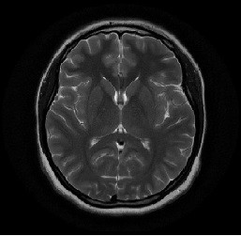
Brain Tumor classification
Learning from Images (WiSe2122)
Prof: Kristian Hildebrand

Slide 2
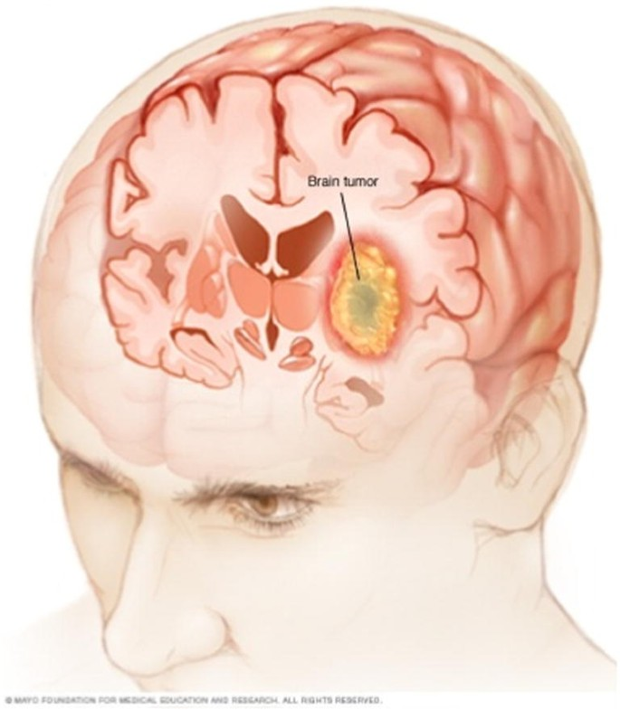
Agenda
Introduction
Methodology
Data Sets
Building Model
Model Performance
Examples
How can we Improve
Challenges
Conclusion

Slide 3
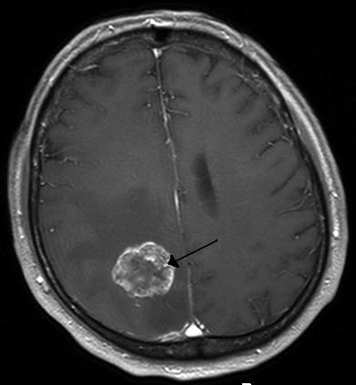
Brain Tumor
A brain tumor occurs when abnormal cells form within the brain.
There are two main types of tumors: cancerous (malignant) tumors and benign tumors.
All types of brain tumors may produce symptoms that vary depending on the part of the brain involved.
These symptoms may include headaches, seizures, problems with vision, vomiting and mental changes.

Slide 4
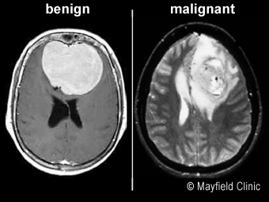
Introduction
Main Objective:
The dataset that we will be using comes from the Brain Tumor Classification, where our primary objective is to build a deep learning model that can successfully recognize and categorize images into either a tumorous or non tumorous.
Definition:
The dataset that we will be using comes from the Brain Tumor Classification, where our primary objective is to build a deep learning model that can successfully recognize and categorize images into either a tumorous or non tumorous.

Slide 5
Artificial Intelligence in Healthcare
Artificial intelligence (AI) in healthcare is the use of complex algorithms and software to estimate human cognition in the analysis of complicated medical data. Specifically, AI is the ability for computer algorithms to approximate conclusions without direct human input.
Various specialties in medicine have shown an increase in research regarding AI
Radiology
Imaging
Tele Health
Electronic Health Records
Industry

Slide 6
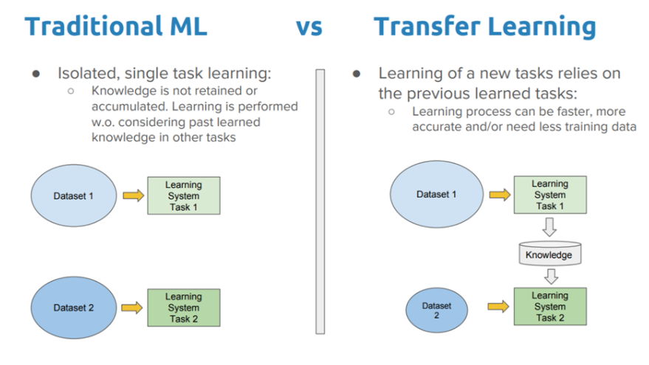
Methodology
Transfer Learning:Transfer learning is a machine learning method where a model developed for a task is reused as the starting point for a model on a second task.

Slide 7
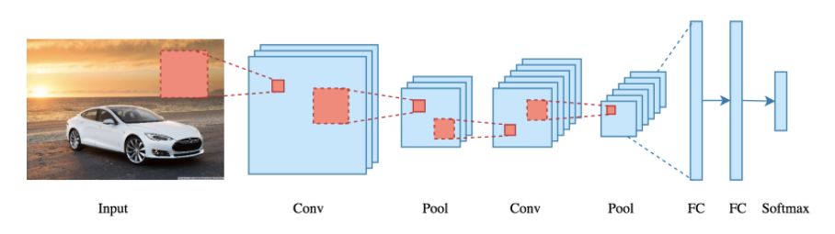
CNN
CNN: Convolutional neural network is a type of Artificial Neural Network used in Image Recognition and processing that is specifically designed to process pixel data.

Slide 8
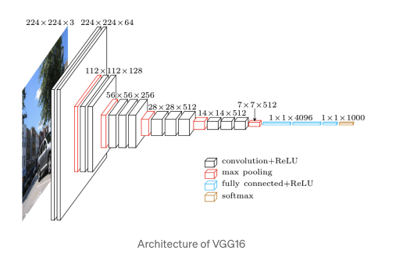
CNN (VGG16)
It is also called the OxfordNet model, named after the Visual Geometry Group from Oxford.
VGG-16 is a convolutional neural network that is 16 layers deep.
We can load a pretrained version of the network trained on more than a million images from the ImageNet database.
It is considered to be one of the excellent vision model architecture.
CNN Layer =3x3+1(stride)
Maxpool layer = 2x2 +2 (stride)
2 Fully connected layers
Softmax output

Slide 9
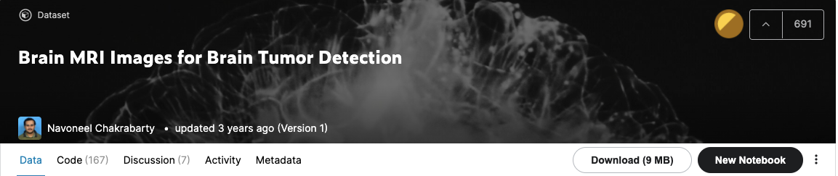
Dataset
The data is obtained from “Kaggle” for this project.
The dataset has 253 images (Y= 155, N=98)
Data could be found at https://www.kaggle.com/navoneel/brain-mri-images-for-brain-tumor-detection

Slide 10
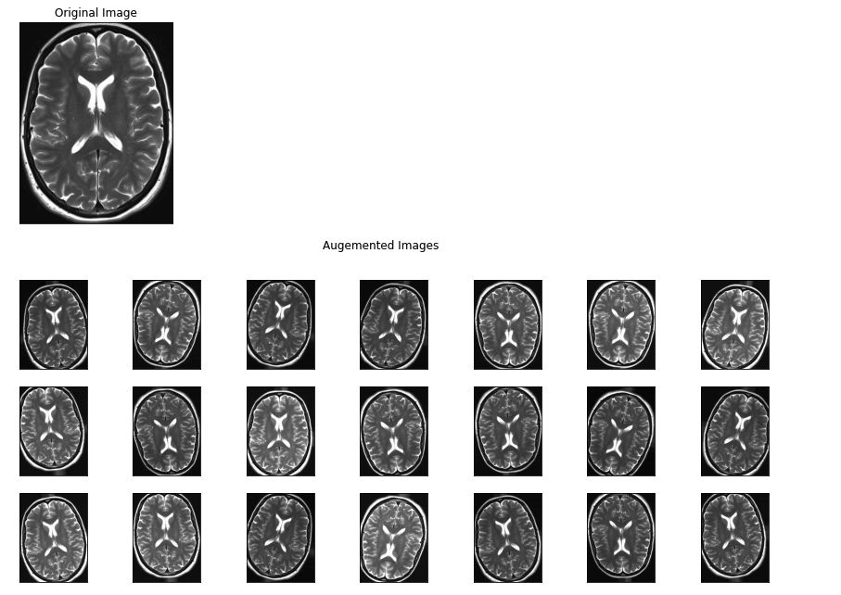
Data Augmentation
Data augmentation is a technique to artificially increase the amount of data.
It generetaes new data points in the existing data.
Data augmentation is useful to improve performance and outcomes of machine learning models.

Slide 11
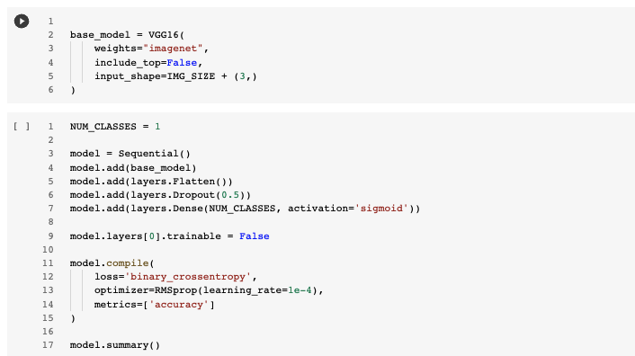
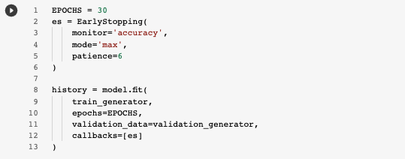
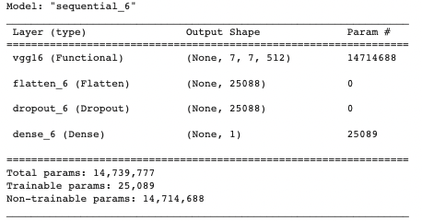
Modeling

Slide 12
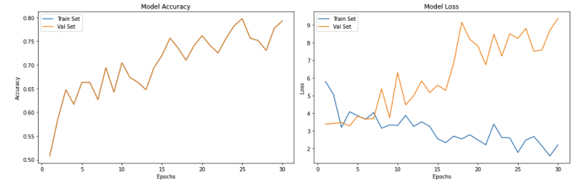
Model Performance

Slide 13
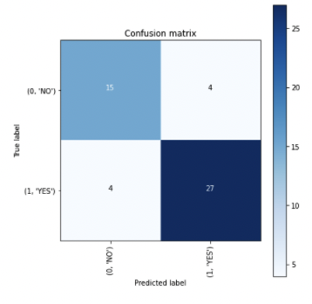
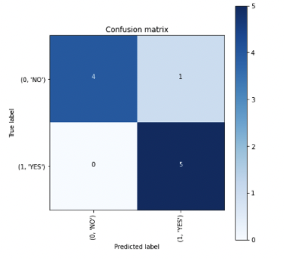
Model Performance
Validation on training data
Train Accuracy = 0.84
Validation on training data
Test Accuracy = 0.90

Slide 14
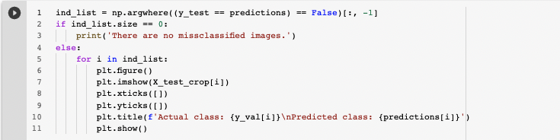
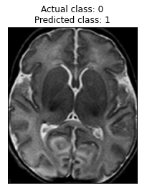
Example

Slide 15
How can we Improve
Size and quality of dataset can improve model performance.
Techniques like data hallucination can also effect model performance.
Training on more epochs and on more parameters may effect the model performance postively.
VGG 19 can also effect it positively because it has more layers.

Slide 16
Challenges
Team coordination challenge.
Communication challenge.
Model complexity challenge (VGG slow to train).
Computational Challenge.
Time Constrains.

Slide 17
Conclusion
The purpose of this project was to build a CNN model that would classify if the subject has a tumor or not.
Dataset can play vital role in getting good results.
Techniques like data augmentation and data hallucination can be helpful.
Different architectures can improve model accuracy.

Slide 18
Reference
https://medium.com/analytics-vidhya/brain-tumor-classification-transfer-learning-e04f84f96443
https://www.analyticsvidhya.com/blog/2021/05/convolutional-neural-networks-cnn/
https://machinelearningmastery.com/transfer-learning-for-deep-learning/
https://towardsdatascience.com/step-by-step-vgg16-implementation-in-keras-for-beginners-a833c686ae6c

