Slide 1
Java Inheritance
Notes:
https://www.guru99.com/java-class-inheritance.html

Slide 2
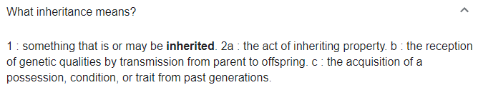
Inheritance Meaning

Slide 3
One of the greatest benefits of the Object approach to programming is that it offers the opportunity for us to REUSE classes that already have been written – either by ourselves or by someone else.
Say you wanted to develop a software system and you have, during your analysis, identified the need for a class called Employees.
You might be aware that a colleague in your organisation has already written an Employee class, rather than having to write your own class, it would be easier to approach your colleague and ask her to let you use her Employee class.
But what if the Employee class that you are given doesn’t quite do everything you had hoped?

Slide 4
Perhaps your employees are part-time, and you want your class to have an attribute like hourlyPay, or methods like calculateWeeklyPay and setHourlyPay, and these attributes and methods do not exist in the Employee class you have been given.
You might think it would be necessary to go into the old class and start messing about with the code.
But there is no need, because OO programming languages provide the ability to extend existing classes by adding attributes and methods to them.
This is called Inheritance.

Slide 5
Inheritance allows developers to create new classes that are similar to existing classes but with added functionality, without having to rewrite code or duplicate efforts.

Slide 6
Inheritance in Java
Java Inheritance (Subclass and Superclass)
In Java, it is possible to inherit attributes/variables and methods from one class to another.
We take a class, and then define other classes based on the first one.
The new class inherits all the variables and methods of the first one, but also variables and methods of their own.
We group the "inheritance concept" into two categories:
subclass (child) - the class that inherits from another class
superclass (parent) - the class being inherited from
To inherit from a class, use the extends keyword.

Slide 7
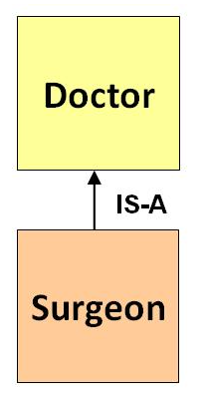
Inheritance
Inheritance represents the IS-A relationship which is also known as a parent-child relationship.

Slide 8
Why And When To Use "Inheritance"?
Inheritance supports the concept of “reusability”, i.e. when we want to create a new class and there is already a class that includes some of the code that we want, we can derive our new class from the existing class.
By doing this, we are reusing the variables and methods of the existing class.

Slide 9
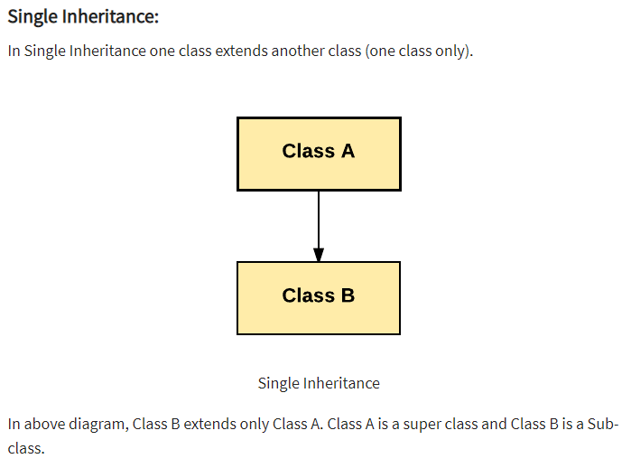
Types of Inheritance

Slide 10
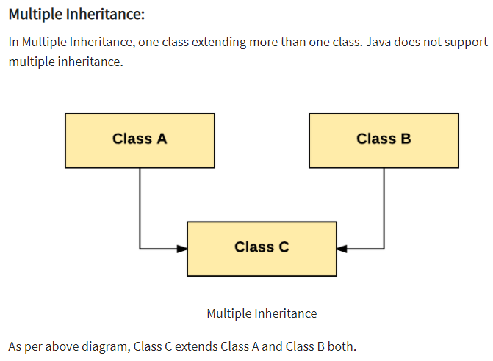

Slide 11
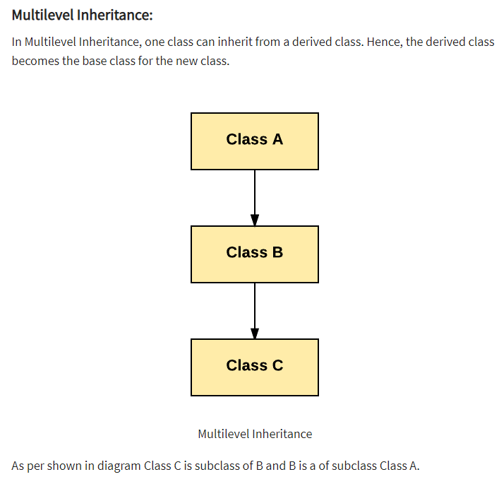

Slide 12
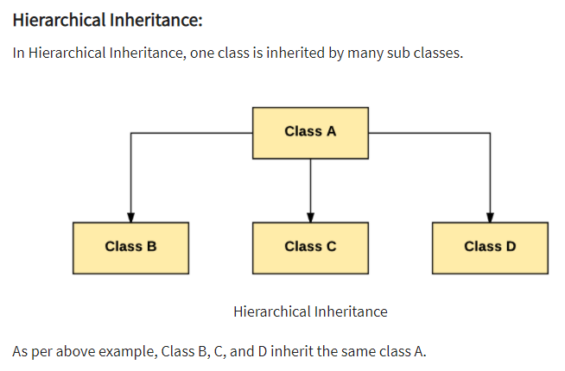

Slide 13
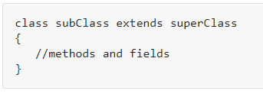
Inheritance Syntax

Slide 14
Example
class Doctor
{
}
class Surgeon extends Doctor
{
}

Slide 15
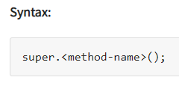
Super Keyword
The super keyword is similar to "this" keyword.
The keyword super can be used to access any data member or methods of the parent class.
Super keyword can be used at variable, method and constructor level.

Slide 16
Medical System
We have a lot of repeated pieces of code in our Medical System:
Nurse & Doctor: ID, regDate, name, email – getters & setters
Hospital: 2 very similar Arraylists nurseList & doctorList with very similar methods numberOfNurses(), numberOfDoctors etc.
MedicalSystem: very similar methods - addNurse() and addDoctor() etc.

Slide 17
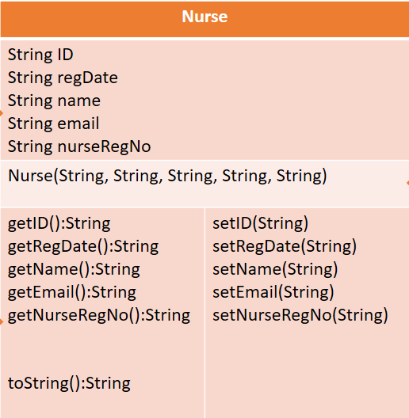
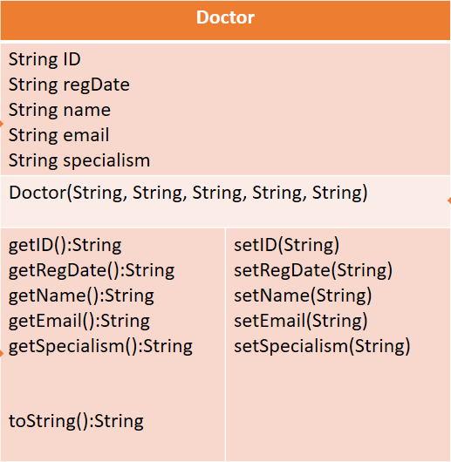
What do these 2 Classes have in common?

Slide 18
Things in Common

Slide 19
Nurse & Doctor
Shared Variables:
ID
regDate
name
email
Shared Methods:
getID()
getRegDate()
getName()
getEmail():String
setID()
setRegDate()
setName()
setEmail()
toString()
All our Medical System Versions to-date have been replicating these variables and methods in Nurse and Doctor

Slide 20
Implementing Inheritance in Medical System
We will create a Super Class (parent) MedicalProfessional which will contain the shared variables and methods we have outlines previously.
We will then create 2 Sub Classes (child) Nurse and Doctor classes that will have access to all variables and methods in MedicalProfessional and have variables and methods unique to their class.

Slide 21
MedicalProfessional
Super Class
Nurse
Doctor
Sub Class
Sub Class
Nurse extends MedicalProfessional
Doctor extends MedicalProfessional

Slide 22
Nurse & Doctor
Shared Variables:
ID
regDate
name
email
Shared Methods:
getID()
getRegDate()
getName()
getEmail():String
setID()
setRegDate()
setName()
setEmail()
toString()
Nurse
Unique Variable:
nurseRegNo
Unique Methods:
getNurseRegNo()
setNurseRegNo
Doctor
Unique Variable:
specialism
Unique Methods:
getSpecialism()
setSpecialism()

Slide 23
MedicalProfessional
String ID String regDate String name String email
MedicalProfessional(String, String, String, String)
getID():String getRegDate():String getName():String getEmail():String setID(String) setRegDate(String) setName(String) setEmail(String) toString():String
Super / Parent
Sub / Child
Sub / Child
Nurse
String nurseRegNo
Nurse(String, String, String, String, String)
getNurseRegNo():String setNurseRegNo(String) toString():String
Doctor
String specialism
Doctor(String, String, String, String, String)
getSpecialism():String setSpecialism(String) toString():String

Slide 24
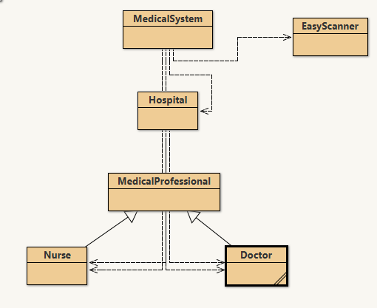

Slide 25
Super Class
MedicalProfessional
//Variables:
ID
regDate
name
email
//Methods:
getID()
getRegDate()
getName()
getEmail():String
setID()
setRegDate()
setName()
setEmail()
toString()
Doctor and Nurse have the variables and methods of MedicalProfessional and have some unique to themselves.
Nurse
// Variable:
nurseRegNo
// Methods:
getNurseRegNo()
setNurseRegNo
toString()
Doctor
// Variable:
specialism
// Methods:
getSpecialism()
setSpecialism()
toString()
Sub Class
Sub Class

Slide 26
Parent Class
MedicalProfessional
//Variables:
ID
regDate
name
email
//Methods:
getID()
getRegDate()
getName()
getEmail():String
setID()
setRegDate()
setName()
setEmail()
toString()
Extends
Extends
Nurse
// Variable:
nurseRegNo
// Methods:
getNurseRegNo()
setNurseRegNo
toString()
Doctor
// Variable:
specialism
// Methods:
getSpecialism()
setSpecialism()
toString()
Child Class
Inherit parent class variables and methods
Child Class

Slide 27
Super Class
Super Class declares the:
Variables
Constructor
Methods
That are generic and that will be shared / inherited by all Sub Classes

Slide 28
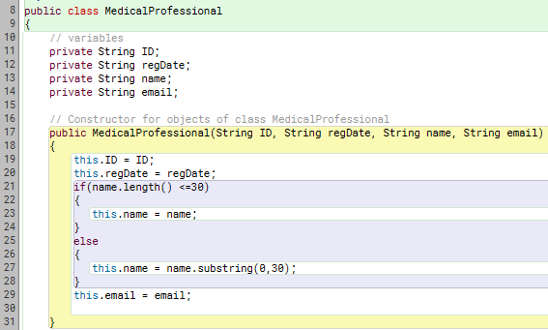
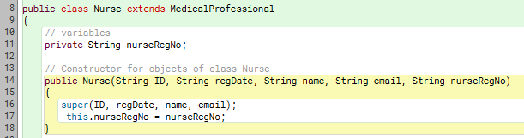
Super Class
Sub Class

Slide 29
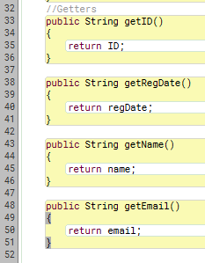
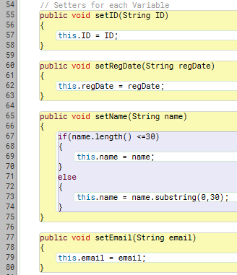
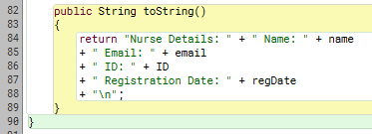
Super Class

Slide 30
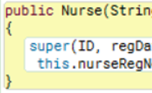
Sub Class
A Sub Class inherits all the variables and methods from a Super Class, and declares any new variables and methods that are unique to the Sub Class.
Sub Class constructors MUST ALWAYS CONTAIN A SUPER CALL.
Super call must be the first statement in the subclass.

Slide 31
Sub Class
Extends Super Class
We still need 5 parameters to construct a Nurse object
4 parameters are sent to the Super Class where they are assigned to variables
1 parameter (unique to Nurse) is assigned here

Slide 32

Super Keyword
Here, the super keyword invokes(calls) the Constructor of the Parent Class – MedicalProfessional
super must be called first in a sub class (child) constructor.
Must be first

Slide 33
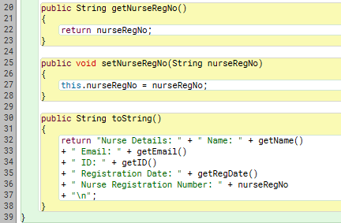
Sub Class
Getter and Setter for nurseRegNo
toString() is made up of values from Super class and Sub class.
Super class variables are private so must be accessed using their get methods

Slide 34
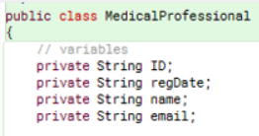
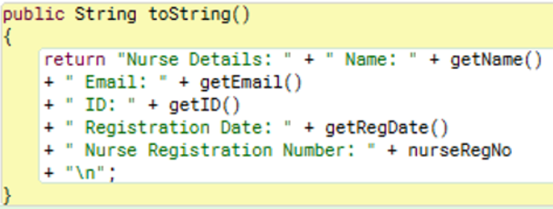
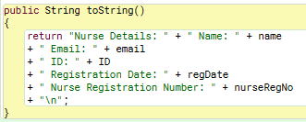
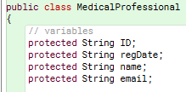
We could set the variables in MedicalProfessional to protected rather than private.
Protected means the variables would be accessible in the same package and subclasses.
MedicalProfessional
Nurse Class

Slide 35
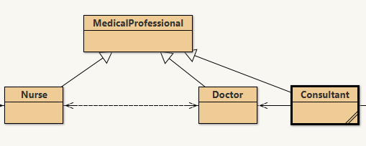
Extending & Reusing
We can extend the MedicalProfessional class to another sub class whenever we like
New Sub Class

Slide 36
2. Repetition in Collection Class Hospital

Slide 37
Both of these contain MedicalProfessional objects
Hospital
//private variable ArrayList<Nurse> nurseList; ArrayList<Doctor> doctorList;
//Constructor – default – does not need to be coded Hospital()
All these duplicate methods have similar code just manipulating a different ArrayList
//New Method | //ArrayList Method used | //Nurse/Doctor Class method used
addNurse(Nurse) addDoctor(Doctor) | add()
removeNurse(int): removeDoctor(int) | remove()
numberOfNurses(): int numberOfDoctors():int | size()
listOfNurses(): String listOfDoctors():String |  | toString()
listNurseByName(String):String listDoctorByName(String):String |  | getName(String) toString()
getNurse() getDoctor() | get()
load() loadDoctor()
save() saveDoctor()

Slide 38

Solution - Polymorphism
Polymorphism means “many forms”.
Polymorphism means ability to take more than one form.

Slide 39
Polymorphism in Java
Polymorphism is one of the OOPs feature that allows us to perform a single action in different ways.
Polymorphism means "many forms", and it occurs when we have many classes that are related to each other by inheritance.
Inheritance lets us inherit attributes and methods from another class.
Polymorphism uses those methods to perform different tasks. This allows us to perform a single action in different ways.

Slide 40
The most common use of polymorphism in OOP occurs when a parent class reference is used to refer to a child class object.
Real life example of polymorphism: A person at the same time can have different characteristic. Like a woman at the same time can be an employee, a volunteer, and a gym member.
So the same person possesses different behaviour in different situations.
This is called polymorphism.

Slide 41
Polymorphic Variables
Object variables in Java are Polymorphic (they can hold objects of more than one type)
They can hold objects of the declared type, or subtypes of the declared type.

Slide 42
The Object Class
All Classes inherit from Object
Object
String
MedicalProfessional
Postgraduate
………………
Nurse
Doctor

Slide 43
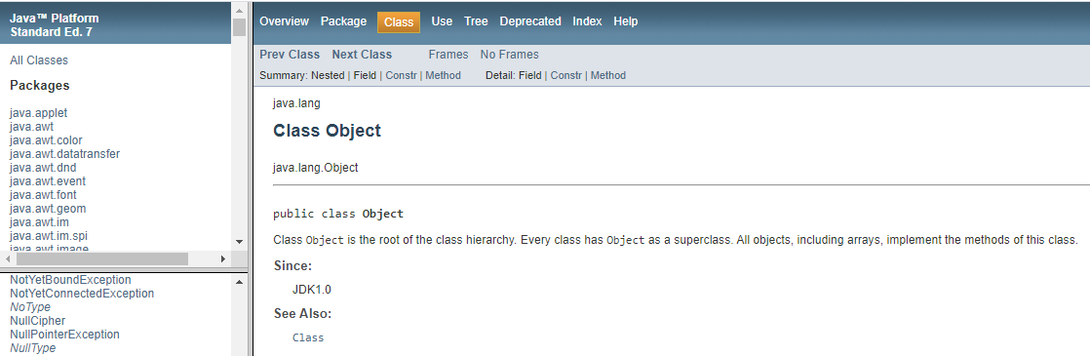
Java API

Slide 44
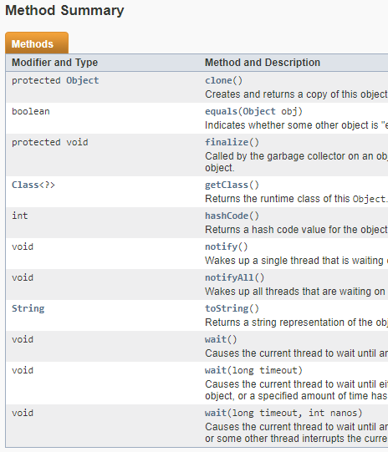
Object Methods

Slide 45
Polymorphic Collections
All Collections (ArrayLists, Hashsets etc) are polymorphic.
The elements could simply be of type Object:
public void add(object element)
public object get(int index)
Usually avoided by using the type parameter with the collection.
public Nurse get(int index)

Slide 46
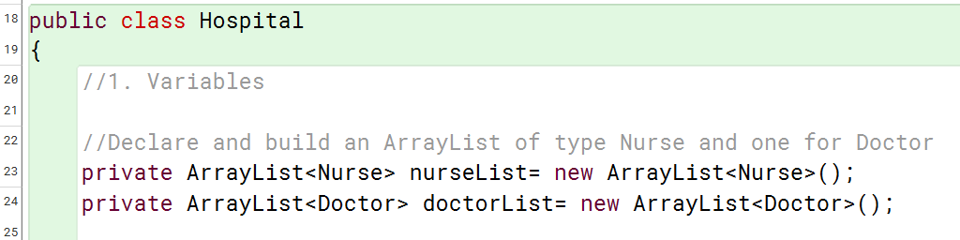
Polymorphic Collections
We now want to avoid duplication in our Collection Class Hospital:
We have created 2 ArrayLists – one for Nurse objects and one for Doctor objects.
Both Nurse & Doctor are sub-classes of the super class MedicalProfessional.

Slide 47
Polymorphism enables us to create one ArrayList to store MedicalProfessional objects
ArrayList<MedicalProfessional> mp = new ArrayList<MedicalProfessional>();
This Arraylist can store:
A MedicalProfessional object
and any sub classes of this object:
A Nurse object
A Doctor object
mp
0 1 2 3 4

Slide 48
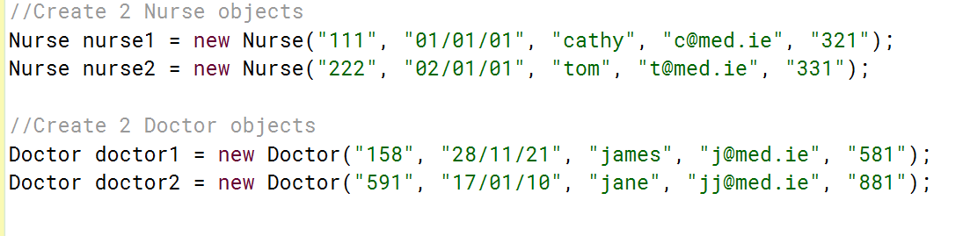
We can write code using add() methods to add either Nurse or Doctor objects to this MedicalProfessional ArrayList – avoiding replicating code and methods.
ArrayList<MedicalProfessional> mp = new ArrayList<MedicalProfessional>();
mp
MedicalProfessional Objects
And any sub class objects
Nurse1 | Nurse2 | Doctor1 | Doctor2
0 1 2 3

Slide 49
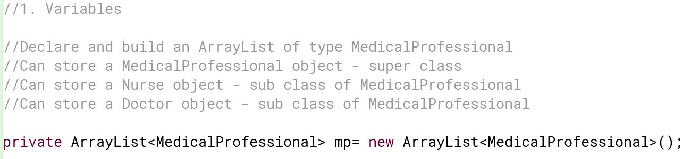
New Polymorphic ArrayList

Slide 50
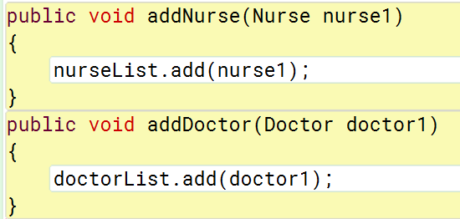
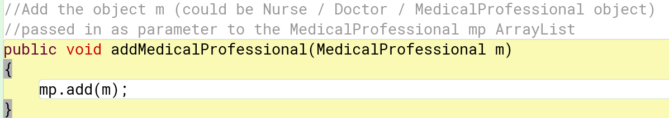
We had 2 separate but similar methods for adding a Nurse object to the nurseList ArrayList and a Doctor object to the doctorList ArrayList.
We can now replace these 2 methods with 1 add method – can add a Nurse or a Doctor (or a MedicalProfessional)

Slide 51
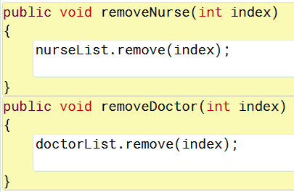
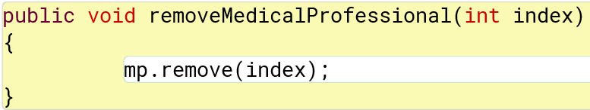
We had 2 separate but similar methods for removing a Nurse object from the nurseList ArrayList and a Doctor object from the doctorList ArrayList.
We can now replace these 2 methods with 1 add method – can add a Nurse or a Doctor (or a MedicalProfessional)

Slide 52
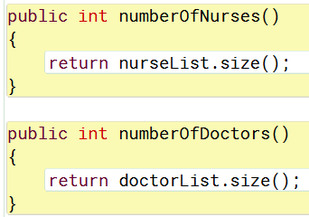
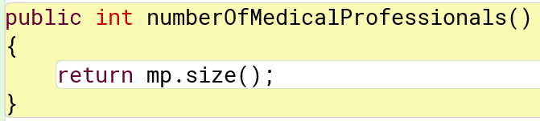
We had 2 separate but similar methods for determining how many elements are in nurseList and how many elements in doctorList.
We can now replace these 2 methods with 1 add method – determines the number of elements in MedicalProfessional (of any type)

Slide 53
We had 2 separate but similar methods listing all Nurses, and listing all Doctors:
We can now replace these 2 methods with 1 add method – listing all Medical Professionals in the ArrayList.
Or
We can write a method to search the ArrayList and only print the Nurses, or only print the Doctors.

Slide 54
Instanceof Operator
The instanceof operator in Java is used to check whether an object is an instance of a specific class or a subclass of that class. It returns true if the object is an instance of the specified class (or a subclass) and false otherwise.

Slide 55
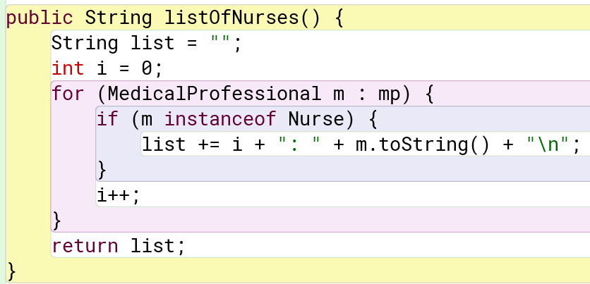
Instanceof operator
Uses simple string concatenation (+=).
Iterates through mp arraylist, checks if the object is an instance of Nurse, and appends it to list.
Returns a string containing only Nurse objects.

Slide 56
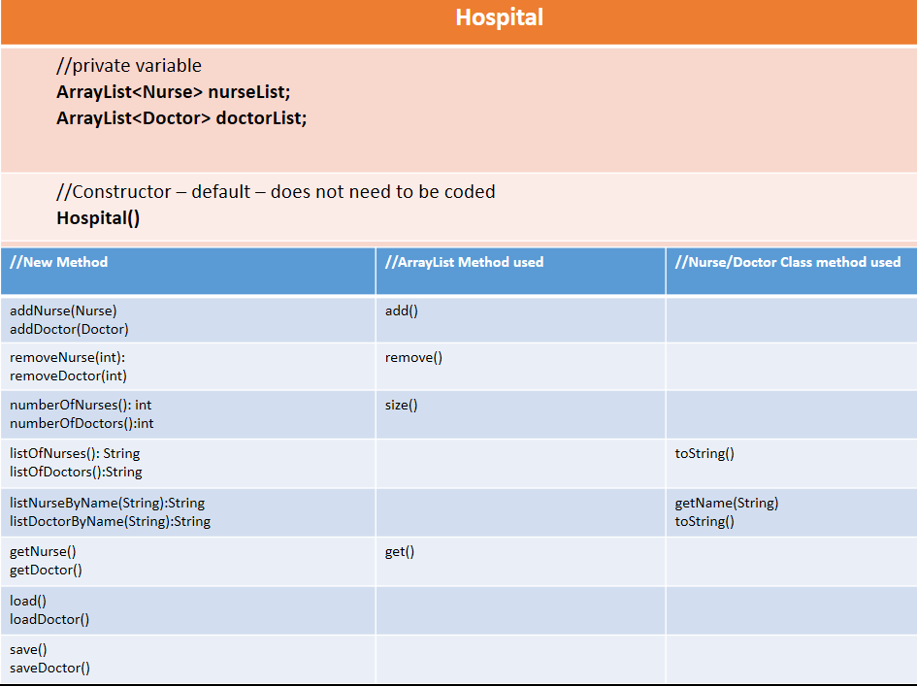
Old UML for Hospital

Slide 57
New UML for Hospital
Hospital
Variables
ArrayList<MedicalProfessional> mp | Declare and initialist mp - mp can store objects created from MedicalProfessional, Nurse or Doctor – polymorphic | Declare and initialist mp - mp can store objects created from MedicalProfessional, Nurse or Doctor – polymorphic
Constructor
Hospital() | Default constructor
Methods
New Method | ArrayList Method called
addMedicalProfessional(MedicalProfessional) | add()
removeMedicalProfessional(int) | remove()
numberOfMedicalProfessionals(): int | size()
listOfMedicalProfessionals():String
listOfNurses():String | Uses instanceof operator
save()
load()

Slide 58
Update User Interface

Slide 59
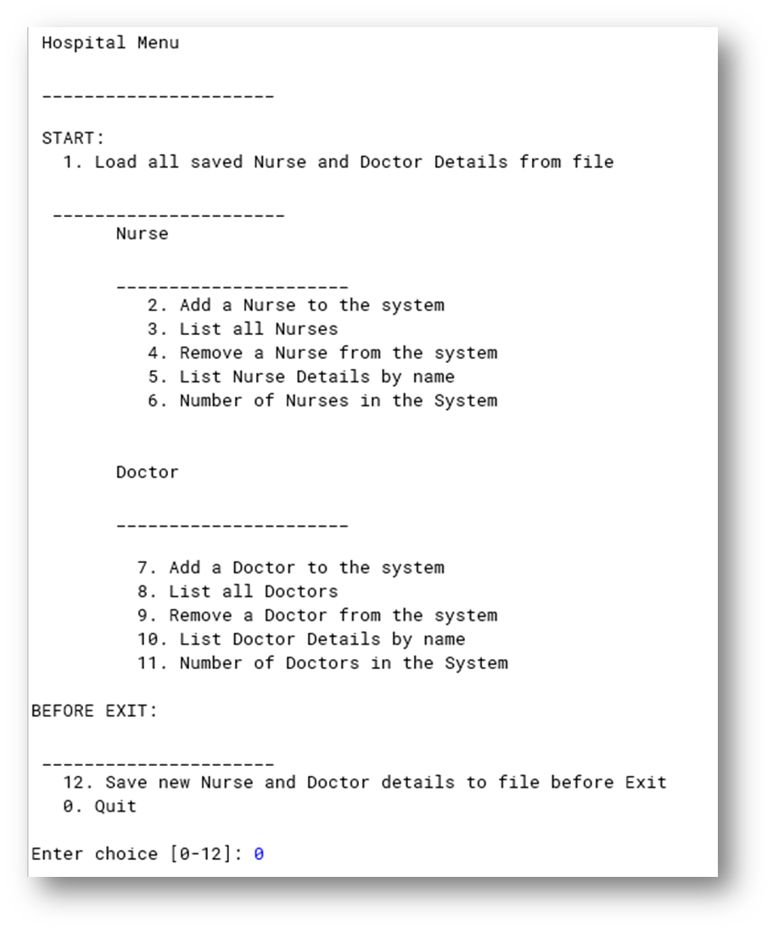
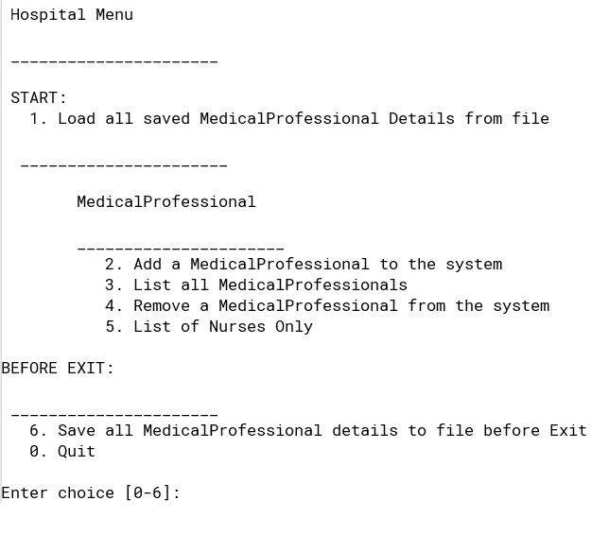
Now our user interface MedicalSystemUI needs to be updated to use the new methods we’ve created in Hospital.
I’ve left out a few menu options in this version – they can be added any time.
Number Of Medical Professionals in the system
searchMedicalProfessionalByName
Update Medical Professionals

Slide 60
Old New
MedicalSystemUI
Hospital hospital1
MedicalSystemUI()
main() run() mainMenu() createNurse() removeNurse() listOfNursesByName() createDoctor() removeDoctor() listOfDoctorsByName()
MedicalSystemUI
Hospital hospital1
MedicalSystemUI()
MedicalSystem methods | Hospital methods
main()
run()
mainMenu()
createMedicalProfessional() | addMedicalProfessional()
removeMedicalProfessional() | numberOfMedicalProfessionals() removeMedicalProfessional()
listOfNurses()

Slide 61
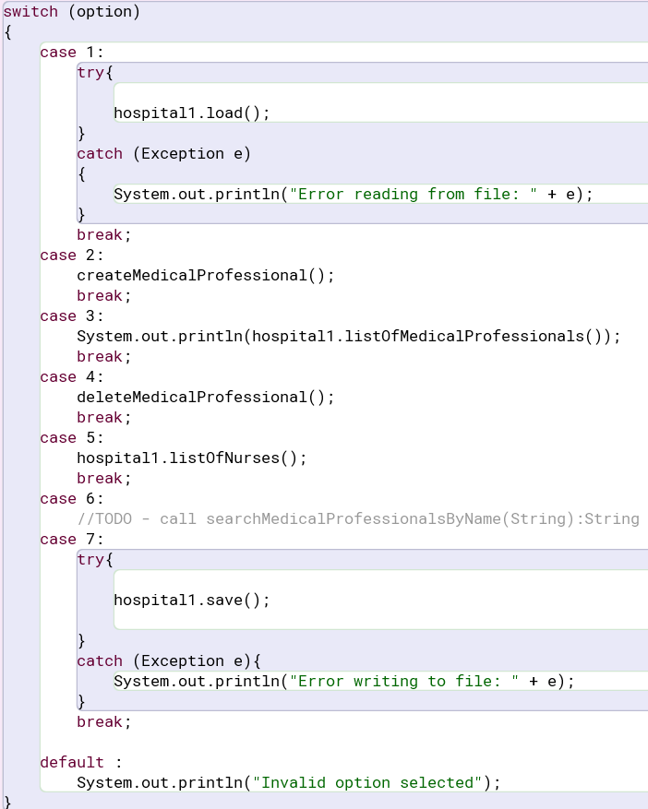
Updated Switch:
Additional methods can be added

Slide 62
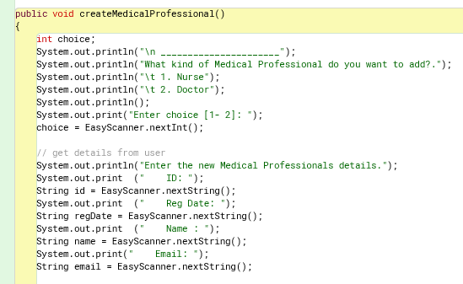
createMedicalProfessional()
We start this method by asking the user which Medical Professional they wish to add
We then take in all the variables required for a Medical Professional:

Slide 63
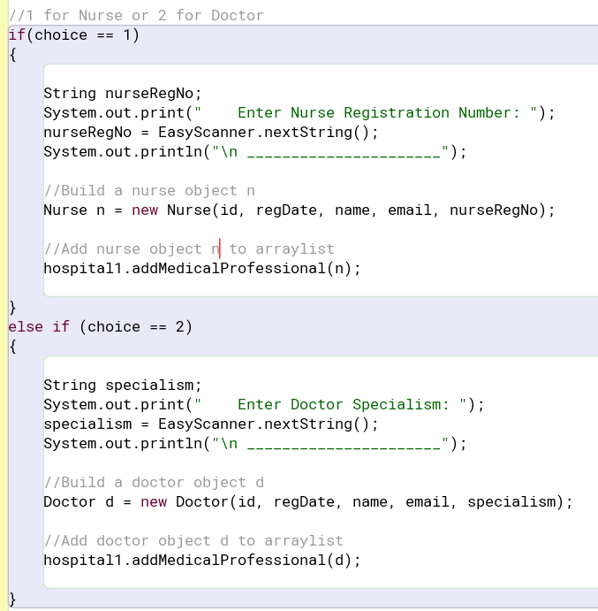
We use the users choice – 1 for Nurse or 2 for Doctor
If 1 – input the Nurse variable nurseRegNo and use the 5 values input to construct a new Nurse object n1
Then add the n1 object to the ArrayList using the addMedicalProfessional() method
If 2 – input the Doctor variable specialism and use the 5 values input to construct a new Doctor object d1
Then add the d1 object to the ArrayList using the addMedicalProfessional() method

Slide 64
Other Methods
The other methods in the MedicalSystemUI class are updated to use the Hospital methods to list all Medical Professionals etc.

Slide 65
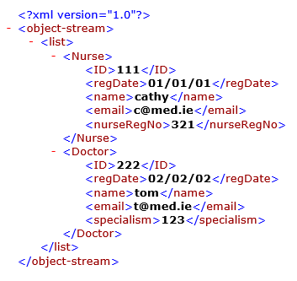
medicalProfessionals.xml
Polymorphism – different objects related by Inheritance (super and sub) can be stored in the one List

