Slide 1

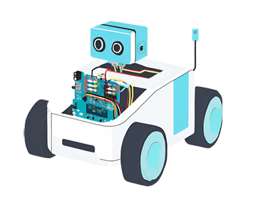
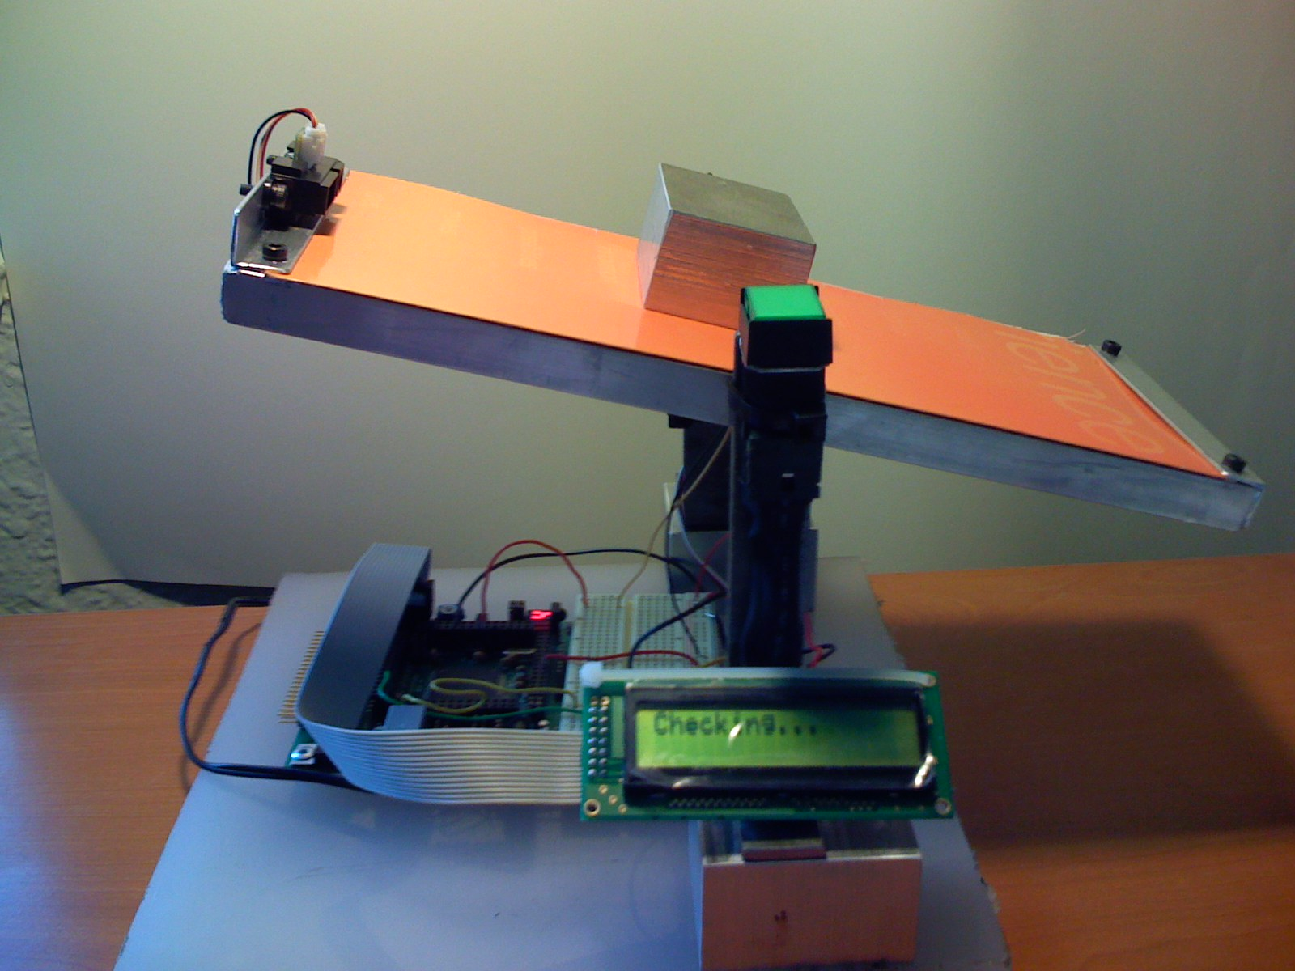
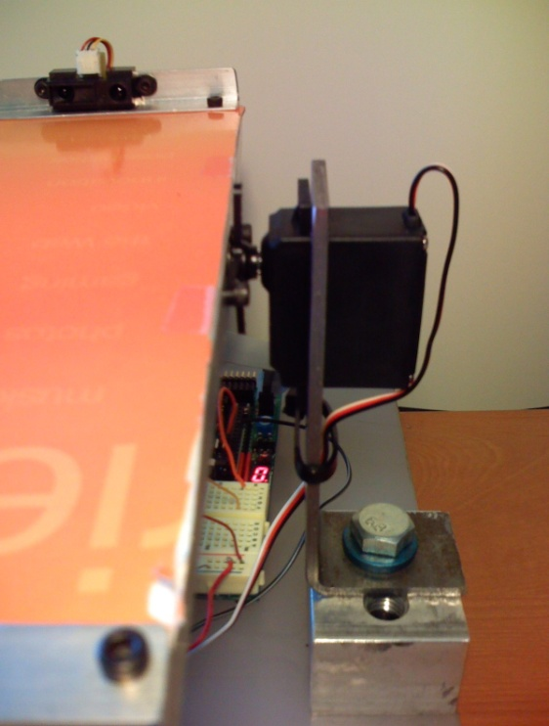
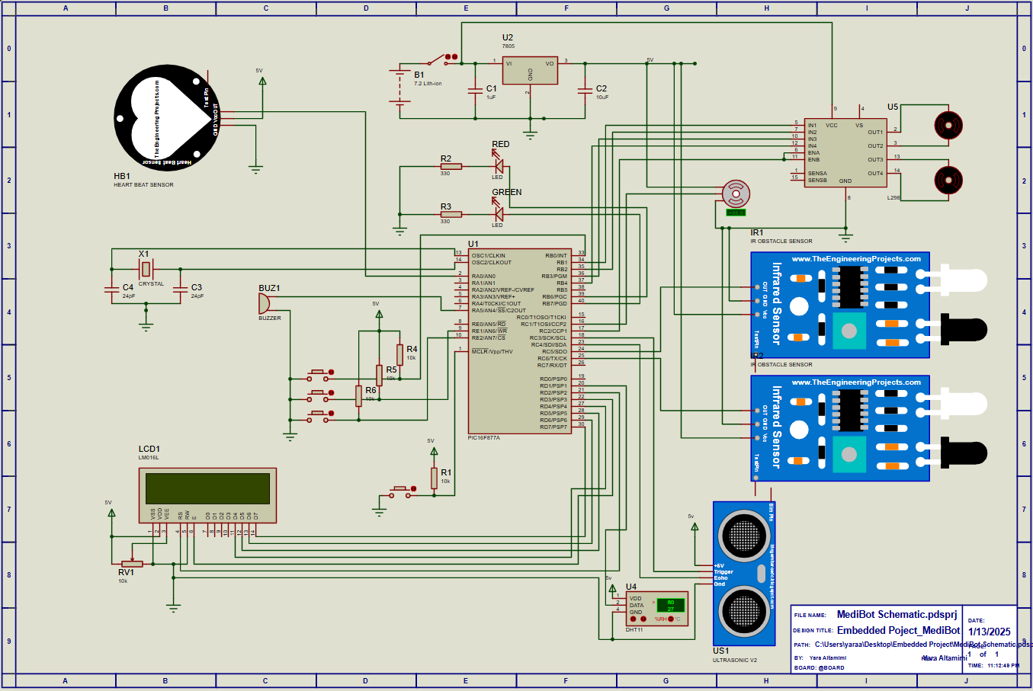
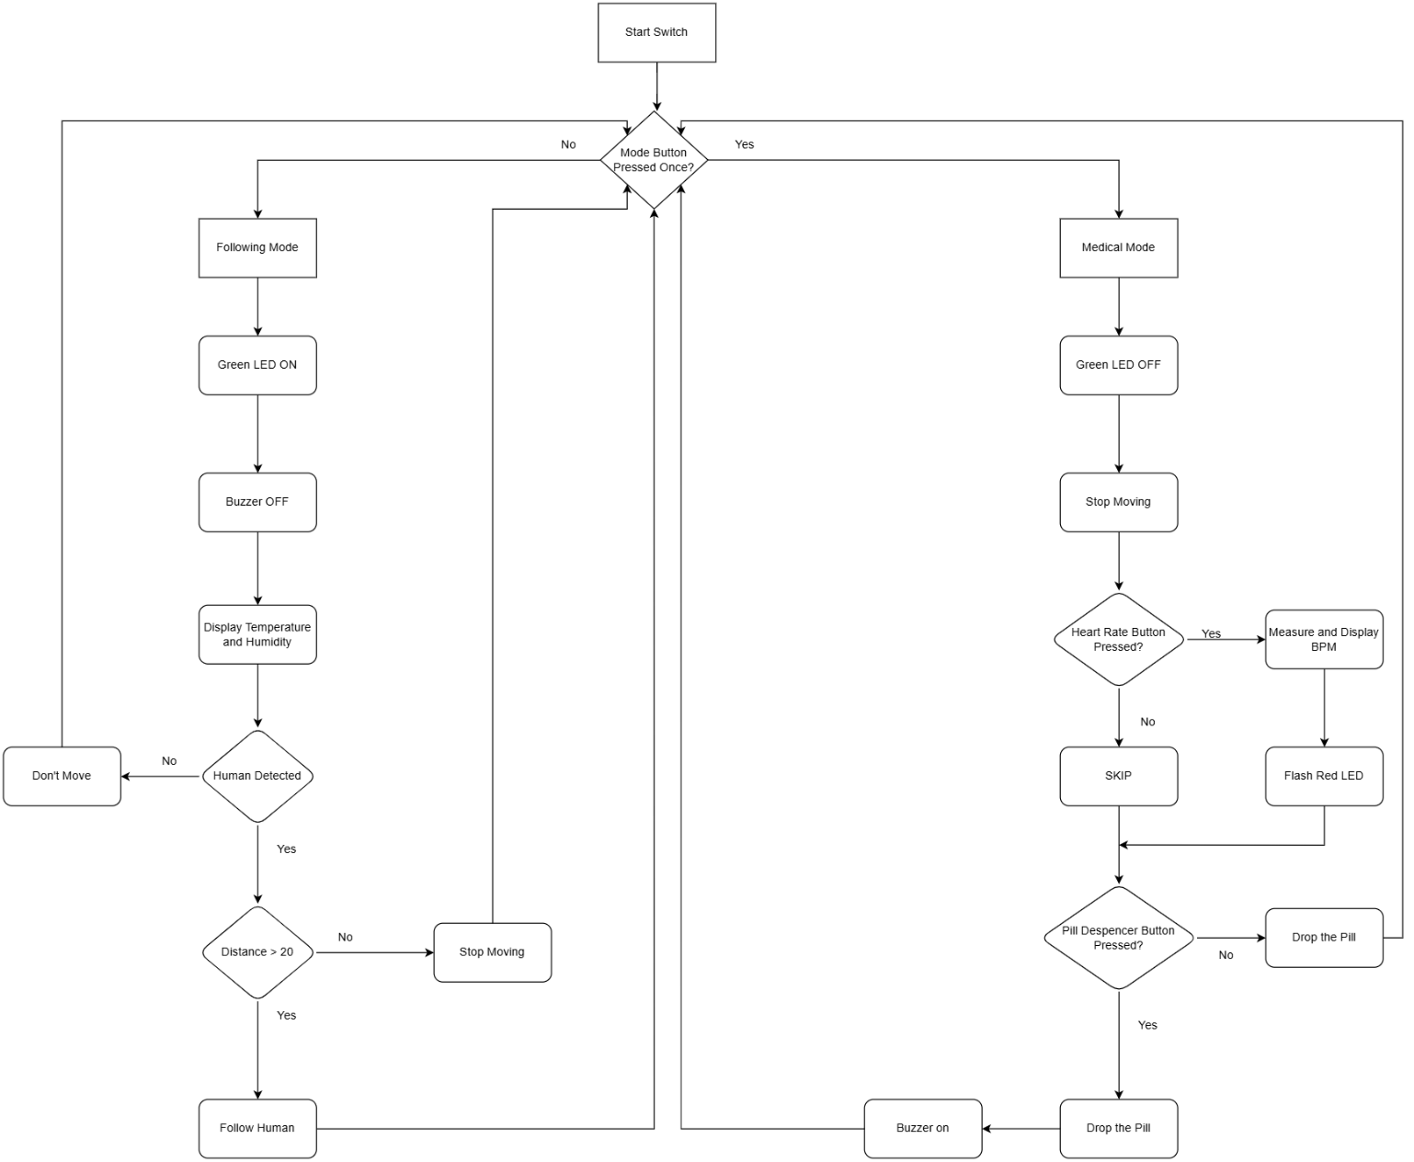
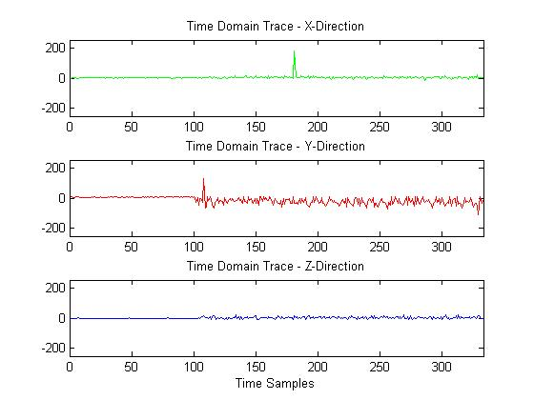
MediBot
Autonomous Patient Monitoring and Care Assistant
Yara Altamimi, Nedal Abu-Haltam, and Abdullah Matar
Supervisor: Belal Sababha,Ph.D. ,Esam Qaralleh,Ph.D
Embedded Systems Final Design Project, Fall 2024
King Abdullah II School of Engineering
Princess Sumaya University for Technology
Introduction
Healthcare has always been a critical area for technological innovation, with automation and robotics playing an increasingly vital role in enhancing the quality of patient care and reducing the burden on healthcare providers. In this context, the development of MediBot—a robotic nurse in the form of a car—demonstrates the potential of embedded systems to address real-world healthcare challenges.
MediBot is designed to assist users in a home or clinical setting by integrating essential health-monitoring and assistance functionalities into a compact, mobile platform. This project leverages the PIC16F877A microcontroller to implement a system capable of operating in two distinct modes: a following mode and a medical mode. The following mode enables MediBot to autonomously follow its user, providing constant monitoring and real-time display of temperature and humidity. In contrast, the medical mode transforms MediBot into a stationary assistant, offering advanced features such as heart rate measurement using a heart monitor sensor and automated pill dispensing.
Results
Blah, blah, blah. Blah, blah, blah. Blah, blah, blah. Blah, blah, blah. Blah, blah, blah. Blah, blah, blah. In Figure 1 blah blah blah blah blah
Figure 4: Blah Blah Blah.
Blah, blah, blah. Blah, blah, blah. Blah, blah, blah. Blah, blah, blah. Blah, blah, blah. Blah, blah, blah. blah blah blah blah blah blah blah (Figure 4).
Figure 5: Blah bla (a), bla blah (b), and blah (c).
Blah, blah, blah. Blah, blah, blah. Blah, blah, blah. Blah, blah, blah. Blah, blah, blah. Blah, blah, blah. In Figure 5a., blah blah blah blah, blah, blah (Figures 5b,c). Blah, blah, blah. Blah, blah, blah. Blah, blah, blah. Blah, blah, blah. Blah, blah, blah. Blah, blah, blah. Blah, blah, blah.
Figure 6: Blah blah blah blah blah.
Blah, blah, blah. Blah, blah, blah. Blah, blah, blah. Blah, blah, blah. Blah, blah, blah. Blah, blah, blah. In Figure 6 blah blah blah blah blah blah blah blah blah blah. Blah, blah, blah. Blah, blah, blah. Blah, blah, blah. Blah, blah, blah. Blah, blah, blah. Blah, blah, blah.
IR Sensor
Servo motor
SW Button
miniDragon+
board
LCD
Design
The design of MediBot integrates electrical, software, and mechanical components to achieve its functionality. The electrical design centers on the PIC16F877A microcontroller, which acts as the system’s core. Key components interfaced with the microcontroller include: DHT11 sensor for temperature and humidity, SparkFun Pulse Sensor for heart rate measurement, ultrasonic sensors and IR sensor, DC motors controlled via an H-bridge, servo motor for pill dispensing, an LCD, LEDs and a buzzer for visual and audio feedback, push buttons for mode selection and user interaction. Power is supplied by lithium-ion batteries, with voltage regulation to ensure stable operation.
Figure 1: Schematic Diagram
Figure 2: Software Flowchart
(a)
(b)
(c)
Conclusion
MediBot demonstrates how embedded systems can address real-world challenges in healthcare by integrating advanced sensing, mobility, and automation into a compact, user-friendly robotic platform. By achieving seamless operation across its two primary modes—following mode and medical mode—MediBot provides practical solutions for environmental monitoring, vital sign measurement, and automated medication dispensing. This project underscores the potential of microcontroller-based systems, like the PIC16F877A, in delivering cost-effective and scalable healthcare solutions. The broader significance of MediBot lies in its application to personalized healthcare, where it can reduce the workload on caregivers and enhance the independence of patients. Its modular design opens opportunities for future advancements, such as incorporating more medical features or expanding its capabilities for smart healthcare environments. MediBot represents a step toward integrating robotics into everyday healthcare, showcasing the transformative potential of technology to improve lives.

