Slide 1

React
Teacher: Tal Yaron

Slide 2
SPA – single page application
Page 1

Slide 3
SPA – single page application
Page 1

Slide 4
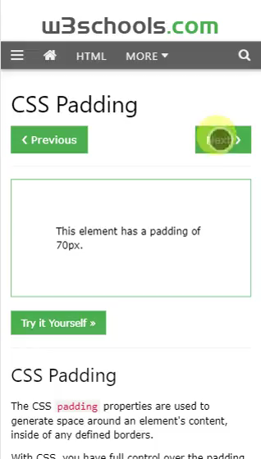
SPA – single page application
Page 1
Page 2

Slide 5
SPA – single page application
Page 1
SPA
Page 1
Page 1
Page 1
Page 1
Page 2

Slide 6
SPA – single page application
Router
Page 1
Page 1
Page 1
Page 1
Page 3
Page 2

Slide 7
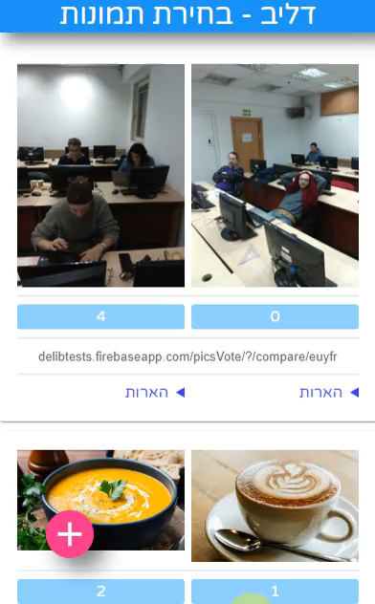
SPA – single page application
Router
Page 1
Page 1
Page 1
Page 1
Page 3
Page 2

Slide 8
SPA – single page application
Router
Page 1
Page 1
Page 1
Page 3
Local data

Slide 9
SPA – single page application
Page 1
Page 1
Page 1
Page 3
Components
Components

Slide 10
Passing props
<Components title=‘something’ />
Props
Components
<div>{props.title}</div>

Slide 11
Changing component state
Components
const = [color, setColor] = useState(‘initial color’)
The UI will update
setColor(‘new color’)

Slide 12
SPA – Mount, update, unmount
app state
JS (Bundle)
Page 1
Page 1
Local data
Page 1
Page 3
Components
Components

Slide 13
SPA – single page application
MVC
Model – data (state)
View – DOM (Components)
Controllers - Functions
Page 1
Local data
Page 1
Page 1
Page 3
Components
Components
app state

Slide 14
React data schema
App state
Redux/Mobx/Context
Page 1
Page 1
Page 1
state
props
state
state
state
state

Slide 15
SPA – Mount, update, unmount
Router
JS (Bundle)
Page 1
Page 1
Local data
Page 1
Page 3
Components
Components
app state
Mount
Update
UnMount

Slide 16
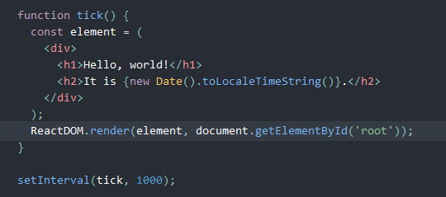
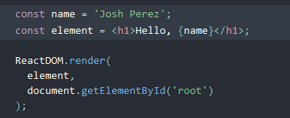
React: elements and JSX
From react tutorial:
Element
JSX

Slide 17

React: components
Function

Slide 18
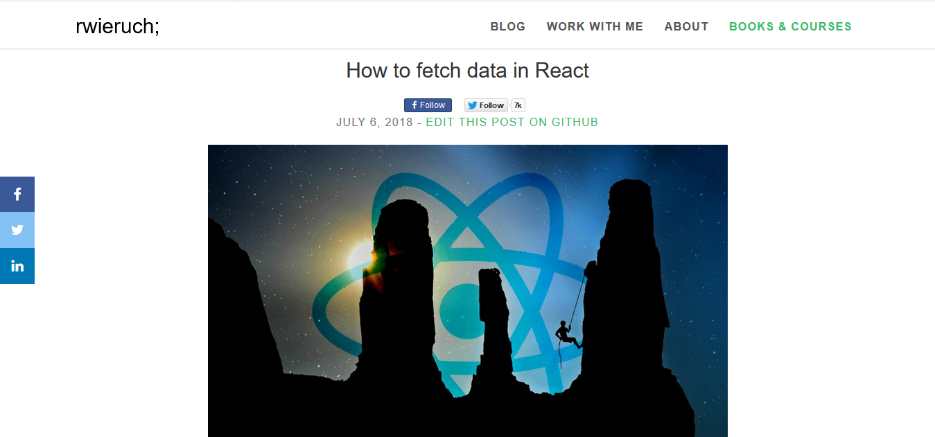
Sample Footer Text
1/10/21
18

Slide 19
React lifecycles
Sharif: advance explanation

Slide 20
Use context and app state
app state
State
(data-ui coupling)
Props
Page 3
Components
Page 1
Page 1
Page 1

Slide 21
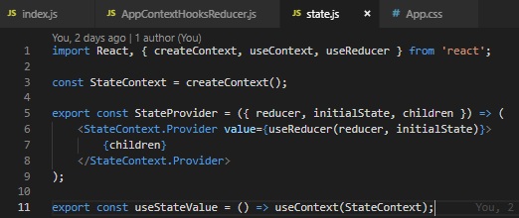
App state – state provider

Slide 22


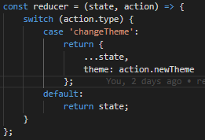
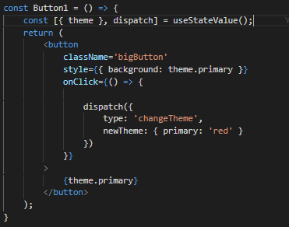
State Provider
Action
Reducer
Payload

