Slide 1
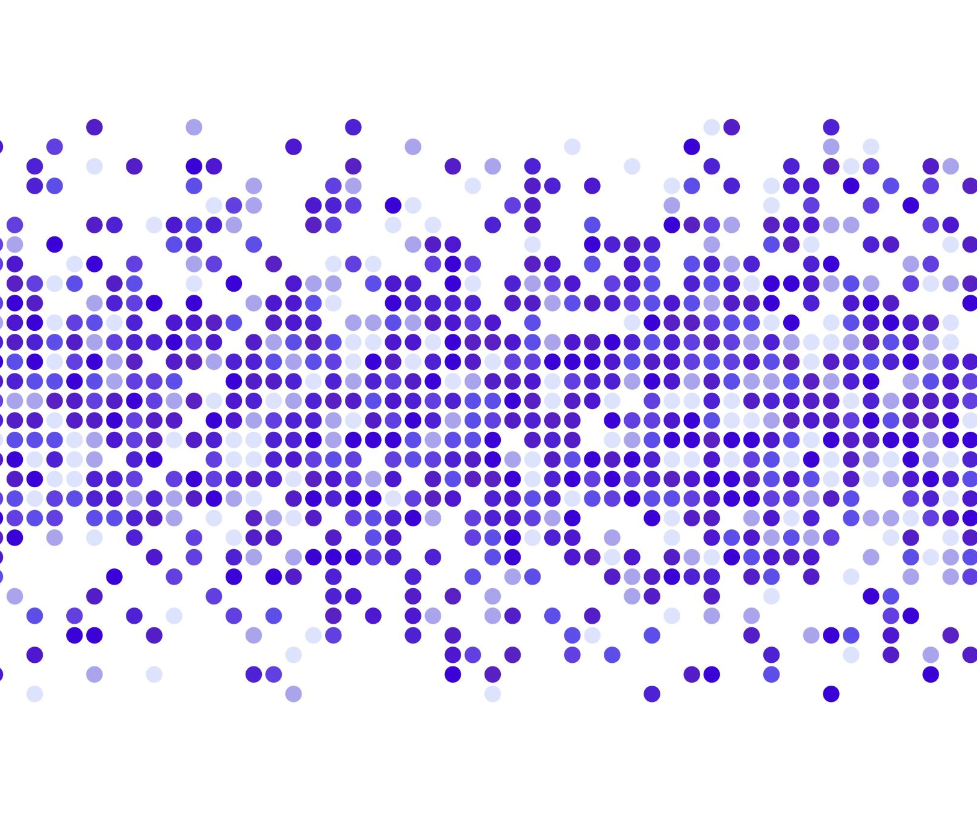
Machine Learning to Predict Velocities
Yara Al-Shorman
Notes:
I’m yara (she/her)
Introduce myself
Rising sophomore
CoE at KU

Slide 2
OVERVIEW
A possible method to predict/estimate bulk flows could be by using ML
Python, Tensorflow
Supervised ML:
Classification
Regression
Algorithms:
Neural Networks
Random Forest
Notes:
There are more algorithms, but their applications are restricted
We previously tried Random Forest, but for what we’re trying to do now it won’t work (I tried it, but not too much)
RF doesn’t take ragged inputs
Neural networks are the most flexible and customizable

Slide 3

Neural Networks
Inspired by the human brain
Consist of ‘neurons’ called nodes that are interconnected in layers

Slide 4
Improved idea
Make the model predict the bulkflow of a cluster from the get-go
Input: a large set of cluster data [redshift, distance mod, glon, glat]
Output: bulkflow in component form: [bx, by, bz]
Notes:
Predicting something less precise with less error can be easier that predicting individual velocities and distances for every object within a cluster

Slide 5
The Data
To better the training of the model:
Need more data
Solution: Rotate existing data: CF3-Outerrim-cz-rand
Generated 3000 new catalogues from the existing 300
10 variations of each
Code and generated data uploaded to shared Drive
Additionally, all my code is uploaded to Github
Repository link is in the reference (documentation) sheet I uploaded with the data
https://github.com/YaraAlShorman/Research-spring-22
This presentation will also likely end up on there

Slide 6
Technical details
(my favorite)
Numpy -> Tensorflow
Numpy arrays -> Tensorflow tensors
Uniform input -> Ragged input
Due to the increased complexity of the input:
GPU for training
KU Supercomputers

Slide 7
Where I am right now
Trying to optimize the model I am currently working on
Learning a lot about
Keras layers
Loss/activation functions
Data preprocessing
Tried to run the model on many variations of the same catalogue
Trying to visualize the data in different ways that may help in analyzing possible issues
Accuracy is not improving, but I still have a couple of ideas in mind

Slide 8
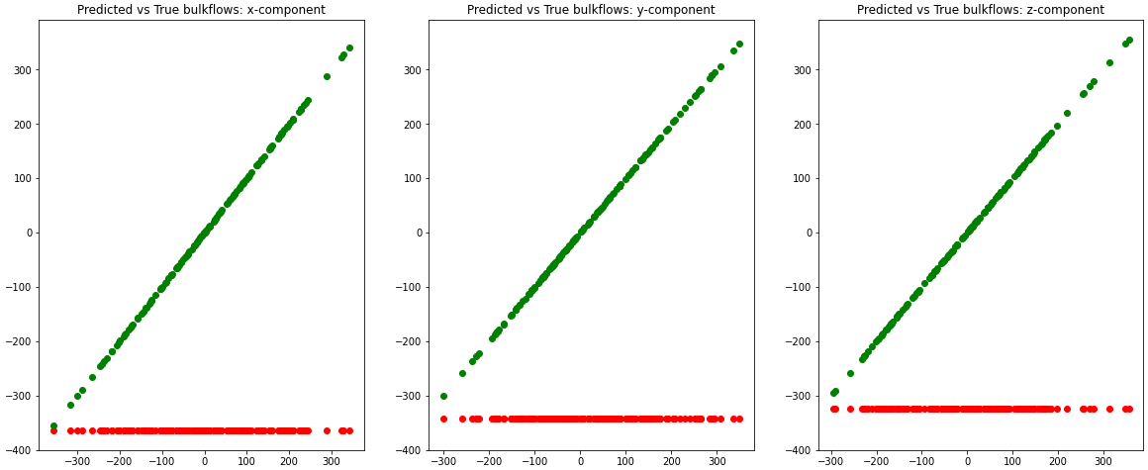
Data from current model
Notes:
As you can see, loss is decreasing but accuracy is low
Moreover, the model tends to predict the same value over and over all the time for all 3 velocity components
My speculation:
Activation function is not working as intended (nodes are not getting activated, so they don’t transfer data, leading to repeated results)
Loss function is broken, making the prediction that minimizes loss not the same as the prediction that is correct
Not inputting enough data and not training for long enough: it is normal to train a model for hours or days or even longer with thousands of data points. Meanwhile, we’re looking for instant gratification…
We need to input weights somehow

Slide 9
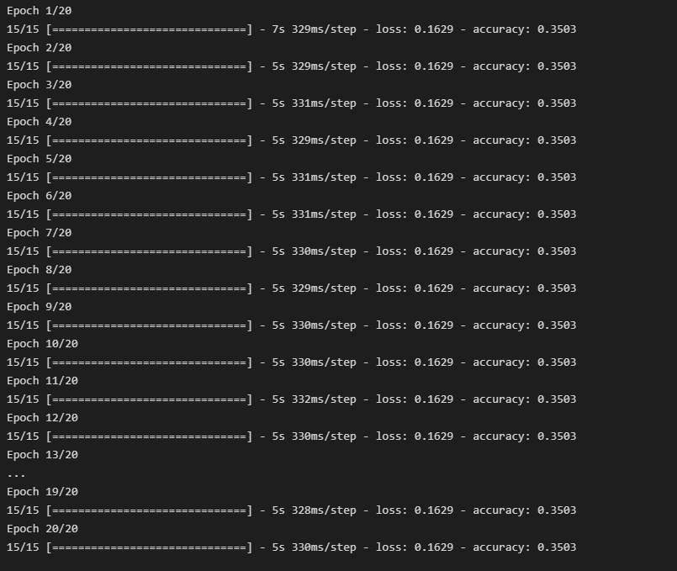

Slide 10
Questions?

