Slide 1
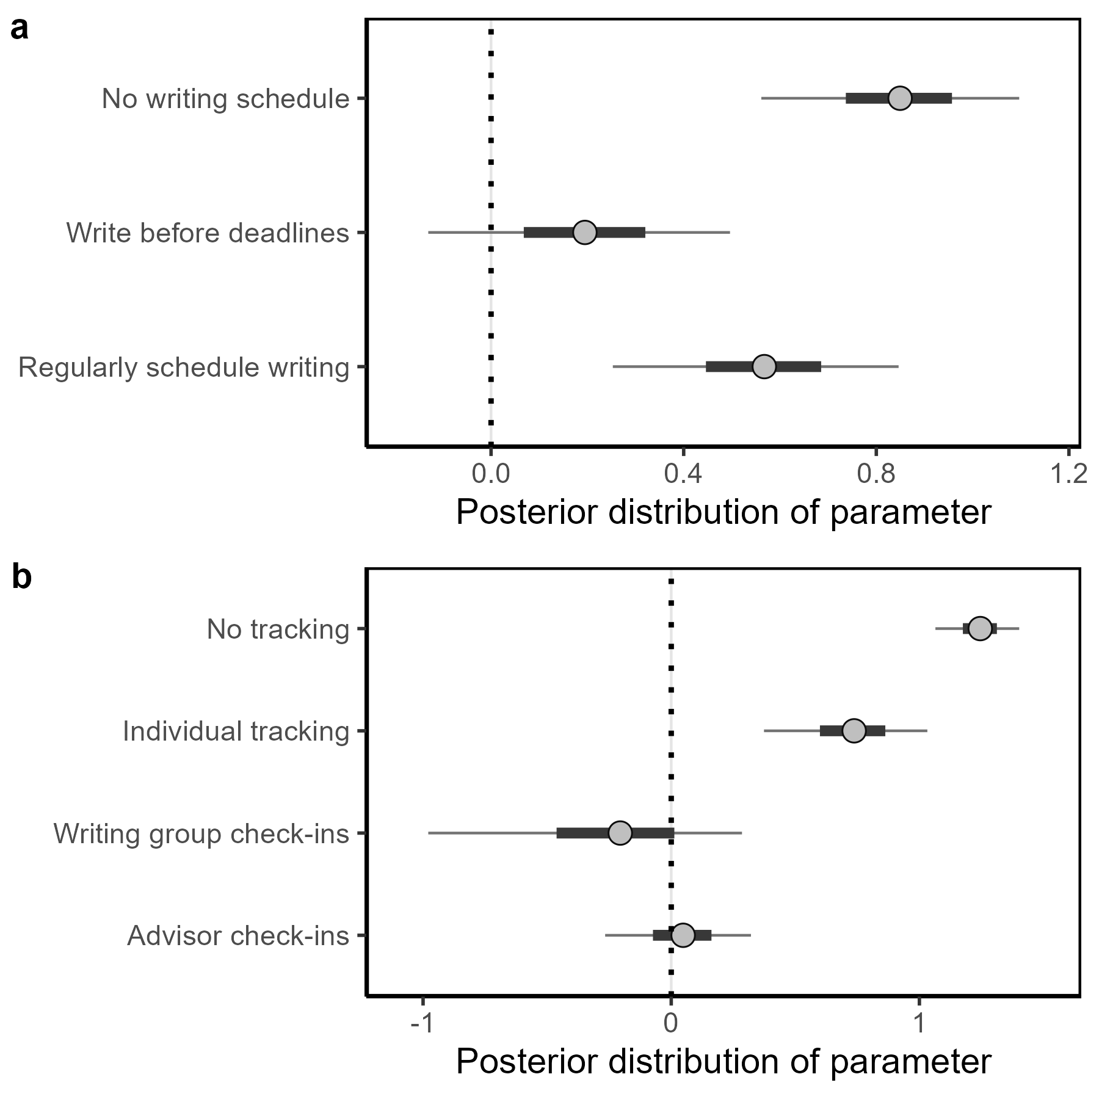
A
B
I do not track or
schedule time
I schedule specific
days each week
I set time before deadlines
I set specific time each week
Predicted first-author publications
I set time during
weekends or breaks
C
Check-in with advisor or mentor
D
Other
I do not track
Electronic application
Physical notebook
Electronic spreadsheet
Predicted first-author publications
Check-in with a writing accountability/support group

