Slide 1
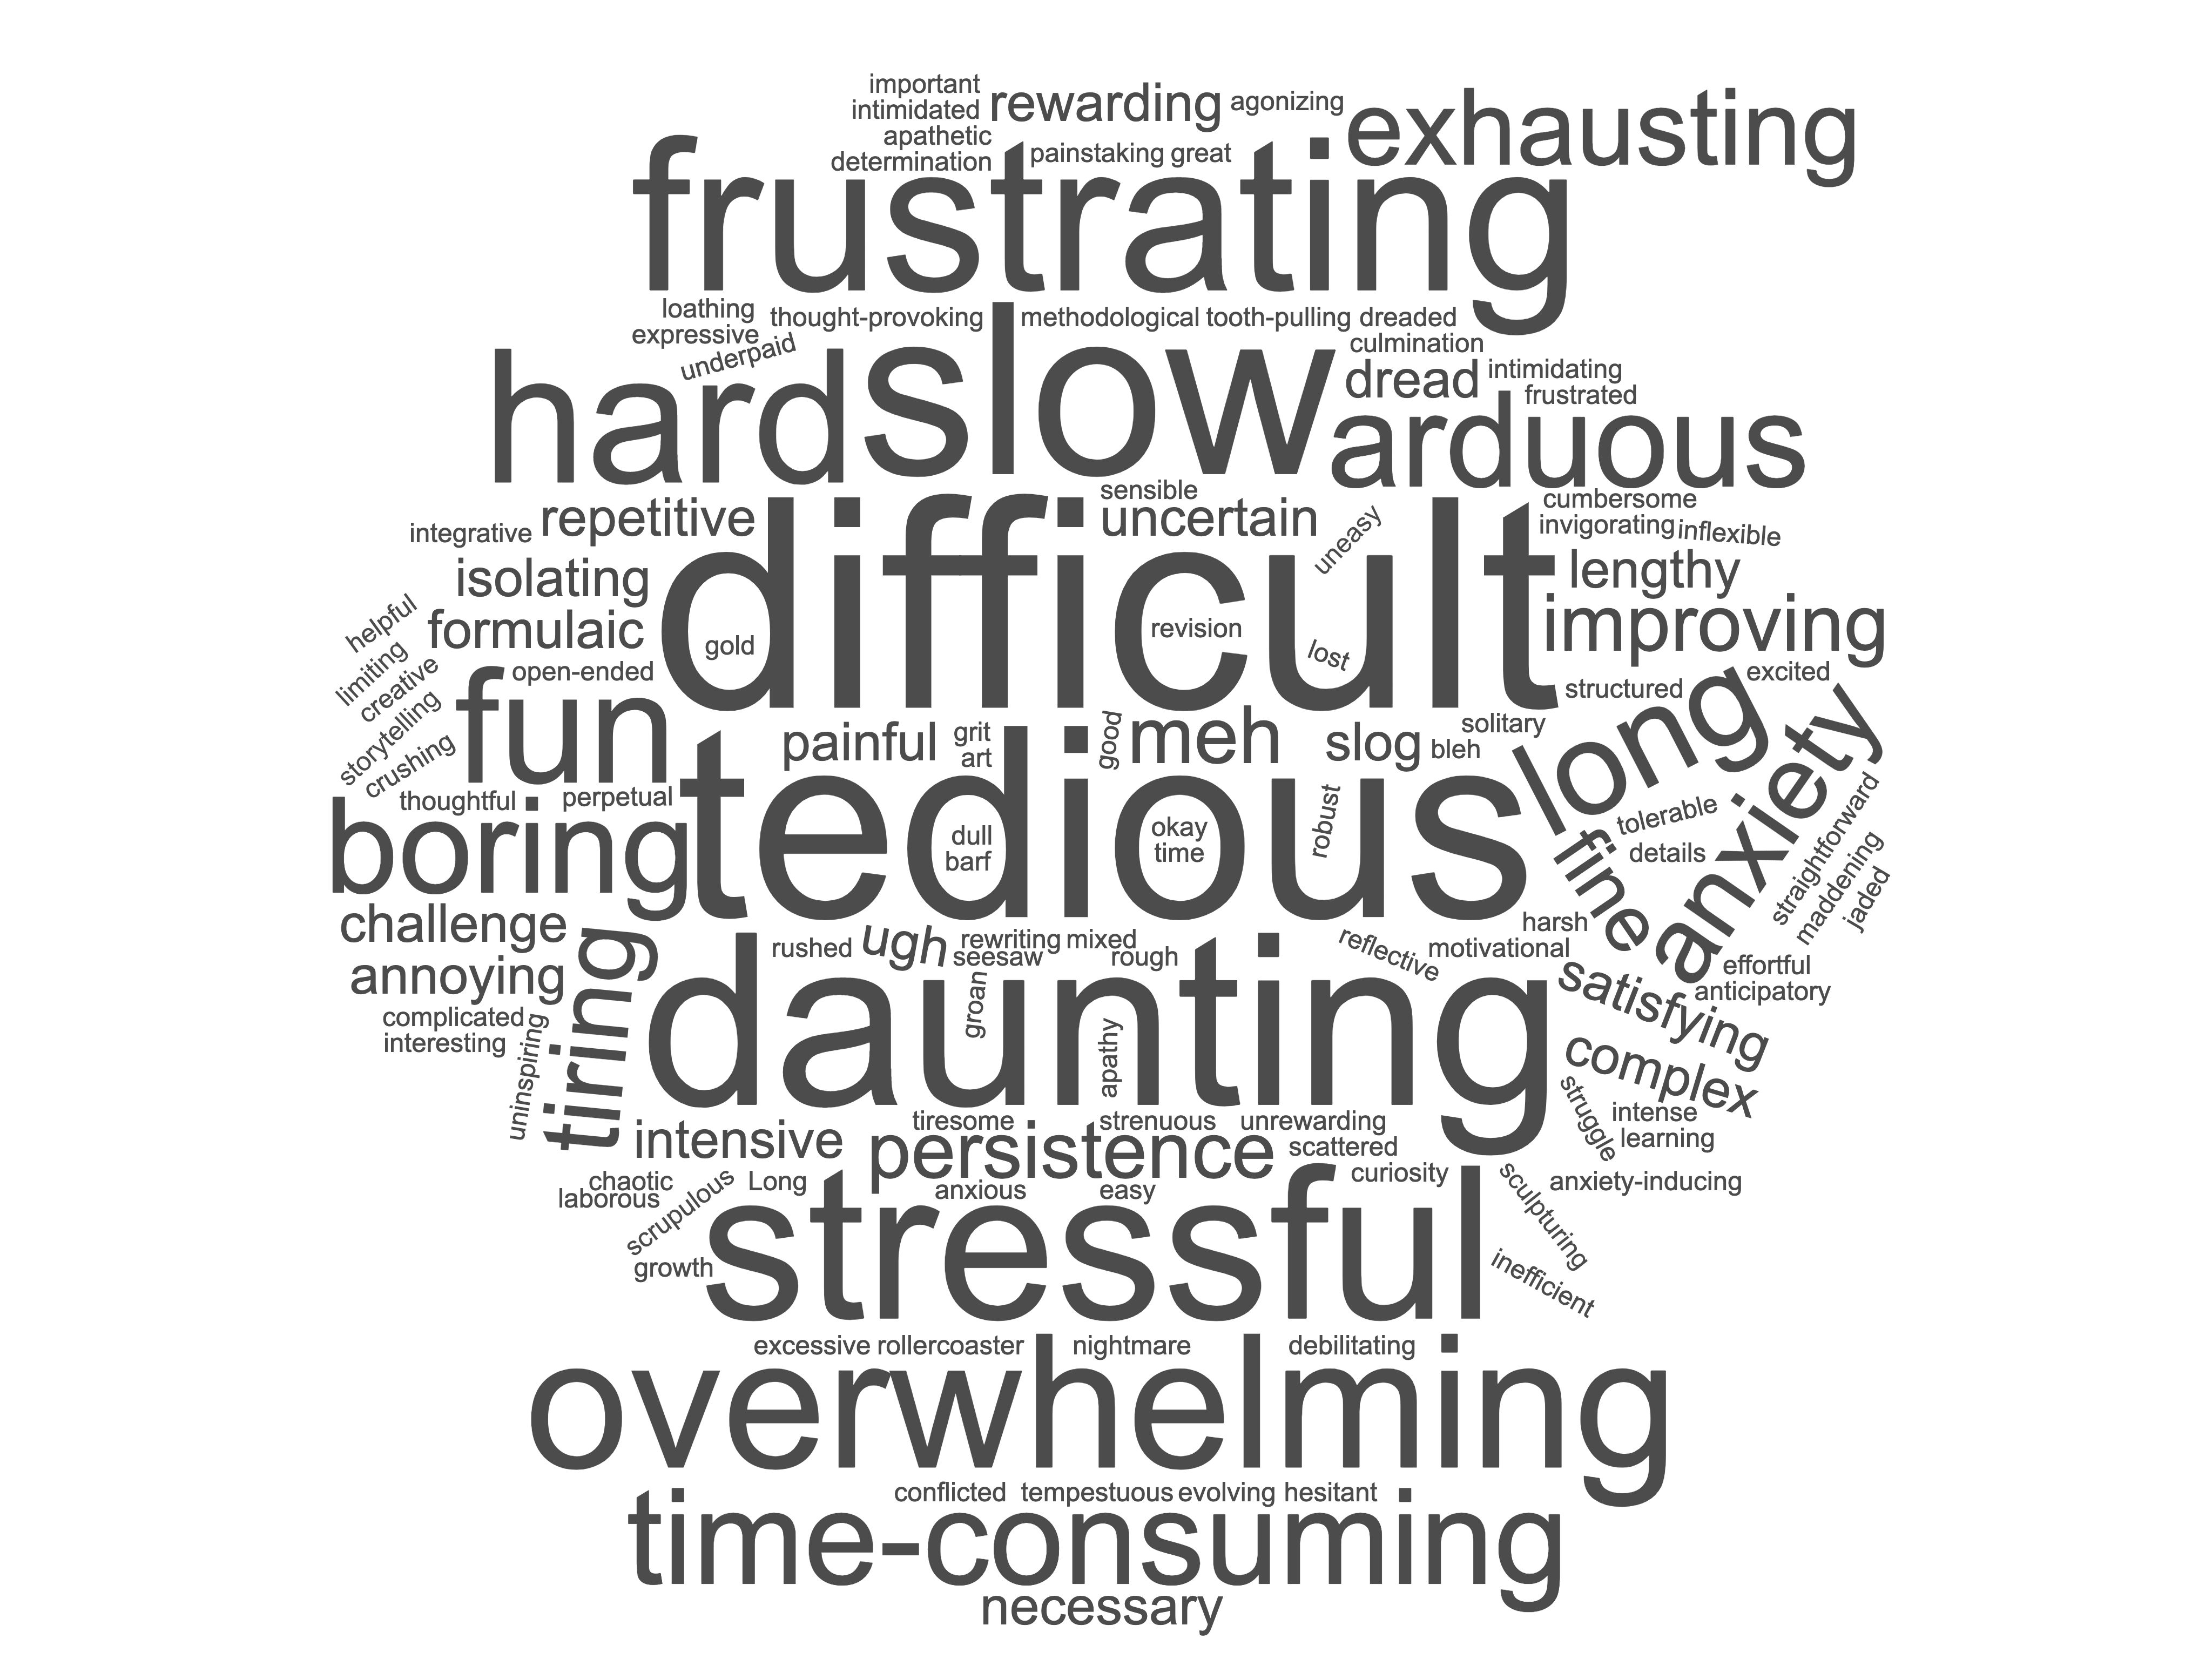

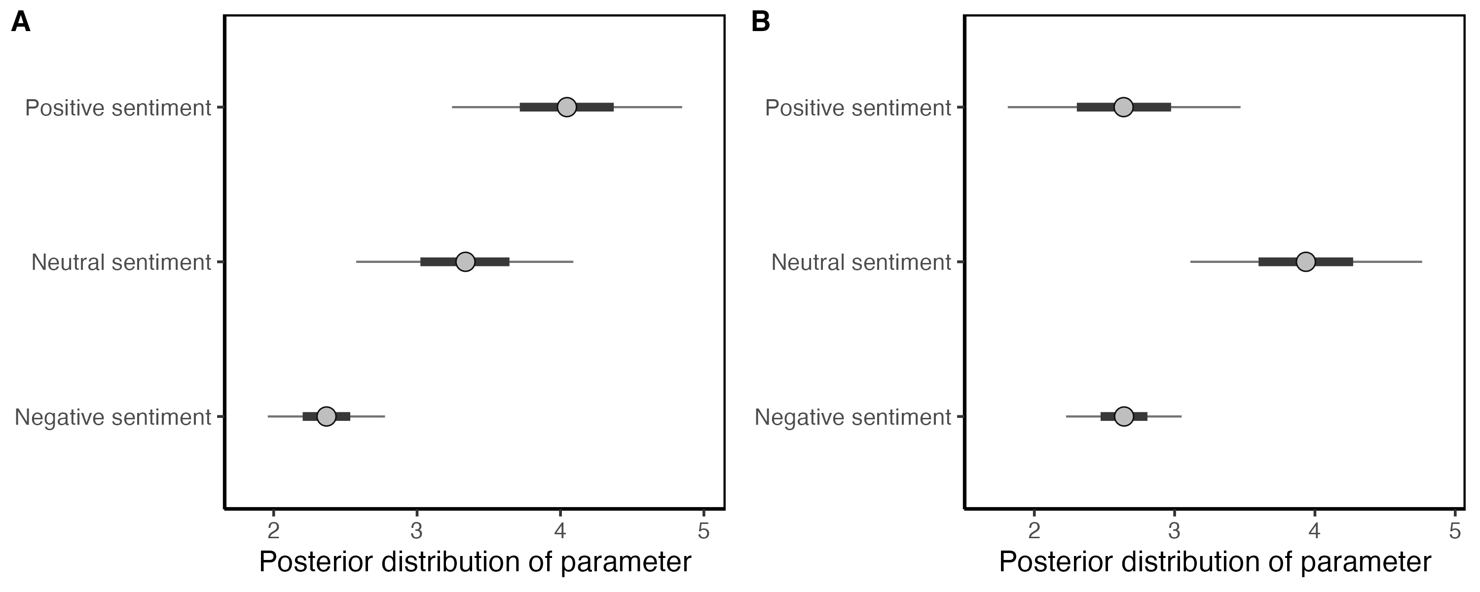
A The writing process is…
B The peer-review process is…
C
D
Predicted first-author publications
Predicted first-author publications

