Slide 1

DreamCraze

Slide 2
Our team
name | id
يارا عماد درويش يوسف | 20211040
هادي محمد عبد الهادي | 20211028
ولاء اسامه عبدالقادر مصطفي | 20211039
احمد عبد النبي عبد المعطي عبد العزيز | 20210076
شهد احمد محمد مصطفي | 20210464
محمد صلاح الدين عبد السميع عبد الجواد | 20210794
مريم ربيع دياب السيد | 202000877

Slide 3
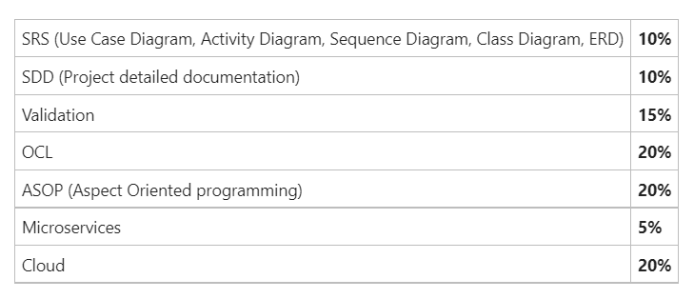
Grading Criteria:
3

Slide 4
PURPOSE
Electronics Store Our platform provides a seamless shopping experience, allowing users to browse, select, search, and order a wide range of products including phones, computer equipment, and more. With just a few simple steps, users can easily place orders, add the product to their cart, track shipments, and even cancel the order, ensuring maximum flexibility and convenience. In addition to that, there is an admin dashboard that enables the admin to add, update , or delete any product or user, and also add offers, track everything, and other things.
4

Slide 5
User module
FUNCTIONAL REQUIREMENTS:
User can login and register
User can handle his profile information (name , picture ,password , phone , address)
User can search for products
User can filter /sort product after searching according price , rating
User can view orders
User can add product to cart or favorite list
User can order product(s) and also cancel it
User can add promo code (discount)
User can choose payment method cash/visa
User can give feedback ,rate a product
User can change languages (Arabic / English)
User can log out

Slide 6
Admin module
FUNCTIONAL REQUIREMENTS:
Admin edit profile system
Admin login and sign up
Admin release system update
Admin view users , products , orders of the system
Admin add users, products
Admin update user account, products ,orders
Admin delete user account , products ,orders
Admin modify the system according to feedback of users
Admin add discount on product

Slide 7
Non-FUNCTIONAL REQUIREMENTS:
1-Performance:
The system shall respond to the request from the user in less than 3 seconds.
The system shall be reliable and fleaxible.
Application shall handle more than 1user simultaneously.
Application shall on average operate without failure for as long a time as possible
2-Maintainability:
system shall be easy to change/ update.
3- Serviceability:
system shall be easy to maintain, including tasks such as monitoring the system, repairing problems that arise, adding and removing users from the system.
4- Data integrity:
system shall be described by accuracy, completeness, and consistency of data mean safety of data and security.
7

Slide 8
Non-FUNCTIONAL REQUIREMENTS:
5- Manageability:
System shall be efficient and easy to monitor and maintain to keep the system performing, secure, and running smoothly.
6- interface:
The system must be with a good interface, any user can understand it.
7- look and feel:
The system shall be painted in comfortable colors for the eyes.
8- Safety and Security:
The system shall ensure that only authorized users are able to gain access.
The system shall distinguish between authorized and non- authorized users.
8

Slide 9
Non-FUNCTIONAL REQUIREMENTS:
9- Usability:
The system shall have a user-friendly interface.
The system shall be easy to use by different users.
10- Availability:
The system shall be available 24 hours in a day.
11- Reliability:
The system shall be reliable and do not have data validation failures.
9

Slide 10
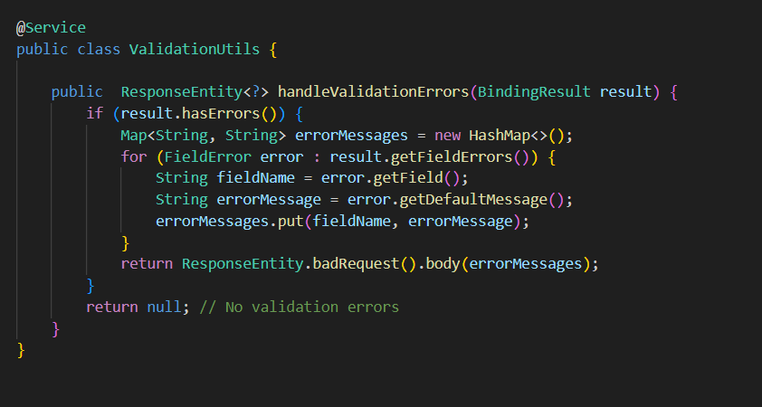
Validation
Service Annotation:
The @Service annotation marks the class as a Spring service component, indicating its role in the application's business logic layer.
handleValidationErrors Method:
This method receives a BindingResult object, which contains validation errors detected during data binding and validation processes.
If validation errors are present (result.hasErrors()), the method constructs a map of field names and error messages from the FieldError objects within the BindingResult.
The map errorMessages contains field names as keys and corresponding error messages as values.
It then returns a ResponseEntity with a status of 400 (bad request) and the error messages map as the response body.
If no validation errors are found, the method returns null to indicate that no error response is needed.
This ValidationUtils service encapsulates the logic for handling validation errors in a reusable and centralized manner. It simplifies the process of converting validation errors into meaningful HTTP responses, enhancing the overall robustness and maintainability of the application.
Top of Form

Slide 11

OCL
Constraints
User
Email ends with (@gmail.com / @outlook.com / @yahoo.com)
Phone starts with 01
Password size 8 characters
Address
Country = Egypt
City (helwan / ain-shams) discount
Order
order price if higher than 50000 discount
order quantity more than 5 items discount
order quantity more than 3 items from the same product discount
Product
Rate >= 2 product remove
Offer price = *0.3

Slide 12
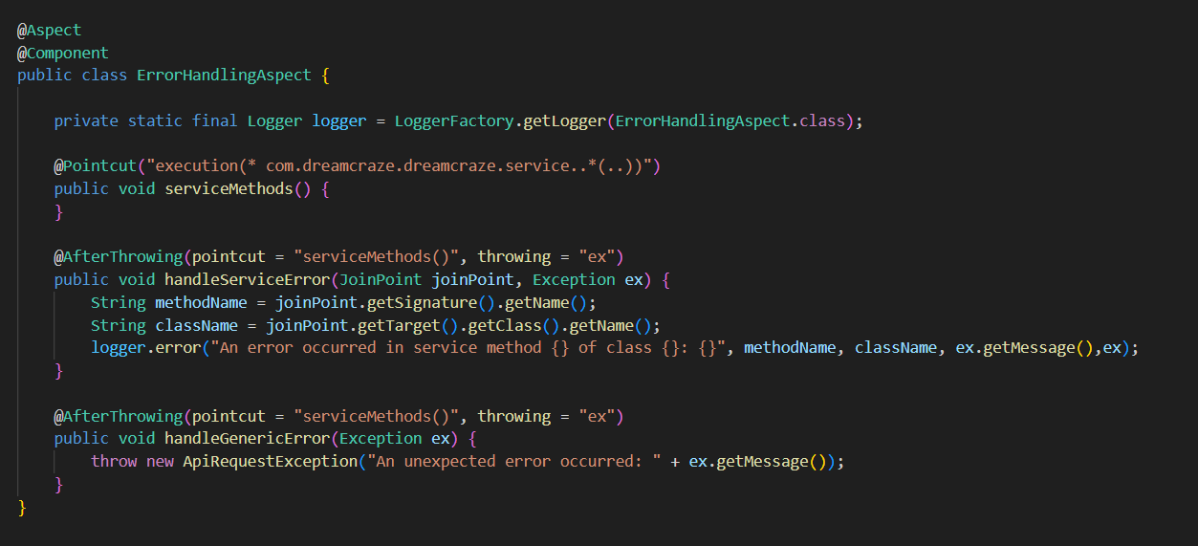
ASOP (Aspect Oriented programming)
error handling
Aspect Annotation:
The @Aspect annotation marks the class as an aspect, allowing it to define pointcuts and advice.
Pointcut Declaration:
The serviceMethods() method defines a pointcut that matches all methods within the com.dreamcraze.dreamcraze.service package and its sub-packages.
After Throwing Advice:
The @AfterThrowing annotation marks methods that act as advice, executed after an exception is thrown by methods matched by the pointcut.
handleServiceError() logs specific service method errors, capturing the method name, class name, and exception message.
handleGenericError() throws a custom ApiRequestException for unexpected errors, including the original exception message.
Logger Usage:
The LoggerFactory.getLogger() method initializes a logger instance for logging error messages.
JoinPoint:
The JoinPoint parameter in advice methods provides access to information about the intercepted method, such as its signature and target class.
Exception Handling:
Both advice methods handle exceptions thrown by service methods, with handleServiceError() providing specific error logging and handleGenericError() throwing a generic exception with a custom message.

Slide 13
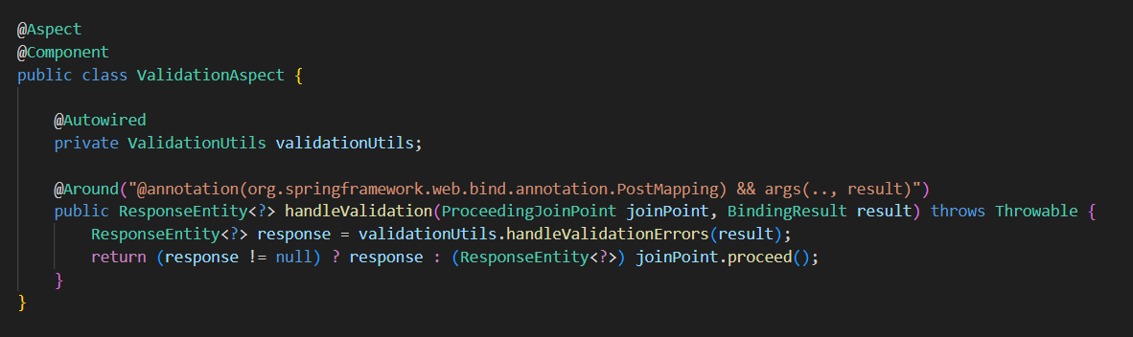
validation
Aspect Annotation:
The @Aspect annotation marks the class as an aspect, allowing it to define pointcuts and advice.
Component Annotation:
The @Component annotation marks the class as a Spring component, enabling auto-detection and instantiation by the Spring container.
Autowired Dependency Injection:
The ValidationUtils bean is injected into the aspect using @Autowired.
Around Advice:
The @Around annotation marks the method as advice, executed around the target method invocation.
The pointcut expression @annotation(org.springframework.web.bind.annotation.PostMapping) && args(.., result) matches any method annotated with @PostMapping that accepts a BindingResult parameter.
handleValidation() intercepts method calls and executes additional logic before and after the target method invocation.
ProceedingJoinPoint:
joinPoint.proceed() proceeds with the execution of the intercepted method.
The ProceedingJoinPoint parameter provides access to the intercepted method's execution.
Input Validation Handling:
Inside the advice, the ValidationUtils bean's handleValidationErrors() method is called to handle validation errors based on the BindingResult.
If validation errors are found (response != null), the advice returns the error response. Otherwise, it proceeds with the execution of the target method.

Slide 14

Microservices
Discount Microservice Container:
The discount microservice container is a self-contained, scalable component within the architecture of the application. It is responsible for managing and applying discounts to products or services offered by the e-commerce platform.
Key features and functionalities of the discount microservice container include:
Discount Calculation: The microservice calculates discounts based on various criteria such as promotional campaigns, user segments, product categories, and order quantities.
Flexible Discount Rules: It supports flexible discount rule configurations, allowing administrators to define and modify discount rules dynamically without requiring code changes.
Integration with Order Management: The microservice integrates seamlessly with the order management system to apply discounts to eligible orders during checkout.
Real-time Updates: Discounts are applied in real-time, ensuring accurate pricing information is displayed to users throughout the shopping experience.
Performance and Scalability: Designed for high performance and scalability, the microservice can handle a large volume of discount calculations and adjustments, even during peak traffic periods.
Logging and Monitoring: Comprehensive logging and monitoring capabilities enable administrators to track discount activities, monitor performance metrics, and identify any issues or anomalies.
Security: The microservice ensures data security and integrity by implementing appropriate authentication, authorization, and data encryption mechanisms to protect sensitive discount-related information.

Slide 15
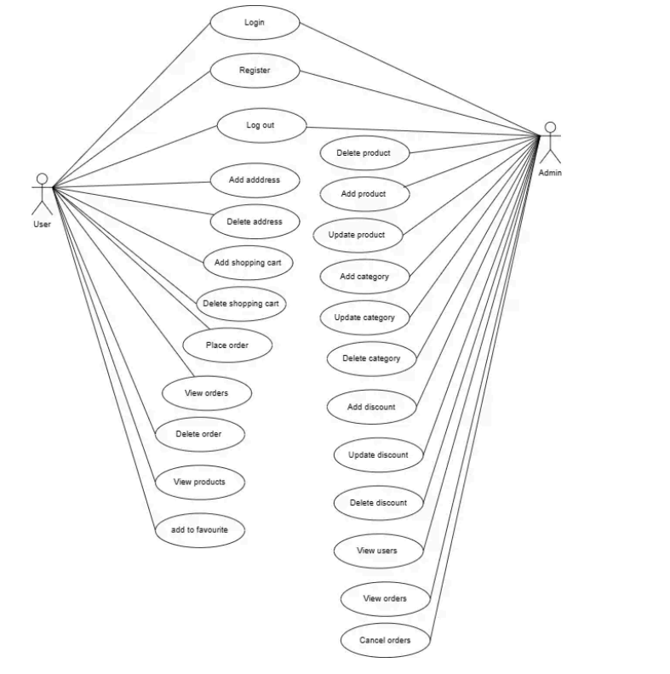
Use-case diagram

Slide 16
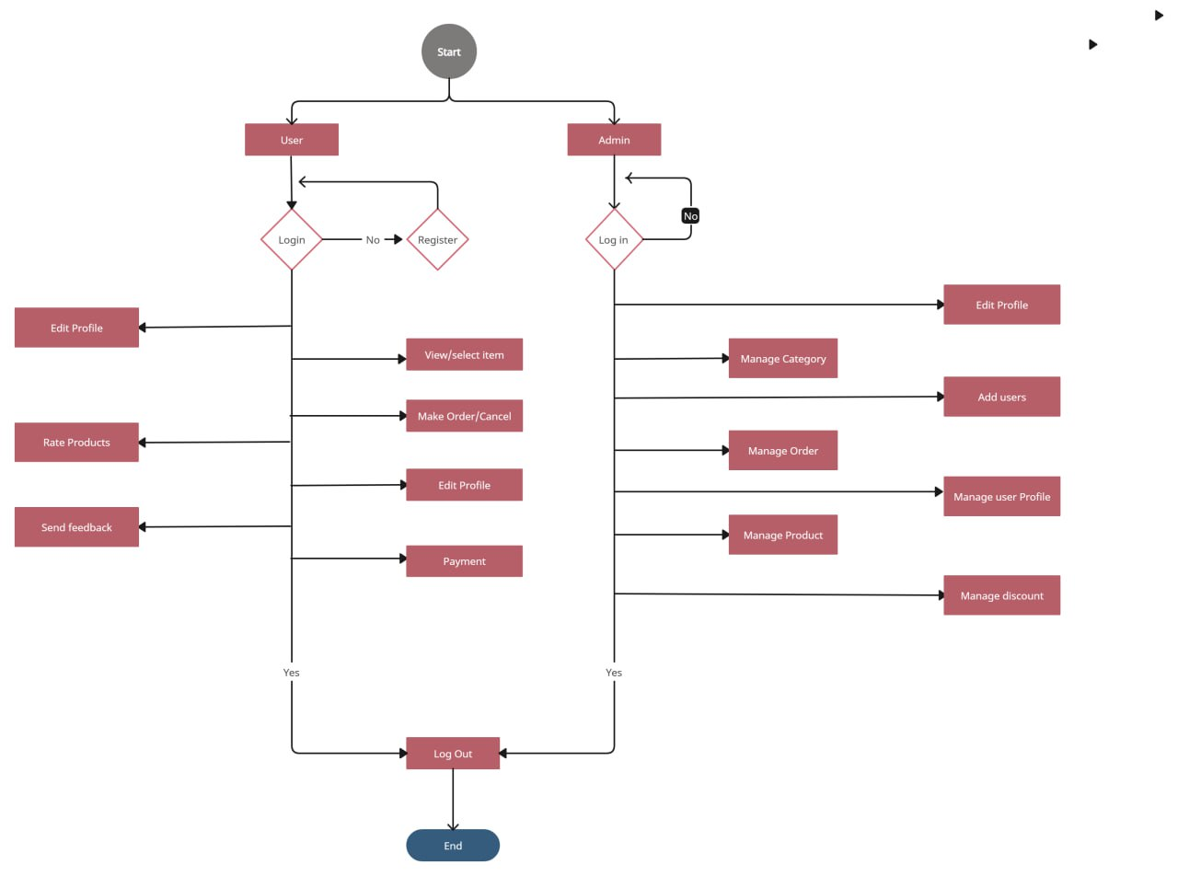
Activity diagram

Slide 17
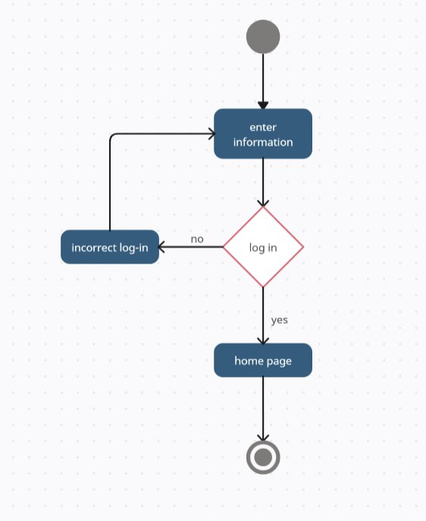
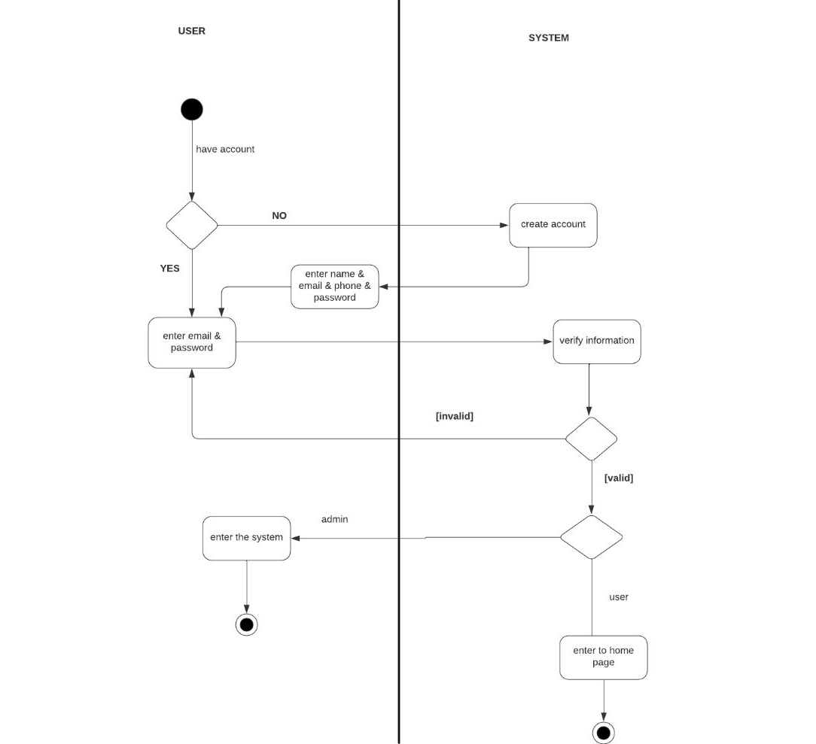
LOGIN
Sign up

Slide 18
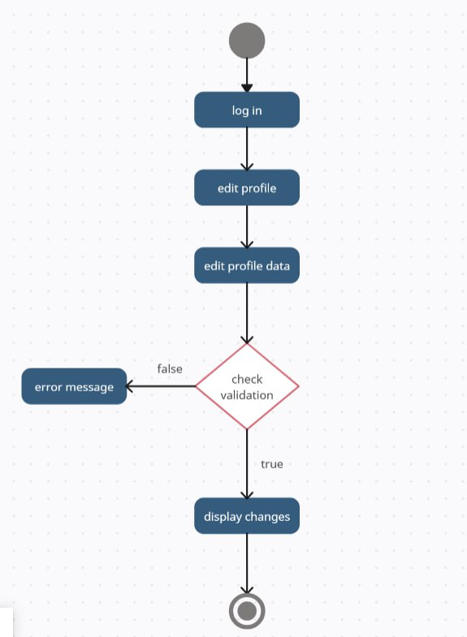
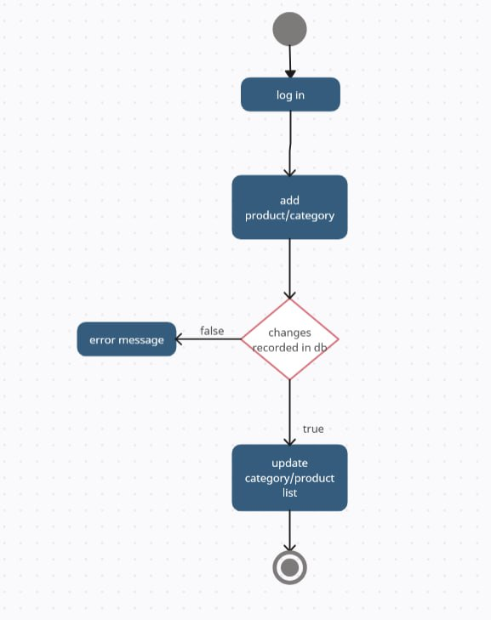
Check validation
Add to cart

Slide 19
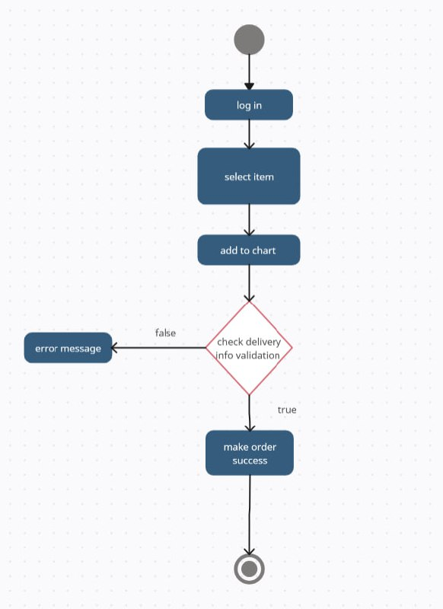
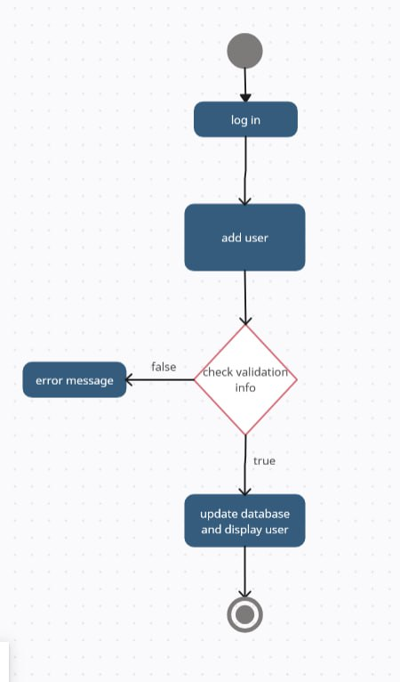
Order
Add User

Slide 20
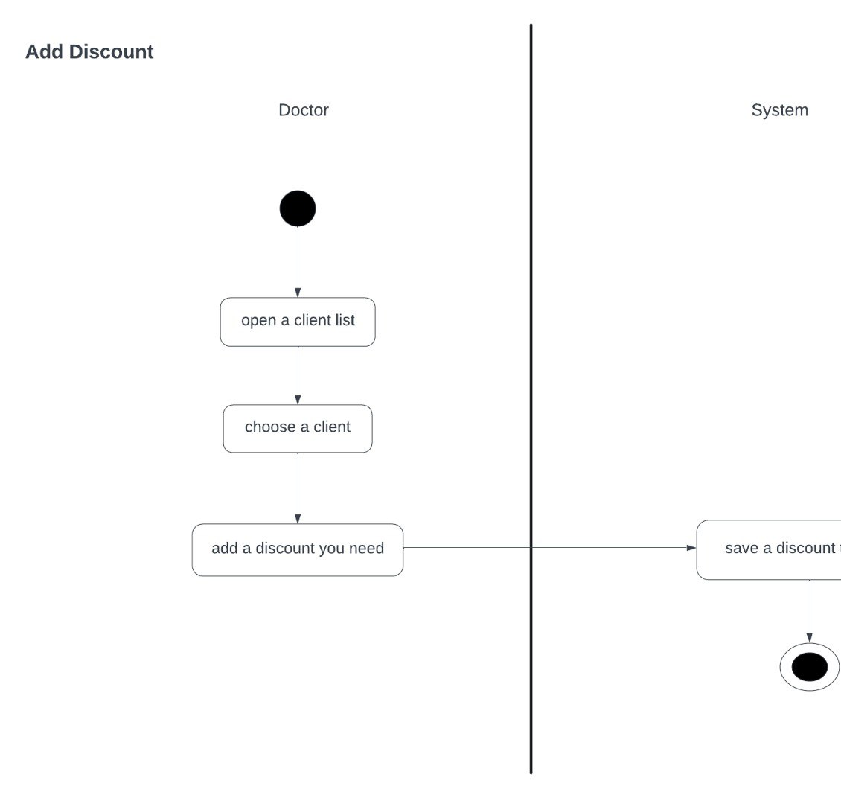
Add discount

Slide 21
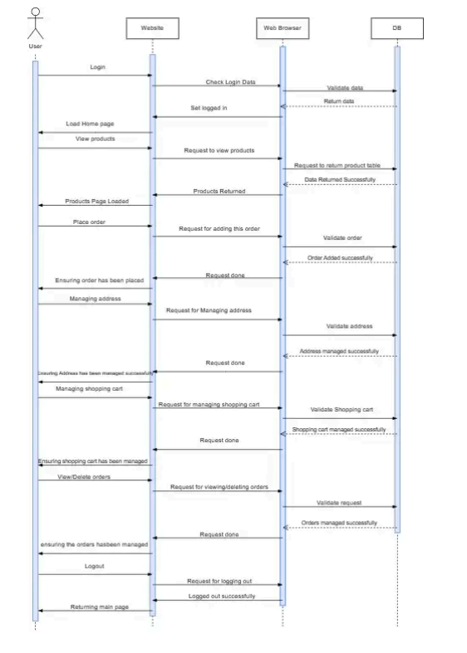
Sequence diagram

Slide 22
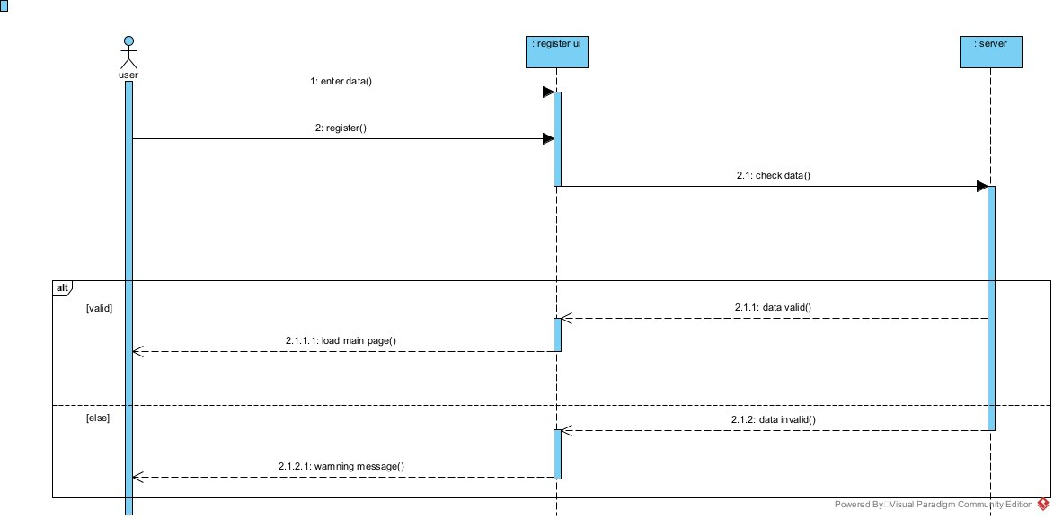
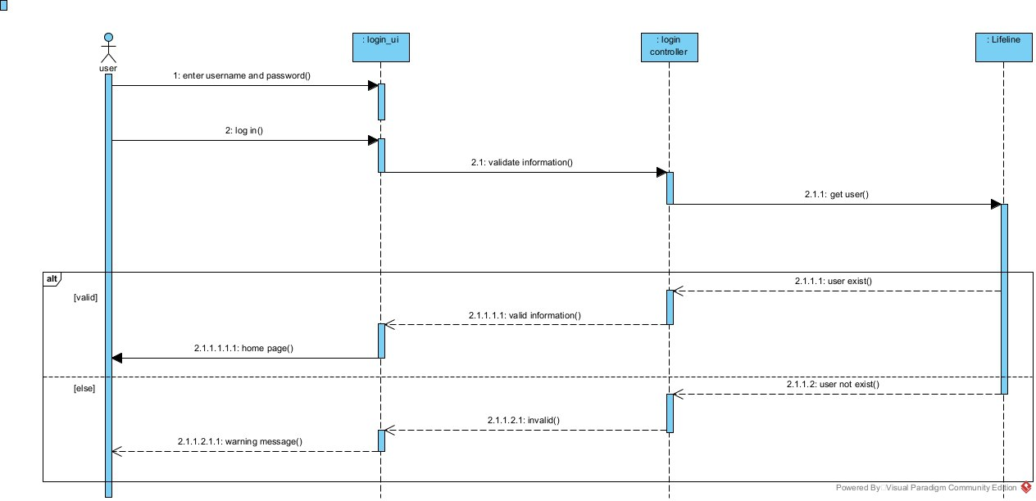
Sign up
Login

Slide 23
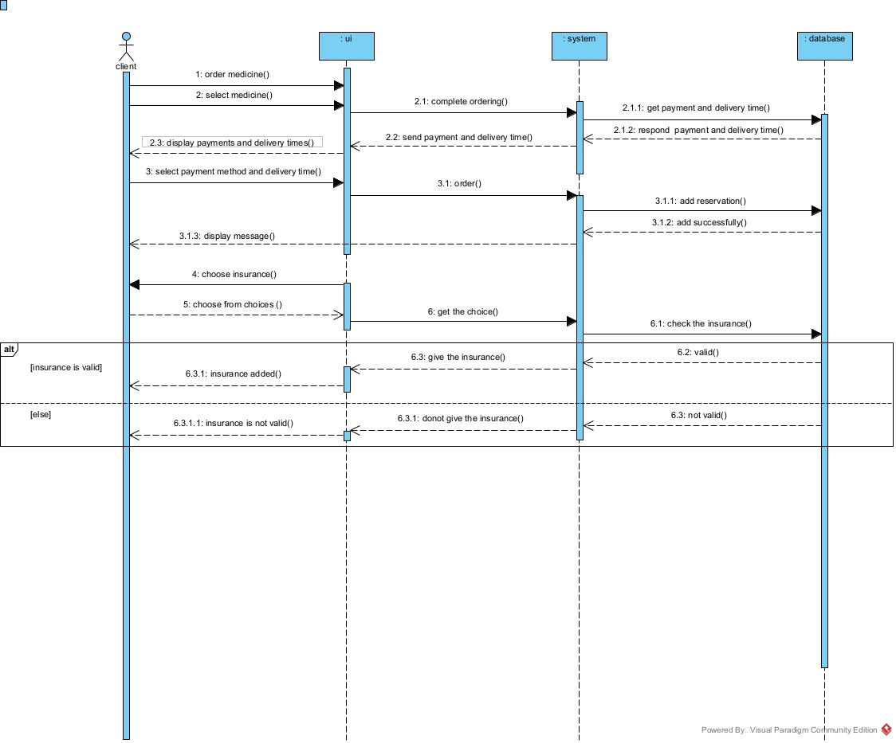
Order

Slide 24
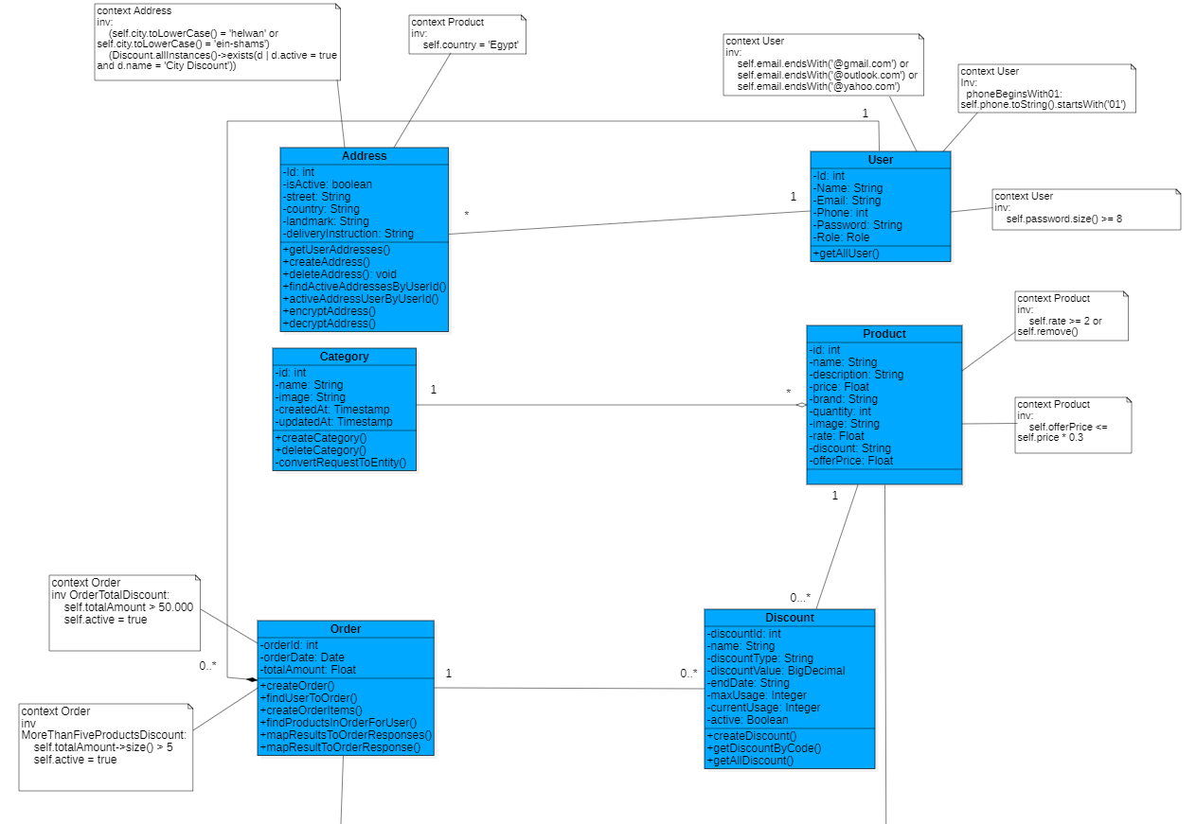
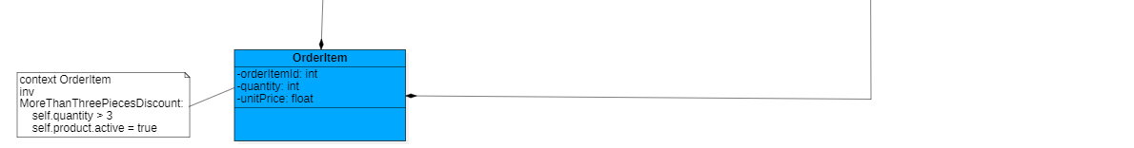
Class diagram

Slide 25
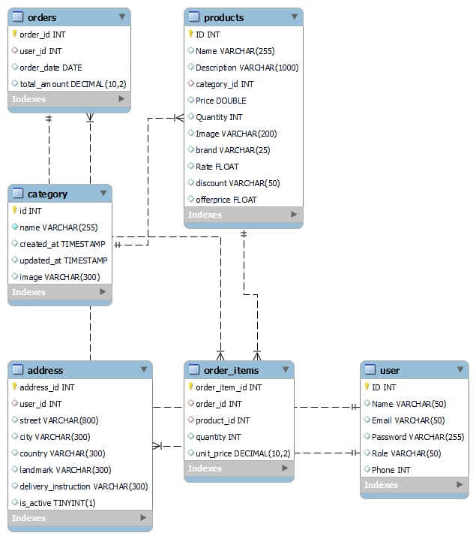
ERD

Slide 26
THANKS

