Slide 1
Operating systems 2 project
Project 2 Word Statistics

Slide 2
Project description:
Write a program that reads all text files form a specific directory and return word statistics (number of words per file/directory, longest word, shortest word, number of “is”, “are” and “you”).-The program should have a simple GUI-The input of the program is a directoryoIt should then search for all text files that reside in that directoryoThere should be an option to check for text files in subdirectories -Whilethe program is processing text files, it should display them (file names) and the up-to-datestatistics. (Statisticsshould be updated in run time)

Slide 3
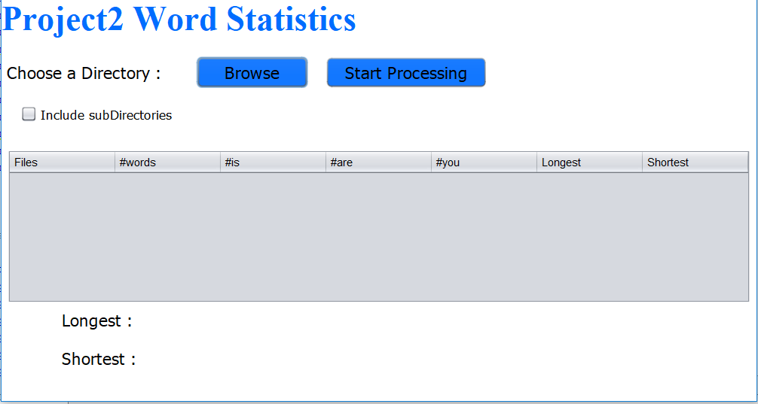
What we Did?
OUR GUI

Slide 4
GUI Guide
Browse Button
this button is to select the directory from the computer
Start Processing
this button is to show the result of the project
Include Sub Directories checkbox
this is for if the directory contain a sub-directory on it if you want to process it press the checkbox

Slide 5
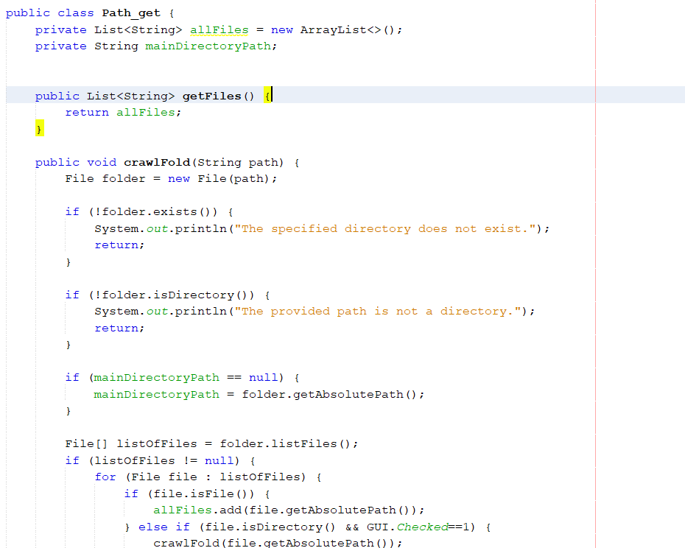
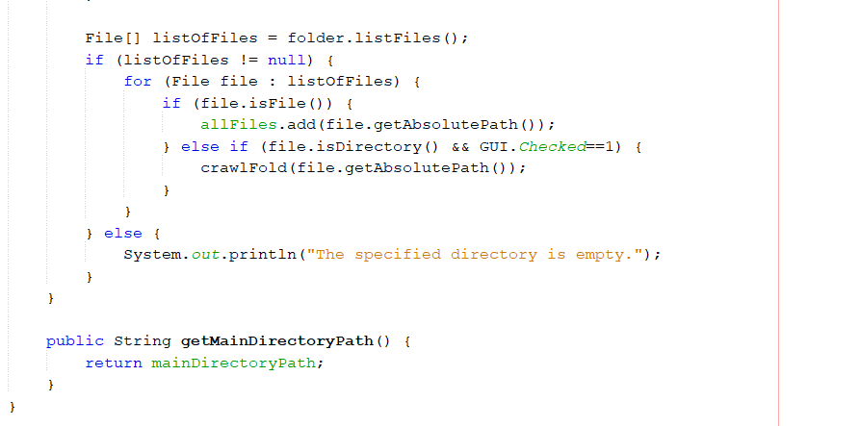
Path_get Class Description
First
“allFiles” → List<String> used to store the paths of all files added during the directory browsing.
Second
“crawlFold” → Takes a directory path as input and crawls through it to collect file paths. It checks if the provided path is a directory and not empty. If so, it iterates through the files in that directory. For each file, if it's a regular file, its absolute path is added to the allFiles list. If it's a directory and (GUI.Checked == 1) “that is for including subDirectory” it recursively crawls through that subdirectory.

Slide 6
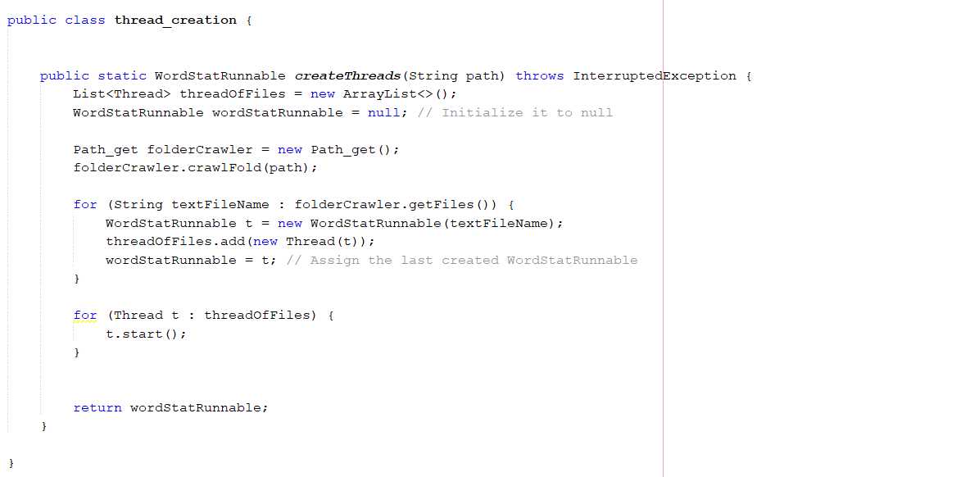
thread_creation Class Description
createThreads →This method takes a directory path as input from path_get class . It initializes a object wordStatRunnable to null . It creates an object of Path_get named folderCrawler . The crawlFold method of Path_get is called with the provided directory path, which populates the folderCrawler object with the file paths found in the directory . It then iterates through each file path obtained from folderCrawler.getFiles(): For each file, it creates a new WordStatRunnable object (t) initialized with the file path. It creates a new thread associated with t and adds it to the “threadOfFiles” list. During each iteration, it updates the wordStatRunnable object to hold the last created thread After creating all threads, it starts each thread using the start() method. it returns the last WordStatRunnable object which represents the last file's processing thread

Slide 7
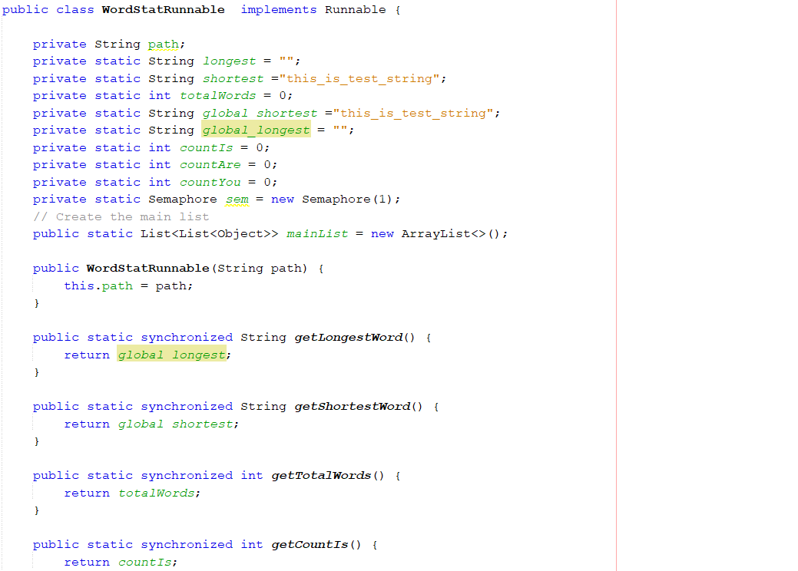
WordStatRunnable Class Description
path: Stores the path of the file to be processed.
longest: Tracks the longest word encountered in a file.
global_longest: the longest word in the directory .
shortest: Tracks the shortest word encountered in a file.
global_shortest: the shortest word in the directory .
totalWords: Counts the total number of words.
countIs, countAre, countYou: Counts occurrences of specific words.
WordStatRunnable → Constructor that initializes the path variable.
The class uses synchronized methods to ensure that shared variables (global_longest, global_shortest, totalWords, countIs, countAre, countYou) are accessed safely in a multi-threaded environment.
A Semaphore (sem) is employed to control access to shared resources, ensuring that multiple threads don't concurrently modify the statistics variables..

Slide 8
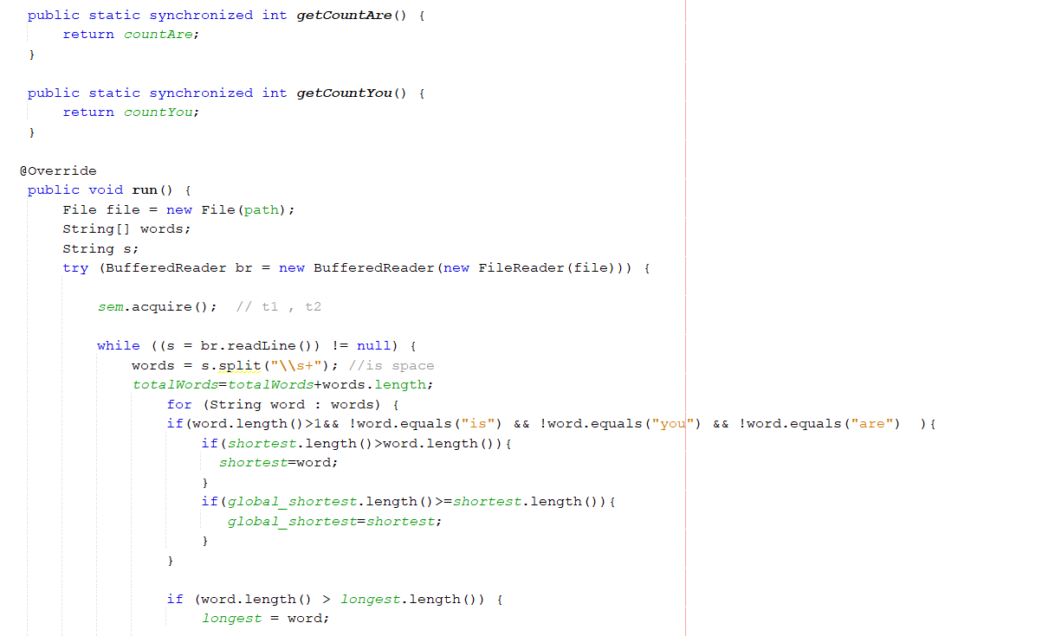
WordStatRunnable Class Description
run(): Overrides the run() method of the Runnable interface. This method is executed when a thread is started.
Opens the file specified by path and reads it line by line.
Splits each line into words using whitespace as a regular expression.
Computes statistics like total words, counts occurrences of certain words, and identifies the longest and shortest words. Acquires a semaphore (sem) to synchronize access to shared variables across threads.

Slide 9
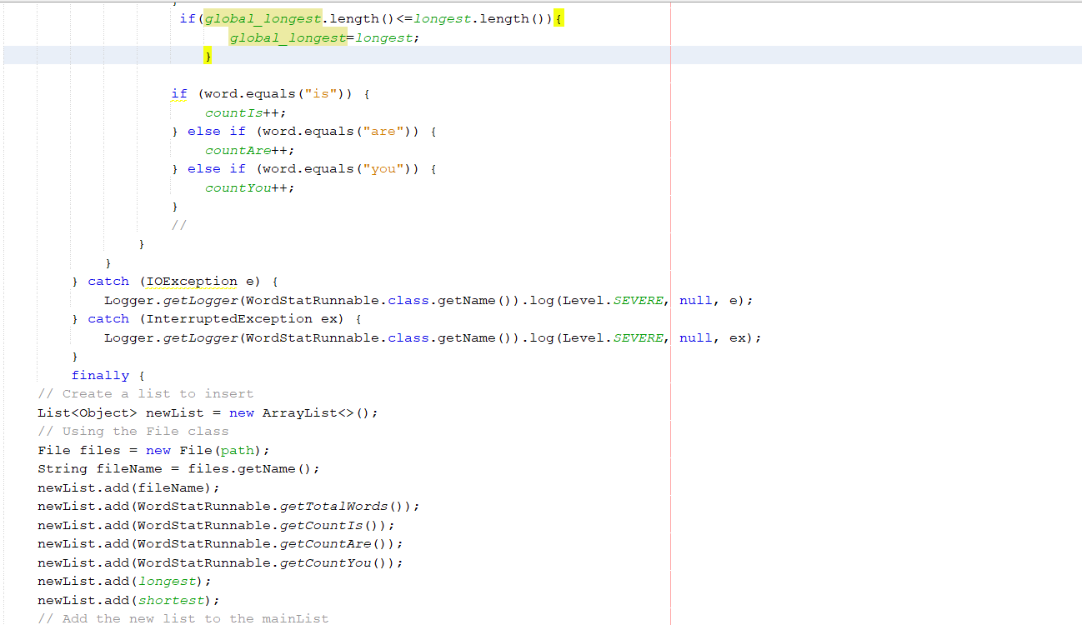
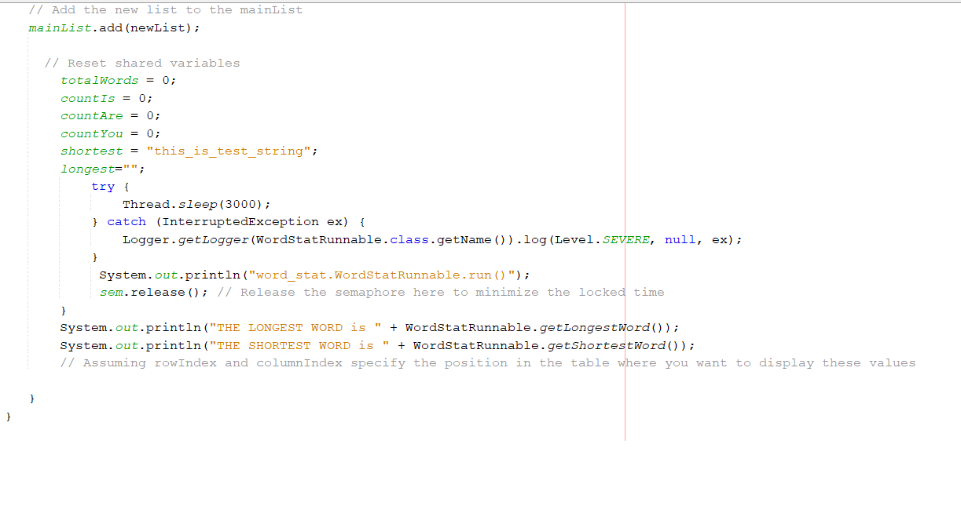
WordStatRunnable Class Description
Adds the statistics for the processed file to a mainList shared among all instances.
Resets statistics variables and releases the semaphore after a delay of 3 seconds.
Prints the longest and shortest words encountered in the file.

Slide 10
Team Members Role
OOP & Functions →يارا عماد درويش يوسف/احمد عبد النبي عبد المعطي عبد العزيز
ولاء اسامه عبدالقادر مصطفي/هادي محمد عبدالهادي/مريم ربيع دياب السيد
احمد عبدالرحمن محمد عبدالرحمن/زينب عماد محمود إبراهيم
GUI → يارا عماد درويش يوسف/احمد عبد النبي عبد المعطي عبد العزيز
Real Time → احمد عبد النبي عبد المعطي عبد العزيز
Documentation → يارا عماد درويش يوسف/ ولاء اسامه عبدالقادر مصطفي

