Slide 1
Depi Graduation Project
By: Peter Beshay & Yara Khalid & Ali Dahy Track: Software Tester Supervisor: Mohamed ElShafey
Date : 25/10/2024

Slide 2
Introduction
The project consists of two parts: Manual And Automation
Overview of the project | The project consists of two parts: Manual And Automation
Problem statement | covering all the possible tests will enhance the user experience and the quality
Objectives and goals | Manual Test cases for the first part, Automation scenarios for LUMA website
002

Slide 3
Project Tools and Requirements
Test Management
Automation
01
03
Framworks
Other
02
04
MS Excel
Selenium WebDriver & Java
TestNG , Cucumber
IntelliJ IDEA, Chrome ,Windows 10

Slide 4
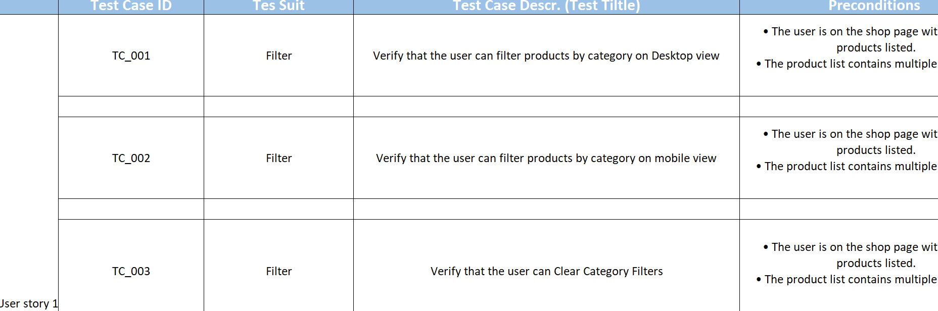
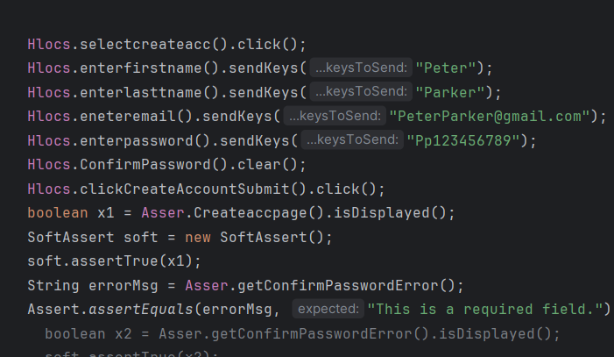
Implementation
For the Manual Part :
We implemented all the possible test cases for the given scenarios .
For the Automation Part :
We wrote the scripts for the given 4 scenarios using both TstNG and Cucumber
the test cases run and passed successfully.
004

Slide 5
01
Manual Testing Part

Slide 6
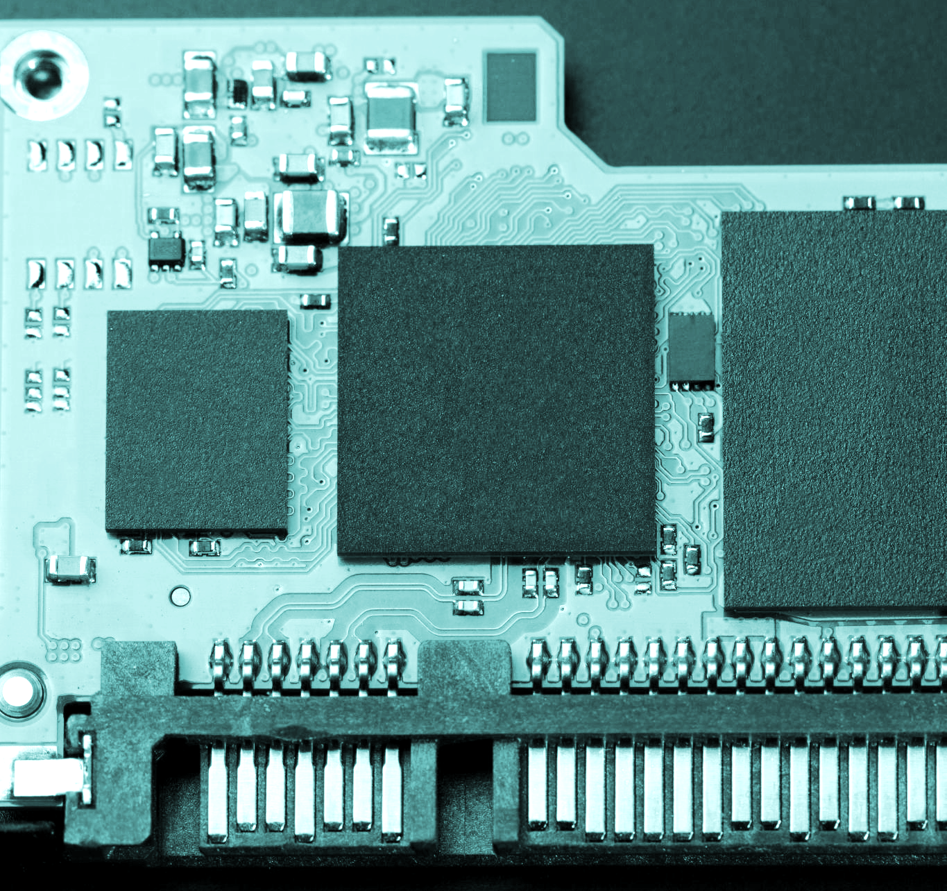
Manual Part Tasks
The Manual Testing Part consists of 3 User stories as follows:
As a customer, I want to filter products by category, so I can easily find items that match my interest.
As a citizen, I want to apply for a new passport online, so I can avoid visiting the passport office in person.
As a patient, I want to schedule an appointment with my doctor online so that I can choose a convenient time without calling the office.
006

Slide 7
Manual part Requirements
01
03
Cover Corner Cases
Test the Happy path/s
02
04
Cover the Negative Scenarioes
Avoid redundant test cases

Slide 8
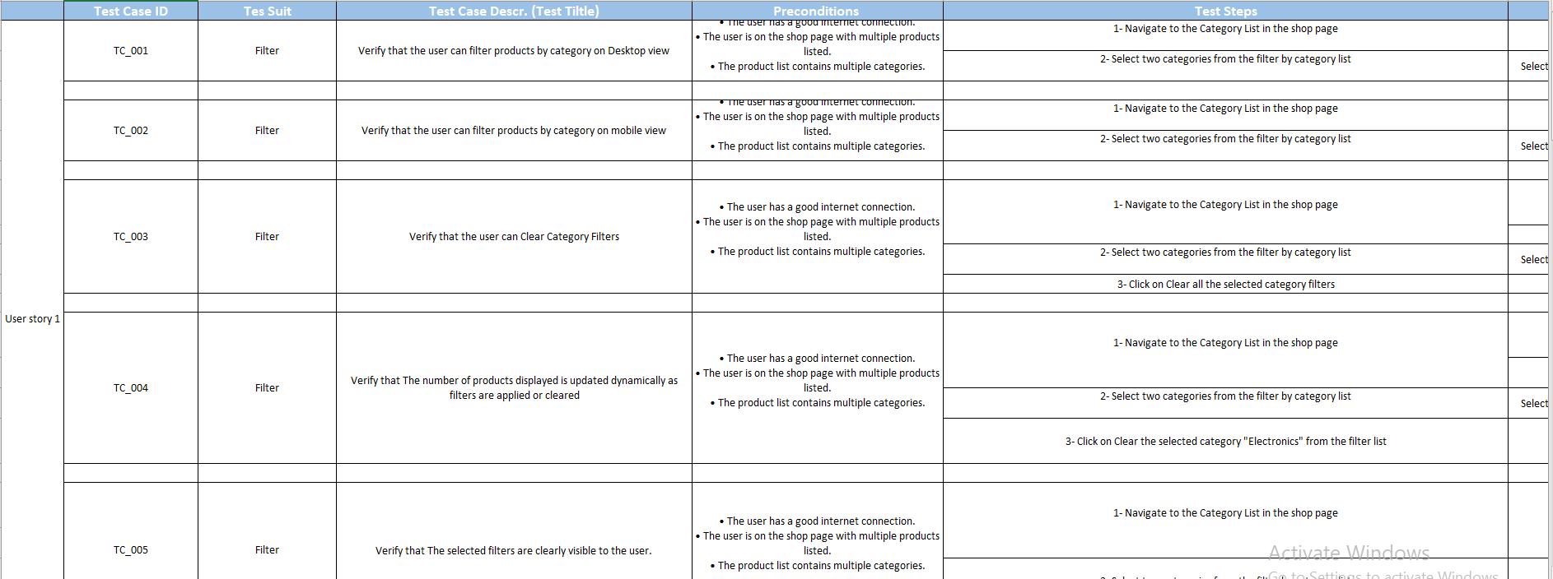
Manual Part Tests
For the Tests:
MS Excel were used, as it’s a very powerful tool for documentation.
008

Slide 9

Outcomes from The Manual Testing Part are: Full coverage for the user provided user stories. Contributing in increasing the quality of the system by detecting bugs Ensure applying unit testing, Integration testing, and system testing Applying Agile Methodology between the team members.
Outcomes

Slide 10
02
Automation Testing Part

Slide 11
For Automation Project
Project Overview
Project Name: Automation Testing for E-commerce Platform
Tools Used: Selenium, Java
Objective: Automate core user flows like registration, login, product listing, cart, and Wishlist functionality.
0011

Slide 12
Project Requirements and Scope
Requirements:
1. Automate both guest and logged-in user workflows.
2. Validate product prices are displayed in "$" and as doubles.
3. Ensure wishlist functionality varies for guest vs. logged-in users.
Scope:
- Functional testing of registration, login, and product interactions.
- Verification of cart and wishlist management.
- Handling edge cases (e.g., mismatched passwords, empty fields).
0012

Slide 13
Challenges and Solutions
Challenges:
- Handling dynamic elements (e.g., Hot Sellers section).
- Validating prices without altering "$".
- Managing different wishlist flows for guests and logged-in users.
Solutions:
- Used efficient XPath locators and assertions.
- Customized logic for price validation.
- Applied preconditions for managing login state.
0013

Slide 14
03
Data Provider Task

Slide 15
Data Provider Task
Utility method to read CSV data
The readCSV method reads data from a CSV (Comma-Separated Values) file and stores it in a two-dimensional String array. Each row of the array corresponds to a line in the CSV file, and each column in that row represents a value separated by commas.
Step-by-Step Execution:
A list, data, is created to store each row temporarily as an array of strings.
Using BufferedReader, each line of the file is read and split by commas to separate values.
Each split line (an array of values) is added to the data list.
After reading all lines, the list data is converted to a 2D array and returned
0015

Slide 16
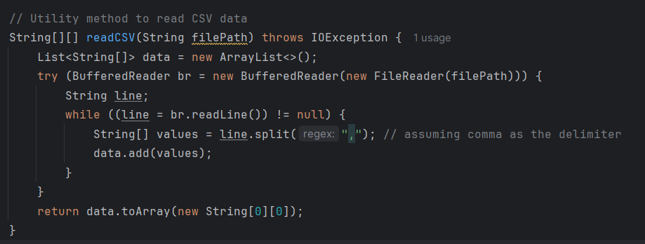
Data Provider Task
Code snippet of the utility method
0016

Slide 17
Conclusion
Summary of Achievements Learned the basics of manual and automation testing. Gained hands-on experience with testing tools and techniques. Applied testing skills to small projects, identifying bugs and improving quality.
Reflection on Impact Increased Confidence: Comfortable using both manual and automation testing for different tasks. Better Understanding of Quality Assurance: Learned how testing improves software reliability and user satisfaction. Skill Growth: Developed new skills in automation and gained a stronger foundation in manual testing.
Final Remarks Both manual and automation testing are essential for effective quality assurance. Excited to continue building on these skills for better testing practices. Grateful for the learning experience and looking forward to more challenges!
0017

Slide 18
Acknowledgements
Sincere thanks to Eng. Mohamed Abdelqader for his invaluable guidance and dedication as the instructor of this course.
Heartfelt thanks to DEPI colleagues for their support, collaboration, and encouragement throughout this course.
0018

Slide 19
Questions?! Thanks!

