Slide 1
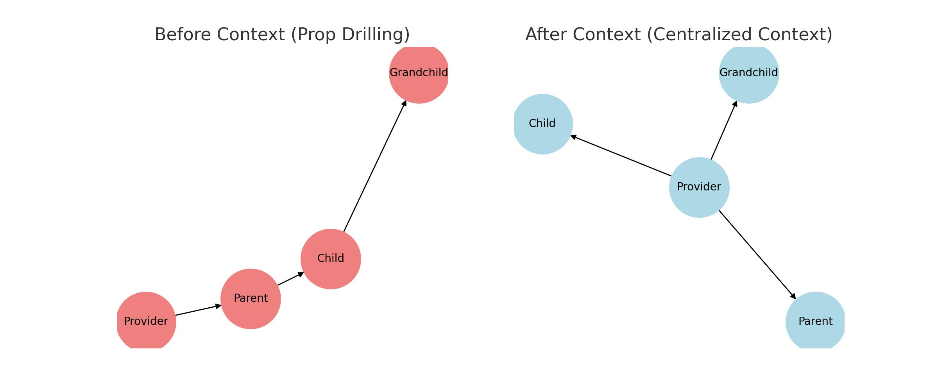
What is React Context?
Purpose:
- Share global data (e.g., themes, user auth) across components.
- Avoid 'prop drilling' (passing data through multiple layers).
Before Context:
- Component tree with tangled props.
After Context:
- Central data hub accessible by any component.
Code Example:
const ThemeContext = createContext('light');

