Slide 1

Order Processing
NineCube.Digital — a reliable order + stock feature for a small retailer
ASP.NET Core 10 Web API · EF Core · SQL Server · JWT + 4 roles
React 18 + TypeScript SPA · hand-written glass / neumorphic CSS
108 backend integration tests · 159 frontend tests · 107 browser tests — all green
183-product catalogue · 55 endpoints · 28 annotated screens in the user manual
Candidate: Yeasin Arafat · Submission: 15 October · figures on the slides measured 16 October

Slide 2

PROBLEM UNDERSTANDING
The four problems, and what actually fixes each one
Reported problem | Root cause | What this implementation does
Orders accepted beyond stock | Availability checked in code, written in a second step | The rule lives inside the UPDATE: `… SET Stock = Stock - @qty WHERE IsActive = 1 AND Stock >= @qty`
Inventory inconsistent under load | Read-then-write (lost update) | Never read-then-write. One atomic conditional UPDATE per line + CHECK (StockQuantity >= 0)
Invalid requests handled inconsistently | Errors raised ad hoc per endpoint | One contract: RFC 7807 ProblemDetails + correlation id, one exception middleware
Staff cannot see availability or status | No single view of stock, no explicit lifecycle | Live stock badges everywhere, explicit status machine, audit trail
Explicitly not a full e-commerce platform and not an ERP — no payments, no email, no delivery tracking.

Slide 3
ARCHITECTURE
One modular monolith, five projects, four modules
• Api — controllers, JWT policies, exception middleware, ProblemDetails
• Application — services, DTOs, FluentValidation validators, rules re-checked inside the service
• Domain — entities, status transition rules, typed exceptions
• Infrastructure — EF Core DbContext + migrations, password hashing, SQL transient-error policy
• Tests — xUnit integration tests against a real SQL Server
•
• Modules inside them: Catalog · Inventory · Orders · Identity
•
• One database transaction per order — order row + stock + ledger commit together or not at all
• No microservices, no CQRS, no broker, no cache.

Slide 4
ARCHITECTURE DECISION
Why a modular monolith, not microservices
• The hard requirement is transactional: reserving stock and creating the order must be atomic.
• A network boundary between Orders and Inventory would turn a rollback into a saga with compensation.
• Scope and team size are small: one team, one release cadence, one database.
• Modules are separated by project and by namespace, so a future split is a service extraction, not a rewrite.
•
• Microservices would be justified by:
  – many teams needing independent deploys · genuinely independent scaling · fault isolation
  – regulatory or data-residency separation · a bounded context with a different consistency model

Slide 5
ROLES & ACCESS
Four roles, and separation of duties
Capability | Customer | Staff (Sales) | Inventory Mgr | Administrator
Browse catalogue + live stock | yes | yes | yes | yes
Place an order | yes | – | – | – (read-only)
Read order | own only (else 404) | all | – | all
Confirm / reject / ship | – | yes | – | –
Cancel an order | own, Pending/Confirmed | yes | – | –
Create/update product, adjust stock | – | – | yes | read-only
Sales summary, invoice | own invoice | yes | – | yes
Users, roles, audit log, settings | – | – | – | yes
The person who handles orders cannot freely change stock — that is the design principle, not a limitation.

Slide 6
DATA
Data model and the guarantees it enforces
• Product (StockQuantity, RowVersion, Currency, provenance) · Customer · User (Role, IsActive, CustomerId)
• Order (Status, TotalAmount, IdempotencyKey unique per customer) · OrderItem (name/category/UnitPrice snapshot)
• Category hierarchy (slug, path, depth ≤ 4) · ProductCategory with one primary · Tag · Brand · ProductLine
• InventoryMovement — append-only ledger · AuditLog · Setting · Notification (per user, per event)
•
• Constraints do the guarding: CHECK (StockQuantity >= 0), CHECK (Quantity > 0), unique SKU, unique (OrderId, ProductId), and a filtered unique index for one primary category
• Money is decimal(18,2) — never double. Displayed in BDT; a product carries its own currency so legacy rows stay honest
•
• Pending → Confirmed → Shipped Pending → Rejected Pending | Confirmed → Cancelled
• Stock is reserved at placement; cancel/reject release it exactly once (conditional status update)

Slide 7
THE DATA BEHIND THE CLAIMS
What is in the system, counted on 16 October
 | Counted | Where the number comes from
Catalogue | 183 products, every one with an image | SELECT COUNT(*) FROM Products — 183 of 183 carry an ImageUrl
Facets | 29 brands · 103 product lines · 46 tags | Brands / ProductLines / Tags tables; 501 product-tag links
Category tree | 43 categories, deepest branch 3 levels, 198 product links | Categories + ProductCategories; one primary per product, enforced by index
Stock signal | 160 in stock · 10 low (1-10 units) · 23 out of stock | Products.StockQuantity, the same figures the badges read
Orders on this machine | 20 orders, 21 lines: 4 Pending, 9 Confirmed, 7 Shipped | Development seed plus the browser runs — demo data, not a sales claim
Audit and ledger | 38 stock movements · 1,018 audit entries · 20 notifications | InventoryMovements / AuditLogs / Notifications, append-only
API surface | 55 endpoints — 24 GET, 17 POST, 10 PUT, 4 DELETE | HTTP method attributes across the controllers
Schema | 13 EF Core migrations, 18 tables | Persistence/Migrations + sys.tables
Code | 15,631 lines of C# · 15,554 lines of TypeScript and CSS | wc -l over the sources, excluding bin, obj and node_modules
Counted with sqlcmd against the LocalDB database the app runs on, and grep/wc over the sources, on 16 October. The manual's 28 annotated screens come from the same instance.

Slide 8
API DESIGN
One API, one error contract
Area | Endpoints
Auth | POST /api/auth/register · POST /api/auth/login · GET /api/auth/me
Products | GET /api/products (q, category, tag, brand, line, inStock, price range, sort — all in the URL) · GET /{id} · low-stock · POST/PUT (Inventory Mgr) · stock-adjustments · movements · images
Bulk + model | POST /api/products/bulk — set-category, add/remove-tags, activate, deactivate, assign-brand (never stock) · categories CRUD/move · tags · brands + lines · PUT /{id}/categories
Orders | POST /api/orders · GET /api/orders · GET /{id} · /cancel · /confirm · /reject · /ship · /invoice
Account | GET/PUT /api/me · password · dashboard · addresses · GET /api/notifications (+ unread-count) · read-all · /{id}/read · DELETE
Reports + Admin | GET /api/reports/sales?from=&to= · users, role, active · /api/admin/audit-logs · /api/admin/settings
400 invalid input · 401 unauthenticated · 403 wrong role · 404 not found (including another customer's order)
409 insufficient stock (body lists productId / requested / available) or an invalid state transition
Never 500 for a business failure. Every response carries a correlation id that is also in the log.

Slide 9
THE CORE REQUIREMENT
Concurrency: one atomic statement, ordered, all-or-nothing
• Per line, in ascending ProductId order (deadlock avoidance):
  – UPDATE Products SET StockQuantity = StockQuantity - @qty WHERE Id = @id AND IsActive = 1 AND StockQuantity >= @qty
• 0 rows affected → roll back everything and return 409 with the short items. Never read-then-write.
• Status changes use the same trick: WHERE Id = @id AND Status = @expected → exactly one winner in a race.
• Idempotency-Key on POST /orders: a repeat returns the original order and never reserves stock twice.
•
• Rejected alternatives:
  – optimistic RowVersion — retry storms under exactly the load we care about
  – pessimistic locks — held across the whole order, invites deadlocks and timeouts
  – SERIALIZABLE — deadlocks and 1205s, and it still needs the retry loop
  – in-process lock — worthless the moment there is a second instance

Slide 10
FRONTEND & UX
Frontend: glass + neumorphism, but readable first
• React 18 + TypeScript + Vite. TanStack Query for server state, React Router for routing, no UI framework.
• Design tokens in one file (colour, space, radius, type, motion) — components hard-code nothing.
• The root route is a public WebGL showcase; the catalogue lives at /products behind the login, because live stock is commercial.
• Live stock badges: Out of stock / Low stock · N left / In stock · N, each with a glyph and a word, never colour alone.
• The stepper cannot exceed live stock, and a 409 keeps the cart and names the short items.
• Every catalogue filter is written to the URL — a view survives reload, bookmark, Back and Forward.
• Role-aware navigation: you only ever see the links your role can use; the server enforces it anyway. The tab you are on carries the same selected amber as the open account menu and the switched-on theme.
• Accessibility: skip link, focus rings, aria-current, arrow-key menus, focus-trapped dialogs, aria-live regions, reduced-motion fallbacks.
• Responsive at 390 / 768 / 1024 / 1440 px in both themes, measured on composited pixels — not assumed.

Slide 11
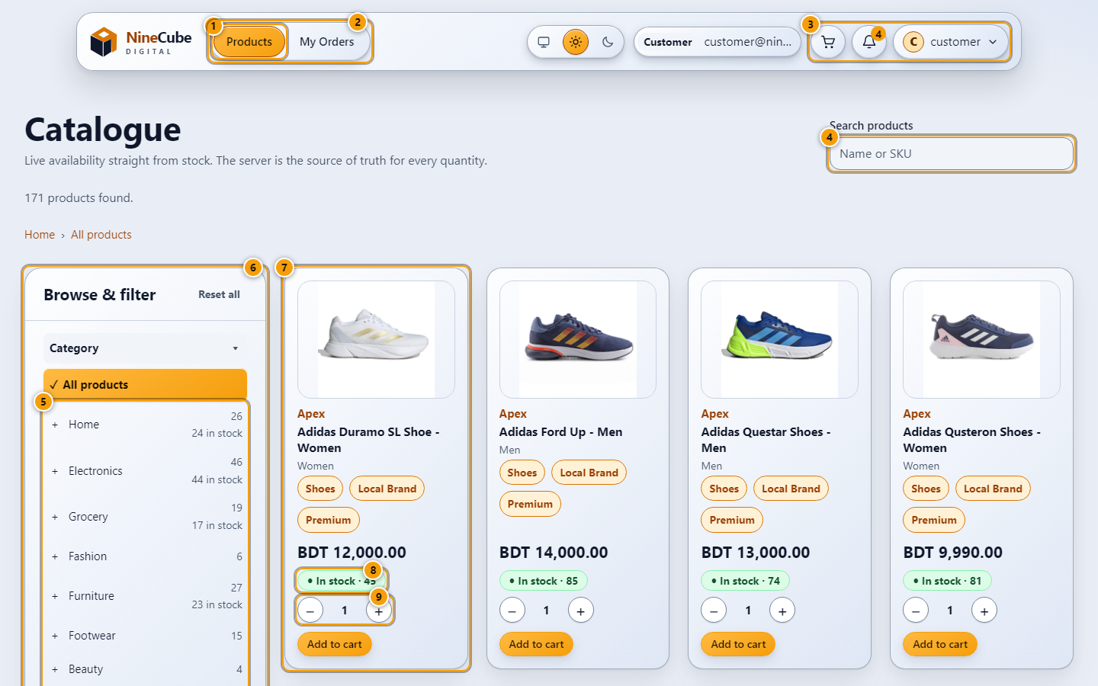
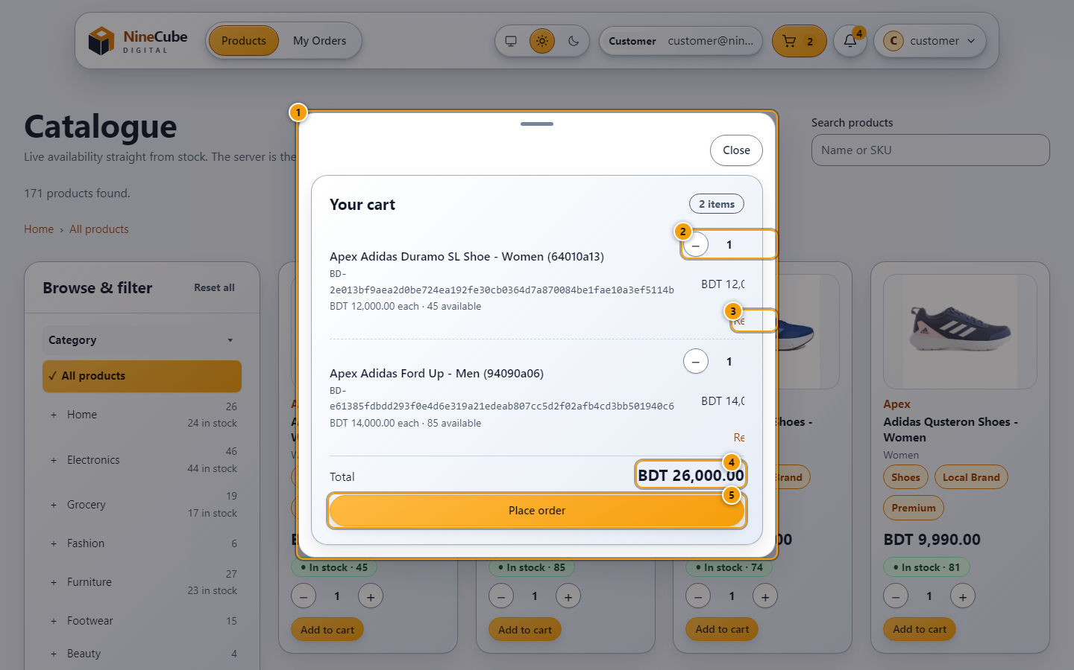
THE CUSTOMER'S SCREENS
Browsing and buying, photographed from the running app
The catalogue: the sidebar tree, the facet chips and the URL that carries them
The cart and checkout: the stepper cannot pass live stock, and a 409 names the short items
USER_MANUAL 2.1-2.2 · catalogue-roles.test.tsx, catalogue-sidebar.test.tsx, sidebar-layout.spec.ts, laptop-catalogue.spec.ts, checkout.test.tsx, order-flow.spec.ts

Slide 12
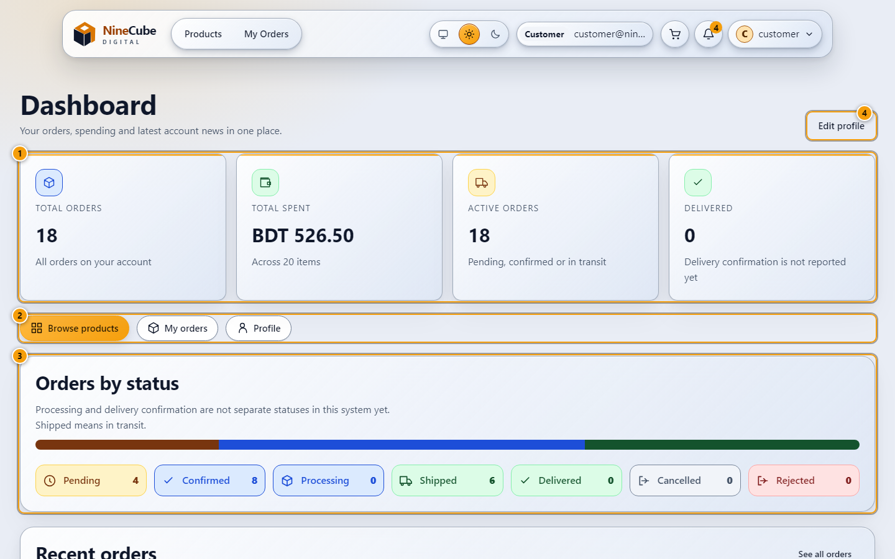
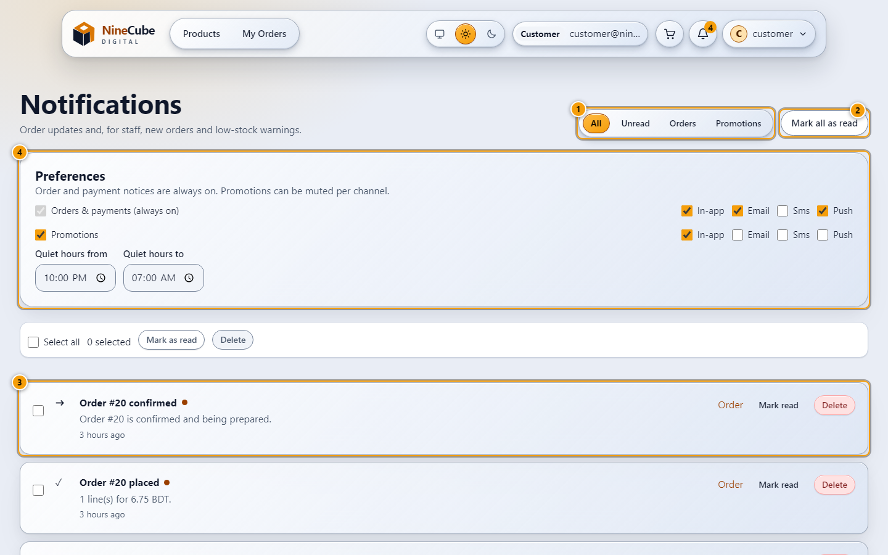
THE CUSTOMER'S OWN ACCOUNT
What the customer sees after the order
Your dashboard: the tiles, the recent orders and the spend the account is entitled to
Notifications: what changed, when, and a link to the order it is about
USER_MANUAL 2.4 and 6.3 · account.test.tsx, modern-customer.spec.ts, sticky-notifications.test.tsx, sticky-notifications.spec.ts, ProfileAndDashboardTests.cs, NotificationTests.cs

Slide 13
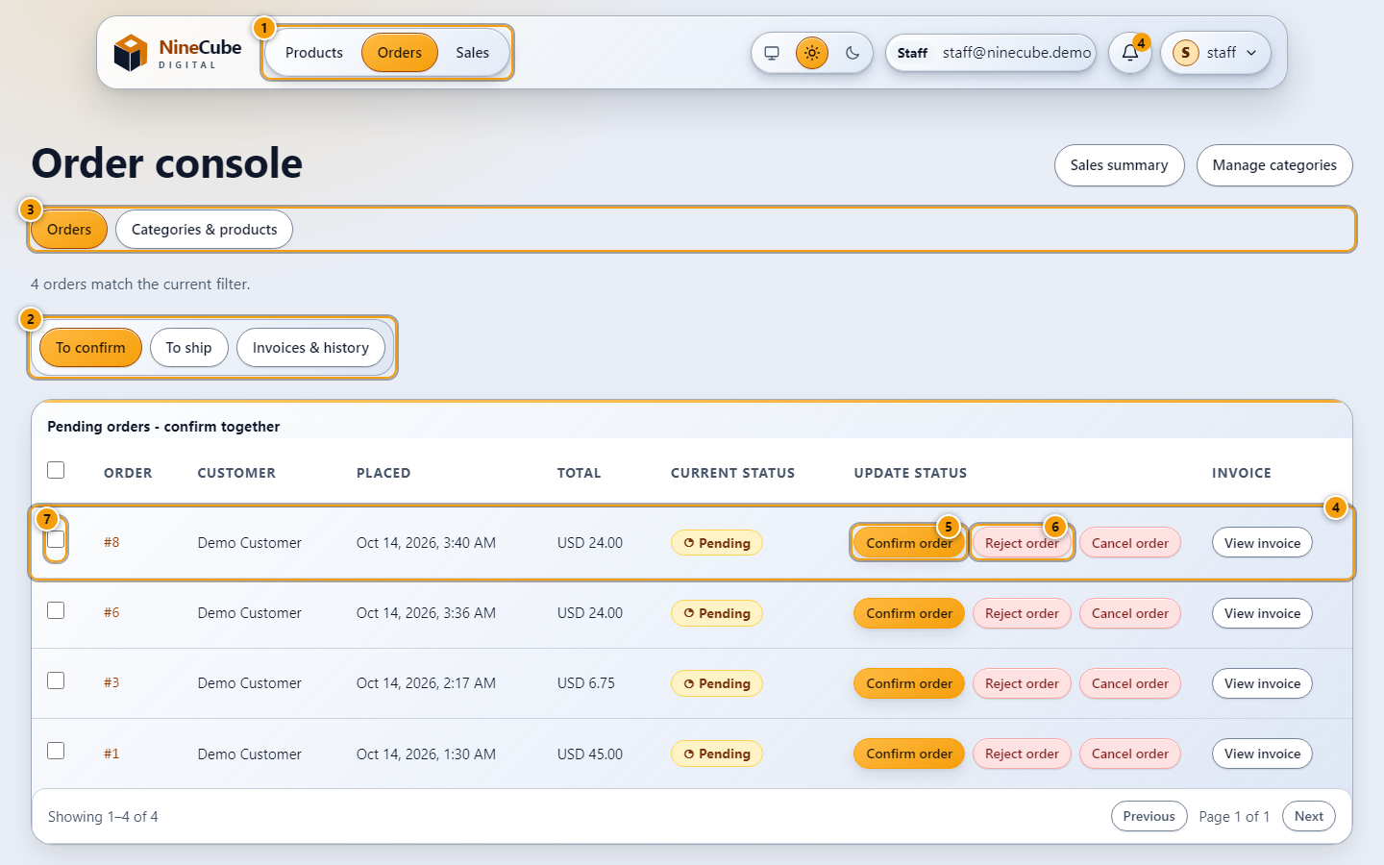
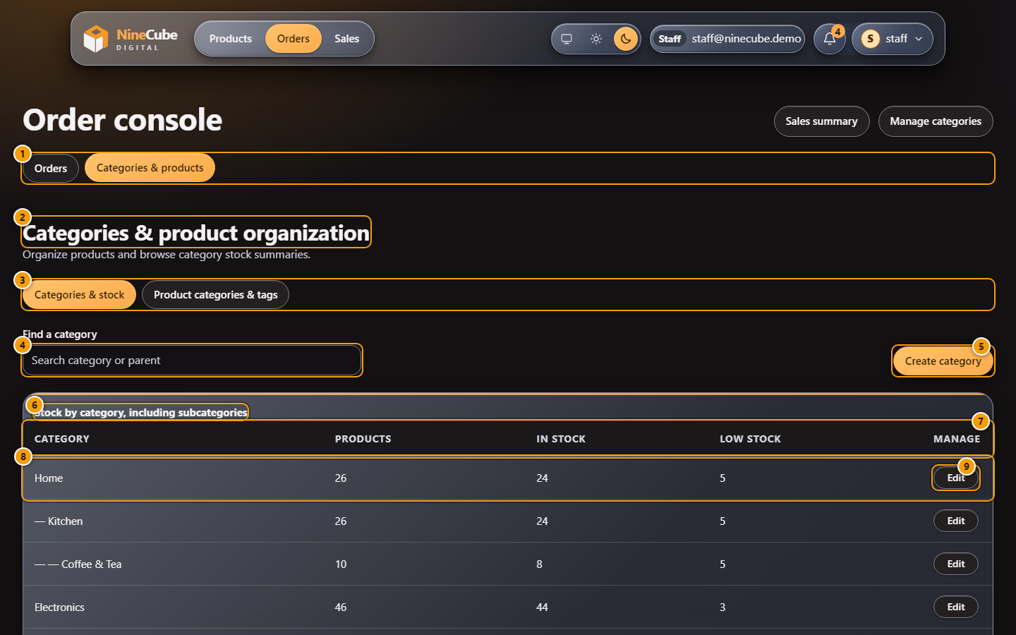
THE STAFF SCREENS
The order console, and the category manager beside it
The staff order console: the queues a Sales Manager works, and nothing else
Categories & stock, in the dark theme: the tree, its branch totals, and no stock control
USER_MANUAL 3.1 and 3.3 · staff-order-bulk.test.tsx + staff-order-bulk.spec.ts for the queues, categories.test.tsx + staff-organization.spec.ts + CategoryTests.cs for the tree

Slide 14
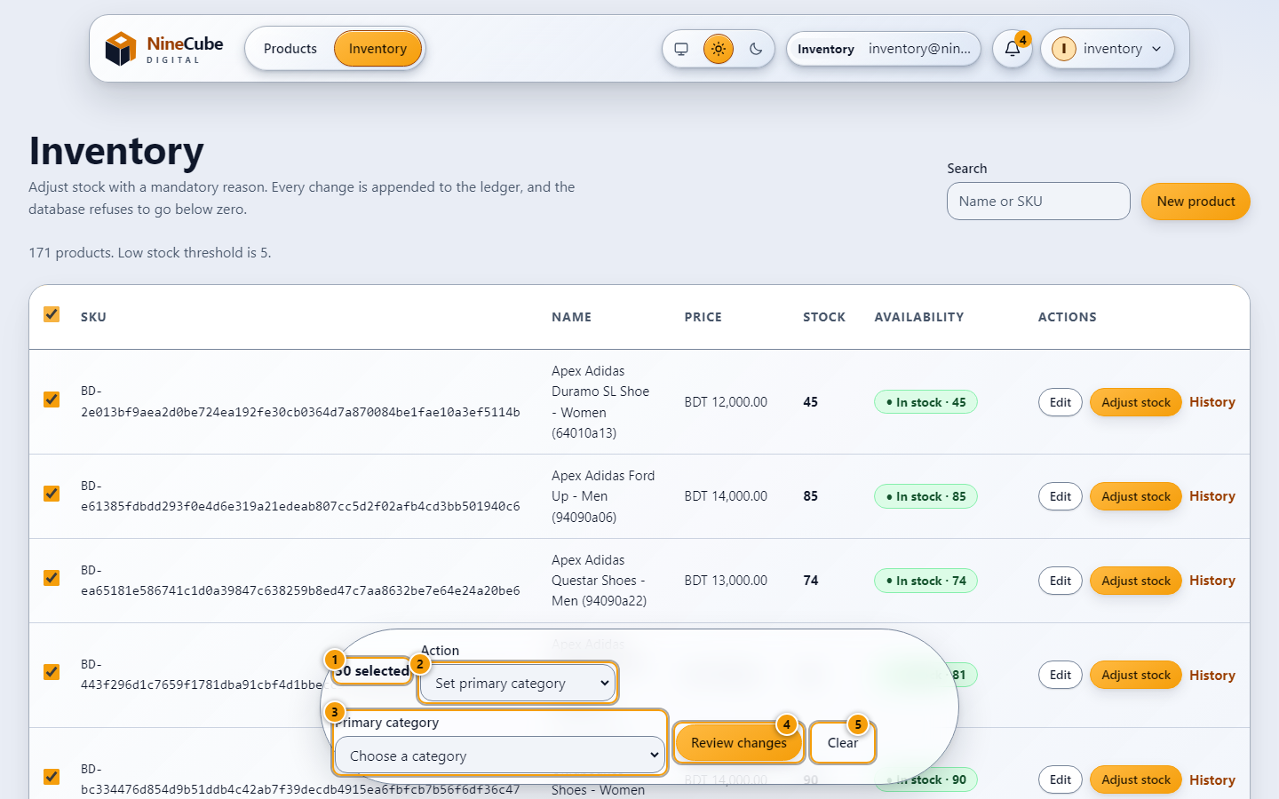
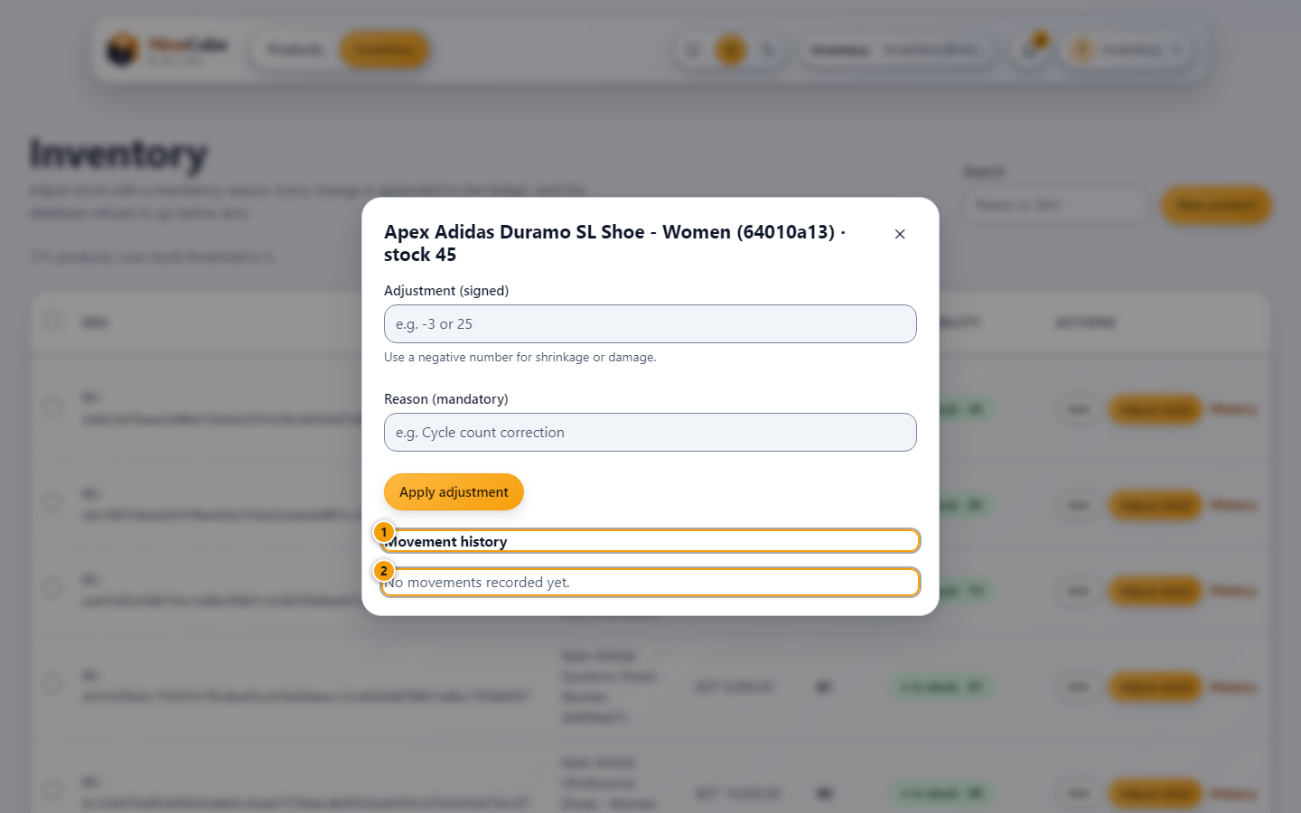
THE INVENTORY SCREENS
Bulk edits that leave stock alone
Bulk editing products: category, tags, brand and active state — stock is not in the list
The movement ledger for one product: every change with its user, reason and balance
USER_MANUAL 4.2-4.3 · inventory-bulk.test.tsx + BulkProductUpdateTests.cs hold the bulk path, StockAdjustmentTests.cs the ledger, and actionable-surfaces.spec.ts checks both in a browser

Slide 15
CATEGORIES · BRANDS · TAGS
A catalogue with a model behind it
• Category hierarchy: unique slug, sibling-name uniqueness, materialized paths, depth 1-4, ordering, activity.
  – One primary category per product, enforced by a filtered SQL Server index — not by convention.
• Brand and series are entities derived from attributed data; nothing is invented to fill a facet.
• Category counts are distinct products with the other active filters applied, so a cross-listed product is counted once.
• Delete needs a reassignment target; children are reparented in the same transaction; a cycle or an excess depth is refused with the reason.
• Order lines snapshot product name and primary category at placement, so a later rename never rewrites an invoice.
•
• None of it can move a stock figure — five category tests and one bulk test assert exactly that.
• Seed data: 183 products priced in BDT, 46 tags and 198 category links in the database today, loaded insert-only so a rerun changes nothing (counted 16 October; SEED_REPORT.md records the pipeline runs).

Slide 16
THE WORKING SCREENS
What each role can actually do
Role | Screens | The rule that matters
Customer | /products · cart · /orders · invoice · /account · /account/profile · /notifications | Stock is reserved at placement, never at add-to-cart. Someone else's record answers 404, not 403.
Sales Manager | /staff queues (to confirm, to ship, invoices & history) · category editor · /staff/sales · bulk order review | Staff move orders; they cannot touch products or stock. A bulk review sends nothing when dismissed.
Inventory Manager | /inventory · new product · edit · images · adjust stock · movement ledger · bulk product edit | Bulk edits cover category, tags, brand and active state — stock keeps its atomic single-product path.
Administrator | /admin users · audit log · settings · read-only orders and invoices | Separation of duties: nobody can both sell and silently restock. The last admin cannot be removed.
Notifications are written where the event happens: placement, status change, a low-stock crossing — once per product, never for a rejection that did not take place.

Slide 17
IMPLEMENTATION
Implementation decisions worth calling out
• Reserve at placement, not at confirmation — the only moment a promise can be kept.
• Every stock change appends to the ledger in the same transaction, with the user and reason.
• Prices are snapshotted onto the order line; the client never sends a price.
• Roles are re-read from the database per request, so a role change or deactivation is immediate.
• Timestamps are UTC with an explicit Z; the SPA renders them in the viewer's time zone.
• Report ranges are local calendar dates converted to inclusive UTC instants at the edges.
• Only a Customer sees ordering controls — the UI never offers an action the API would refuse.
• Anonymous browsing is disabled: live stock is commercial information (recorded as an assumption).

Slide 18
TEST EVIDENCE
Verified results on this machine (16 October)
Suite | Command | Result
Backend — 108 tests, real SQL Server | dotnet test src/NineCube.Tests | 108 passed, 0 failed, 0 skipped (net10.0)
Frontend unit/component — 159 | cd web && npm run test:run | 159 passed in 23 files
Types + production build | npm run typecheck && npm run build | tsc exit 0; per-route code splitting
Browser — Playwright, 23 spec files | npm run e2e (Chromium, live API + live data) | 107 tests: order flow, bulk console, categories, themes, navbar states, surfaces, UI audit
Annotated manual | node scripts/capture-manual.mjs | 28 screens from the live app, every callout located
Live system | /health, 4 role logins, unauthenticated call | Healthy · 200/200/200/200 · 401
Proven, not asserted: stock 1 + two parallel orders → one 201 + one 409; stock 10 + 50 parallel orders → exactly 10 × 201, final stock 0; cancel restores stock exactly once under concurrency.

Slide 19
DELIVERABLES
Documented from the running system
• USER_MANUAL.md — every screen, photographed from a real browser against the real API, role by role. NineCube-User-Manual.docx is the same text laid out for print, with the 28 figures numbered.
  – tools/build_manual_docx.py writes that document from the Markdown, so the two cannot disagree.
  – docs/manual/ — 28 annotated PNGs with numbered callouts drawn over the measured bounding boxes of the actual controls, plus callouts.json.
• web/scripts/capture-manual.mjs regenerates them; a callout whose control is not on screen is reported, so the pictures cannot drift from the words.
• Every behaviour in the manual names the tests that cover it — 108 backend, 159 frontend, 107 browser.
• FIX_REPORT.md records each defect as a measured cause, a fix, and the test that now holds it. README.md §15 states what AI assistance was used and how it was verified.
• Nothing is claimed as tested that was not executed; what could not run here is marked NOT RUN.
• This deck is generated too: tools/build_deck.py draws its tables from the code and its screens from docs/manual/, and a geometry audit refuses a slide whose text will not fit.

Slide 20
ERROR HANDLING
Error handling is part of the contract
Situation | Status | Body
Malformed / invalid payload | 400 | ValidationProblemDetails: one entry per field
No or expired token | 401 | ProblemDetails + WWW-Authenticate
Authenticated, wrong role | 403 | ProblemDetails: forbidden
Unknown product or someone else's order | 404 | ProblemDetails — deliberately not 403, so existence is not leaked
Not enough stock | 409 | ProblemDetails + shortItems[] { productId, requested, available }
Invalid status transition / double restore | 409 | ProblemDetails: invalid state transition
Unexpected failure | 500 | ProblemDetails, correlation id only — no stack trace to the client

Slide 21
SCOPE
Limitations — stated, not hidden
• No payment processing and no payment verification: orders start Pending and Staff confirm them.
• No email/SMS, no delivery tracking, no returns or refunds.
• No rate limiting, no refresh tokens (30-minute access tokens; the SPA keeps them in sessionStorage).
• No caching layer — deliberate on stock-sensitive data.
• No multi-warehouse, multi-currency or tax handling; users are deactivated, never deleted.
• Backups are a documented database procedure (FULL/DIFF/LOG + restore drills), not application code.

Slide 22
ROADMAP
What production would add next
• Payments + verification: hosted payment intent, outbox-backed webhook, PaymentStatus on the order.
• Transactional outbox for notifications and integrations — a mail outage must never roll back an order.
• Refresh tokens in httpOnly cookies with rotation and reuse detection; access tokens down to minutes.
• Reservations with a TTL plus a sweeper, so an abandoned basket releases stock.
• Rate limiting per IP and per account on login, per customer on order placement.
• OpenTelemetry traces SPA → API → SQL; alert on the 409 ratio and p95 placement latency.
• CI/CD: build, tests against a container SQL Server, Playwright smoke, gated migrations as a release stage.
• Secrets in a managed vault with rotation; idempotency-key retention policy.

Slide 23
DEMO
Run it
• API http://127.0.0.1:5080 (Swagger at /swagger) SPA http://127.0.0.1:5173
•
• Demo logins (Development seed; passwords come from NINECUBE_SEED_PASSWORD — no secret is committed):
  – customer@ninecube.demo · staff@ninecube.demo · inventory@ninecube.demo · admin@ninecube.demo
•
• Database: docker compose up -d (SQL Server 2022) or any SQL Server / LocalDB via ConnectionStrings__Default.
• Tests: dotnet test src/NineCube.Tests · cd web && npm run test:run · npm run e2e
• Everything above was executed here; TESTING.md holds the raw output and the database modes, FIX_REPORT.md the defects found and fixed while verifying, USER_MANUAL.md the screens.

