Slide 1


Final Project
Working with Data Using SQL

Slide 2
INTRODUCTION
VivaK is a thriving retail chain in the fashion industry with its head office in Southlake, Texas, USA, and operates seven offices worldwide, with 11 departments at each location and a structured management team. The HR Manager has noted that the current data management system is not robust, and the data is stored in various formats with anomalies, and therefore wanted a team of consultants to devise an Online Analytical Processing (OLAP) database for their HR department.
This presentation includes analyzing provided data, designing a complete MySQL data model, creating a schema, importing and cleaning data, and performing various calculations and updates.
The goal is to provide a well-structured and efficient OLAP database for VivaK's HR department to ensure accurate and consistent data.

Slide 3
TABLE
OF
CONTENTS
Analysis and design of the provided data
Schema Creation
Data import and cleaning
Data Calculation and Update

Slide 4



Analysis and design of the provided data
From the various data/file formats that Vivak has provided, 7 entities were identified, the diagram in the next slide shows the relationship between the entities, as well as the primary keys, foreign keys, and data types from each attribute within each entity.
The symbols in the diagram have the next meaning:
Primary key
Foreign key
Not null value
TC

Slide 5
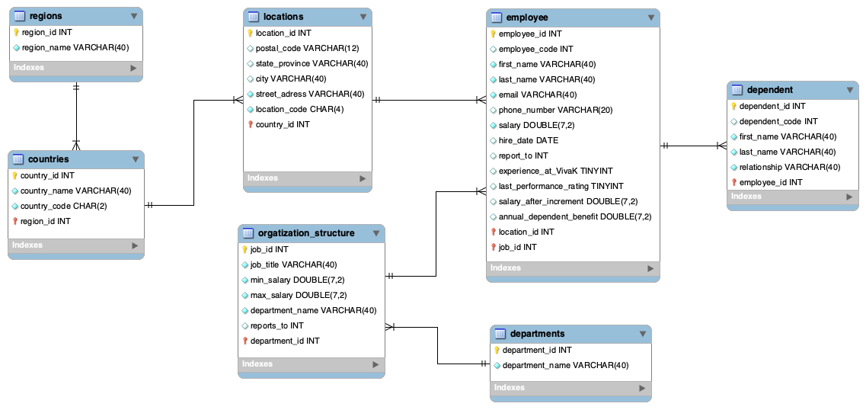

Slide 6

Schema Creation
TC

Slide 7
Regions Table
Location Table
CREATE TABLE `regions` (
`region_id` int NOT NULL AUTO_INCREMENT,
`region_name` varchar(40) NOT NULL,
PRIMARY KEY (`region_id`),
UNIQUE KEY `region_name` (`region_name`)
);
CREATE TABLE `locations` (
`location_id` int NOT NULL AUTO_INCREMENT,
`location_code` char(4) NOT NULL,
`street_address` varchar(40) NOT NULL,
`postal_code` varchar(12) DEFAULT NULL,
`city` varchar(40) NOT NULL,
`state_province` varchar(40) DEFAULT NULL,
`country_id` int NOT NULL,
PRIMARY KEY (`location_id`),
UNIQUE KEY `location_code` (`location_code`),
KEY `country_id` (`country_id`),
CONSTRAINT `locations_ibfk_1` FOREIGN KEY (`country_id`) REFERENCES `countries` (`country_id`)
);
Countries Table
CREATE TABLE `countries` (
`country_id` int NOT NULL AUTO_INCREMENT,
`country_code` char(2) NOT NULL,
`country_name` varchar(40) NOT NULL,
`region_id` int NOT NULL,
PRIMARY KEY (`country_id`),
UNIQUE KEY `country_code` (`country_code`),
UNIQUE KEY `country_name` (`country_name`),
KEY `region_id` (`region_id`),
CONSTRAINT `countries_ibfk_1` FOREIGN KEY (`region_id`) REFERENCES `regions` (`region_id`)
);

Slide 8
Employees Table
Dependents Table
CREATE TABLE `employees` (
`employee_id` int NOT NULL AUTO_INCREMENT, `employee_code` int DEFAULT NULL,
`first_name` varchar(40) NOT NULL, `last_name` varchar(40) NOT NULL,
`email` varchar(40) NOT NULL, `phone_number` varchar(20) DEFAULT NULL,
`salary` double(7,2) NOT NULL, `hire_date` date DEFAULT (curdate()),
`job_id` int NOT NULL, `location_id` int NOT NULL, `report_to` int DEFAULT NULL,
`experience_at_VivaK` tinyint DEFAULT NULL,
`last_performance_rating` tinyint DEFAULT NULL,
`salary_after_increment` double(7,2) DEFAULT NULL,
`annual_dependent_benefit` double(7,2) DEFAULT NULL,
PRIMARY KEY (`employee_id`), UNIQUE KEY `email` (`email`),
KEY `job_id` (`job_id`), KEY `location_id` (`location_id`),
CONSTRAINT `employees_ibfk_1` FOREIGN KEY (`job_id`)
REFERENCES `organization_structure` (`job_id`),
CONSTRAINT `employees_ibfk_2` FOREIGN KEY (`location_id`)
REFERENCES `locations` (`location_id`)
);
CREATE TABLE `dependents` (
`dependent_id` int NOT NULL AUTO_INCREMENT,
`dependent_code` int DEFAULT NULL,
`first_name` varchar(40) NOT NULL,
`last_name` varchar(40) NOT NULL,
`relationship` set('Child','Spouse') NOT NULL,
`employee_id` int NOT NULL,
PRIMARY KEY (`dependent_id`),
KEY `employee_id` (`employee_id`),
CONSTRAINT `dependents_ibfk_1` FOREIGN KEY (`employee_id`) REFERENCES `employees` (`employee_id`)
);

Slide 9
Organization structure Table
Departments Table
CREATE TABLE `organization_structure` (
`job_id` int NOT NULL AUTO_INCREMENT,
`job_title` varchar(40) NOT NULL,
`min_salary` double(7,2) NOT NULL,
`max_salary` double(7,2) NOT NULL,
`department_name` varchar(40) NOT NULL,
`reports_to` int DEFAULT NULL,
`department_id` int NOT NULL,
PRIMARY KEY (`job_id`),
UNIQUE KEY `job_title` (`job_title`),
KEY `department_id` (`department_id`),
CONSTRAINT `organization_structure_ibfk_1` FOREIGN KEY (`department_id`) REFERENCES `departments` (`department_id`)
);
CREATE TABLE `departments` (
`department_id` int NOT NULL AUTO_INCREMENT,
`department_name` varchar(40) NOT NULL,
PRIMARY KEY (`department_id`),
UNIQUE KEY `department_name` (`department_name`)
);

Slide 10

Importing and cleaning the data.
TC

Slide 11
Handle duplicates
Checking for duplicates in the candidate keys of each table using the following code:
CREATE TABLE `dependents` (
`dependent_id` int NOT NULL AUTO_INCREMENT,
`dependent_code` int DEFAULT NULL,
`first_name` varchar(40) NOT NULL,
`last_name` varchar(40) NOT NULL, `relationship` set('Child','Spouse') NOT NULL,
`employee_id` int NOT NULL,
PRIMARY KEY (`dependent_id`),
KEY `employee_id` (`employee_id`),
CONSTRAINT `dependents_ibfk_1` FOREIGN KEY (`employee_id`) REFERENCES `employees` (`employee_id`)
);
select ‘candidate keys’ from ‘Table’ group by ‘candidate keys’ having count(*)>1;
It was found that the dependent_id in the dependent table was duplicated.
We decided to keep the column dependent_id in our schema, but in another column called dependent_code in our schema the column dependent_id will be unique.

Slide 12
Format the data according to the designated data types
Ensure the floating-point data is represented as double.
Validating floating point data as double in salary
CODE:
select count(*) from employees_json where cast(salary as unsigned) <> salary;
Those salaries don't have any floating point value and is already treated as a double column. It doesn’t have to be fixed.

Slide 13
Format the data according to the designated data types
Ensure that the phone numbers are all recorded in the format: ‘+000-000-000-0000’
Step 1. Added new column to store the phone number with the correct format.
CODE:
alter table employees_json add column phone_number_fix varchar(20);
Step 2. Department_id in employees_json should match with the location_id. Updated
department_id according to the number of row.
CODE:
alter table hr.locations add column department_id int;
set @rownum=0;
update hr.locations set department_id = (@rownum:=1 + @rownum);
CODE:
Step 3. Updated phone_number_fix column. Joined ‘employees_json’ table and ‘locations’ table via
‘department_id’.Assigning the respective country code using CASE Expression.
update vivakhr.employees_json e
join hr.locations l using (department_id)
set e.phone_number_fix = concat(
case when l.country_id in ('US','CA') then '+1'
when l.country_id = 'UK' then '+44'
else '+45' end, '-', replace(e.phone_number,'.','-')
)
where e.phone_number is not null and e.phone_number != '';
CODE:

Slide 14
Format the data according to the designated data types
Ensure the dates are recorded in the format: ‘yyyy-mm-dd’
Step1. Validating date format ‘yyyy-mm-dd’.Added new column(‘hire_date_fix’) to store the date with the
correct format.
CODE:
alter table employees_json add column hire_date_fix date;
Step2. Updated hire_date_fix column to the format: ‘yyyy-mm-dd’
update employees_json e
join employees_json e2 using(employee_id)
set e.hire_date_fix = date_format(date(e2.hire_date),'%Y-%m-%d');
CODE:

Slide 15
Treat Missing Values
Fill up the report_to column by analyzing the available data.
CODE:
Found that all rows has missing values in manager_id. We used manager_id column to fill report_to column from the table employees of our schema.
update employees_json e
join orgstructure_csv o using(job_id)
set e.manager_id = 100
where e.job_id <> 1
and o.reports_to = 1;
Only 1 employee whose the job title of president doesn't have to report to anyone.
Step1. Join 'employees_json' table and 'orgstructure_csv' table via 'job_id’. We updated all the employees that report to the president.

Slide 16
Treat Missing Values
Fill up the report_to column by analyzing the available data.
create temporary table temp
select e.employee_id,
(select employee_id from employees_json where job_id=o.Reports_to and department_id=e.department_id) manager_id
from employees_json e
join orgstructure_csv o using(job_id)
where e.job_id <> 1;
Step 2. Created temporary table with employee_id and the manager_id
CODE
update employees_json e
join temp t using(employee_id)
join orgstructure_csv o using(job_id)
set e.manager_id = t.manager_id
where e.job_id <> 1
and o.reports_to > 1;
Step 3. Updated manager_id column from table employees_json
CODE

Slide 17
Treat Missing Values
Strategy to treat the missing values.
Assumption
If an employee go paid more salary, he won't notify the company. But if he got paid less, he will notify the company.
Approach
Filling the missing values in salary according to the min_salary associated to the job of the employees.
Imported organization structure data from a csv file provided by the client, and updated employees with missing values in salary.
CODE:
update employees_json e
join orgstructure_csv o using(job_id)
set e.salary = o.min_salary
where e.salary is null or e.salary = ' ';

Slide 18

Data Calculation and Update
TC

Slide 19
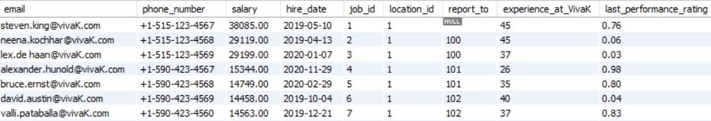
update employees
set experience_at_VivaK = (
SELECT TIMESTAMPDIFF(MONTH, hire_date, CURRENT_DATE())
);
experience_at_VivaK: Time difference (in months) between the hire date and the current date for each employee.
CODE
alter table employees
modify last_performance_rating double(7,2);
update employees
set last_performance_rating = (
SELECT ROUND((RAND() * (1.00-0.00))+0,2)
);
last_performance_rating: Random rating (a decimal number with two decimal points between 0 and 10) for each employee.
CODE
Result

Slide 20
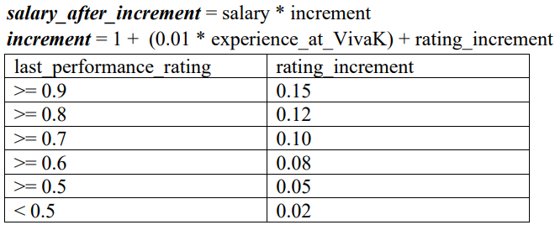
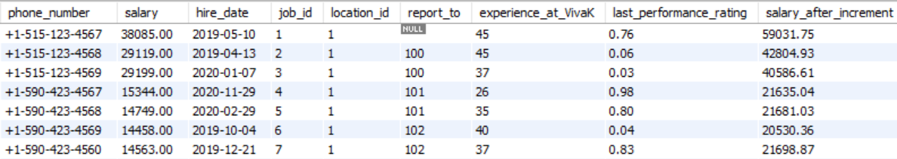
CODE:
salary_after_increment: Salary after the performance appraisal by using the formulas.
update employees
set salary_after_increment = (
select (
salary * (1 + (0.01 * experience_at_VivaK)
+ case when last_performance_rating >= 0.9 then 0.15
when last_performance_rating >= 0.8 then 0.12
when last_performance_rating >= 0.7 then 0.10
when last_performance_rating >= 0.6 then 0.08
when last_performance_rating >= 0.5 then 0.05
else 0.02 end)
)
);
Result

Slide 21
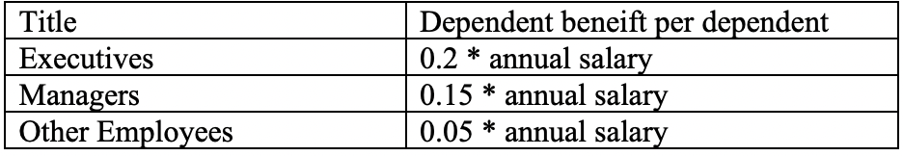
Create temporary table temp
select e.employee_id, e.job_id, (case when o.job_title like '%Manager%' then 'Managers'
when o.department_name like '%Executive%' then 'Executive'
else 'Other Employees' end) title,
(case when o.job_title like '%Manager%' then 0.15
when o.department_name like '%Executive%' then 0.2
else 0.05 end) dependent_benefit,
salary,
salary*12 annual_salary,
count(d.dependent_id) dependent
from employees e
join organization_structure o using(job_id)
left join dependents d using(employee_id)
group by e.employee_id,e.job_id,o.job_title,o.department_name,salary
order by e.job_id;
Calculate the annual dependent benefit per dependent (in USD) and update the column as per the table below:
CODE
Replace employee email addressed to ‘@vivaK.com’.
CODE:
update employees
set email = concat(
substring_index(email,'@',1),
'@vivaK.com'
);
update employees e
join temp t using(employee_id)
set e.annual_dependent_benefit = (
(t.dependent_benefit * t.annual_salary) * t.dependent
);

