Slide 1


FINAL R PROJECT
DIPLOMA IN DATA ANALYTICS CO-OP
Data Handling and Decision Making (10012022-DIP-321-DHDM-G1)

Slide 2
Introduction

Slide 3

BurgundySip is a successful wine cellar/store that promotes high-quality wines from all over the world. BurgundySip management recently decided to use data analytics to streamline their pricing strategy. BurgundySip has provided a data set that has been subjected to a Data analysis process in order to provide and highlight important information that will help to streamline their pricing strategy. The following presentation shows the findings about the data set, the objectives of this analysis as well as the whole process the data has been through since the beginning, to obtain information that must be relevant to develop the most accurate price strategy.

Slide 4
Analytical objectives

Slide 5
Descriptive (statistical) questions
Identify the variables that are correlated using a heatmap​
Identify the main average features of every type of wine​
Identify the relation of the subjective variables with the price​
Perform Winey price discrimination and description​
Compare the relationship between the winery, name, price, and number of testers​
Price difference depending on the variety of wine​
The relationship that the winery can have with price and regions.

Slide 6
Predictive objectives
Identify the variables that have the most impact on the wine price​
Develop at least two analytical predictive modeling approaches to optimize the price strategy of BurgundySip

Slide 7
Cluster-based learning objectives
Identify groups of features that help to predict or define the price of the wine based on the available variables.
Develop three analytical cluster modeling approaches.

Slide 8
Assumptions

Slide 9
The observation “N.V.” on the variables SN and YR will be treated as NA.
The name of the wine could be a character or a group of numbers.
Every serial number SN has duplicates due to the collection of samples of the same batch.
The variety of wine is a descriptive variable that could summarize the main categorical features of the wine.

Slide 10
Data Analysis Process

Slide 11
Data Analysis Process
Analytical
Objectives
Importing Data
Data Sanity checks
Transform
Model
Visualization
Evaluation
Understand the case
Import data set
Check for the structure of the dataset
Transform Variables
Descriptive statistics
Data representation and graph
Verify the objectives were achieved.
Set descriptive
objectives
Perform a variable summary
Rename Variables
Predictive analysis
Set predictive
objectives
Handle missing values
Merge Data
Cluster-based Analysis
Set assumptions
Handle duplicates
Subset variables and observations
Handle ourliers
Notes:
During the analysis process, there are moments when previous steps must be eliminated or changed, and iteratively when insights or alterations are found in the processing of the data set.
There are processes that can be permanent and applicable to several moments of the analytical process, and their place in the graph does not necessarily indicate a single moment such as the visualization process.

Slide 12
Data Sanity Checks

Slide 13
Missing values and duplicates.
The dataset was scanned for NAs by using the summary feature and was found that all the variables except ”NUMR” had missing values while scanning through the data found that the variables RSG, AL, and DN had blank spaces and “NA”s that were strings instead of numerical, so cleaned the data by getting rid of those stringed NAs and blank spaces using GSUB for the three variables. After that was found that there were duplicate entries which further increased the number of NAs present, to treat the duplicates as well aggregating the columns RSG, AL, and DN because even though there were duplicates, there were slight variations in those columns.​
After doing this the categorical variables “NAME”,”WINE”,”REG” and “TP” were grouped according to the top 10 most common wines and the remaining wines were grouped together with the NAs and labelled “OTHER”.​
After doing this the NAs in the numerical variables were replaced using trimmed mean according to each category they fall in, except YR which was replaced with the mean.​
Notes:
To deal with duplicates, it was assumed that there were observations of the same batch of wines with the same serial number, so Mean_AL, Mean_DN and Mean_RSG are the mean of the observations for each serial number, assuming that the batch is the same and that is why there are duplicates.

Slide 14
Outliers​
To treat outliers, was a need to first plot a boxplot to show the variables that had outliers and found that the variables "YR","RT","NUMR","PR","BD","ACD","Mean_RSG","Mean_AL" and "Mean_DN“ contained outliers. To treat the outliers the correlation with both numerical and categorical variables was calculated and checked and then proceeded to replace the outliers with the calculated trimmed mean for each variable.​

Slide 15
Descriptive Analysis and Findings: Data Summarization, Visualization, Statistical Analysis, and Calculations

Slide 16
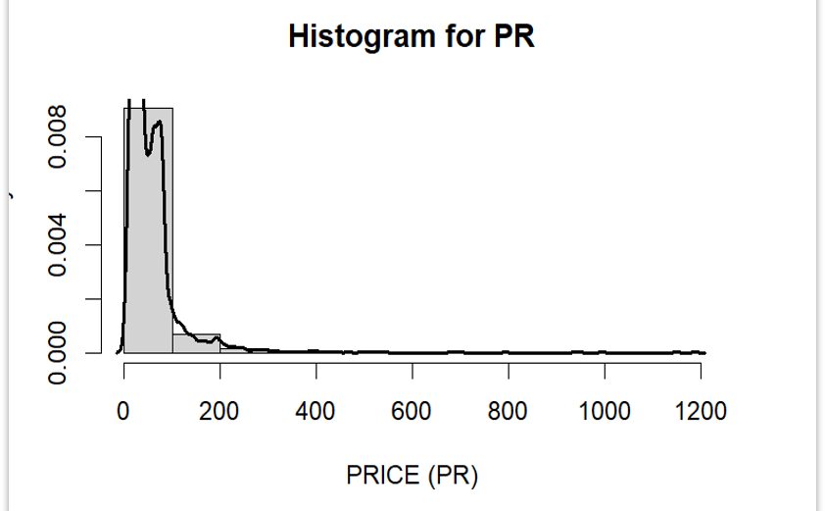
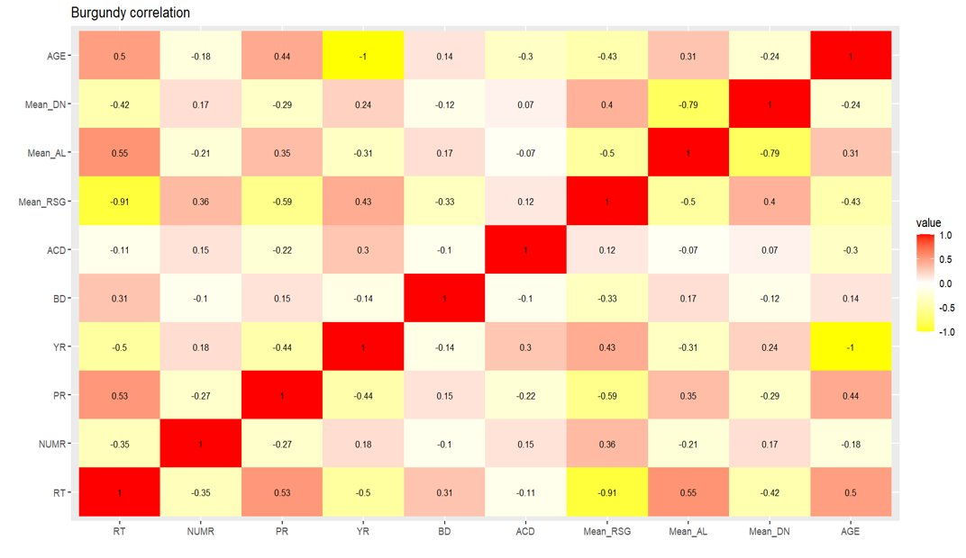
The PR variable (dependent response variable) has a range of 4.99 to 1190, mean of 56.81 and a standard deviation of 69.42.
Based on the heat map correlation the PR variable does not have a strong relationship with any numerical variable.
Notes:
The range of the variable is wide. This means a high dispersion in the value of the data and indicates that the mean is not a good indicator for predicting the price of wine.​
​
The strongest and inversely proportional relationship of the variable PR is with the calculated variable Mean_RSG with a value of -0.59. Which is a moderate correlation.

Slide 17
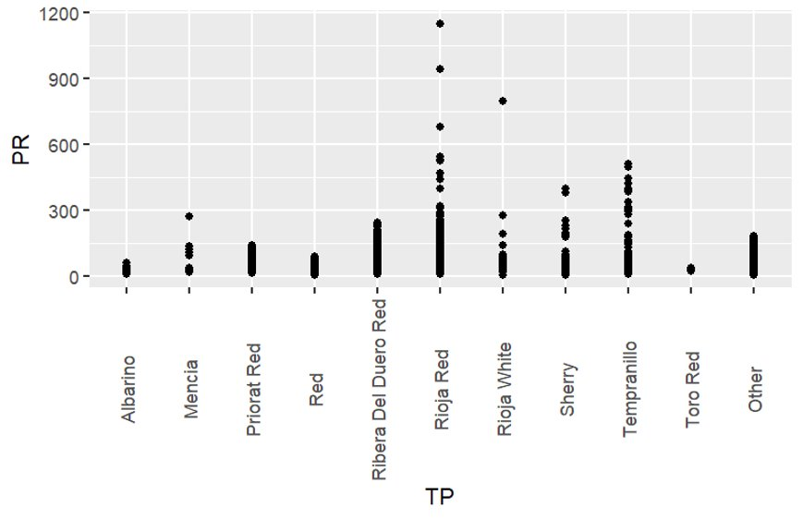
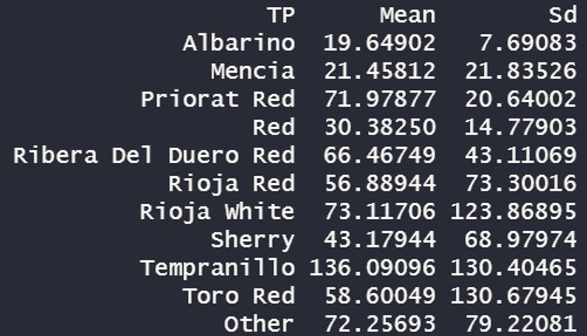
The mean of the price segregated by Wine Variety is different for each factor. This could address the analysis to use a regression model to predict the value of the price of the wine using the TP categories
Notes:
According to the categorical variable TP it can be concluded that the price of wine varies according to the variety and that even within the same variety of wine there is high dispersion in the price value. This may be related to the impact of the responsa variable from other variables in the data frame.

Slide 18
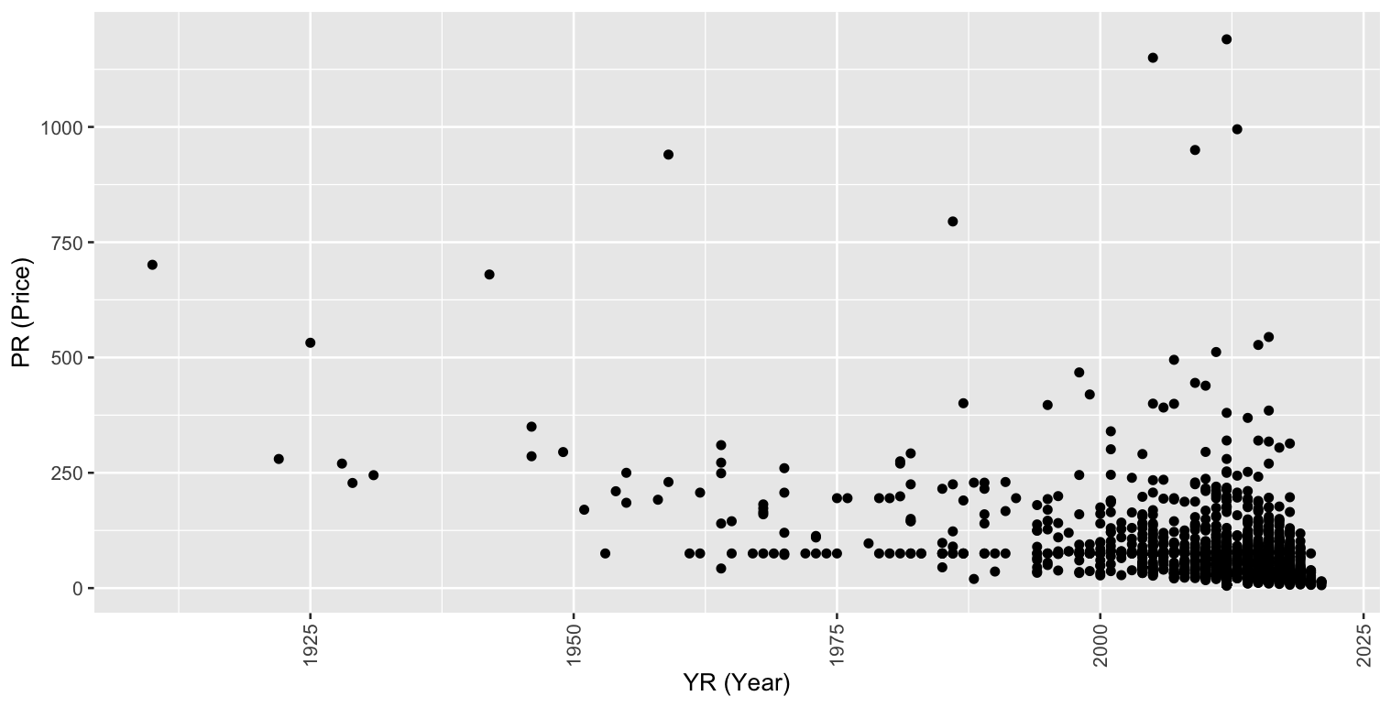
YR(Year) and PR (Price)
To observe the behavior between the independent variable YR (Year) and the dependent variable PR (Price)a plot graph was run, as the chart demonstrates, the distribution of the observations doesn't show a correlation, which means the variable price doesn't get affected by the year. The correlation coefficient between these two variables was -0.44, there's a negative correlation but the coefficient value was not strong enough to prove that the lower the year higher the price. It follows that the Year of the wine doesn't affect its price.

Slide 19
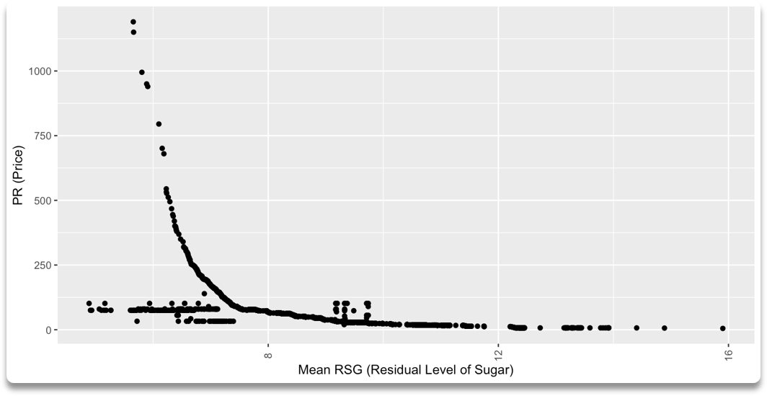
Mean_RSG (Residual Level of sugar) and PR (Price)
The following graph seems to demonstrate a negative relation between RSG(Residual Sugar Level) and PR (Price), which indicates that as the price decrease the residual sugar level increase. To prove if there's a strong relationship between these two variables the cor() function was used to obtain the correlation coefficient, the value was -0.59, this value it's not high enough to accept that there is a strong relationship between this variables. Therefore, it concludes that the price of the wine it's not really affected by the residual sugar lever on it.

Slide 20
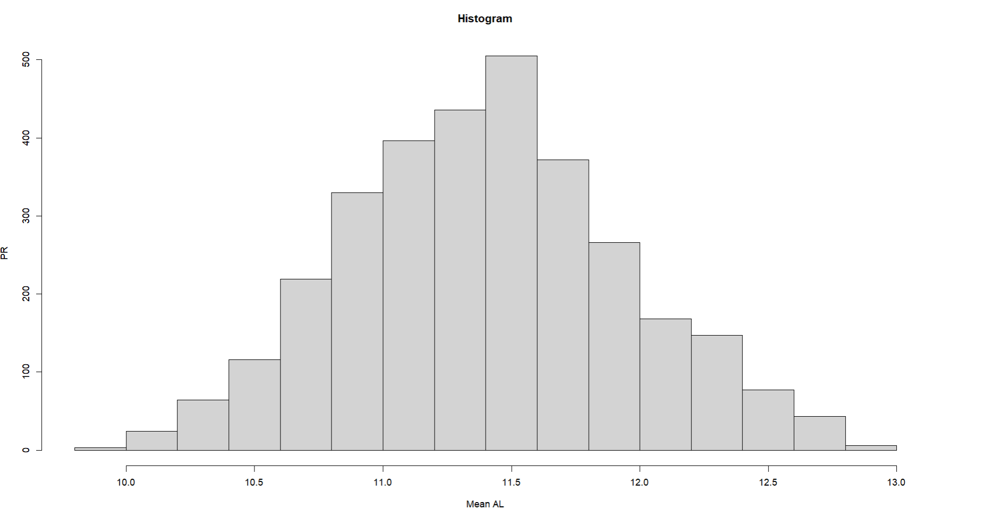
Mean_AL (Alcohol percentage of the wine) and PR (Price)
To show the behavior between the variable Al and the variable PR we have the histogram type graph to symbolize the distribution of the alcohol percentage of the wine.
The average AL is 11.4029 with a minimum of 11.0167 and a maximum of 11.7523 and shows a normal distribution.

Slide 21
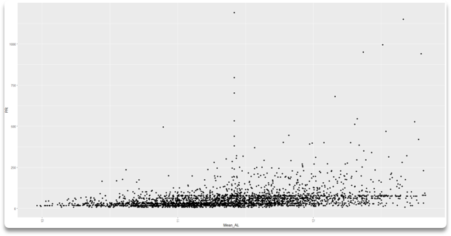
Mean_AL (Alcohol percentage of the wine) and PR (Price)
The values of the variables indicate a positive correlation, which means that the values of both variables tend to increase together.
The correlation is 0.3104696 which means that it is a weak positive linear relationship.
This means that when one variable increases, the other also tends to increase, but in a weak or unreliable way.

Slide 22
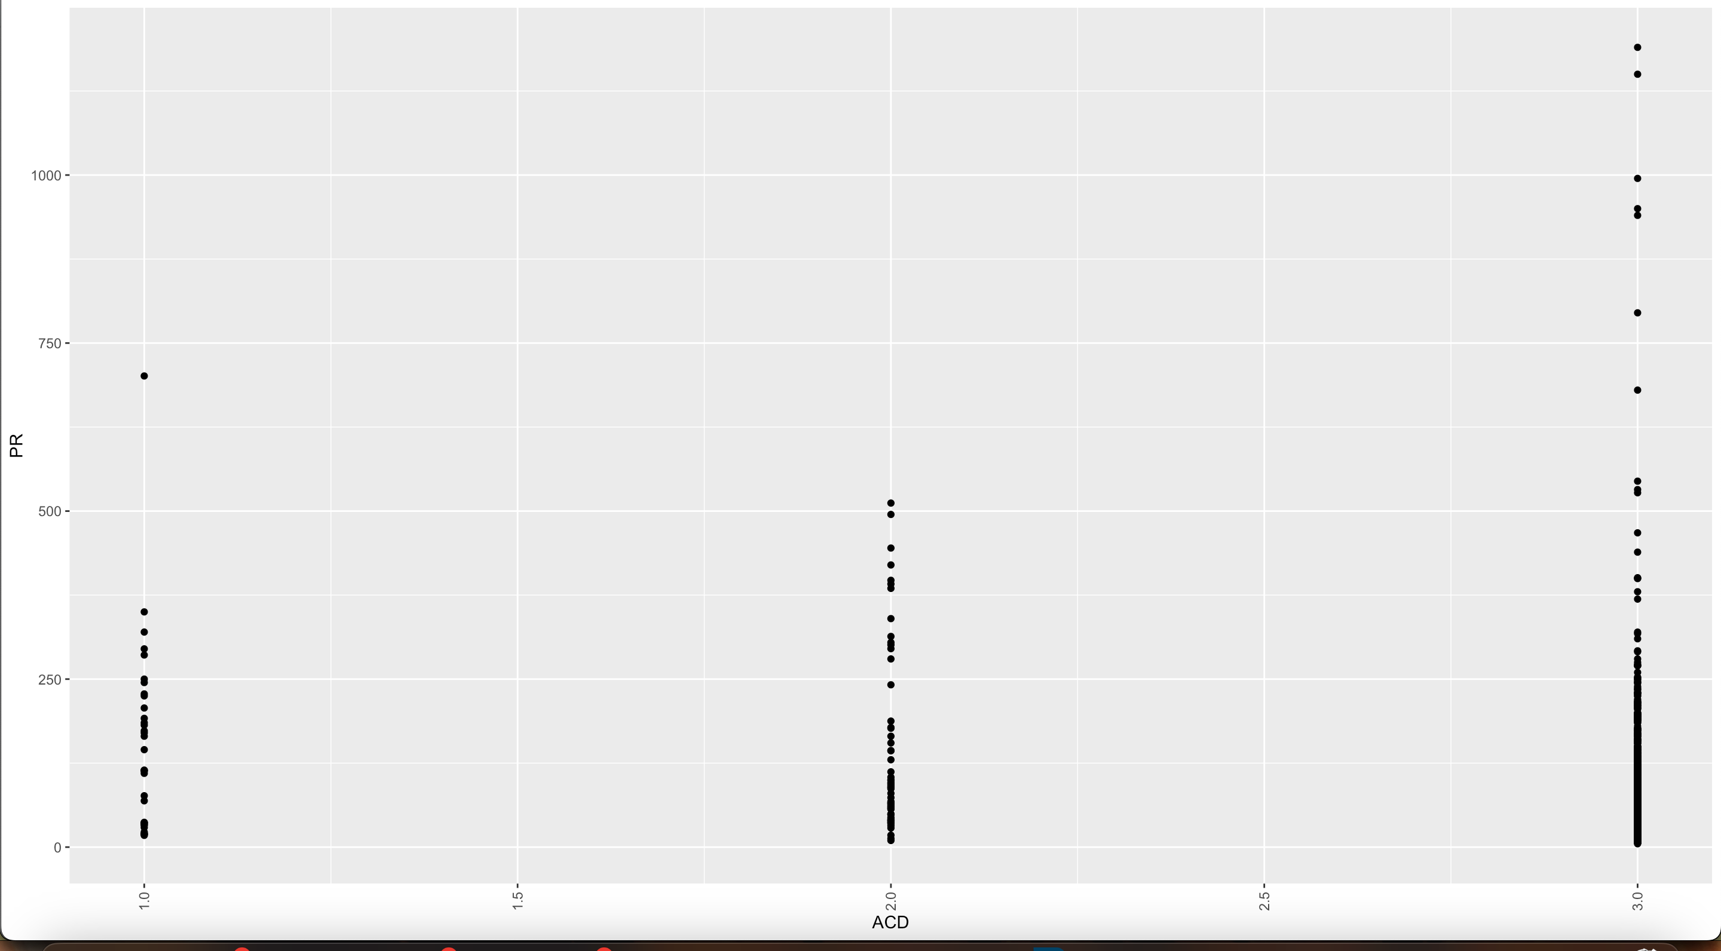
ACD (Acidity score) and PR (Price)
The pattern of the ACD and PR variable relationships is logistic, and it indicates that a logistic regression analysis may be used to predict price, but with a correlation coefficient of –0.22, it indicates that there is not a very strong relationship between price and ACD.

Slide 23
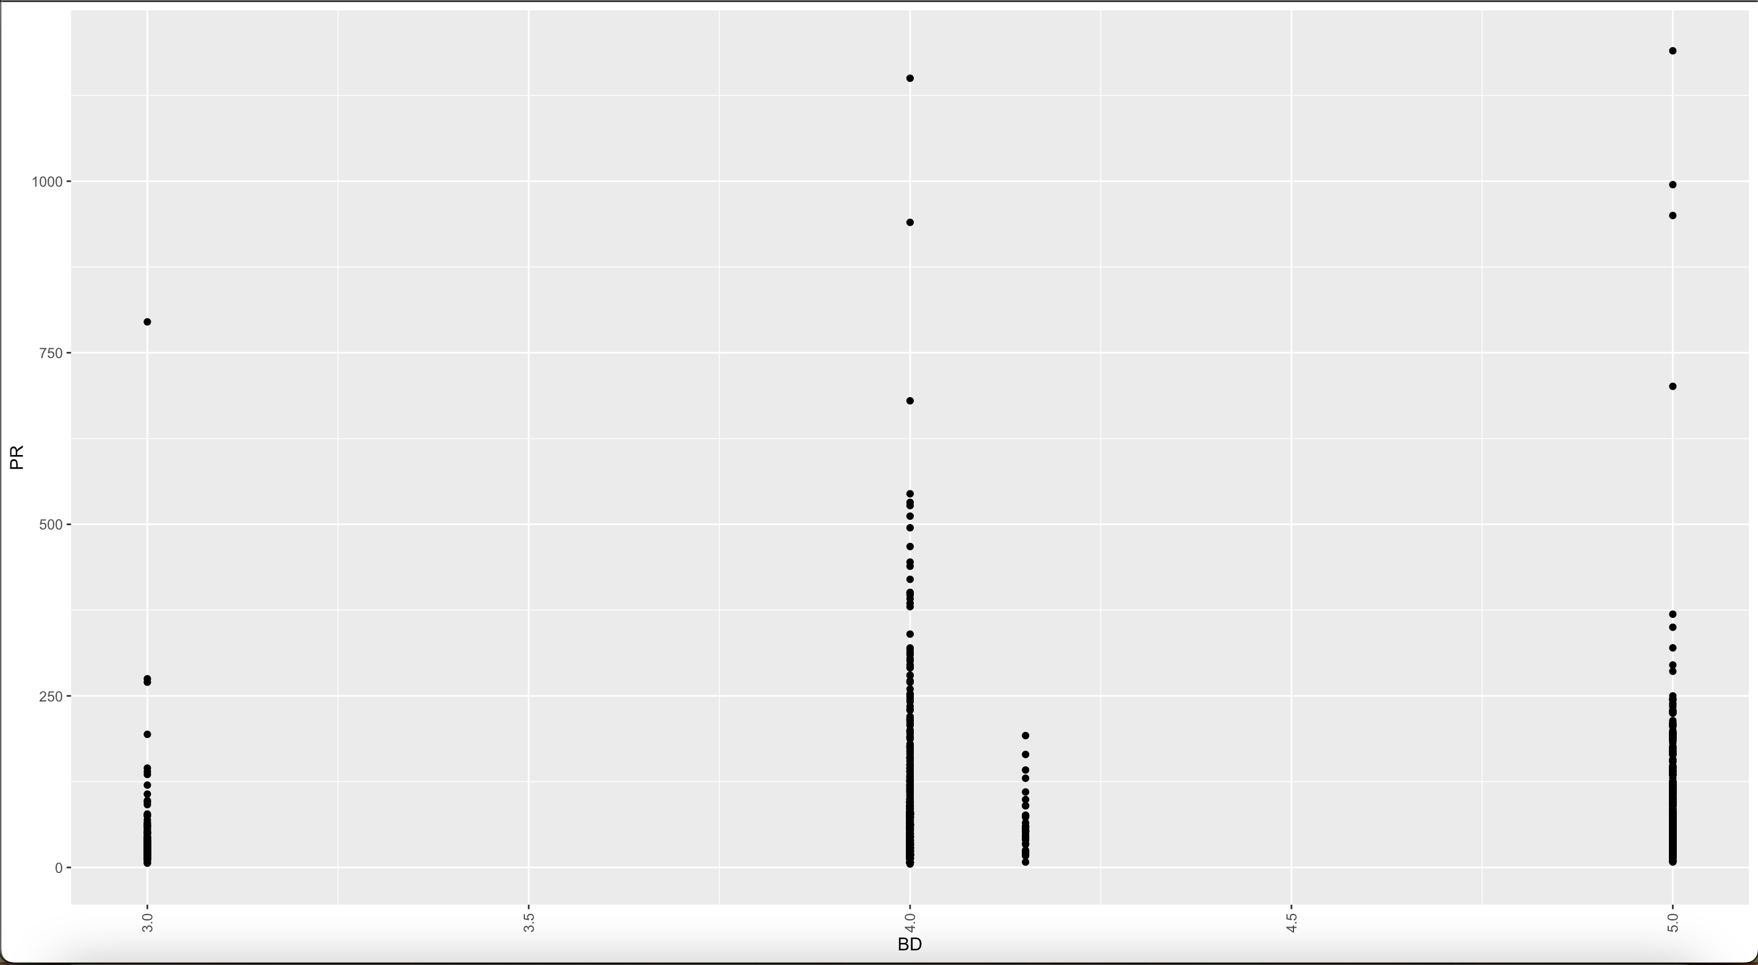
BD (Body Score) and PR (Price)
The relationship between PR and BD also looks logistic, but it has a lower coefficient of –0.14 which implies it does not have a strong effect on price.

Slide 24
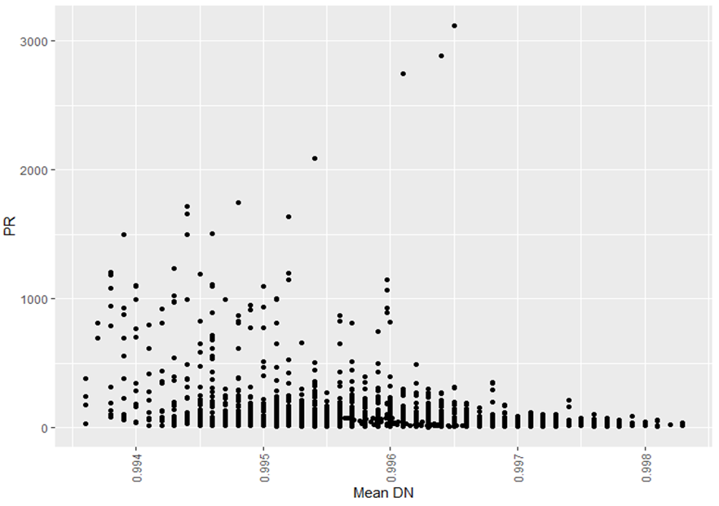
Mean_DN(Density) and PR (Price)
The variable Density doesn´t seem to show a relationship with the price owing to the dispersion of the dots it´s noticeable, to prove that there´s not a strong relationship between these two variables the cor() function was used to obtain the correlation coefficient obtaining a value of -0.29, this value proves that the density of the wine does not affect the price.

Slide 25
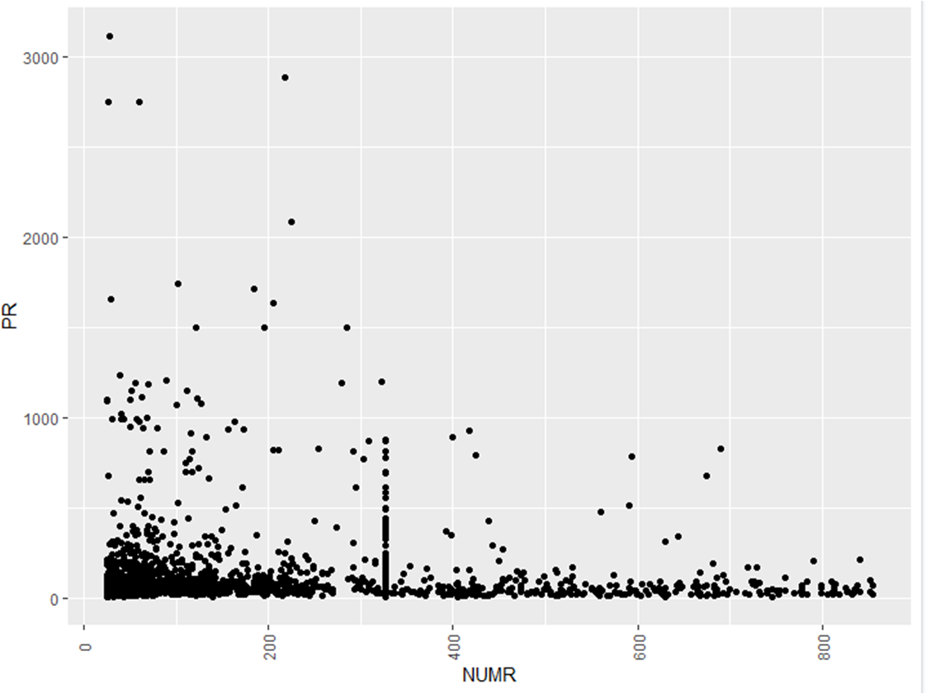
PR (Price) and NUMR (Number of testers that reviewed the wine)
The following chart doesn’t seem to show any relationship with between the variable price and the variable NUMR, to prove that the price of the wine its not affected by the number of tasters of the wine the cor() function was used as result the correlation coefficient was -0.27, proving that the price if the wine its not affected by the number of tasters of it.

Slide 26
Predictive Analysis and Findings

Slide 27
Predictive Analysis
Graphs and plots in the descriptive analysis were used to relate the dependent variable with the independent ones, as well as the correlation indicator to confirm the strength and direction of the relations between the variables
Two linear models and three nonlinear models were proposed to predict the variable PR (Price of the wine).
The best models were defined by the indicator RSE (Residual standard error), where the best model is the one with minimum value.
Also, a value of 80% of the complete data set was used to train the models, and the residual 20% was used to perform and test the predictions.

Slide 28
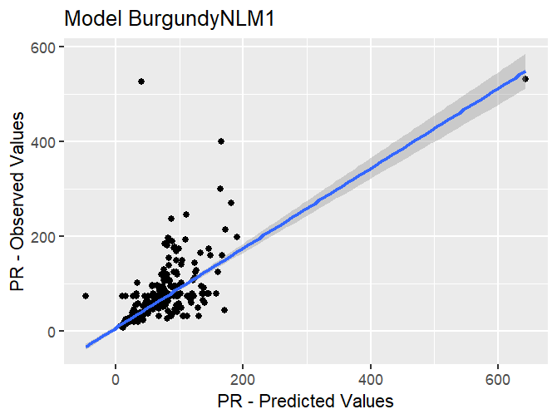
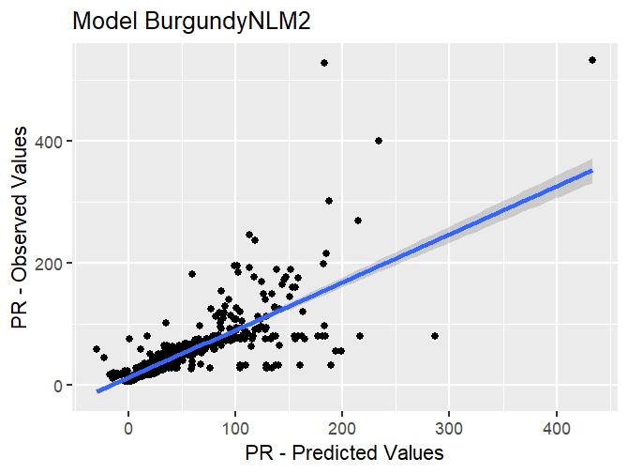
Predictive Analysis
5 linear and nonlinear regression models were performed.
BurgundyLM1 PR~(RT+NUMR+BD+ACD+Mean_RSG+Mean_AL+Mean_DN+AGE)
Residual standard error: 46.85
BurgundyLM2 PR~(RT+NUMR+BD+Mean_RSG+Mean_AL+AGE)
Residual standard error: 46.94
BurgundyNLM1 PR~(RT+NUMR+BD+AGE)
Residual Standard Error: 45.29
BurgundyNLM2 PR~(BD+Mean_RSG+Mean_AL+AGE)
Residual Standard Error: 41.8
BurgundyNLM3 PR~(RT+Mean_RSG+AGE)
Residual Standard Error: 114
Notes:
The two better models are BurgundyNLM1 and BurgundyNLM2.
The variable PR did not describe a strong relationship with any numerical variable, because the value of the higher positive correlation is variable RT with a value of 0.53 and the negative correlation with the calculated variable Mean_RSG with a value of -0.59. Due to this, Seems that the variable PR could be likely better described by categorical variables base on the summarization done in the previous section.

Slide 29
Cluster-Based Analysis and Findings

Slide 30
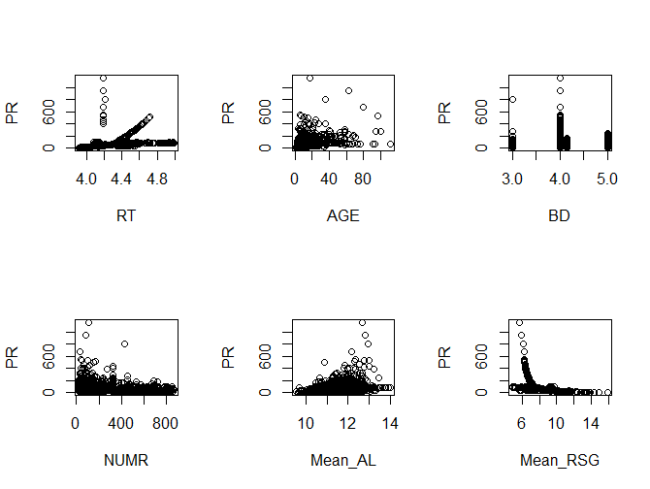
Cluster-Based Analysis
The clustering models help to identify groups or clusters of observations with similar features and to aggregate them.
For this case three different groups of numerical variables were used to perform a cluster analysis process.
The definition of the variables was based on the correlation of the variables with the main dependent variable (PR) and between the other variables present in the dataset.
Also, the scatter-plot graphs were used and helpful in order to identify the possible better options for clustering the variables.

Slide 31
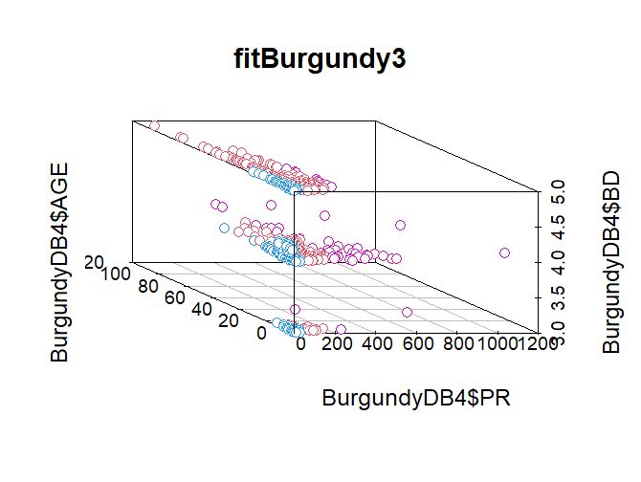
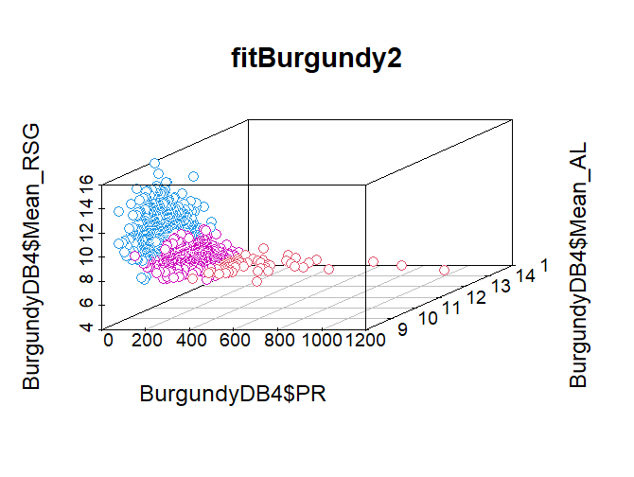
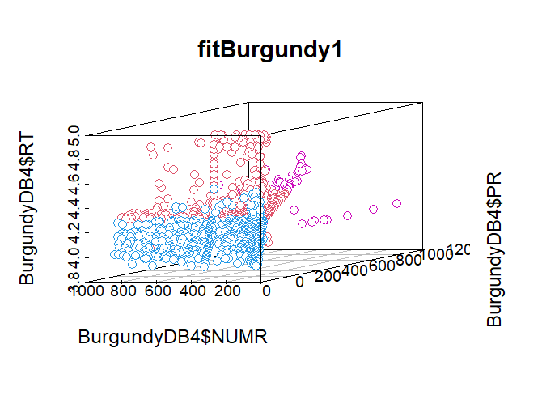
Cluster-Based Analysis
Three cluster models using the K-means approach
fitBurgundy1 <- kmeans(BurgundyDB4[,c("PR","AGE","RT")], 3)
fitBurgundy2 <- kmeans(BurgundyDB4[,c("PR","Mean_AL","Mean_RSG")], 3)
fitBurgundy3 <- kmeans(BurgundyDB4[,c("PR","BD","AGE")], 3)

Slide 32
Click in the link below for complete R CODE
https://github.com/YarazethGarcia/R_code/blob/main/R_code.R

Slide 33
References
Graphical Representation of the Data (no date) 6.6.1.2. graphical representation of the Data. The National Institute of Standards and Technology (NIST). Available at: https://www.itl.nist.gov/div898/handbook/pmc/section6/pmc612.htm (Accessed: December 18, 2022).

