Slide 1
iSLA-2025-(G##)-####-R##-WID.pptx
WI: SLB-mmW Meeting #### SparkLink mmW Channel Model
Date: 2025 Jan 15-16
Source:
Affiliation | Contact | Email
Huawei Technologies. Co. Ltd | Tommi Jamsa | tommi.jamsa@huawei.com

Slide 2
Contents
Motivation
Requirements
Available Channel Models
High-Level Comparison
Proposal

Slide 3
Motivation
Channel model for SparkLink mmW performance evaluation is needed.
Low frequency (below 7 GHz) performance differs from 60 GHz significantly.
Path loss is much higher
Penetration loss is much higher
Reflection loss is almost equal
Diffraction loss is much higher
Scattering depends on the material roughness and size
We compare different models an propose the most suitable one.

Slide 4
Free Space Path Loss
Path loss PL[dB] = 10log(PT/PR)
frequency
distance [log(d)]

Slide 5

Free Space Path Loss and Antenna Aperture
”Friis equation”
Path loss [dB] at a fixed distance
Constant electrical size of TX and RX antenna
Constant physical size of TX or RX antenna
Constant physical size of TX and RX antenna
frequency [log(f)]

Slide 6
Requirements for SparkLink mmW Channel Model
Standardized and Mature (no need to invent the wheel again)
Support SparkLink Use Cases
Propagation Scenarios: [Indoor office, Indoor home, Large hall, Ultra-short range, Open area]
Reasonable Complexity
Support mmW (at least 60 GHz, preferably 10 – 100 GHz)
Support wide bandwidth (up to 2 GHz)
Include path loss, fast fading, and MIMO.

Slide 7
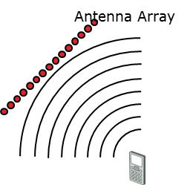
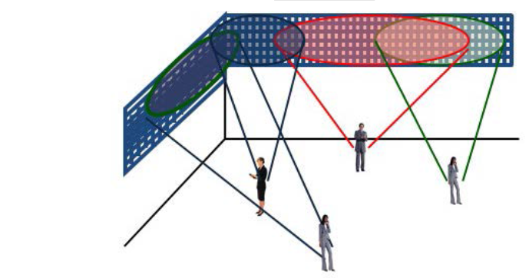

Massive MIMO Challenges
1) Plane wave assumption is not always adequate → spherical wave
2) Spatial Resolution Issue: SCM / WINNER / ITU-R / 3GPP (GSCM) models are not adequate for massive-MIMO. GSCM model approximation is ok for small array but not for large array.
3) For very large arrays, the propagation conditions may be different between two ends of the array.
Source: METIS

Slide 8
Development of MIMO Channel Models
mmW
6G
standard
project
report
standardization
Aerial
IMT-Advanced
ITU
MIMO OTA
3D-MIMO
NTN
SCM
LTE Eval.
LTE-A
D2D
38.901
3GPP
802.11n
802.16m
802.15.3c
802.11ax
IEEE
802.11ac
802.11ad
802.11ay
RCT
802.15 UWB
WiMAX
802.15.3e
COST 259
In-car, Radar, Joint Radar-V2X, ICAS, Sub-THz, etc.
COST 273
COST 2100
COST IC1004
COST IRACON
COST INTERACT
WINNER
WINNER II
WINNER+
METIS
mmMAGIC
SCME
WINNER
D5.4
WINNER II D1.1.2
WINNER+ D5.3
METIS D1.4
2002
2004
2006
2008
2010
2012
2014
2016
2018
2020
2022
2023

Slide 9
Frequency Bands
 |  |  |  |  |  |  |  |  |  |  | ETSI THz
 | 3GPP TR38.901 & ITU-R M.2412-0
 |  | METIS
 | IMT-Advanced (4G)
 |  | SCM(E)
0.3 |  | 1 |  | 3 |  | 10 |  | 30 |  |  | 100 |  | 300
802.15.3d
802.15.3c/e
802.11ay
f [GHz]

Slide 10
mmW Channel Models
Standards
ITU-R IMT-2020
3GPP NR
IEEE 802.11ad
IEEE 802.11ay
IEEE 802.15.3c
ETSI ISG-THz
ETSI ISG-ISAC
Projects
EU: METIS, MiWEBA, mmMAGIC, COST, QuaDRiGA
USA: NYU Wireless, 5G mmWave CM Alliance
China: IMT-2020 5G Promotion Association
Etc.

Slide 11
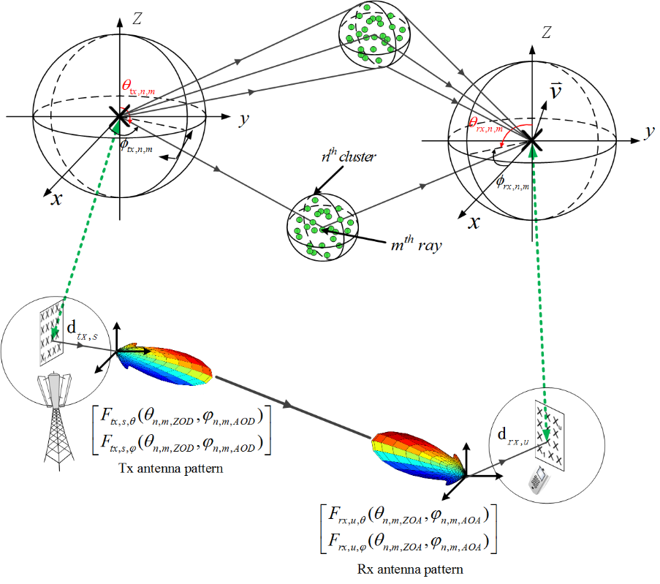
IMT-2020 Channel Model

Slide 12
3GPP Channel Model TR38.901 ” Study on channel model for frequencies from 0.5 to 100 GHz”
TR38.901
NR Channel Model
IIOT
Others
V2X
NTN
Aerial…

Slide 13
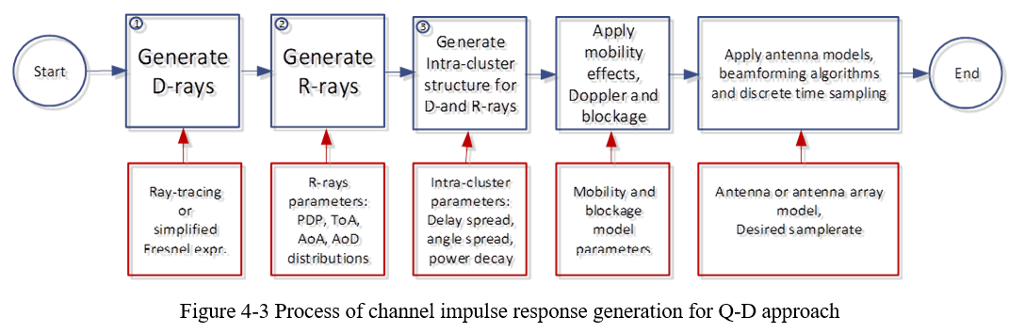
IEEE 802.11ad/ay Model
Designed for 60 GHz band
802.11ad three scenarios
802.11ay much more scenarios, MIMO extension
Quasi-Deterministic Model

Slide 14
Comparison of mmW Channel Models (features)
Feature | IEEE 802.11ad | IEEE 802.11ay | METIS Model |  |  | 3GPP TR 38.901 |  | ITU M.2412
 |  |  | stochastic | map-based hybrid | map-based | stochastic | map-based hybrid | stochastic | map-based hybrid
Parametric Model | no | no | yes | no | no | yes | no | yes | no
Ray Based Model | yes | yes | no | yes | yes | no | yes | no | yes
Support Phased Arrays | yes | yes | yes | yes | yes | yes | yes | yes | yes
Support MIMO | no | yes | yes | yes | yes | yes | yes | yes | yes
Support massive-MIMO | no | yes | limited | yes | yes | yes | yes | yes | yes
Support spherical waves | no | yes | no | no | yes | no | no | no | no
Support extremely large arrays beyond stationarity interval | no | no | idea | no | yes | no | no | no | no
Support dual mobility | no | no | limited | yes | yes | limited | yes | limited | yes
Support Mesh networks | no | no | no | yes | yes | No | yes | No | yes
Support 3D (elevation) | yes | yes | yes | yes | yes | yes | yes | yes | yes
Support mmW | yes | yes | limited | yes | yes | yes | yes | yes | yes
Dynamic modelling | limited | limited | no | no | yes | limited | no | limited | no
Spatial consistency | no | no | limited | yes | yes | partial | yes | partial | yes

Slide 15
Comparison of Channel Models (maturity)
Channel Model | Maturity | Complexity
IEEE 802.11ad | Mature | Medium
IEEE 802.11ay | Mature | Medium
IEEE 802.11bq | Under development | N/A
METIS stochastic | Mature | Medium
METIS map-based hybrid | Medium | High
METIS map-based | Low | Very high
3GPP TR38.901 | Mature | Medium
ITU-R M.2412 | Mature | Medium

Slide 16
Comparison of Channel Models (scenarios)
Channel Model | Scenarios
IEEE 802.11ad | Conference Room, Cubicle Environment, Living Room
IEEE 802.11ay | MIMO extension to 11ad; Open Area Outdoor Hotspot, Outdoor Street Canyon, Large Hotel Lobby, NLOS, Ultra-Short Range, Data center, D2D Communications
METIS | Dense urban, Urban Micro, Urban Macro, Rural, Office, Shopping Mall, Highway, Open Air Festival, Stadium
3GPP TR38.901 | UMi – Street Canyon, UMa, RMa, InO, InF
ITU-R M.2412 | InH, UMa, UMi, RMa

Slide 17
Comparison of mmW Channel Models (key parameters)
Feature | IEEE 802.11ad | IEEE 802.11ay | METIS Model |  |  | 3GPP TR 38.901 |  | ITU M.2412
 |  |  | stochastic | map-based hybrid | map-based | stochastic | map-based hybrid | stochastic | map-based hybrid
Frequency Range (GHz) | 60 – 66 | 60 – 66 | up to 70 GHz |  | up to 100 GHz | 0.5 – 100GHz |  | 0.5 – 100GHz
Bandwidth (MHz) | 2000 | 2000 | 100 MHz < 6 GHz, 1 GHz @ 60 GHz |  | 10 % of the centre frequency | 10 % of the centre frequency, but less than 2 GHz |  | 10 % of the centre frequency, but less than 2 GHz
Range (m) | 10 | 300
Number of Scenarios | 3 | 10 | 3* | 3* | unlimited | 5 | 5 | 4 | 4
* 9 scenarios, but only 3 supports mmW.

Slide 18
Next Steps
Group to decide the channel model
Recommendation
Decision
Slide 18

Slide 19
References
IEEE P802.11 Wireless LANs, Channel Model for 60 GHz WLAN Systems, IEEE 802.11-09/0334r8, May 2010.
IEEE P801.11 Wireless LANs, Channel Models for IEEE 802.11ay, IEEE 802.11-15/1150r9, May 2016.
ITU-R, Guidelines for evaluation of radio interface technologies for IMT-2020, Report ITU-R M.2412-0 (10/2017).
3GPP TSG RAN, Study on channel model for frequencies from 0.5 to 100 GHz (Release 17), 3GPP TR 38.901 V17.1.0 (2023-12).
Y. Koda, R. Ouyang, N. Ohmi, and H. Harada, ”Survey, Taxonomy, and Unification of Standard mmWave Channel Models for WPAN, WLAN, and Cellular Systems in 6G”, pp. 44-52, IEEE Communications Standards Magazine, September 2024.
Slide 19

Slide 20
Thank you

