Slide 1
SI: SLB-mmW Meeting # Beam Management
Date: 2025-01-15
Source:
Affiliation | Contact | Email
Huawei Technologies. Co. Ltd | Dor Chay | dor.chay@huawei.com
Huawei Technologies. Co. Ltd | Xu Li | lixu11@huawei.com

For approval

For discussion
For information



Slide 2
Contents
Motivation
Beam Management Terminology
SparkLink Flows & Beam Management
Opens
Next Steps

Slide 3
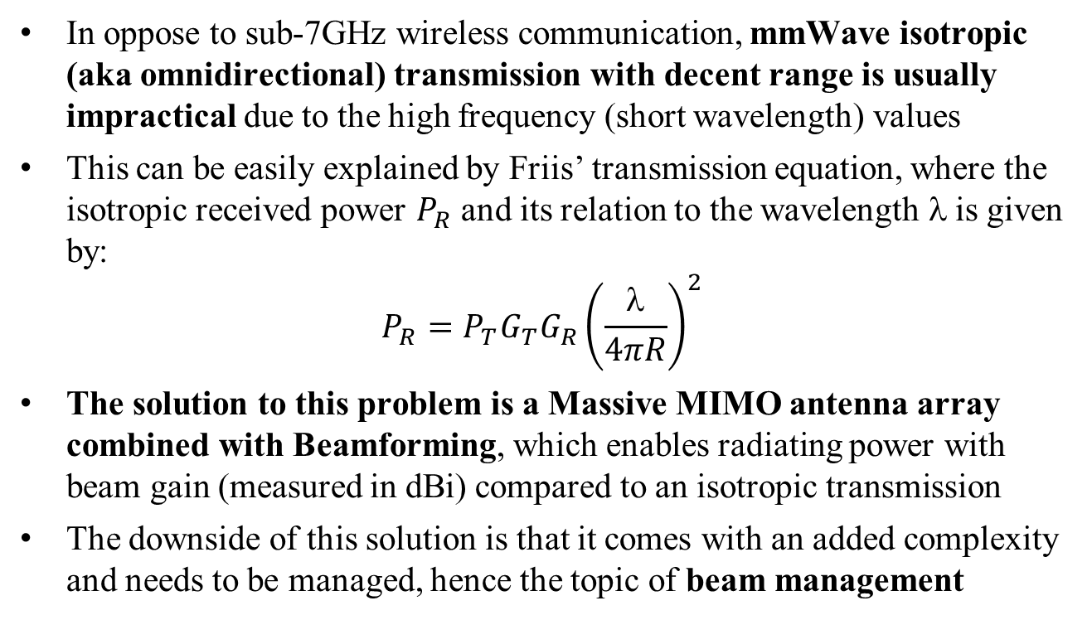
Motivation
In oppose to sub-7GHz wireless communication, mmWave isotropic (aka omnidirectional) transmission with decent range is usually impractical due to the high frequency (short wavelength) values
This can be easily explained by Friis’ transmission equation, where the isotropic received power $P_{R}$ and its relation to the wavelength $$is given by:
$$P_{R}=P_{T}G_{T}G_{R}{\left(\frac{λ}{4πR}\right)}^{2}$$
The solution to this problem is a Massive MIMO antenna array combined with Beamforming, which enables radiating power with beam gain (measured in dBi) compared to an isotropic transmission
The downside of this solution is that it comes with an added complexity and needs to be managed, hence the topic of beam management

Slide 4
Beam Management Terminology

Slide 5
Beam Management vs. Beamforming
Beam management is a set of processes for scanning, reporting, and maintaining of Tx/Rx beams for optimal performance
Beamforming is the transmission of a directional signal, i.e. concentrating the signal energy towards a specific direction
Beamforming can be either analog, digital or hybrid (both)

Slide 6


1. Beam Sweeping
Beam sweeping is the process of scanning several spatial directions with beam transmission or reception
In this technique, the transmitter/receiver simply transmits/receives towards a specific direction at a specific time, and repeats this process until it covers all required directions
All transmissions should be equal in their PHY characteristics (e.g. Tx power) for fair comparison
N-1
N-2
N-3
…
2
1
0

Slide 7
1. Beam Sweeping
As a design goal, this process should consume as little overhead as possible, i.e. the transmitter/receiver should cover as much area with as little time as possible
This means the transmitter may use a limited number of relatively wide beams when latency is in high priority
We divide beam sweeping into 3 procedures:
Procedure 1: G-node & T-node joint beam sweeping
Procedure 2: G-node beam sweeping
Procedure 3: T-node beam sweeping

Slide 8
1. Beam Sweeping
Procedure 1: G-node & T-node joint beam sweeping (Tx & Rx)
N-1
M-1
N-2
M-2
N-3
M-3
…
…
2
2
1
1
0
0

Slide 9
1. Beam Sweeping
Procedure 2: G-node beam sweeping
N-1
N-2
N-3
…
2
1
0

Slide 10
1. Beam Sweeping
Procedure 3: T-node beam sweeping
M-1
M-2
M-3
…
2
1
0

Slide 11
2. Beam Measurement
Beam measurement is a process where the receiver measures the characteristics of a received beamformed signal
Typically this will be performed by the receiver during beam sweeping process by the transmitter
Beam Number
N-1
N-1
N-2
N-2
N-3
N-3
…
…
2
2
1
1
0
0
SNR [dB]

Slide 12
3. Beam Reporting
Beam reporting is a process where the receiver of a beamformed signal reports back information to the transmitter about the signal
Typically the reporting will include Reference Signal Received Power (RSRP) or Signal-to-Noise Ratio (SNR)
The transmitter and receiver should have an agreed signal ID method so the transmitter could match the reporting with specific reference signals (and beam) transmitted

Slide 13
4. Beam Determination
Beam determination is a process where a node selects its operating beams towards a specific receiver or towards a group of receivers
Typically this process should be performed by the G-node after beam reporting from the T-node
Typically the decision will be based on Reference Signal Received Power (RSRP) or Signal-to-Noise Ratio (SNR)
Beam Number
N-1
N-2
N-3
…
2
1
0
SNR [dB]

Slide 14
5. Beam Maintenance (Beam Tracking & Beam Refinement)
Beam maintenance is a process where a G-node and a T-node maintain their optimal selected beams beams by beam refinement in order to adapt to changes (e.g. mobility or blockage) and maintain optimal performance
Beam Tracking is a beam maintenance process where each node tracks his potential Rx/Tx beams for optimal beam selection
Typically it will be done by probing the closest beams (much like rate adaptation)

Slide 15
5. Beam Maintenance (Beam Tracking & Beam Refinement)
Beam Refinement is a process where each node performs narrow beam sweeping, i.e. focus and narrow down its beam so it will be optimal for performance
This, in oppose the beam sweeping performed for initial beam establishment and broadcast which should be fast, hence the beams will be relatively wide (i.e. not optimal for performance)

Slide 16
6. Beam Recovery
Beam recovery (aka beam failure recovery) is a process where a node identifies beam failure and performs the required flow(s) to reacquire a beam
Since mmWave is very susceptible to hand blocking, angular changes etc., this process is likely to occur from time to time
Typically, the beam failure is based on Reference Signal (RS) quality or multiple consecutive misdetections
Once a beam failure is identified, the beam recovery process is initiated
A non-standalone solution assumption will make this process much simpler and faster since we can rely on FB1 for both continuous data service and beam failure report between nodes

Slide 17
7. Beam Correspondence
Beam correspondence is an assumption that a Tx/Rx beam for UL can be selected based on DL indication, and vice versa
This assumption is based on channel reciprocity assumption
The upside of this assumption – it enables reduced beam management overhead
The downside of this assumption – it’s not always accurate and may lead to suboptimal beam selection and performance
We can decide whether to assume beam correspondence or not

Slide 18
SparkLink Flows & Beam Management

Slide 19
1. Association
Broadcast – Theoretically, in this case the transmitter & receiver need to sweep all possible directions.
A non-standalone solution assumption can make this process much simpler and faster since we can rely on FB1 for broadcast
Unicast - For unicast transmissions, the transmitter and receiver need to select an initial beam to work with
The transmitter has no knowledge about the location of the receiver and vice versa
Beam selection is required for both Tx & Rx
The suggested flow is: Beam sweeping by transmitter + beam sweeping by the receiver (procedure 1) → beam measurement by the receiver → beam reporting from receiver to transmitter
The G-node needs to perform this process with each one of its T-nodes at the start of the connection

Slide 20
2. Ongoing Connection
During ongoing connection, both G-node & T-node perform:
Beam Maintenance (including Beam Tracking & Beam Refinement)
Beam Recovery (upon Beam Failure)

Slide 21
Opens
1. Support for low cost solution (1 RF chain)

Slide 22
Next Steps
Close all opens
Continue the study of each beam management process
Adapt the beam sweeping terminology & flows to SparkLink mmWave architecture and framework

Slide 23
Thank you

