Slide 1
SI: SLB-mmW Meeting # Association
Date: 2025-01-15
Source:
Affiliation | Contact | Email
Huawei Technologies. Co. Ltd | Dor Chay | dor.chay@huawei.com

For approval

For discussion
For information



Slide 2
Contents
Motivation
Non-standalone Association - Functional Partition
Power Consumption Considerations
Opens
Next Steps

Slide 3
Motivation
Association (aka initialization/initial attachment/connection setup etc.) is the initial flow required in order to connect a G-node and a T-node
The FB2 mmWave association is expected to be different than that of FB1 due to:
mmWave vs. Sub-7GHz characteristics – mmWave isotropic (aka omnidirectional) transmission with decent range is usually impractical due to the high frequency values
FB1 presence – we can choose to assume a Non-standalone solution and use FB1 connection as an anchor to FB2 association
We would like to define a new fast, secure and efficient association flow that will leverage all of the existing SparkLink specification & implementation
Power consumption is a key consideration in deciding to activate/de-activate the FB2 mmWave link

Slide 4
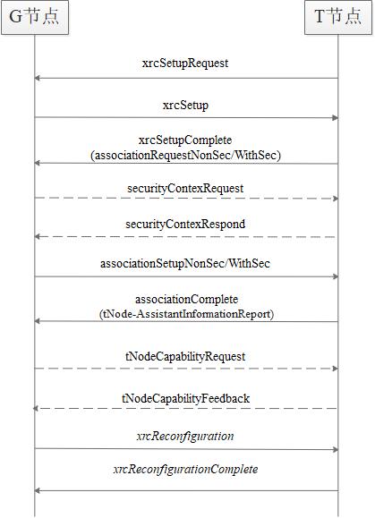
Standalone Association - Existing Flow*
G-node
Physical Radio Channel Synchronization & Random Access Procedure
T-node
Contention Resolution
Association Request
Security & Authentication
Association Response
Association Complete
(Optional) Capabilities Exchange
Logical & physical channel re-configuration
* Contention-based access scenario

Slide 5
Non-standalone Association - Suggested Functional Partition
 | FB1 (Primary) | FB2 (Secondary)
FB1 Physical Radio Channel Synchronization & Random Access Procedure | 
Contention Resolution | 
Association Request | 
Security & Authentication | 
Association Response & Association Complete | 
[Modified] (Optional) Capabilities Exchange [Indicate Basic FB2 Support] | 
Logical & physical channel re-configuration | 
FB1 CONNECTION ESTABLISHED
[New] FB2 Capability Request & Response (FB2 full capabilities exchange) | 
[New] FB2 Physical Radio Channel Synchronization & Random Access Procedure |  | 
[New] Mutual Beam Sweeping & Beam Measurement |  | 
[New] Mutual Beam Reporting | 
FB2 CONNECTION ESTABLISHED

Slide 6
Power Consumption Considerations
Associating and maintaining an additional link in FB2 might result in higher power consumption (the exact numbers are unknown at this point)
As a design goal, we would prefer associating in FB2 only when all the following conditions are true:
# | Condition | Example Criteria | Notes
1 | Additional performance is required in FB1 | PHY Rate, throughput, latency | Additional performance may be required on either G-link or T-link (indicated by Data Volume Reporting or by an explicit Resource Request)
2 | The G-node & T-node can consume the additional power expected in FB2 | Platform Battery %, platform power saving ON/OFF, device thermal state | In some cases the power consumption will be more important than the extra added performance; may require new signaling on the T-link
3 | Additional performance is expected in FB2 | PHY Rate | We would like to estimate it before FB2 association & with minimal power consumption

Slide 7
Power Consumption Considerations
If the FB2 link is already up and running, we should use these conditions to decide whether to de-activate it or not
Example 1 – if we finished using a real-time video service and we don’t need the extra performance, we can de-activate FB2 and stay with FB1
Example 2 – if the device thermal state forces us to reduce the device temperature, then we would prefer de-activating FB2
Conditions logic summary:
De-activate → activate: all of the conditions are true (AND)
Activate → de-activate: one or more of the conditions is false (OR)

Slide 8
Opens
1. Non-standalone: range in FB1 vs. range in FB2
We would prefer not to start an association in FB2 (or even power up the radio) if we don’t have enough link margin. Can we do a basic PHY characterization for realizing the estimated FB2 RSRP as a function of FB1 RSRP (taking into account the initial beam selection gain at FB2)?

Slide 9
Next Steps
Close all opens
Continue the study of each association step
Suggest actual criteria for power consumption considerations
Suggest additional protocol signaling required to support dual-connectivity association

Slide 10
Thank you

