Slide 1
SparkLink Tutorial Synchronized Low-latency Broadband (SLB) 1.0bis
2025/1/15

Slide 2
Table of Content
1. SLB 1.0 bis Feature summary
2. SLB 1.0 bis Feature
Numerology, time domain / frequency domain
Synchronization / MIB / SIB
FISA and Multi-domain Synchronization
Access process
Data transmission (self-contain, GCI, two-stage HARQ feedback)
Flexible Bandwidth
Enhanced Polar Codec and MCS design
Enterprise level Security
HARQ = Hybrid Automatic Repeat Request

Slide 3
SLB 1.0 bis Feature at-a-glance
SLB 1.0 bis
Coverage expansion：km-level
Low latency：SLA E2E ~1ms
Anti-interference：3D-FISA
High concurrency：multicast and flexible topology
High data rate：flexible duplex / bandwidth, multi-band / multi-component carrier
Versatile：communication + positioning + Sensing
High security：ZUC256, enterprise level security
Notes:
T1 -→ G1 G2-→T2
T1和T2距离很近
连续发送
非连续发送
RTS， CTS

Slide 4
SLB 1.0 bis：Numerology，time / frequency domain
SLB 1.0 symbol design
CP
14Ts = 0.4557μs
OFDM Symbol
64Ts Symbol = 1.7204μs
SLB Coverage Enhance Symbol
CP
64Ts=2.0833μs
OFDM Symbol
256Ts Symbol = 8.332μs
An example of wireless frame time domain configuration, 120kHz subcarrier space, 12 symbols
SLB 1.0 bis wireless frame design：
Cyclic prefix length 64Ts=2.083μs，OFDM symbol length 256Ts=8.332μs，CP-OFDM symbol length 320Ts=10.417μs
CP-OFDM symbol per frame: 12，frame length 3840Ts*12=3840Ts，6 times of SLB 1.0 wireless frame length
Support G-Link before T-Link, T-Link before G-Link, and hybrid G/T Link. A S/R transition GAP between continuous G/T symbols
64Ts
G/T/GAP1
64Ts
G/T/GAP1
64Ts
G/T/GAP1
64Ts
G/T/GAP1
64Ts
G/T/GAP1
64Ts
G/T/GAP1
64Ts
G/T/GAP1
64Ts
G/T/GAP1
64Ts
G/T/GAP1
64Ts
G/T/GAP1
64Ts
G/T/GAP1
64Ts
G/T/GAP2
20.833μs wireless frame，480kHz subcarrier space
SLB 1.0 wireless frame design：
wireless frame length 640Ts=1/(48KHz)=20.833μs, R/S transition GAP 47Ts=1.5299μs, CP-OFDM symbols per frame: 7
Cyclic prefix length 14Ts=0.4557μs，OFDM symbol length 64Ts=1.7204μs，CP-OFDM symbol length 78Ts=2.5391μs
Support G-Link before T-Link and T-Link before G-Link. 12 frame type. 1st and 2nd GAP is between G/T symbols
The symbols of the first link in the wireless frame is used as the system overhead symbols
14Ts
Symbol #0，G Symbol
14Ts
Symbol #0，G Symbol
14Ts
Symbol #0，G Symbol
14Ts
Symbol #0，G Symbol
1st GAP
14Ts
Symbol #0，T Symbol
14Ts
Symbol #0，T Symbol
14Ts
Symbol #0，T Symbol
2nd GAP
G-link
T-link
14Ts
Symbol #0，G Symbol
14Ts
Symbol #0，G Symbol
14Ts
Symbol #0，G Symbol
14Ts
Symbol #0，G Symbol
1st GAP
14Ts
Symbol #0，T Symbol
14Ts
Symbol #0，T Symbol
14Ts
Symbol #0，T Symbol
2nd GAP
T-link
G-link
Notes:
T1 -→ G1 G2-→T2
T1和T2距离很近
连续发送
非连续发送
RTS， CTS

Slide 5
SLB 1.0 enhancement: Numerology, time domain frame design, 120kHz sub-carrier space
0.5ms
0.5ms
①
G | G | G | G | G | G | … | G | G | GAP1 | T | GAP1
G | G | G | G | G | G | … | G | G | GAP1 | T | GAP1
②
G | G | GAP1 | T | T | T | … | T | T | T | T | GAP1
G | G | GAP1 | T | T | T | … | T | T | T | T | GAP1
③
G | G | G | G | G | G | … | G | G | G | G | G
G | G | G | G | G | G | … | G | G | GAP1 | T | GAP1
④
T | T | T | T | T | T | … | T | T | T | T | T
T | T | T | T | T | T | … | T | T | T | T | GAP1
Based on SLB 1.0 480kHz subcarrier spacing, proportionally reduced subcarrier spacing to 120kHz, extended symbol lengths and CP lengths
½ Super frame Symbol Number | Common Cyclic prefix | Common CP-OFDM Symbol GAP 1 | Edge Cyclic prefix | Edge CP-OFDM Symbol
56 | 18Ts，0.586μs | 274Ts，8.919μs | 34Ts，1.107μs | 290Ts，9.440μs
52 | 39Ts，1.270μs | 295Ts，9.603μs | 59Ts，1.921μs | 315Ts，10.254μs
48 | 64Ts，2.083μs | 320Ts，10.417μs | 64Ts，2.083μs | 320Ts，10.417μs
44 | 93Ts，3.027μs | 349Ts，11.361μs | 97Ts，3.158μs | 353Ts，11.491μs
Wireless frames are aligned according to 0.5ms to ensure multi-node time domain/frequency domain synchronisation in dense deployment scenarios.
Support flexible configuration of G and T-symbol in the wireless frame.
Support unidirectional G-symbol.
Support unidirectional T symbols.
Support scaling of subcarrier interval, symbol length, radio frame length, etc., and support wider and narrower bandwidth.
Notes:
增加一页，子载波变化前后的说明.
拉长竖线
给出帧结构中，控制信息和数据信息的示意图
低时延场景配置
短距数传配置
广覆盖场景配置
扩展覆盖时，典型配置，包括接入时的配置
保留特性的情况下，新增哪些特性
Wifi6开销（CP在OFDM符号中的占比）： CP长度，0.8，开销 0.941 CP长度，1.6，开销 0.889
CP长度，3.2，开销 0.800
增加UE category和UE capability
第一通过法规
第二灵活双功和灵活带宽
第三增加UE category和UE capability
第四移动性管理和增强

Slide 6
SLB 1.0 bis：Carrier Configuration, 20/40/60/80MHz @ 2.4GHz
120KHz
120KHz
120KHz
120KHz
ScG#0
ScG#1
ScG#...
ScG#...
ScG#7
ScG#8
ScG#...
ScG#...
ScG#14
ScG#15
ScG#0
ScG#1
ScG#...
ScG#...
ScG#7
ScG#8
ScG#...
ScG#...
ScG#14
ScG#15
ScG#0
ScG#1
ScG#...
ScG#...
ScG#7
ScG#8
ScG#...
ScG#...
ScG#14
ScG#15
ScG#0
ScG#1
ScG#...
ScG#...
ScG#7
ScG#8
ScG#...
ScG#...
ScG#14
ScG#15
20MHz x 4
460KHz
600KHz
600KHz
600KHz
460KHz
Null subcarrier/DC subcarrier
+10.120MHz
Null subcarrier/DC subcarrier
+30.040MHz
Null subcarrier/DC subcarrier
+49.960MHz
Null subcarrier/DC subcarrier
+69.880MHz
ScG#0
ScG#1
ScG#...
ScG#...
ScG#7
ScG#8
ScG#...
ScG#...
ScG#14
120KHz
120KHz
ScG#15
ScG#16
ScG#17
ScG#...
ScG#...
ScG#23
ScG#24
ScG#...
ScG#...
ScG#30
ScG#31
ScG#0
ScG#1
ScG#...
ScG#...
ScG#7
ScG#8
ScG#...
ScG#...
ScG#14
ScG#15
ScG#16
ScG#17
ScG#...
ScG#...
ScG#23
ScG#24
ScG#...
ScG#...
ScG#30
ScG#31
40MHz x 3
460KHz
Null subcarrier/DC subcarrier
+20.080MHz
600KHz
Null subcarrier/DC subcarrier
+59.920MHz
460KHz
ScG#0
ScG#1
ScG#...
ScG#...
ScG#7
ScG#8
ScG#...
ScG#...
ScG#14
ScG#15
ScG#16
ScG#17
ScG#...
ScG#...
ScG#23
ScG#24
ScG#...
ScG#...
ScG#30
ScG#31
ScG#32
ScG#33
ScG#...
ScG#...
ScG#39
ScG#40
ScG#...
ScG#...
ScG#46
ScG#47
ScG#0
ScG#1
ScG#...
ScG#...
ScG#7
ScG#8
ScG#...
ScG#...
ScG#14
ScG#15
60MHz x 2
460KHz
Null subcarrier/DC subcarrier
+30.040MHz
600KHz
Null subcarrier/DC subcarrier
+69.880MHz
460KHz
ScG#0
ScG#1
ScG#...
ScG#...
ScG#7
ScG#8
ScG#...
ScG#...
ScG#14
ScG#15
ScG#16
ScG#17
ScG#...
ScG#...
ScG#23
ScG#24
ScG#...
ScG#...
ScG#30
120KHz
ScG#31
ScG#32
ScG#33
ScG#...
ScG#...
ScG#39
ScG#40
ScG#...
ScG#...
ScG#46
ScG#47
ScG#48
ScG#49
ScG#...
ScG#...
ScG#55
ScG#56
ScG#...
ScG#...
ScG#62
ScG#63
80MHz x 1
460KHz
Null subcarrier/DC subcarrier
+40.000MHz
460KHz
ScG: Sub-carriers Group
Notes:
结论：
161一个20
20之间5个子载波
一个子载波组16
存在1个空子载波，5个空子载波
2.4GHz，20MHz*4， 80MHz*1

Slide 7
SLB 1.0 bis：20/40/80/100/120/160/200MHz @ 5150-5350MHz
700KHz
Sub-carrier space：120KHz
700KHz
20MHz
No. of S-c: 161
Center sub-carrier
10.360 MHz
20MHz
No. of S-c: 161
Center sub-carrier
30.280 MHz
20MHz
No. of S-c: 161
Center sub-carrier
50.200 MHz
20MHz
No. of S-c: 161
Center sub-carrier
70.120 MHz
20MHz
No. of S-c: 161
Center sub-carrier
90.040 MHz
20MHz
No. of S-c: 161
Center sub-carrier
109.960 MHz
20MHz
No. of S-c: 161
Center sub-carrier
129.880 MHz
20MHz
No. of S-c: 161
Center sub-carrier
149.800 MHz
20MHz
No. of S-c: 161
Center sub-carrier
169.720 MHz
20MHz
No. of S-c: 161
Center sub-carrier
189.640 MHz
80MHz
No. of S-c: 659，Center sub-carrier: 40.240 MHz
80MHz
No. of S-c: 659，Center sub-carrier: 119.920 MHz
80MHz
No. of S-c: 659，Center sub-carrier: 60.160 MHz
80MHz
No. of S-c: 659 ，Center sub-carrier: 139.840 MHz
80MHz
No. of S-c: 659，Center sub-carrier: 80.080 MHz
80MHz
No. of S-c: 659，Center sub-carrier: 159.760 MHz
100MHz
No. of S-c: 825，Center sub-carrier: 50.200 MHz
100MHz
No. of S-c: 825，Center sub-carrier: 149.800 MHz
120MHz
No. of S-c: 991，Center sub-carrier: 60.160 MHz
120MHz
No. of S-c: 991，Center sub-carrier: 100.000 MHz
120MHz
No. of S-c: 991，Center sub-carrier: 139.840 MHz
160MHz
No. of S-c: 1323，Center sub-carrier: 80.080 MHz
160MHz
No. of S-c: 1321，Center sub-carrier: 119.920 MHz
200MHz
No. of S-c: 1655，Center sub-carrier: 100.000 MHz
Notes:
161单载波
5子载波做gap
16子载波一个子载波组
信道资源shifting

Slide 8
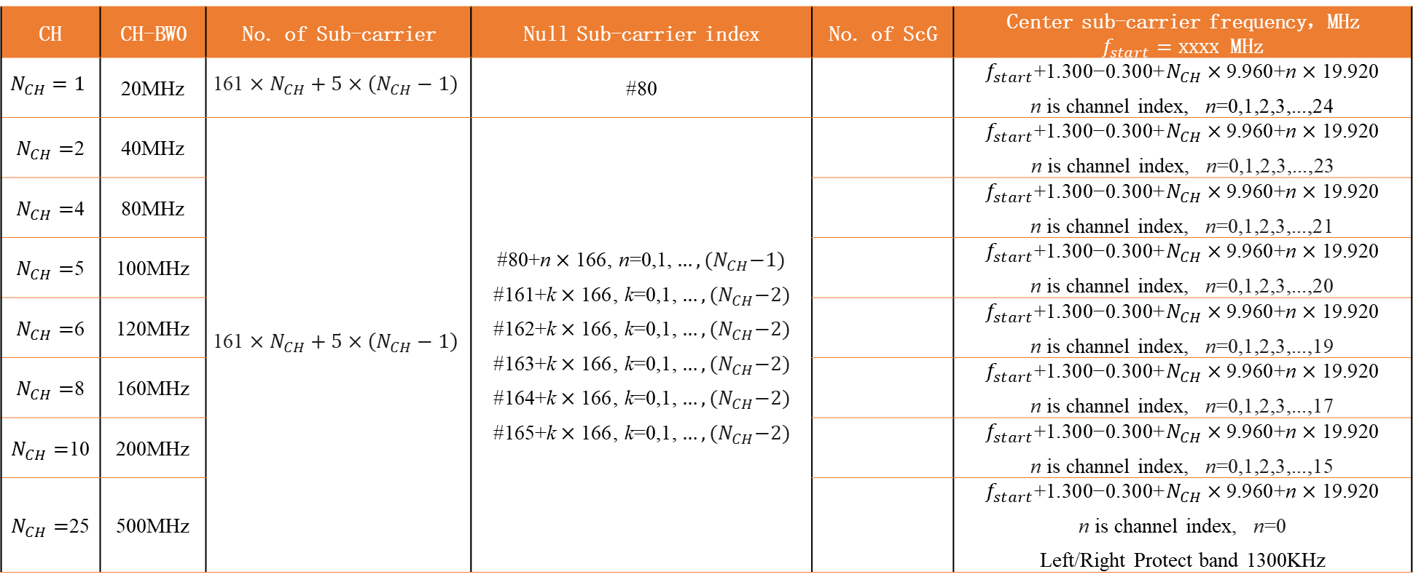
SLB 1.0 bis：20/40/80/100/120/160/200MHz/500MHz@L6GHz
Sub-Carrier Space：120KHz
CH | CH-BW0 | No. of Sub-carrier | Null Sub-carrier index | No. of ScG | Center sub-carrier frequency，MHz $f_{start}=xxxx$ MHz
$$N_{CH}=1$$ | 20MHz | $$\text{161}×N_{CH}+5×\left(N_{CH}−1\right)$$ | #80 |  | $$f_{start}\text{+}\text{1.300−0.300+}N_{CH}×\text{9.960}\text{+}\text{n}×\text{19.920}$$ $\text{n}$ is channel index, $\text{n}\text{=0,1,2,3,...,24}$
$N_{CH}=$2 | 40MHz | $$\text{161}×N_{CH}+5×\left(N_{CH}−1\right)$$ | #80+$\text{n}×\text{166}$, $\text{n}\text{=0,1,}…,{(N}_{CH}−1)$ #161+$\text{k}×\text{166}$, $\text{k}\text{=0,1,}…,{(N}_{CH}−2)$ #162+$\text{k}×\text{166}$, $\text{k}\text{=0,1,}…,{(N}_{CH}−2)$ #163+$\text{k}×\text{166}$, $\text{k}\text{=0,1,}…,{(N}_{CH}−2)$ #164+$\text{k}×\text{166}$, $\text{k}\text{=0,1,}…,{(N}_{CH}−2)$ #165+$\text{k}×\text{166}$, $\text{k}\text{=0,1,}…,{(N}_{CH}−2)$ |  | $$f_{start}\text{+}\text{1.300−0.300+}N_{CH}×\text{9.960}\text{+}\text{n}×\text{19.920}$$ $\text{n}$ is channel index, $\text{n}\text{=0,1,2,3,...,}$23
$N_{CH}=$4 | 80MHz |  |  |  | $$f_{start}\text{+}\text{1.300−0.300+}N_{CH}×\text{9.960}\text{+}\text{n}×\text{19.920}$$ $\text{n}$ is channel index, $\text{n}\text{=0,1,2,3,...,21}$
$N_{CH}=$5 | 100MHz |  |  |  | $$f_{start}\text{+}\text{1.300−0.300+}N_{CH}×\text{9.960}\text{+}\text{n}×\text{19.920}$$ $\text{n}$ is channel index, $\text{n}\text{=0,1,2,3,...,20}$
$N_{CH}=$6 | 120MHz |  |  |  | $$f_{start}\text{+}\text{1.300−0.300+}N_{CH}×\text{9.960}\text{+}\text{n}×\text{19.920}$$ $\text{n}$ is channel index, $\text{n}\text{=0,1,2,3,...,19}$
$N_{CH}=$8 | 160MHz |  |  |  | $$f_{start}\text{+}\text{1.300−0.300+}N_{CH}×\text{9.960}\text{+}\text{n}×\text{19.920}$$ $\text{n}$ is channel index, $\text{n}\text{=0,1,2,3,...,17}$
$N_{CH}=$10 | 200MHz |  |  |  | $$f_{start}\text{+}\text{1.300−0.300+}N_{CH}×\text{9.960}\text{+}\text{n}×\text{19.920}$$ $\text{n}$ is channel index, $\text{n}\text{=0,1,2,3,...,15}$
$N_{CH}=$25 | 500MHz |  |  |  | $$f_{start}\text{+}\text{1.300−0.300+}N_{CH}×\text{9.960}\text{+}\text{n}×\text{19.920}$$ $\text{n}$ is channel index, $\text{n}\text{=0}$ Left/Right Protect band 1300KHz
Notes:
161单载波
5子载波做gap
16子载波一个子载波组
信道资源shifting
Channel 带宽：20MHz基础值，可以拉宽或者缩短，20*alpha，alpha [1/8, --, 50?]，毫米波倍数与ganming确认。
宽发窄收，各带宽考虑自身是默认。
500MHz，考虑100MHz带宽，
800MHz，考虑160MHz，200MHz，80MHz
200MHz和260MHz，考虑20MHz，80MHz，160MHz
80MHz和160MHz，考虑20MHz，80MHz，
40MHz，只考虑20MHz，
场景一：宽发窄收，T节点带宽能力受限
场景二：1T多G，G1和G2配置的带宽不同

Slide 9
SLB 1.0 bis: extend system parameters in 120kHz Sub-Carrier space
System Parameters
 | 0.125 | 0.25 | 0.5 | 1 | 2 | 4 | 8 | 16 | 32 | 64 | 128 | 256
Sub-Carrier Space / KHz | 15 | 30 | 60 | 120 | 240 | 480 | 960 | 1920 | 3840 | 7680 | 15360 | 30720
Base Frequency / MHz | 3.84 | 7.68 | 15.36 | 30.72 | 61.44 | 122.88 | 245.76 | 491.52 | 983.04 | 1966.08 | 3932.16 | 7864.32
Time unit μs | 0.260417 | 0.130208 | 0.065104 | 0.032552 | 0.016276 | 0.008138 | 0.004069 | 0.002035 | 0.001017 | 0.000509 | 0.000254 | 0.000127
Single Carrier min BW / MHz | 2.5 | 5 | 10 | 20 | 40 | 80 | 160 | 320 | 640 | 1280 | 2560 | 5120
Wireless Frame Length (μs) | 1000 | 500 | 250 | 125 | 62.5 | 31.25 | 15.625 | 7.8125 | 3.90625 | 1.953125 | 0.9765625 | 0.48828125
Cyclic Prefix Length 1 (μs) | 4.687500 | 2.343750 | 1.171875 | 0.585938 | 0.292969 | 0.146484 | 0.073242 | 0.036621 | 0.018311 | 0.009155 | 0.004578 | 0.002289
Cyclic Prefix Length 2 (μs) | 10.156250 | 5.078125 | 2.539063 | 1.269531 | 0.634766 | 0.317383 | 0.158691 | 0.079346 | 0.039673 | 0.019836 | 0.009918 | 0.004959
Cyclic Prefix Length 3 (μs) | 16.666667 | 8.333333 | 4.166667 | 2.083333 | 1.041667 | 0.520833 | 0.260417 | 0.130208 | 0.065104 | 0.032552 | 0.016276 | 0.008138
Cyclic Prefix Length 4 (μs)
OFDM symbol Length (μs) | 66.666667 | 33.333333 | 16.666667 | 8.333333 | 4.166667 | 2.083333 | 1.041667 | 0.520833 | 0.260417 | 0.130208 | 0.065104 | 0.032552
Centre Carrier Adjustment / MHz | -0.0375 | -0.075 | -0.15 | -0.3 | -0.6 | -1.2 | -2.4 | -4.8 | -9.6 | -19.2 | -38.4 | -76.8
Centre Carrier Offset / MHz | 1.245 | 2.49 | 4.98 | 9.96 | 19.92 | 39.84 | 79.68 | 159.36 | 318.72 | 637.44 | 1274.88 | 2549.76
Channel Carrier Offset / MHz | 2.49 | 4.98 | 9.96 | 19.92 | 39.84 | 79.68 | 159.36 | 318.72 | 637.44 | 1274.88 | 2549.76 | 5099.52
120KHz Sub-Carrier Space, Single carrier 20MHz：
20/40/60/80MHz @ 2400-2483.5MHz
20/40/80/100/120/160/200MHz @ 5150-5350MHz
20/40/80/100/120/160/200/240MHz @ 5470-5725MHz
20/40/60/80/100/120MHz @ 5725-5850MHz
20/40/80/100/120/160/200MHz/500MHz@ 5925-6425MHz
480KHz Sub-Carrier Space, Single carrier 80MHz：
80/160/320/640/800MHz @ 7163-8812MHz
[ 960KHz/1920KHz ] Sub-Carrier Space @ mmW, Single carrier 160MHz、320MHz
[ 15KHz/30KHz ] Sub-Carrier Space @ Sub 1GHz， Single carrier 2.5MHz，5MHz
Notes:
161单载波
5子载波做gap
16子载波一个子载波组
信道资源shifting
Channel 带宽：20MHz基础值，可以拉宽或者缩短，20*alpha，alpha [1/8, --, 50?]，毫米波倍数与ganming确认。
宽发窄收，各带宽考虑自身是默认。
500MHz，考虑100MHz带宽，
800MHz，考虑160MHz，200MHz，80MHz
200MHz和260MHz，考虑20MHz，80MHz，160MHz
80MHz和160MHz，考虑20MHz，80MHz，
40MHz，只考虑20MHz，
场景一：宽发窄收，T节点带宽能力受限
场景二：1T多G，G1和G2配置的带宽不同

Slide 10
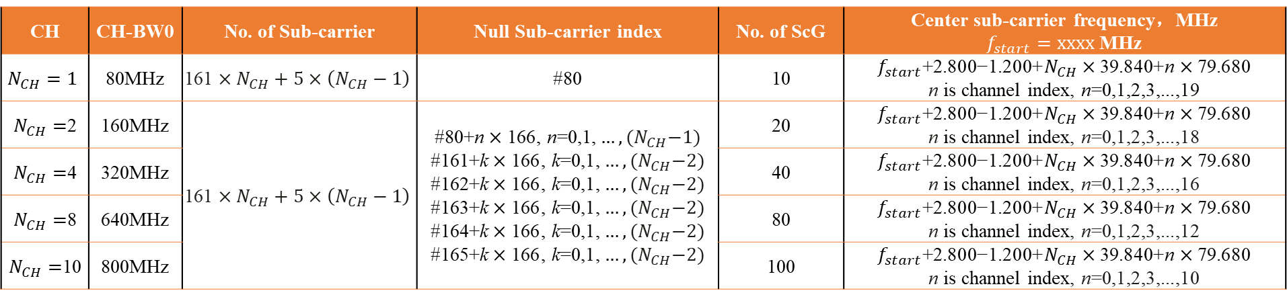
SLB 1.0 bis：80/160/320/640/800MHz @ 7163-8812MHz
Parameters | Indicator
Tx BW（-10dB BW） | >= 500MHz
Frequency | 7163 ~ 8812MHz
Equivalent Isotropic Radiated Power Spectral Density limits | <= -41dBm/MHz
Out-of-band transmit power limit | Frequency Scope | Limit（e.i.r.p） (dBm/MHz )
 | 5.925-7.125 GHz（include 7.125 GHz） | -70
 | 7.125-7.163 GHz | -51
 | 8.812-9 GHz | -51
 | 9-10.6 GHz（include 9 GHz） | -65
In-band
dBm/MHz
-41
Out-band
-51
-70
-65
5925
7125
7163
8812
9000
10600
MHz
Sub-Carrier Sparce：480KHz
CH | CH-BW0 | No. of Sub-carrier | Null Sub-carrier index | No. of ScG | Center sub-carrier frequency，MHz $f_{start}=xxxx$ MHz
$$N_{CH}=1$$ | 80MHz | $$\text{161}×N_{CH}+5×\left(N_{CH}−1\right)$$ | #80 | 10 | $$f_{start}\text{+}\text{2.800−1.200+}N_{CH}×\text{39.840}\text{+}\text{n}×\text{79.680}$$ $\text{n}$ is channel index, $\text{n}\text{=0,1,2,3,...,19}$
$N_{CH}=$2 | 160MHz | $$\text{161}×N_{CH}+5×\left(N_{CH}−1\right)$$ | #80+$\text{n}×\text{166}$, $\text{n}\text{=0,1,}…,{(N}_{CH}−1)$ #161+$\text{k}×\text{166}$, $\text{k}\text{=0,1,}…,{(N}_{CH}−2)$ #162+$\text{k}×\text{166}$, $\text{k}\text{=0,1,}…,{(N}_{CH}−2)$ #163+$\text{k}×\text{166}$, $\text{k}\text{=0,1,}…,{(N}_{CH}−2)$ #164+$\text{k}×\text{166}$, $\text{k}\text{=0,1,}…,{(N}_{CH}−2)$ #165+$\text{k}×\text{166}$, $\text{k}\text{=0,1,}…,{(N}_{CH}−2)$ | 20 | $$f_{start}\text{+}\text{2.800−1.200+}N_{CH}×\text{39.840}\text{+}\text{n}×\text{79.680}$$ $\text{n}$ is channel index, $\text{n}\text{=0,1,2,3,...,18}$
$N_{CH}=$4 | 320MHz |  |  | 40 | $$f_{start}\text{+}\text{2.800−1.200+}N_{CH}×\text{39.840}\text{+}\text{n}×\text{79.680}$$ $\text{n}$ is channel index, $\text{n}\text{=0,1,2,3,...,16}$
$N_{CH}=$8 | 640MHz |  |  | 80 | $$f_{start}\text{+}\text{2.800−1.200+}N_{CH}×\text{39.840}\text{+}\text{n}×\text{79.680}$$ $\text{n}$ is channel index, $\text{n}\text{=0,1,2,3,...,12}$
$N_{CH}=$10 | 800MHz |  |  | 100 | $$f_{start}\text{+}\text{2.800−1.200+}N_{CH}×\text{39.840}\text{+}\text{n}×\text{79.680}$$ $\text{n}$ is channel index, $\text{n}\text{=0,1,2,3,...,10}$
Notes:
161单载波
5子载波做gap
16子载波一个子载波组
信道资源shifting
Channel 带宽：20MHz基础值，可以拉宽或者缩短，20*alpha，alpha [1/8, --, 50?]，毫米波倍数与ganming确认。
宽发窄收，各带宽考虑自身是默认。
500MHz，考虑100MHz带宽，
800MHz，考虑160MHz，200MHz，80MHz
200MHz和260MHz，考虑20MHz，80MHz，160MHz
80MHz和160MHz，考虑20MHz，80MHz，
40MHz，只考虑20MHz，
场景一：宽发窄收，T节点带宽能力受限
场景二：1T多G，G1和G2配置的带宽不同

Slide 11
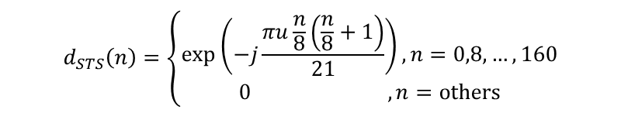
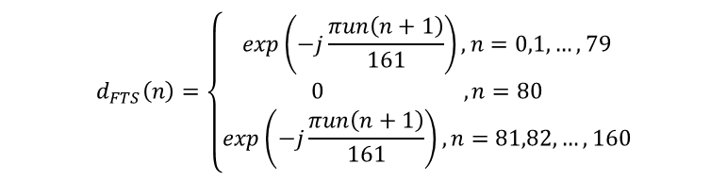
SLB 1.0 bis：Synchronized Channel Slot and Seq
0
1
2
3
4
5
6
7
8
9
10
11
12
13
14
15
16
17
18
19
1ms
precursor code
Frame #0 |  |  |  |  |  |  |  |  |  |  |  |  |  | Frame #1 |  |  |  |  |  |  |  |  |  |  |  |  |  |  | Frame #7
S T S | FTS | FTS | Sync Info 1 | Sync Info 2 |  |  |  |  |  |  |  |  |  |  |  |  |  |  |  |  |  |  |  |  |  |  |  | …
Frame #0 |  |  |  |  |  |  |  |  |  |  |  |  |  | Frame #1 |  |  |  |  |  |  |  |  |  |  |  |  |  |  | Frame #7
STS | FTS | FTS | Sync Info 1 | Sync Info 2 | PBCH1 | PBCH2 |  |  |  |  |  |  |  |  |  |  |  |  |  |  |  |  |  |  |  |  |  | …
$$d_{STS}\left(n\right)=\left\{\begin{matrix}\exp\left(−j\frac{πu\frac{n}{8}\left(\frac{n}{8}+1\right)}{21}\right),n=0,8,…,160 \\ 0 , n=others\end{matrix}\right.$$
Sync Info
Sync Block
Description：
FTS after STS (To avoid AGC Adjustment time window)
FTS & STS uses ZC Seq, BW = 20MHz
STS mapping Sub-carrier space 960kHz, FTS mapping Sub-carrier space 120kHz
STS ZC number: 20，FTS ZC number: 2
Indicate CP by STS Seq
Sync Block period，PBCH Period
Scheduled Sending: [1/2/4/8] ms, PBCH Period = 8ms
Contention-Based Sending: Send Sync Block and PBCH in the first frame of each COT. Then, send Sync Block per [1/2/4/8]ms, and PBCH per 8ms
Content of Sync Block:
Format Indicator
G Node Indicator: 24bit
G Node Multi-domains Sync Capability Indicator: 8bit
Sync Block Period: 2bit
Others
$$d_{FTS}\left(n\right)=\left\{\begin{matrix}\exp\left(−j\frac{πun\left(n+1\right)}{161}\right),n=0,1,…,79 \\ 0 , n=80 \\ \exp\left(−j\frac{πun\left(n+1\right)}{161}\right),n=81,82,…,160\end{matrix}\right.$$
40ppm | Rate of STS matching without synchronization errors for ideal AWGN channels
SNR | -10 | -9 | -8 | -7 | -6 | -5
4STS 2part | 0.2 | 0.24 | 0.31 | 0.32 | 0.41 | 0.5
4STS 4part | 0.78 | 0.88 | 0.97 | 1 | 1 | 1
20STS 2part | 0.05 | 0.06 | 0.07 | 0.08 | 0.13 | 0.17
20STS 4part | 0.58 | 0.78 | 0.82 | 0.92 | 0.97 | 1
Notes:
连续：PBCH 10ms周期（FTS/STS G节点标识，PBCH） ；STS和G节点标识每ms都出现,TTS不要。
非连续：每次占用的第一个TTI以上面的那个开始（FTS STS G节点标识，TTS PBCH），后面的TTI（FTS STS G 节点标识 TTS），
GAP+RS 时间为大约20ms

Slide 12
SLB 1.0 bis：Broadcast and MIB format
Length / bit | Field Content | Description
2 | Cyclic Prefix (CP) info | 0: CP0，1: CP1，2: CP2，3:CP3
1 | Transmission Type | 0: Scheduled, 1: Contention-Based
19 | Frame Number | The Frame Number that Broadcast info located
3 | TTI Length | 0: 1 frame，1: 2 frame，2: 4 frame，3: 8 frame，4: 16frame, 5: 32frame, 6: 64 frame，7: Reserved
2 | SIB0 Sending Period | Wireless frame start number is a multiple of 0: 512, 1: 1024, 2: 2048, 3: 4096
2 | SIB0 Checking Period | Up to [0: 8, 1: 16, 2: 32, 3: 64] Continuous TTIs from the starting frame number
2 | Number of symbols in the common search space of the control channel | 0: 1 Symbol, 1: 2 Symbols, 2: 4 Symbols, 3: 8 Symbols
2 | Broadcast or system message changing period | 0: 512 frame, 1: 1024 frame, 2: 2048 frame, 3: 4096 frame
1 | Broadcast or system message changing Indicator | 0: No change in next period 1: Change in next period
6 | Reserved | All 0 in current
24 | CRC | CRC
34 bits active, 6 bits reserved, 24 bits CRC, total 64 bits. Transmitted via 2 CP-OFDM symbols, QPSK modulation, channel coding rate 0.1
Notes:
161单载波
5子载波做gap
16子载波一个子载波组
信道资源shifting
Channel 带宽：20MHz基础值，可以拉宽或者缩短，20*alpha，alpha [1/8, --, 50?]，毫米波倍数与ganming确认。
宽发窄收，各带宽考虑自身是默认。
500MHz，考虑100MHz带宽，
800MHz，考虑160MHz，200MHz，80MHz
200MHz和260MHz，考虑20MHz，80MHz，160MHz
80MHz和160MHz，考虑20MHz，80MHz，
40MHz，只考虑20MHz，
场景一：宽发窄收，T节点带宽能力受限
场景二：1T多G，G1和G2配置的带宽不同

Slide 13
SLB 1.0 bis: System Message SIB transmission method
Broadcast Message MIB
System Message SIB0
SIB-0
SIB-1
SIB-2
SIB-3
SIB-4
SIB-5
SIB-x Time resource configuration
Communication domain string domain name
Multi-domain synchronization information
Time Domain Adjustment
Frequency Domain Adjustment
Adjustment target time
High-Level Service Information
Device Discovery
High layer service broadcast
Measure Configuration
Domain ID, L2ID
Domain System Wall Clock
System BW Info, Carrier Location Info
RACH channel Time/Frequency resource
ACK/NACK resource configuration in access process
System level power control configuration
G Node security Configuration (e.g. key agreement algorithm)
Notes:
测量的配置单独放置一个SIB-x

Slide 14
SLB 1.0 bis: Multi-domains Synchronization process
Synchronization source: the domain to be synchronized synchronizes to the G-node of the domain whose received signal strength exceeds a certain threshold within the same band and whose metric field in the synchronization block is the largest, and the G-node of the domain providing the reference clock is called the synchronization source. Thus, the domain to be synchronized and the synchronization source reach a unified understanding of the time and frequency resources and at least symbol-level synchronization, while reducing the neighboring frequency interferences between the communication links.
2. Local Synchronization
Method 1：G Node gradually fine-tune
Method 2：G-nodes and T-nodes agree to make timing changes uniformly
Notify each T-node via XRC unicast signaling.
Notify each T-node via SIB2 broadcast.
1. Source select/update
Execute when power-up or some key features change (e.g., timing source change);
The local domain G-node metric value is related to the multi-domain synchronization capability (8bit including coverage, version, power supply method, timing source, networking scale, etc.) and the node ID (24bit), which is carried in the synchronization block;
①
Local G Node’s metric
①
Execute when power-up, or with [1s] period. Scans the neighboring G-nodes within the same band whose signal exceeds the target threshold. Capture the synchronization signals, synchronizes and parses them to obtain the metric values.
3. G-node synchronization tracking of the synchronization source
Detect the synchronization source, then update the time-frequency synchronization offset and adjust if the detection is successful
Detecting the synchronization source during the idle state of the G-node with a period of 250μs
G-node detects the synchronization source for 4 consecutive 250μs after each occupied channel ends
②
Synchronization and resolution of neighborhood SSBs
②
Compare the metric (domain identity ID) field in the captured synchronization block of each G-node, select the G Node with the largest metric as the synchronization source.
③
Select Source
③
If the synchronization source is not local, then synchronize. The local G/T nodes use the timed transmissions from the synchronization source
④
Local Synchronization
④
Notes:
连续：PBCH 10ms周期（FTS/STS G节点标识，PBCH） ；STS和G节点标识每ms都出现,TTS不要。
非连续：每次占用的第一个TTI以上面的那个开始（FTS STS G节点标识，TTS PBCH），后面的TTI（FTS STS G 节点标识 TTS），
GAP+RS 时间为大约20ms

Slide 15
SLB 1.0 bis: FISA
G Node State Machine
The current TTI is not the last TTI of the last synchronization cycle of the COT and there is data to be transmitted subsequently.
Transmission State
No data to be transmitted
No data to be transmitted
in following sync period
Idle State
Contested Channel Success
Contested channel failure and no subsequent data to be transmitted (data timeout expires)
The last synchronization cycle of the COT has ended and subsequent data is pending transmission
Data to be transmitted
contention channel state
CH1：
CH2：
CH3：
CH4：
Channel Occupied
Channel Release
Channel Occupied
Channel Release
Channel Occupied
Channel Release
Channel Occupied
Channel Release
Contested channel failure and subsequent pending data transmission
Notes:
SLB 1.0和1.0bis的区别点。

Slide 16
SLB 1.0 bis: Access process
G Node
T Node
STS：AGC adjust，rough Sync
FTS：Fine Sync, ，jointly with STS to determine the domain ID
[Blind Detection/Indication] determines the domain CP length
Synchronization information block contains G-node identification (G-node randomly generates 24-bit ID, supports G-node's own re-selection of identification and notification to T-node [via SIB message or XRC signaling]) and capability information (8 bits)
1COT
1
1. SSB(FTS/STS/Sync Block)，G-Link（PHY）
CP Length
Frame Sequence Number
TTI length
G-link common control channel (GCI) resources
System message resources, system message change indication
2
2. PBCH/MIB/Broadcast，G-Link (PHY)
Send scheduling information GCI in G-link public control channel resources and scramble CRCs
[Indication of time-frequency resources for RACH]
Select a RACH time-frequency resource
Send RACH including FTS/STS/access information
Send carrying the T-node 24-bit identification (the G-node can reconfigure this ID after the access is completed)
Determine T-node TA based on access information
（ 3. System Message/SIB，G-Link）
3
4
4. XRC-Setup-Request(MSG3) ，T-Link
(PHY)
Scheduled via GCI, GCI-CRC scrambled via 24-bit T-node Phy-ID (does not fully resolve conflicts)
The 5th message is the XRC-Setup of the T-node, including
ACK/NACK resources available to the T-node
TA indication
Power control
Data Link Layer Configuration
Optional (when the G-node allows the use of the configured key PSK): the L2ID of the G-node, the resolvable randomized identity; PSK not allowed: not sent
Other configuration information
5
Scheduled via GCI, GCI-CRC is scrambled via 24-bit T-node PHY-ID
Timed to be sent after pressing TA. This message is not sent if XRC-Setup is not received.
MSG3 is the XRC-Setup-complete of the T-node, including the T-node security information. The security information can distinguish between the case with and without security context, containing the encrypted L2ID of the T-node, and indicating the encryption method to be used by PSK or password through the XRC message.
Yes: AssociationRequestWithSec
No: AssociationRequestNoneSec
The G-node discovers a unique T-node
T cannot consider the conflict resolved
~1 COT
5. XRC-Setup(MSG4) ，G-Link
（XRC，No ACK/NACK）
6. XRC-Setup-Complete ，T-Link（XRC）
7. Security Negotiation（XRC）
Security Negociation：
7.1：SecurityContextRequest（Unencrypted，Integrity Protected）
7.2：SecurityContextRespond（Encrypted，Integrity Protected）
7.3: Association establishment, carrying G-node L2ID and T-node L2ID, completes conflict resolution
AssociationSetupWithSec
AssociationSetupNoneSec
8. G-T Node Capability Negotiation
6
G-T Node XRC reconfigure（XRC）
7
Notes:
SIB-CRC加扰的序列产生，是否需要G节点特定。
和安全团队讨论刷新安全相关的流程
和1.0相比的改动。放在本页中。
MSG4没了。SSB。MSG1包含T节点ID。

Slide 17
SLB 1.0 bis: RACH
RACH format
Short format: preamble+L2ID of the sending node
Long format: preamble + L2ID of the sending node + L2ID of the receiving node + TCI + data
RACH preamble
Global-common set, which is not bound to a specific G node.
ZC sequence
NZC and FTS have the same length and generation mode, and use different u values.
RACH time-frequency resource
Indicates the number of symbols occupied by the local domain-based coverage configuration.
The 120 kHz SCS version supports 10 km coverage and a maximum of six symbols.
Same bandwidth as the FTS.
Related Processes
Short RACH access
Fast data transfer without connection
G Node
T Node
4. XRC-Setup-Request (original MSG3), T link
5. XRC-Setup (original MSG4), G link
6. XRC-Setup-Complete, T-Link
Node 1
Other Node
preamble + transmit node L2ID + receive node L2ID + TCI + data
Notes:
161单载波
5子载波做gap
16子载波一个子载波组
信道资源shifting
Channel 带宽：20MHz基础值，可以拉宽或者缩短，20*alpha，alpha [1/8, --, 50?]，毫米波倍数与ganming确认。
宽发窄收，各带宽考虑自身是默认。
500MHz，考虑100MHz带宽，
800MHz，考虑160MHz，200MHz，80MHz
200MHz和260MHz，考虑20MHz，80MHz，160MHz
80MHz和160MHz，考虑20MHz，80MHz，
40MHz，只考虑20MHz，
场景一：宽发窄收，T节点带宽能力受限
场景二：1T多G，G1和G2配置的带宽不同

Slide 18
SLB 1.0 bis: GCI Design - Information Bearer
Field information | TB-based scheduling | CBG-based scheduling | Level-1 scheduling based on two-level CBG feedback | Second-level scheduling based on two-level CBG feedback
GCI level indicator | None | None | 1 bit. The value 0 indicates the level-1 GCI, and the value 1 indicates the level-2 GCI.
Link indicator | 1 bit. The value 0 indicates the G link, and the value 1 indicates the T link. |  |  | 64 bits, level-2 CBG indication This parameter is available only when the first-level scheduling indicator T link quantity is used for CBG retransmission indicated by the two-level GCI. According to the CBG that needs to be retransmitted and indicated by the CBG in the first-level scheduling GCI and the CB included in each retransmitted CBG, perform sub-CBG correspondence by using 64 bits, and indicate retransmission of the sub-CBG. When the value is 0, Retransmission is not performed on the corresponding Sub-CBG. When the value of this parameter is 1, retransmission is performed on the corresponding Sub-CBG.
Multi-stream indication | 3 bits. The number of demodulation reference signal ports is calculated as follows: (3 bits + 1)
Frequency domain resource indicator | 16 bits, indicating a frequency domain subcarrier group by using a bitmap
Start symbol indication | 10-bit, index of the start symbol in the 8 ms TTI
End symbol indication | 10-bit, index of the end symbol in the 8 ms TTI
HARQ process | Two bits, HARQ process
New packet indication | 1 bit. When the value is reversed, the new packet is transmitted. When the value remains unchanged, the old packet is retransmitted.
MCS indicator | MCS indicator: 5 bits
Retransmission type indicator | None | None | 2 bits 0 indicates CBG retransmission, 1 indicates the T link quantity. Two-level GCI-indicated CBG retransmission 2 indicates retransmission on the G link based on the first-level CBG feedback, 3: indicates retransmission on the G link based on the first-level and second-level CBG feedback
Retransmission version indicator | 2 bits, 0 indicates version 0; 1 indicates version 1. 2: indicates version 2. 3 indicates version 3.
CBG indication | None | 8-bit bitmap, If the values are all 1s, TB retransmission is triggered. | 8-bit bitmap This parameter is valid only when the retransmission type indicator is set to 0 or 1. Other invalid
ACK/NACK resource | 5 bits, indicating resources in the ACK/NACK resource pool configured by higher layer XRC signaling
CRC | 24-bit CRC
Total length | 78 bits | 86 bits | 89 bits | 89 bits
For example, if the first-level CBGs that need to be retransmitted are # 0 and # 7, the number of CBs included in the CBG #0 is # 66, and the number of CBs included in the CBG #7 is 65
Therefore, the quantities of CBs included in the 64 sub-CBGs are respectively # 3, # 3, # 3, # 2, # 2, # 2, ..., # 2, where the first three Sub-CBGs include three CBs, and the remaining 61 CBGs include two CBs.
Notes:
161单载波
5子载波做gap
16子载波一个子载波组
信道资源shifting
Channel 带宽：20MHz基础值，可以拉宽或者缩短，20*alpha，alpha [1/8, --, 50?]，毫米波倍数与ganming确认。
宽发窄收，各带宽考虑自身是默认。
500MHz，考虑100MHz带宽，
800MHz，考虑160MHz，200MHz，80MHz
200MHz和260MHz，考虑20MHz，80MHz，160MHz
80MHz和160MHz，考虑20MHz，80MHz，
40MHz，只考虑20MHz，
场景一：宽发窄收，T节点带宽能力受限
场景二：1T多G，G1和G2配置的带宽不同

Slide 19
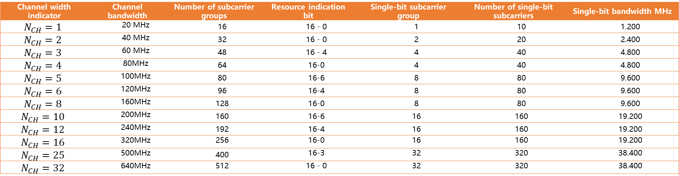
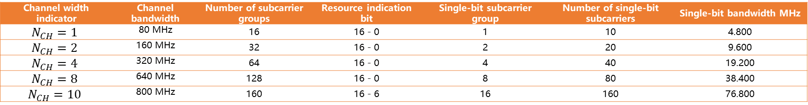
SLB 1.0 bis: GCI Design-Frequency Domain Resource Indication Information
Subcarrier spacing: 120 kHz
Channel width indicator | Channel bandwidth | Number of subcarrier groups | Resource indication bit | Single-bit subcarrier group | Number of single-bit subcarriers | Single-bit bandwidth MHz
$$N_{CH}=1$$ | 20 MHz | 16 | 16 - 0 | 1 | 10 | 1.200
$$N_{CH}=2$$ | 40 MHz | 32 | 16 - 0 | 2 | 20 | 2.400
$$N_{CH}=3$$ | 60 MHz | 48 | 16 - 4 | 4 | 40 | 4.800
$$N_{CH}=4$$ | 80MHz | 64 | 16-0 | 4 | 40 | 4.800
$$N_{CH}=5$$ | 100MHz | 80 | 16-6 | 8 | 80 | 9.600
$$N_{CH}=6$$ | 120MHz | 96 | 16-4 | 8 | 80 | 9.600
$$N_{CH}=8$$ | 160MHz | 128 | 16-0 | 8 | 80 | 9.600
$$N_{CH}=10$$ | 200MHz | 160 | 16-6 | 16 | 160 | 19.200
$$N_{CH}=12$$ | 240MHz | 192 | 16-4 | 16 | 160 | 19.200
$$N_{CH}=16$$ | 320MHz | 256 | 16-0 | 16 | 160 | 19.200
$$N_{CH}=25$$ | 500MHz | 400 | 16-3 | 32 | 320 | 38.400
$$N_{CH}=32$$ | 640MHz | 512 | 16 - 0 | 32 | 320 | 38.400
Subcarrier spacing: 480 kHz
Channel width indicator | Channel bandwidth | Number of subcarrier groups | Resource indication bit | Single-bit subcarrier group | Number of single-bit subcarriers | Single-bit bandwidth MHz
$$N_{CH}=1$$ | 80 MHz | 16 | 16 - 0 | 1 | 10 | 4.800
$$N_{CH}=2$$ | 160 MHz | 32 | 16 - 0 | 2 | 20 | 9.600
$$N_{CH}=4$$ | 320 MHz | 64 | 16 - 0 | 4 | 40 | 19.200
$$N_{CH}=8$$ | 640 MHz | 128 | 16 - 0 | 8 | 80 | 38.400
$$N_{CH}=10$$ | 800 MHz | 160 | 16 - 6 | 16 | 160 | 76.800
Notes:
161单载波
5子载波做gap
16子载波一个子载波组
信道资源shifting
Channel 带宽：20MHz基础值，可以拉宽或者缩短，20*alpha，alpha [1/8, --, 50?]，毫米波倍数与ganming确认。
宽发窄收，各带宽考虑自身是默认。
500MHz，考虑100MHz带宽，
800MHz，考虑160MHz，200MHz，80MHz
200MHz和260MHz，考虑20MHz，80MHz，160MHz
80MHz和160MHz，考虑20MHz，80MHz，
40MHz，只考虑20MHz，
场景一：宽发窄收，T节点带宽能力受限
场景二：1T多G，G1和G2配置的带宽不同

Slide 20
SLB 1.0 bis: Configuration Example of Two-Level ACK/NACK Feedback on T Nodes
Level 1 A/N Feedback
The number of CBGs included in the first-level A/N feedback is configured by the higher-level management: 2/4/8/16...
The modulation scheme used for the first-level A/N feedback is configured by the higher layer: QPSK/16QAM.
Level 2 A/N Feedback
The number of bits for the second-level A/N feedback is configured by the higher layer as follows: 2/4/8/16/32/64/128/256/512/1024, that is, the power of 2
Default modulation mode: If the data modulation mode is QPSK–256QAM, the modulation mode for two-stage feedback is QPSK. The modulation scheme of data is 1024QAM or higher, and the modulation scheme of second-level feedback is 16QAM.
Calculation manner of the CB included in the child CBG
C1 represents the total number of CBs in the to-be-retransmitted CBG, N1 represents the total number of configured sub-CBGs, ceil() represents a rounding up operation, floor() represents a rounding down transport operation, and mod() represents a modulo operation.
L=min(C1, N1), L1=Mod(C1, L), if L1>0, K1=ceil(C1/L) and K2=floor(C1/L), among the L sub CBGs, sub CBGs #0 to #(L1-1) include K1 CBs, sub CBGs from #L1 to #(L-1) include K2 CBs; If L1=0, each sub CBG includes (C1/L) CBs, and the number of CBs included in N1-L is 0.
A resource is indicated by using five bits in GCI, indicating an ACK/NACK feedback resource pool configured by using a higher layer. A higher layer may configure a plurality of resource pools, and the instruction indicates selecting one of the plurality of resource pools. Resource pools support combing in the frequency domain and power boosting.

Slide 21
SLB 1.0 bis: ACK/NACK resource allocation (including level-1 and multi-level feedback)
Level-1 A/N feedback (spread spectrum mode)
Single-user single-bit:
Comb 1
Comb 2, even carrier
Comb 2, odd carrier
Comb 4, mode 4 and 0 carriers
Comb 4, mode 4 and one carrier
Comb 4 and 2 carriers in mode 4
Comb 4, mode 4 and remaining 3 carriers
2 bits per user:
Comb 2 even carriers (1 bit) and Comb 2 odd carriers (1 bit)
Comb 4 mode 4 remaining 0 carriers (1 bit) and comb 4 mode 4 remaining 2 carriers (1 bit)
Comb 4 mode 4 remaining one carrier (1 bit) and comb 4 mode 4 remaining three carriers (1 bit)
4 bits per user
Comb 4 mode 4 remaining 0 carriers (1 bit), Comb 4 mode 4 remaining 1 carrier (1 bit), Comb 4 mode 4 remaining 2 carriers (1 bit), Comb 4 mode 4 remaining 3 carriers (1 bit)
One bit per user for two users:
Comb 2 even carriers (user 1, 1 bit) and comb 2 odd carriers (user 2, 1 bit)
Comb 4 mode 0 carrier (user 1, 1 bit) and Comb 4 mode 2 carrier (user 2, 1 bit)
Comb 4 mode 1 carrier (user 1, 1 bit) and Comb 4 mode 3 carrier (user 2, 1 bit)
User 1 feeds back 1 bit, and user 2 feeds back 2 bits.
Comb 2 even carrier (user 1, 1 bit), Comb 4 mode 1 carrier, and Comb 4 mode 3 carrier (user 2, 2 bits)
Comb 2 odd carrier (user 1, 1 bit), Comb 4 mode 0 carrier, and Comb 4 mode 2 carrier (user 2, 2 bits)
Four subscribers: 1 bit for each subscriber:
Comb 4 mode 0 carrier (user 1), Comb 4 mode 1 carrier (user 2), Comb 4 mode 2 carrier (user 3), Comb 4 mode 3 carrier (user 4)
Level-2 A/N feedback (data transmission mode)
For level-1 A/N feedback, Polar coding is used, and the maximum number of CBGs included in level-1 A/N feedback is notified by using higher layer signaling, which may be 2, 4, or 8, and the modulation scheme is QPSK.
The second-level A/N feedback also uses polar coding.

Slide 22
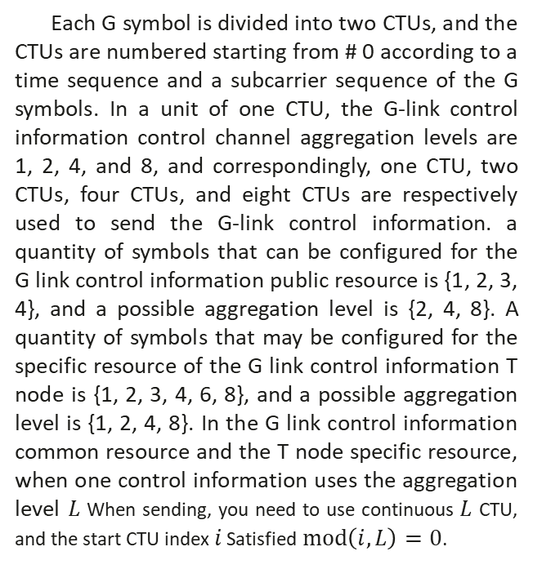
SLB 1.0 bis: ACK/NACK resource allocation (including level-1 and multi-level feedback)
Each G symbol is divided into two CTUs, and the CTUs are numbered starting from # 0 according to a time sequence and a subcarrier sequence of the G symbols. In a unit of one CTU, the G-link control information control channel aggregation levels are 1, 2, 4, and 8, and correspondingly, one CTU, two CTUs, four CTUs, and eight CTUs are respectively used to send the G-link control information. a quantity of symbols that can be configured for the G link control information public resource is {1, 2, 3, 4}, and a possible aggregation level is {2, 4, 8}. A quantity of symbols that may be configured for the specific resource of the G link control information T node is {1, 2, 3, 4, 6, 8}, and a possible aggregation level is {1, 2, 4, 8}. In the G link control information common resource and the T node specific resource, when one control information uses the aggregation level $L$When sending, you need to use continuous $L$ CTU, and the start CTU index $i$ Satisfied$mod\left(i,L\right)=0$.
G Symbol # 0
G Symbol # 1
Subcarrier # 160 | Subcarrier group # 3
...
Subcarrier # 122
Subcarrier # 121
Subcarrier # 120 | Subcarrier group # 2
...
Subcarrier # 82
Subcarrier # 81
Subcarrier # 80 | DC
Subcarrier # 79 | Subcarrier group # 1
...
Subcarrier # 41
Subcarrier # 40
Subcarrier # 39 | Subcarrier group # 0
...
Subcarrier # 1
Subcarrier # 0
Subcarrier # 160 | Subcarrier group # 3
...
Subcarrier # 122
Subcarrier # 121
Subcarrier # 120 | Subcarrier group # 2
...
Subcarrier # 82
Subcarrier # 81
Subcarrier # 80 | DC
Subcarrier # 79 | Subcarrier group # 1
...
Subcarrier # 41
Subcarrier # 40
Subcarrier # 39 | Subcarrier group # 0
...
Subcarrier # 1
Subcarrier # 0
CTU #2
CTU #3
CTU #0
CTU #1
Notes:
连续：PBCH 10ms周期（FTS/STS G节点标识，PBCH） ；STS和G节点标识每ms都出现,TTS不要。
非连续：每次占用的第一个TTI以上面的那个开始（FTS STS G节点标识，TTS PBCH），后面的TTI（FTS STS G 节点标识 TTS），
G节点指示是否是最后一个

Slide 23
SLB 1.0 bis: Data transmission process
TB
CRC
Code block segmentation
Channel coding
Rate matching
Channel interleaving
Code block concatenation
BF
Resource mapping
OFDM signal generation
Antenna Port Mapping
Bit scrambling
Modulate
Layer Map
Antenna Port Mapping
Resource mapping
OFDM signal generation
Notes:
161单载波
5子载波做gap
16子载波一个子载波组
信道资源shifting
Channel 带宽：20MHz基础值，可以拉宽或者缩短，20*alpha，alpha [1/8, --, 50?]，毫米波倍数与ganming确认。
宽发窄收，各带宽考虑自身是默认。
500MHz，考虑100MHz带宽，
800MHz，考虑160MHz，200MHz，80MHz
200MHz和260MHz，考虑20MHz，80MHz，160MHz
80MHz和160MHz，考虑20MHz，80MHz，
40MHz，只考虑20MHz，
场景一：宽发窄收，T节点带宽能力受限
场景二：1T多G，G1和G2配置的带宽不同

Slide 24
SLB 1.0 bis: Self-contained HARQ (Downlink)
Example: TTI for initial transmission
TTI for retransmission
RS
GCI
>16us
>15us
>16us
>16us
Downlink data arrival
Downlink data scheduling
Downlink Data Transmission #M
Uplink ACK
NACK
Downlink retransmission scheduling
Uplink ACK
NACK
Downlink data retransmission #M+1
OS, 8.33us

Slide 25
SLB 1.0 bis: Self-contained HARQ (Uplink)
Example: TTI for initial transmission
TTI for retransmission
RS
GCI
Uplink data arrival
Scheduling request
Uplink data scheduling
Uplink Data Transmission #M
Retransmission of Uplink Data Transmission #M
>16us
>16us
>16us

Slide 26
SLB 1.0 bis: Pilot
Configuring one DMRS per radio frame
Single-port
Two ports
Initial radio frame
Radio Frame
Radio Frame
Radio Frame
Symbolic
 |  |  |  |  |  |  |  |  |  |  |  | subcarrier
Symbolic
 |  |  |  |  |  |  |  |  |  |  |  | subcarrier
control class symbol
DMRS
data symbol
DMRS
data symbol
DMRS
data symbol
DMRS
data symbol
 | .. . |  |  |  | .. . |  |  |  |  |  |  |  |  | .. . |  |  |  |  |  |  |  |  | .. . |  |  | .. . |  |  |  |  |  | .. .
 |  |  |  |  |  |  |  |  |  |  |  | ... |  |  |  |  |  |  |  |  | ... |  |  |  |  |  |  |  |  | ...
 | .. . |  |  |  |  |  |  |  |  |  |  |  |  | .. . |  |  |  |  |  |  |  |  | .. . |  |  | .. . |  |  |  |  |  | .. .
Three ports
Four ports
Symbolic
 |  |  |  |  |  |  |  |  |  |  |  | subcarrier
Symbolic
 |  |  |  |  |  |  |  |  |  |  |  | subcarrier
Time domain
Description:
1, 2, 3, and 4 ports are supported and different pilot patterns are configured.
Single-port: All REs mapped to the scheduled subcarrier.
two-port scenario: mapping is performed based on two combs of a subcarrier sequence number, where port 0 is mapped to an even-numbered RE; and; Port 1 is mapped to odd-numbered REs.
Three-port scenario: mapping based on the subcarrier sequence number three-comb.
Four-port scenario: mapping is performed based on two combs of a subcarrier sequence number. Port 0 and port 1 share even REs and are multiplexed in a code division manner. Port 2 and port 3 share odd REs and are multiplexed in code division mode.
DMRS RE Port0
DMRS RE Port1
DMRS RE Port0/1
DMRS RE Port2/3
Notes:
161单载波
5子载波做gap
16子载波一个子载波组
信道资源shifting
Channel 带宽：20MHz基础值，可以拉宽或者缩短，20*alpha，alpha [1/8, --, 50?]，毫米波倍数与ganming确认。
宽发窄收，各带宽考虑自身是默认。
500MHz，考虑100MHz带宽，
800MHz，考虑160MHz，200MHz，80MHz
200MHz和260MHz，考虑20MHz，80MHz，160MHz
80MHz和160MHz，考虑20MHz，80MHz，
40MHz，只考虑20MHz，
场景一：宽发窄收，T节点带宽能力受限
场景二：1T多G，G1和G2配置的带宽不同

Slide 27
SLB 1.0 bis: Flexible bandwidth between bands
frequency domain
High-level system configuration resources
synchronization block
User # 2, # 3
Control information GCI symbol
GAP
User # 2, # 3
ACK
NAC
Feedback resources
GAP
Next transmission
Configurable bandwidth
40 MHz
100 MHz system bandwidth
Initial system access resources
Initial Access
20MH
synchronization symbol
Broadcast channel symbol
Control information GCI symbol
GAP
Default ACK
NAC
Feedback resources
GAP
Configurable bandwidth
20 MHz
Sync Block
User# 1
Control information GCI symbol
GAP
User # 0
ACK
NAC
Feedback resources
GAP
Sync Block
User # 0
Control information GCI symbol
GAP
User # 0
ACK
NAC
Feedback resources
GAP
Configurable bandwidth
20 MHz
Radio Frame
Radio Frame
Radio Frame
Radio Frame
Notes:
161单载波
5子载波做gap
16子载波一个子载波组
信道资源shifting
Channel 带宽：20MHz基础值，可以拉宽或者缩短，20*alpha，alpha [1/8, --, 50?]，毫米波倍数与ganming确认。
宽发窄收，各带宽考虑自身是默认。
500MHz，考虑100MHz带宽，
800MHz，考虑160MHz，200MHz，80MHz
200MHz和260MHz，考虑20MHz，80MHz，160MHz
80MHz和160MHz，考虑20MHz，80MHz，
40MHz，只考虑20MHz，
场景一：宽发窄收，T节点带宽能力受限
场景二：1T多G，G1和G2配置的带宽不同

Slide 28
SLB 1.0 bis: Flexible bandwidth between bands
frequency domain
Next transmission
synchronization symbol
Broadcast channel symbol
Control information GCI symbol
GAP
ACK
NAC
Feedback resources
GAP
5.8 GHz
120 kHz subcarrier system
20MHz
Broadcast channel symbol
Next transmission
synchronization symbol
Control information GCI symbol
5.1 GHz
120 kHz subcarrier system
GAP
ACK
NAC
Feedback resources
GAP
20MHz
synchronization symbol
Next transmission
Broadcast channel symbol
Control information GCI symbol
GAP
ACK
NAC
Feedback resources
GAP
2.4 GHz
120 kHz subcarrier system
20MHz
Radio Frame
Radio Frame
Radio Frame
Radio Frame
Notes:
161单载波
5子载波做gap
16子载波一个子载波组
信道资源shifting
Channel 带宽：20MHz基础值，可以拉宽或者缩短，20*alpha，alpha [1/8, --, 50?]，毫米波倍数与ganming确认。
宽发窄收，各带宽考虑自身是默认。
500MHz，考虑100MHz带宽，
800MHz，考虑160MHz，200MHz，80MHz
200MHz和260MHz，考虑20MHz，80MHz，160MHz
80MHz和160MHz，考虑20MHz，80MHz，
40MHz，只考虑20MHz，
场景一：宽发窄收，T节点带宽能力受限
场景二：1T多G，G1和G2配置的带宽不同

Slide 29
SLB 1.0 bis: MCS table
MCS Table0（High reliability）
MCS Table1(Normal）
MCS Table2(High Rate）
Modulation and coding index | Modulation mode | Coding Rate (R) x 1024
0 | QPSK | 64
1 | QPSK | 80
2 | QPSK | 96
3 | QPSK | 112
4 | QPSK | 128
5 | QPSK | 160
6 | QPSK | 192
7 | QPSK | 224
8 | QPSK | 256
9 | QPSK | 288
10 | QPSK | 320
11 | QPSK | 384
12 | QPSK | 448
13 | QPSK | 512
14 | QPSK | 576
15 | QPSK | 640
16 | QPSK | 704
17 | 16QAM | 384
18 | 16QAM | 448
19 | 16QAM | 512
20 | 16QAM | 576
21 | 16QAM | 640
22 | 16QAM | 704
23 | 64QAM | 448
24 | 64QAM | 512
25 | 64QAM | 576
26 | 64QAM | 640
27 | 64QAM | 704
28 | 64QAM | 768
29 | 64QAM | 832
30 | 64QAM | 896
31 | 64QAM | 960
Modulation and coding index | Modulation mode | Coding Rate (R) x 1024
0 | QPSK | 96
1 | QPSK | 128
2 | QPSK | 192
3 | QPSK | 256
4 | QPSK | 320
5 | QPSK | 448
6 | QPSK | 576
7 | QPSK | 704
8 | 16QAM | 384
9 | 16QAM | 448
10 | 16QAM | 512
11 | 16QAM | 576
12 | 16QAM | 640
13 | 16QAM | 704
14 | 64QAM | 448
15 | 64QAM | 512
16 | 64QAM | 576
17 | 64QAM | 640
18 | 64QAM | 704
19 | 64QAM | 768
20 | 64QAM | 832
21 | 64QAM | 896
22 | 256QAM | 640
23 | 256QAM | 704
24 | 256QAM | 768
25 | 256QAM | 832
26 | 256QAM | 896
27 | 256QAM | 960
28 | 1024QAM | 768
29 | 1024QAM | 832
30 | 1024QAM | 896
31 | 1024QAM | 960
Modulation and coding index | Modulation mode | Coding Rate (R) x 1024
0 | QPSK | 96
1 | QPSK | 192
2 | QPSK | 320
3 | QPSK | 576
4 | 16QAM | 384
5 | 16QAM | 448
6 | 16QAM | 512
7 | 16QAM | 576
8 | 16QAM | 640
9 | 16QAM | 704
10 | 64QAM | 448
11 | 64QAM | 512
12 | 64QAM | 576
13 | 64QAM | 640
14 | 64QAM | 704
15 | 64QAM | 768
16 | 64QAM | 832
17 | 64QAM | 896
18 | 256QAM | 640
19 | 256QAM | 704
20 | 256QAM | 768
21 | 256QAM | 832
22 | 256QAM | 896
23 | 256QAM | 960
24 | 1024QAM | 768
25 | 1024QAM | 832
26 | 1024QAM | 896
27 | 1024QAM | 960
28 | 4096QAM | 768
29 | 4096QAM | 832
30 | 4096QAM | 896
31 | 4096QAM | 960
Description:
1. Use a highly reliable table during initial access.
2. After the connection is established, the node is reconfigured as a regular table or a high-rate table based on the node capability.
Notes:
161单载波
5子载波做gap
16子载波一个子载波组
信道资源shifting
Channel 带宽：20MHz基础值，可以拉宽或者缩短，20*alpha，alpha [1/8, --, 50?]，毫米波倍数与ganming确认。
宽发窄收，各带宽考虑自身是默认。
500MHz，考虑100MHz带宽，
800MHz，考虑160MHz，200MHz，80MHz
200MHz和260MHz，考虑20MHz，80MHz，160MHz
80MHz和160MHz，考虑20MHz，80MHz，
40MHz，只考虑20MHz，
场景一：宽发窄收，T节点带宽能力受限
场景二：1T多G，G1和G2配置的带宽不同

Slide 30
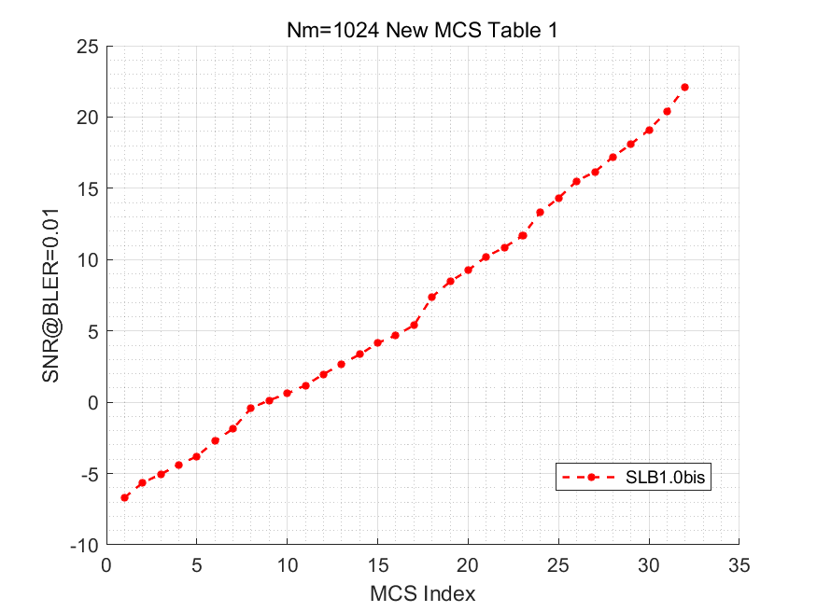
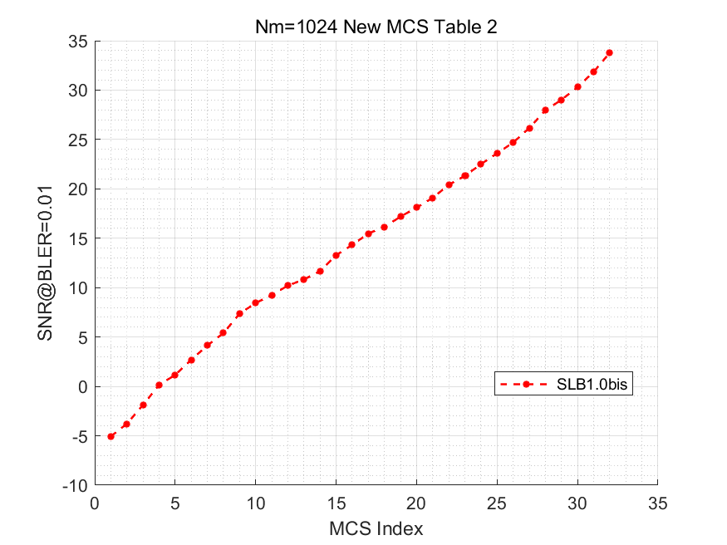
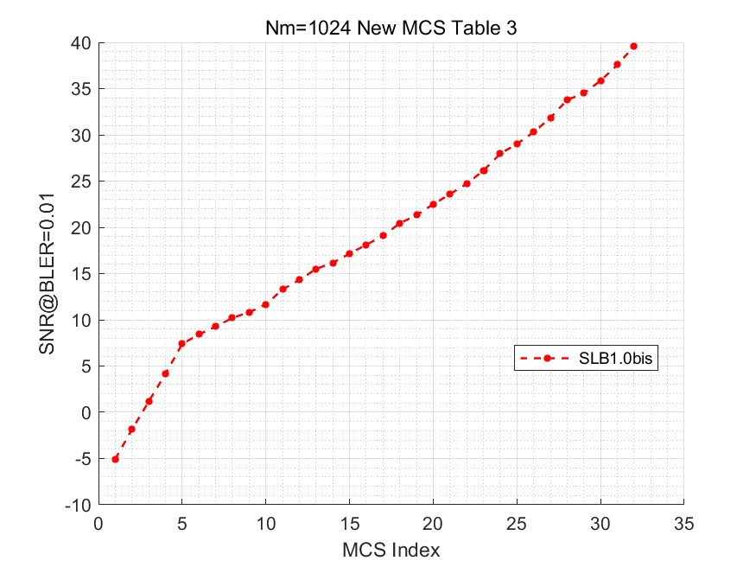
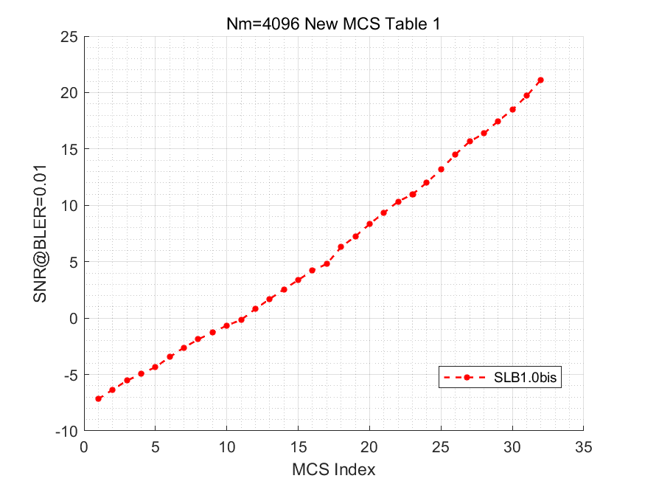
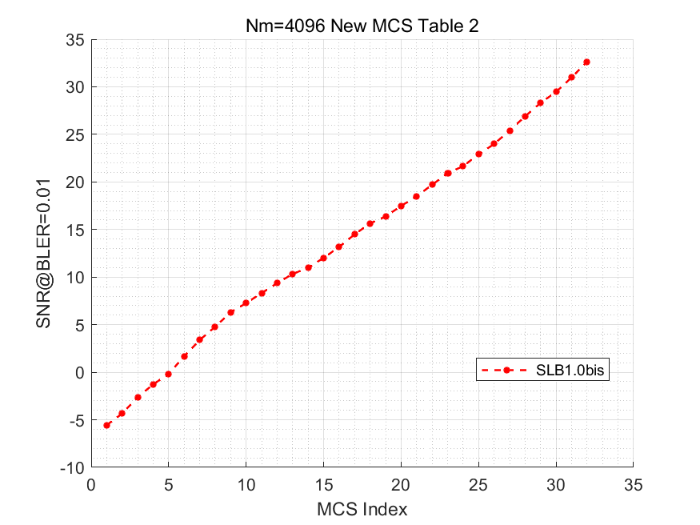
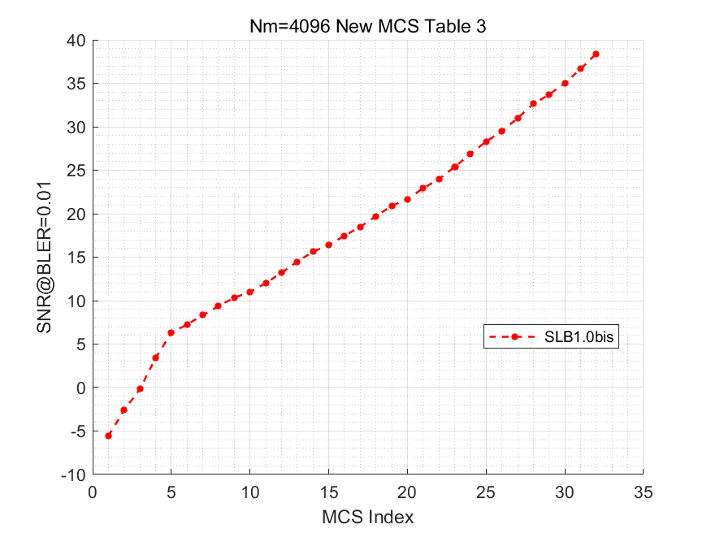
SLB 1.0 bis: MCS table
Notes:
161单载波
5子载波做gap
16子载波一个子载波组
信道资源shifting
Channel 带宽：20MHz基础值，可以拉宽或者缩短，20*alpha，alpha [1/8, --, 50?]，毫米波倍数与ganming确认。
宽发窄收，各带宽考虑自身是默认。
500MHz，考虑100MHz带宽，
800MHz，考虑160MHz，200MHz，80MHz
200MHz和260MHz，考虑20MHz，80MHz，160MHz
80MHz和160MHz，考虑20MHz，80MHz，
40MHz，只考虑20MHz，
场景一：宽发窄收，T节点带宽能力受限
场景二：1T多G，G1和G2配置的带宽不同

Slide 31
SLB 1.0 bis: Polar channel coding
CB length E, CB information length K
Determine a mother code length, and determine a pre-freezing position based on sub-block interleaving
Sparklink 1.0 Coding Link
Reads information bit mapping based on the sequence.
CRC cascading
(24 bit)
Insertion and encoding of information to be encoded with CRC
Subblock Interleaving
Rate Matching
Channel Interleaving
Data to be transmitted by the CB is sent to the modulation module.
CB Payload
To-be-encoded information
To-be-encoded information with CRC
CB length E, CB information length K
Sparklink 1.0bis Coding Link
Determine the mother code length, and calculate the pre-frozen bit according to E and K
According to the sequence
Step-by-step reading
Information bit mapping
CB Payload
CRC cascading
The CB CRC is changed to 16 bits.
Insertion and encoding of information to be encoded with CRC
Sub-block interleaving
Rate Matching
Channel Interleaving
Data to be transmitted by the CB is sent to the modulation module.
To-be-coded information
To-be-encoded information with CRC
Simplify/Optimize the coding process
Improving coding efficiency
Unify the initial transmission and retransmission logic
Supports HARQ and ARQ at the physical layer
SC decoding performance is improved
10x better area efficiency
Supports a 100 Gbit/s transmission rate
Notes:
161单载波
5子载波做gap
16子载波一个子载波组
信道资源shifting
Channel 带宽：20MHz基础值，可以拉宽或者缩短，20*alpha，alpha [1/8, --, 50?]，毫米波倍数与ganming确认。
宽发窄收，各带宽考虑自身是默认。
500MHz，考虑100MHz带宽，
800MHz，考虑160MHz，200MHz，80MHz
200MHz和260MHz，考虑20MHz，80MHz，160MHz
80MHz和160MHz，考虑20MHz，80MHz，
40MHz，只考虑20MHz，
场景一：宽发窄收，T节点带宽能力受限
场景二：1T多G，G1和G2配置的带宽不同

Slide 32
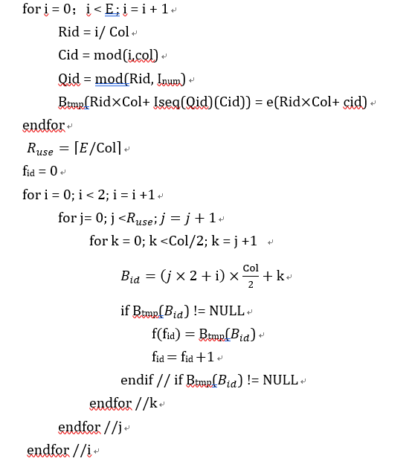
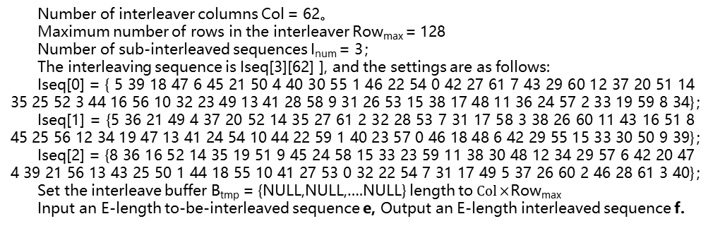
SLB 1.0 bis: Polar Channel Coding-Channel Interleaving
{Row-0/Bank-0,
Row-1/Bank-0 ,
Row-2/Bank-0… ,
Row-x/Bank-0,
Row-0/Bank-1,
Row-1/Bank-1…}
Number of interleaver columns Col = 62。
Maximum number of rows in the interleaver Row_{max} = 128
Number of sub-interleaved sequences I_{num} = 3；
The interleaving sequence is Iseq[3][62] ], and the settings are as follows:
Iseq[0] = { 5 39 18 47 6 45 21 50 4 40 30 55 1 46 22 54 0 42 27 61 7 43 29 60 12 37 20 51 14 35 25 52 3 44 16 56 10 32 23 49 13 41 28 58 9 31 26 53 15 38 17 48 11 36 24 57 2 33 19 59 8 34}；
Iseq[1] = {5 36 21 49 4 37 20 52 14 35 27 61 2 32 28 53 7 31 17 58 3 38 26 60 11 43 16 51 8 45 25 56 12 34 19 47 13 41 24 54 10 44 22 59 1 40 23 57 0 46 18 48 6 42 29 55 15 33 30 50 9 39}；
Iseq[2] = {8 36 16 52 14 35 19 51 9 45 24 58 15 33 23 59 11 38 30 48 12 34 29 57 6 42 20 47 4 39 21 56 13 43 25 50 1 44 18 55 10 41 27 53 0 32 22 54 7 31 17 49 5 37 26 60 2 46 28 61 3 40}；
Set the interleave buffer B_{tmp} = {NULL,NULL,….NULL} length to$Col×$Row_{max}
Input an E-length to-be-interleaved sequence e, Output an E-length interleaved sequence f.
Each row contains two banks, and each bank has 31 bits,
Row-x/Bank-0
Row-x/Bank-1
…
Row-5/Bank-0
Row-5/Bank-1
Total x+1 lines written
The red arrow indicates the output sequence. The output is parallel based on the 31-bit bank size.
Row-4/Bank-0
Row-4/Bank-1
Row-3/Bank-0
Row-3/Bank-1
Row-2/Bank-0
Row-2/Bank-1
Row-1/Bank-0
Row-1/Bank-1
Based on the row ID, the data is written to the row. The 62 bits obtained by interleaving are written each time.
Enter two banks in a row in parallel.
Row-0/Bank-0
Row-0/Bank-1
0
2
Select= mod（Row-id，3）
1
Fixed Sequence Interleave Iseq[0]
(Fixed Connected Networks-0）
Fixed Sequence Interleave Iseq[1]
(Fixed Connected Networks-1）
Fixed Sequence Interleave Iseq[2]
(Fixed Connected Networks-2）
Input data, which is combined into 62-bit parallel data.
Notes:
161单载波
5子载波做gap
16子载波一个子载波组
信道资源shifting
Channel 带宽：20MHz基础值，可以拉宽或者缩短，20*alpha，alpha [1/8, --, 50?]，毫米波倍数与ganming确认。
宽发窄收，各带宽考虑自身是默认。
500MHz，考虑100MHz带宽，
800MHz，考虑160MHz，200MHz，80MHz
200MHz和260MHz，考虑20MHz，80MHz，160MHz
80MHz和160MHz，考虑20MHz，80MHz，
40MHz，只考虑20MHz，
场景一：宽发窄收，T节点带宽能力受限
场景二：1T多G，G1和G2配置的带宽不同

Slide 33
SLB 1.0 bis: Measurement definition, configuration, and process
I：Link measurement information
1、RSRP
2、RSRI
3、RSRQ
4、SINR
II： Interference measurement information
1、RSSI
III： Location measurement information
1、AOA
2、DOA
IV： Time service measurement information
1、 Frequency deviation information
2、 Time deviation information
Notes:
161单载波
5子载波做gap
16子载波一个子载波组
信道资源shifting
Channel 带宽：20MHz基础值，可以拉宽或者缩短，20*alpha，alpha [1/8, --, 50?]，毫米波倍数与ganming确认。
宽发窄收，各带宽考虑自身是默认。
500MHz，考虑100MHz带宽，
800MHz，考虑160MHz，200MHz，80MHz
200MHz和260MHz，考虑20MHz，80MHz，160MHz
80MHz和160MHz，考虑20MHz，80MHz，
40MHz，只考虑20MHz，
场景一：宽发窄收，T节点带宽能力受限
场景二：1T多G，G1和G2配置的带宽不同

Slide 34
SLB 1.0 bis: Link budget update, all sets, and non-standard
SLB 1.0bis link budget：AWGN channel
Physical channel name | Data channel MCS0 (BLER=0.1%) | Synchronize (Capture probability：99%) | DCI (BLER=0.1%) | BCH (BLER=1%) | ACK (BLER=0.1%) | [AR] (Access success rate 90%)
Data rate(kbps) |  | / | / | / | / | /
Transmitter
Max Tx power (dBm) | 14 | 14 | 14 | 14 | 14
Receiver
(2) Thermal noise density (dBm/Hz) | -174 | -174 | -174 | -174 | -174
(3) Receiver noise figure (dB) | 3.2 | 3.2 | 3.2 | 3.2 | 3.2
(4) Interference margin (dB) | 0 | 0 | 0 | 0 | 0
(5) Occupied channel bandwidth (MHz) | 19.2 | 19.2 | 19.2 | 19.2 | 19.2
(6) Effective noise power = (2) + (3) + (4) + 10 log((5)) (dBm) | -97.97 | -97.97 | -97.97 | -97.97 | -97.97
(7) Required SINR (dB) | -3.19 | -6.00 | -4.00 | -3.85 | -5.72
(8) Receiver sensitivity = (6) + (7) (dBm) | -101.16 | -103.97 | -101.97 | -101.82 | -103.68
(9) MCL = (1) - (8) (dB) | 115.16 | 117.97 | 115.97 | 115.82 | 117.68
(10) Receive sensitivity distance of each channel MCS0 | 0.00 | -2.81 | -0.81 | -0.66 | -2.53
Note: (1)BCH：QPSK； (2)DCI：QPSK、Aggregation Level 8、89 bits (3)ACK：QPSK pseudorandom sequence、COMB1、DMRS demodulation for ACK (4)AR: power boosting
Notes:
161单载波
5子载波做gap
16子载波一个子载波组
信道资源shifting
Channel 带宽：20MHz基础值，可以拉宽或者缩短，20*alpha，alpha [1/8, --, 50?]，毫米波倍数与ganming确认。
宽发窄收，各带宽考虑自身是默认。
500MHz，考虑100MHz带宽，
800MHz，考虑160MHz，200MHz，80MHz
200MHz和260MHz，考虑20MHz，80MHz，160MHz
80MHz和160MHz，考虑20MHz，80MHz，
40MHz，只考虑20MHz，
场景一：宽发窄收，T节点带宽能力受限
场景二：1T多G，G1和G2配置的带宽不同

Slide 35

Thank you！

