Slide 1
WI：SLB-mmW meeting 2 TG2 Spectrum Study
Date: 2025-1-15
Source:
Affiliations | Contact | Email
University of Thessaly (UTH) | Theodoros Tsiftsis | tsiftsis@uth.gr
DEKRA | Juan Carlos Morale | juancarlos.mora@dekra.com

Slide 2
1st Meeting 2024-12-02
Approval of the agenda
Approved (participants: Theodoros, Lorenzo, Tommi)
How to approach this task
Theodoros: we should have a document (Technical Requirement document); at first a Table of Contents (example: ITU, ETSI. CEPT, EU, etc.); unlicensed or licensed band?
Tommi: unlicensed as a starting point but not excluding license
Lorenzo: in Italy start from state regulation which is pointing to ETSI and CEPT
Tommi: we should decide the scope (EU, USA, Global, etc.); main focus Europe
Lorenzo: possibility to use external paid services from companies like https://www.policytracker.com/
Tommi: (Action Item) check internally if material available in Huawei

Slide 3
1st Meeting 2024-12-02
Theodoros (Action Item) to provide a skeleton for Technical Report
Fix next meeting
Theodoros (action item) send a Doodle to fix the meeting
Possible days:
10 December in the morning or afternoon
16 December afternoon or 18 December afternoon

Slide 4
2nd Meeting 2024-12-12
Approval of the agenda
Approved (participants: Theodoros, Lorenzo, Tommi, Juan Carlos )
Technical Report (Skeleton)
Theo: Proposed the following ToC for the study of the technical requirement document:
Introduction & Scope of the Study
Regulatory requirements for mmWave band for Unlicensed band
Regulatory requirements per country according to ITU Regions
Regulatory requirements for mmWave band for Licensed bands
Regulatory requirements per country according to ITU Regions
Deployment Scenarios for Short-Range Communications
Functionalities
Physical Layer
MAC-Layer
…

Slide 5
2nd Meeting 2024-12-12
Technical Report (Skeleton)
Lorenzo: Proposed to study the first 4 sections. Study functionalities in a different task group.
Tommi: To be included in the feasibility study report of SLB.
Juan Carlos: Stated the following:
Need to scope the work to be done by the Spectrum Group.
Priority 1 is Europe (all countries).
Information to capture from Regulatory of those countries (to list it)
Setup a project plan when the info ready
We also need to identify the sources or associations we have to obtain the info from. Like CEPT, or ETSI, from ITU, or EU, where it might be necessary to collect the reports on CEPT (recommendation the technology itself, and the regulations suggested
Theo: Stated that priority should be given in Europe as we agreed during our plenary meeting in France.
Lorenzo: Presented the situation of 60GHz at CEPT (REC 70-03) with related ETSI standard cited there, and the Italian situation

Slide 6
2nd Meeting 2024-12-12
Technical Report (Skeleton)
Action Item #1: Propose to the plenary to split the TR on Spectrum Study i.e.,
Part 1: Survey Analysis
Part 2: Functionalities & Performance Evaluation
Action Item #2: Focus on Europe and specifically on Italy (Lorenzo)
Action Item #3: Spectrum regulation preliminary roadmap for Europe (Juan Carlos & Theo) i.e., technology, frequency range,…

Slide 7
2nd Meeting 2024-12-12
Huawei material for spectrum regulations
Tommi: Continues to work on it
Fix Next Meeting
Next meeting after plenary (January 2025)

Slide 8
3rd Meeting 2024-12-12
Approval of the agenda
Approved (participants: Theodoros, Lorenzo, Tommi, Juan Carlos )
Spectrum Roadmap
Theo: Spectrum regulation preliminary roadmap for Europe
EU 60GHz Spectrum Regulation report (Spectrum) –DEKRA
Lorenzo: Country, Bandwidth, Specification
Actions for F2F Malaga Meeting
Theo & Juan-Carlos: Present EU 60GHz Spectrum Regulation provided DEKRA
Juan-Carlos: Present the Tool (DEKRA)
Tommi: Discuss & decide countries and spectrum of interest

Slide 9

Observations
Spectrum area is chaotic (plenty of regulations, specifications depending on countries & frequencies, and various SDOs etc)
SPECTRUM REGULATIONS ROADMAP

Slide 10
Focus @ 60GHz in EU Countries
In Europe, the 60 GHz frequency band (57–66 GHz) is designated for unlicensed use, facilitating high-capacity wireless communications such as WiGig (IEEE 802.11ad) and other short-range communications.
CEPT and ETSI have established regulations and standards to ensure harmonized use across member countries.

Slide 11
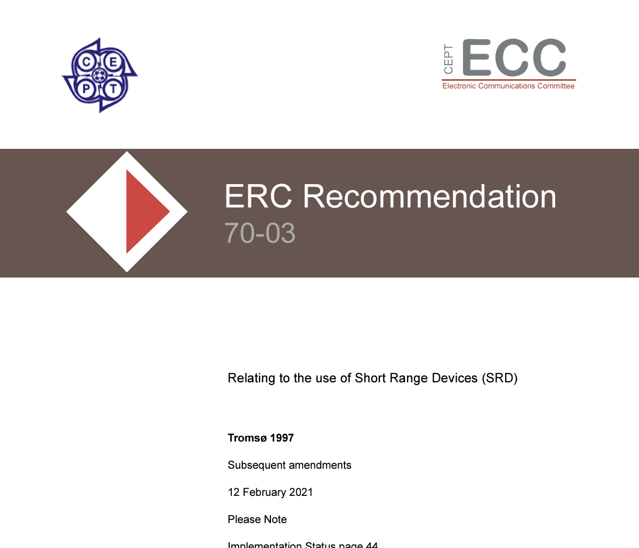
Key Regulatory Documents @ 60GHz in EU Countries
CEPT Recommendation 70-03 (Annex 3):
This recommendation outlines the use of Short-Range Devices (SRDs) in the 60 GHz band, specifying technical parameters to minimize interference and ensure efficient spectrum use.

Slide 12

Key Regulatory Documents @ 60GHz in EU Countries
ETSI EN 302 217:
This harmonized standard specifies technical characteristics and methods of measurement for Fixed Radio Systems, including those operating in the 60 GHz band.

Slide 13
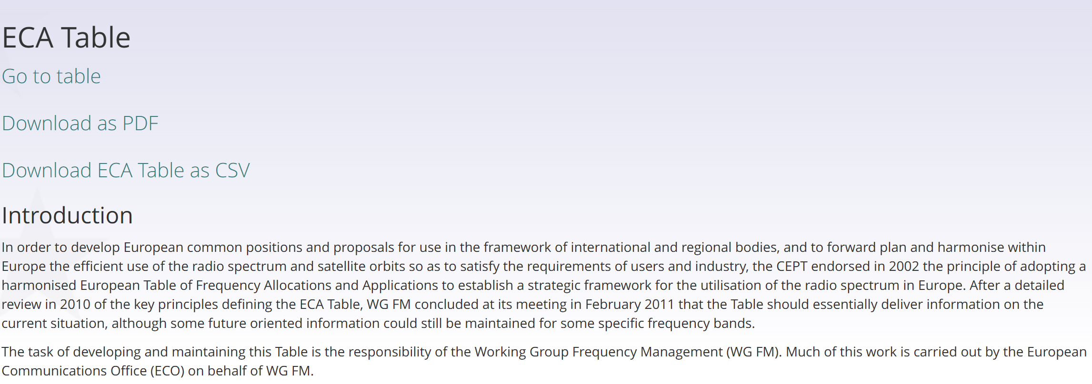
Key Regulatory Documents @ 60GHz in EU Countries
European Common Allocation (ECA) Table:
Maintained by the European Communications Office (ECO), the ECA Table provides detailed information on frequency allocations and applications, including the 60 GHz band.

Slide 14
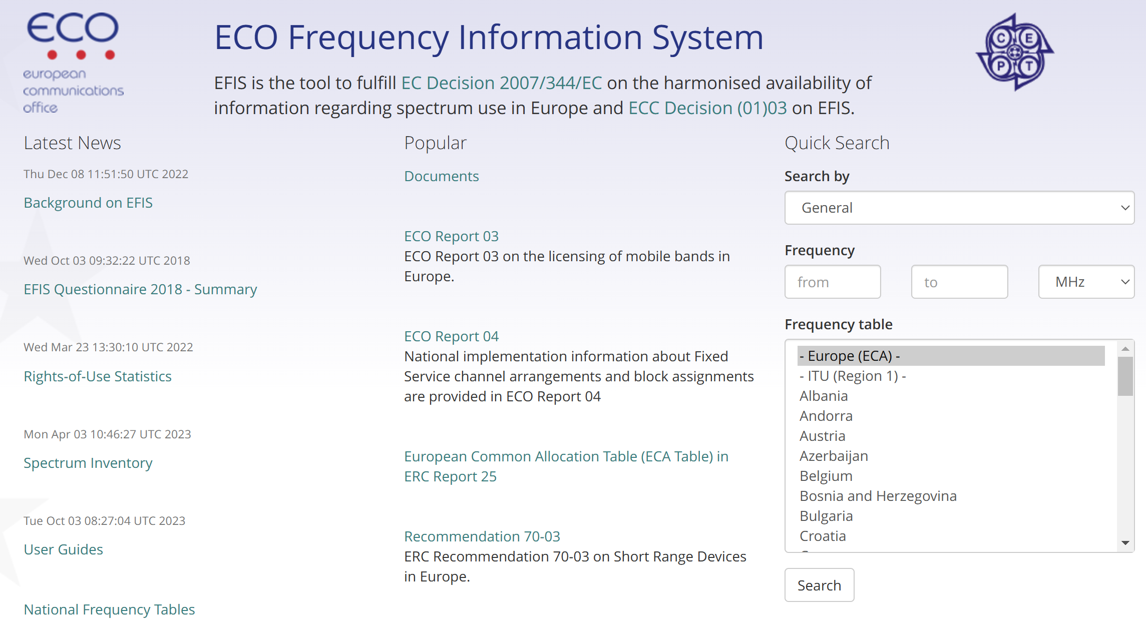
Key Regulatory Documents @ 60GHz in EU Countries
ECO Frequency Information System (EFIS):
EFIS is an online database offering comprehensive information on spectrum use and regulations across European countries. It includes national frequency allocation tables, relevant documents, and application information for the 60 GHz band

Slide 15
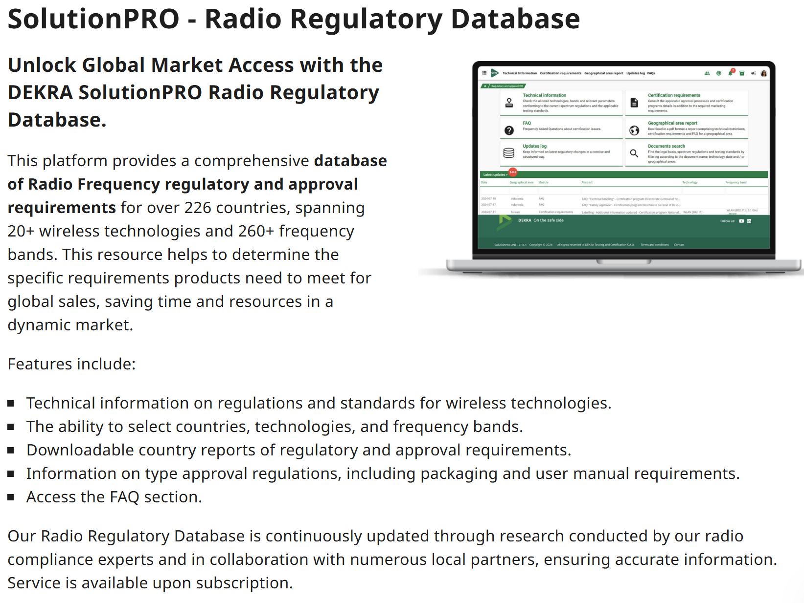
Tool for Spectrum Regulations Roadmap
DEKRA presented a tool called DEKRA SolutionPRO

Slide 16
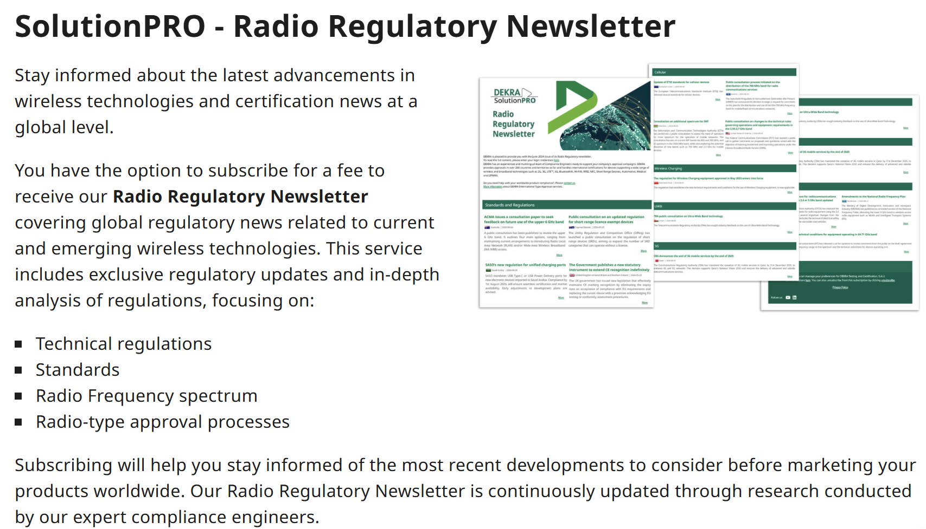
Tool for Spectrum Regulations Roadmap
DEKRA presented a tool called DEKRA SolutionPRO

Slide 17
Tool for Spectrum Regulations Roadmap
Juan Carlos (DEKRA) provided (for free) a 7 pages report on the regulations @ 60GHz for EU countries
The report can be created for other European countries (non-EU members)
Reports can be created:
226 Countries
20+ wireless technologies
260+ frequency bands
Updated regularly

Slide 18
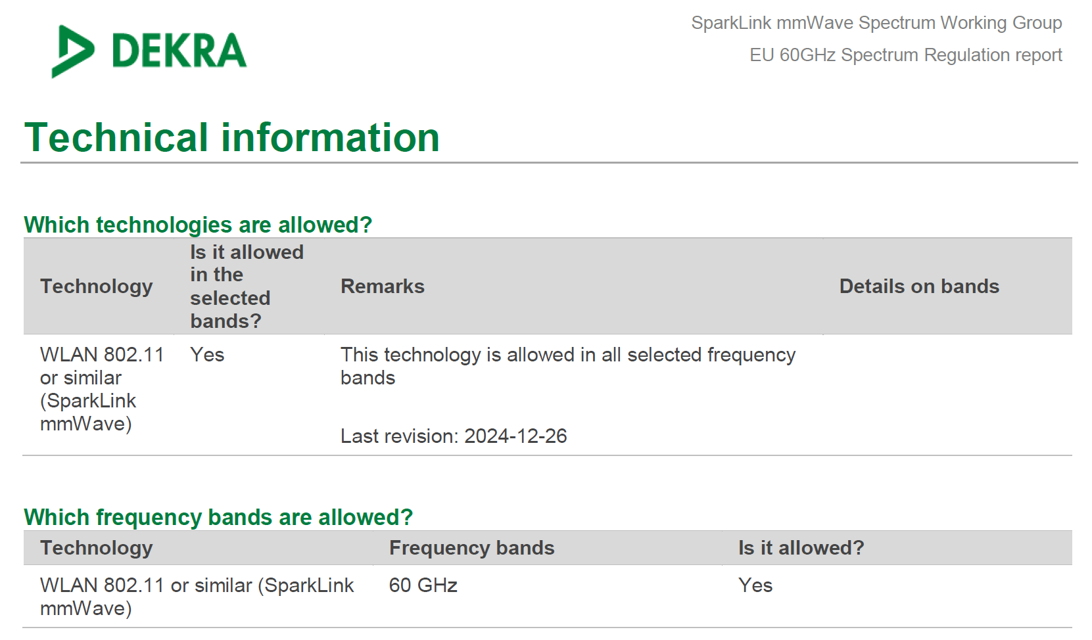
Tool for Spectrum Regulations Roadmap

Slide 19
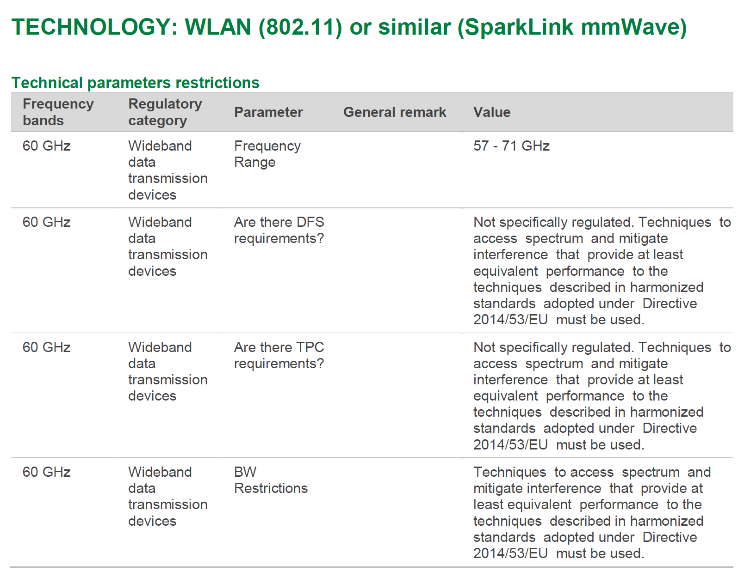
Tool for Spectrum Regulations Roadmap

Slide 20
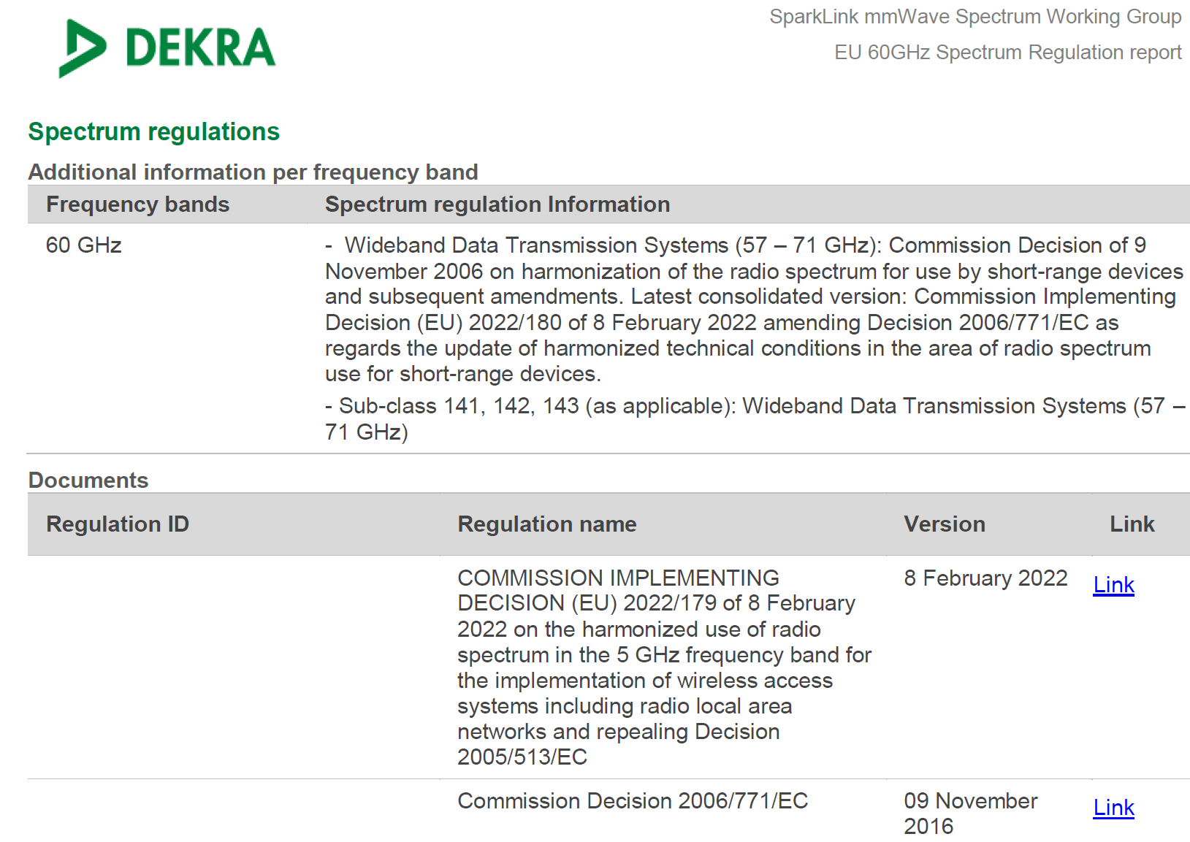
Tool for Spectrum Regulations Roadmap

Slide 21
Thank you!

