Slide 1
SI: SLB-mmW Meeting # Beam Management Challenges
Date: 2025-03-06
Source:
Affiliation | Contact | Email
Huawei Technologies. Co. Ltd | Dor Chay | dor.chay@huawei.com

For approval

For discussion
For information



Slide 2
Contents
Motivation
Challenge 1: Asymmetric Link
Challenge 2: Beam Failure Detection
Challenge 3: Frequency-selective Beam Management
Challenge 4: Multiple T-nodes
Next Steps

Slide 3
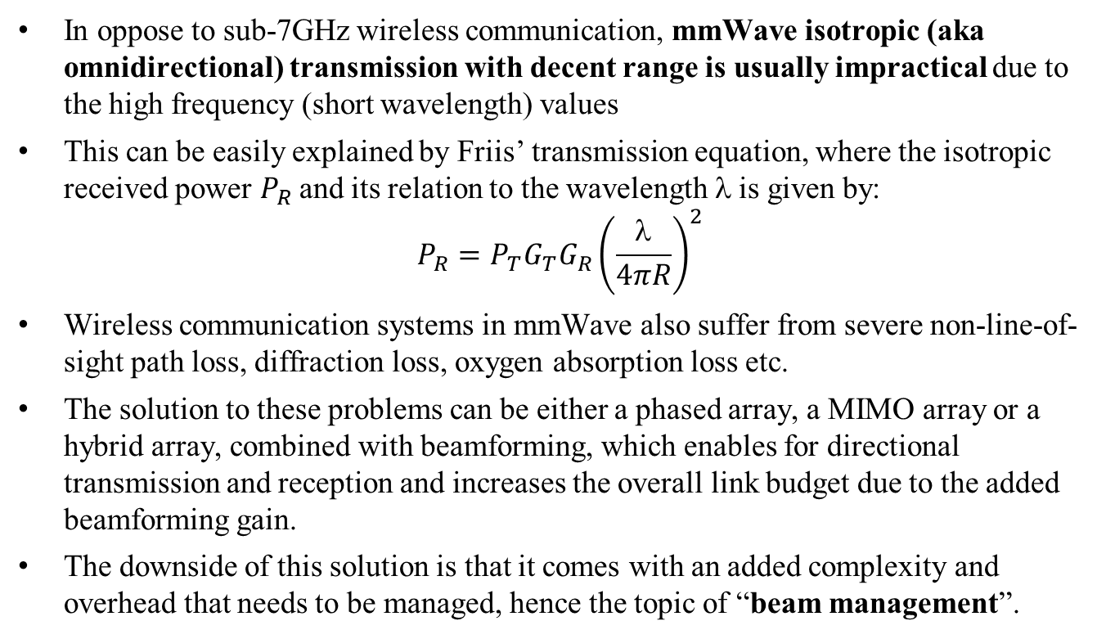
Motivation
In oppose to sub-7GHz wireless communication, mmWave isotropic (aka omnidirectional) transmission with decent range is usually impractical due to the high frequency (short wavelength) values
This can be easily explained by Friis’ transmission equation, where the isotropic received power $P_{R}$ and its relation to the wavelength $$is given by:
$$P_{R}=P_{T}G_{T}G_{R}{\left(\frac{λ}{4πR}\right)}^{2}$$
Wireless communication systems in mmWave also suffer from severe non-line-of-sight path loss, diffraction loss, oxygen absorption loss etc.
The solution to these problems can be either a phased array, a MIMO array or a hybrid array, combined with beamforming, which enables for directional transmission and reception and increases the overall link budget due to the added beamforming gain.
The downside of this solution is that it comes with an added complexity and overhead that needs to be managed, hence the topic of “beam management”.

Slide 4
Motivation
Beam management is a set of processes for scanning, measuring, reporting and maintaining of Tx/Rx beams for enabling basic communication up to optimal performance between two nodes
Beam management comes with added complexity and overhead, and has several technical challenges that needs to be addressed
In this presentation we present few of these technical challenges

Slide 5
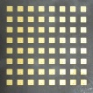
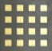


Challenge 1: Asymmetric Link
The asymmetric link problem occurs when the beamforming characteristics of the G-node and T-node are not identical. This creates issues where:
The G-node might have a much more accurate and stronger beamforming, resulting in significant dB difference (e.g. because it has more antennas or more sophisticated beamforming techniques)
The T-node, on the other hand, might not be able to provide the same quality of beamforming. This often happens because the T-node might have fewer antennas, limited computational power, or lower capability in adjusting its beam compared to the G-node.
G-node
T-node
8x8 phased array
4x4 phased array
Example: a G-node with more antennas than the T-node

Slide 6
Challenge 1: Asymmetric Link
A T-node that listens to the G-node beam sweeping and wants to send a beam reporting back need to have enough T-link link margin
However, its Tx beam is not established yet, and the link margin for a response in a quasi-omnidirectional mode might not be sufficient
Beam Number
N-1
G-link works
N-1
N-2
N-2
N-3
N-3
…
…
2
2
1
T-link doesn’t work
1
G-node
0
T-node
0
8x8 phased array
4x4 phased array
SNR [dB]

Slide 7
Challenge 1: Asymmetric Link
Potential solutions:
Assume reciprocity (not always possible)
Add a beam sweeping procedure that includes sweeping of both links (results in longer convergence time and thus higher latency)
Find smart ways to identify an asymmetric link cases and adapt the beam sweeping flow only for these specific cases

Slide 8
Challenge 2: Beam Failure Detection
In FB2 (mmWave) directional communication, the link between G-node and T-node is very susceptible to channel dynamics like high mobility, blockage, interference etc.
For example, a slight tilting of the T-node can cause beam failure:


Tilt



Slide 9
Challenge 2: Beam Failure Detection
Beam failure can manifest in several ways, but the most common indicators include:
Loss of Signal Strength: The most obvious indicator of beam failure is a significant drop in signal strength or signal-to-noise ratio (SNR). If the signal strength falls below a threshold (up to no reception at all for a predefined period) due to misalignment or blockage, it could be a sign that the beam is no longer effective
Increased Error Rates: Beam failure might also be inferred from a sudden increase in PER/BER or packet loss, as the communication link degrades
Feedback Signaling: Some systems implement feedback mechanisms where the receiver informs the transmitter if the current beam is ineffective or if there is significant signal degradation. A lack of appropriate feedback (or the receipt of an explicit negative feedback) might indicate beam failure

Slide 10
Challenge 2: Beam Failure Detection
When discussing beam failure detection algorithm, there is a clear trade-off between the stability of our beam selection and latency
One the one hand, if we declare “beam failure” upon every RSRP degradation event, we will initiate beam recovery very fast (good latency) but our beam selection will be unstable
On the other hand, if we insist on staying with the selected beam for too long despite RSRP degradation, we will have good stability but may suffer from high latency in case the RSRP degradation is constant
There is a need for smart, adaptive beam failure algorithm to handle various channel dynamics (mobility, interference, blockage etc.)
There is a need to use several link indications for detecting beam failure
There is a need for reliance on FB1 for:
More link indications
Fallback
Beam recovery message exchange

Slide 11
Challenge 3: Frequency-selective Beam Management
The propagation characteristics of the mmWave band are highly frequency dependent.
The channel conditions such as path loss, delay spread and multipath may vary in different sub-bands of the 60GHz band.
This means that the ideal beam for a particular frequency might not be the best at another frequency within FB2.

Slide 12
Challenge 3: Frequency-selective Beam Management
Why would this affect SLB-mmW Beam Management?
SLB-mmW is expected to operate in an open frequency band and deploy interference avoidance algorithms. Hence, we are expected to experience interference followed by frequency shift, which might affect our beam management algorithm
SLB-mmW is expected to use wide bandwidths, which can result in frequency-selective fading. The channel may vary across different sub-bands of the available bandwidth, meaning that the ideal beam might differ for each sub-band
In addition, the SLB G-node may schedule G-link and T-link over different resource units (sub-bands) within the channel, resulting in different frequency, which might affect our beam management algorithm

Slide 13
Challenge 3: Frequency-selective Beam Management
There is a need for offline simulations or measurements of the ideal beam selection in different sub-bands of the 60GHz band under different use cases (LOS, NLOS, w/ vs. w/o interference etc.)
There might be a need for frequency awareness in our beam management algorithm

Slide 14
Challenge 4: Multiple T-nodes
There are several challenges that differ from beam management for a single T-node compared to beam management for multiple T-nodes in parallel
Note: in this discussion we assume that the G-node can only transmit with a single beam at any given moment
…
…
…

Slide 15
Challenge 4: Multiple T-nodes
Beam management overhead: For a single T-node, beam management overhead is relatively low, as the system only needs to monitor and adjust beam parameters for that one device. For multiple T-nodes, beam management overhead increases in the order of number of T-nodes.
Broadcast: all broadcast messages needs to be transmitted per T-node (per beam)
Scheduling & latency: scheduling changes because the G-node can (usually) only transmit to a single T-node per beam. This causes a latency challenge since we assume there is no transmission to more than one T-node in parallel.

Slide 16
Challenge 4: Multiple T-nodes
Beam management algorithm, and specifically its overhead and latency, should be evaluated under multiple T-node use case
We may need to rely on FB1 (sub-7GHz) for broadcast messages

Slide 17
Next Steps
Address these challenges explicitly as part of our beam management study item

Slide 18
Thank you

