Slide 1
WI：SLB-mmW meeting # New Use Cases from Vehicular and Manufacturing Industry
Date: 2025-02-26
Source:
Affiliation | Contact | Email
Huawei Technologies. Co. Ltd | Francesc Fons | francesc.fons@huawei.com

Slide 2
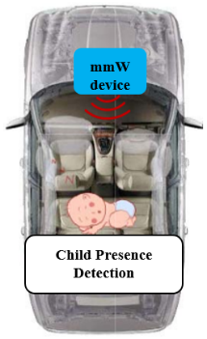
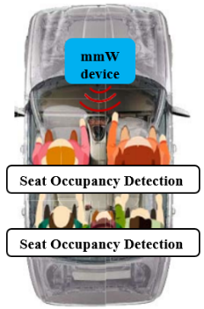
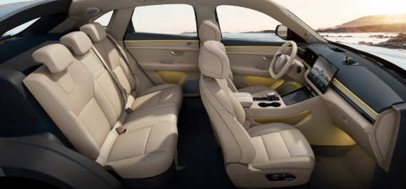
Child Presence Detection & Seat Occupancy Detection
Pre-Conditions:
The number of accidents involving forgotten children dying by hyperthermia in a locked vehicle has been increasing.
Child presence detection could become part of the safety assessment criteria in the European New Car Assessment Programme (Euro NCAP).
Current visual sensors which have blind spots, are unable to detect in scenarios where seats block the view, in dark conditions, or when a child is covered by clothe or blanket. The gravity sensor cannot distinguish between lifeform and heavy objects. If the weight is too small, it cannot trigger the gravity sensor, and if the face is too small, vision cannot recognize it. Therefore, there are challenges in detecting infants and children.
Environment:
The mmW device may be installed in a vehicle to monitor the human body inside, with a distance usually less than 5 meters.
Traffic Conditions:
There may be other moving targets in the vehicle that cause interference.
Use Case:
When the mmW device detects that the driver has locked the car but a child is still left inside, it reminds the user.
Based on mmW device installed in the vehicle, the occupancy status of each seat is detected. If someone is sitting without wearing a seat belt, a reminder will be issued.
Application:
Child Presence Detection (CPD): detect the presence of a child in car when the driver locks the car door.
Seat Occupancy Detection (SOD): detect a lifeform in any seat to issue a seatbelt reminder, as well as to determine the force of airbag deployment in the event of a crash.
mmW device

Slide 3
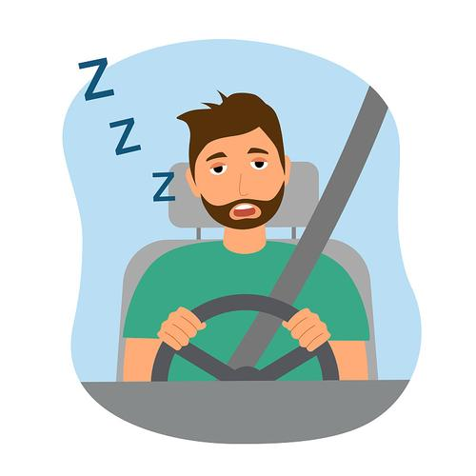
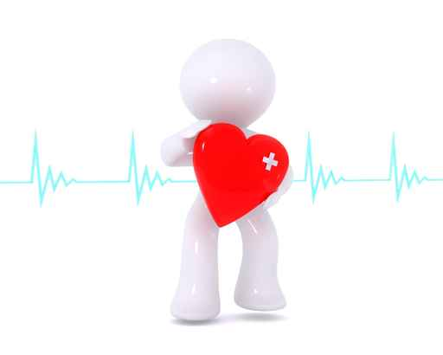
Driver/Passenger Vital Sign Monitoring
Pre-Conditions:
Real-time monitoring of the driver's health condition to prevent accidents caused by sudden illnesses.
Based on the passenger's health data, adjust the in-car environment (such as temperature, air quality, etc.) to provide a more comfortable driving experience.
Detecting abnormal health conditions, the system issues a timely alarm and may activate the autonomous driving function to ensure safety.
Traffic Conditions:
Monitoring breathing and heart rate for driver and passengers becomes challenging when they are in motion, as it can be difficult to accurately monitor these vital signs.
Use Case:
The mmW device detects the vital signs of driver and passengers, and provides warnings.
Application:
Driver vital sign monitoring: monitor the heartbeat and respiration of the driver, to warn and remind of fatigue driving.
Passenger vital sign monitoring: monitor the heartbeat and respiration of the passenger.
mmW device
Environment:
The mmW device may be installed in a vehicle to monitor the vital signs of people, with a distance usually less than 5 meters.

Slide 4
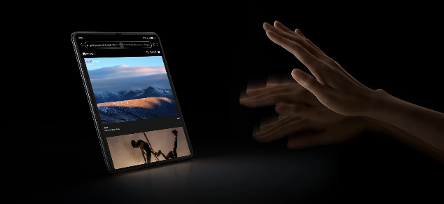
Gesture Recognition
Pre-Conditions:
Enhancing Driving Safety: By using gesture recognition, drivers can adjust in-car systems (such as navigation, music, etc.) without diverting their attention, thereby reducing the risk of traffic accidents caused by distracted operation.
Optimizing User Experience: Passengers can control the in-car environment through simple gestures, such as adjusting the temperature, dimming the lights, etc., providing a more intelligent and convenient riding experience.
Traffic Conditions:
It is necessary to accurately identify different gestures to avoid misrecognition of similar actions or gestures.
Use Case:
The mmW device detects and recognizes the gesture of driver and passengers, and provides corresponding services.
Application:
Gesture Recognition: Continuously monitor the gestures of driver and passengers, and control the operating system based on user gestures, thereby achieving intelligent interaction and enhancing the driving experience.
mmW device
Environment:
The mmW device may be installed in a vehicle to detect and recognize the gesture, with a distance usually less than 2 meters.

