Slide 1

WI：SLB-mmW Meeting #6
TG1 Spectrum Study: Report
Date: 2025-3-06
Source:
Affiliations | Contact | Email
University of Thessaly (UTH) | Theodoros Tsiftsis | tsiftsis@uth.gr
For approval
For discussion
For information

Slide 2
Possible ways forward
Meeting #4 2025.02.05
“summary” of the different regulations primarily for unlicensed mmWave bands
Heavy and “copy & paste” (pay attention to copyright)
Checking against different regulations primarily for unlicensed mmWave bands
We need to “wait” for at least tentative proposals
Mixed
Working together with the “main” track and ongoing check
Remaining question: access to external tools and services

Slide 3
Action Items
Meeting #4 2025.02.05
Spectrum group to focus on EU countries and unlicensed bands.
Theo will Prepare a preliminary draft of a technical report by checking all the potential bands (strong candidates) to be presented in the next plenary meeting.

Slide 4
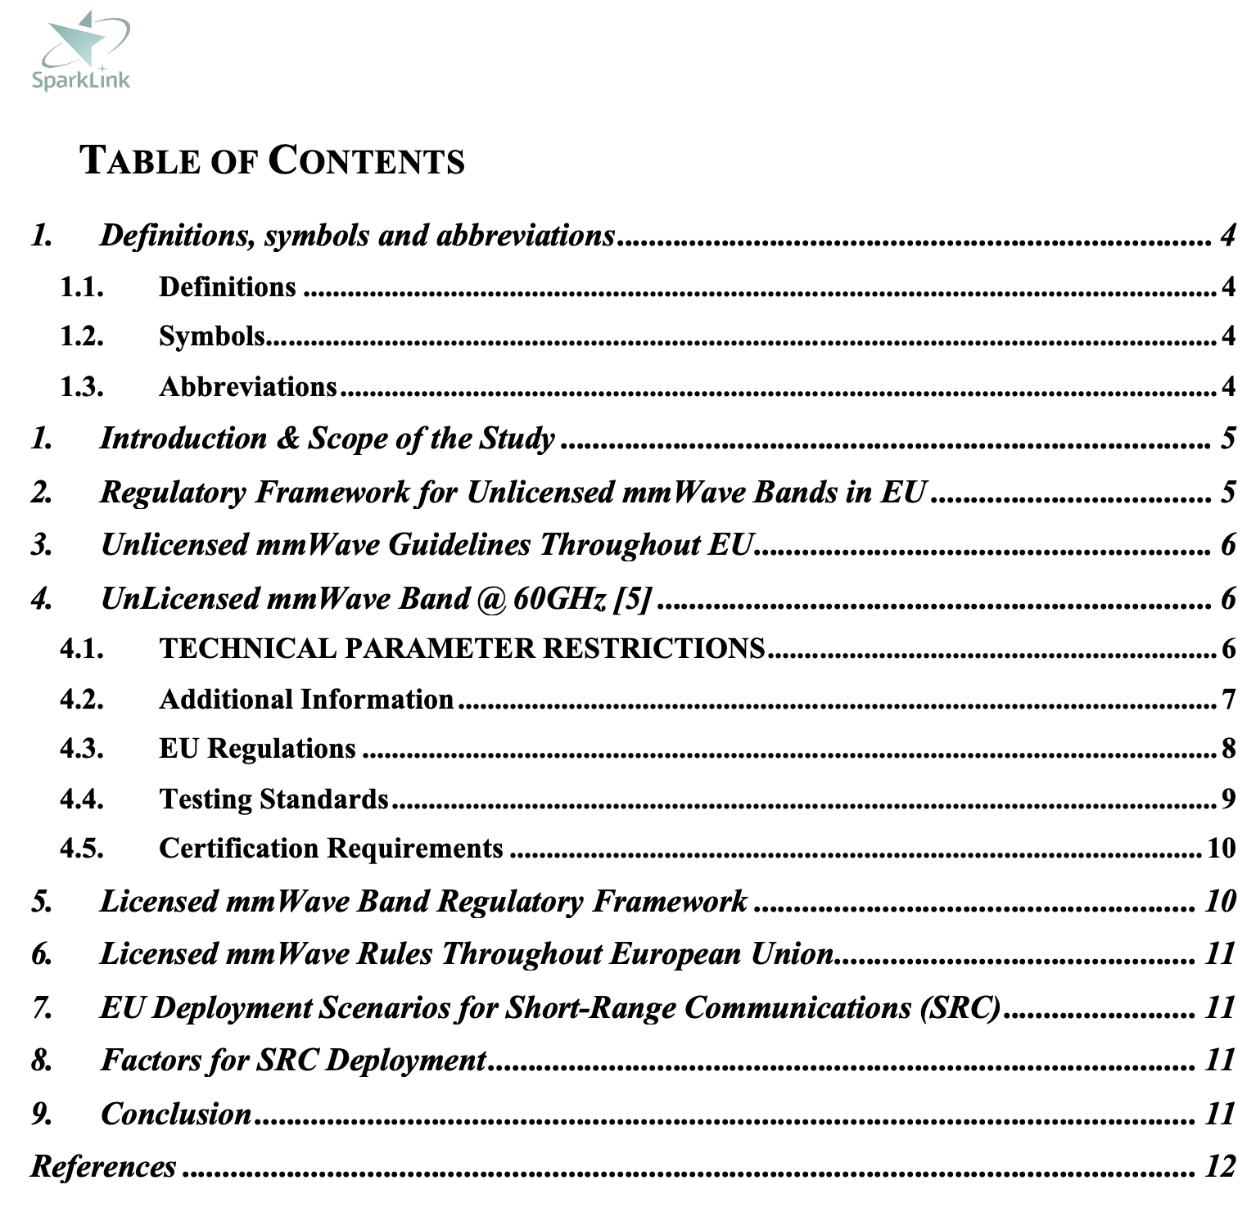
Report

Slide 5
Introduction & Scope of Study
This report explores the regulatory landscape for millimeter-wave communication in the European Union (EU), focusing on licensed and unlicensed bands.
It explores deployment scenarios for short-range communication
Considering ETSI and CEPT/ECC in the European process of standardization and regulation.

Slide 6
Unlicensed mmWave Bands in EU
Unlicensed mmWave bands in the EU provide flexibility for wireless technology innovation, with CEPT and national authorities managing governance.
Key factors include harmonized 57-66 GHz range, power transmission limits, adaptive spectrum allocation, and Radio Equipment Directive (RED) compliance.

Slide 7
Unlicensed mmWave Regulators in EU
Austria: RTR supervises 60 GHz band compliance with ECC/DEC/(09).
Belgium:BIPT lets unlicensed access within the 57–66 GHz spectrum under controlled power limits.
Bulgaria: CRC guarantees follow-through to CEPT recommendations for unlicensed bands.
Croatia: HAKOM controls short-range mmWave consumption.
Cyprus: OCECPR applies spectrum rules covering the EU.
Czech Republic: CTU adheres to CEPT mmWave spectrum recommendations.
Denmark: Energistyrelsen oversees unlicensed band national spectrum policies.
Estonia:The Technical Regulatory Authority conforms rules to CEPT.
Finland: Traficom lets unapproved use of the 57-66 GHz spectrum.
France: ARCEP follows CEPT recommendations in controlling mmWave unlicensed bands.
Germany: BNetzA applies ECC/DEC/(09)01 under further operational restrictions.
Greece: EETT allows only restricted unlicensed mmWave use.

Slide 8
Unlicensed mmWave Regulators in EU
Hungary: NMHH controls mmWave spectrum access under CEPT rules.
Ireland: ComReg grants unlicensed uses access to the 60 GHz band.
Italy: AGCOM uses CEPT guidance on unlicensed mmWave spectrum.
Latvia: SPRK follows CEPT-aligned unlicensed mmWave policies.
Lithuania: RRT develops national guidelines for unapproved mmWave spectrum.
Luxembourg: ILR permits unapproved 60 GHz band access.
Malta: MCA guarantees spectrum policies compliant to EU for unlicensed bands.
Netherlands: Agentschap Telecom controls mmWave spectrum access.
Poland: UKE follows spectrum policy aligned with CEPT.
Portugal: ANACOM lets unapproved use of the 57–66 GHz spectrum.
Romania: AN COMply with ECC/DEC/(09)01.
Slovakia: RU adheres to CEPT mmWave guidelines.
Slovenia: AKOS controls mmWave spectrum policies.
Spain: CNMC lines its spectrum rules with EU-wide guidelines.
Sweden: PTS lets unlicensed usage of the 60 GHz band.

Slide 9
Unlicensed mmWave Band at 60GHz
Technical parameter restrictions is presented for wideband data transmission devices.
EU regulations
Testing Standards
Certification requirements: The current type approval regulation at EU level, Radio Equipment Directive (RED), is in effect as of 13th June 2016, with a transition period that expires on 12th June 2017. After 12th June 2017 all devices must meet the RED requirements, so that devices in compliance with Radio Equipment and Telecommunications Terminal (R&TTE) must be re-certified in order to be placed on the European market after such date.

Slide 10
Licensed mmWave Band Regulatory Framework
High-priority uses including 5G networks, satellite services, and private wireless deployments fall under licensed mmWave spectrum.
Important regulatory factors consist in:
Frequency Allocations: Under Decision (EU) 2019/784 the 24.25–27.5 GHz band (26 GHz) has been set aside for 5G services in the EU.
Licensing Methods: Either direct assignments or auctions all help to allocate spectrum.
Interference Management: Operators have to follow spectrum sharing guidelines described in ECC Recommendation (19)01.

Slide 11
Licensed mmWave Band Rules in EU
Licenced mmWave spectrum allocation varies throughout EU countries. Here is a synopsis of the various regulatory strategies:
• Germany, France, Italy, Spain: 5G installations have been auctioned over the 26 GHz spectrum.
• Scandinavian Countries: Provide flexible licenses for commercial and industrial application.
• Eastern and Central European Nations: Gradually phasing in licensed mmWave.

Slide 12
EU Deployment Scenarios
Industrial 5G Networks: Private mmWave 5G deployments enhance connectivity in manufacturing, logistics, and smart factories, guided by ECC Recommendation (20)01.
Vehicle-to-Everything (V2X) Systems: Autonomous vehicle networks rely on mmWave for ultra-low latency communication, regulated under ETSI EN 302 571.
Public Wi-Fi and FWA: Urban and remote areas benefit from high-speed wireless access using mmWave bands under ETSI EN 305 550.
Immersive AR/VR: Virtual reality applications depend on mmWave’s high-bandwidth capabilities, governed by IEEE 802.11ay standards.

Slide 13
References
[1] https://docdb.cept.org/download/1564
[2] https://www.wi-fi.org/discover-wi-fi/wi-fi-certified-wigig
[3]https://www.etsi.org/deliver/etsi_en/305500_305599/30555002/01.02.01_60/en_30555002v010201p.pdf
[4] https://single-market-economy.ec.europa.eu/sectors/electrical-and-electronic-engineering-industries-eei/radio-equipment-directive-red_en
[5] European process of standardisation and regulation for radiocommunications devices and systems – cooperation between CEPT/ECC and ETSI, related to MoU between CEPT and ETSI, June 2018.
[6] European Union – Spectrum and Certification, Technical Report, DEKRA, 26.12.2024.

Slide 14
Decisions made by TG1 to be discussed approved in Barcelona
Meeting #5 2025.02.27
Focus on 60GHz as a first priority band.
Second priority other bands such as 24 GHz and 45GHz.
Priority on consumer indoor 60 GHz.

Slide 15
Thank you!

