Slide 1

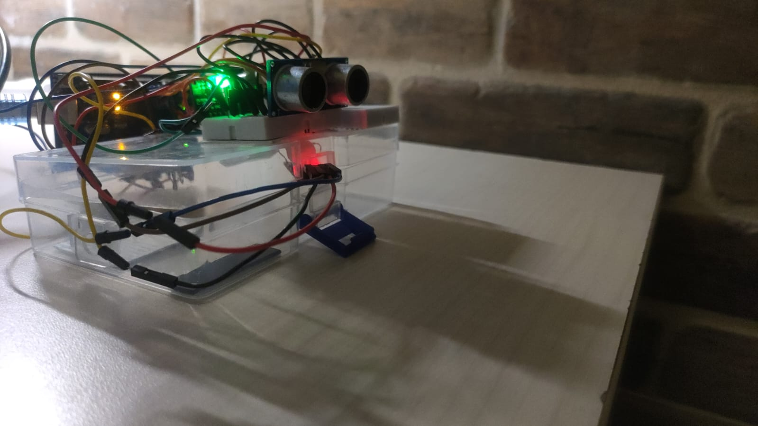
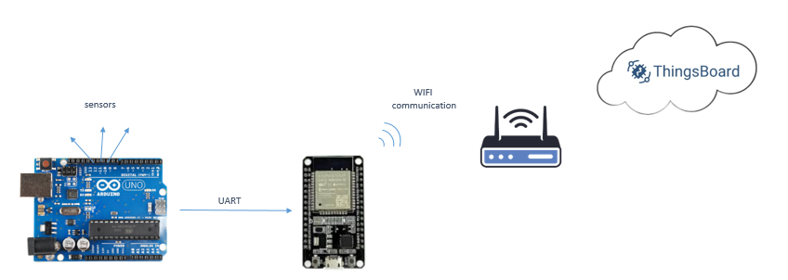
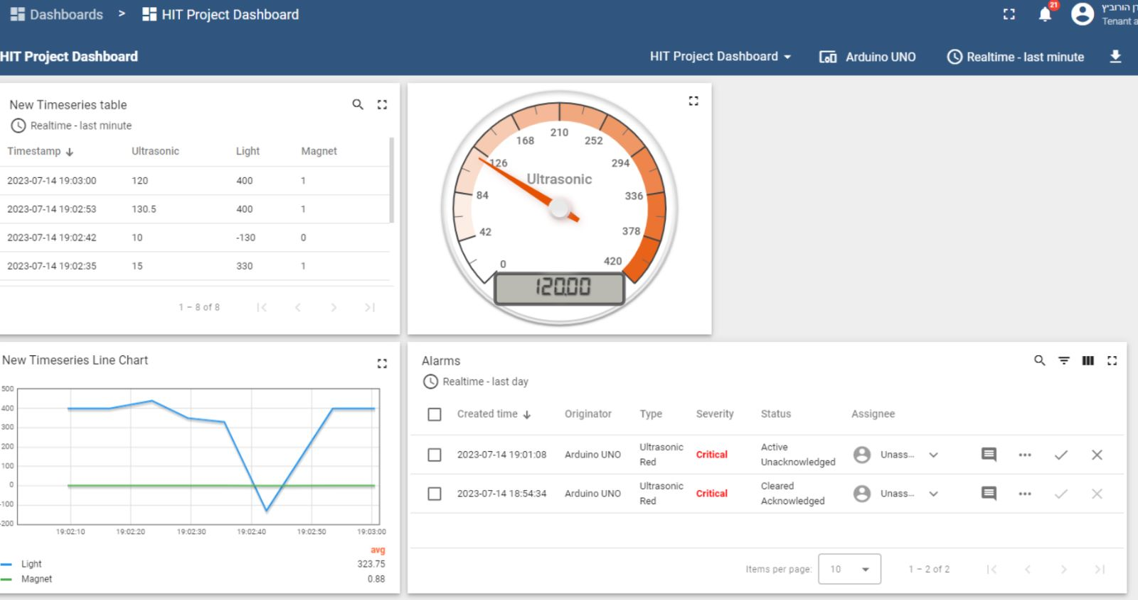
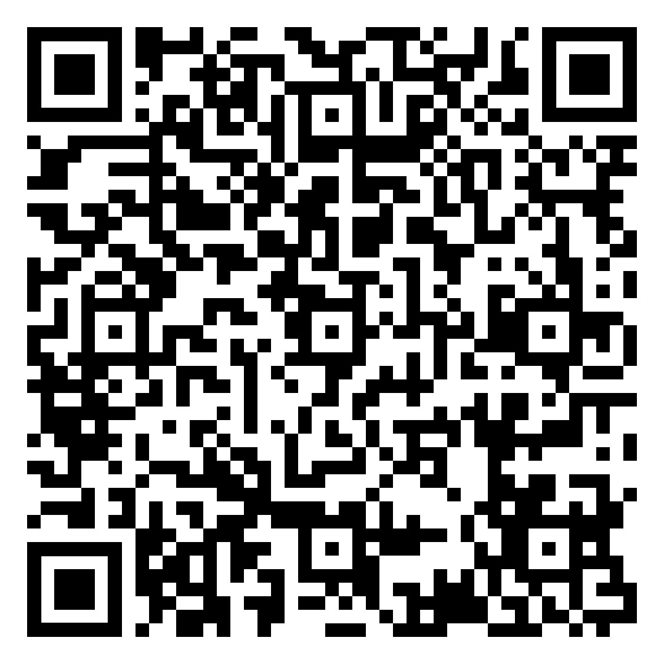
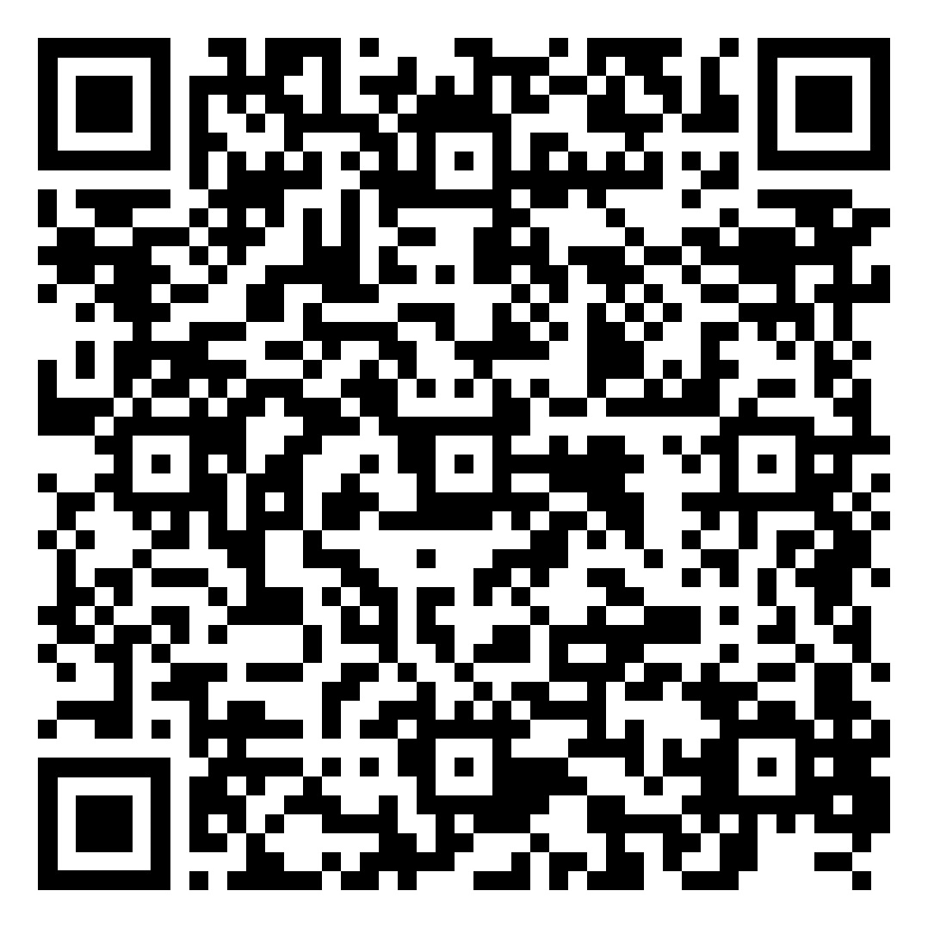
Introduction to Embedded Software and Applications | Smart Security for Museum Display Cases Presented by Yarden Horowitz & Eden Sheiko Third year of study, Summer Semester 2023
Vladi Budnitski
Introduction to the Problem
Museums are continually grappling with the task of safeguarding valuable artifacts and artworks. The current security measures often lack real-time monitoring and fall short of providing comprehensive data for effective analysis.
Motivation behind the Project
Our aim is to create a cost-effective, efficient solution to enhance museum display case security. We are leveraging IoT technology to implement a system that enables real-time monitoring and provides actionable insights for preventive measures.
System Design
The core of our system is the Arduino Uno microcontroller. We connected it with an Ultrasonic sensor, a Magnetic sensor, and a Light sensor. The system also includes actuators like a buzzer alarm and LED indicators. An ESP32 Gateway device establishes a connection between the local Wi-Fi network and the ThingsBoard cloud platform.
Implementation Details
The Ultrasonic sensor measures the proximity of viewers to the display case, triggering different LED colors and buzzer states based on the distance. The Light sensor serves as an additional identifier to determine if the museum is closed or if there's a potential threat. The Magnetic sensor detects any unauthorized opening of the display case, sending an alert to security personnel via ThingsBoard.
Challenges and Resolutions
We encountered challenges in sensor calibration, communication between Arduino and the gateway device, and integrating with the ThingsBoard platform. These were addressed through extensive testing, error handling, and careful study of ThingsBoard integration guides.
Conclusion
Our IoT Arduino-embedded museum display case security system has successfully enhanced artifact security through real-time monitoring and cloud connectivity. It also serves as a deterrent to potential threats. This project has provided us with valuable insights into the practical considerations of real-time monitoring and the implementation of IoT solutions.
Acknowledgements
Special thanks to Vladi Budnitski and Dr. Yakov Damatov for their invaluable support throughout this project.
Contact Information
Eden Sheiko - edensheiko@gmail.com
Yarden Horowitz - yarden218@gmail.com

