Slide 1

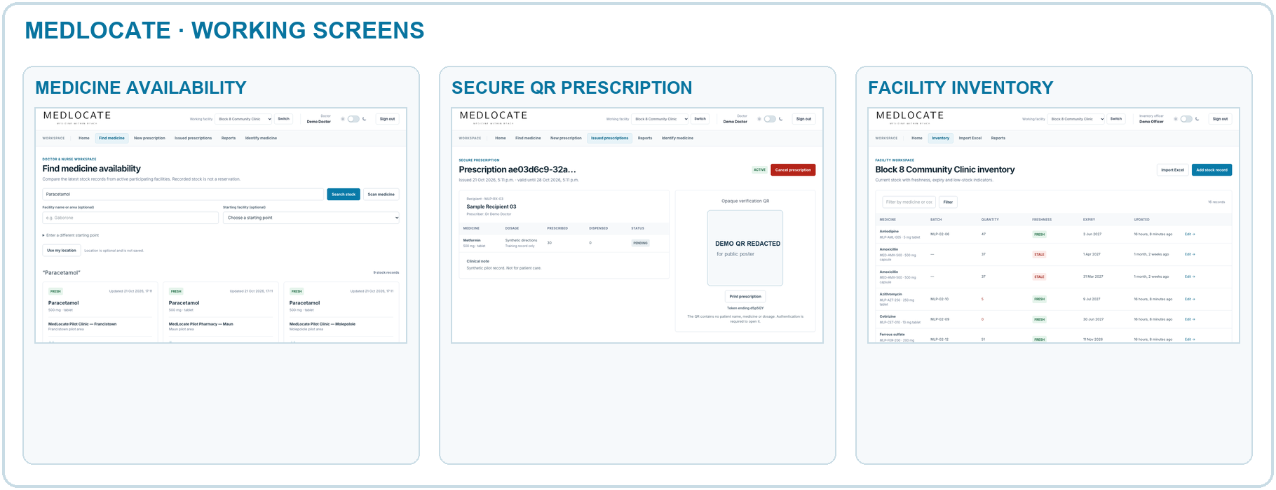
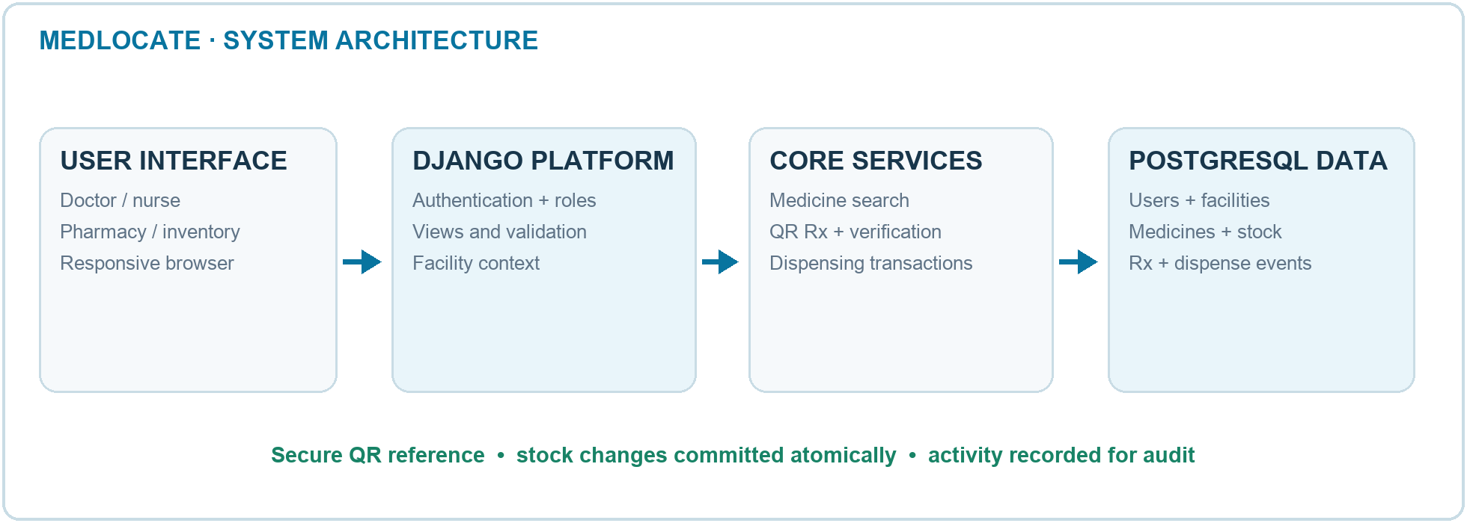
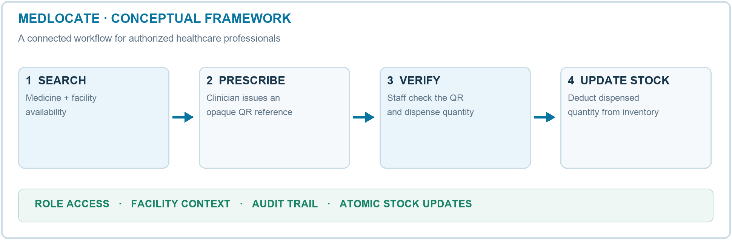
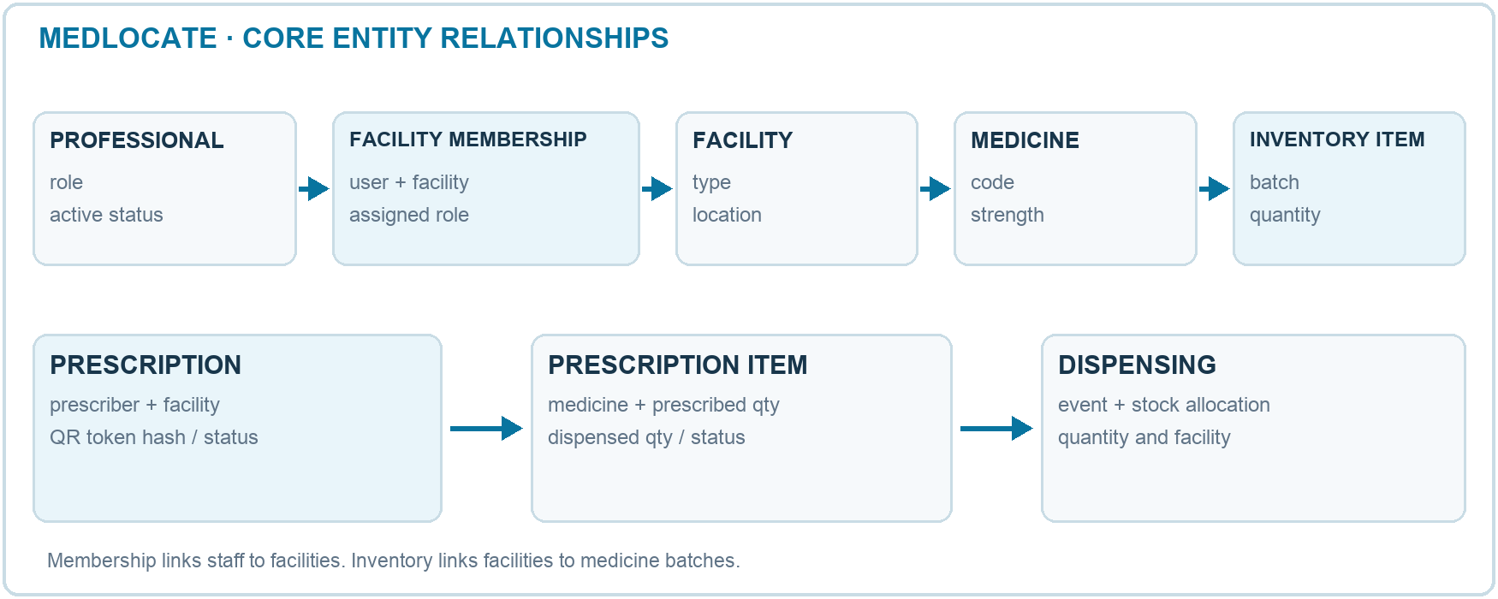

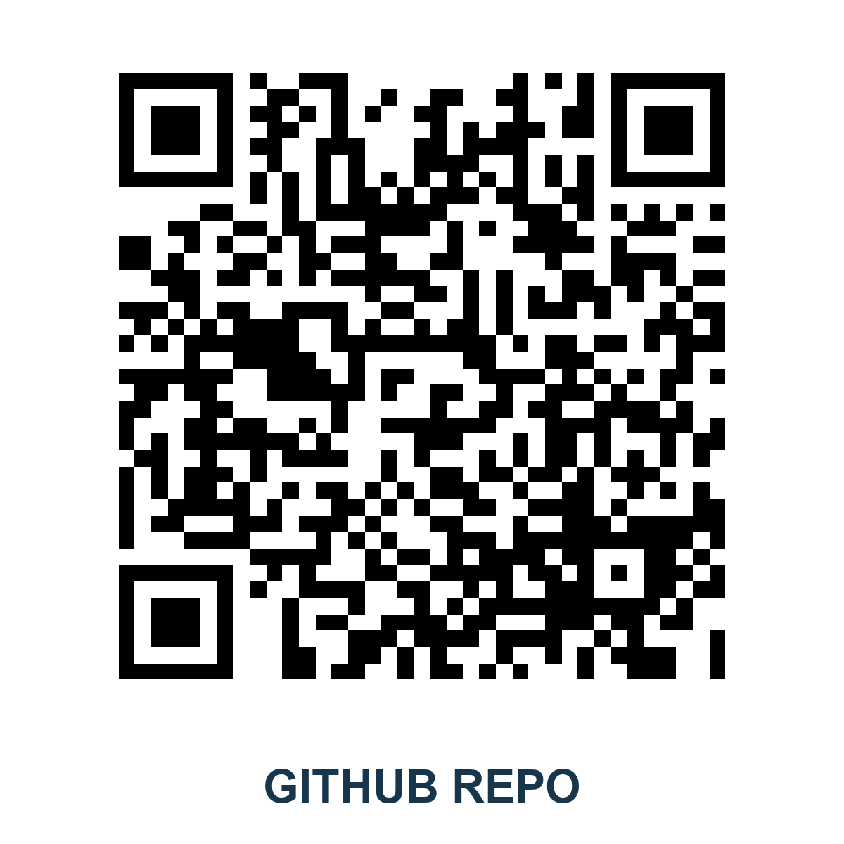
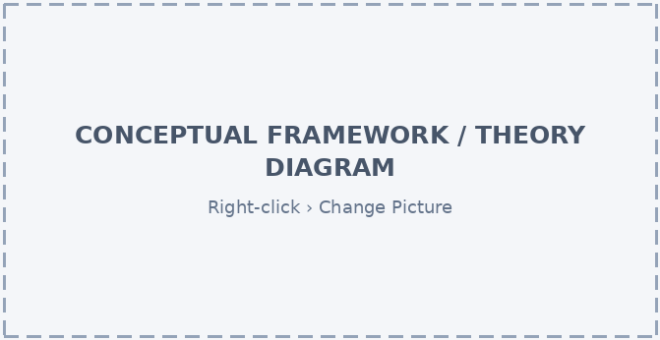

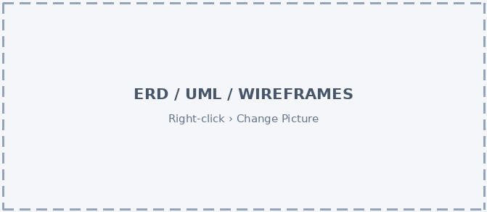
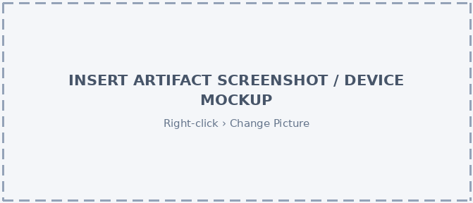


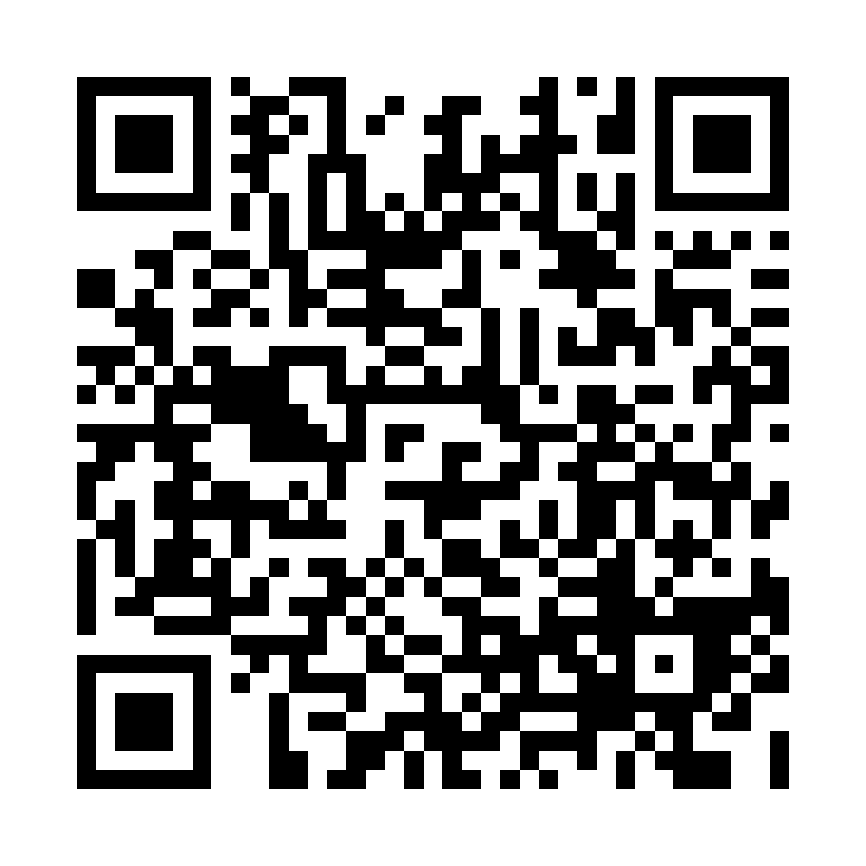
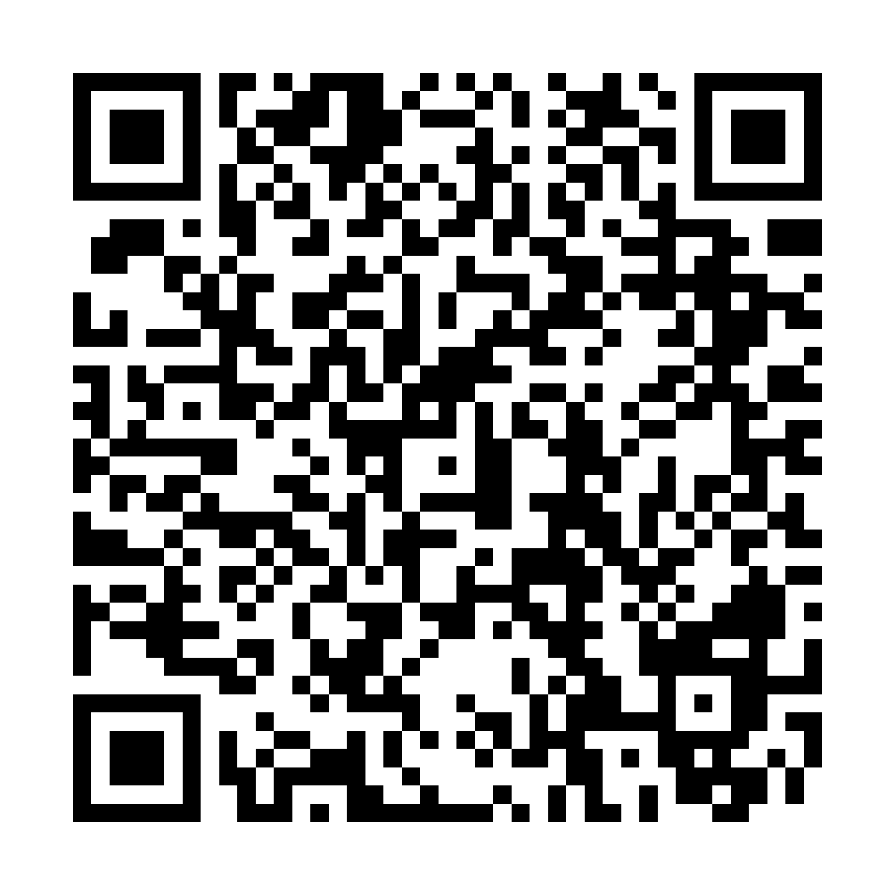
BSBS • SYSTEM DEVELOPMENT PROJECT
TECH STACK
MedLocate
Python · Django · PostgreSQL
DURATION
A web platform for licensed healthcare workers in Botswana to find available medicines and manage secure QR prescriptions
[To be filled]
SUPERVISOR
Group Members: Mmetla Leboa Rami Sejoe | Mmoloki Phuthego | Ame Atlang Moremi| Tlamelo Molly Mokenti
Mr. Resego Tom Rabalone
Botswana School of Business Sciences • [BSc (Hons) in Network Computing] • [2026]
1
INTRODUCTION & PROBLEM STATEMENT
3
SYSTEM DESIGN
4
RESULTS & DISCUSSION
Primary: medicine search, inventory, QR Rx generation, verification & dispensing, stock integrity. Secondary: location, scanning, history, dashboards.
Django monolithic architecture with role-based access (Doctor, Nurse, Pharmacy Staff) and PostgreSQL database.
Use-case diagram (RQ01–RQ09), ERD for pprescriptions/stock/dispensing, activity & sequence diagrams for QR verification.
Python, Django, PostgreSQL. Role-based permissions. Secure QR references (no readable medical data on code).
Research-informed design: findings from existing systems mapped to requirements and architecture decisions.
Unit & integration tests on core flows; transactional integrity checks; role-based access verification.
Working screens show medicine availability search, an issued secure QR prescription and facility inventory. The demonstration uses synthetic records. Evaluation against primary requirements (RQ01–RQ05) is pending.
Background
In 2025 Botswana faced medicine shortages. WHO notes gaps in health data and supply chains that digital health can address.
Doctors, nurses and pharmacists lack a single system to check stock, prescribe securely and dispense while updating inventory.
Problem Statement
No integrated platform currently links medicine search, secure QR e-prescriptions and automatic stock deduction for authorized healthcare staff.
Existing tools handle search, inventory or e-prescribing in isolation; none combine all three for Botswana’s health facilities.
2
LITERATURE REVIEW
Users &
Requirements
Interface
Layer
Application
Logic / API
Data
Layer
Digital health integration of inventory, e-prescribing and dispensing supports Botswana’s eHealth Strategy and WHO digital-health goals.
ChekaMeds (search), OpenLMIS (stock), Open mSupply (dispensing–inventory link) and NHS EPS (e-prescriptions) were reviewed.
Each system solves part of the problem but none combine secure QR prescribing, partial dispensing and automatic stock update for authorized staff.
MedLocate integrates medicine search, QR e-prescriptions and transactional stock updates in one role-based Django platform for Botswana.
Figure 5. MedLocate working screens using synthetic demonstration data
Figure 2. High-level design – Users & Requirements layers
Evaluation criterion | Method | Target | Result
Functionality | Test cases passed | [ ] | [ ]
Usability | User testing / SUS survey | [ ] | [ ]
Performance | Response time, accuracy | [ ] | [ ]
Existing work | Strength | Limitation
ChekaMeds (n.d.) | Local medicine search & provider visibility | No QR Rx, partial dispense or auto stock update
OpenLMIS / Open mSupply | Robust stock records & dispensing–inventory link | Not focused on QR e-Rx for Botswana facilities
NHS EPS (2026) | Secure electronic prescription flow | Not linked to local inventory search
Proposed artifact | Combines search + secure QR Rx + transactional stock update for authorized staff
5
CONCLUSION
MedLocate integrates medicine availability search, secure QR e-prescriptions and transactional stock updates for authorized healthcare staff in Botswana.
Practical contribution: a single platform addressing fragmented search, prescribing and inventory processes aligned with Botswana’s eHealth Strategy.
Core requirements (search, inventory, QR Rx, verification, stock integrity) are designed and being implemented; evaluation pending.
Figure 3. System architecture (Django + PostgreSQL)
6
RECOMMENDATIONS & FUTURE WORK
Adopt role-based access and facility assignment. Train staff on QR workflow. Keep stock data current for reliable search results.
Currently limited to authorized staff (no patient access). Offline capability and full multi-facility scale testing still needed.
Future work: offline support, patient-facing features (if policy allows), mobile optimization, analytics dashboards and integration with national systems.
Figure 1. Conceptual framework – integrated search, QR e-Rx and stock integrity
Figure 4. Core entity relationships for stock and prescriptions
REFERENCES
Botswana Ministry of Health. (2020). Botswana eHealth Strategy 2020-2024. | ChekaMeds. (n.d.). | mSupply Foundation. (n.d.). | NHS England. (2026). Electronic Prescription Service. | OpenLMIS. (n.d.). | Reuters. (2025). Botswana declares public health emergency… | WHO Regional Office for Africa. (2025). Botswana bets on the digital future…

