Slide 1
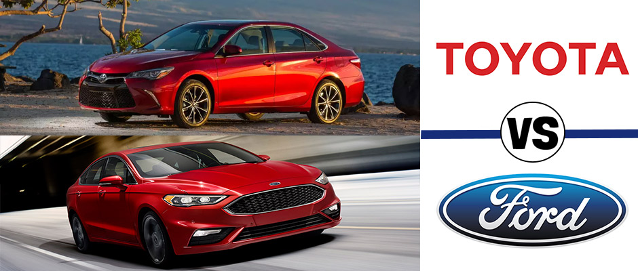
Used Car Price Prediction
Joseph Onwukeme ● Matthew Witschorke ● Sam Slomowitz ● Yarely Vargas

Slide 2

Hypotheses
Data
Analysis
Projection
Limitations & Future Analysis
Q&A
AGENDA

Slide 3


About our Data
Purpose: To help others determine how much to sell their used cars (based on Market price)
How:
Contains web-scraped data on 100,000 used cars divided into csv based on brands. In this project we focused on Toyota & Ford)
Gets better:
The data set contains mostly clean data with variables such as Price, mileage, mpg, year of model, and engine size.

Slide 4



Data Cleaning
Price - Only kept the mean price + 2 standard deviations
Mileage - Only kept the mean mileage + 2 standard deviations
Years only included 2013-2020
Models- only kept Aygo, Yaris, Fiesta, Focus
Engine size not equal to 0

Slide 5

Data Cleaning

Slide 6
Corrs of our Data

Slide 7
Shape of Price

Slide 8
Price vs Model

Slide 9
Price vs Model

Slide 10
Price vs Model

Slide 11
Price vs Model

