Slide 1
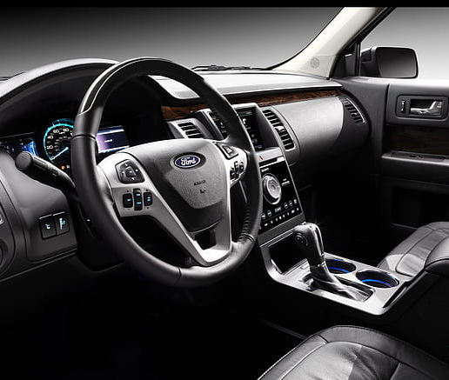
Used Car Price Prediction
Ford vs Toyota
Joseph Onwukeme
Matthew Witschorke
Sam Slomowitz
Yarely Vargas

Slide 2

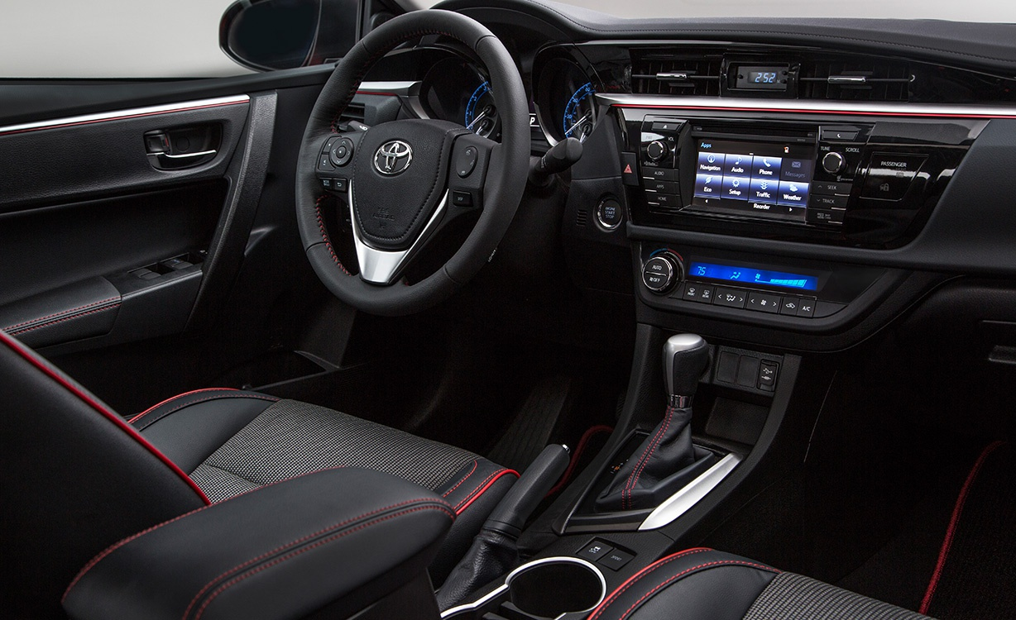





AGENDA
DATA
ANALYSIS
HYPOTHESIS
PROPOSITION & LIMITATIONS
Q&A

Slide 3



About our Data
PURPOSE:
To help others determine how much to sell their used cars (based on Market price)
HOW:
Contains web-scraped data on 100,000 used cars divided into csv based on brands. In this project we focused on Toyota & Ford)
GETS BETTER:
The data set contains mostly clean data with variables such as Price, mileage, mpg, year of model, and engine size.

Slide 4

Data Cleaning
Price
Only kept the mean price + 2 standard deviations
Mileage
Only kept the mean mileage + 2 standard deviations
Years
Only included 2013-2020
Models
Only kept Aygo, Yaris, Fiesta, Focus
Engine
Size not equal to 0

Slide 5
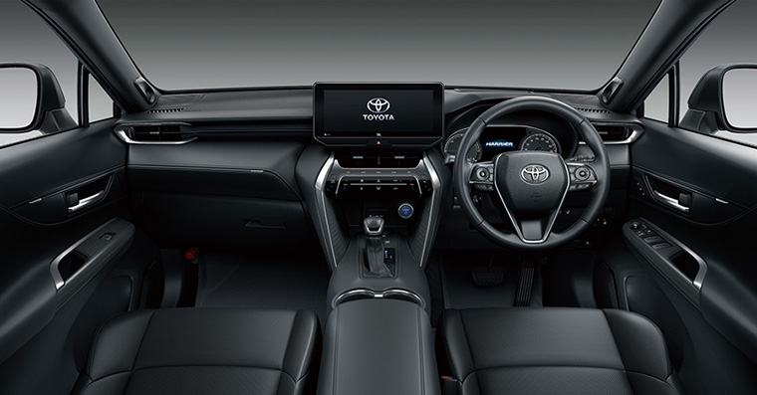


Hypotheses
There is a difference between sell price for models within brands
The year of a used car impacts the market price of the car.
There is a difference in Market price between Ford and Toyota

Slide 6
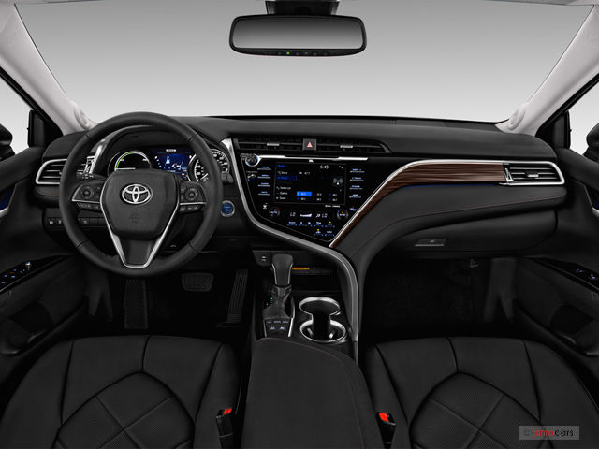
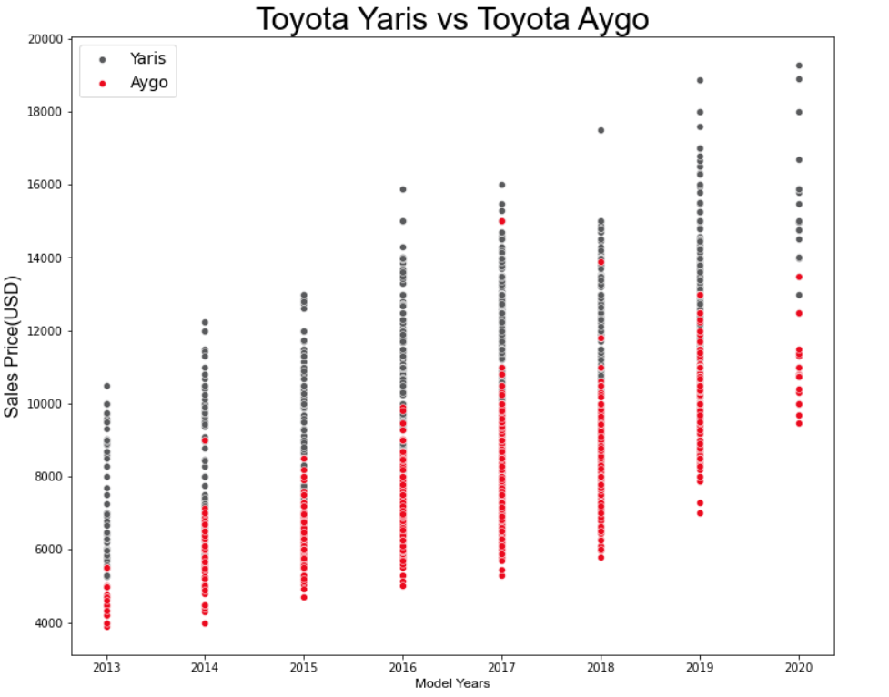
Price vs Model

Slide 7
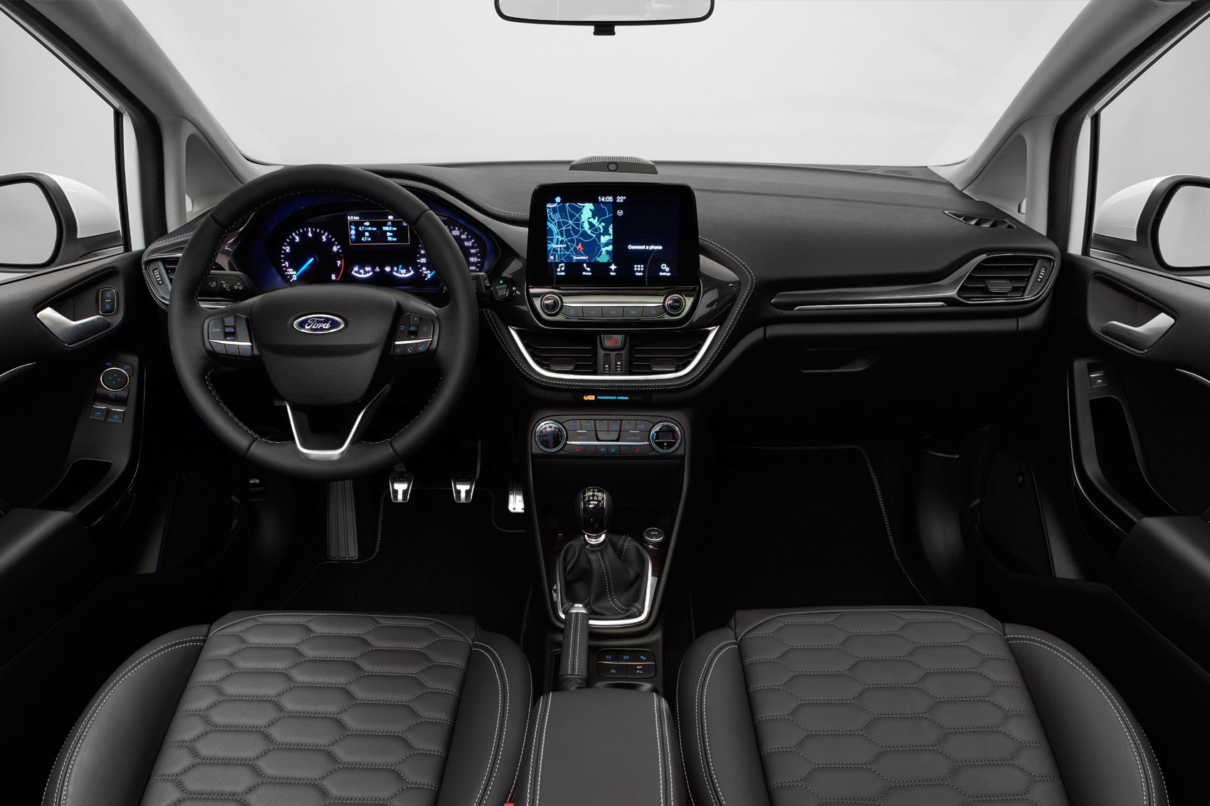
Shape of Price
Price vs Model

Slide 8
Hypotheses Review
There is a difference between sell price for models within brands
The year of a used car impacts the market price of the car.
There is a difference in Market price between Ford and Toyota

Slide 9
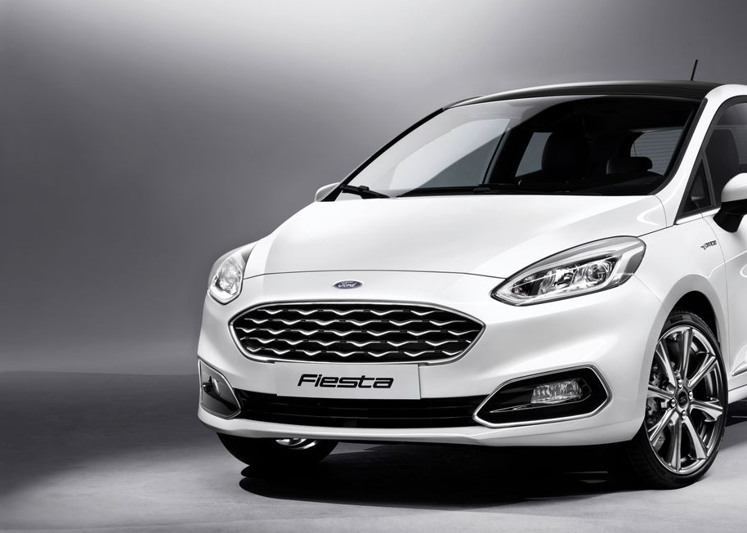
Thank You!
Q & A

