Slide 1
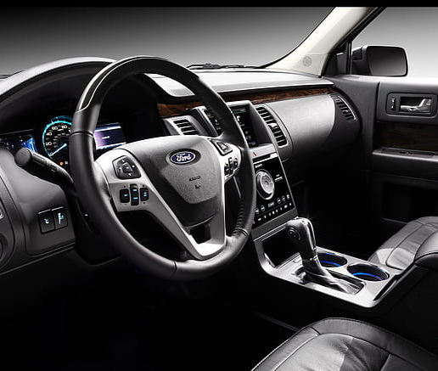
Used Car Price Prediction
Ford vs Toyota
Joseph Onwukeme
Matthew Witschorke
Sam Slomowitz
Yarely Vargas

Slide 2

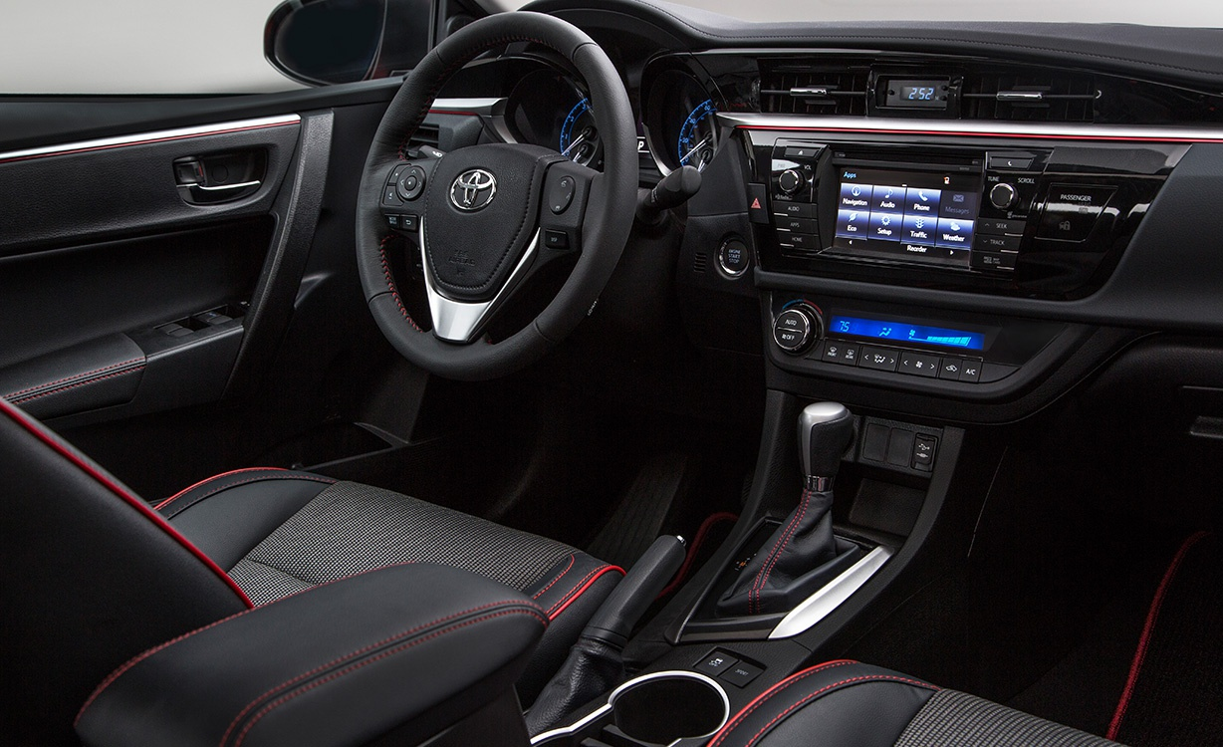






AGENDA
DATA
ANALYSIS
HYPOTHESIS
PROPOSITION & LIMITATIONS
Predictions
Q&A

Slide 3



About our Data
PURPOSE:
To help others determine how much to sell their used cars (based on Market price)
HOW:
Contains web-scraped data on 100,000 used cars divided into csv based on brands. In this project we focused on Toyota & Ford)
GETS BETTER:
The data set contains mostly clean data with variables such as Price, mileage, mpg, year of model, and engine size.

Slide 4

Data Cleaning
Price
Only kept the mean price + 2 standard deviations
Mileage
Only kept the mean mileage + 2 standard deviations
Years
Only included 2013-2020
Models
Only kept Aygo, Yaris, Fiesta, Focus
Engine
Size not equal to 0

Slide 5
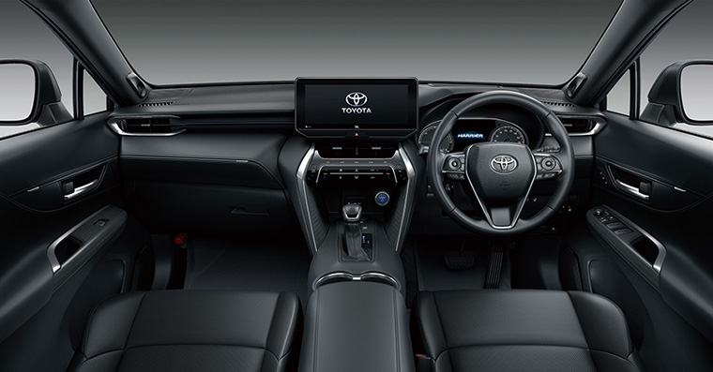


Hypotheses
There is a difference between sell price for models within brands
The year of a used car impacts the market price of the car.
There is a difference in Market price between Ford and Toyota

Slide 6
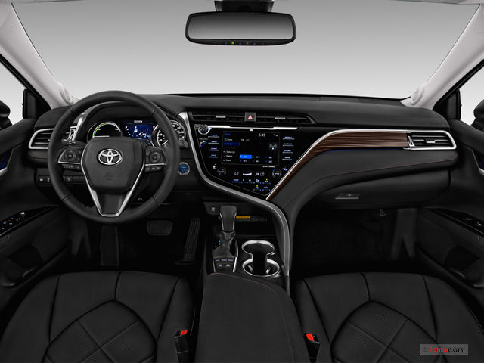
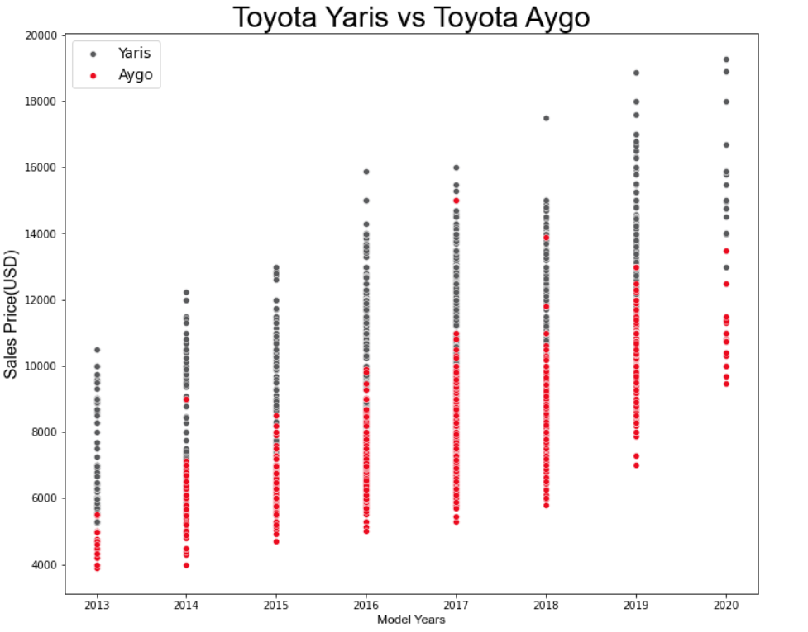
Price vs Model

Slide 7
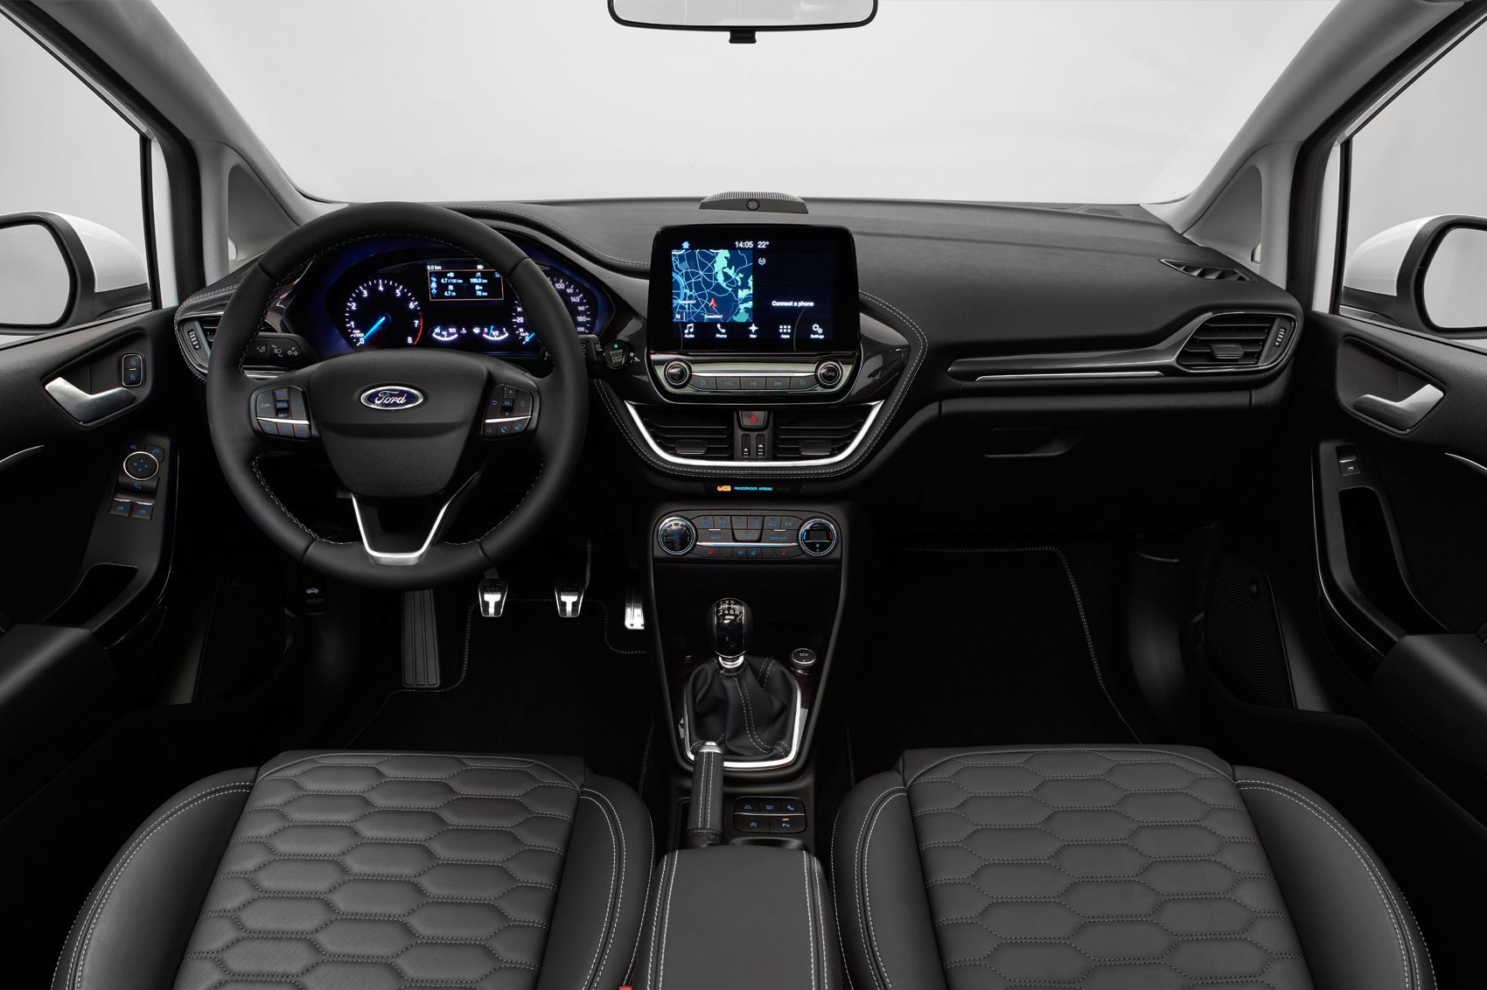
Shape of Price
Price vs Model

Slide 8
Hypotheses Review
There is a difference between sell price for models within brands
The year of a used car impacts the market price of the car.
There is a difference in Market price between Ford and Toyota

Slide 9



Live! Price Prediction
Models:
Fiesta • Focus • Aygo • Aygo
Mileage:
3,000 to 9,000
MPG:
55 to 65
(whole numbers only)
Engine Size:
1 to 1.5
Disclaimer: Price prediction does not consider, year of used car, damage of used car, fuel type, transmission type or emotional attachment to used car. Model should be used purely as estimate and not fact.

Slide 10
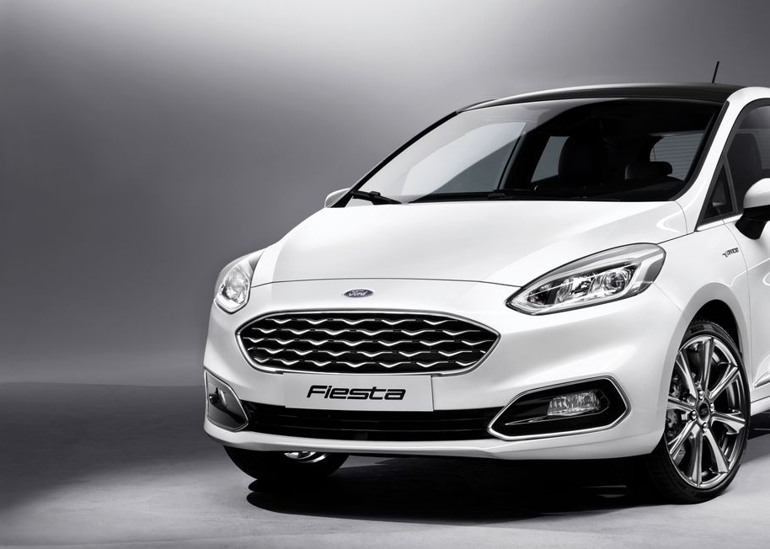
Thank You!
Q & A

