Slide 1
Capstone Presentation - Churn prediction Model
Yaresh Vijayasundaram
BATCH: PGPDSBA.O.SEP22.A
Post Graduate Program in Data Science and Business Analytics

Slide 2

BUSINESS PROBLEM UNDERSTANDING
Business Objective:
The E-commerce company is facing intense competition, leading to customer retention challenges. Account churn, particularly impactful due to multiple customers per account, needs attention. The objective is to develop a churn prediction model and devise a strategy campaign that retains customers without incurring significant losses.

Slide 3

DATASET OVERVIEW:
Dataset Overview for Churn Prediction
Data Shape: 11,260 accounts, 19 columns/account.
Missing Data: Some columns lack information (e.g., "Tenure," "City Tier," "CC_Contacted_LY"). Impact on analysis and predictions.
Data Types: Integers, floats, categorical data (objects).
Duplicate Values: No duplicates in dataset.
Outliers: Numerical variables contain outliers.
Normal Distribution: Numerical variables not normally distributed.
Churn Column: The "Churn" column denotes account churn (0/1), serving as the critical prediction target; exhibits an imbalanced distribution.

Slide 4
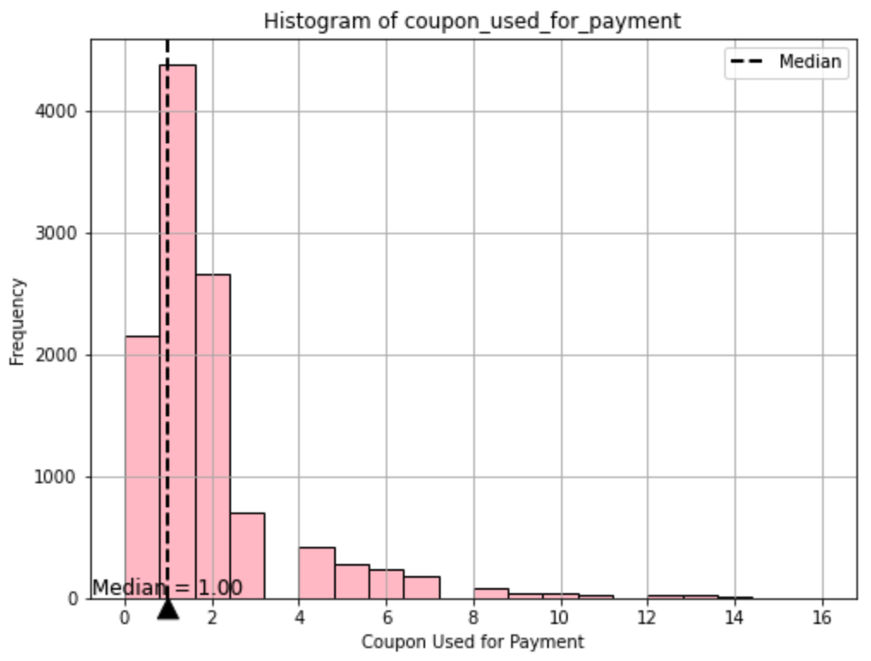
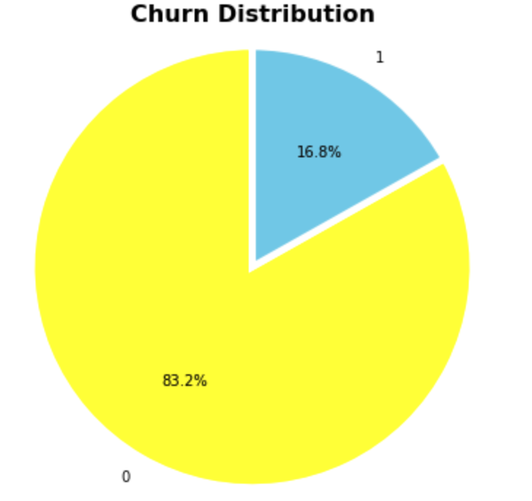
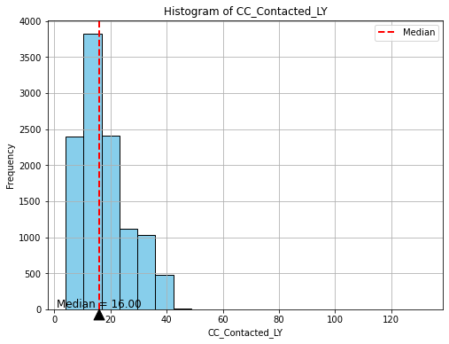
IMPORTANT INSIGHTS FROM UNIVARIATE ANALYSIS
Coupon Usage and Customer Behaviour:
Histogram of "coupon_used_for_payment" reveals intriguing patterns.
Majority of customers have used coupons at least once (median = 1).
Some customers exhibit high coupon usage (up to 14 times), highlighting a subset reliant on coupons.
Customer Care Interaction Trends:
"CC_Contacted_LY" histogram showcases customer care interaction patterns.
Median at 16 interactions in the last 12 months.
Majority of interactions within 0 to 50 range, underscoring customer service engagement.
Churn Class Imbalance:
Distribution of "Churn" variable unveils class imbalance.
Non-churn (0) accounts make up 83.2%, while churn (1) accounts are 16.8%.
Addressing class imbalance is vital for accurate churn prediction model.

Slide 5
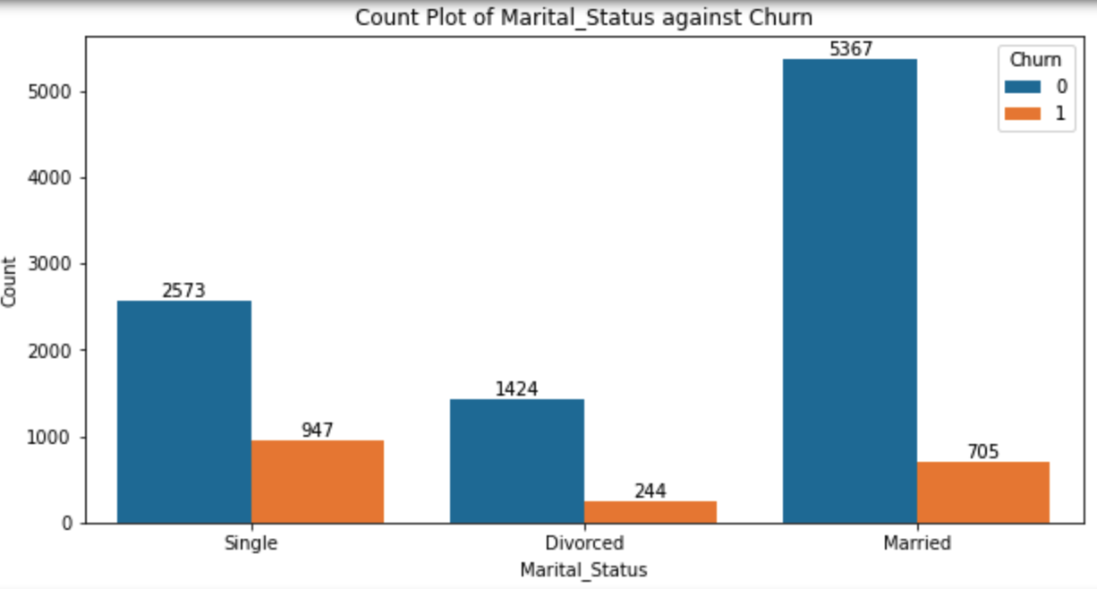
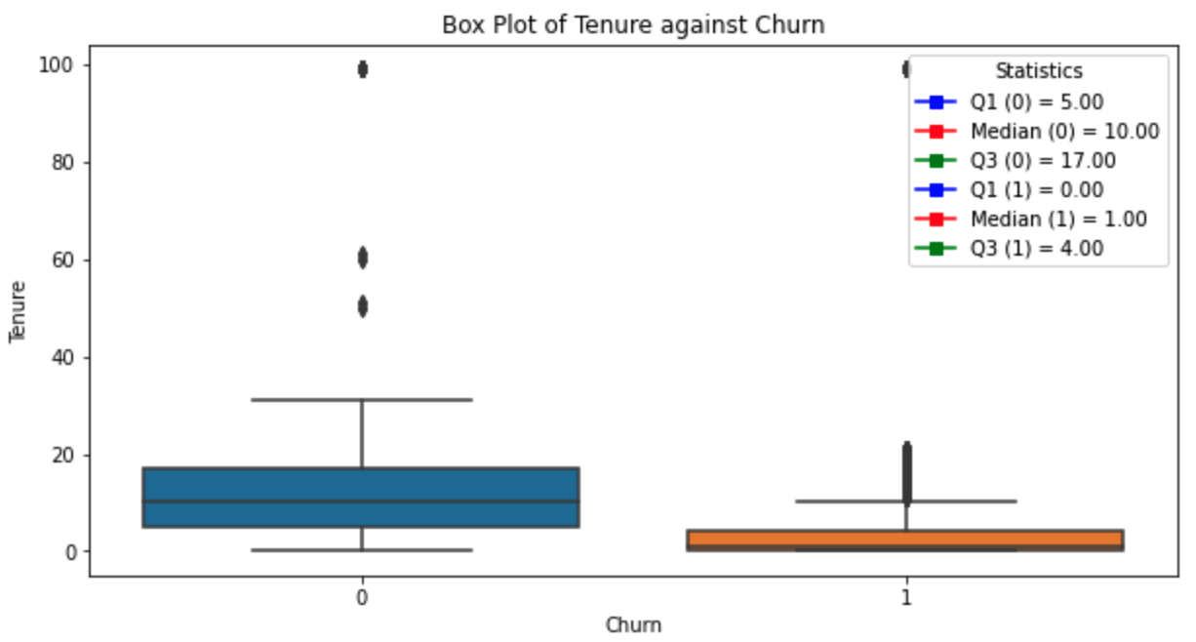
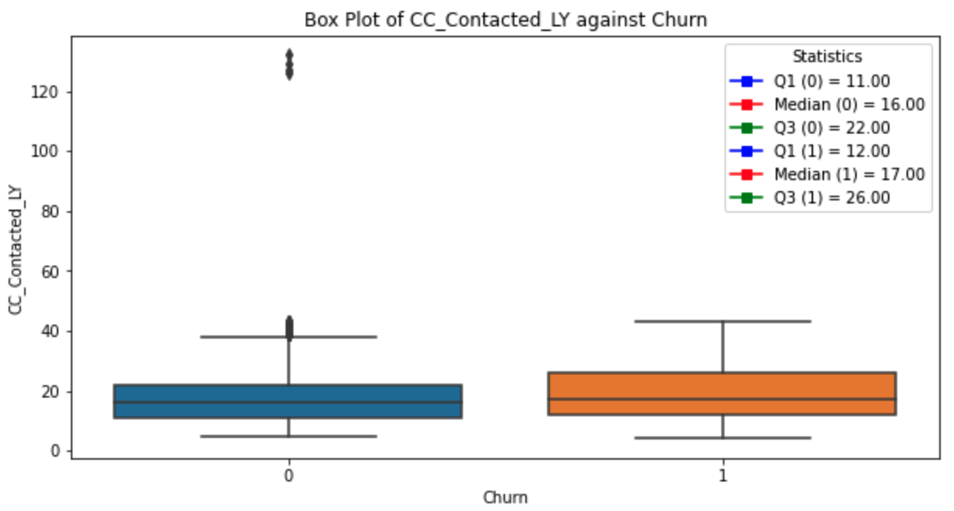
IMPORTANT INSIGHTS FROM BIVARIATE ANALYSIS
Marital Status Impact:
Bar chart: Marital Status vs. Churn.
Notable churn among single customers.
Suggests single customers could be more sensitive to churn factors.
Tenure and Churn Relationship:
Boxplot: Tenure of Account vs. Churn.
Churned customers have shorter account tenures.
Majority of churned customers under 10 tenure.
Longer tenure linked to higher loyalty and lower churn likelihood.
Customer Care Interaction and Churn:
Boxplot: CC_Contacted_LY vs. Churn.
Similar pattern for both groups, with minor differences.
Churned customers tend to contact customer care more often.

Slide 6

ADDITIONAL INSIGHTS FROM EXPLORATORY ANALYSIS
Outlier Indicators: Variables display signs of outliers.
Data Anomalies: Notable presence of anomalies and questionable data.
Variable Variability: Wide variation in value ranges.
Importance of Scaling: Necessity of scaling for fair comparison.
Addressing Data Imbalance: Addressing data imbalance is vital for model accuracy.

Slide 7

MODEL APPROACH USED & WHY?
Data Preparation Steps for Churn Prediction Model:
Unwanted Variable Removal:
Eliminated "Account ID" for streamlined analysis.
Null Value Handling:
Imputed missing values using median or mode.
Outlier Treatment:
Implemented log transformation to mitigate skewness and yet detected outliers.
Corrected outliers using IQR method (25th to 75th percentiles).
Variable Encoding:
Ordinal and one-hot encoding for categorical features.
Uniform Data Format:
Standardized data types to float64.
Scaling Data:
Standardized numerical variables for improved model accuracy.
VIF Analysis:
Identified and removed variables with VIF > 5.

Slide 8
MODEL APPROACH USED & WHY? (cont.)
Churn hurts businesses. Therefore, various models were built to predict it and boost retention.
Prior to constructing the model, the crucial train-test split allocates 70% for training and 30% for testing, enabling models to grasp patterns from known data and demonstrate excellence in predicting unseen data.
Models & Techniques:
Logistic Regression (basic/tuned, SMOTE)
Linear Discriminant Analysis (basic/tuned, SMOTE)
K-Nearest Neighbors (basic/tuned, SMOTE)
Naïve Bayes (basic/tuned, SMOTE)
Random Forest (basic/tuned, SMOTE)
Bagging, AdaBoost, Gradient Boosting) (basic/tuned, SMOTE)
Support Vector Machines (basic/tuned, SMOTE)

Slide 9
INTERPRETATION OF THE MOST OPTIMUM MODEL (INSIGHT FROM ANALAYSIS) -
Models | Training Dataset (70%) |  |  |  |  |  |  |  | Testing Dataset (30)%
Performance Metrics | Precision (0) | Recall (0) | F1-score (0) | Precision (1) | Recall (1) | F1-score (1) | Accuracy | AUC Score | Precision (0) | Recall (0) | F1-score (0) | Precision (1) | Recall (1) | F1-score (1) | Accuracy | AUC Score
Bagging with SMOTE | 1 | 1 | 1 | 1 | 0.99 | 0.99 | 1 | 0.99 | 0.96 | 0.97 | 0.97 | 0.86 | 0.82 | 0.84 | 0.95 | 0.9
KNN with Hyper Tuning | 1 | 1 | 1 | 1 | 1 | 1 | 1 | 1 | 0.97 | 0.99 | 0.98 | 0.92 | 0.82 | 0.87 | 0.96 | 0.96
Random Forest with SMOTE | 1 | 1 | 1 | 1 | 1 | 1 | 1 | 1 | 0.97 | 0.98 | 0.98 | 0.9 | 0.85 | 0.88 | 0.96 | 0.98
SVM Model with Hyper Tuning | 0.96 | 0.99 | 0.98 | 0.96 | 0.81 | 0.88 | 0.96 | 0.99 | 0.94 | 0.98 | 0.96 | 0.9 | 0.71 | 0.79 | 0.94 | 0.95
Models Evaluated: After analysing 27 models, four standout performers were identified
Top model: Top models showcased robust precision and recall, yet indicated possible overfitting, encompassing Bagging with SMOTE, KNN with Hyper Tuning, and Random Forest with SMOTE.
Why "SVM Model with Hyper Tuning" is Optimum:
Balanced Performance: Maintained reliable precision-recall balance on both training and test data.
Overfitting Resilience: Adapted well to new data, avoiding overfitting.
From the models assessed, the "SVM Model with Hyper Tuning" presents a balanced, dependable churn prediction that avoids overfitting, rendering it a suitable option for practical use. However, additional regularization is needed to improve recall.

Slide 10

KEY BUISNESS INSIGHT FROM EDA (Cont.)
Coupon Usage and Behaviour:
Many customers use coupons (median = 1), with some relying heavily on them.
Churn Imbalance:
Significant class imbalance (83.2% non-churn, 16.8% churn) requires attention.
Marital Status Impact:
Notable churn among single customers, suggesting sensitivity to churn factors.
Tenure and Churn:
Shorter account tenures correlate with higher churn rates.
Customer Care and Churn:
Churned customers engage more with customer care, though not drastically.

Slide 11
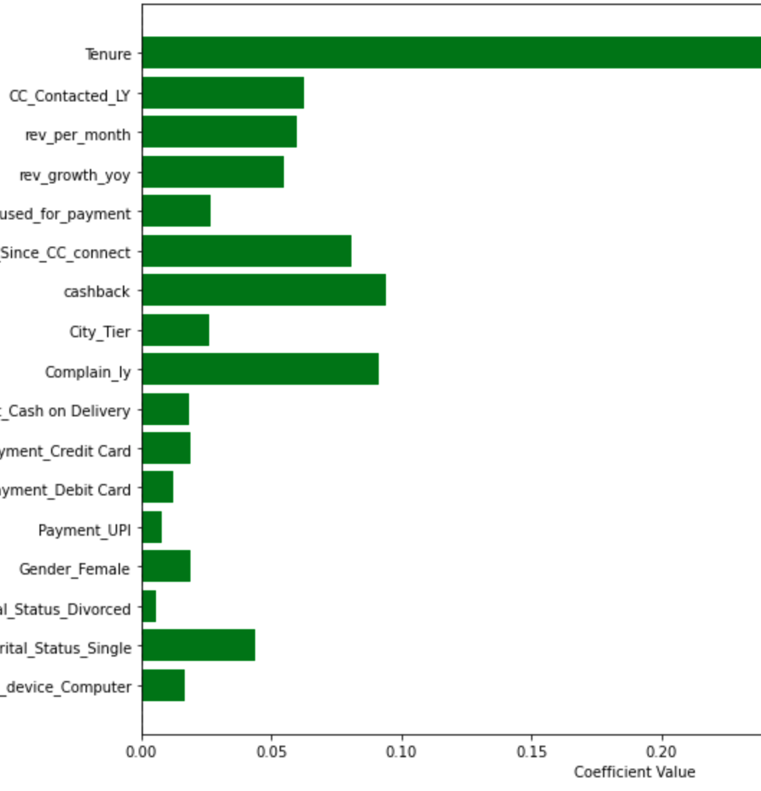
BUSINESS INSIGHT FROM ANALYSIS (Cont.)
Business Insight: Unveiling Key Churn Indicators
In-depth analysis of 27 models illuminates the pivotal role played by specific common features in predicting customer churn.
"Tenure," "Compliant_ly,” "Cashback" and "Day since CC connect” emerge as fundamental elements significantly influencing customer churn decisions.
These attributes act as potent indicators, providing valuable insights into customer behaviour and shaping their decisions regarding our services.
Enhancing the understanding of these indicators can guide targeted strategies to retain valuable customers and foster business growth.

Slide 12

RECOMMENDATION
Strategic Customer Outreach: Leverage "Tenure" insights for loyal customers. Start personalized campaigns, thanking them and offering exclusive deals to boost loyalty and curb churn.
Swift Service Recovery: Address "Compliant_ly" concerns promptly. Formulate a rapid service recovery team to resolve issues, enhancing satisfaction and rapport.
Timely Engagement: Utilize "Day since CC connect" for prompt follow-ups. Show genuine care to strengthen positive experiences and engagement.
Loyalty Rewards: Maximize "Cashback" importance. Create a tiered loyalty program based on "Tenure" and usage, incentivizing longer commitments.

Slide 13
THANK YOU!

