Slide 1

DATA EXPLORATION & VISUALIZATION PROJECT
Healthcare Financing &
Mortality Reduction Dashboard
Analyzing SDG Health, Poverty & Financing Indicators Across Nigeria, Ukraine, the United States & Yemen
Abdussamad Yargamji
Medical Doctor | MSc Data Science Scholar, Nigerian University of Technology and Management

Slide 2
OVERVIEW
What We'll Cover
1
Background & the SDGs
5
Dashboard Overview
2
Data Source & Scope
6
Key Terms & Definitions
3
Project Objective
7
Key Findings
4
Intended Stakeholders
8
Recommendations & Conclusion
HEALTHCARE FINANCING & MORTALITY REDUCTION DASHBOARD
01

Slide 3


BACKGROUND
The SDGs Behind This Analysis
SDG 1
SDG 3
End Poverty in All Its Forms
Good Health & Well-Being
1.1.1 Proportion of the population living below the international poverty line, by sex, age, employment status and location 1.a.2 Proportion of total government spending on essential services (education, health, social protection)
3.1.1 Maternal mortality ratio 3.2.1 Under-5 mortality rate 3.2.2 Neonatal mortality rate
Together, these two goals frame the core question of this project: does how much a country invests in health and social protection change how many mothers, newborns, and children survive?
HEALTHCARE FINANCING & MORTALITY REDUCTION DASHBOARD
02

Slide 4

METHODOLOGY
Data Source & Scope
United Nations Global SDG Data Portal
unstats.un.org/sdgs/dataportal
4
24
3
Countries Compared
Based on World Bank Income Grouping
Years of Data
Core Health Indicators
Nigeria · Ukraine · United States · Yemen
Historical trend, 2000 – 2023
MMR · U5MR · NMR, cross-referenced with financing & poverty
Tool: Microsoft Power BI · Modeling: Power Query + DAX
HEALTHCARE FINANCING & MORTALITY REDUCTION DASHBOARD
03

Slide 5

OBJECTIVE
To analyze the relationship between healthcare financing, poverty, and mortality indicators — guiding policy decisions toward achieving the Sustainable Development Goals by 2030.

Slide 6



AUDIENCE
Who This Analysis Serves
State Governor
Commissioner for Health
Commissioner for Budget & Planning
Ministry of Finance Officials
Government Decision-Makers responsible for translating dashboard insight into budget and policy action.
HEALTHCARE FINANCING & MORTALITY REDUCTION DASHBOARD
04

Slide 7

THE DASHBOARD
The Power BI Dashboard
SDG Target Gauges
SDG Gap Analysis
6
NMR, U5MR & MMR vs. official SDG targets
Average NMR ranked by country
Key Visuals
Neonatal Mortality Trend
Spending vs. MMR
Yearly trend, 2000 – 2023
Health financing against maternal mortality
One page. Fully interactive.
Filter by country and year to explore every indicator on demand.
Poverty vs. Under-5 Mortality
Country & Year Filters
Poverty share against child mortality
Slice every visual in one click
HEALTHCARE FINANCING & MORTALITY REDUCTION DASHBOARD
05

Slide 8


GLOSSARY
Key Terms — Maternal Mortality
Maternal Mortality (MM)
Maternal Mortality Ratio (MMR)
The death of a woman while pregnant or within 42 days of termination of pregnancy, from any cause related to or aggravated by the pregnancy or its management — but not from accidental or incidental causes.
The number of women who die from pregnancy-related causes, per 100,000 live births.
per 100,000
live births
Source: WHO
Source: WHO
HEALTHCARE FINANCING & MORTALITY REDUCTION DASHBOARD
06

Slide 9


GLOSSARY
Key Terms — Child Mortality & Poverty
Neonatal Mortality Rate (NMR)
Under-5 Mortality Rate (U5MR)
People Below the Poverty Line
Deaths within the first 28 completed days of life, per 1,000 live births.
Probability a newborn dies before reaching exactly 5 years of age, per 1,000 live births.
People surviving on less than $3.00 per person, per day.
per 1,000
per 1,000
< $3.00
Source: WHO
Source: UNICEF
Source: World Bank
HEALTHCARE FINANCING & MORTALITY REDUCTION DASHBOARD
07

Slide 10

THE DATA
Country Snapshot: Mortality vs. SDG Targets
Country | NMR (target ≤ 12) | U5MR (target ≤ 25) | MMR (target ≤ 70) | SDG Status
Nigeria | 38.64 | 136.99 | 1,100.0 | Off Track
Yemen | 27.26 | 58.1 | 158.6 | Off Track
Ukraine | 6.95 | 11.72 | 22.1 | On Track
United States | 4.07 | 7.25 | 16.2 | On Track
MMR shown per 100,000 live births · NMR and U5MR shown per 1,000 live births · Targets reflect UN SDG 2030 thresholds
Nigeria and Yemen exceed every SDG mortality target — Nigeria’s MMR is over 15x the SDG threshold.
HEALTHCARE FINANCING & MORTALITY REDUCTION DASHBOARD
08

Slide 11
KEY FINDING 01
Nigeria Lags Behind on Every Indicator
SDG 2030 TARGET
NMR ≤ 12
Nigeria: 38.64 — more than 3x the target
Yemen: 27.26 — over 2x the target
Ukraine & the US already meet the target
HEALTHCARE FINANCING & MORTALITY REDUCTION DASHBOARD
09

Slide 12
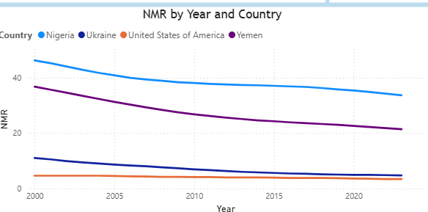
KEY FINDING 02
Mortality Is Falling — But Too Slowly
Neonatal mortality is declining across all four countries — but Nigeria and Yemen remain far above the SDG target, and the pace of decline is too slow to close the gap by 2030.
AT CURRENT PACE
Nigeria will not reach the SDG neonatal mortality target of 12 by 2030 without accelerated intervention.
Source: Power BI dashboard — Neonatal Mortality Rate by Year and Country
HEALTHCARE FINANCING & MORTALITY REDUCTION DASHBOARD
10

Slide 13
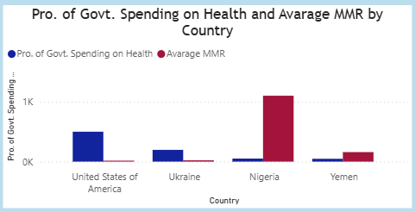
KEY FINDING 03
More Health Spending, Fewer Maternal Deaths
Maternal Mortality Ratio falls as government spending on health rises. The United States spends the most on health and records the lowest MMR — Nigeria spends the least proportionally and records the highest.
Higher, well-targeted health financing is one of the clearest levers available to reduce maternal deaths.
Source: Power BI dashboard — Proportion of Govt. Health Spending vs. Average MMR
HEALTHCARE FINANCING & MORTALITY REDUCTION DASHBOARD
11

Slide 14
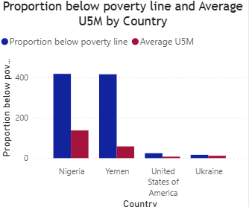
KEY FINDING 04
Poverty Is a Powerful Driver of Child Mortality
Nigeria and Yemen have both the highest proportion of population below the poverty line and the highest Under-5 mortality rates in the comparison set.
TAKEAWAY
Poverty reduction is not just an economic goal — it is a direct lever for child survival.
Source: Power BI dashboard — Proportion Below Poverty Line vs. Average U5M
HEALTHCARE FINANCING & MORTALITY REDUCTION DASHBOARD
12

Slide 15


WHAT THIS MEANS
Policy Recommendations
01
02
03
Increase & Target Health Financing
Scale Poverty-Reduction Programs
Prioritize NMR, U5MR & MMR in SDG Strategy
Direct increased, more efficient healthcare funding toward maternal and neonatal services where the gap to target is widest.
Pair health financing with poverty-reduction and social-protection programs — poverty is a leading driver of child mortality.
Make these three indicators an explicit, tracked priority within the national 2030 SDG strategy and annual budget planning.
HEALTHCARE FINANCING & MORTALITY REDUCTION DASHBOARD
13

Slide 16
CONCLUSION
Off Track, But Not
Out of Reach
Nigeria is currently off track to meet the 2030 SDG targets for neonatal, under-5, and maternal mortality. Although mortality rates are declining, the pace of reduction is insufficient. The analysis reveals strong relationships between healthcare funding, poverty, and mortality outcomes — pointing clearly toward where policy action can have the greatest impact.
HEALTHCARE FINANCING & MORTALITY REDUCTION DASHBOARD
14

Slide 17

Thank You
Abdussamad Yargamji
Medical Doctor | MSc Data Science Scholar
Nigerian University of Technology and Management

