Slide 1
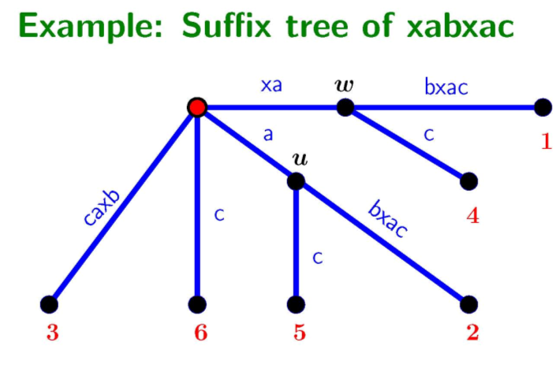
Suffix Tree

Slide 2
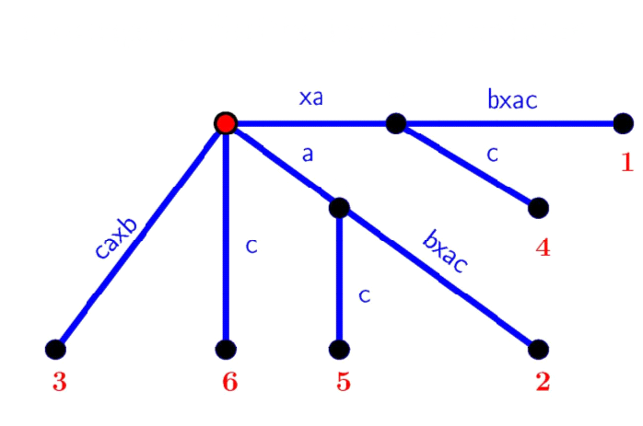
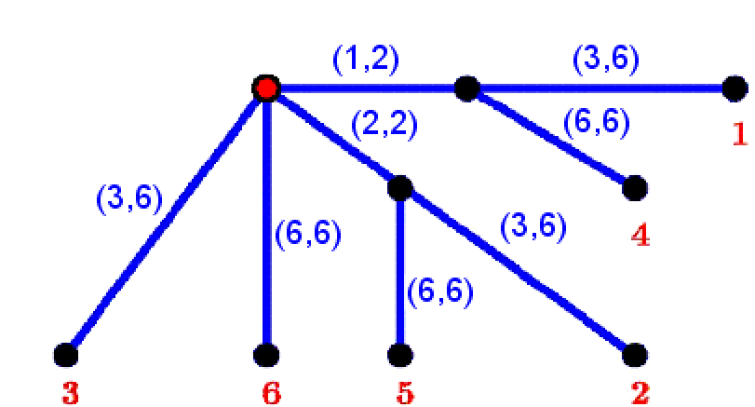
Suffix Tree Representation
S=xabxac
Represent every edge using its start and end text location

Slide 3
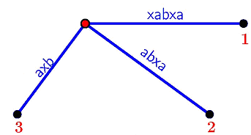
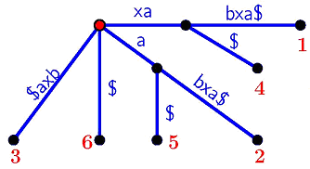
Implicit => Explicit
S=xabxa ( Implicit )
S$=xabxa$ ( Explicit )
1. No suffix of S is a prefix of a different suffix of S.
2. There is a leaf for each suffix of S.

Slide 4
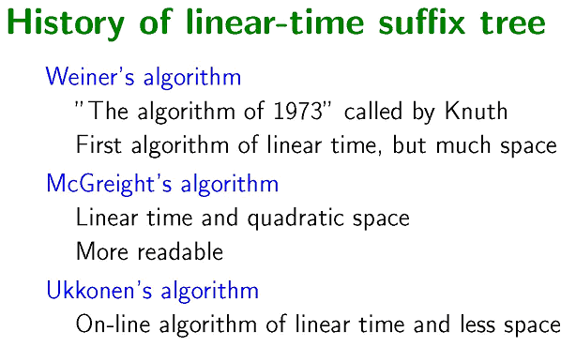
History

Slide 5
Ukkonen
String S$= S(1) S(2) …. S(m-1) S(m) $
S$ Prefixes:
Pref(1) = S(1)
Pref(2) = S(1)S(2)
. . .
Pref(i) = S(1)S(2)…S(i)
. . .
Pref(m-1) = S(1)S(2)….S(m-1)
Pref(m) = S(1)S(2)….S(m-1)S(m)
Pref(m+1) = S(1)S(2)….S(m-1)S(m)$ = S$
Ukkonen’s insertion order:
Suffixes(Pref(1))
Suffixes(Pref(2))
…
Suffixes(Pref(i))
…
Suffixes(Pref(m-1))
Suffixes(Pref(m))
Suffixes(Pref(m+1))

Slide 6
Implicit suffix tree
The intermediate Ukkonen Suffix Tree will be in the implicit form, until the last prefix insertion, which transform it to the explicit one.

Slide 7
Straightforward Construction
Input: string S[1…m]
1. Construct T(1), the Suffix tree of S[1]
2. for ( i = 1 ; i <= m-1 ; i++ )
{
// Convert T to Suffix tree of S[1..i+1]
for ( j = 1 ; j <= i+1 ; j++ )
{
// Find the end of path for S[j…i].
// Extend the path, if needed, to S[j..i+1].
}
}
3. Convert T(m) into the real suffix tree.
Time: O(m³)

Slide 8
Extended rule 1
Extending path S[j..i] to S[j..i+1]
Case 1: Path S[j..i] ends at a leaf.
- Extend the string on the last edge by one character S[i+1]
- Constant time

Slide 9
Extended rule 2
Extending path S[j..i] to S[j..i+1]
Case 2: Path S[j..i] has an extension that starts with S[i+1].
- Nothing need to be done, since we are working on the on the implicit suffix tree.
- Also constant time

Slide 10
Extended rule 3
Extending path S[j..i] to S[j..i+1]
Case 3: Path S[j..i] has extensions but none of them start with S[i+1]
- Create a new internal node if needed.
Add a new edge to a new leaf j

Slide 11
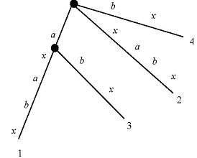
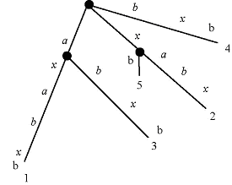
Extended rules (example)
S = axabxb….

Slide 12
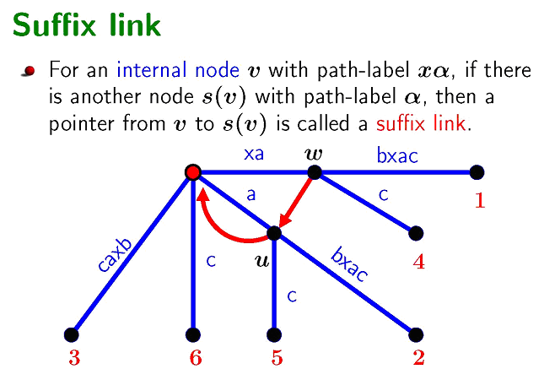
Important improvement
- Same as in Weiner, except the direction of the links
No need for associating with characters
Still use and create suffix links during construction

Slide 13
Useful lemmas
Lemma 1: If a new internal node v with path-label xα is added to the current tree in extension j of some phase i + 1, then either the path labeled α already ends at an internal node of the current tree or an internal node at the end of string α will be created (by the extension rules) in extension j + 1 in the same phase i + 1.
Lemma 2: In Ukkonen’s algorithm, any newly created internal node will have a suffix link from it by the end of the next extension.
Lemma 3: In any implicit suffix tree T(i), if internal node v has path-label xα, then there is a node s(v) of T(i) with path-label α.

Slide 14
Algorithm using suffix links
Single extension algorithm: extension j > 2 of phase i + 1
Find the first node v at or above the end of S[j -1..i] that either has a suffix link from it or is the root. This requires walking up at most one edge from the end of S[j - 1..i] in the current tree. Let γ (possibly empty) denote the string between v and the end of S[j - 1..i].
2. If v is not the root, traverse the suffix link from v to node s(v) and then walk down from s(v) following the path for string γ. If γ is the root, then follow the path for S[j..i] from the root (as in the naive algorithm).
3. Using the extension rules, ensure that the string S[j..i]S(i + 1) is in the tree.
4. If a new internal node w was created in extension j - 1 (by extension rule 3), then by Lemma 1, string α must end at node s(w), the end node for the suffix link from w. Create the suffix link (w, s(w)) from w to s(w).

Slide 15
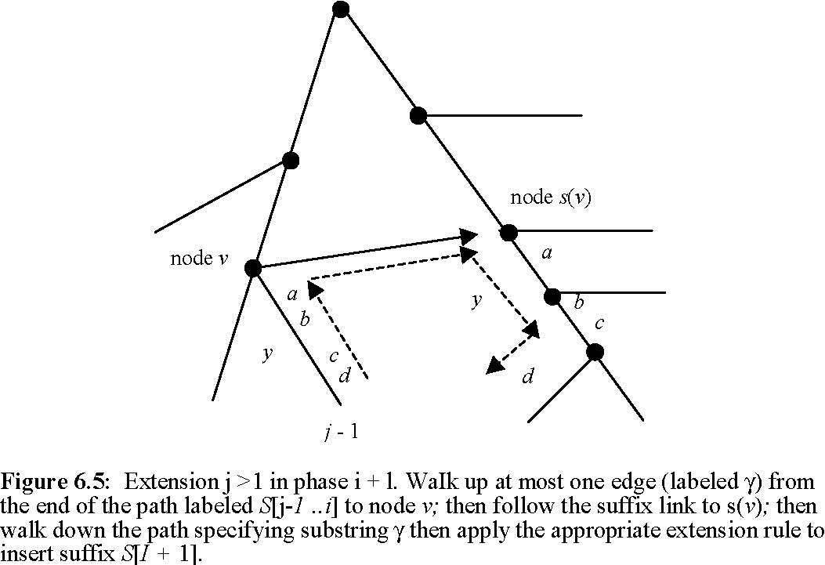
Single Extension algorithm (example)

Slide 16
Skip/Count Trick
Improvement for looking γ from the previous process
When the algorithm identifies the next edge on the path, it compares the current value of g to the number of characters g′ on that edge.
When g is at least as large as g′ the algorithm skips to the node at the end of the edge, sets g to g − g, sets h to h + g′, and finds the edge whose first character is character h of γ and repeats.
When an edge is reached where g is smaller than or equal to g′, then the algorithm skips to character g on the edge and quits, assured that the γ path from s(v) ends on that edge exactly g characters down its label.
The total time to traverse the path is proportional to the number of nodes on it rather than the number of characters on it.

Slide 17
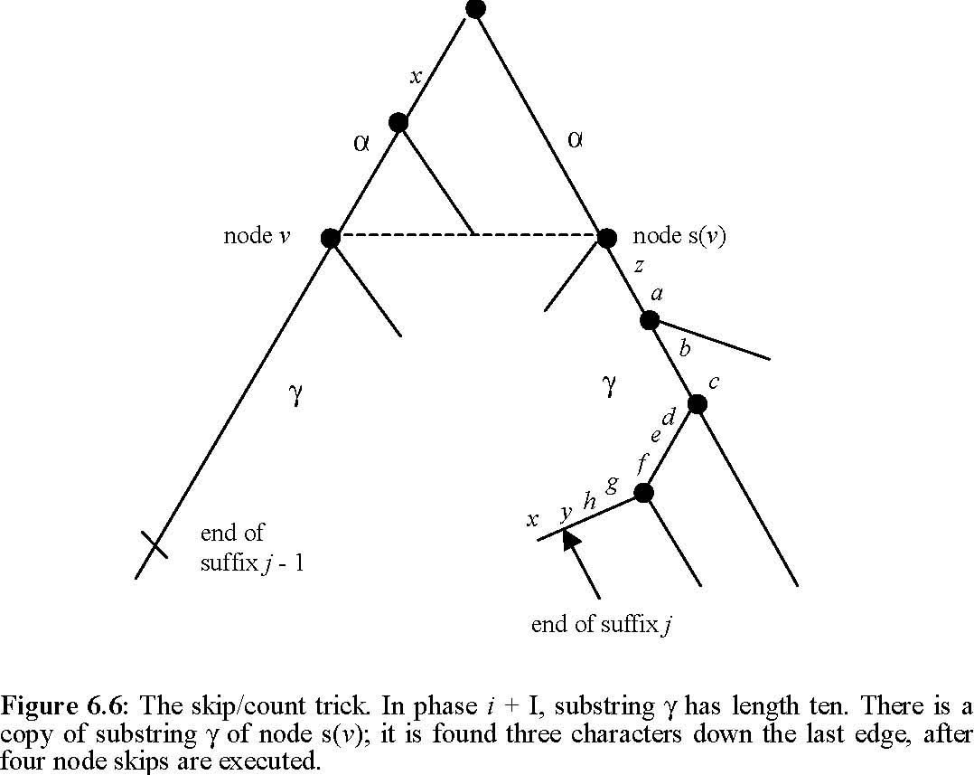
Skip/Count Trick (Example)

Slide 18
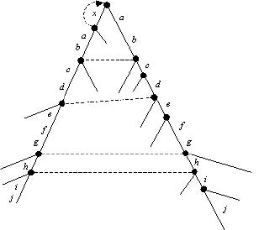
Time Improvement
Lemma 4: Let (v , s(v )) be any suffix link traversed during Ukkonen’s algorithm. At that moment, the node-depth of v is at most one greater than the node depth of s(v).
Theorem 1: Using the skip/count trick any phase of Ukkonen’s algorithm takes 0(m) time.

Slide 19
Skip iterations trick 1
Observation 1: Once a leaf, always a leaf
If Case 1 applies during a particular (i,j) iteration, it will also apply for all iterations with a larger i and same j.
Proof:
Path S[j..i] ends at a leaf. Extend the string on the last edge by 1 character (S[i+1]). Now the Path S[j..i+1] ends at the same leaf and it will be the same for every extension of it to S[j..i+2] etc.

Slide 20
Skip iterations trick 2
Observation 2: Extensions stopper
If Case 2 applies during a particular (i,j) iteration, it will also apply for all iterations with the same i and larger j.
Proof:
Path S[j..i] has at least one extension that starts with S[i+1]. Since S[j..i+1] is already in the tree, S[j+1..i+1] must also be in the tree.

Slide 21
Skip iterations trick 3
Observation 3: Make a node, be a leaf
If Case 3 applies during a particular (i,j) iteration, Case 1 will apply for all iterations with the a larger i and same j.
Proof:
Path S[j..i] has extensions but none of them start with S[i+1]. Add a new branch to a new leaf labeled j. Now the path S[j..i+1] ends at a leaf, and Case 1 will apply for every extension of it to S[j..i+2] etc.

Slide 22
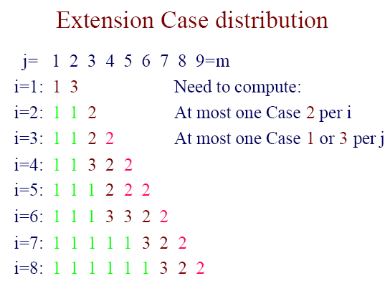
Possible execution

Slide 23
Creating a true suffix tree
Run another iteration of Ukkonen algorithm on S$
No suffix is now a prefix of any other suffix.
As a result, each suffix will end at a leaf.
Replace each index on every leaf edge with the number m.
Total Algorithm time O(m)

