Slide 1

Advanced Software Development
Yarin Gridish & Ofry Zarfaty
Lecturer: Dr. Eliahu Khalastchi
Course ID 600098

Slide 2
Mile Stones
1
4
Server side architecture design that maintains the SOLID and GRASP principles
Implementing a custom language Interpreter – converting text to commands while using the Command Pattern
2
5
Designing GUI for the simulator using JavaFX
Server solver and Cache Manager implementation – files and socket streaming
3
Algorithm Implementation – Pseudo Code to OOP, implementing the A-star and BFS algorithms

Slide 3
Running Example

Slide 4
Project Design – Server Side
<<Server>>
<<ClientHandler>>
<<Solver>>
MySerialServer
MyClientHandler
<<CacheManager>>
<<FileCacheManager>>

Slide 5
Project Design – Server Side
<<Searcher>>
<<Searchable>>
BFS
A-star
Graph
Matrix

Slide 6
Project Design – Client side
View Model
store and manage data
View
Responsible of user interface
Model
Creates logic and data

Slide 7
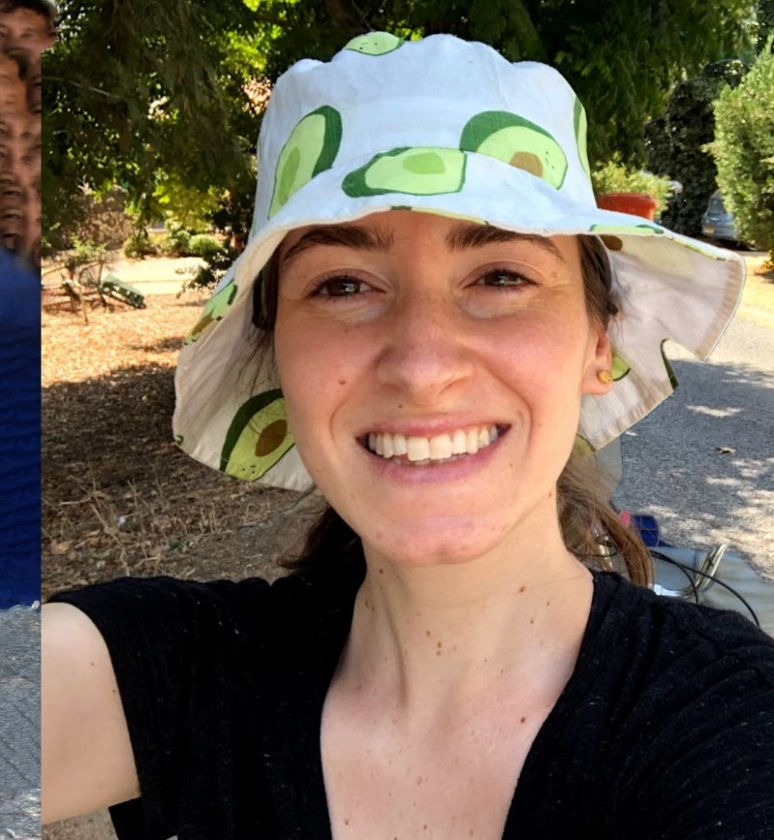
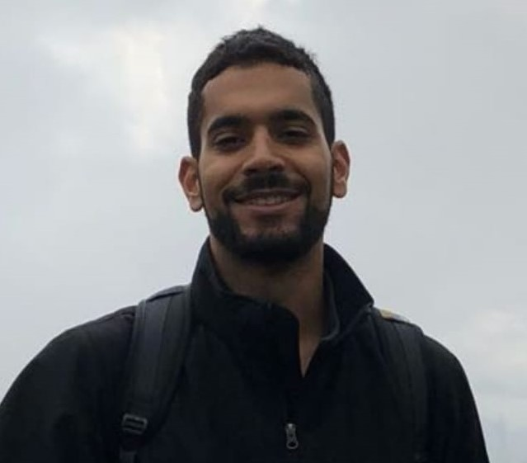
Thank you for watching
Ofry Zarfaty
https://www.linkedin.com/in/ofry-zarfaty-b85b10146/
ofryzarfaty@gmail.com
Yarin Gridish
https://www.linkedin.com/in/yarin-gridish-1411791a0/
yarinman@hotmail.com

