Slide 1


הרצאה Angular-Js
Yarin benisty

Slide 2
What is AngularJS
AngularJS is a JavaScript framework used for front-end web development.
It is maintained by Google and by a community of individuals and corporations.
AngularJS is an efficient framework that can create Rich-Internet-Applications (RIA). AngularJS provides developers an options to write client side applications using JavaScript in a clean Model-View-Controller (MVC) way.
Applications written in AngularJS are cross-browser compliant. AngularJS automatically handles JavaScript code suitable for each browser. AngularJS is open source, completely free, and used by thousands of developers around the world.
Overall, AngularJS is a framework to build large scale, high-performance and easy to maintain web applications with.

Slide 3

Model-view-controller (mvc)
Its an architecture which is a software design pattern commonly used for developing user interfaces that divides the related program login into three interconnected elements: model, view and controller.
- Model: the central component of the pattern. It is the application’s dynamic data structure, independent of the user interface. It directly manages the data, logic and rules of the application.
- View: any representation of information such ass a chart /diagram / table. Multiple perspective of the same information are possible, such as a bar chart for management and a tabular view for accountant.
- Controller: accepts input and converts it to commands for the model of view.
The reason behind using this pattern is to separate internal representations of information from the ways information is presented to and accepted from the user.

Slide 4
advantages & disadvantages
advantages :
- Provides the capability to create Single Page Application in a very clean and maintainable way.
- It provides data binding capability to HTML. Thus, it gives user a rich and responsive experience.
- AngularJS code is unit testable.
- AngularJS uses dependency injection and make separation of concerns.
- AngularJS provides reusable components.
- you can achieve more functionality with short code using AngularJS.
- AngularJS separates the html and the javaScript code which makes the view more pure and simple
disadvantages :
- Its not secure: being javaScript only framework, apps written in angularJS isn’t safe. Server side authentication and authorizations is a must to keep an applications safe.
- Its not degradable: if the user disables javaScript, then nothing would be visible except the basic page(html).

Slide 5
Core Features
The core features of angularJS are as follows:
- Data binding: It is the automatic synchronization of data between model and view components.
- Scope: These are objects that refer to the model. They act as a glue between controller and view.
- Controller: These are JavaScript functions bound to a particular scope.
- Services: AngularJS comes with several built in services such as $http to make a “XMLHttpRequests”. These are singleton objects which are instantiated only once in app.
- Filters: These select a subset of items from an array and returns a new array.
- Directives: they are markers on DOM elements such as elements, attributes, CSS, and more. These can be used to create custom HTML tags that serve as new, custom widgets. AngularJS has built-in directives such as ng-Bind, ng-Model, etc.
- Templates: These are the rendered view with information from the controller and model. These can be a single file (such as index.html) or multiple views in one page using partials.
- Routing: It is concept of switching views.
- Model View Whatever: MVW is a design pattern for dividing an application into different parts called Model, View, and Controller, each with distinct responsibilities. AngularJS does not implement MVC in the traditional sense, but rather something closer to MVVM (Model-View-ViewModel). The Angular JS team refers it humorously as Model View Whatever.
- Deep Linking: Deep linking allows to encode the state of application in the URL so that it can be bookmarked. The application can then be restored from the URL to the same state.
- Dependency Injection: AngularJS has a built-in dependency injection subsystem that helps the developer to create, understand, and test the applications easily.

Slide 6
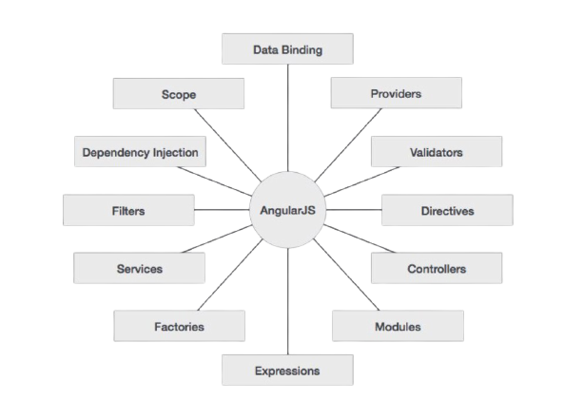
This diagram shows the important part of AngularJS

Slide 7
AngularJS Directives
The AngularJS framework can be divided into three major parts:
* ng-app: This directive defines and links an AngularJS application to HTML
* ng-model: This directive binds the values of AngularJS application data to HTML input controls.
* ng-bind: This directive binds the AngularJS application data to HTML tags

Slide 8
Example
<html>
<head>
<script src="https://ajax.googleapis.com/ajax/libs/angularjs/1.3.beta.17/
angular.min.js"></script>
</head>
<body ng-app="myapp">
<div ng-controller="HelloController" >
<h2>Welcome {{helloTo.title}} to the world of Tutorialspoint!</h2>
</div>
<script>
angular.module("myapp", []) .controller("HelloController",function($scope){
$scope.helloTo = {};
$scope.helloTo.title = "AngularJS"; });
</script>
</body>
</html>

Slide 9
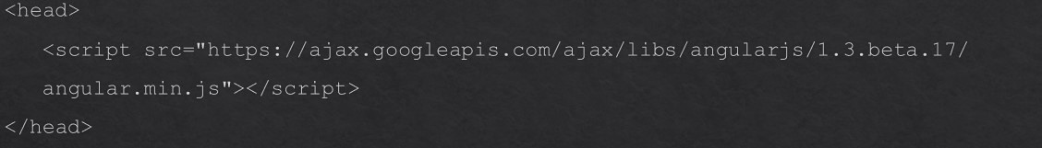


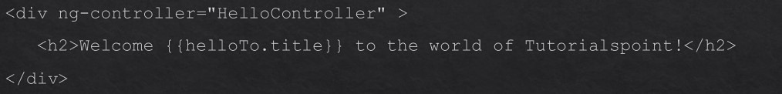
Explanation
Step-1: we include the angularJS javaScript file in the html page so that we can use it:
Step-2: adding the “ng-app” attribute to the root html element of the angularJS app.
Step-3: “ng-controller” tells angularJS which controller to use with this view. “helloTo.title” tells angularJS to write the model value named “helloTo.title” in html at this location.

Slide 10
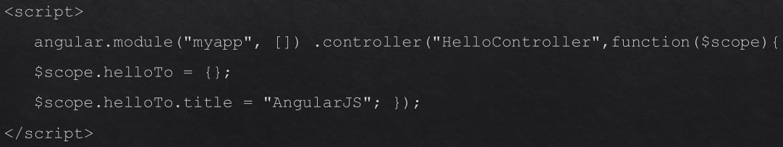
Step-4: this code registers a controller function named “HelloController” in the angular module named “myapp”. The controller function is registered in angular via the angular.module().controller().function call.
* The $scope parameter model is passed to the controller function. The controller function adds a “helloTo” javaScript object and in that object it adds a title field.
Execution: Save the above code as ”myFirstExample.html” and open it in any browser. You get to see the following output:

Slide 11
The Process
What happens when the page is loaded in the browser? Lets see:
* HTML document is loaded into the browser, and evaluated by the browser. * AngularJS JavaScript file is loaded, the “angular-global-object” is created. * The JavaScript which registers controller functions is executed. * Next, AngularJS scans through the HTML to search for AngularJS apps as well as views. * Once the view is located, it connects that view to the corresponding controller function. * Next, AngularJS executes the controller functions. It then renders the views with data from the model populated by the controller. The page is now ready.

Slide 12
Example - 2
testAngularJS.html file:
<html>
<title>AngularJS First Application</title>
<body>
<h1>Sample Application</h1>
<div ng-app=“”>
<p>Enter your Name: <input type=“text” ng-model=“name”></p>
<p>Hello <span ng-bind=“name”></span>!</p>
</div>
<script src=“http://ajax.googleapis.com/ajax/libs/angularjs/1.2.15/angular.min.js”>
</script>
</body>
</html>

Slide 13


Explanation - 2
Step-1: Load framework - Being a pure JavaScript framework, it can be added using <Script> tag.
Step-2: Define AngularJS application using “ng-app” directive
Step-3: Define a model name using “ng-model” directive
Step-4: Bind the value of above model defined using ng-bind directive

Slide 14
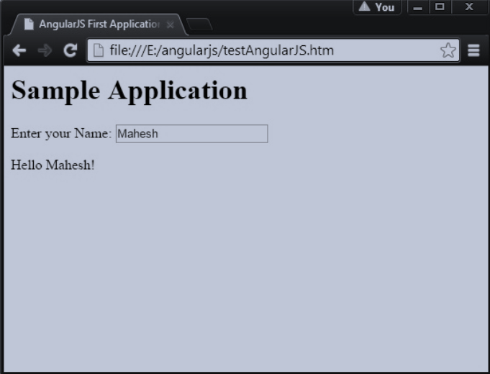
Output
Open the “filetestAngularJS.html” in a web browser. Enter your name and see the result.

Slide 15
How AngularJS Integrates with HTML
* The ng-app directive indicates the start of AngularJS application.
* The ng-model directive creates a model variable named “name”, which can be used with * the HTML page and within the div having ng-app directive.
* The ng-bind then uses the “name” model to be displayed in the HTML <span> tag whenever user enters input in the text box.
* Closing </div> tag indicates the end of AngularJS application.

