Slide 1


King Fahd University of Petroleum and Minerals
Business School
FinTech Business Hackathon
FinCoders

Slide 2



Problem
Low-income people
Small loans

Slide 3




Slide 4



Value Proposition
Small loans
Unknown people
Secure way

Slide 5
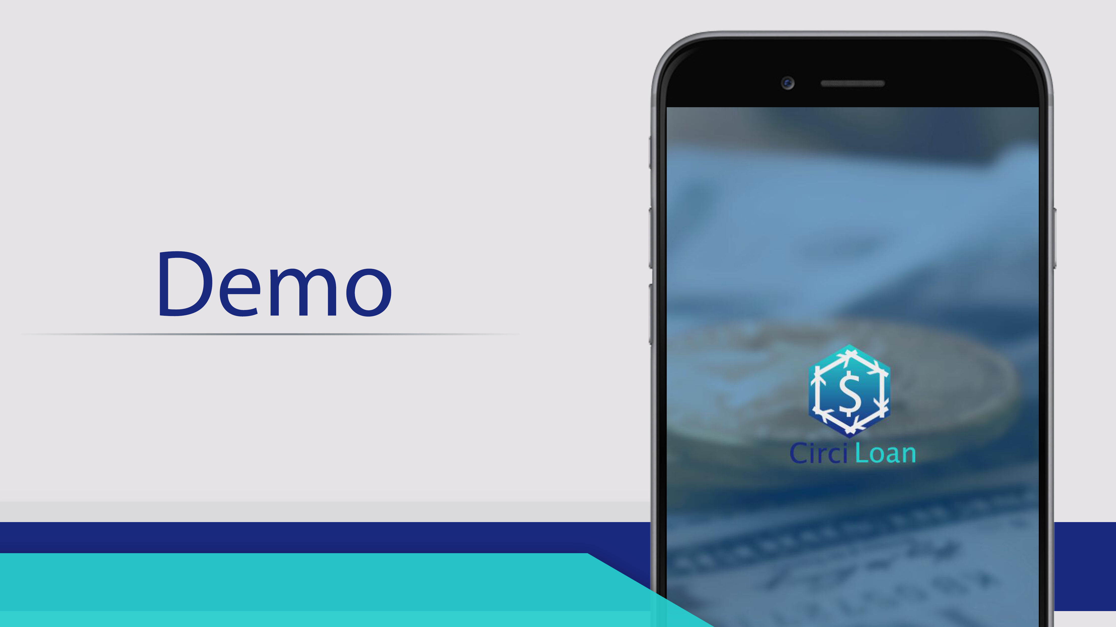

Slide 6
Business Model
Small-loans customers
Low-income customers

Slide 7


How to reach to customers
Already-existing channels
Monitor desired customers

Slide 8
Any competitors .. ?
NO local bank adopts this methodology !!
NO local bank supports small loans

Slide 9


Who are we ?
Software Engineers
Business Analysis

Slide 10
We talk money ..
37% of low-income people take payday loans.
The monthly proposed percentage to be taken out of the
lump sum is 0.5-1%.
If we take an average lump sum at 5000 S.R. divided
among 10 people, we can get 500 S.R. out of each lending
circle each year.

Slide 11

Funding
Development
Marketing

