Slide 1
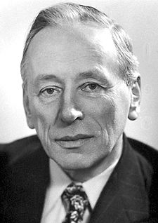
Binary Shape Clustering via Zernike Moments
By:
Stephen Yoo
Michael Vorobyov

Slide 2
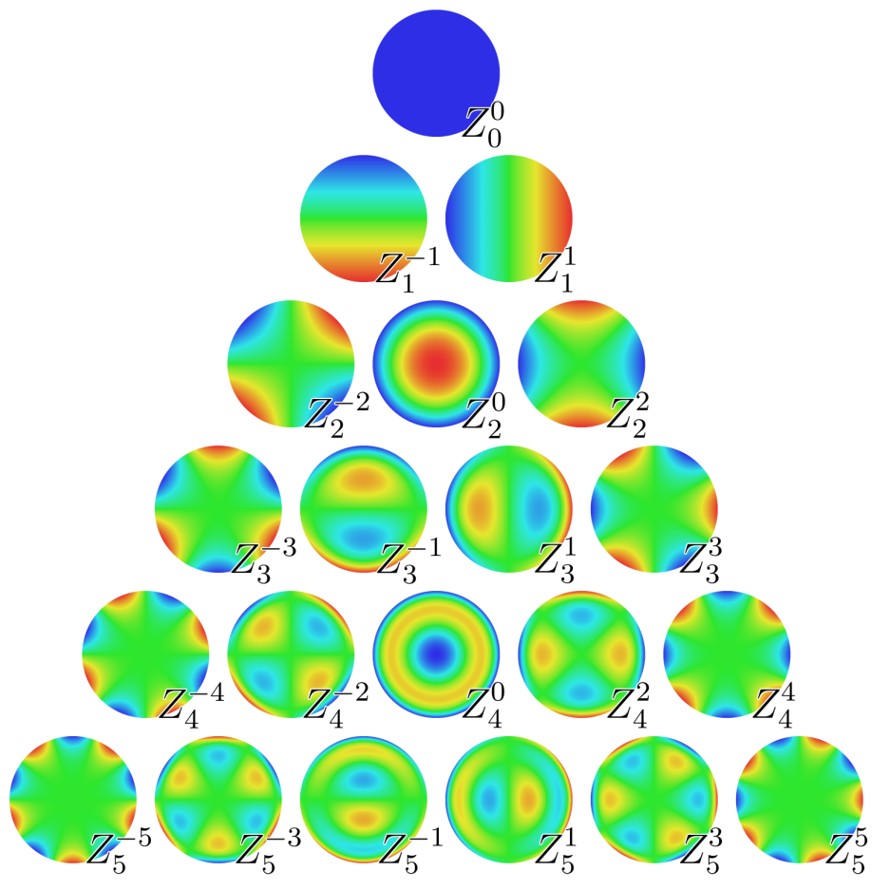
Moments
In general, moments describe numeric quantities at some distance from a reference point or axis.

Slide 3


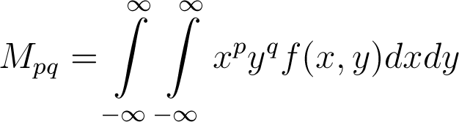
Regular (Cartesian) Moments
A regular moment has the form of projection of onto the monomial

Slide 4
Problems of Regular Moments
The basis set is not orthogonal → The moments contain redundant information.
As increases rapidly as order increases, high computational precision is needed.
Image reconstruction is very difficult.

Slide 5
Benefits of Regular Moments
Simple translational and scale invariant properties
By preprocessing an image using the regular moments we can get an image to be translational and scale invariant before running Zernike moments

Slide 6
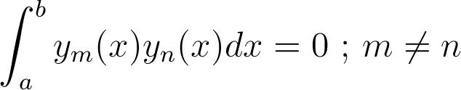
Orthogonal Functions
A set of polynomials orthogonal with respect to integration are also orthogonal with respect to summation.

Slide 7
Orthogonal Moments
Moments produced using orthogonal basis sets.
Require lower computational precision to represent images to the same accuracy as regular moments.

Slide 8


Zernike Polynomials
Set of orthogonal polynomials defined on the unit disk.

Slide 9
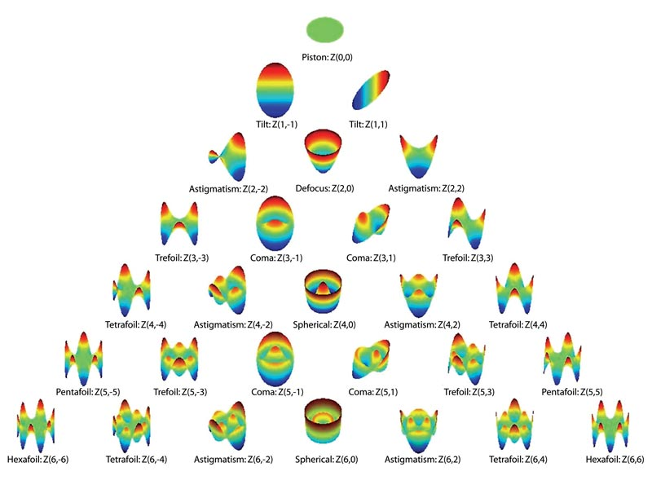

Slide 10
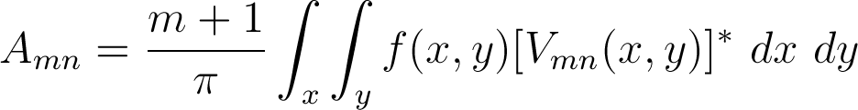

Zernike Moments
Simply the projection of the image function onto these orthogonal basis functions.

Slide 11
Advantages of Zernike Moments
Simple rotation invariance
Higher accuracy for detailed shapes
Orthogonal
Less information redundancy
Much better at image reconstruction (vs. normal moments)

Slide 12
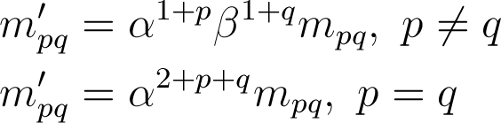

Scale and Translational Invariance
Scale: Multiply by the scale factor raised to a certain power
Translational: Shift image’s origin to centroid (computed from normal first order moments)

Slide 13
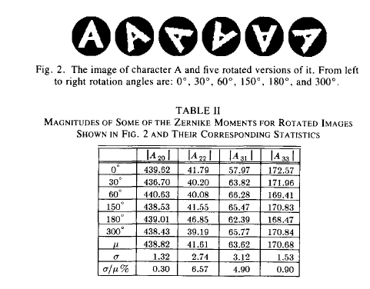
Rotational Invariance
The magnitude of each Zernike moment is invariant under rotation.

Slide 14
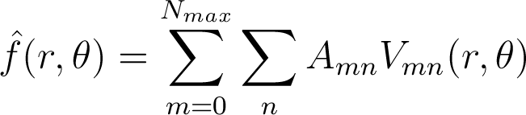
Image Reconstruction
Orthogonality enables us to determine the individual contribution of each order moment.
Simple addition of these individual contributions reconstructs the image.

Slide 15
Image Reconstruction
Reconstruction of a crane shape via Zernike moments up to order 10k-5,
k = {1,2,3,4,5}.
(a)
(b)
(c)
(d)
(e)
(f)

Slide 16



Determining Min. Order
After reconstructing image up to moment
Calculate the Hamming distance,
which is the number of pixels that are
different between and .
Since, in general, decreases as
increases, finding the first for which
will determine the minimum order to reach a predetermined accuracy.

Slide 17
Experimentation & Results
40th order moments on 22 binary 128 x 128 images of 7 different leaf types.
Clustering was done by K-means, with the farthest-first approach for seeding original means.

Slide 18







Original Clusters
Type 1
Type 5
Type 2
Type 6
Type 3
Type 7
Type 4

Slide 19


The Zernike Clusters
Type 1
Type 5
Type 2
Type 6
Type 3
Type 7
Type 4

Slide 20
Conclusion
Zernike moments have rotational invariance, and can be made scale and translational invariant, making them suitable for many applications.
Zernike moments are accurate descriptors even with relatively few data points.
Reconstruction of Zernike moments can be used to determine the amount of moments necessary to make an accurate descriptor.

Slide 21
Future Research
Better seeding algorithm for K-means/ different clustering algorithm
Apply Zernike’s to supervised classification problem
Make hybrid descriptor which combines Zernike’s and contour curvature to capture shape and boundary information

