Slide 1
RAD51

Slide 2
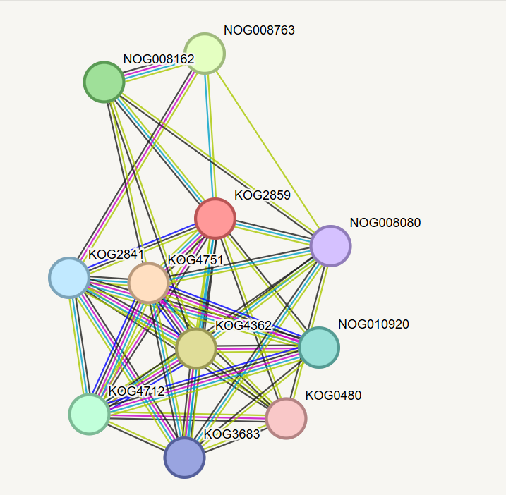
Recombinase for homologous DNA recombination
1. Function of RAD51 protein
Function: repair of double-strand DNA breaks via homologous recombination
Partners: BRCA1, BRCA2 (assembly regulator), PALB2, RAD51B/C/D (paralogues), XRCC2/3 (stabilisation), BLM (remodelling helicase)
Localisation: cell nucleus (NLS signal at the N-terminus)
Expression: peaks in the S–G2 phases of the cycle when the cell replicates DNA
Mechanism: forms a helical filament on ssDNA, scans the genome for a homologous sequence, catalyses invasion and strand exchange
Involvement in pathologies: Fanconi syndrome anaemia (mutational loss of function), breast cancer (mutational resistance), pancreatic cancer (overexpression leads to chemoresistance)
Figure 1 Protein-protein interaction network reflecting the functional relationships of RAD51

Slide 3
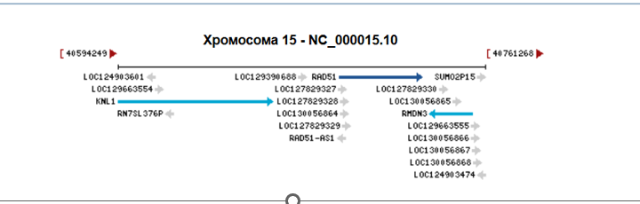
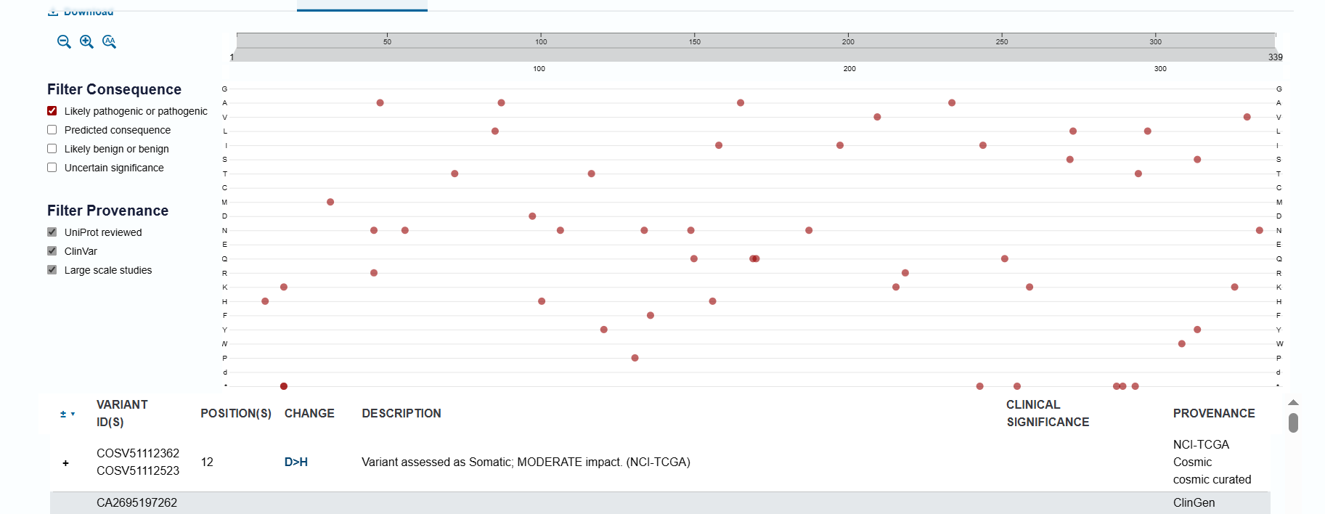
2. Nucleotide and amino acid sequence
Chromosome: 15q15.1 (gene length: ~32 kb, 9 exons)
ORF: 1368 bp (during transcription) → 339 amino acids (translated in ribosomes)
Molecular weight: 37 kDa (determined by mass spectrometry)
ORF type: one dominant frame in the forward direction; ALTER transcripts do not alter the RecA core
Pathogenic mutations (LOSS OF FUNCTION):
c.172C>T → STOP58 (Fanconi anaemia FANCR, loss of entire catalytic domain)
c.872A>G → Y291C (breast cancer, loss of DNA-binding competence) Figure 3 Mutation distribution graph
68+ somatic mutations
Figure 2 Genomic context of the RAD51 gene: localisation on the long arm of the chromosome
Figure 3 Mutation distribution graph

Slide 4
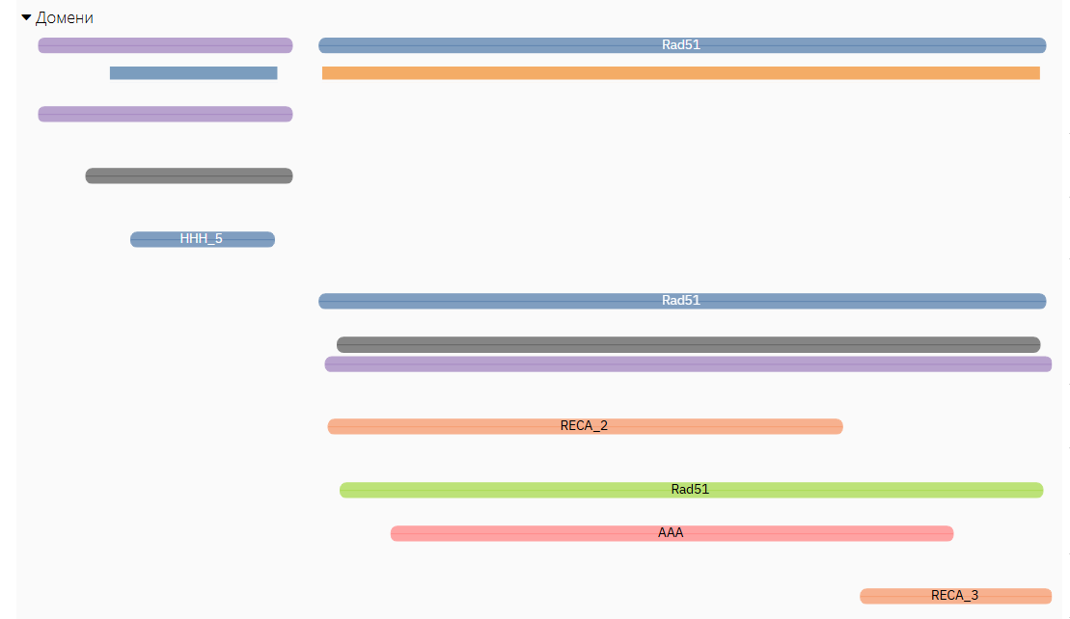
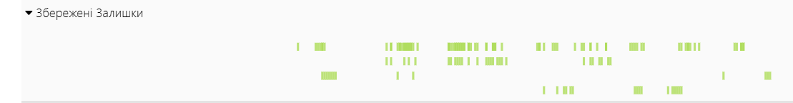
3. Domain structure and conservative residues
Figure 4 RAD51 domain architecture
Figure 5 Visualisation of conserved amino acid residues

Slide 5
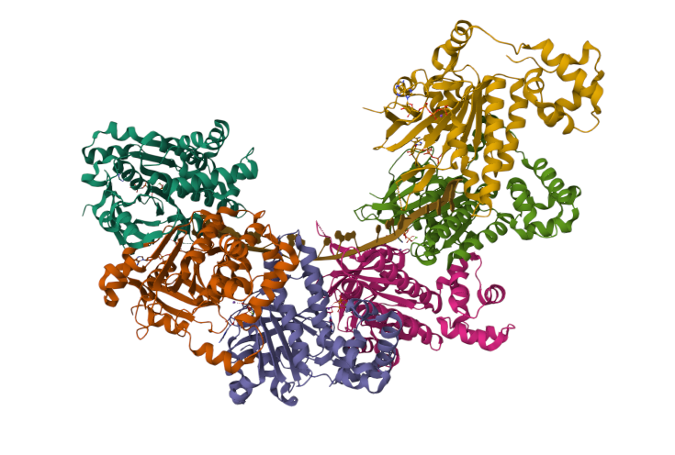
4. Three-dimensional structure
Mechanism: activators (RS-1) stabilise the active conformation of the filament; inhibitors (B02/DIDS/RI-1/CAM833) block assembly or DNA pairing through competition for critical surfaces.
PDB ID 9QNA: full length
Filament architecture: helical organisation (6–7 monomers per turn), RAD51–ssDNA and RAD51–RAD51 contacts
ATP pocket: deep pocket in the centre of the RecA domain, interacts with the adenosine moiety and magnesium
L1/L2 loops: hydrophobic surface at the periphery, contacts with ssDNA via π-stacking Phe248, Met251
BRCA2-binding site: linker region (D321–G317)
Docking hypothesis: small molecules target two orthogonal sites — (1) L1/L2 for DNA interaction activators/inhibitors, (2) ATP pocket for ATP hydrolysis inhibitors
Figure 6 3D model of the spiral organisation of the RAD51 filament

Slide 6
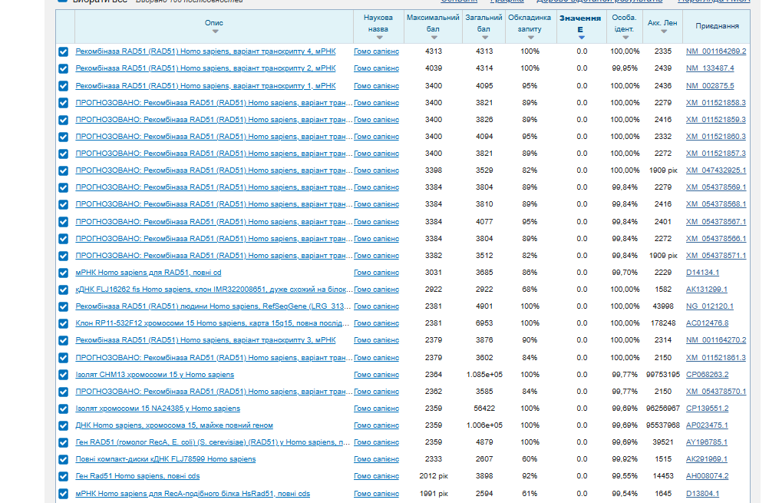
5. BLAST
Figure 7 Table of BLAST search results

Slide 7
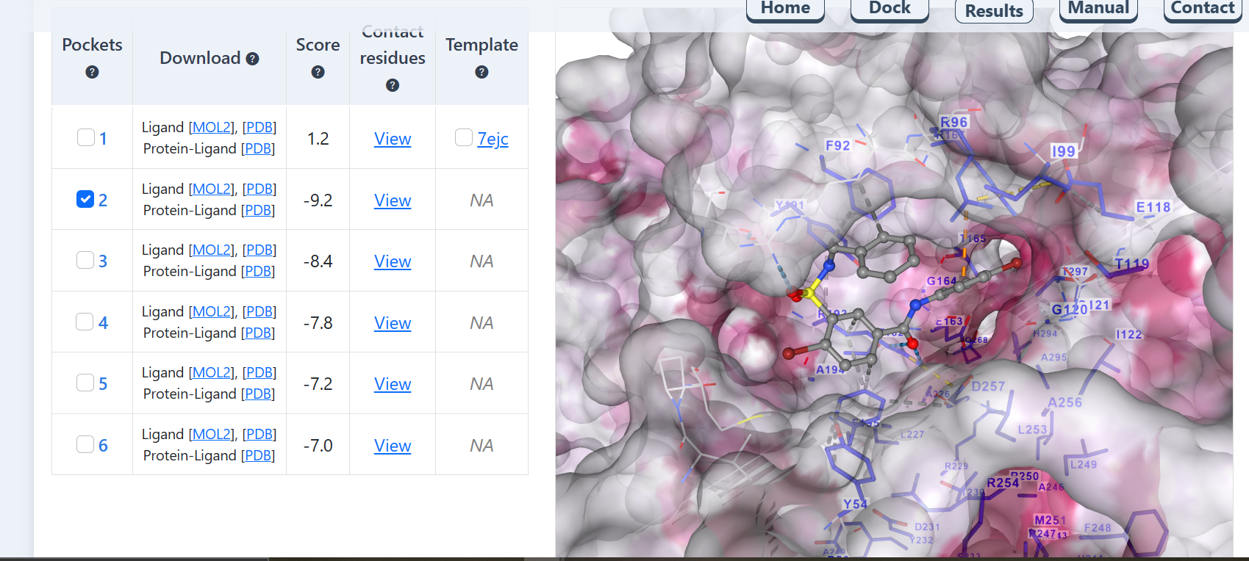
Figure 8 Molecular docking results
6. Molecular docking
Figure 8 Molecular docking results

