Slide 1
Multi-class classification of Diabetes Project
Team of (6):
Yaroslaw Bagriy
Derefaa Cline
William Ruiz De Castilla
Dula Tufa
Christopher Antholz
Henrik Floeter

Slide 2

Diabetes Health Indicators Dataset
253,680 survey responses
21 feature variables (important risk factors)
Multi-class classification of Diabetes
0 = no diabetes or only during pregnancy
1 is for prediabetes
2 is for diabetes
Data Dictionary
Data Cleaning
The dataset has been cleaned and addresses the following issues:
Reduce the original 330 features to 21 based on diabetes disease research regarding factors influencing diabetes disease and other chronic health conditions, only select features are included in this analysis.
Missing values, “Don’t know/Not sure” or “Refused”
Modifying and cleaning values to be more suitable for ML algorithms
Making feature names more readable

Slide 3
Model Prediction process
Clean data, i.e. NAN, NULL
Change categorical values -> Concatenate into DF
Split into train and test
Standardize the numeric training data. This has been separated from Test data
Concatenate into a training set
Remove Outliers
Re-Standardize data
Train model
Predicting new data
Evaluate Performance
Categorical values must be encoded into numbers so that models can process and analyze patterns
Avoid data leakage: Test set cannot influence training set since they are separated
Scaler will only be fit on training data to calculates Mean & STD stored on the scaler. The test data then uses the scaler that has only seen the training data for its standardization
After eliminating outliers, it is essential to re-standardize the data since outliers can skew the mean and standard deviation, resulting in inaccurate scaled values.

Slide 4

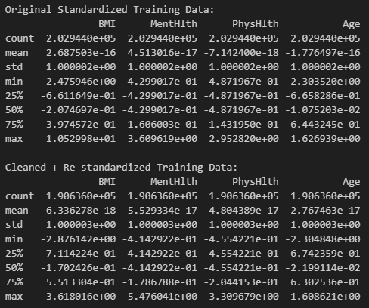
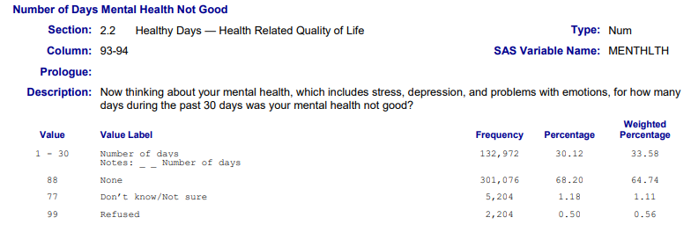
Outliers
z-score with a threshold of 3 which includes ~99.7% of data
Only the most extreme values were excluded.
Removed 12,308 outliers from training data
Examine BMI and MentHlth
MentHlth
- For MentHlth 50% of the values are all the same number -0.429 which suggests that a single uniquely low value is being captured
In the Data Dictionary. This was the question asked associated with that question.
- Currently we are excluding these as an outlier, we should keep this in

Slide 5
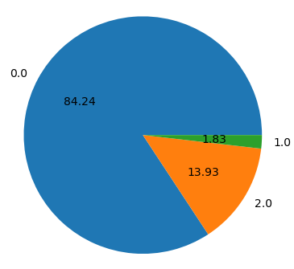

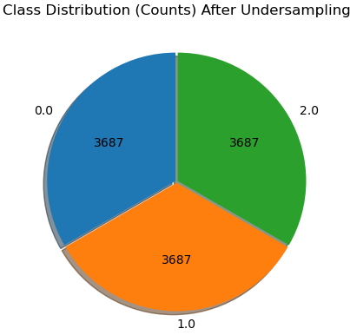
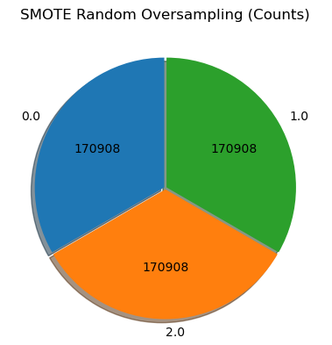
Unbalanced Dataset
Synthetic Minority Over-sampling Technique
(SMOTE) Creates artificial samples of the minority class
Uses K nearest neighbors to find nearby minority class samples for each data point
creates new synthetic points by randomly placing them between that point and one of its neighbors.
APIs for other imbalanced datasets
RandomUnderSampler class
Randomly removes samples from the majority class
Scaling, removal of outliers and test/train split have already happened prior
Less skew of feature especially in the majority class.

Slide 6
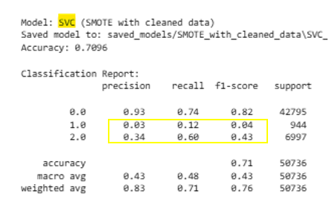
It matters WHEN and WHERE you apply
Under Sampling
Over Sampling
Experiment 1:
Apply over and under sampling
After the split of training and test data
Only applied to training data to avoid data leakage
Not applied to testing data
The test data remained unbalanced
Experiment 1 – Results:
Even though the training data was balanced
No significant performance change
Balancing the training data alone doesn't fix test set issues.
The model still struggles with minority classes if the test data is unbalanced.
…….
Models tried:
SVC (linear and non-linear),
Random Forest,
Gradient Boost,
One-Vs-Rest,
OneClassSVM,
Regression (Logistic and Linear)
Different Models – Similar Outcomes when testing data was unbalanced

Slide 7
It matters WHEN and WHERE you apply
Under Sampling
Over Sampling
Experiment 2:
Apply under sampling
Before the split of training and test data
Before Standardization
Applied to both training and test data
({2.0: 35,346, 0.0: 25,000, 1.0: 4,631})
~64K samples
All minority data is kept
Class 2 has more influence, better for recall
Test size = 20% of 64,977 → rounds to 12,996
Under sampling was used as SMOTE takes 18 hrs to run on my computer or the UST computer labs
Clean data, i.e. NAN, NULL
Change categorical values -> Concatenate into DF
2a note: Random Under Sampler works best with numeric input. So, you need to convert the categorical columns first. You’re not losing any class 1 or 2 data, only trimming class 0 to ensures recall and precision have enough signal to work with, especially for class 2
Split into train and test Apply Random Under Sampling
Split into test and train w/ undersample_strategy
Standardize the numeric training data. This has been separated from Test data
Etc …

Slide 8
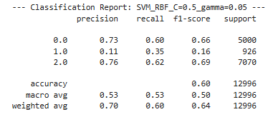
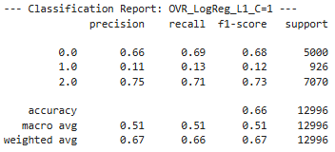
Experiment 2 – Results: Under sampling to deal with unbalanced data before the split
SVM.OneClassSVM(kernel="rbf")
Building a one-class SVM for each class against itself
Experiment 1 : Best results
.93 .74 .82
.04 .07 .05
.39 .54 .46
-14
+ 7
+27
One-vs-Rest Logistic Regression (with L1 penalty) trains a separate logistic model for each class vs. the others. This approach allows more focus on each class individually,

Slide 9
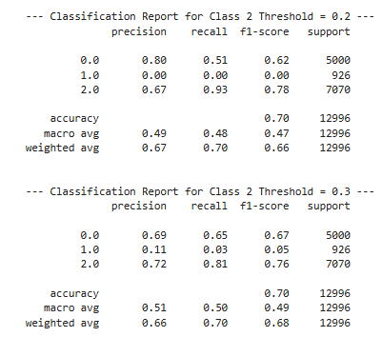
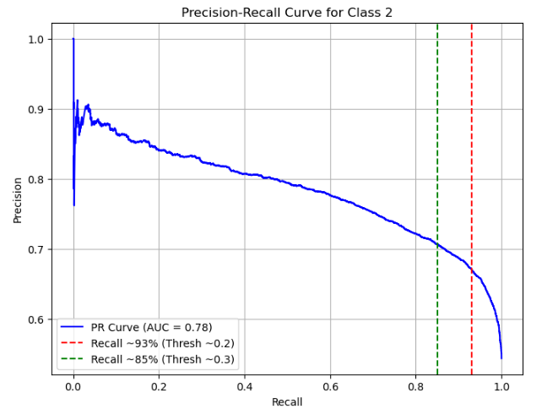
Threshold Testing - OneVsRestClassifier(LogisticRegression)
The precision-recall curve for class 2 shows that at a threshold of ~0.2, recall reaches 93% but precision drops to around 67-70%. At a more moderate threshold of ~0.3, recall is 85% with improved precision, indicating a better balance point.
Best results before threshold
.75 .71 .73
-3 +10 +3
Threshold = 0.2 for Class 2 → Low Barrier for Class 2 Prediction
If class 2 probability ≥ 0.2, the model aggressively predicts class 2.
Even if class 2 is only mildly likely, it’s now chosen.
Almost all real class 2 samples are caught → Recall = 93% (excellent).
But some class 0 or 1 samples are misclassified as class 2, because the bar is set low → Precision = 67%.

Slide 12
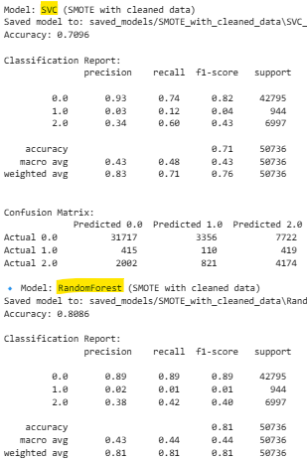
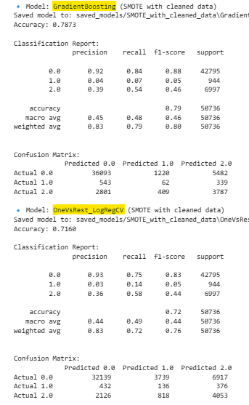
Different Models – Similar Outcomes when testing data was unbalanced
Random Forest is decision trees that handles non-linear patterns well, is robust to noise and outliers, and works out of the box for multi-class problems.
Gradient Boosting builds trees sequentially, correcting the errors of previous trees to improve accuracy. I used it to compare its performance to Random Forest in a more focused, error-driven way.
SVC finds a linear decision boundary that separates classes with the widest margin. It's simple, efficient, and works well when data is linearly separable. I chose it as a baseline model to compare performance against more complex models and see how well simple linear boundaries perform across three classes.
One-vs-Rest trains a separate logistic model for each class vs. the others. This approach allows more focus on each class individually, which should have been helpful in imbalanced or overlapping classes.
I chose it to improve class-specific recall and precision, and to give more flexibility in handling the class imbalance in my dataset.

