Slide 1
Amazon E-Commerce Performance & Operational Analytics
Strategic Sales Diagnostics, Delivery SLA Benchmarks & Multi-Million Dollar Reverse Logistics Optimization
Koushik Yarram
Newton_School_May_2026_Batch

Slide 2
EXECUTIVE CONTEXT | INTRODUCTION
Multi-Year Hypergrowth vs. Operational Friction
Macro performance reveals strong top-line scale overshadowed by massive reverse logistics loss.
$107.24M
+42.8%
$29.37M
38.9%
TOTAL GROSS SALES
2020 CUSTOMER SURGE
GROSS RETURN LOSS
PREVENTABLE DEFECTS
The Top-Line Hook
The Hidden Friction
Explosive 2020 revenue surge (+43.0% YoY). Tech categories drive 72.2% of GMV with a strong $949.02 AOV.
27.01% return rate erodes margins. Flat $11.51 freight fee leaks capital. Zero monetization of top spenders.

Slide 3



BUSINESS CONTEXT | PROBLEM STATEMENT
Three Structural Bottlenecks Inhibiting Scalability
Analysis of 113,000 transactions identified critical barriers to EBITDA growth.
2. Freight Disconnect
3. Unleveraged Spenders
1. $29.37M Return Crisis
Uniform $11.51 shipping fee across all modes.
27.01% return rate (30,526 orders).
18.6% of base drives 56.8% of GMV.
38.9% caused by warehouse errors.
Severe carrier cross-subsidization losses.
Zero repeat loyalty infrastructure exists.
Project Objective: Deploy Power BI & MySQL analytics to formulate a roadmap recovering $11.4M+ in margin.

Slide 4
DATA OVERVIEW | PREPROCESSING
Dataset Summary & ETL Hygiene Protocols
Auditing raw records to establish an error-free analytical baseline.
Transaction Scope
Power Query ETL Protocols
113,000 Valid Orders: Complete multi-year dataset spanning 2015–2020.
Ghost Rows Removed: Filtered 199 empty rows to restore 113K exact count.
$107.24M Sales: Reconciled GMV across 50,000 unique customer profiles.
Ghost Columns Dropped: Eliminated 5 empty trailing columns.
Pricing Reconciled: Sale Price = (Unit Price * Quantity) + Shipping.
Category Imputation: Order #5075931 aligned to 'Health and beauty'.
Catalog Depth: 44 unique SKUs mapped across 18 subcategories.
Promotions Validated: Audited 8 legitimate zero-unit-price orders.

Slide 5
DATA MODELING | RELATIONAL ARCHITECTURE
Star Schema Model & DAX Library
High-performance dimensional modeling optimized for query compression.
Fact Table: Orders
DAX Business Logic
113,000 rows. Transaction grain tracking Sales, SLAs, Returns.
Dynamic Field Parameters: Single slicer pivoting axes between Sales, Returns, and Satisfaction.
Time Intelligence: CALCULATE, SUMX, and SAMEPERIODLASTYEAR matrices.
Dimension Tables
Customers (50K profiles) & Continuous Calendar via DAX.
Contextual Filtering: Fashion Abroad Sales isolated precisely at $3,623,178.50.
Strict 1-to-Many Relationships
Zero circular dependencies. Single-directional filtering applied.

Slide 6
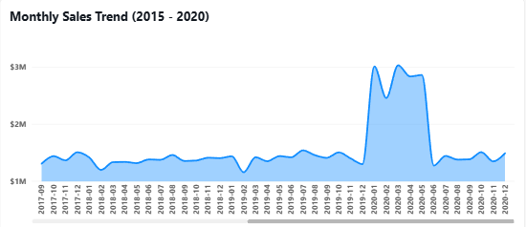
OBJECTIVE ANALYSIS | SALES DYNAMICS
Monthly Revenue Trend & 2020 Surge
2020 Hyper-Growth: +43.0% YoY revenue surge to $23.98M.
Audience Expansion: +42.8% active purchaser increase (25,179 shoppers).
Q1 Pullback: Recurring post-holiday sales dip in January/February.
Q4 Peak: Monthly revenues consistently spike past $2.2M during holidays.

Slide 7
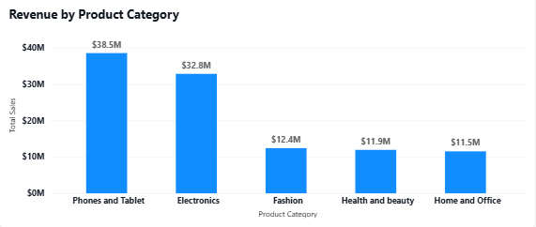
OBJECTIVE ANALYSIS | CATALOG BREAKDOWN
Revenue & Volume by Category
Tech Concentration: Phones & Electronics drive 72.2% ($77.42M) of total GMV.
Synchronized Growth: All 5 categories surged ~42% simultaneously in 2020.
Stable Order Value: Remarkable AOV consistency across catalog averaging $949.02.
Subscription Opportunity: Health & Beauty ($8.93M) perfectly positioned for auto-delivery.

Slide 8
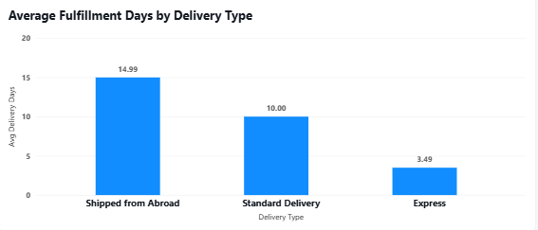
OBJECTIVE ANALYSIS | LOGISTICS OPERATIONS
Fulfillment SLAs & Freight Leakage
Three Transit Tiers: Express (3.49 days), Standard (10.00 days), Abroad (14.99 days).
Category Invariance: Delivery duration strictly driven by logistics mode, not product.
Flat $11.51 Leakage: Identical flat fee charged regardless of courier speed or weight.
Margin Subsidization: Lightweight electronics heavily subsidize bulky appliance freight.

Slide 9
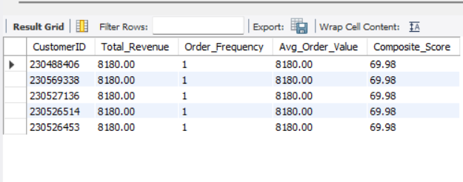
ADVANCED SQL ANALYTICS | CUSTOMER COHORTS
High-Value Spending Concentration
Top Individual Spender: Customer 230488406 leads with $8,180.20 total lifetime spend.
Extreme Concentration: 21,023 customers (18.6% of base) spend >30% above average.
56.8% Revenue Dependency: This elite cohort generates $60.91M of total platform GMV.
Loyalty Imperative: Zero repeat-purchase infrastructure puts this critical GMV at high churn risk.

Slide 10
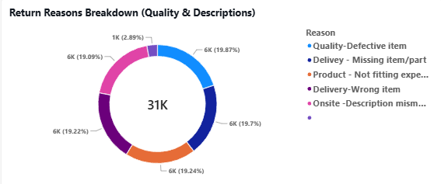
SUBJECTIVE INSIGHTS | REVERSE LOGISTICS
The $29.37M Return Defect Crisis
Severe Margin Bleed: 27.01% return rate impacts 30,526 orders and 163,224 units.
38.9% Preventable Defects: 11,885 returns stem from wrong items, damage, or delays.
Subjective Factors: 61.1% driven by remorse, poor description, or perceived quality issues.
Immediate Recovery: Barcode packing gates can recapture $11.43M in operational margin.

Slide 11
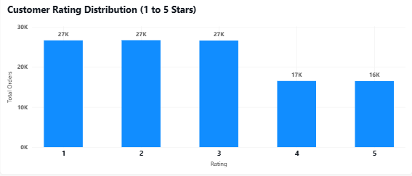
SUBJECTIVE INSIGHTS | SATISFACTION ANALYTICS
Ratings vs. Return Propensity
Binary Return Behavior: 4- and 5-star orders exhibit a flawless 0.00% return rate.
Concentrated Vulnerability: 1- to 3-star orders drive a massive 38.10% return rate.
Debunking Spend Fallacy: Average spend varies by less than 1.9% (~$949) across all ratings.
Core Takeaway: Dissatisfaction is driven by operational friction, not product pricing.

Slide 12
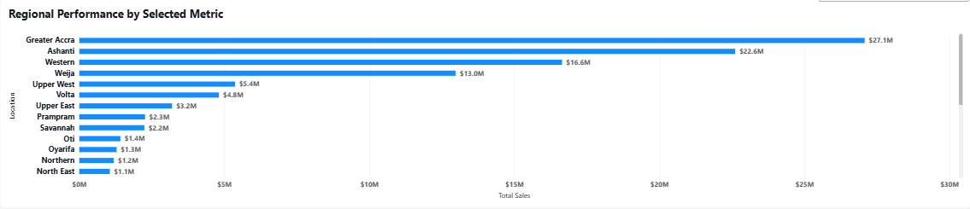
SUBJECTIVE INSIGHTS | GEOGRAPHIC DISTRIBUTION
Regional Market Concentration
Heavy Urban Concentration: Top 3 metro regions generate 61.9% ($66.42M) of total GMV.
Accra Commercial Core: Highest density of Express orders and fastest local transit times.
Hinterland Dispersal: Remaining 13 regions suffer 10-15 day standard delivery SLAs.
Micro-Hub Strategy: Local hubs in Accra and Kumasi cover 44.1% of all customer orders.

Slide 13
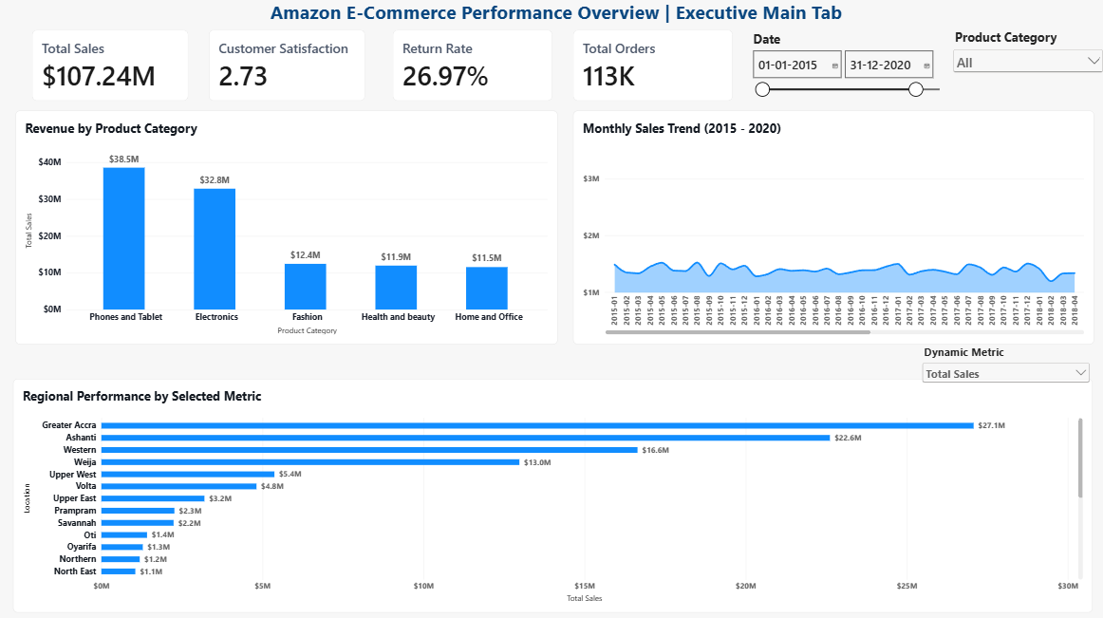

Slide 14
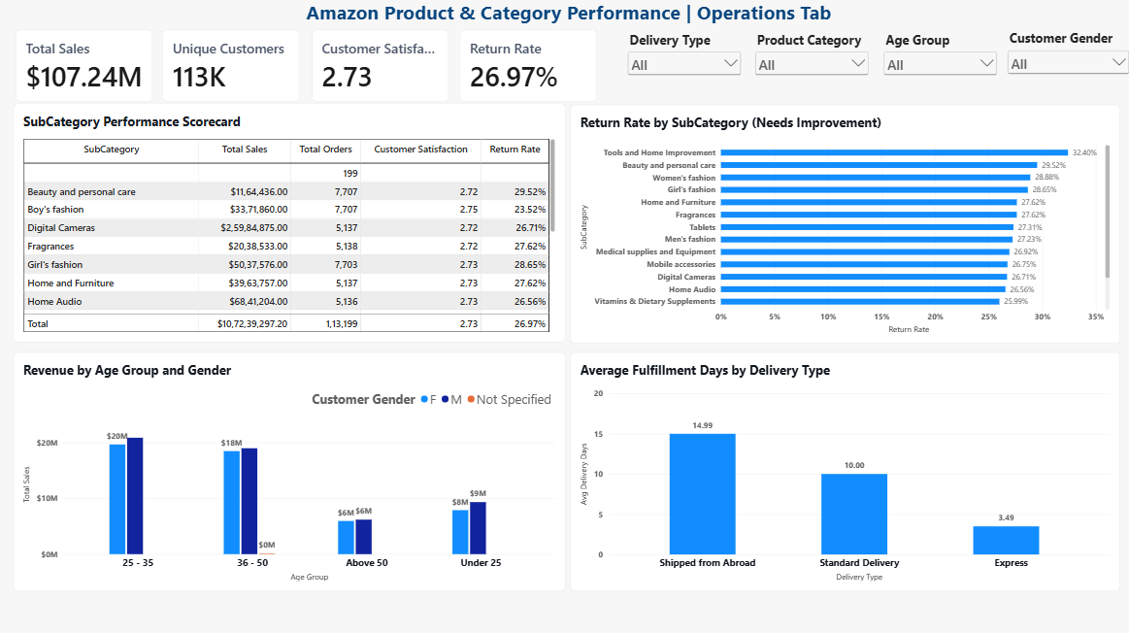

Slide 15
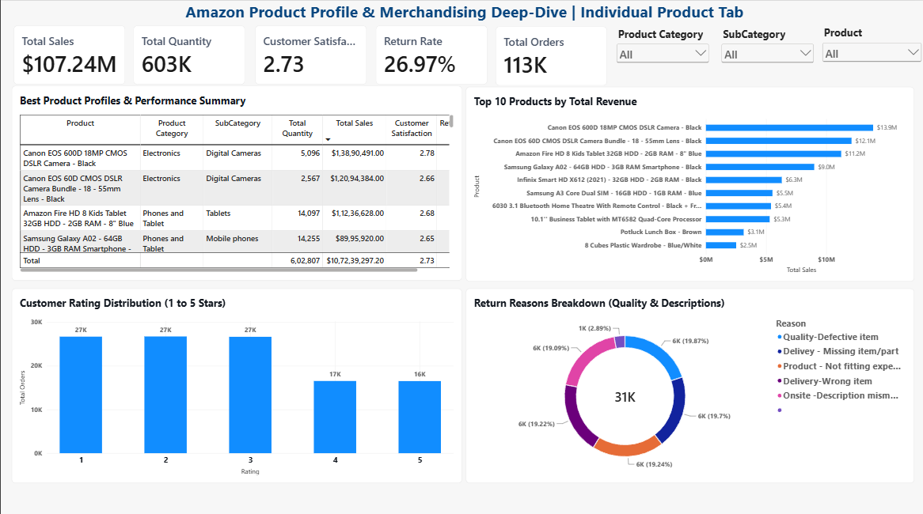

Slide 16
POWER BI SUITE | INTERACTIVE REPORTING
Multi-Tab Operational Dashboards
Three role-tailored report tabs utilizing Star Schema modeling and dynamic Field Parameters.
Executive Main Overview
Category Operations
SKU Diagnostics
Audience: C-Suite Leadership.
Audience: Operations Directors.
Audience: Product Merchandisers.
Features: Top-level KPI banner, chronological multi-year revenue trends.
Features: 5-category matrix breakdown measuring satisfaction and returns.
Features: Single-product SKU selector, Top 10 revenue ranking, rating distribution.
Mechanics: Single-select Field Parameter slicer toggling chart axes dynamically.
Logistics: Delivery SLA benchmarks isolating Express vs. Standard transit times.
Quality: Defect root-cause donut chart for targeted supplier chargebacks.

Slide 17



STRATEGIC ROADMAP | PILLAR 1: CUSTOMER RETENTION
4-Tier Prime Loyalty Program
Capitalizing on 21,023 elite spenders to drive repeat purchase frequency and expand LTV.
Bronze
Silver
Gold
Platinum Elite
SPEND < $500
SPEND $500–$999
SPEND $1K–$2K
SPEND $2,000+
Free standard shipping on orders >$50. Standard support.
3% cashback points. 5-day delivery guarantee.
Guaranteed 2-day delivery in top 3 metros. 5% cashback.
Dedicated VIP manager. Free next-day express delivery.
Projected Impact: Generates +$8.2M in incremental GMV and expands top-spender LTV by +34%.

Slide 18
STRATEGIC ROADMAP | PILLAR 2: FULFILLMENT & RETURNS
Micro-Fulfillment & Barcode Verification
Eliminating $11.43M in preventable logistics errors through localized infrastructure.
Automated Barcode Quality Gates
Accra & Kumasi Micro-Hubs
Target: Eliminate 11,885 wrong-item and damage defects.
Target: Compress 10.00-day standard domestic SLA.
Location: Regional hubs servicing 44.1% of platform demand.
Mechanism: Computer-vision scan matches SKU, size, and seal prior to courier handoff.
Inventory: Pre-position top 20% high-velocity SKUs locally.
Packaging: Drop-tested reinforced boxes for high-value electronics.
Outcome: Slashes urban delivery duration from 10.00 days to 2.50 days.
Outcome: Reduces preventable warehouse defects by 65% in 90 days.

Slide 19
STRATEGIC ROADMAP | PILLAR 3: MARGIN OPTIMIZATION
Dynamic Volumetric Freight & Subscriptions
Realigning shipping economics with true carrier costs and securing recurring cash flows.
Dynamic Volumetric Pricing
Subscribe & Save Replenishment
The Problem: Uniform ~$11.51 fee severely subsidizes heavy goods.
Target Category: Health & Beauty ($8.93M GMV) consumables.
Formula: Base Fee + (Dimensional Weight * Zone Factor) + Speed Surcharge.
Mechanism: Automated 30/60/90-day delivery with a 10% discount.
Express Monetization: Premium pricing ($15–$25) implemented for 3.5-day courier service.
Cash Flow Smoothing: Mitigates post-holiday Q1 revenue dips.
Outcome: Recaptures +$2.1M annually in logistics carrier subsidies.
Outcome: Converts 25% of consumable sales into recurring monthly GMV.

Slide 20
EXECUTIVE SYNTHESIS | FINANCIAL IMPACT | CONCLUSION
Quantified Business Impact & 24-Month Roadmap
Strategic initiatives deliver $21.7M+ in combined margin recovery and incremental growth.
$11.4M
+$8.2M
+$2.1M
REVERSE LOGISTICS RECOVERY
INCREMENTAL PRIME GMV
FREIGHT SUBSIDY RECOVERY
MONTHS 1–3
MONTHS 4–8
MONTHS 9–15
MONTHS 16–24
Hygiene & Pricing
Retention & Subs
Hub Deployment
Nationwide Scale
Deploy dual-scan barcode gates. Launch volumetric freight pricing.
Roll out 4-Tier Prime Loyalty. Pilot Subscribe & Save.
Commission Accra & Kumasi hubs. Cut metro SLAs to 2.5 days.
Expand regional hubs to Western Region. Scale Prime VIP.

