Slide 1

Astro-Sage Call Center Performance Analysis
Strategic Insights & Operational Investment Plan
Prepared by Koushik Yarram

Slide 2

Problem Statement
With a ₹1 crore investment aimed at upgrading call center operations, AstroSage needs to deeply analyze historical interaction data and performance metrics. The primary challenge is identifying operational bottlenecks to allocate these funds effectively, ensuring a boost in efficiency, elevated customer satisfaction, and maximized long-term profitability.

Slide 3

Project Objective
To conduct a comprehensive analysis of historical consultation records, pinpointing specific operational bottlenecks and service quality gaps. The ultimate aim is to deliver data-backed recommendations that optimize agent efficiency, enhance the user experience, and drive sustainable revenue growth.

Slide 4
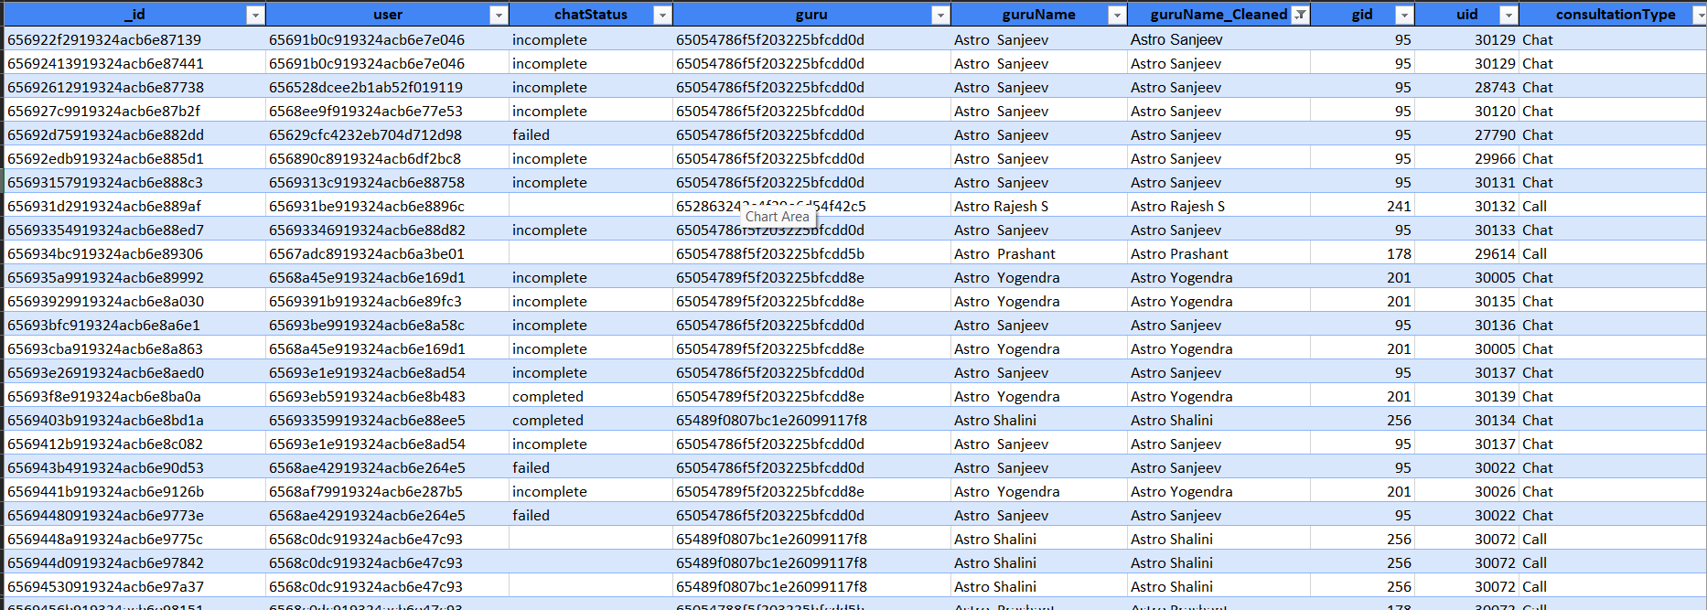

Dataset Overview
Analyzed a robust dataset containing over 28,000 unique consultation records from 2023-2024.
Encompasses detailed metrics on calls, chats, user ratings, financial revenue, and individual agent performance.
Captures comprehensive platform activity (App vs. GuruCool) and temporal trends (hourly/daily).
Provides the foundational metrics necessary for a deep-dive operational evaluation.

Slide 5
Methodology
Raw Data
Data Cleansing: Ensured data accuracy through rigorous validation, handling missing values and formatting inconsistencies.
Cleaning
Feature Engineering: Extracted specific temporal elements to enable daily and hourly trend analysis.
Analysis
Aggregation: Utilized advanced pivot tables for metric summarization and cross-referencing.
Visualization: Developed a dynamic, interactive dashboard to uncover hidden patterns and ongoing monitoring.
Visualization
Insights

Slide 6
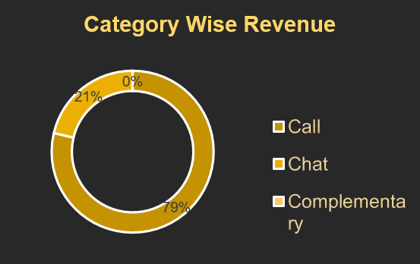
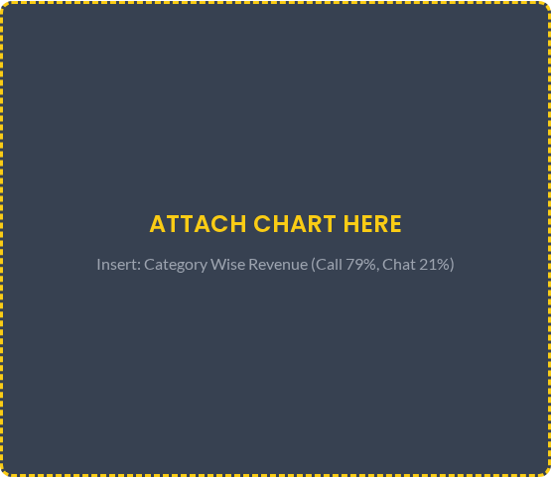
Revenue by Consultation Type
Voice calls constitute the primary revenue driver for the platform.
Calls contribute approximately 79% of total earnings.
Chat consultations make up a significantly smaller portion (21%) of the revenue stream.
Optimizing the voice call experience and infrastructure is crucial for protecting baseline profitability.

Slide 7
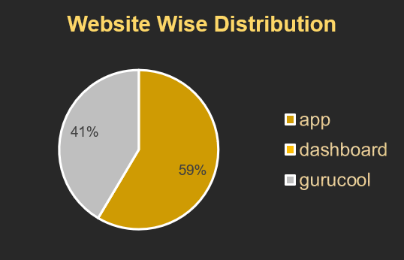
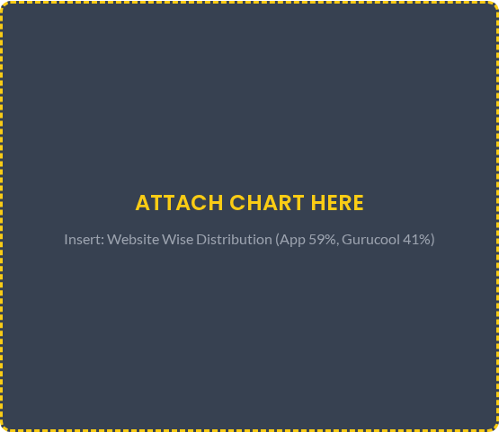
Revenue Distribution by Platform
The mobile app dominates revenue generation, capturing 59% of total platform income.
The GuruCool web platform trails behind, contributing 41%.
These disparities highlight distinct user preferences in how they access AstroSage services.
Significant opportunities exist to boost engagement and optimize the user journey on the GuruCool platform.

Slide 8

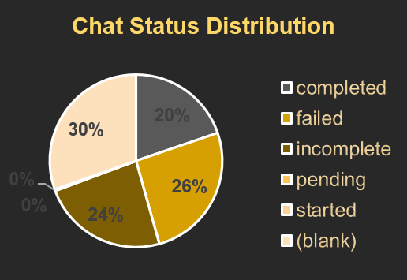
Chat Status Distribution
'On-call' chats represent the largest active share of interactions at 30%.
A highly concerning portion of chats end up as 'Failed' (26%) or 'Incomplete' (24%).
Successfully 'Completed' chats represent only 20% of the total volume.
Resolving technical interruptions and connectivity issues is urgently required to improve chat reliability.

Slide 9
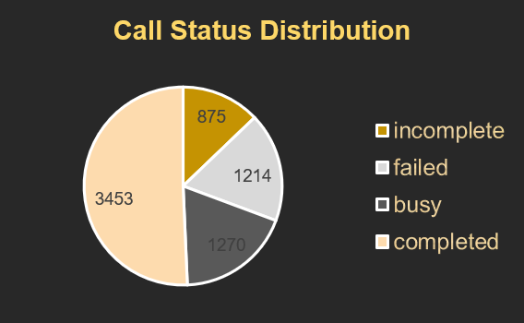

Call Status Distribution
While a strong percentage of calls are successfully completed, inefficiencies exist in connection rates.
A notable volume of calls register as 'Busy' or 'No-answer', indicating potential capacity limits.
Failed calls directly impact customer trust and immediate revenue realization.
Upgrading the routing engine could significantly reduce missed connection opportunities.

Slide 10
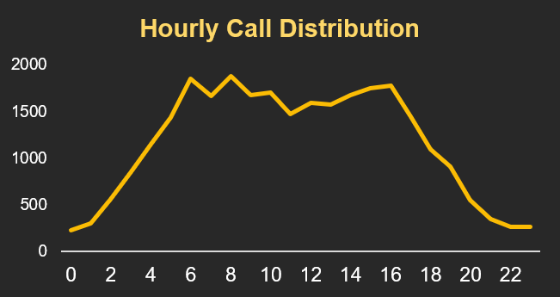

Hourly Call Distribution
Consultation traffic builds steadily throughout the early morning hours.
Demand reaches its absolute peak during midday and early afternoon segments.
Activity remains consistently high before tapering off sharply in the late evening.
Agent shift scheduling must be optimized to align strictly with this predictable daily curve.

Slide 11
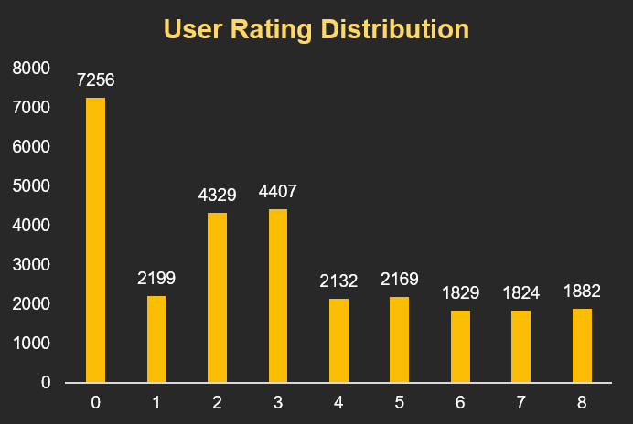

User Rating Distribution
A concerning volume of interactions resulted in an absolute zero rating (7,256 instances).
Mid-range scores (2 and 3) represent the next highest frequency of ratings.
The overall platform average rating sits at a low 2.93 out of 8.
This skewed distribution indicates an urgent, systemic need for quality assurance and agent retraining.

Slide 12
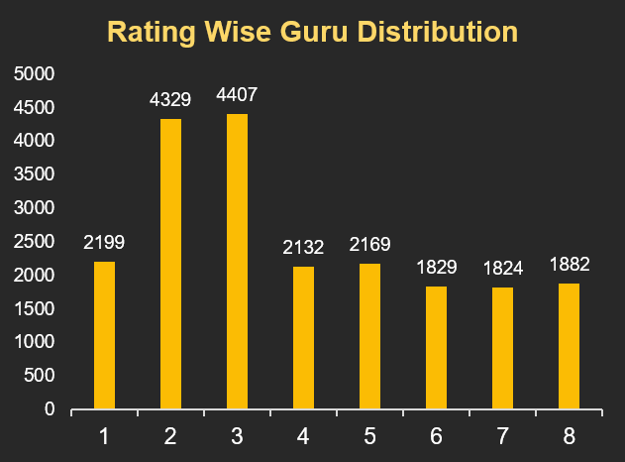

Rating-wise Guru Performance
Individual agent performance closely mirrors the overall platform rating trends.
The vast majority of agents are heavily concentrated in the 2 and 3 average score brackets.
The scarcity of agents maintaining top-tier ratings suggests broad inconsistencies in service delivery.
Standardized training programs are required to elevate the baseline performance across all consultants.

Slide 13
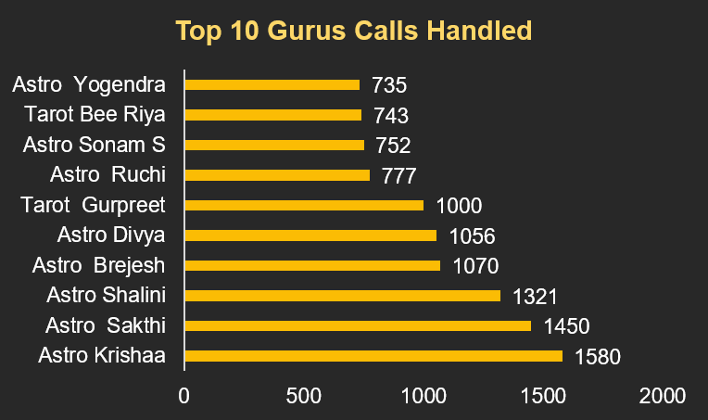

Top Gurus by Calls Handled
Workload is disproportionately distributed across the agent pool.
Top-performing experts (e.g., Astro Krishaa, Astro Sakthi) manage exceptionally high volumes.
This severe imbalance risks critical burnout for the platform's most valuable agents.
A revamped, intelligent call routing algorithm is needed to balance allocation and utilize idle capacity.

Slide 14
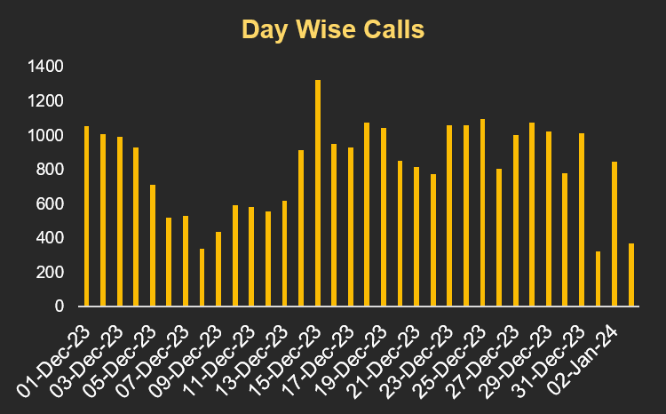

Day-wise Call Volume Trend
Consultation volumes exhibit significant and somewhat unpredictable day-to-day variance.
Distinct demand spikes occur randomly, alongside noticeably lower-activity days.
Current static staffing models struggle to adapt to these daily fluctuations.
Predictive forecasting models based on historical patterns can optimize daily resource allocation.

Slide 15









Data-Driven Strategic Recommendations
1. Optimize Peak Staffing
2. Balance Workload
3. Elevate Standards
Shift agent schedules dynamically to match the identified daytime volume spikes, minimizing wait times.
Implement an intelligent routing ACD to distribute calls evenly, preventing burnout among top performers.
Deploy targeted QA and upskilling programs specifically designed to lift the stagnant 2.93 average CSAT.
4. Forecast Proactively
5. Stabilize Infrastructure
6. Boost Web Engagement
Utilize historical daily volume trends to build predictive models for advanced shift planning.
Allocate funds to stabilize the chat infrastructure, directly addressing the high failure and drop rates.
Launch targeted UX improvements for the GuruCool platform to bridge the revenue gap with the mobile app.

Slide 16
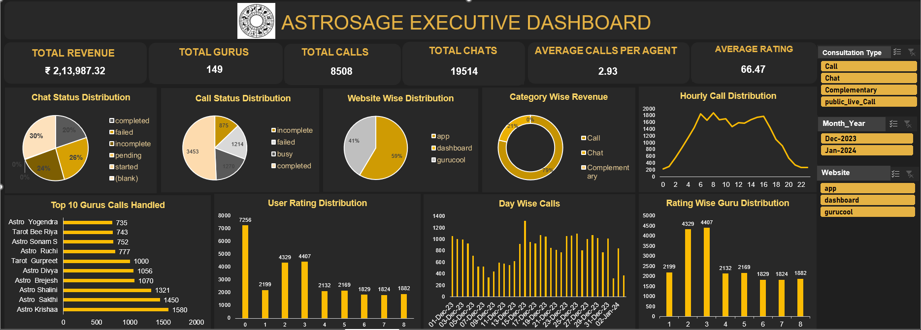

Interactive Performance Dashboard

Slide 17

Conclusion
The operational data reveals clear avenues for high-ROI improvements. While overall capacity is sufficient, inefficiencies in routing algorithms and inconsistent service quality are hampering growth. By directing the ₹1 crore investment toward intelligent workload distribution, robust technical infrastructure, and agent upskilling, AstroSage can drastically elevate user satisfaction and secure long-term profitability.

Slide 18

Thank You

