Slide 1
Chinook Music Store Project
Koushik Yarram
Newton_School_May_2026_Batch

Slide 2
Problem Statement
Chinook Record Store requires strategic optimization across business operations, marketing, and catalog management.
1. Business Challenge
2. Data Analysis
3. Customer Insights
4. Business Actions
Measure retention and identify high-value users.
Understand behavior and pinpoint churn risk.
Develop targeted promotional strategies.
Identify top products & global genre trends.

Slide 3
CHINOOK DIGITAL MUSIC STORE DATASET
Data Overview
11
59
24
614
RELATIONAL TABLES
CUSTOMERS
COUNTRIES
INVOICES
3,485
347
274
25
TRACKS
ALBUMS
ARTISTS
GENRES
Data Quality: High integrity. Zero duplicate primary keys. Expected NULLs in optional customer contact fields and track composers. Total 4,757 invoice lines analyzed.

Slide 4
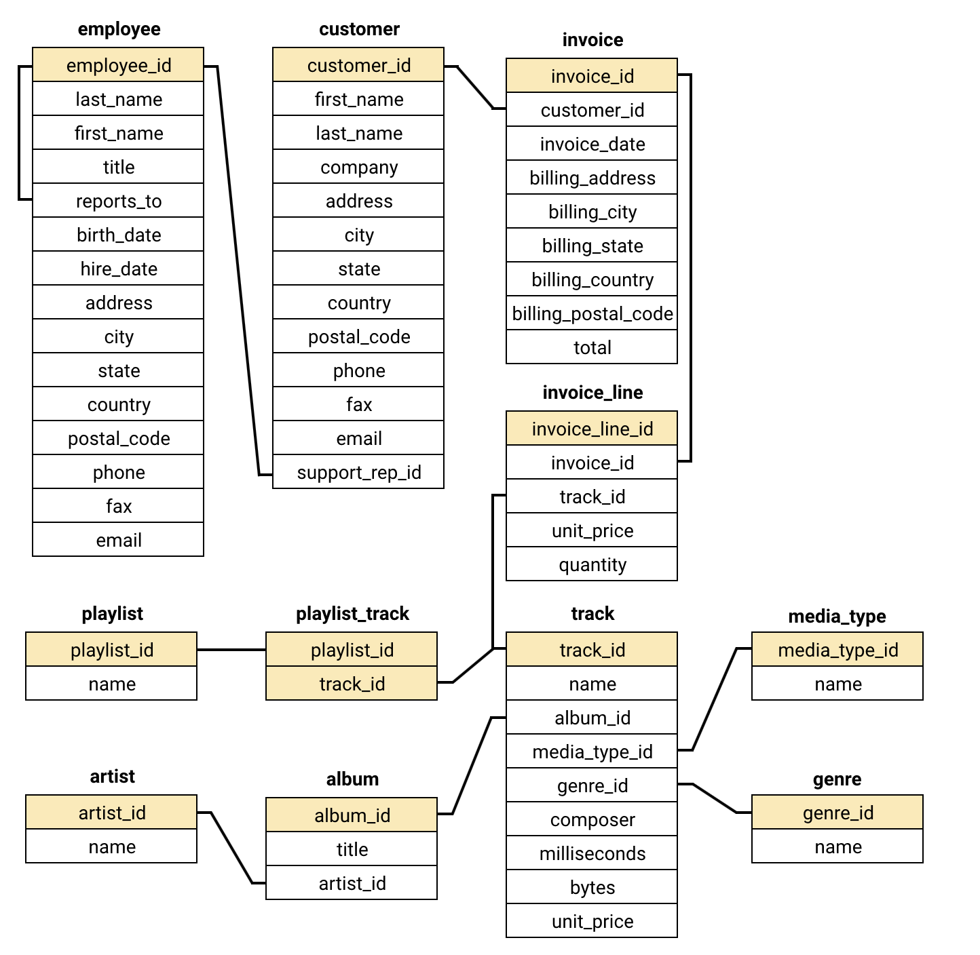
Database Schema
Core transactional flow flows from Customer to Invoice to Invoice_Line.
Track connects directly to Album and Genre.
Tracks strictly categorized by Genre and Media_Type.
[SCHEMA / ERD PLACEHOLDER]
Insert: Chinook Database ERD / Schema Diagram
Employee table represents organizational reporting structure.
Size visually to fill this region.

Slide 5
Top Tracks in the USA Market
KEY INSIGHT 01
Rock and Alternative/Metal exclusively dominate top 5 sold tracks.
KEY INSIGHT 02
War Pigs leads with $5.94 revenue (6 units sold), nearly 20% more than the 2nd ranked track, showing a clear frontrunner.
KEY INSIGHT 03
Sales volume mirrors revenue, indicating consistent track pricing.

Slide 6
Global Customer Demographics
KEY INSIGHT 01
USA commands largest global customer base with 13 users.
KEY INSIGHT 02
Canada represents strong secondary market with 8 customers.
KEY INSIGHT 03
Brazil (5), France, Germany, and UK drive critical international growth.

Slide 7
Revenue Generation by Country
$1,040.49
TOP REVENUE (USA)
KEY INSIGHT 01
Canada follows USA generating $535.59 in total revenue.
KEY INSIGHT 02
Major cities like Brasilia, Paris and Berlin anchor respective country revenues.
KEY INSIGHT 03
Brazil ranks 3rd globally with $427.68, making it the strongest emerging market outside North America.

Slide 8
Overall Customer Churn Rate
37.29%
CUSTOMER CHURN RISK
KEY INSIGHT 01
22 out of 59 customers show no purchases in last 3 months.
KEY INSIGHT 02
Over one-third of customer base requires urgent re-engagement attention.

Slide 9
Genre Market Share in the USA
KEY INSIGHT 01
Rock dominates the USA market with 53.38% market share ($554.40), more than all other genres combined.
KEY INSIGHT 02
Alternative & Punk (12.37%) and Metal (11.8%) form a strong secondary cluster, together accounting for ~24% of USA sales.
KEY INSIGHT 03
Remaining 14 genres share only ~12% of sales — indicating a highly concentrated market with a clear Top 3 dominance.

Slide 10
Promotional Recommendations for the US
KEY INSIGHT 01
"Are You Experienced?" by Jimi Hendrix leads top US genre.
KEY INSIGHT 02
"Green" by R.E.M. performs strongest in Alternative & Punk.
KEY INSIGHT 03
"Mezmerize" by System Of A Down represents prime Metal candidate.

Slide 11
Top Genres Outside the USA
KEY INSIGHT 01
Rock reliably remains the leading genre across international markets.
KEY INSIGHT 02
Latin music demonstrates prominent traction specifically in South America.
KEY INSIGHT 03
Metal secures strong market footing throughout European territories.

Slide 12
Customer Purchasing Behavior
KEY INSIGHT 01
Long-term customers purchase approximately 23% more frequently than new customers.
KEY INSIGHT 02
Lifetime spend runs 25% higher for long-term users ($841 vs $675).
KEY INSIGHT 03
Basket sizes remain nearly identical at approximately $9.80 per order.

Slide 13
Frequently Bought Together — Product Affinity
KEY INSIGHT 01
Rock + Metal represents primary co-purchase behavior occurring 219 times.
KEY INSIGHT 02
Rock anchors broader catalogs appearing in 4 of top 5 pairs.
KEY INSIGHT 03
Green Day and Foo Fighters act as most frequently bundled artists.

Slide 14
Regional Market Analysis & Churn
KEY INSIGHT 01
Germany exhibits severe 75% churn; Brazil follows at 60% churn.
KEY INSIGHT 02
Czech Republic and Portugal achieve 0% churn alongside high average spend.
KEY INSIGHT 03
USA anchors revenue baseline while maintaining moderate 23% churn levels.

Slide 15
Customer Risk Distribution
73%
15
LOW RISK
MED RISK USERS
KEY INSIGHT 01
73% of customers (43 users) classified as stable Low Risk baseline.
KEY INSIGHT 02
15 Medium Risk customers represent direct win-back campaign targets.
KEY INSIGHT 03
Low Risk customers historically outspend High Risk customers by 36%.

Slide 16
Customer Lifetime Value Segments
KEY INSIGHT 01
7 High Value segment customers spend robust $116.96 on average.
KEY INSIGHT 02
Purchase frequency strongly associates with overall lifetime customer value.
KEY INSIGHT 03
Recency and frequency indicators outweigh genre breadth regarding churn signals.

Slide 17
Campaign Impact Tracking
KEY INSIGHT 01
Monthly revenue fluctuates substantially between approximately $28 and $142.
KEY INSIGHT 02
Returning customers account for predominant revenue volume post early-2017.
KEY INSIGHT 03
Low-revenue months like June and December represent targeted promotional opportunities.

Slide 18
Average Customer Spend by Region
KEY INSIGHT 01
Czech Republic achieves peak $136.62 average spend despite 2 customers.
KEY INSIGHT 02
Ireland, Spain, Portugal, and Germany emerge as higher-value European markets.
KEY INSIGHT 03
USA commands largest volume base but ranks 11th in average spend.
Note: Interpret average spend alongside customer count to avoid over-interpreting small markets.

Slide 19
Strategic Recommendations
MARKETING
RETENTION
Focus US promotional activity on strong Rock performers.
Prioritize win-back campaigns for Medium Risk customers.
Test Rock + Metal cross-selling bundles to maximize existing affinity.
Focus heavily on higher-churn markets such as Germany and Brazil.
LOYALTY
GLOBAL EXPANSION
Consider deploying frequency-based loyalty strategies.
Explore localized Latin music promotions in South America.
Purchasing frequency associates strongly with overall customer lifetime value.
Pursue premium album opportunities across higher-value European markets.

Slide 20
Conclusion
Chinook maintains highly engaged core customer base driven heavily by Rock genre.
USA generates peak overall revenue; several European markets demonstrate higher average customer value.
Customer frequency and recency emerge as critical dimensions dictating retention and value.
Elevated churn across Germany and Brazil warrants targeted intervention.
Genre-specific and region-specific strategies present clear tactical expansion vectors.
"SQL analysis transforms transactional data into actionable insights across customers, products, markets and retention."

