Slide 1
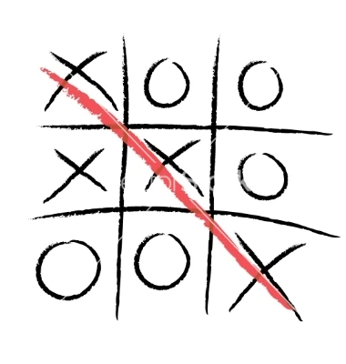
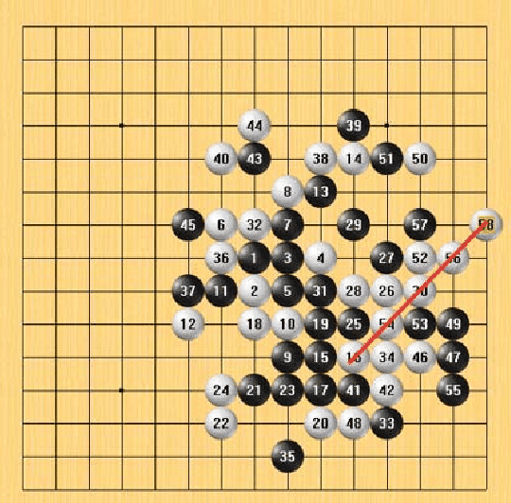
Gomoku
Game-Playing Agent
15 × 15
Board Size
Using Minimax & Alpha-Beta Pruning
5 in a row
Yaru Gao · Zeyuan Zhang · Md Borhan Uddin · Gregory Shanygin
Win Condition
Alpha-Beta
Algorithm
Notes:
Hi everyone, we're presenting our Gomoku game-playing agent. Think of Tic-tac-toe — you need three in a row to win on a tiny 3 by 3 board.
Gomoku is the same idea, but you need five in a row, on a 15 by 15 board. Way more moves, way more complexity. Our AI uses a search algorithm called Alpha-Beta Pruning to find the best move every turn.

Slide 2

FORMULATION
Problem Formulation
Game Model
Two-player · Zero-sum · Perfect information
State Space
Each cell ∈ { 0, 1, 2 } → 15×15 matrix
Terminal Values
+1 player wins
−1 opponent wins
0 draw
Minimax Objective
max min max ··· V(s)
Win directions detected:
→ Horizontal
↓ Vertical
↘ Main diagonal
↗ Anti-diagonal
Notes:
So how do we turn this into a CS problem?
The board is a grid. Each cell is empty, black, or white. Win, lose, or draw.
That's the whole outcome. The game ends when someone gets five in a row in any direction, or the board is full. Our agent looks at the board and picks the best move.
It uses Minimax, which means it assumes the opponent always plays perfectly and plans ahead accordingly.

Slide 3
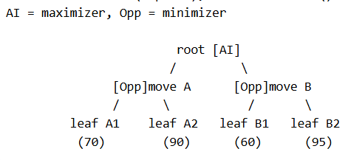
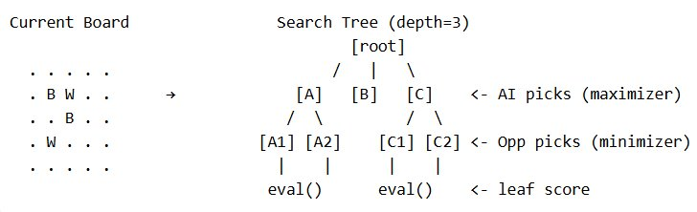
Project Goal: Build an AI agent that chooses the best Gomoku move by searching future board states and evaluating possible outcomes.
FORMULATION
Gomoku as a Search Tree
Opponent chooses 60 to prevent AI from reaching 95, prune 95 and choose 70 (best score under worst case)
Alpha-Beta Minimax Searches a game tree where:
Node = board state
Edge = one move (place a stone somewhere)
Max Layer (α) = AI chooses the move with highest score | Min Layer (β) = opponent chooses the move that is worst for AI
Alpha-Beta pruning skips branches that cannot change the final choice
Heuristic = looks only a few moves ahead, then estimates the board value

Slide 4
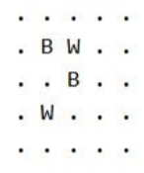
Workflow
Overall Workflow: AI's turn to place stone
Run Alpha-Beta Minimax search:
Step 1: Decide all candidate moves
Step 2: Order moves by priority (how good each move is)
Step 3: Simulate each move recursively and use returned scores
AI layer keeps highest returned score and updates α
Opponent layer keeps lowest returned score and updates β
Prune branches when β ≤ α
Step 4: When a branch reaches the depth limit, evaluate the board:
Use heuristic patterns such as five, open four, rush four, and open three
Return the score back up the search tree (step 3)
End root search when: all candidate moves are searched, all remaining branches are pruned, or an immediate winning move is found.
Return and play the best move
The root search returns the best move
The game places that move on the real board

Slide 5
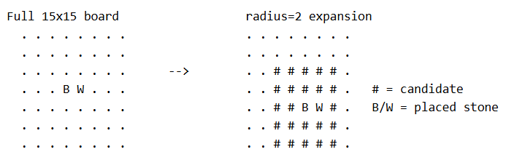
Workflow
Steps in Detail
Step 1: Decide Candidate Moves​ --->
Step 2: Order the Moves by Priority
Try the most promising moves first (highest α score):
Move Priority: immediate winning moves > blocking opponent wins > other moves.
This helps α and β update faster.
Step 3: Simulate each move recursively
After each move, update α and β:
α = best score AI can guarantee
β = worst score opponent can let AI have
If β ≤ α, prune remaining branches

Slide 6
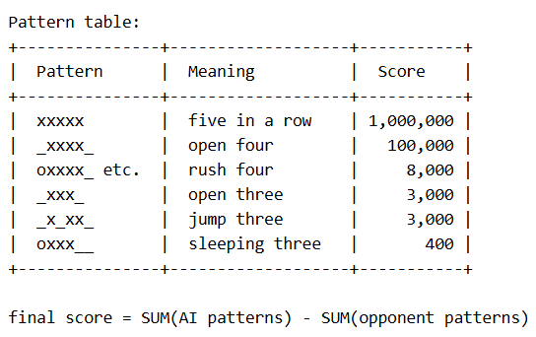
Return Score
Step 4: Stop at the depth Limit:
(i.e., depth = 4: AI -> Player -> AI -> Player)
Use heuristic function to:
Scans 4 directions ( → ↓ ↘ ↗ ) and detect patterns.
Calculate the score: Final score = AI pattern score − opponent pattern score
Minimax uses this score to compare moves and choose the best one. Return the score back to the recursive search tree (step 3)
End root search when: all candidate moves are searched, all remaining branches are pruned, or an immediate winning move is found. Now the AI does the best move and place the stone.

Slide 7
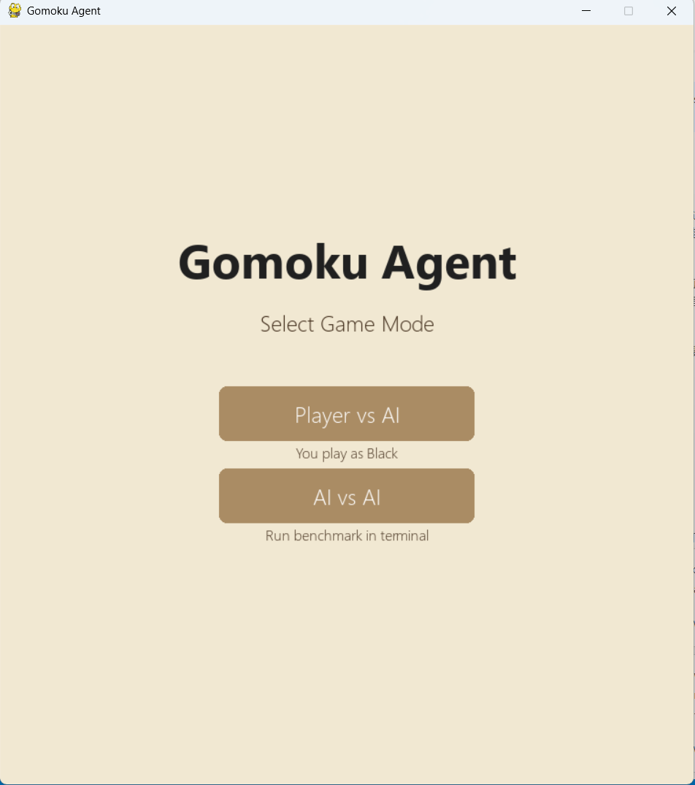
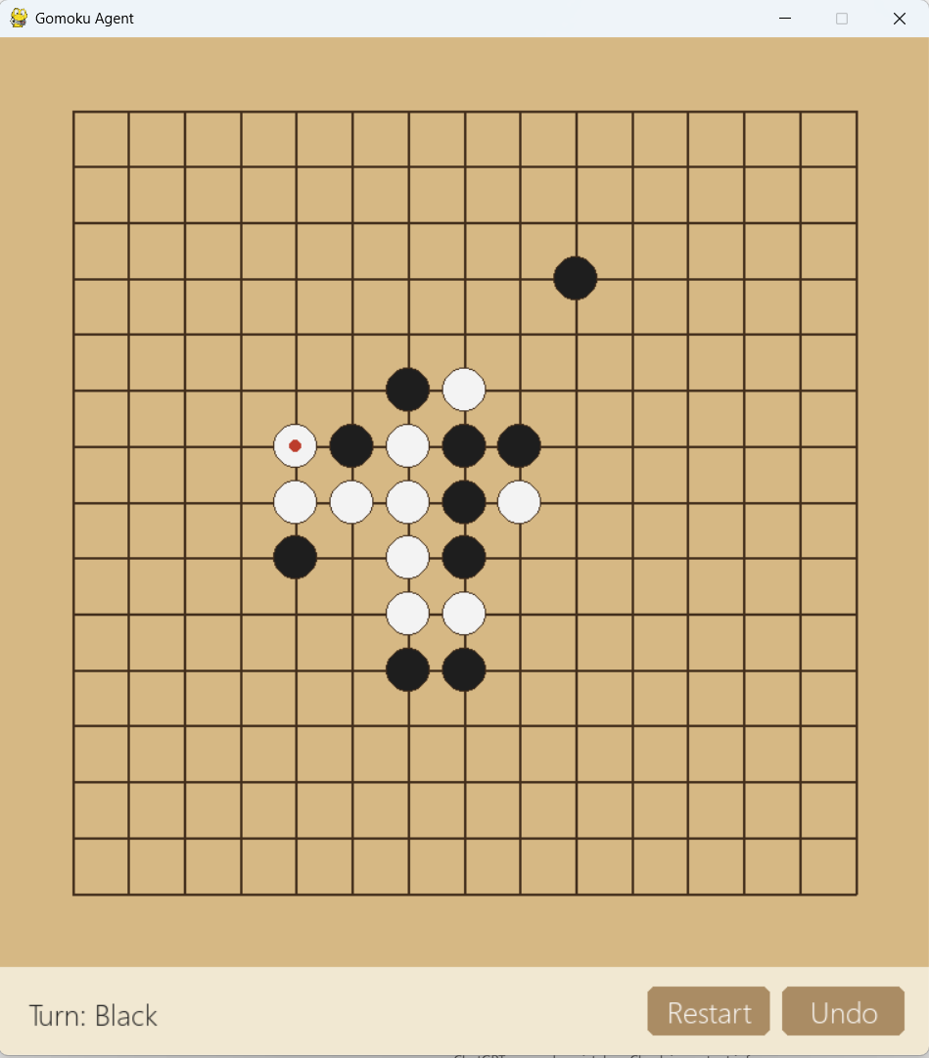

Slide 8
EXPERIMENTS
AI vs. Random Player
100%
12.5
0.031s
Win Rate vs Random
(100 games, depth 2)
Avg moves to win
(agent wins quickly)
Avg decision time
(depth 2, per move)
Setup: AI (Black, Alpha-Beta depth=2) vs Random Player (White) · 100 games · random.seed(42)
Decision Time by Search Depth
Depth 1
0.008s
Depth 2
0.031s
Depth 3
0.269s
Notes:
Our results are strong and consistent. Over 100 games, the agent won every single game against a random player — a 100% win rate. Games ended quickly, with the agent winning in an average of just 12.5 moves. This shows the heuristic effectively guides the agent to winning positions fast. Decision time at depth 2 is about 31 milliseconds per move — well within real-time performance requirements. These numbers were generated by our performance metrics script, which we can run any time to verify results.

Slide 9
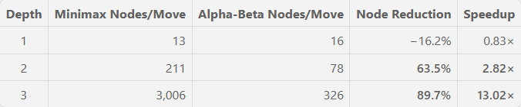
EXPERIMENTS
Minimax vs Alpha-Beta Pruning
Setup: Minimax vs Alpha-Beta · same depth for both · 3 games / depth · Minimax alternates Black/White each game · random opening from centre 5×5 (seeded per game) · 9 games total
Node Count Comparison
At Depth 1, Alpha-Beta provides no benefit — the tree is too shallow to prune
At Depth 2, Alpha-Beta eliminates 63.5% of nodes → 2.8× faster
At Depth 3, Alpha-Beta eliminates 89.7% of nodes → 13× faster (2.4 s → 0.18 s per move)

Slide 10
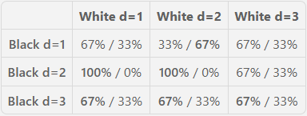
EXPERIMENTS
Depth Analysis: Depth x vs. Depth y
Setup: all depth pairs (3×3 matrix) · 3 games / matchup · random opening from centre 5×5 region (seeded per game) · 27 games total
Win Rates Between Depths (Black win% / White win%)
Depth 2 decisively beats Depth 1 (67% → 100% win rate)
Depth 3 beats Depth 2 in most matchups
Horizon Effect: Although White searched deeper, it sometimes missed threats just beyond its depth limit. Black d=1 exploited short-term tactical opportunities and won more often.

Slide 11
Thanks for your listening!
References:
https://rexwordpuzzle.blogspot.com/2023/08/japanese-board-game-also-called-five-in.html
https://en.wikipedia.org/wiki/Alpha%E2%80%93beta_pruning
https://sortingsearching.com/2020/05/18/gomoku.html

