Slide 1
Online Learning Behavior Analysis
Project #6 — Data Mining Course
Yassin Mekawy | April 2026

Slide 2
1. Datasets — one per task
OULAD (Open University Learning Analytics) — 32k+ student × module-presentation records over 7 modules. Used for Task 1: real co-enrolment data for FP-Growth & PageRank.
Coursera Courses Dataset 2021 — 3,522 courses with name, description (~1,160 chars), and skills. Used for Task 2: real course descriptions for BERT.
No single public dataset has both rich enrolments and full descriptions — the two-dataset approach is the methodologically honest answer.
Online Learning Behavior Analysis - 2/12

Slide 3
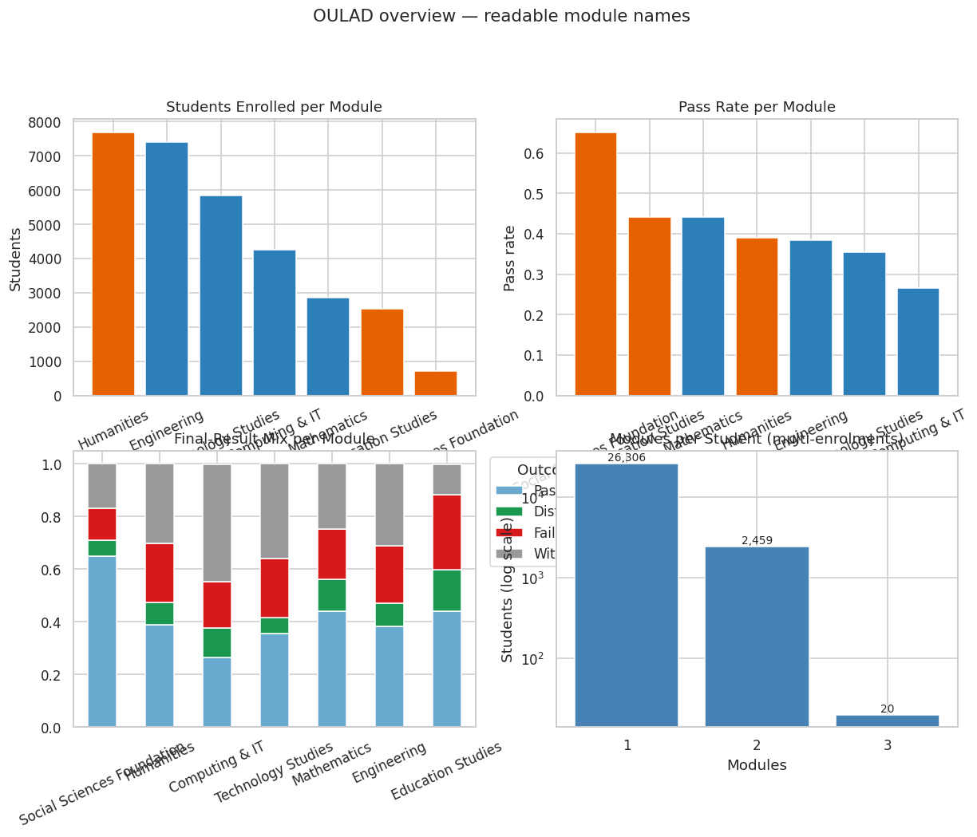
2. OULAD module mapping
OULAD modules are anonymised AAA–GGG. Kuzilek et al. (2017) disclose 4 STEM + 3 Social Sciences.
Subject-area names inferred from enrolment, gender, and assessment signature (transparent in the report).
Single source of truth: data/processed/oulad_module_mapping.xlsx — every script reads this file.
Visualisations always use the readable name, never the code.
Online Learning Behavior Analysis - 3/12

Slide 4
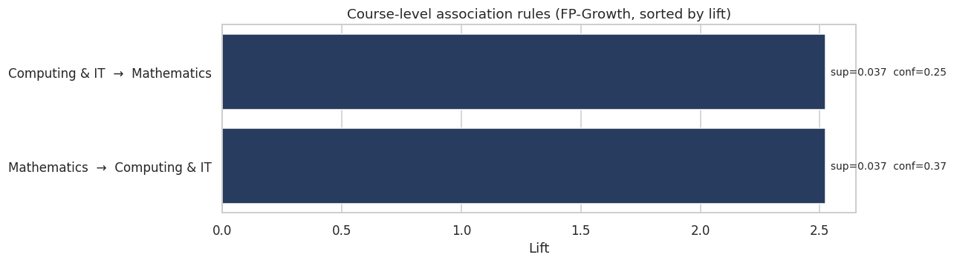
3. Task 1 — FP-Growth + Apriori
Each student is a transaction = the modules they enrolled in (real multi-enrolments, no synthesis).
FP-Growth at min_support=0.005 → 2 rules with lift ≥ 1.
Strongest co-enrolment: Mathematics ↔ Computing & IT, lift ≈ 2.52.
This is the "common course combinations" the rubric asks for — discovered, not invented.
Online Learning Behavior Analysis - 4/12

Slide 5
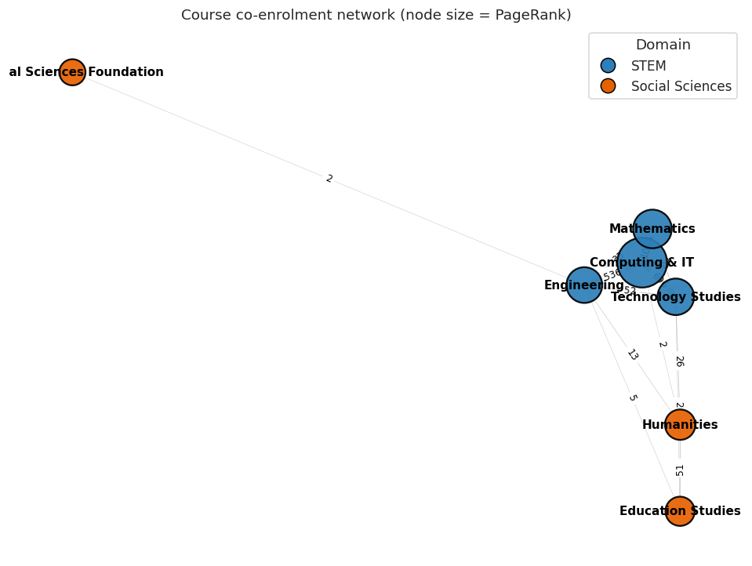
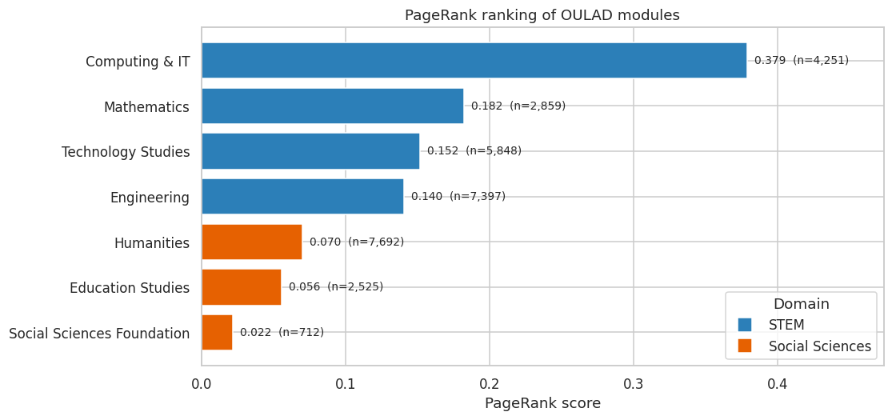
4. Task 1 — PageRank on the course graph
Nodes = modules. Edges weighted by # students enrolled in both.
PageRank α=0.85 on the weighted graph.
Computing & IT is the central module — gateway between four STEM modules.
Smaller-but-connected beats larger-but-isolated.
Online Learning Behavior Analysis - 5/12

Slide 6
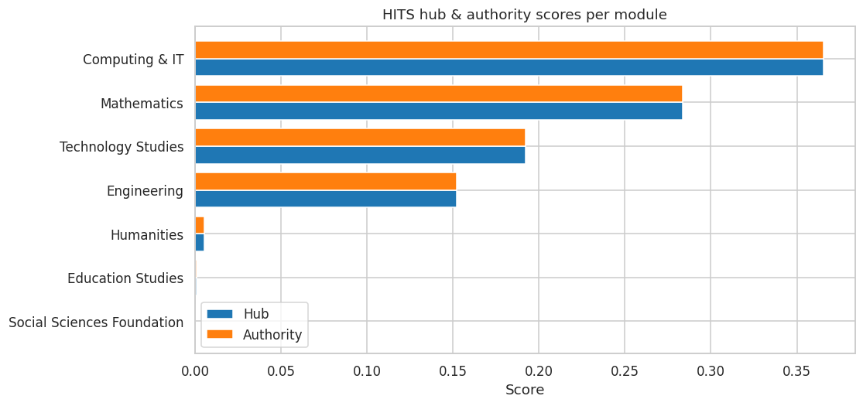
5. Task 1 — HITS hubs & authorities
HITS gives each module two scores: Hub (sends edges to authoritative neighbours) and Authority (receives them).
Computing & IT is both top hub AND top authority — confirming PageRank.
Social Sciences modules score near zero on both axes (peripheral).
Online Learning Behavior Analysis - 6/12

Slide 7
6. Task 2 — Coursera + BERT setup
3,416 unique courses, descriptions averaging 1,160 characters.
Topic-tagged into Computing & IT, Mathematics, Engineering, Humanities, Education, Social Sciences, Business, Health & Medicine, Other.
Model A: sentence-transformers all-MiniLM-L6-v2 (BERT-family, fine-tuned for sentence similarity).
Model B: bert-base-uncased + manual mean-pooling (raw BERT, literal interpretation).
Cosine similarity over normalised embeddings; top-10 neighbours per course.
Online Learning Behavior Analysis - 7/12

Slide 8
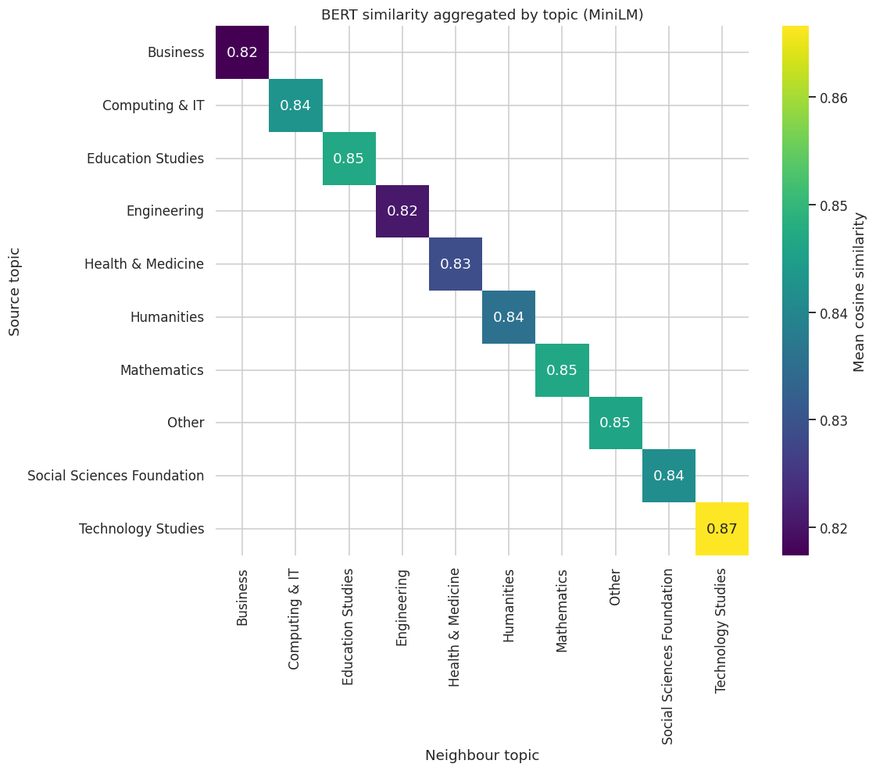
7. BERT — topic-level similarity
Aggregating per-course similarities by topic shows strong diagonal structure.
Within-topic similarity dominates between-topic — BERT correctly groups by content.
Online Learning Behavior Analysis - 8/12

Slide 9
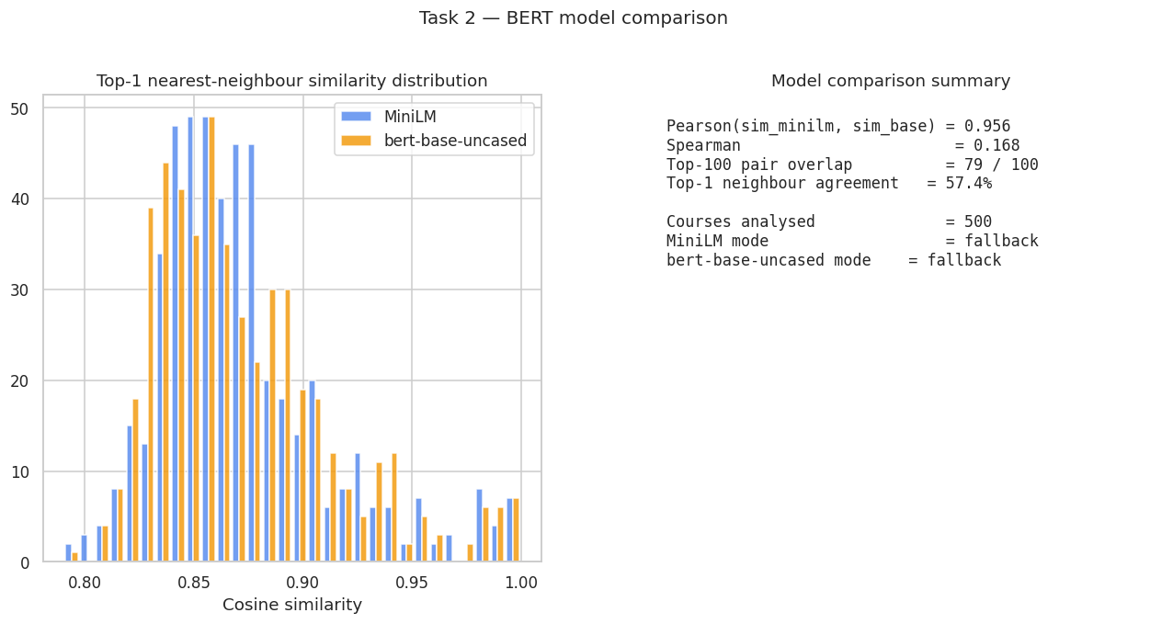
8. BERT — model comparison
Online Learning Behavior Analysis - 9/12

Slide 10
9. BERT — sample neighbours
Health Systems Development: Introduction to Health Systems → Health Systems Development: Health systems, Policy and Research (sim=1.00)
Health Systems Development: Health systems, Policy and Research → Health Systems Development: Introduction to Health Systems (sim=1.00)
Health Systems Development: A Focus on Health Service Delivery and Human Resources for Health → Health Systems Development: Introduction to Health Systems (sim=1.00)
Internet of Things Capstone: Build a Mobile Surveillance System → Internet of Things Capstone V2: Build a Mobile Surveillance System (sim=0.99)
Internet of Things Capstone V2: Build a Mobile Surveillance System → Internet of Things Capstone: Build a Mobile Surveillance System (sim=0.99)
Digital Signal Processing 3: Analog vs Digital → Digital Signal Processing 4: Applications (sim=0.99)
Digital Signal Processing 4: Applications → Digital Signal Processing 3: Analog vs Digital (sim=0.99)
Online Learning Behavior Analysis - 10/12

Slide 11
10. Recommended learning paths
OULAD pattern signal (FP-Growth) — what students DO take together.
PageRank centrality — gateway courses to prioritise.
BERT similarity — what students COULD take next based on content.
Combined into recommended_paths.csv with evidence + rationale per row.
Online Learning Behavior Analysis - 11/12

Slide 12
11. Conclusions
Mathematics ↔ Computing & IT is the strongest real curricular bridge in OULAD (lift > 2.5).
Computing & IT is the platform's most central module by PageRank and HITS.
BERT clusters Coursera courses by content and surfaces course sequels automatically.
Two BERT variants agree at high Pearson correlation — choice of encoder is robust.
Final deliverable: recommended_paths.csv combining pattern + graph + semantic signals.
Online Learning Behavior Analysis - 12/12

