Slide 1

Credit Risk Modelling- Loan Default Sprint 1
YM
by Yasaman Sheikh Monazzah

Slide 2

Understanding Credit Risk
What is Credit Risk?
Impact of Default
The likelihood a borrower won't repay their loan to the lender.
Lenders lose principal, interest, and face collection costs.
Default Event
When borrowers can't make required payments, they default.
Lenders must assess this risk for each borrower.
Risk Mitigation
Lenders use collateral requirements and risk-based pricing:
Charging higher interest rates to riskier borrowers

Slide 3

The 2008 Financial Crisis: A Warning
1
Low Interest Rates
Encouraged Financial institutions to increase mortgage lending.
Banks financed 100% or more of home values.
Housing Bubble
2
High mortgage approval rates increased home demand and prices. .
Home prices rose, leading many homeowner to borrow against their homes.
A lot of them were high credit risk.
3
Subprime Defaults
High-risk borrowers couldn't repay loan and defaulted.
4
Financial Collapse
Financial institutions based on mortgages lost value, causing bank failures.
Some bank were bankrupt, and some bailed out by government.

Slide 4
Project Objectives
Predict Loan Defaults
Develop models to identify borrowers likely to default on loans based on borrower characteristics.
Minimize Business Risk
Avoid rejecting good applicants while screening out likely defaulters.
Identify Key Factors
Determine which variables best predict default probability.
Create Actionable Insights
Provide clear recommendations for lending decisions.

Slide 5




Dataset Overview
Size & Source
Key Variables
Target Variable
350,000+ consumer loans issued from 2007 to 2015 by Lending Club.
Loan status, borrower income, employment length, home ownership, debt ratio.
Loan status
(fully paid vs. charged off).

Slide 6



Dependent & Independent Variables
Dependent Variable
Loan status: Whether borrowers have defaulted (charged off) or fully paid their loans.
Independent Variables
Loan Characteristics: Loan amount, term, interest rate, and installment amount
Borrower Demographics: Annual income, home ownership, and employment length
Credit Behavior Indicators: Open accounts, revolving balance, total accounts, and mortgage accounts
Prediction Target
The model will predict the probability of default based on these independent variables.

Slide 7
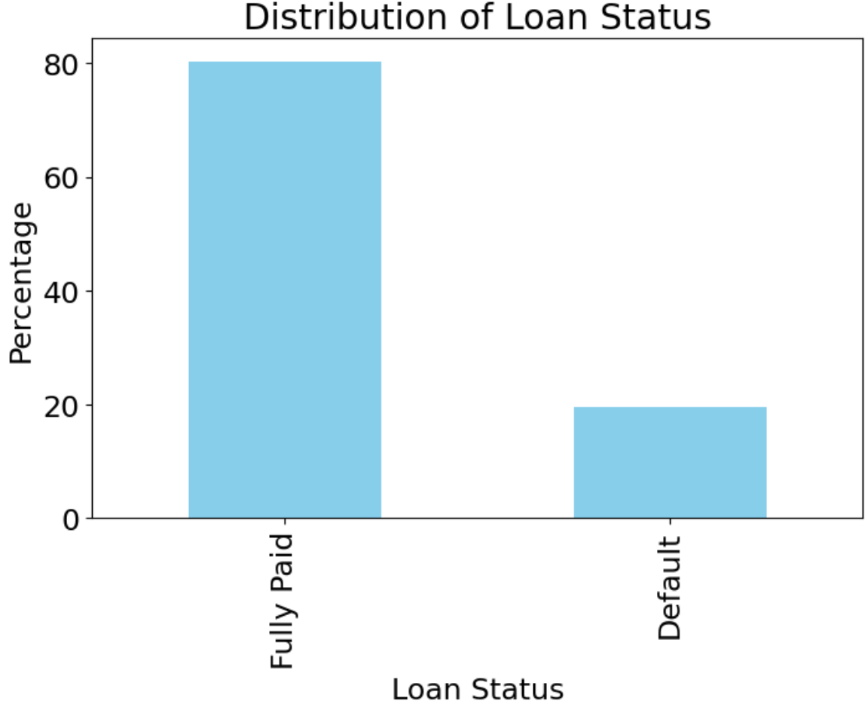
Loan Status Distribution

Slide 8
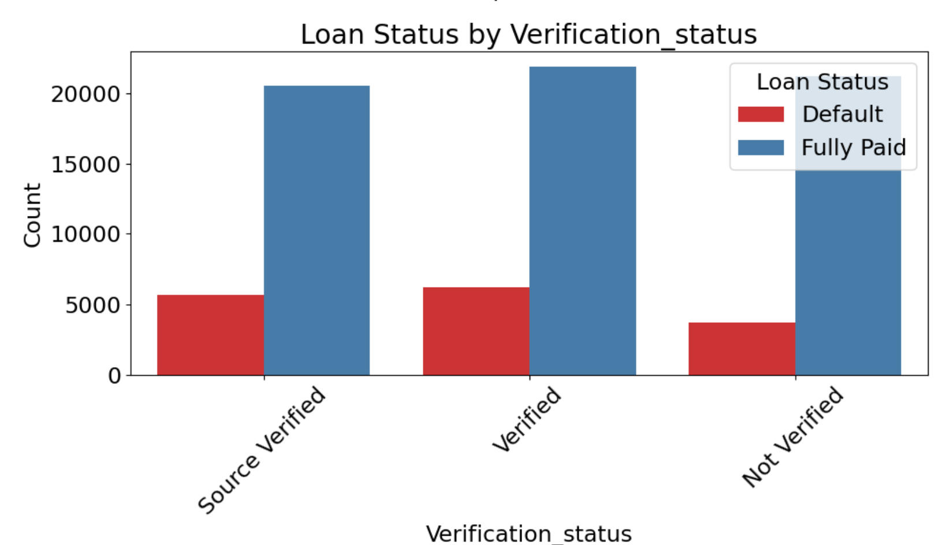

Slide 9

Data Preprocessing Steps
Data Cleaning
Converting text to numeric values. Handling missing values by replacing with zeros or appropriate substitutes.
Exploratory Analysis
Identifying patterns and relationships between variables. Understanding data distribution before modeling.
Feature Engineering
Extract features. Converting categorical variables to integers for processing.
Dummy Encoding
Applying one-hot encoding for categorical variables.
Combining categories when needed to reduce dimensionality.

Slide 10
Next Steps
Feature Importance
Performance Evaluation
Identify which variables most strongly predict loan defaults.
Training & Validation
Model Selection
Train models with cross-validation.
Assess models using appropriate metrics for imbalanced data.
Choose logistic regression algorithms for classification task.

