Slide 1
Simpson Lab Meeting
March 2023
“cfDNAfragmentomics”
R package
Yasamin Nouri Jelyani
Supervisors:
Professor Jared Simpson
Jonathan Broadbent

Slide 2
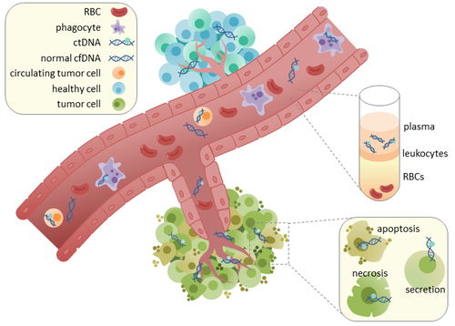



Section I
Introduction
cfDNA
ctDNA (originates from tumour cells)
cfDNA (originates from healthy cells)
Circulating tumor DNA - Wikipedia

Slide 3
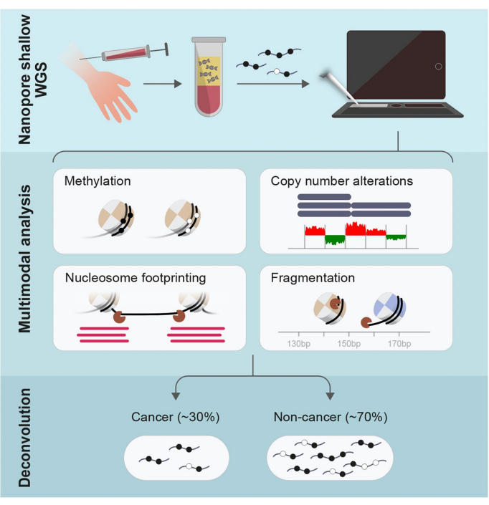
Motivation
Introduction
Detection with liquid Biopsies
Blood samples
cfDNA (cell-free DNA)
Healthy
Nanopore sequencing
ctDNA (circulating tumour DNA)
Berman et. Al.

Slide 4
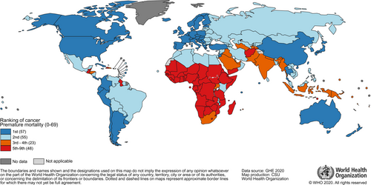
Motivation
Introduction
2020 – 10 million cancer deaths
Early detection
More curable
Myers et. al.
Screening – 20% increased survival
Late detection
Less survival
More aggressive care
Health care costs
GLOBOCAN Estimates
Notes:
“Global Cancer Statistics 2020: GLOBOCAN Estimates of Incidence and Mortality Worldwide for 36 Cancers in 185 Countries.” CA : a Cancer Journal for Clinicians. 71, no. 3 (2021): 209–49. https://doi.org/10.3322/caac.21660.

Slide 5
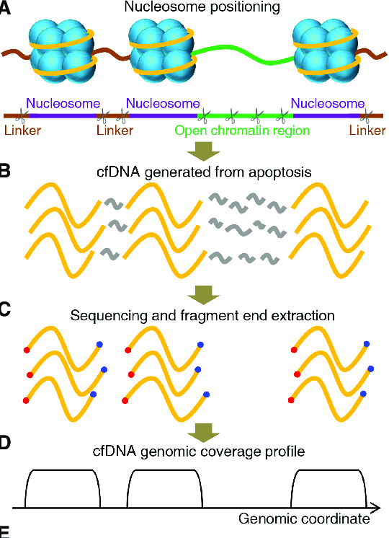
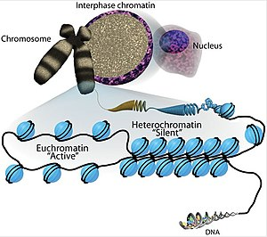
Nucleosome Coverage
Introduction
Euchromatin - Wikipedia
Sun, Kun & Peiyong, et al. (2019). Genome Research.

Slide 6
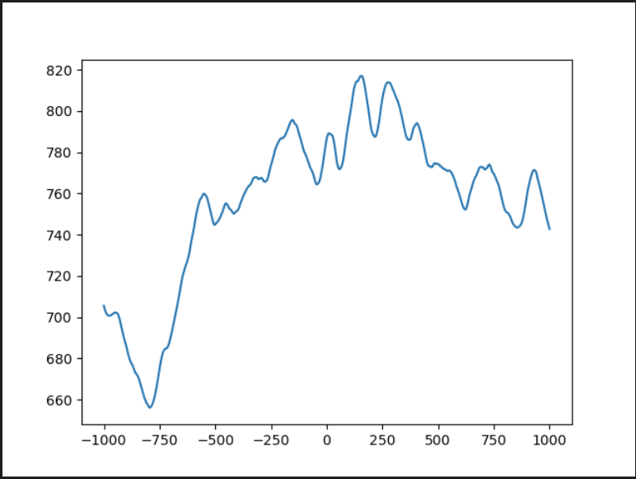
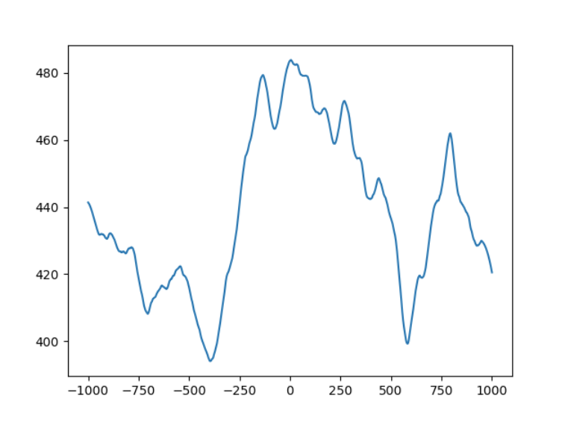
Results
Nucleosome coverage
Lung cancer – Using Cristiano et.al. data
Lung cancer – Using Snyder et.al. data

Slide 7
Code:
Nucleosome coverage
python <./location/nucleosome_occupancy.py> -t <./location/TFBS_loc.tsv> -w <Window size> -n <name> <./locationdata/gene.hg38.frag.bed>

Slide 8
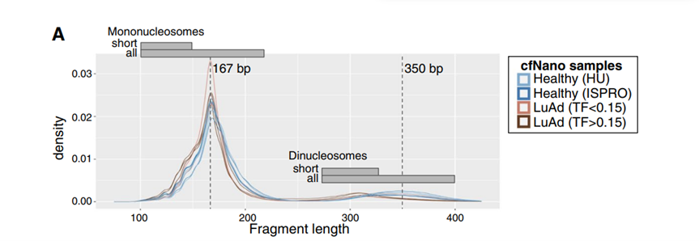
Fragmentation Lengths
Figure from: Katsman et.al.

Slide 9
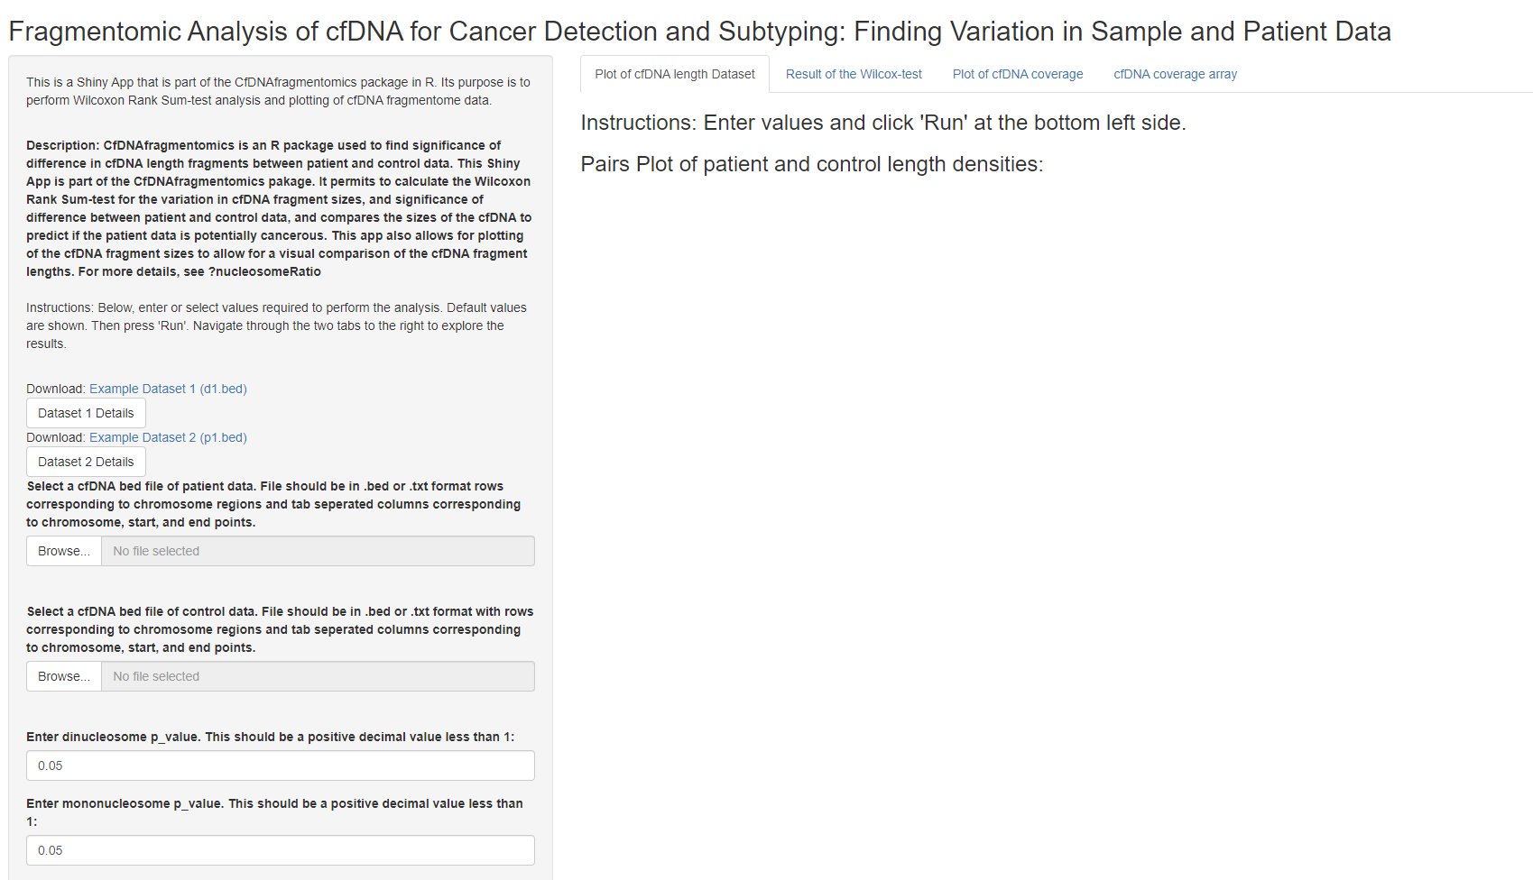
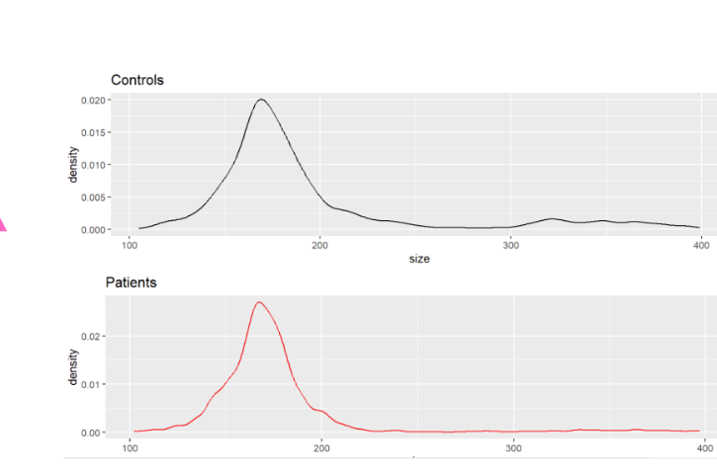

Slide 10
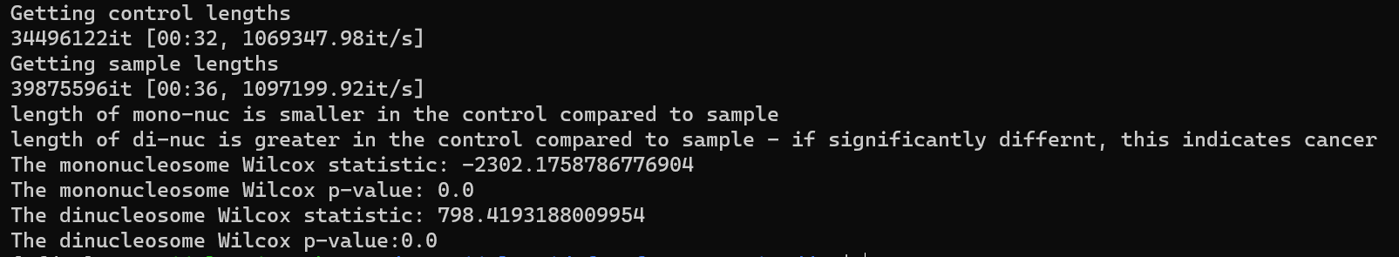
Results
Wilcoxon test
Snyder et.al. cfNDA lengths for cancer and healthy
Compare the lengths
Wilcoxon test
Sample Output:

Slide 11
Code:
Nucleosome coverage
python <./location/nuc_ratio.py> <control_data.tsv> -s <sample_data.tsv>

Slide 12
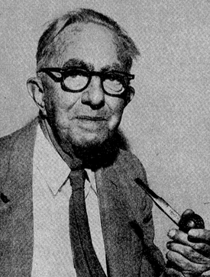
Wilcoxon Rank Sum Test
Fragmentation features
No normal assumption
No equal variance assumption
Frank Wilcoxon

Slide 13
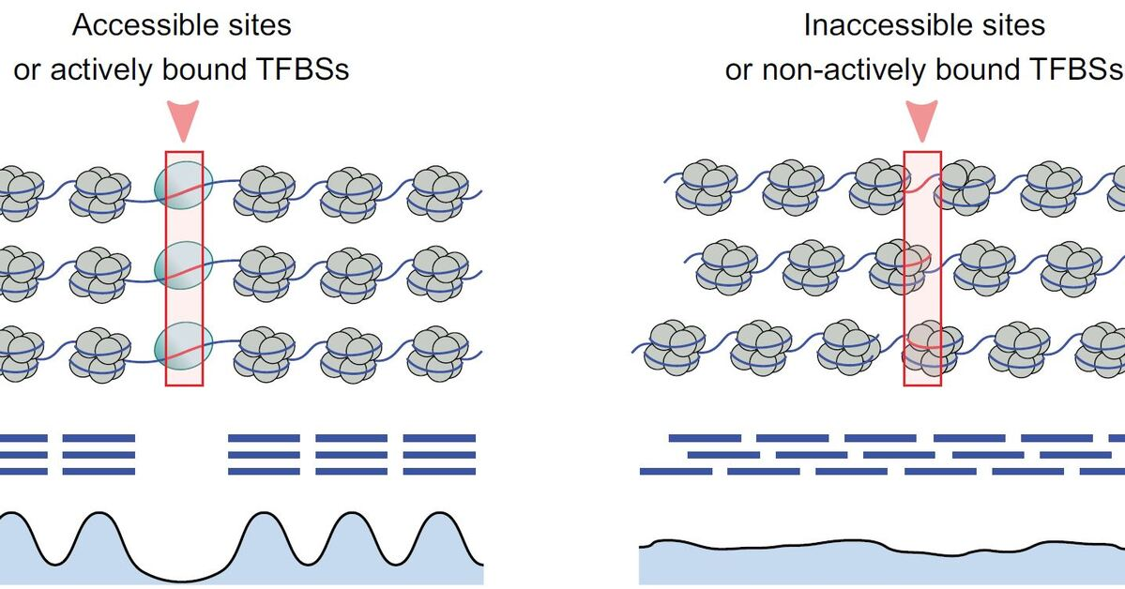
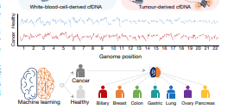
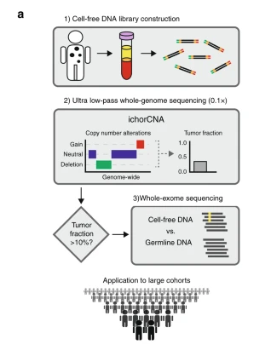
Current Technologies
Griffin
ML model
DELFI
ML model
ichorCNA
HMM
Bayesian
Griffin
DELFI
ichorCNA

Slide 14



cfDNAfragmentomics
Introduction
R package
Simplistic Analysis
DNA Fragment Ratio
Mononucleosome
Dinucleosome
Nucleosome Coverage
Plot of nucleosome coverage
Tech Stack
R
Generate shiny app
Python
Generate nucleosome plots

Slide 15

Next Steps…
Conclusion
Machine Learning model
Optimization
Usable interface

Slide 16
See paper for Complete set of references
References

