Slide 1
Simpson Lab Meeting
April 2023
cfDNAfragmentomics
R and Python Package
Yasamin Nouri Jelyani
1

Slide 2
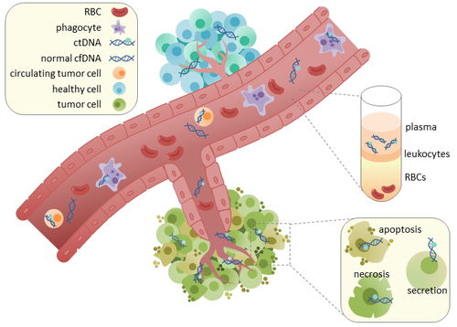



Section I
Introduction
cfDNA
ctDNA (originates from tumour cells)
cfDNA (originates from healthy cells)
Rachel June Wong (2017)
2

Slide 3
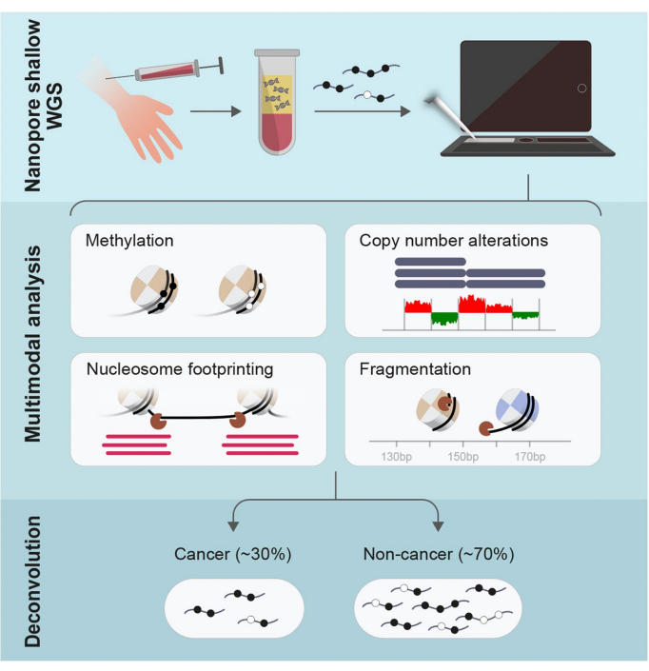
Motivation
Introduction
Detection with liquid Biopsies
Blood samples
cfDNA (cell-free DNA)
Healthy
Nanopore sequencing
Illumina
ctDNA (circulating tumour DNA)
3
Berman et. al.(2022)

Slide 4
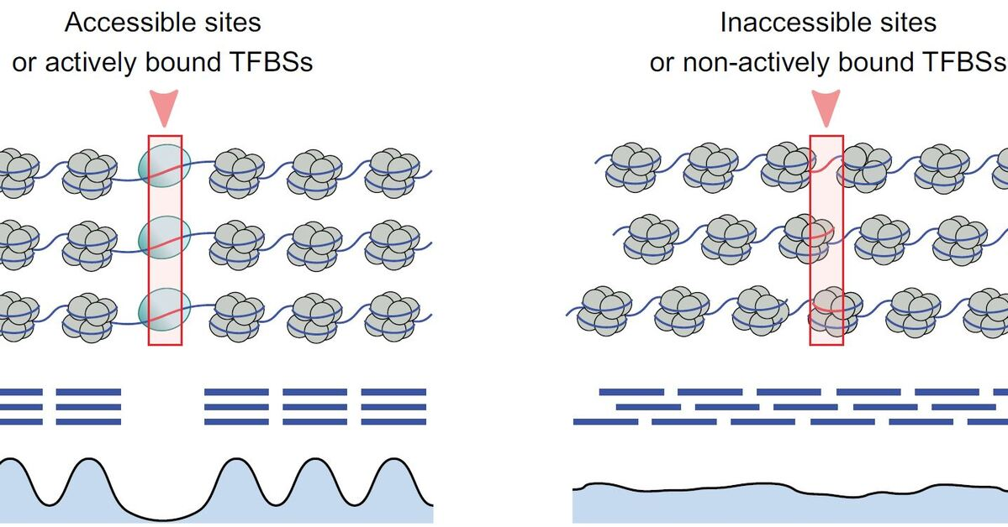
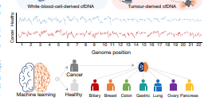
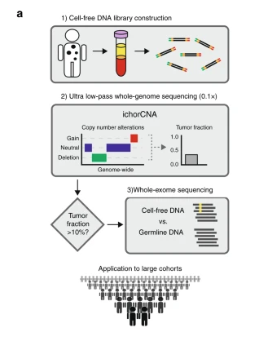
Current Technologies
Griffin
ML model
DELFI
ML model
ichorCNA
HMM
Bayesian
Griffin
DELFI
ichorCNA
4

Slide 5
Methods
Fragmentation
Nucleosome Occupancy
5

Slide 6
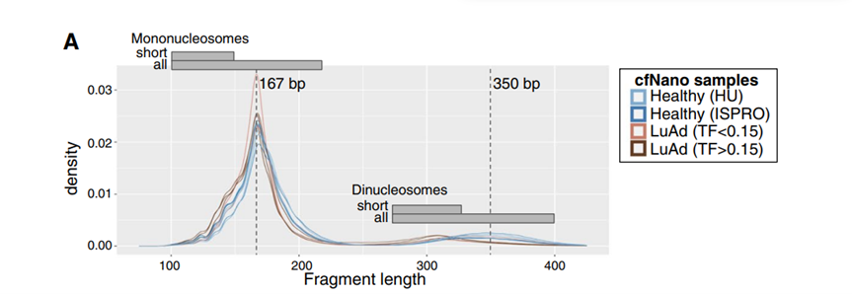
Fragmentation Lengths
Katsman et.al. (2022)
6

Slide 7
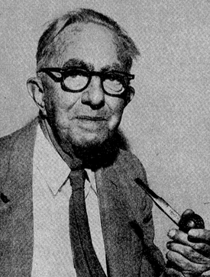
Wilcoxon Rank Sum Test
Fragmentation features
No normal assumption
No equal variance assumption
Frank Wilcoxon
7

Slide 8
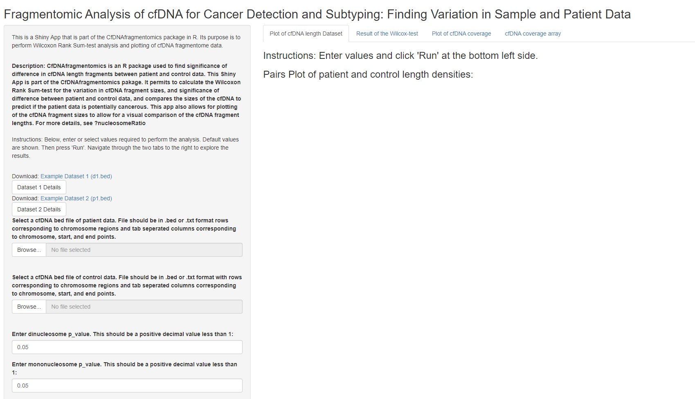
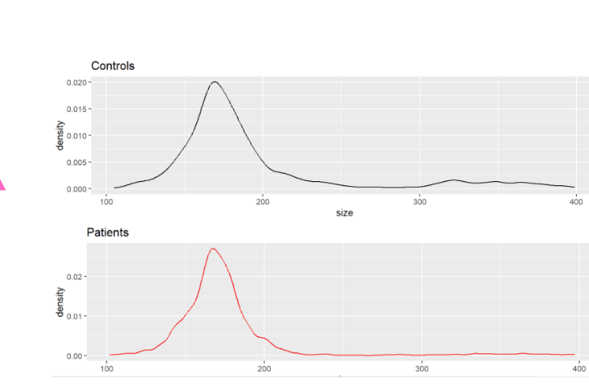
8

Slide 9
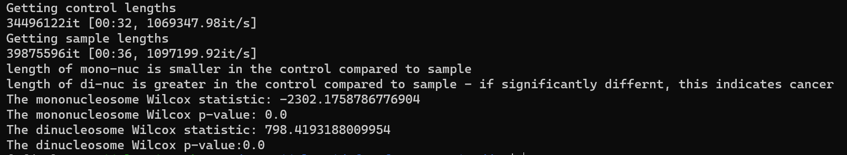
Results
Wilcoxon test
Snyder et.al. cfNDA lengths for cancer and healthy
Compare the lengths
Wilcoxon test
Rounded p-values
Sample Output:
9

Slide 10
Code:
Fragment Lengths
python <./location/nuc_ratio.py> <control_data.tsv> -s <sample_data.tsv>
10

Slide 11
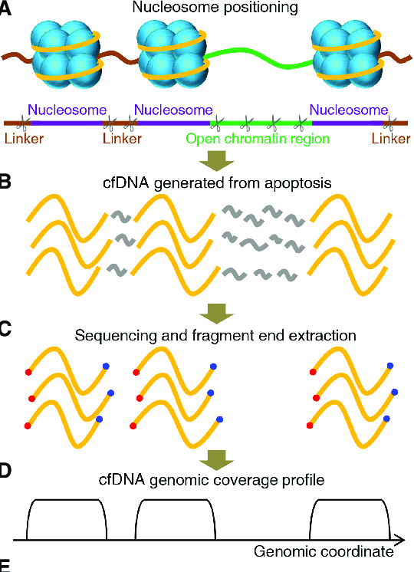
Nucleosome Coverage
Introduction
Panel A: DNA wrapped around Histones
Panel B: Upon Apoptosis -> fragmentation by endonucleases
Panel C: Sequencing
Panel D: Nucleosome coverage plots
Sun, Kun & Peiyong, et al. (2019).
11

Slide 12
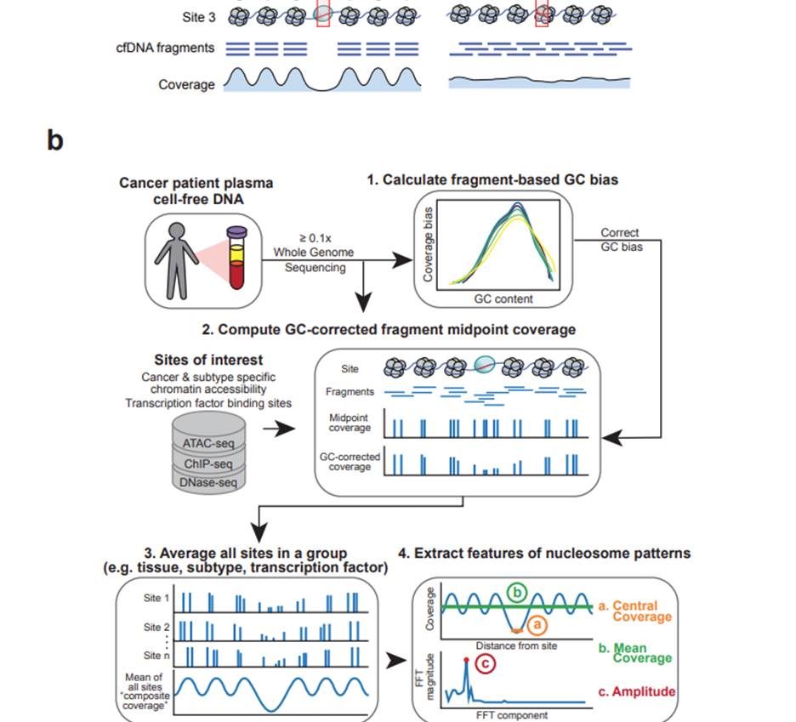
Nucleosome occupancy
Aggregate coverage
Midpoint active TFBS
high coverage at TFBS
Savitzky-Golay filter
12
Doebley et. al. 2021

Slide 13
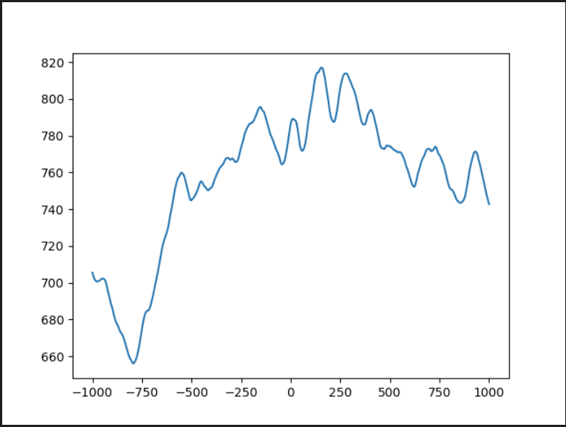
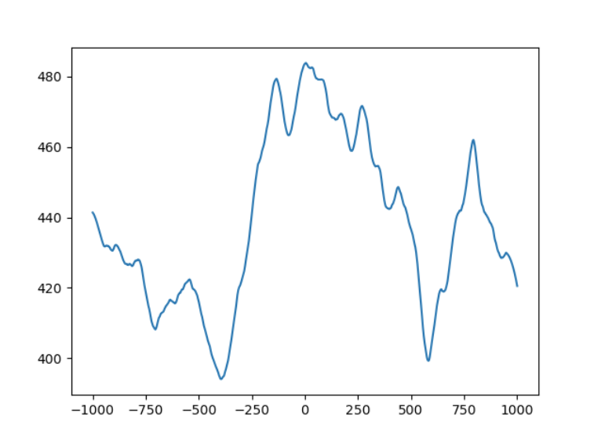
Results
Nucleosome coverage
Lung cancer – Using Cristiano et.al. data
Lung cancer – Using Snyder et.al. data
13

Slide 14
Code:
Nucleosome coverage
python <./location/nucleosome_occupancy.py> -t <./location/TFBS_loc.tsv> -w <Window size> -n <name> <./locationdata/gene.hg38.frag.bed>
14

Slide 15
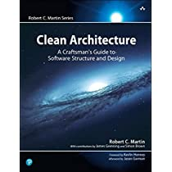


cfDNAfragmentomics
R package
DNA Fragment Ratio
Mononucleosome
Dinucleosome
Nucleosome Coverage
Plot of nucleosome coverage
Tech Stack
R
Generate shiny app
Python
Generate nucleosome plots
15

Slide 16

Next Steps…
Conclusion
Machine Learning model
Optimization
More epigenomic features
16

Slide 17
See paper for Complete set of references
References

Slide 18
Acknowledgements:
Supervisor:
Dr. Jared Simpson
Code Contributions:
Jonathan Broadbent

