Slide 1
Simpson Lab Meeting
March 2023
cfDNAfragmentomics
R package
Yasamin Nouri Jelyani
Supervisors:
Professor Jared Simpson
Jonathan Broadbent
Notes:
Hi everyone!
This year, I have been working on a project for analysis cell free DNA from the blood and use it as a tool that given cancer detection

Slide 2
Section I
Introduction

Slide 3
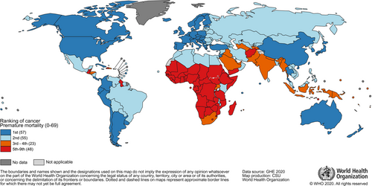
Motivation
Introduction
2020 – 9.9 million cancer deaths
Early detection
More curable
Screening – 41% less death risk
91% survival
Late detection
Less survival
More aggressive care
Health care costs
GLOBOCAN Estimates
Notes:
“Global Cancer Statistics 2020: GLOBOCAN Estimates of Incidence and Mortality Worldwide for 36 Cancers in 185 Countries.” CA : a Cancer Journal for Clinicians. 71, no. 3 (2021): 209–49. https://doi.org/10.3322/caac.21660.

Slide 4
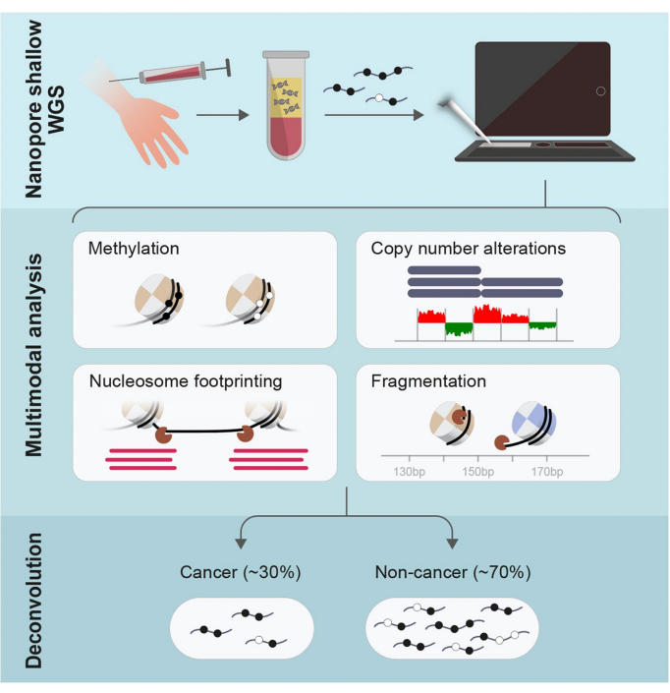
Motivation
Introduction
Detection with liquid Biopsies
Blood samples
cfDNA (cell-free DNA)
Healthy
Nanopore sequencing
ctDNA (circulating tumour DNA)
Berman et. Al.

Slide 5
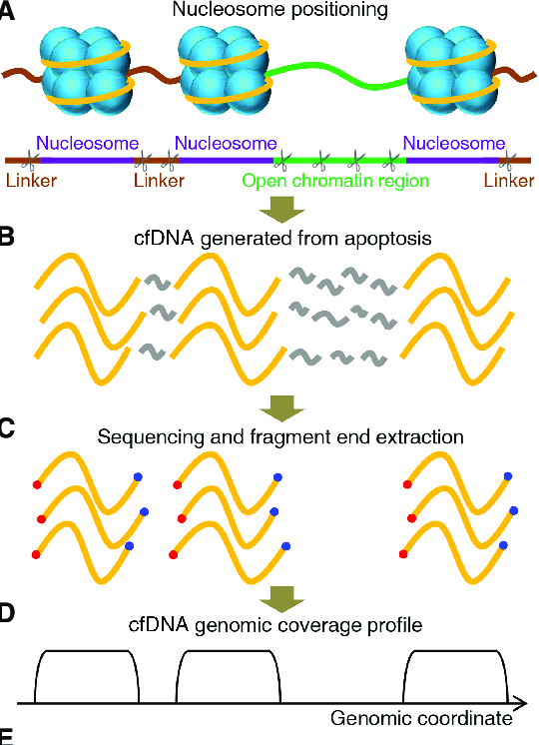
Motivation
Introduction
How does cfDNA enter the blood?
Apoptosis
Necrosis
Fragments
Nucleosome locations
Sun, Kun & Peiyong, et al. (2019). Genome Research.

Slide 6
Current Technologies
Introduction
DELFI
GRIFFIN
Lo, Y. M. D., Han, D. S. C., Jiang, P., & Chiu, R. W. K. (2021), American Association for the Advancement of Science (AAAS).
Notes:
Two technologies that have been published

Slide 7
Current Technologies
Introduction
DELFI
Lo, Y. M. D., Han, D. S. C., Jiang, P., & Chiu, R. W. K. (2021), American Association for the Advancement of Science (AAAS).
Notes:
Two technologies that have been published

Slide 8
Current Technologies
Introduction
GRIFFIN
Lo, Y. M. D., Han, D. S. C., Jiang, P., & Chiu, R. W. K. (2021), American Association for the Advancement of Science (AAAS).
Notes:
Two technologies that have been published

Slide 9
cfDNAfragmentomics
Introduction
R package
Simplistic Analysis
DNA Fragment Ratio
Mononucleosome
Dinucleosome
Nucleosome Coverage
Plot of nucleosome coverage
Lo, Y. M. D., Han, D. S. C., Jiang, P., & Chiu, R. W. K. (2021), American Association for the Advancement of Science (AAAS).

Slide 10
Section II
Methods

Slide 11
cfDNAfragmentomics
Methods
Tech Stack
R
Generate shiny app
Python
Generate nucleosome plots
Lo, Y. M. D., Han, D. S. C., Jiang, P., & Chiu, R. W. K. (2021), American Association for the Advancement of Science (AAAS).

Slide 12
cfDNAfragmentomics
Methods
DNA Fragment Ratio
Input:
Bed files
P-value
Output:
Nucleosome ratio plots
Wilcox-test analysis results
Nucleosome Coverage
Plot of nucleosome coverage –Developed by Jonathan
Lo, Y. M. D., Han, D. S. C., Jiang, P., & Chiu, R. W. K. (2021), American Association for the Advancement of Science (AAAS).
Notes:
DNA Fragment Ratio
Input:
Bed files
P-value
Output:
Nucleosome ratio plots : what I wanted it to look like (berman vs what the plots actually look like)
Nucleosome Coverage
Plot of nucleosome coverage what I wanted it to look like (griffin vs what the plots actually look like)

Slide 13
Section III
Analysis Pipeline

Slide 14
Get .bed files of cfNDA data
Testing of Galfyre on Berman cfDNA Samples
#! /bin/bash
bedtools intersect –a $input_bam –b RPR.sorted.bed –wa –sorted > intersecting.bam
bedtools intersect –a $intersecting.bam –b RPR.sorted.bed –wa –sorted –F 1 > $output.bam
Sources from finaleDB

Slide 15
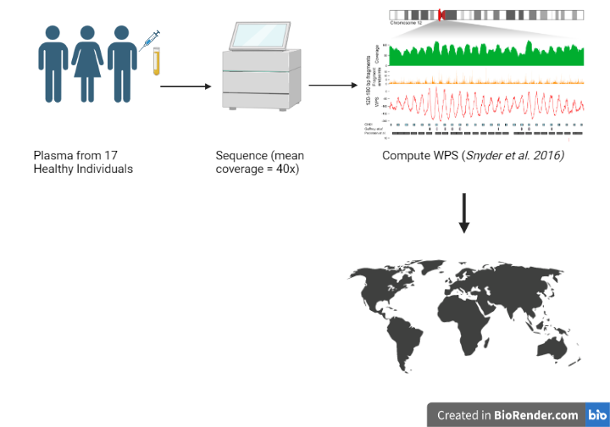
Sample Input
Galyfre
Create a map (bed file) of recurrently protected regions in the cfDNA of healthy individuals
12.7 million regions (median length = 39bp)

Slide 16
Sample Output
Analysis
Data source:
DNA Fragment Ratio
Nucleosome Coverage
Lo, Y. M. D., Han, D. S. C., Jiang, P., & Chiu, R. W. K. (2021), American Association for the Advancement of Science (AAAS).
Notes:
DNA Fragment Ratio
Input:
Bed files
P-value
Output:
Nucleosome ratio plots : what I wanted it to look like (berman vs what the plots actually look like)
Nucleosome Coverage
Plot of nucleosome coverage what I wanted it to look like (griffin vs what the plots actually look like)

Slide 17
Section IV
Conclusion

Slide 18
Sample Output
Colnclusion
Data source:
DNA Fragment Ratio
Nucleosome Coverage
Lo, Y. M. D., Han, D. S. C., Jiang, P., & Chiu, R. W. K. (2021), American Association for the Advancement of Science (AAAS).
Notes:
DNA Fragment Ratio
Input:
Bed files
P-value
Output:
Nucleosome ratio plots : what I wanted it to look like (berman vs what the plots actually look like)
Nucleosome Coverage
Plot of nucleosome coverage what I wanted it to look like (griffin vs what the plots actually look like)

Slide 19
Analysis of the output
Colnclusion
Comparing to Griffin
Comparing to DELFI
Lo, Y. M. D., Han, D. S. C., Jiang, P., & Chiu, R. W. K. (2021), American Association for the Advancement of Science (AAAS).
Notes:
DNA Fragment Ratio
Input:
Bed files
P-value
Output:
Nucleosome ratio plots : what I wanted it to look like (berman vs what the plots actually look like)
Nucleosome Coverage
Plot of nucleosome coverage what I wanted it to look like (griffin vs what the plots actually look like)

Slide 20
Section IV
References

